Slide 1
Professionalism: Overview, an orientation of the course and Key Elements
Prof. Hanan Habib & Dr. Kamran Sattar
College of Medicine
King Saud University

Slide 2
Professionalism Course
Course title : Professionalism
Code : SKL 221
Target : Second year medical students
Course duration : First semester
Credit hours : 6 hours
Note : ( patient safety topics to be given during the second semester with different objectives and topics)

Slide 3
Today’s session. Contents:
Objectives of the professionalism course
Topics /Sessions
Teaching and learning strategies
Student’s assessment and evaluation
Mark distribution
Overview about professionalism
Key elements
Learning resources
Professionalism : Guide for students

Slide 4
Objectives of the Professionalism Course. At the end of the course, the participants shall be able to;
Define the attributes of professionalism.
Respect for confidentiality and awareness of the legal, ethical and medical issues concerning patient’s documentation.
Practice effectively in teamwork during an inter-professional activity.
Demonstrate the attributes and behavior of a professional medical student.
Recognize and manage conflicts at workplace.

Slide 5
Objectives of the Professionalism Course-cont.
Demonstrate commitment of lifelong learning and the capacity for reflection and self evaluation .
Demonstrate how to manage stress.
Work effectively with patients, their families, colleagues and other health professionals .
Participate as a volunteer for the community services in collaboration with health societies and agencies.

Slide 6
Professionalism course: Topics
Overview of the course, orientation and key elements of professionalism.
Accountability ,initiatives ,integrity & trustworthiness
Historical standards of professionalism behavior and Islamic values and rules of medical professionalism.
Effective communication skills: impact on being an effective team player.
unprofessional behaviors.
Inter-professional education and collaboration.( 2 sessions)
Continuous professional development, life long learning and professionalism through mentoring..
Stress management
Leadership and management skills
Professionalism in different cultural contexts( sensitivity to other belief and world views).
Community services and volunteer works.( 2 sessions)

Slide 7
Teaching Strategies
Interactive lectures
Student led seminars
Simulated inter-professional team
Simulated scenario based discussions
Preparation of community services and awareness campaigns.
Attending seminars in collaboration with health education.

Slide 8
Teaching strategies: student led seminar
Includes assignments and projects. Students will be divided into 3 Subgroups at the beginning of the academic year by the tutor . Each Subgroup shall participate in 2 topic/session ( preparation, role play, discussion and presentation accordingly).
Slides with the main points of the topic , summary handouts and references will be given to students earlier before the day of the session to help in preparing the topic.
Student will be evaluated after presentation and discussion.

Slide 13
Student’s Assessment
Short answer questions ( SAQs)
Multiple choice questions (MCQs)
Seminar presentation
Assignment and project report
Rating on inter-professional team work.

Slide 14
Mark distribution
Continuous assessment ( 40 marks):
A- Project/assignment: 20 marks each
B- Student led seminar: 20 marks
Final exam ( 60 marks):
A- MCQs : 30 marks
B- SAQs: 30 marks
Total : 100 marks
Note: at the end of year ; 50 marks will be counted for professionalism and 50 marks for patient safety for this academic year only.

Slide 15
Professional conducts required during the lecture/session
Include:
Interaction during lecture
Professional conduct
Punctuality ,communication,.. etc.
Random check of attendance by the tutor at each lecture

Slide 16
Overview About Professionalism

Slide 17
Professionalism Lecture contents:
-Definition of professionalism
-Why professionalism is important?
-Professionalism in medicine
-Concepts of professionalism
Key elements
Learning resources

Slide 18
Definition of professionalism
There are different definitions .
Q: What could possibly be the cause for these differences?
Ans: Although there are common key elements in the definition of professionalism that must be fulfilled, the definition might varies depending on culture, law, and community needs.

Slide 19
Definitions, cont.
It is also the measure that could be used to assess our performance by our patients, colleagues, and the profession.
What resources would you use to help you in identifying the definition of professionalism?

Slide 20
Definitions , cont.
The resources for defining professionalism might include:
Literature, published research papers, legal and ethical documents, as well as disciplinary action documents in the hospital, and workplace (These documents are confidential).

Slide 21
Definition of Professionalism
Profession is an occupation whose core elements is work, based on the mastery of a complex body of knowledge and skills.
Oxford English Dictionary
Profession is the conduct, aims, or qualities that characterize a person in a work setting or profession
Professionalism “constituting those attitude and behaviors that serve to maintain patient interest above physician self-interest.”
American Board of Internal Medicine
Professionalism is exhibited by one of the professional character, spirit , methods or the standing practice , or methods of a professional as distinguished from an amateur’’. American College Dictionary

Slide 22
Definition ,cont.
MEDICINE is a vocation in which a doctor’s knowledge, clinical skills ,and judgment are put in the service of protecting and restoring human well-being.
The purpose of definitions is to realize the partnership between a patient and doctor. It is based on mutual respect ,individual responsibility and appropriate accountability.

Slide 23
The Holy Quran & Hadith
The holy Quran and Al-Hadith have stated that Muslims have duty to care for the sick and this often referred to ‘‘Medicine of Prophet’.
According to the sayings of the Prophet Mohamed’ peace be upon him’ that ‘Allah has sent a cure for aliment and that it was the duty of Muslim to care of the body and spirit.
This includes improving the quality of care and ensures access of healthcare to every body.

Slide 24
Why Professionalism Is Important?
There is a great increase in interest in developing medical professionalism of the students.
The ethical demands upon medical profession have increased due to changes in the traditional modes of health care delivery, increased complexity in the methods of reimbursement, and developing national trends toward managed care.

Slide 25
Why Professionalism Is Important? cont.
Most people desire to be treated by physicians who, in addition to being competent ,care deeply about their patients.
Professionalism and humanism sometimes confused as being synonymous.
Professionalism is not only about being competent and skillful but also behaving in an ethical way.

Slide 26
Professionalism In Medicine
Professionalism embodies the relationship between medicine and society as it forms the basis of patient –physician trust. It attempts to make tangible certain attitudes, behaviors , and characteristics that are desirable among the medical profession.
University of Ottawa,2012
Medical professionalism is the ‘heart and soul of medicine.’ more than adherence to a set of medical ethics , it is the daily expression of what originally attracted them to the field –a desire to help people and to help society as a whole by providing quality health care.
Advancing medical professionalism to improve health care. ABIM Foundation , 2013

Slide 27
Concepts of Professionalism
Professionals have codes, guidelines, creeds, oaths, commitments statements, belief statement such as statement on ethics.
Professionals in many professions are licensed, certified and specific initial and advanced education, many require both initial and ongoing testing for admission and maintaining membership.
Examples of professionals : medical doctors, engineers, pilots, etc,..

Slide 28
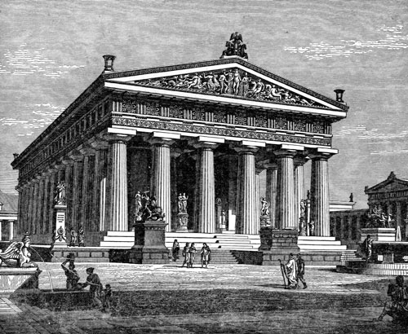
Key Elements of Professionalism

Slide 29
Objectives of Key Elements
Understand the key elements and attributes of medical/health professionalism.
Discuss practical examples (case scenarios) about professionalism and key principles learnt.

Slide 30
Key Elements of Professionalism: include;
Excellence.
Humanism.
Respect.
Accountability.
Altruism.
Integrity.

Slide 31
Key Elements ( Bases of Professionalism)
Ethical and Legal Boundaries.
Communication and Interpersonal Skills.
Continuous Learning and Self Development.
Clinical Competence (Knowledge and Skills).

Slide 32
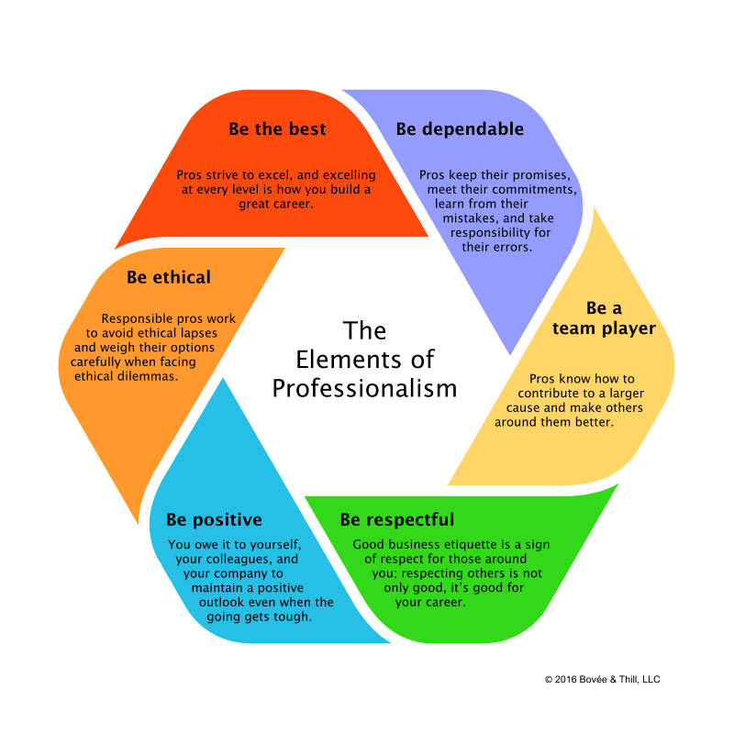

Slide 33
Key Elements
1.EXCELLENCE: ( a talent or quality that is unusually good and surpasses ordinary standards)
Time management /Punctuality
Positive attitude ( enjoy work).
Commitment to life long learning, to exceed ordinary expectations.
Confidentiality.
Consider the language and culture of work.
Give the best of your talents and skills.

Slide 34
Key Elements. cont
2. HUMANISM:
Empathy & Compassion.
Support & Encouragement.
Love and care.
Positive attitude.
Values and integrity.

Slide 35
Humanism –cont. The differences between professionalism and humanism:
Professionalism is a way of acting. It comprises a set of observable behaviors.
Humanism is a way of being. It comprises a set of deep-seated personal convections about one’s obligations to others especially others in need.
Humanism manifested as : altruism, duty, integrity, respect for others and compassion.

Slide 36
Key elements
3. RESPECT:
Dignity & Respect for patients, patients’ families, colleagues, and other healthcare professionals.
Demonstrate good attitude and effective communication.
Respect all patients in the same way regardless to their social status.

Slide 37
Respect also includes:
Respect for the feeling of others
Respect for differences
Respect for rules
Self-respect.

Slide 38
Key Elements
4. ACCOUNTABILITY:
Accept responsibility.
Always consider confidentiality.
Work on resolving conflicts.
Avoid the business of blaming others, circumstances or how much you are busy.
Honoring the patient/physician relationship
Addressing the health needs of the public

Slide 39
Key Elements
5. ALTURISM:
Put the patient’s interest first.
Avoid any conflict between your needs and the patients’ rights.
Give full commitment to your patient.
Avoid any financial or relationship biases that could have any negative impact on the patient-doctor relationship

Slide 40
Key Elements
6.. INTEGRITY :
Be a principle-based person.
Be honest, and stand by your words.
Be fair.
Do not abuse your position/authority.
Do what you say.
Behave in a good manner whether you are watched or not.
Adhere to good work-place ethics.

Slide 41
Professionalism & Ethics Though the terms professionalism and ethics are used interchangeably by some people, there are a lot of difference between the two. Professionalism can be defined as the skills, competence and the conduct displayed by an individual of a certain profession. Ethics are guidelines for individuals, which clearly state the dos and don’ts.
Professionalism
Ethics
Competence
Honesty
Compassion
Respect others
Responsibility for the profession & society
Morals
Deliberation and explicit arguments to justify particular actions
Principles governing ideal human character
Focus on reasons why an action is right or wrong.

Slide 42
Learning resources

Slide 43
THANK YOU.

