Slide 1
Continuous professional development, life long learning and professionalism throw mentoring

Slide 2
CPD

Slide 3
What is the definition of continuing professional development?
Continuing professional development (CPD) involves maintaining and enhancing the knowledge, skills and experience related to your professional activities following completion of your formal training. Just as importantly, it involves the development of those personal qualities that are required for carrying out professional and technical duties during a professional’s life. Both technical and non-technical skills need to be developed.
Continuing professional development should be a lifelong, systematic and planned process to maintain and develop professional competence, creativity and innovation. The outcome has value for both the individual and their profession.
What makes CPD different is the way in which it focuses on a proactive and conscious approach to personal development, rather than the more typical passive and reactive approach.
There are a variety of different learning methodologies incorporated in CPD, which include e-learning programmes, classroom-based study, conferences, workshops and private research.

Slide 4
Different elements of CPD
An effective CPD scheme should have three quality components:
· Professional improvement that ensures personal learning related to the populations' changing needs and developing
healthcare service
· Effective learning interventions should be designed upon clear, attainable, and measurable learning outcomes and
offer relevant and evidence-based content to the physician's clinical practice
· It must be accountable, transparent, amenable to regulation, and useful for assuring quality in the process of re-licensure.

Slide 5
Difference between CPD & CME
CME (continuing medical education): Refers to expanding medical knowledge, skills and attitudes
another definition: a lifelong learning process pursued by doctors from medical school until retirement, and has traditionally been viewed in term of knowledge updating
•Usually only including medical knowledge and skills
CME levels of evaluation that should match teaching strategies and learning outcomes:
1- Perception and satisfaction
2- Competencies
3- Professional performance
4- Healthcare outcome
they later added new 2 levels:
1- Participation related to an education event’s attendance
2- Return of investment related to cost-effectiveness
Notes:
Allulu Alsulayhim

Slide 6
Difference between CPD & CME
CPD
Lifelong based on ongoing self-assessments designed to address the educational needs of individuals.
Generally learner centered/driven.
Comprehensive in scope. encompasses the clinical domain as well as practice management, leadership, administration, education, and an entire spectrum of professional activities.
A variety of learning formats and delivery methods (active learning)
Conducted in a variety of a different venues including locations other than lecture halls and conference rooms
CME (continuing medical education)
Episodic interventions designed to address the education needs of groups of learners
Generally teacher centered/driven
Principally encompasses the clinical domain
Lecture based format (passive learning)
Most often conducted in formal setting such as lecture halls or conference rooms

Slide 7
Lifelong Learning

Slide 8
Define lifelong learning
Lifelong learning is the process of continuous, voluntary and self motivated learning for either personal or professional reasons throughout lifetime.

Slide 9
Skills/competencies needed for lifelong learning
Those who want to learn are :
1/ open to new experiences.
2/ actively seeking out ways to learn and develop.
3/ They always want to know how to improve.
4/ time management

Slide 10
Skills/competencies needed for lifelong learning
Basic computer skills
Speed reading
Effective study skulls
Searching the web
Negotiation skills
Financial management skills

Slide 11
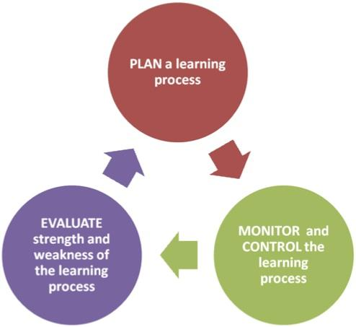
Self-directed learning
What is Self-directed learning?
A long-standing concept in the education literature, relatively new to medical education journals.
What do you understand from the definition?

Slide 12
Self-directed learning
teach individual self-directed learning competencies, the following are important:
situate learners to experience "real" problems.
encourage learners to reflect on their own performance.
create an educational atmosphere in clinical training situations.

Slide 13
Mentoring

Slide 14
• Mentoring is to support and encourage people to manage their own learning in order that they may maximise their potential, develop their skills, improve their performance and become the person they want to be
• Mentoring is a powerful personal development and empowerment tool. It is an effective way of helping people to progress in their careers and is becoming increasing popular as its potential is realised. It is a partnership between two people (mentor and mentee) normally working in a similar field or sharing similar experiences. It is a helpful relationship based upon mutual trust and respect.
• Many organization worldwide acquire mentorship for the core interest of professional development in the field of clinical prac-tice.in health care , mentoring has been used for teaching student and novice nurses about clinical practice
Concept of mentoring:

Slide 15
Who is mentor and mentee?
A mentor is a person or friend who guides a less experienced person.
A mentee is the student who needs to absorb the mentor’s knowledge and have the ambition and desire to know what to do with this knowledge.

Slide 16
Mentor roles :
1. Have a clear understanding of why you want to be a mentor.
2. Have a clear understanding of your expectations for your mentee
3. Develop mutual trust and respect
4. Provide guidance, motivation, emotional support
5. Help the mentee solve his or her own problem, rather than give direction
6. Recognize your mentee’s weaknesses and build on his/her strengths
7. Be realistic about setting timelines
8. Stay flexible in changing expectations or plans
9. Offer feedback
10. After mentoring is completed, follow up on successes

Slide 17
Mentee roles :
1. Have a clear understanding of why you want to be mentored
2. Select a Mentor based on criteria relevant to your goals
3. Inform your mentor about your preferred learning style
4. Allow your mentor to take the lead in the relationship
5. Use active listening skills during discussions with your mentor
6. Demonstrate that you are open to hear new ideas and suggestions to bring out your best
and overcome any blind spots.
7. Respect your mentor’s time
8. Ask for feedback
9. Follow up with your mentor after termination to keep in touch, to share your progress

Slide 18
Benefits of mentoring
For mentor
For mentee
Improves self-confidence
Educates the mentee on how to accept feedback
Develop critical thinking
Improves the mentee's interpersonal relationship skills
Assists with problem solving
Helps the mentee better understand the organization's culture and unspoken rules, which can be critical for success
Offers professional development
Provides encouragement
Improves communication skills
Strengthens the mentor’s active listening
Encourages the mentor to share knowledge, which helps increase the mentor's sense of self-worth
Strengthens the mentor's interpersonal relationship skills
Teaches the mentor about other departments within the organization
Helps re-energize the mentor's career
Provides personal and job satisfaction
Develops professional relationships
Provides a sense of responsibility

Slide 19
Reflection and reflective practice

Slide 20
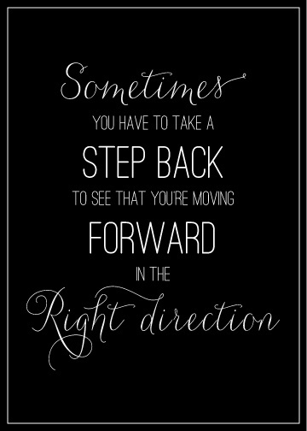
Define Reflection (reflection in/on) and reflective practice :
Reflection: the image of something in a mirror or on any reflective surface.
Reflect on: To influence people's opinion of a person, group, or organization.

Slide 21
Define Reflection (reflection in/on) and reflective practice :
Reflective practice:
Is practice based professional learning in which people learn from their own professional experience rather than just knowledge transfer.

Slide 22
Models of reflection :
Reflective practice was used in meditation teachings.
Reflective meditation involves repeatedly turning your attention to a theme but being open to whatever arises from the experience .

Slide 23
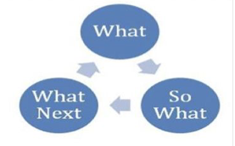
There are four models that apply the reflective practice in proper way :
1-Borton model (learning cycle ) Model consists of three questions like:
(what? So, what? What next?)
These questions would be generated in the mind of learner at the end of teaching encounter

Slide 24
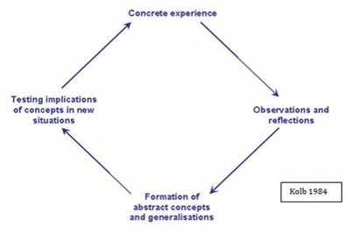
2- Kolb model (experiential learning )
Experience about action is a sequence of events which starts with proper observations, reflections followed by formation of abstract concepts and testing them

Slide 25
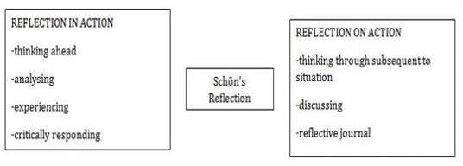
3- Argyris model
suggested two ways of reflective practice:
1- Reflection in action
2- Reflection on action.

Slide 26
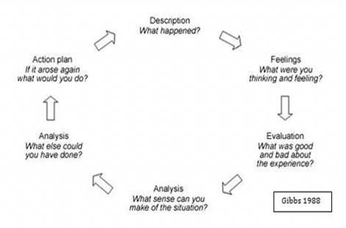
4- Gibb's reflective model (Gibb's reflective cycle)
Gibbs described a structured model to facilitate Kolb’s model
Model is known as Gibb’s reflective cycle is useful
for the students who are new to reflecting

Slide 27
How to Approach to your Needs assessment :
A needs assessment is a process for determining and addressing needs , or gaps between current condition and desired condition
Why do we do needs assessment ?
Experts stated that learning is more likely to lead to change in practice when needs assessment has been conducted
Needs assessment can be done for many reasons , so its purpose should be defined and should determine the method used

Slide 28
4 steps to conducting a needs assessment
1- Perform a "Gap" Analysis:
there are two parts to this: Current situation / desired or necessary situation
The “gap” between the current and the necessary will identify our needs, purposes and objectives
2- Identify Priorities and Importance
3- Identify Causes of Performance Problems and/or Opportunities
4- Identify Possible Solutions and Growth Opportunities

Slide 29
There are four models that apply the reflective practice in proper way :
1- Borton model (learning cycle )
Model consists of three questions like:
(what? So, what? What next? )
These questions would be generated in the mind of learner at the end of teaching encounter

Slide 30
Thanks

