Slide 1
Interprofessional education & collaboration

Slide 2
Objectives
Define interprofessional educatin (IPE)/ collaboration (C)
1
Describe the basic competencies of IPE/C
2
Identify the methods and tools to implement IPE/C
3
Identify the opportunities for using IPE/C to improve interprofessional collaboration.
4
Appreciate the importance of interprofessional collaboration for reducing harm to patients
5
Participate in an activity to explain how IPE/C work
6

Slide 3
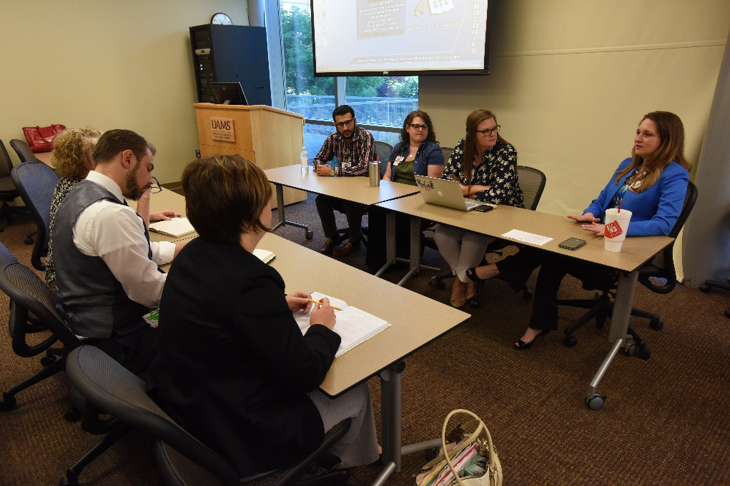
Definition of IPE
Learners from two or more professions learn about, from, and with each other to enable effective collaboration
(WHO 2010).

Slide 4
Definition of Interprofessional collaboration (IPC)
When multiple health workers
from different professional backgrounds
work together with patients, families, [careers], and communities
to deliver the highest quality of care.

Slide 5
“It is no longer enough for health workers to be professional. In the current global climate, health workers also need to be interprofessional.” ~ WHO, 2010.

Slide 6
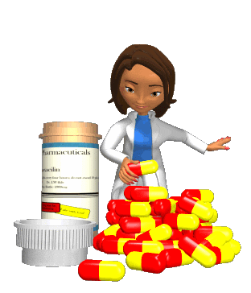
Excuse me, but Nurses actually work directly with Patients…
We are the Doctors. We Lead!
When you get to the mouth, call us.
Without me, you both wouldn’t know a benzodiazapine from a barbiturate.

Slide 7
Interprofessional Education competencies
© 2017 Office of Interprofessional Education All Rights Reserved
“Collaboration and teamwork can BEST be achieved if it starts early.”
Robert Wood Johnson Foundation, 2011
Notes:
Education takes our students through these same domains…

Slide 8
Definition of IPE/C competencies
Integrated enactment of knowledge, skills, and values/attitudes
that define working together across the professions, with other healthcare workers, patients, families, and communities as appropriate
to improve health outcomes in specific care contexts.

Slide 9
Competency Domains
Values/Ethics for Interprofessional Practice
Work with individuals of other professions to maintain a climate of mutual respect and shared values
IPEC. Core Competencies for Interprofessional Collaborative Practice. May 2011

Slide 10
Values and ethics
VE1. Place the interests of patients and populations at the center of interprofessional health care delivery.
VE2. Respect the dignity and privacy of patients while maintaining confidentiality in the delivery of team-based care.
VE3. Embrace the cultural diversity and individual differences that characterize patients, populations, and the health care team.
VE4. Respect the unique cultures, values, roles/responsibilities, and expertise of other health professions.
VE5. Work in cooperation with those who receive care, those who provide care, and others who contribute to or support the delivery of prevention and health services.
VE6. Develop a trusting relationship with patients, families, and other team members .
VE7. Demonstrate high standards of ethical conduct and quality of care in one’s contributions to team-based care.
VE8. Manage ethical dilemmas specific to interprofessional patient/ population centered care situations.
VE9. Act with honesty and integrity in relationships with patients, families, and other team members.
VE10. Maintain competence in one’s own profession appropriate to scope of practice.

Slide 11
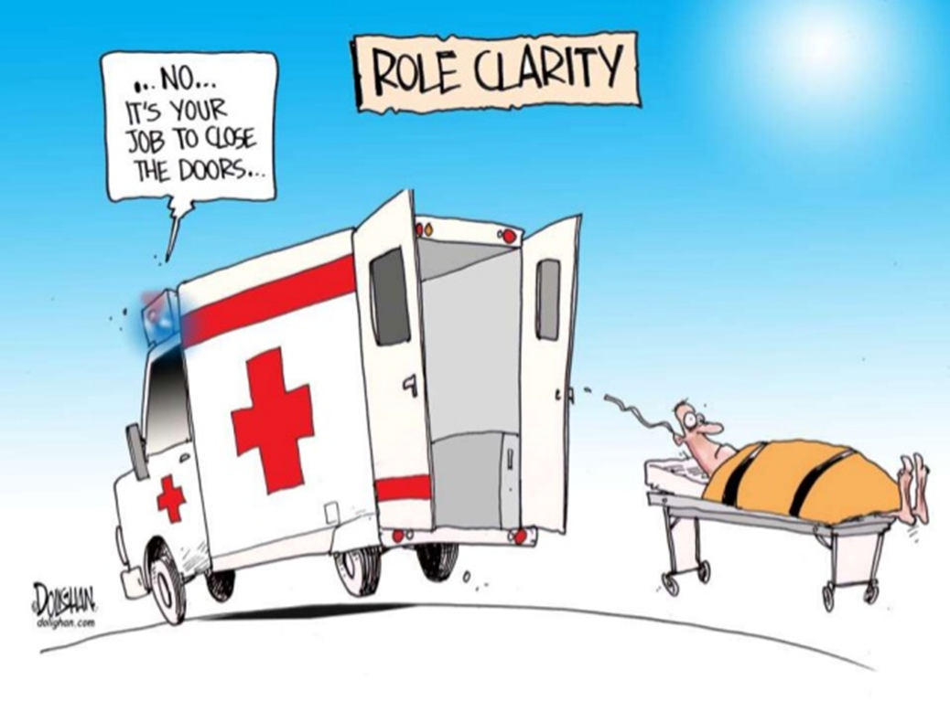
Competency Domains
Roles/Responsibilities
Use the knowledge of one’s own role and those of other professions to appropriately assess and address the health care needs of the patients and populations served
IPEC. Core Competencies for Interprofessional Collaborative Practice. May 2011

Slide 12
Roles and responsibilities
RR1. Communicate one’s roles and responsibilities clearly to patients, families, and other professionals.
RR2. Recognize one’s limitations in skills, knowledge, and abilities.
RR3. Engage diverse healthcare professionals who complement one’s own professional expertise, as well as associated resources, to develop strategies to meet specific patient care needs.
RR4. Explain the roles and responsibilities of other care providers and how the team works together to provide care.
RR5. Use the full scope of knowledge, skills, and abilities of available health professionals and healthcare workers to provide care that is safe, timely, efficient, effective, and equitable.
RR6. Communicate with team members to clarify each member’s responsibility in executing components of a treatment plan or public health intervention.
RR7. Forge interdependent relationships with other professions to improve care and advance learning.
RR8. Engage in continuous professional and interprofessional development to enhance team performance.
RR9. Use unique and complementary abilities of all members of the team to optimize patient care.

Slide 13
Competency Domains
Interprofessional Communication
Communicate with patients, families, communities, and other health professionals in a responsive and responsible manner
IPEC. Core Competencies for Interprofessional Collaborative Practice. May 2011

Slide 14
communication
CC1. Choose effective communication tools and techniques, including information systems and communication technologies, to facilitate discussions and interactions that enhance team function.
CC2. Organize and communicate information with patients, families, and healthcare team members in a form that is understandable, avoiding discipline-specific terminology when possible.
CC3. Express one’s knowledge and opinions to team members involved in patient care with confidence, clarity, and respect, working to ensure common understanding of information and treatment and care decisions.
CC4. Listen actively, and encourage ideas and opinions of other team members.
CC5. Give timely, sensitive, instructive feedback to others about their performance on the team, responding respectfully as a team member to feedback from others.
CC6. Use respectful language appropriate for a given difficult situation, crucial conversation, or interprofessional conflict.
CC7. Recognize how one’s own uniqueness, including experience level, expertise, culture, power, and hierarchy within the healthcare team, contributes to effective communication, conflict resolution, and positive interprofessional working relationships .
CC8. Communicate consistently the importance of teamwork in patient-centered and community focused care.

Slide 15
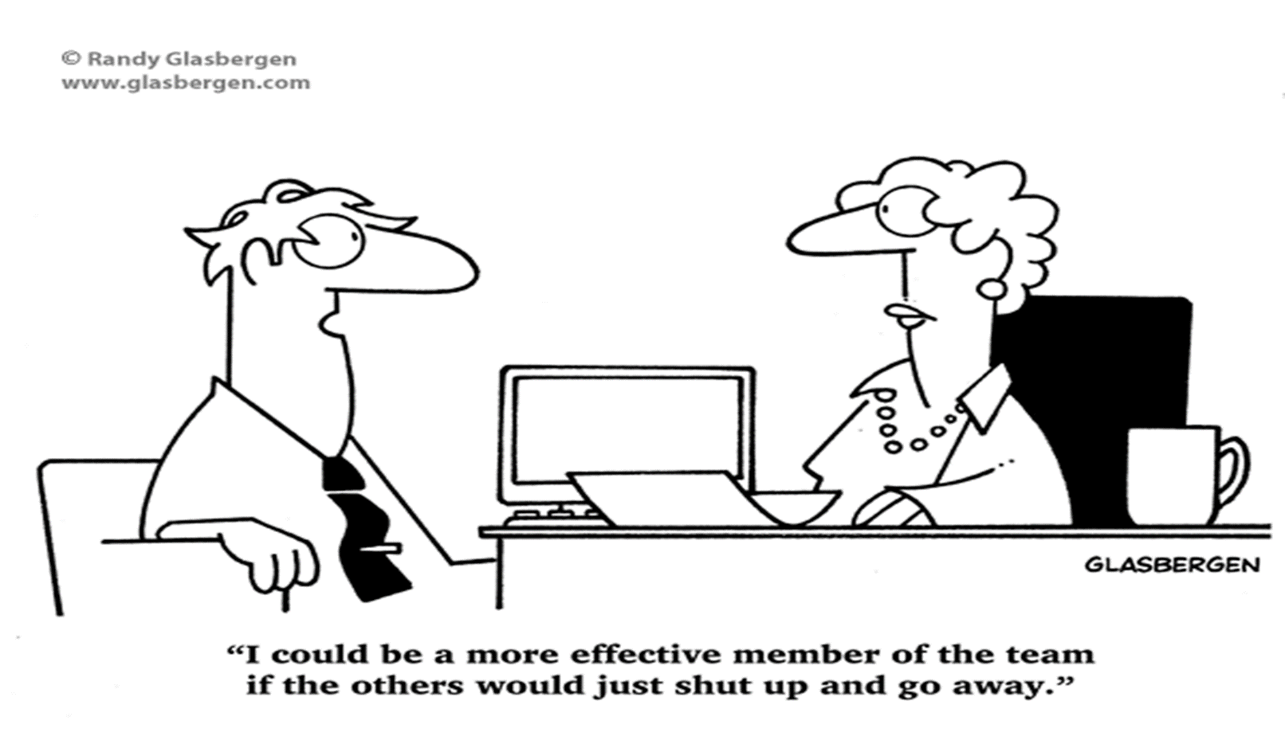
Competency Domains
Teams and Teamwork
Apply relationship-building values and the principles of team dynamics to perform effectively in different teams roles.

Slide 16
Teams and teamwork
TT1. Describe the process of team development and the roles and practices of effective teams.
TT2. Develop consensus on the ethical principles to guide all aspects of patient care and team work.
TT3. Engage other health professionals in shared patient-centered problem-solving.
TT4. Integrate the knowledge and experience of other professions, appropriate to the specific care situation to inform care decisions, while respecting patient and community values and priorities/ preferences for care.
TT5. Apply leadership practices that support collaborative practice and team effectiveness.
TT6. Engage self and others to constructively manage disagreements about values, roles, goals, and actions that arise among healthcare professionals and with patients and families.
TT7. Share accountability with other professions, patients, and communities for outcomes relevant to prevention and health care.
TT8. Reflect on individual and team performance for individual, as well as team, performance improvement.
TT9. Use process improvement strategies to increase the effectiveness of interprofessional teamwork and team-based care.
TT10. Use available evidence to inform effective teamwork & team-based practices.
TT11. Perform effectively on teams and in different team roles in various settings.

Slide 17
Students experience
https://youtu.be/5z_gIWP3y5I

Slide 18
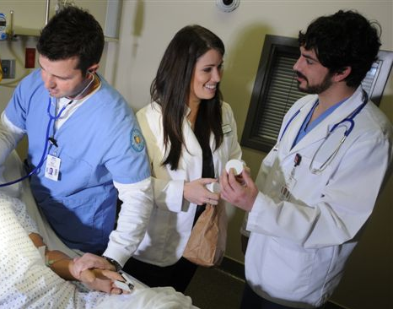
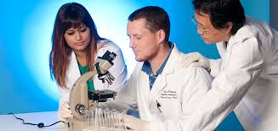
© 2017 Office of Interprofessional Education All Rights Reserved
HOW we interact together improves quality of outcomes in all environments.
Clinical
Research
Educational
Notes:
IPE Is not just a curriculum or a course for our students; it is a methodology that changes who we interact together- whether in the clinical, educational, or research settings.

Slide 19
methods and tools to implement IPE/C
Student-delivered lectures
Simulation-based education
Interprofessional training ward
Student-delivered lectures
Health promotion activities
Health promotion activities
Clinical anatomy course where nursing students will be taught by medical students
Patient-care scenarios using a high-fidelity patient simulator
Real-life clinical training in IPE training wards in hospitals under professional supervision
Pharmacy students deliver case-based lectures to health professional students
Students collaborate to develop and deliver healthy-living modules to school students
Students form an interprofessional and collaborative team for dissemination of nutrition/exercise knowledge

Slide 20
opportunities for using IPE/C to improve patient’s care
Community-based related activities
Service learning:
Students teams up and identify a community partner (nursing home, Rehab center, etc) and conduct a community project
Health campaigns
Screening programs
Free- or Mobile clinic (e.g. in Hajj)
Extracurricular activities

Slide 21
opportunities for using IPE/C to improve patient’s care
Experiential training programs
Clinical Sessions during internship
Interprofessional clinical rounds
Interprofessional ambulatory clinics:
Students team up and assigned a real patient from outpatient clinic
Case presentations
Case studies
Journal clubs

Slide 22
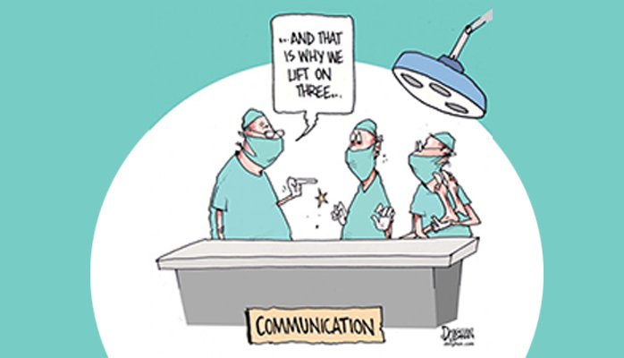
Is IPE/C important?
In 2006, the Joint Commission on Accreditation of Health Care Organization reported that
70% of medical errors were caused by
lack of communication between team members.

Slide 23
Benefits of IPC
Increased efficiency
Improve employee morale, increases inter-staff support
Fosters creativity, ideas
Reduced competition & conflict, better conflict resolution
Better clinical outcomes, cost-effectiveness, safety
Facilitated collaborative projects

Slide 24
Benefits of IPC
It Empowers Team Members
It Closes Communication Gaps
It Enables Comprehensive Patient Care
It Minimizes Readmission Rates
It Promotes a Team Mentality
It Promotes Patient-Centered Care

Slide 25
Activity
https://youtu.be/jO6anVZ0JxA
Or
https://youtu.be/sQ-HH5tapzo

