Slide 1
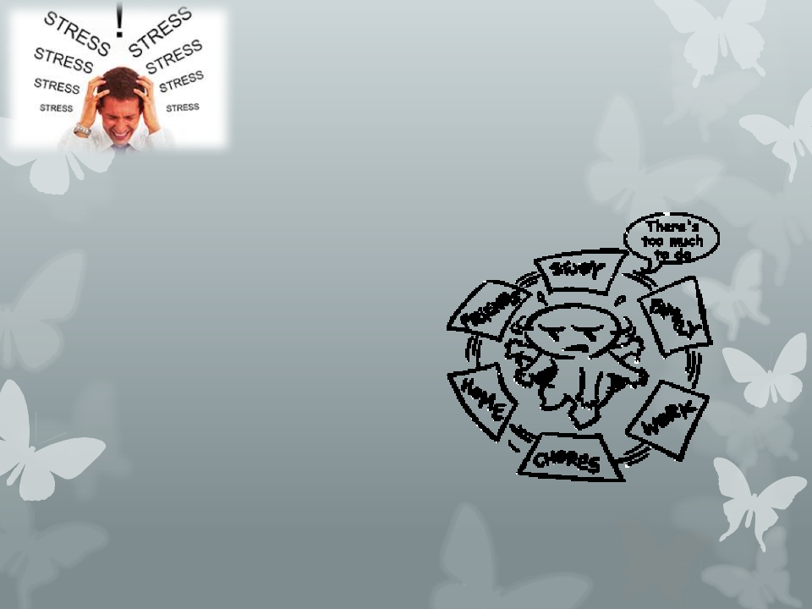
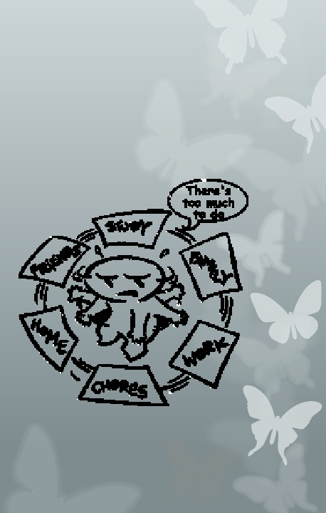
Stress Management
Dr Aljohara almeneessier
KSU November 2017
2nd year students

Slide 2
Objectives:
1. Define stress
2. Identify the stress by self assessment.
3. Identify the types of stress
4. Recognize the mechanisms of stress
5. Identify the relation of stress and our health
6. Discuss stress management strategies

Slide 3
Contents:
1- Stress definition.
2- Differentiate stress from other psychiatric disorder.
3- Stress and stressors
4- Stress management

Slide 4
What Is Stress?
Stress is a feeling that's created when we react to
particular events. It's the body's way of rising to a
challenge and preparing to meet a tough situation
with focus, strength, stamina, and heightened
alertness.

Slide 5
Stress Definitions??
Stress is a condition or feeling experienced when a person
perceives that demands exceed the personal and social
resources.
(Richard S Lazarus)

Slide 6
Why we talk about stress
Health professionals face many stressors in their
work environment:
• Sleep deprivation
• Disruptions in social support
• Clinical vs. educational conflicts
• Caring for critically ill or dying patients
• Certification or licensing examinations
(French et al., 1982; Peterlini et al., 2002 )

Slide 7
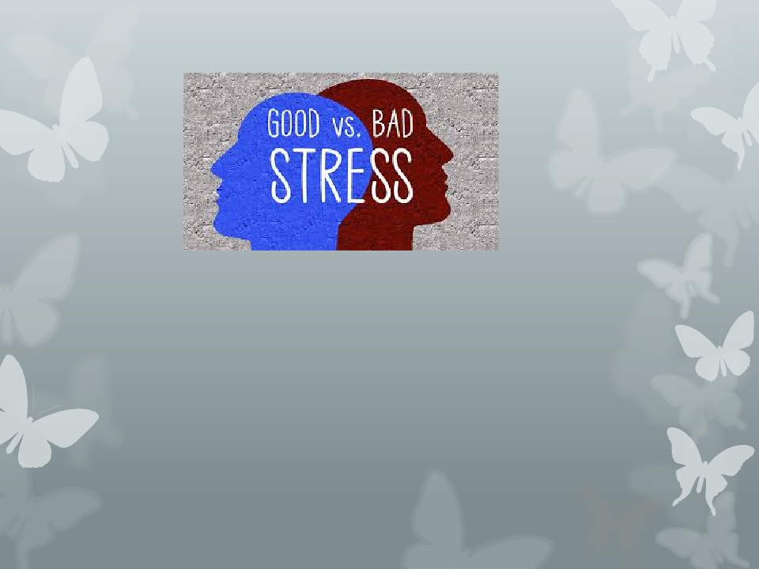
Types of stress
• If person’s capacities handle the demand and
enjoy the stimulation involved, then stress is
welcome and helpful.
• If the capacities cannot handle the demand,
then stress is unwelcome and unhelpful.

Slide 8
Not All Stress is Bad…
Distress
• Is a continuous experience of feeling overwhelmed,
oppressed, and behind in our responsibilities.
• It is the all encompassing sense of being imposed
upon by difficulties with no light at the end of the
tunnel.
Examples of distress include financial difficulties, conflicts in relationships,
excessive obligations, managing a chronic illness, or experiencing a trauma.

Slide 9
Not All Stress is Bad…
Eustress
• is the other form of stress that is positive and
beneficial.
• We may feel challenged, but the sources of the stress
are opportunities that are meaningful to us.
• Eustress helps provide us with energy and motivation
to meet our responsibilities and achieve our goals.
Examples of eustress include graduating from college, getting married,
receiving a promotion, or changing jobs.

Slide 10
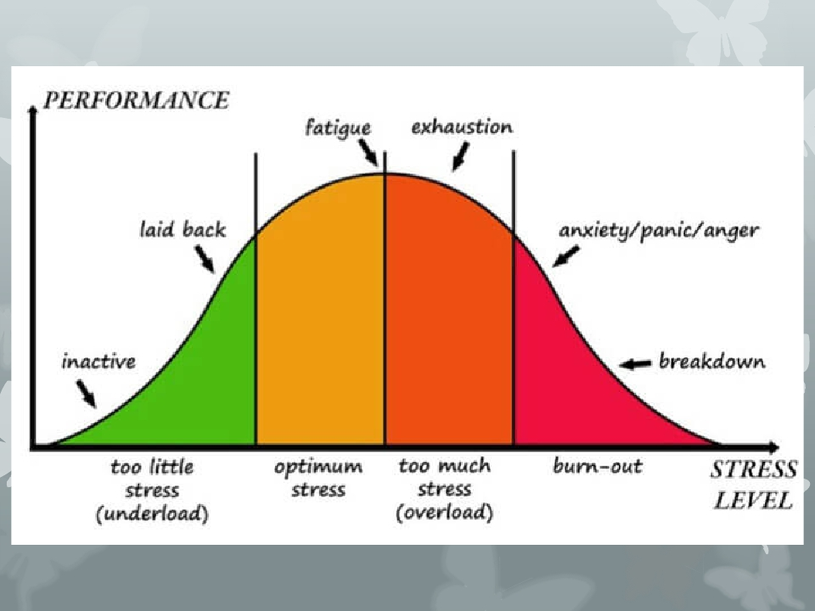
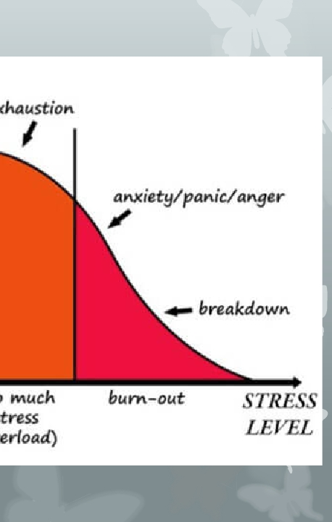
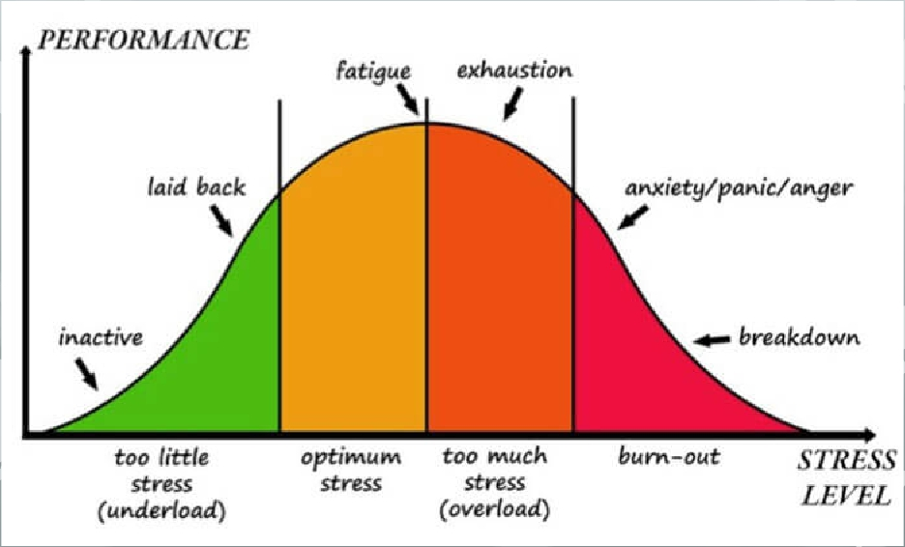

Slide 11
Stressors:
Stressorsare the events that provoke stress, and
they cover a whole range of situations (Environmental,
Physiological, Thoughts)
Environmental (noise, weather, traffic, time
pressures, job performance standards)
Physiological (illness, lack of sleep, poor diet, aging)
Thoughts (worry, negative self-talk, fear)

Slide 12
Stress
Mechanisms of stress :
1- Fight-or-Flight
2- The General Adaptation Syndrome and Burnout

Slide 13
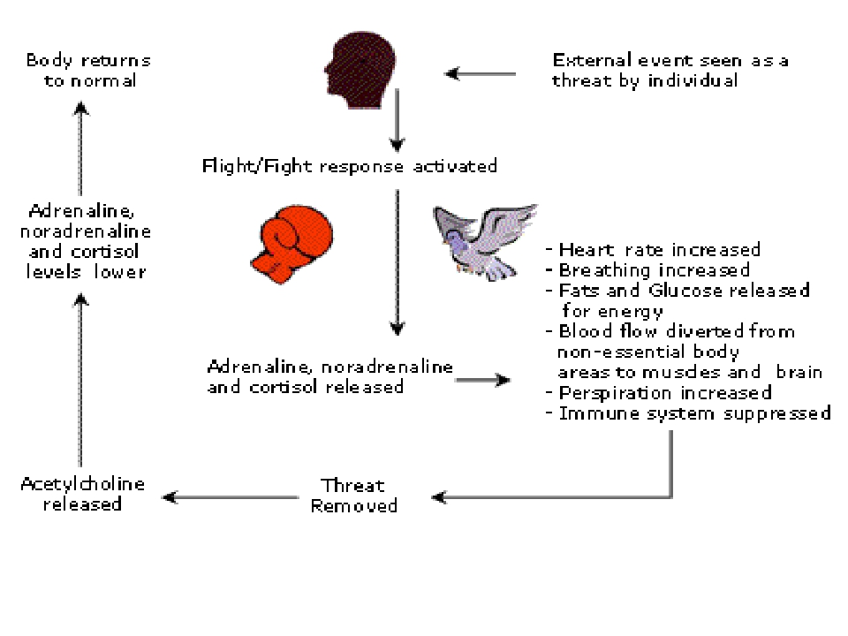
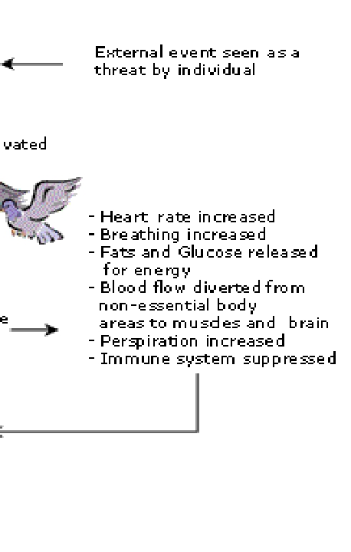
The Stress Response
http//:www.gladeanamcmahon.com/ stressmanagement.shtml

Slide 14
• It results in certain physiological changes:
• gastrointestinal,
• glandular and
• cardiovascular disorders
• It affects the entire body, not just a single part.
• Differences in response within and between
individuals.

Slide 15
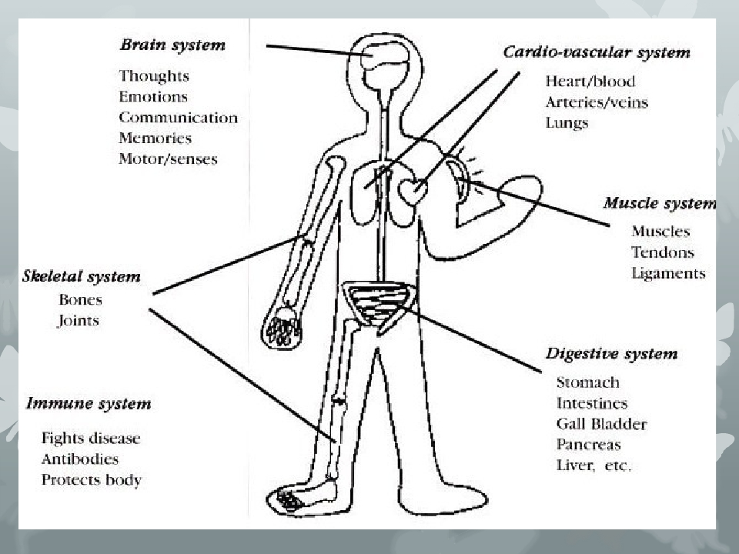
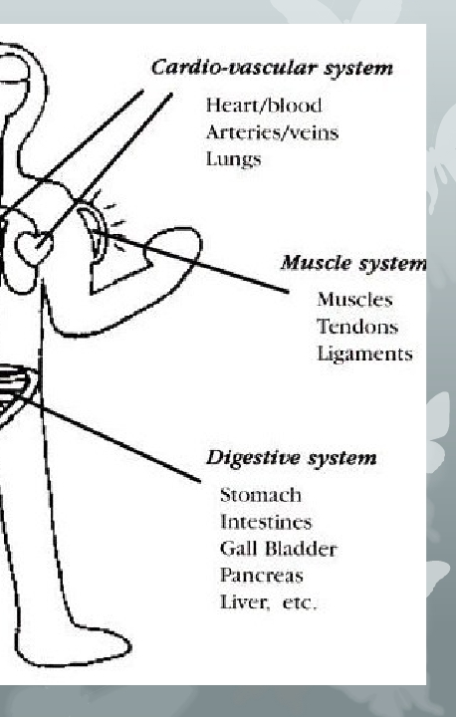
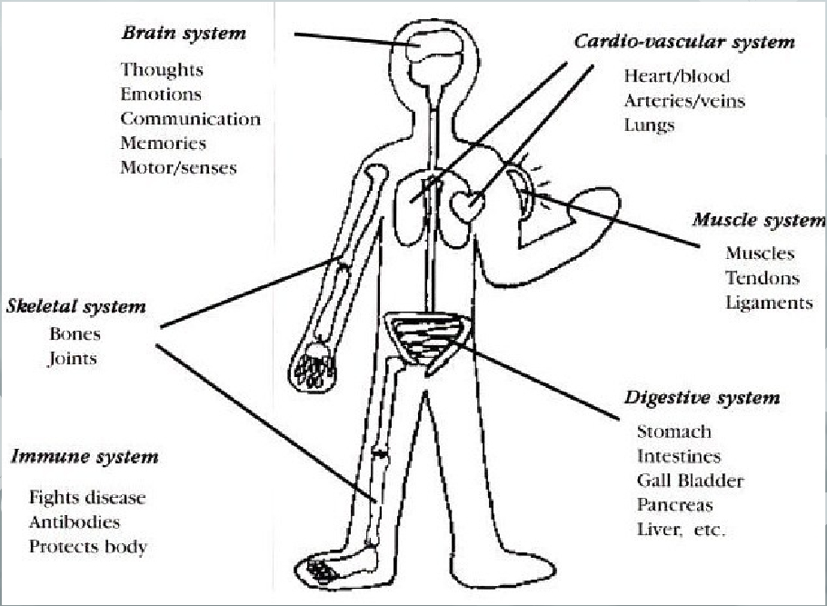

Slide 16
The General Adaptation Syndrome
and Burnout

Slide 17
THREE STAGES OF ADAPTASION IN STRESS
1.Alarm reaction: when a person is exposed to an unadapted
stimulus there is an initial shock (in which resistance is
lowered) followed by a rebound reaction (counter shock
phase) during which the organism’s defense mechanisms
become active.
2.Stage of resistance: during this stage the person’s full
adaptation may lead to successful return to equilibrium.
3.Stage of exhaustion: in case of failure of adaptability the
organism becomes exhausted.

Slide 18
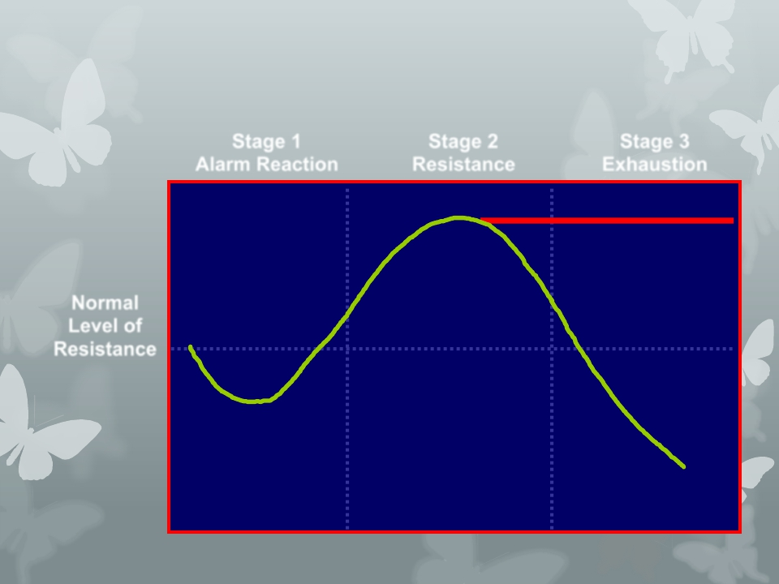
General Adaptation Syndrome
Stage 1
Alarm Reaction
Stage 2
Resistance
Stage 3
Exhaustion
DANGER ZONE
Normal
Level of
Resistance

Slide 19
What are some symptoms of unmanaged stress?
• Increased heart rate and blood pressure;
feeling tense, irritable, fatigued, or depressed
• Lack of interest and ability to concentrate, apathy
• Avoidance behaviors: abuse of drugs, alcohol,
tobacco
©Academic Skills Center, Dartmouth College 2001

Slide 20
Possible signs of stress
· Anxiety
· Back pain
· Constipation or diarrhea
· Depression
· Fatigue
· Headaches
· High blood pressure
· Insomnia
· Problems with relationships
· Shortness of breath
· Stiff neck
· Upset stomach
· Weight gain or loss

Slide 21
They may complain of:
Physical | Emotional
Fatigue | Irritability
Tension headaches | Feeling helpless
Upset stomach | Loss of self-esteem
Difficulty sleeping | Frustration
Tense muscles | Loss of concentration
Shortness of breath | Withdrawal
Change in appetite | Anxiety

Slide 22
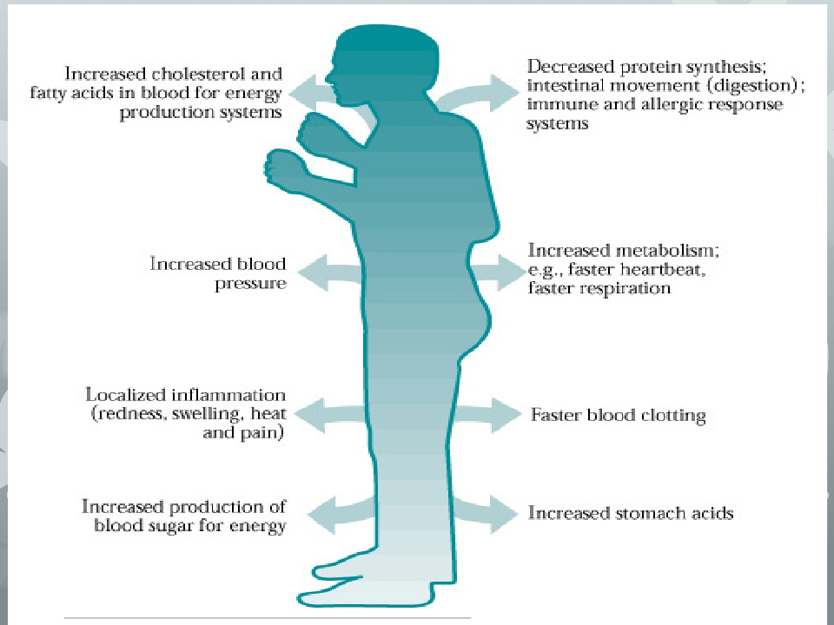
http://www.worksafesask.ca/files/ont_wsib/certmanual/prelim.html#

Slide 23
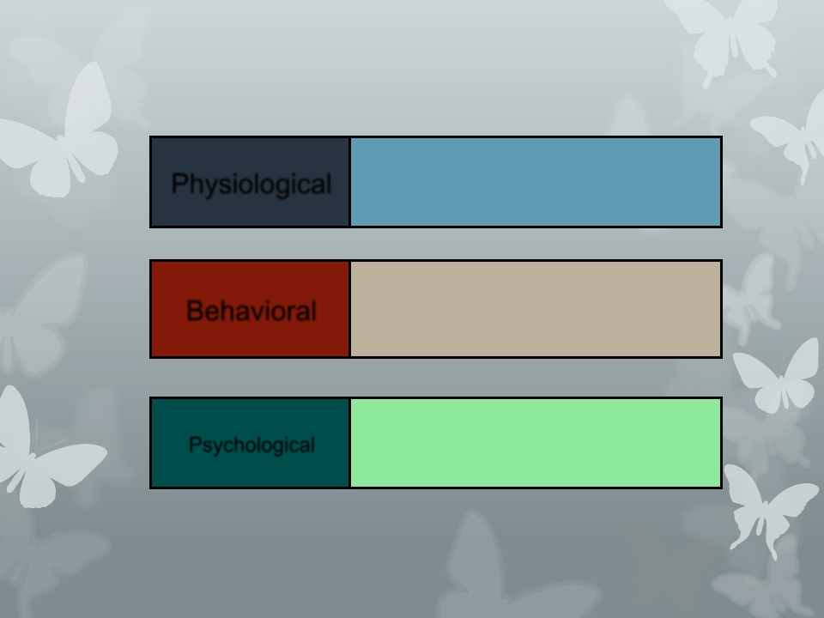
Consequences of Stress
Cardiovascular disease,
hypertension, headaches
Work performance,
accidents, absenteeism,
aggression, poor decisions
Dissatisfaction, moodiness,
depression, emotional
fatigue
Physiological
Behavioral
Psychological

Slide 24
Methods for Reducing Stress

Slide 25
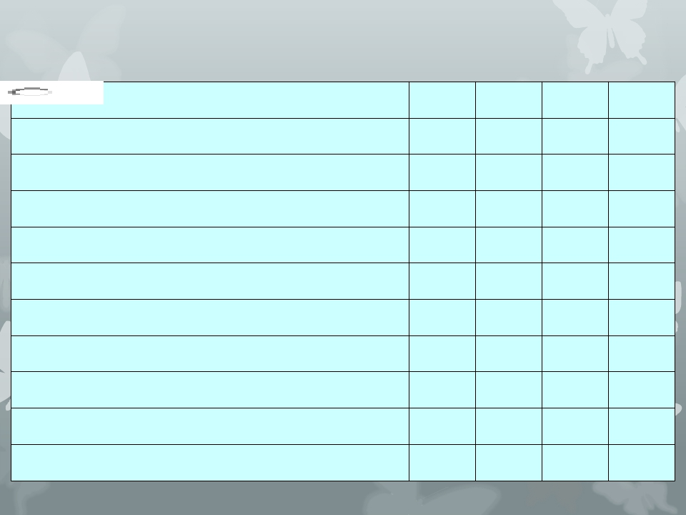
NEVER
0
SELDOM
1
OFTEN
2
ALWAYS
3
1 Do you miss meals?
2 Do you suffer from stomach complaints?
3 Do you bite your nails?
4 Are you restless when relaxing?
5 Do you suffer from depression?
6 Do you work late too often?
7 Do you suffer road rage?
8 Do you win at sports?
9 Do you argue with your partner and family?
10 Do you struggle for perfection?

Slide 26
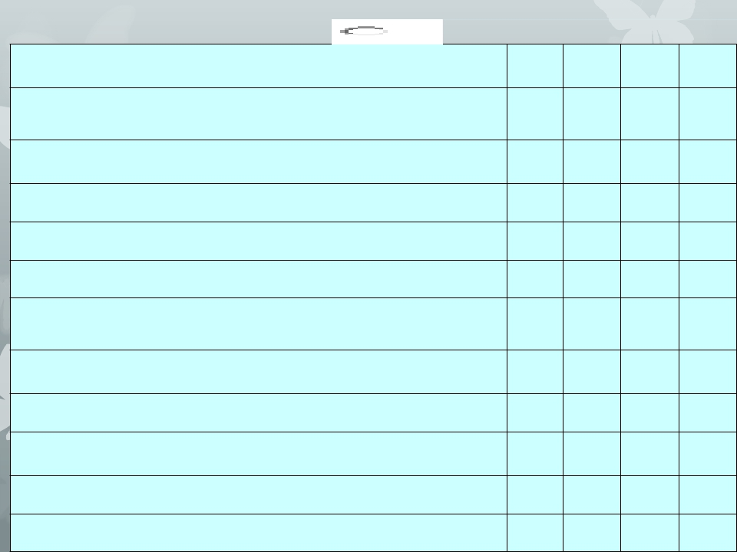
 | NEVER 0 | SELDOM 1 | OFTEN 2 | ALWAYS 3
11Doesyourfamilycomplainthattheydon'tseeyou enough?
12Doyouhavedifficultysleeping?
13Doyoudrink?
14Doyousmoke?
15Doyoufeeltrappedbylife?
16Areyoutoobusytoenjoydoingthethingsyoulikedoing?
17Doyoufindithardtomakedecisions?
18Doesthefutureworryyou?
19Doyoufindithardtoconcentrate?
20Doyousufferfromheadaches?
total

Slide 27
If you scored more than 45
Your score is too high. You need to look at a Stress Management
Programme and / or seek medical advice.
If you have scored between 35 and 44
You need to review your work / life balance.
If you scored between 25 and 34
You are coping with your stress levels but could benefit from
additional relaxation.
A score below 25
CONGRATULATIONS! You have the balance right. But don't
become complacent.
http://www.smartway.org.uk/pages/test.htm

Slide 28
Stress management

Slide 29
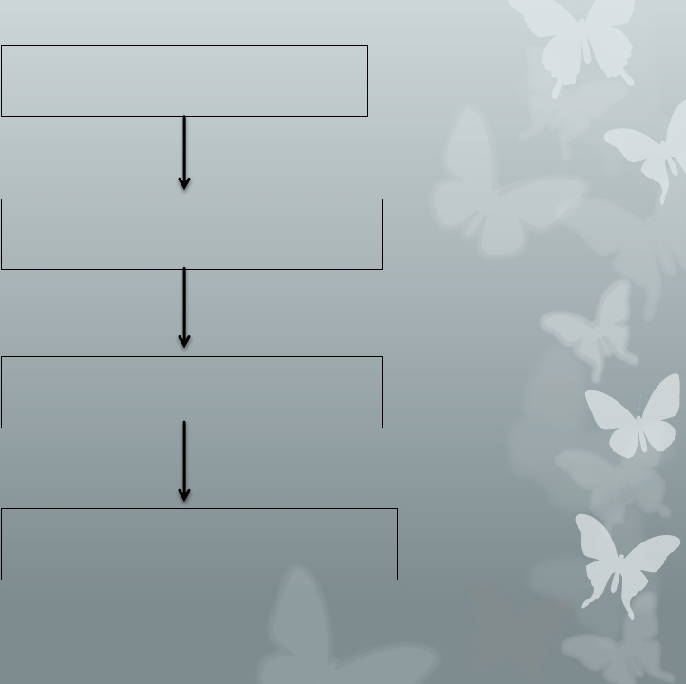
Identify the sources of stress
in your life
List and prioritize the sources of
stress in your life
Identify appropriate stress
management techniques
Create your stress management
plan
Stress management plan process

Slide 30
Intervention to
consider for stress
management
Time
Management
Personal
Management

Slide 31
What are the ways to manage stress effectively?
• Add balance to life; don't overdo studies or play.
• Know and accept what kind of person you are:
strengths and weaknesses.
• Get a thorough physical exam.
• Take "time outs", especially during study.
• Expand your support network, reinforce friendships.
• Exercise regularly.
©Academic Skills Center, Dartmouth College 2001

Slide 32
What are ways to manage stress effectively?
• Watch your breathing.
• Walk loosely and walk more.
• Learn and practice relaxation skills.
• Study each subject regularly for moderate periods
of time.
• Discuss problems with friends, family, dean or
counselor.
©Academic Skills Center, Dartmouth College 2001

Slide 33
Methods for Reducing Stress
•Predict it with awareness •Nutrition
•Assertiveness
•Look at self-talk
•Emotional
•Rest or Sleep
•Physical activity
•Relax/Deep breathing
expression/Sharing
•Look at past experiences •Find support
•Diversion/Recreation
•Humor
•Preparation/Organization •Writing
•Allow enough time
•Counseling

Slide 34
Methods for Reducing Stress
•Mindfulness
•Anger management
•Set realistic goals
•Set healthy limits
•Correct thinking
distortions
•Enjoy the beauty of
nature
•Manage triggers: alter,
avoid, accept
•Prioritize
•Hobbies
•Music
•Massage
•Nurturing
•Pet an animal
•Balance time alone, with
others, work, rest, and fun

Slide 35
Interrupting Stress –A 4 StepApproach
Stop

÷
Each time you encounter a stress…stop…before
(automatic) thoughts escalate into worst possible
scenarios.

Breathe
÷
After you stop, breathe deeply to release
physical tension…most time one tends to hold
breath in the midst being stressed…even a
momentary interruption can help.

Slide 36
Interrupting Stress –A 4 StepApproach

Reflect
÷
Focus energy on problem & reflect on the cause
of stress

Choose
÷
Time to choose how to deal with stress

Slide 38
Thank you

