Slide 1
Volunteering
Hana Alzamil

Slide 2
objectives
Definition.
Spectrum of community services.
Aims of volunteer work
Steps of preparation of volunteers.
The expectations of volunteers.
Acting along social, public and community responsibilities as a professional.
Opportunities in the volunteering.
Ethics of volunteering.
Practicing as a volunteer.

Slide 3
العمل التطوعي
التطوع لغة: تَنَفَّلَ، أي تَكَلَّفَ الطاعة. يقال: قام بالعبادة طائعًا مختارًا دون أن تكون فرضًا لله وفى التنزيل الحكيم: ﴿ فَمَنْ تَطَوَّعَ خَيْرًا فَهُوَ خَيْرٌ لَهُ ﴾ [سورة البقرة: آية 184].
اصطلاحًا: العمل التطوعي هو عمل يقوم به فرد أو مجموعات سواء كان ذلك العمل بدني أو فكري أو اجتماعي أو مادي أو ديني الباعث له هو احتساب الأجر والثواب من الكريم الوهاب
رابط الموضوع: http://www.alukah.net/sharia/0/108690/#ixzz50llF2ykA

Slide 4
دعوة القرآن الكريم للعمل التطوعي
من صور العمل التطوعي الإيثار قال الله تعالى: ﴿ وَيُؤْثِرُونَ عَلَى أَنفُسِهِمْ وَلَوْ كَانَ بِهِمْ خَصَاصَةٌ ﴾ [الحشر: 9]، أي: يقدمون خدمة الآخرين ومصلحتهم العامة على المصلحة الشخصية الخاصة
ذو القرنين وبناء السد كان بناء السد نعمة عظمى للبشرية وسببًا من أسباب هناء العيش على الأرض " قالوا يا ذا القرنين إن يأجوج ومأجوج مفسدون في الأرض فهل نجعل لك خرجا " فقال ذو القرنين بعفة وديانة وصلاح وقصد للخير:" ما مكّني فيه ربي خير " أي إن الذي أعطاني الله من الملك والتمكين خير لي من الذي تجمعونه
قصة الخضر وموسى عليهما السلام وبناء الجدار
موسى عليه السلام - وتطوعه لسقي الأنعام

Slide 5
دعوة السنة النبوية للعمل التطوعي
وردت أحاديث كثيرة تدل على مشروعية العمل التَّطوعي منها:
عن أنس بن مالك - رضي الله عنه - أن رسولَ الله -صلى الله عليه وسلم- قال: «ما من مُسلم يَغْرِسُ غَرْسا، أو يَزْرَعُ زَرْعا، فيأكلَ منه طَير، أو إنسان، أو بَهِيمة، إلا كان له به صدقة». أخرجه البخاري ومسلم والترمذي.
قال صلى الله عليه وسلم: "الساعي على الأرملة والمسكين كالمجاهد في سبيل الله أو القائم الليل الصائم النهار)؛ متفق عليه. رابط الموضوع: http://www.alukah.net/sharia/0/108690/#ixzz50mGBol2y

Slide 6
What is volunteering?
Volunteering is any activity that involves spending time, unpaid, doing something that aims to benefit the environment or someone (individuals or groups)
Giving your time and skills to help others and to progress yourself.

Slide 7
What is Community service?
Work done by a person or group of people that benefits others.
It is often done near the area where you live, so your own community reaps the benefits of your work.
You do not get paid to perform community service, but volunteer your time.
Community service can help many different groups of people:
Children People with disabilities,
Animals and the environment. Senior citizens,

Slide 8
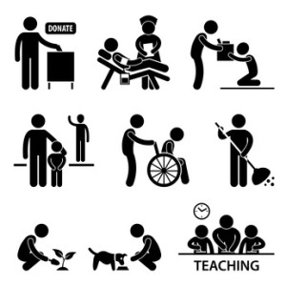
Is there any difference between community service & volunteering?

Slide 9
difference between community service & volunteering?
Community service
volunteering
A requirement imposed on a person by a school, their parents, the court system or other persons of authority.
Technically isn't volunteering because you would not be doing it if you were not being required to.
You are doing so of your own choosing without any worry of punishments or rewards.
You feel strongly about something and want to offer your time or services to help.
Read more: http://www.advicenators.com/qview.php?q=522751#ixzz50qHVhTqj

Slide 10
Spectrum of community services
Use Your Knowledge
Volunteer for an event.
Make a Commitment
Send cards to soldiers serving at the borders
Hold a bake sale for your favorite charity
Collect unused makeup and perfume to donate to a center for abused women
Do Your Own Thing

Slide 11
تجارب وخبرات في التطوع
https://youtu.be/0YLKKfPKMis

Slide 12
Why people Volunteer? Aims
Learn or develop a new skill
Be part of your community
Sense of achievement
Boost your career options
Give something back
New interests and hobbies
New experiences
Meeting a diverse range of people
Send a signal to your future employer
Impress your friends and family…
Have fun

Slide 13
volunteer have the right to:
Have
healthy and safe environment
Receive
orientation or induction session
Provided
with the organization’s policies and procedures
Sign
volunteer agreement with the expected tasks and working hours
Provided
with sufficient training and supervision
Reimbursed
for necessary out of pocket expenses
Protected
by appropriate insurance

Slide 14
volunteer have the right to:
Have
your personal information dealt with in a confidential manner
Take
holidays
Say
'no' if you are uncomfortable or feel you are being exploited
Be
informed and consulted on matters which affect you and your work.
Receive
feedback on your work
Receive
recognition for your contribution

Slide 15
volunteers are expected to:
Be
punctual and reliable
Respect
confidentiality
Carry out
the duties listed in your volunteer position description
Be
accountable
Give
notice if your availability changes or you are leaving the organization
Report
any injuries or hazards that you notice in the workplace

Slide 16
volunteers are expected to:
Adhere
to the organization's policies and procedures
Deal
with complaints in the appropriate manner
Undertake
training as requested
Ask
for support when needed
Support
other team members.

Slide 17
Acting along social, public and community responsibilities as a professional.
An individual’s social connections, typically measured by the number of social roles that an individual has, provides meaning and purpose to his or her life, while protecting him or her from isolation in difficult periods.
A study of adults aged 65 and older found that the positive effect of volunteering on physical and mental health is due to the personal sense of accomplishment that an individual gains from his or her volunteer activities. (Herzog et al., 1998)

Slide 18
Acting along social, public and community responsibilities as a professional.
As professional and community leaders, we have unlimited opportunities to become involved in and have a positive impact on local, national, and international communities and organizations.
Physicians have the potential to influence thousands, even millions, of lives.
As community leaders, we have the ability to inspire other people to be involved in supporting worthy causes and to truly make a positive difference in the community.
https://www.acog.org/Resources-And-Publications/Committee-Opinions/Committee-on-Health-Care-for-Underserved-Women/Community-Involvement-and-Volunteerism

Slide 19
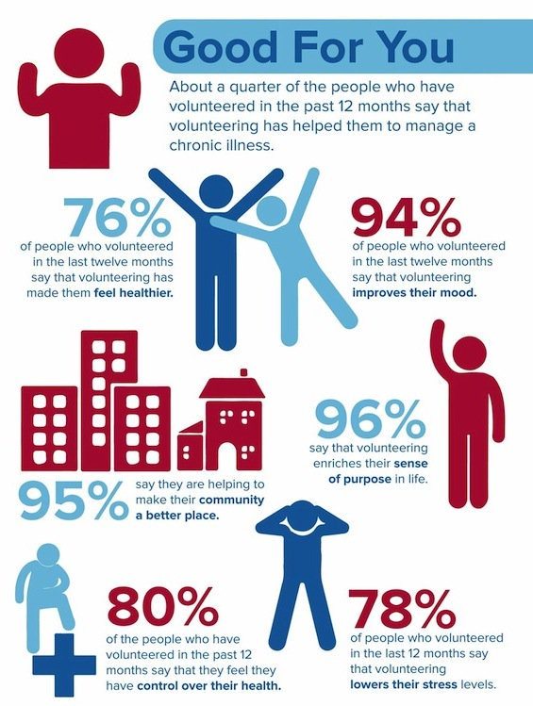
Benefits of volunteering
Help in managing chronic illness
Improvement in health
Improvement in mood
Make the community a better place
Sense of purpose in life
Lower stress
Have control on health.
http://ow.ly/YImZ309akmv

Slide 20
Opportunities in volunteering
Personal growth
New skills
Learn more about self and others
Overcome challenges
Enhance self-esteem and confidence.
Experience in a safe environment.

Slide 21
تجارب وخبرات في التطوع
https://youtu.be/aS-mAz34NA0

