Slide 1
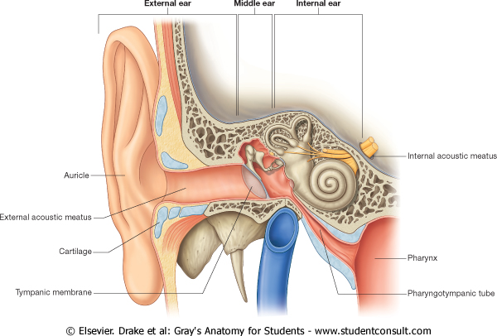
T H E E A R

Slide 2
Objectives
By the end of the lecture the student should be able to:
List the parts of the ear: External, Middle (tympanic cavity) and Internal (labyrinth).
Describe the parts of the external ear: auricle and external auditory meatus.
Identify the boundaries of the middle ear : roof, floor and four walls (anterior, posterior, medial and lateral).

Slide 3
Objectives
Define the contents of the tympanic cavity:
I. Ear ossicles,: (malleus, incus and stapes)
II. Muscles, (tensor tympani and stapedius).
III. Nerves (branches of facial and glossopharyngeal).
List the parts of the inner ear, bony part filled with perilymph (Cochlea, vestibule and semicircular canals), in which is suspended the membranous part that filled with endolymph).
List the organs of hearing and equilibrium.

Slide 4
EXTERNAL EAR
It is formed of the auricle, & the external auditory meatus.
The Auricle has a characteristic shape and collects air vibrations.
It consists of a thin plate of elastic cartilage covered by a double layer of skin.
It receives the insertion of extrinsic muscles, which are supplied by the facial nerve. Sensation is carried by great auricular & auriculotemporal nerves.

Slide 5
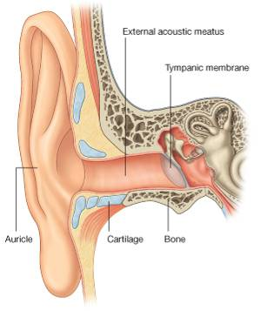
The external auditory canal is a curved S-shaped tube about 2.5 cm, that conducts & collects sound waves from the auricle to the tympanic membrane. Its outer 1/3rd is elastic cartilage, while its inner 2/3^{rds} are boney.
It is lined by skin, and its outer 1/3rd is provided with hairs, sebaceous and Ceruminous Glands: (modified sweat glands that secrete a yellowish brownish substance called the ear wax).

Slide 6
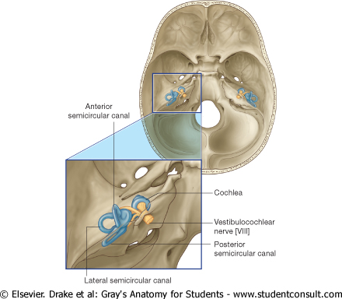
MIDDLE EAR (TYMPANIC CAVITY)
Middle ear is a narrow, oblique, slit- like cavity (air-filled) in the petrous temporal bone & lined with mucous membrane.
It contains the auditory ossicles, which transmit the vibrations of the tympanic membrane (eardrum) to the internal ear.

Slide 7
Communications of Middle Ear (Tympanic Cavity)
Anteriorly:
with the Nasopharynx through the Auditory Tube, which extends from the anterior wall downward, forward, and medially to the nasopharynx).
The posterior 1/3rd of the canal is bony, and its anterior 2/3rds are cartilaginous.
Its function is to equalize the pressure on both sides of the ear drum.

Slide 8
The middle ear has:
Roof,
Floor,
and 4 walls:
Anterior,
Posterior,
Lateral, and
Medial.
Anterior
Posterior
ROOF
MEDIAL
FLOOR

Slide 9
The Roof is formed by a thin plate of bone, called tegmen tympani, which is part of the petrous temporal bone.
It separates the tympanic cavity from the temporal lobe of the brain.
The Floor is formed by a thin plate of bone, which separates the middle ear from the bulb of the internal jugular vein.

Slide 10
Anterior wall
The anterior wall is formed below by a thin plate of bone that separates tympanic cavity from the internal carotid artery.
There are 2 canals at the upper part of the anterior wall.
The upper smaller is the canal for the tensor tympani muscle.
The lower larger is for the auditory tube.

Slide 11
The posterior wall has in its Upper part a large, irregular opening, the aditus to the mastoid antrum (a cavity behind the middle ear, within mastoid process, it contains air cells)
.Below : a small, hollow, conical projection, the pyramid, which houses the stapedius muscle and its tendon.
The tendon emerges from the apex of the pyramid.
Posterior wall
P
O
S
T
E
R
I
O
R
A
N
T
E
R
I
O
R

Slide 12
The lateral wall :
Is largely formed by the tympanic membrane.
The membrane is obliquely placed, facing downward, forward, & laterally.
It is extremely sensitive to pain.
Nerve supply of ear drum:
Outer surface:
1- Auriculotemporal nerve.
2- Auricular branch of vagus.
Inner surface:
Tympanic branch of the glossopharyngeal nerve.

Slide 13
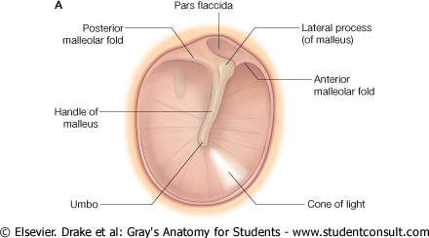
TYMPANIC MEBRANE
Normally, It is concave, and directed downwards, forwards and laterally. At the depth of its concavity there is a small depression, “ the Umbo” produced by the tip of the handle of the malleus.
When the membrane is illuminated through an otoscope, the concavity produces a “Cone of Light," which radiates anteriorly and inferiorly from the umbo.
Most of the of the membrane is tense and is called the Pars Tensa.
A small triangular area on its upper part is slack and called the Pars Flaccida

Slide 14
Greater part of the medial wall shows a rounded projection, (Promontory)
Above and behind the promontory lies the Oval window (Fenestra Vestibuli), Below and behind the promontory lies the Round window (Fenestra Cochleae),
Medial wall

Slide 15
Auditory Ossicles
The auditory ossicles are (3) malleus, incus, and stapes.
They transmit sound waves from tympanic membrane to the perilymph of the internal ear.
They are covered by mucous membrane & articulate by synovial joints.

Slide 16
Muscles within the tympanic cavity
TENSOR TYMPANI
Origin: Cartilage of the auditory tube and the bony walls of its own canal.
Insertion: into the handle of the malleus.
Nerve supply: Mandibular nerve.
Action: Contracts reflexly in response to loud sounds to limit the excursion of the tympanic membrane.

Slide 17
Stapedius (the smallest voluntary muscle)
Origin: Internal walls of the hollow pyramid.
Insertion: The tendon emerges from the apex of the pyramid and is inserted into the neck of the stapes.
Nerve supply: Facial nerve.
Action: Reflexly damps down the vibrations of the stapes by pulling on the neck of that bone.

Slide 18
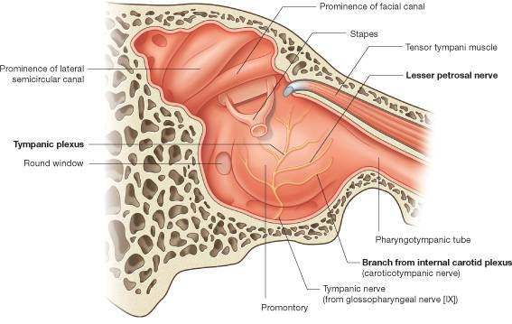
NERVES WITHIN MIDDLE EAR
Tympanic nerve
a branch of the glossopharyngeal nerve.
It gives:
Tympanic plexus on the promontory
The tympanic plexus gives the,
Lesser petrosal nerve which relays in the otic ganglion.
It gives secretomotor supply to the parotid gland

Slide 19
FACIAL NERVE
Enters through the
Internal acoustic meatus with the 8th nerve.
It expands to form Geniculate ganglion.
passes vertical behind the pyramid.
leaves the middle ear through the stylomastoid foramen.

Slide 20
BRANCHES
OF
FACIAL NERVE
1. Greater Petrosal nerve.
Arises from Geniculate
Ganglion.
Carries preganglionic parasympathetic to :
Lacrimal,
Nasal &
Palatine glands.
2. Nerve to Stapedius.
3. Chorda Tympani:
Arises just before the facial nerve exits.

Slide 21
INTERNAL EAR, (LABYRINTH)
Labyrinth is situated in the petrous part of the temporal bone, medial to the middle ear.
It consists of : Bony & Membranous labyrinth

Slide 22
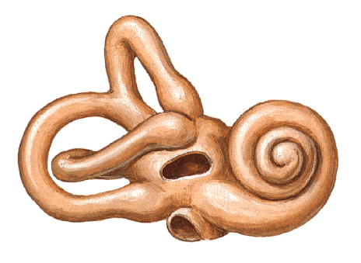
It is a series of bony chambers lined by endosteum.
They contain a clear fluid, the perilymph,
It consists of:
Cochlea
Vestibule,
Semicircular canals,
Sc
V
C
Bony Labyrinth

Slide 23
Cochlea
Its first turn produces the promontory on the medial wall of the tympanic cavity.
It contains the cochlear duct

Slide 24
Vestibule,
Is the central part of the bony labyrinth.
Contains the utricle & saccule

Slide 25
In the lateral wall of the vestibule are the fenestra vestibuli, which is closed by the base of the stapes, and the fenestra cochleae, which is closed by the secondary tympanic membrane.

Slide 26
Semicircular Canals
Semicircular canals: superior (anterior), posterior & lateral.
Each canal has a swelling at one end called the ampulla.
The canals open into the vestibule by five orifices, one of which is common to two of the canals.
Lodged within the canals are the semicircular ducts.

Slide 27
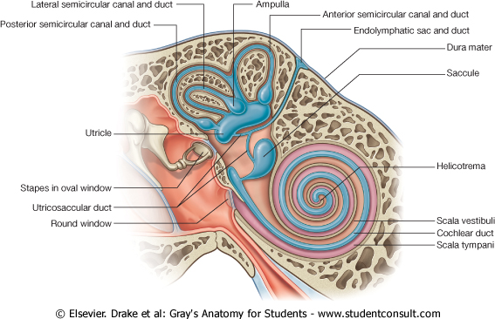
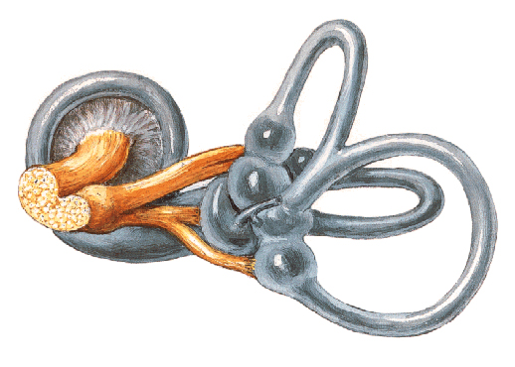
The Membranous Labyrinth :consists of series of membranous sacs and ducts within the bony labyrinth, It is filled with Endolymph.
(Four ducts & Two sacs) Which are freely communicate with one another :
Sacs: Utricle & Saccule (within the bony vestibule).
Ducts: Three semicircular Ducts ,(within the bony semicircular canals),
Cochlear Duct: (within the bony cochlea).

Slide 28
Located on the walls of the utricle and saccule are specialized sensory receptors, which are sensitive to the orientation of the head to gravity or other acceleration forces.
The utricle, saccule and semicircular ducts are concerned with maintenance of Equilibrium

Slide 29
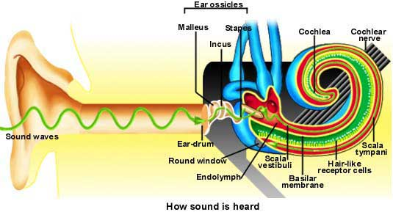
The highly specialized epithelium on the floor of cochlear duct forms the Spiral organ of Corti that
contains the sensory receptors for Hearing.

Slide 30
THANK YOU

