Slide 1
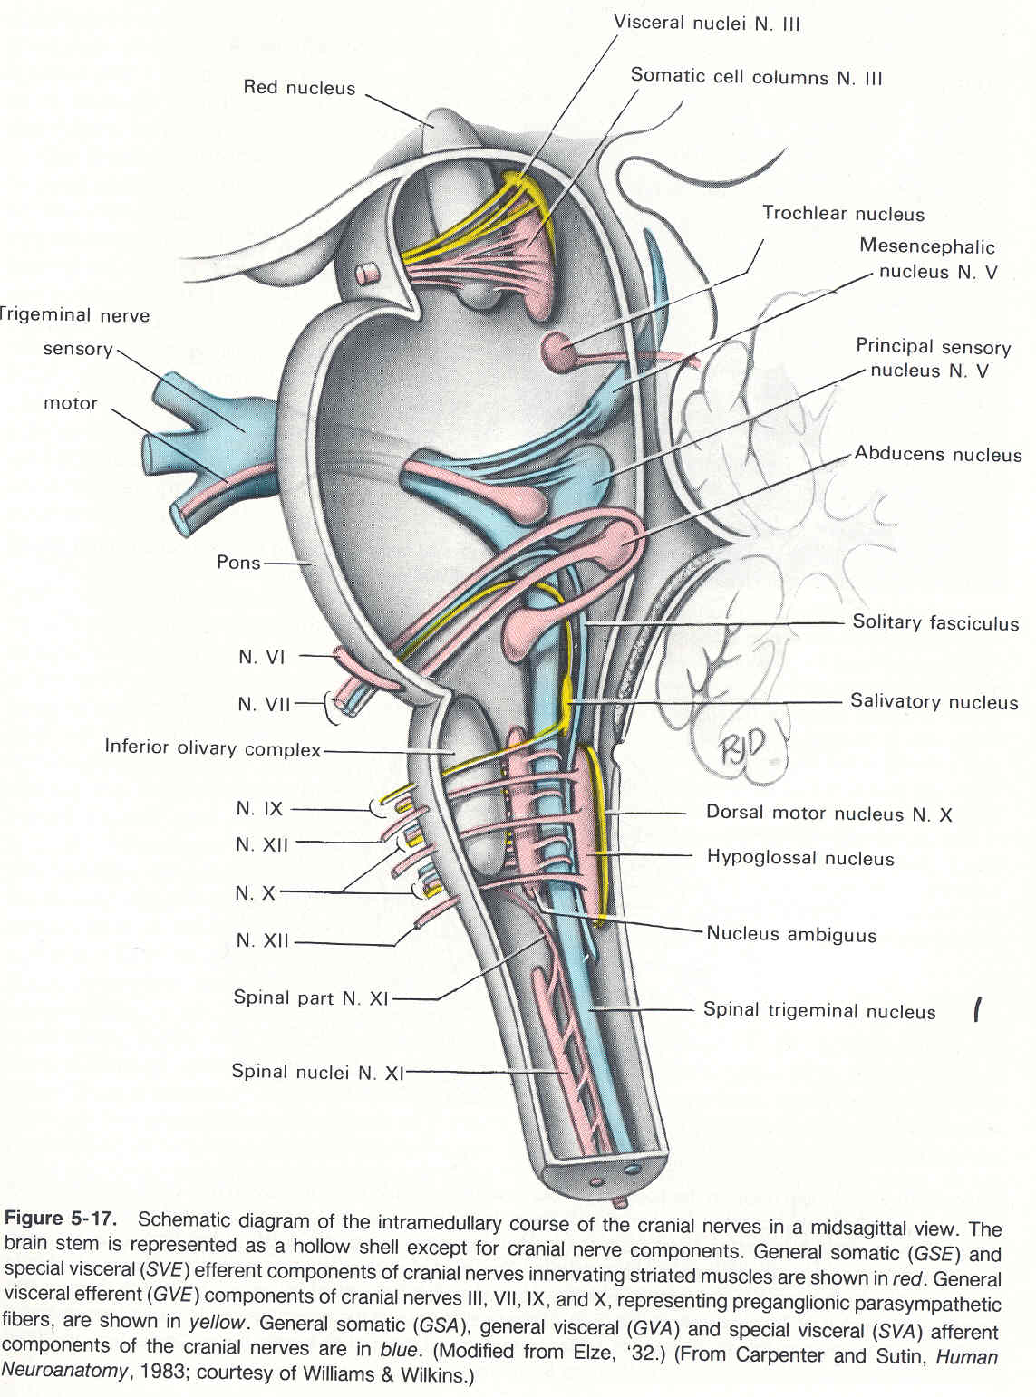
The Cranial Nerves 2, 3,4,6
By Prof. Saeed Abuel Makarem &
Dr.Sanaa Alshaarawy

Slide 2
Objectives
By the end of the lecture, you should be able to:
List the cranial nuclei related to occulomotor, trochlear, and abducent nerves in the brain stem.
Describe the type and site of each nucleus.
Describe the site of emergence and course of these 3 nerves.
Describe the important relations of occulomotor, trochlear, and abducent nerves in the orbit.
List the orbital muscles supplied by each of these 3 nerves.
Describe the effect of lesion of each of these 3 nerves.
Describe the optic nerve and visual pathway.

Slide 3
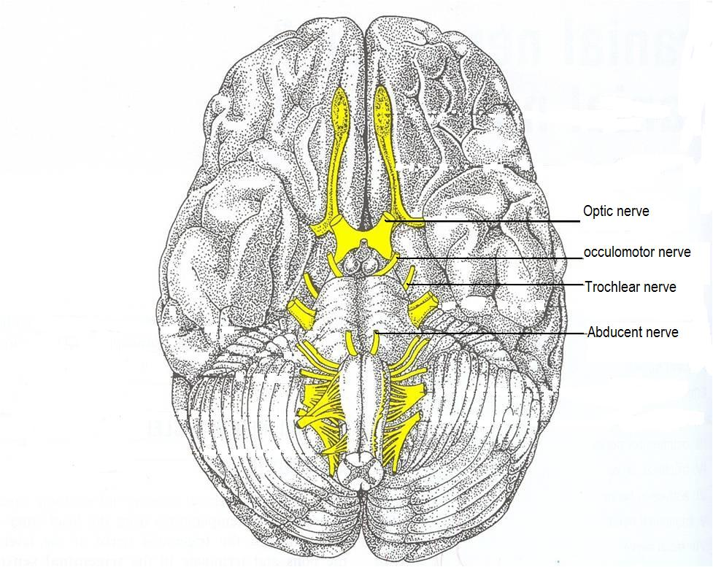
Brain (Ventral view) Brain stem (Lateral view)

Slide 4
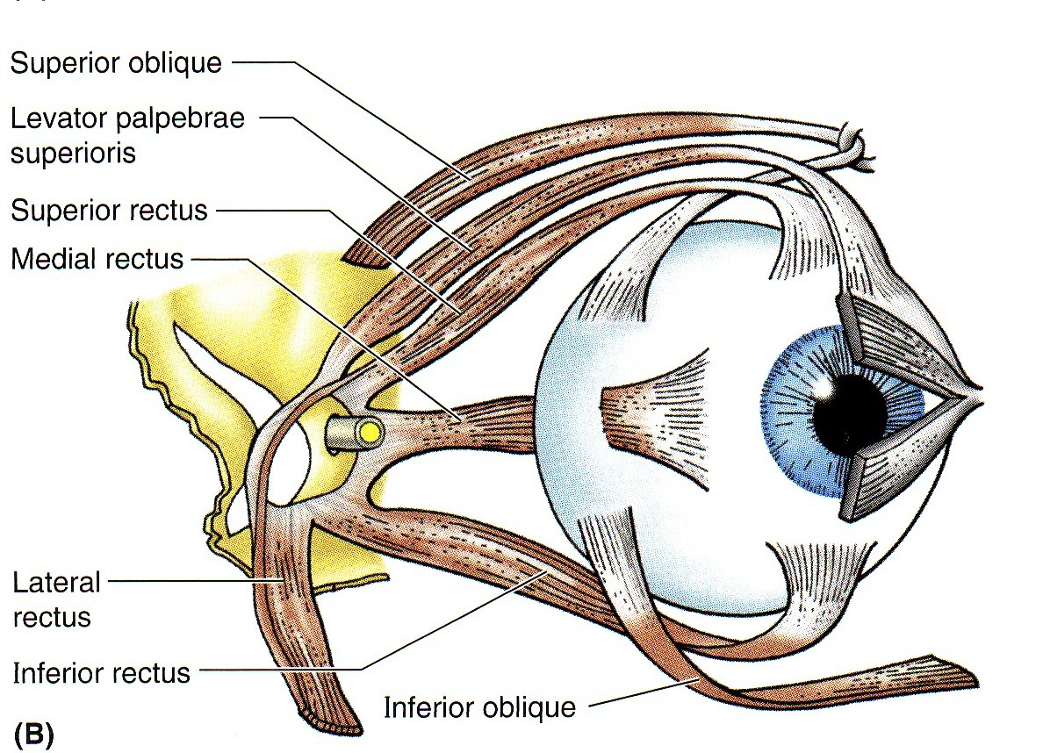
EXTRA-OCULAR MUSCES (7 muscles).
1- Levator palpebrae superioris.
4 Recti muscles:
Superior rectus,
Inferior rectus,
Medial rectus,
Lateral rectus,
2 Oblique muscles:
Superior oblique,
Inferior oblique.
NB. All muscles of the eye are supplied by the oculomotor nerve , EXCEPT LR6 + SO4

Slide 5
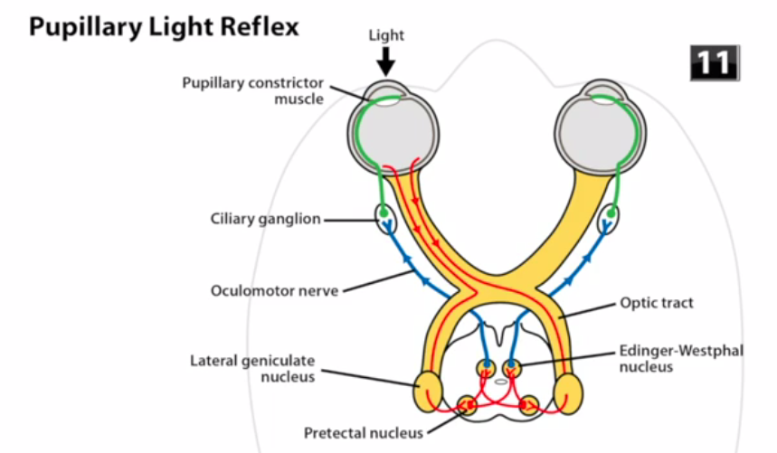
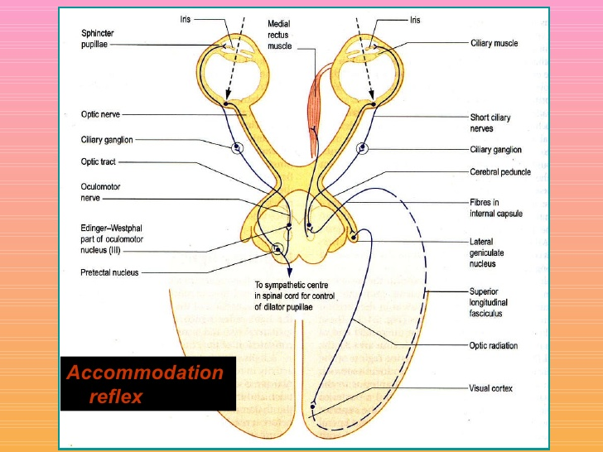
Occulomotor Nerve
Motor for most of extraocular muscles.
Also carries preganglionic parasympathetic fibers to the pupillary constrictor (pupillary reflex) and ciliary muscles (accomodation).
Has two nuclei:
1- Main occulomotor nucleus :
Lies in the mid brain, at the level of superior colliculus, located in the periaqueductal grey matter
2- Accessory nucleus (Edinger-Westphal nucleus) :
Lies dorsal to the main motor nucleus,
Its cells are preganglionic parasympathetic neurons.
It receives; Fibres from the pretectal nucleus for the direct and consensual pupillary reflexes, and Corticonuclear fibers for accommodation reflex .

Slide 6
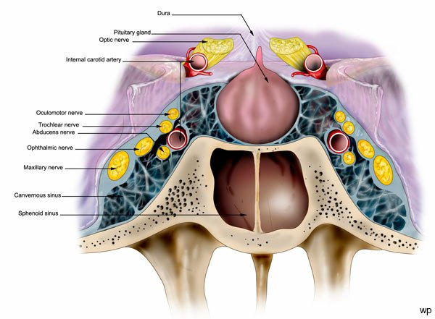
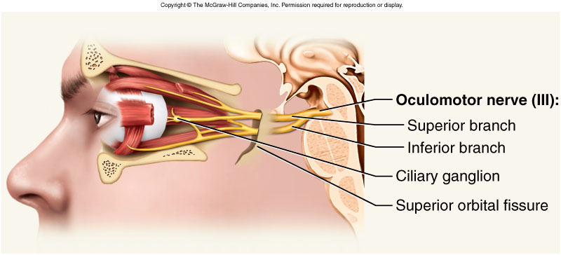
Occulomotor Nerve
Axons from the oculomotor nucleus curve ventrally through the tegmentum and the red nucleus in the midbrain.
The nerve emerges on the anterior surface of the midbrain in the interpeduncular fossa.
Then it passes forward between posterior cerebral and superior cerebellar arteries.
In the middle cranial fossa it runs in the lateral wall of the cavernous sinus, then it divides into superior and inferior divisions which pass to the orbit through the superior orbital fissure.

Slide 7
Axons from the Edinger-Westphal nucleus accompany the oculomotor nerve fibers to the orbit, where they terminate in the ciliary ganglion.
Postganglionic fibers pass through the short ciliary nerves to the eyeball, where they supply:
Constrictor pupillae muscle of the iris and
Ciliary muscle.

Slide 8
So,Occulomotor nerve supplies:
Motor to:
Levator palpebrae superioris
Superior rectus muscle
Medial rectus muscle
Inferior rectus muscle &
Inferior oblique muscle.
Parasympathetic fibers to:
1- Constrictor pupillae and
2- Ciliary muscles.
So; It is responsible for;
Elevation of upper eyelid (open the eye).
Turning the eyeball upward,
downwards and medially,
Constriction of the pupil (Pupillary reflex).
Accommodating reflex of the eyes.

Slide 9
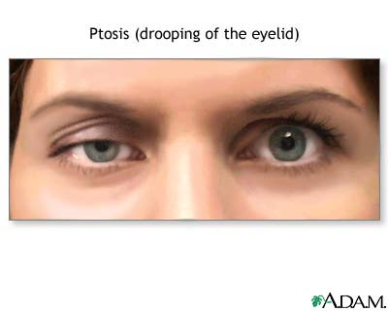
Occulomotor Nerve Lesion
Lesion results in:
Lateral squint.
Ptosis.
Diplopia.
Pupillary dilatation.
Loss of accommodation.Sphincter& ciliary ms.
The eyeball is fully abducted and depressed ( down and out) because of the unopposed activity of lateral rectus and superior oblique.
The preganglionic parasympathetic fibers run superficially in the nerve and are therefore the first axons to suffer when a nerve is affected by external pressure. Consequently, the first sign of compression of the occulomotor nerve is ipsilateral defect of the pupillary response to light.

Slide 10
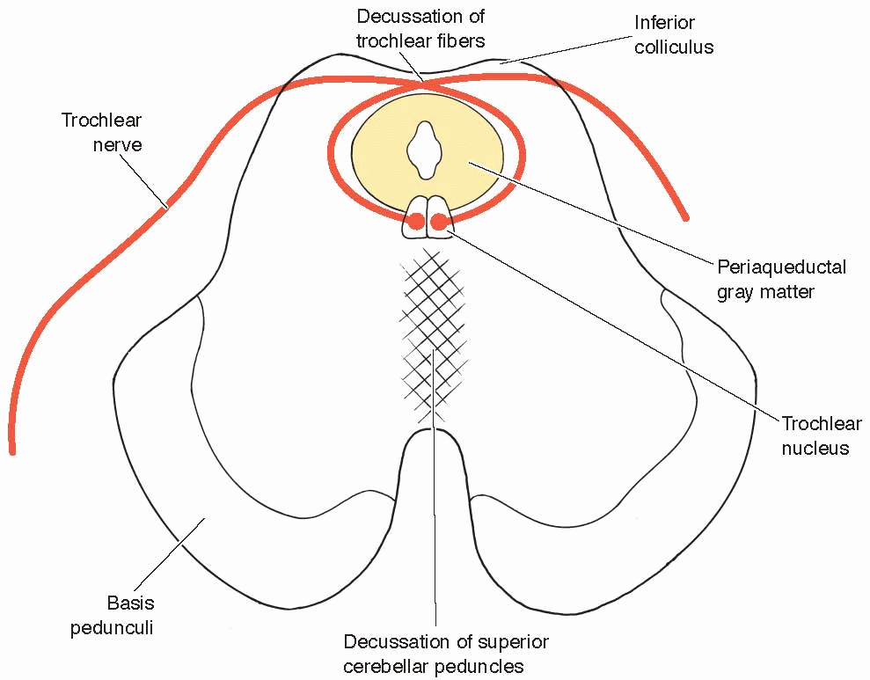
Trochlear Nerve
Type: motor
Small motor nucleus located in the periaqueductal grey matter at the level of inferior colliculus.
Fibers curve backwards and decussate.
The nerve emerges immediately caudal to the inferior colliculus, on the dorsal surface of brain stem.

Slide 11
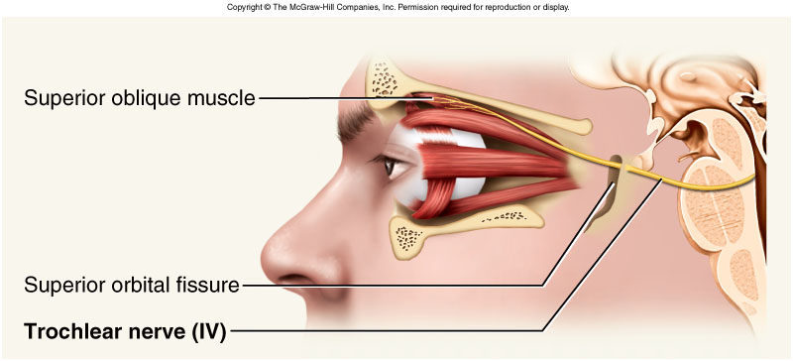
Trochlear Nerve
It passes forward through middle cranial fossa in the lateral wall of the cavernous sinus.
The nerve then enters the orbit through the superior orbital fissure.
It supplies;
Superior oblique muscle, (only one muscle).
Its function;
Rotates the eye ball downwards and laterally.

Slide 12
Trochlear Nerve Lesion
Lesion results in diplopia &
Inability to rotate the eyeball infero-laterally.
So, the eye deviates; upward and slightly inward (medially).
This person has difficulty in walking downstairs

Slide 13
Abducent Nerve
Only one motor nucleus.
Lies in caudal pons in the floor of the 4th ventricle.
Lies close to the middle line, in a line with 3rd, 4th & 12th nerves.
It forms the facial colliculus with the fibers of facial nerve looping around the nucleus.
It emerges from the ventral aspect of brain , at the junction of the pons and the pyramid of the medulla oblongata.

Slide 14
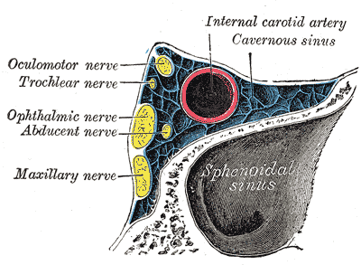
Abducent Nerve
It passes through cavernous sinus, lying below and lateral to the internal carotid artery
Then it enters the orbit through the superior orbital fissure.
It supplies; the lateral rectus muscle which rotates the eye ball laterally ; (abduction).

Slide 15
Abducent Nerve Lesion
Lesion results in:
Inability to direct the affected eye laterally, so it result in (medial squint).
A nuclear lesion may also involve the nearby nucleus or axons of the facial nerve, causing paralysis of all facial muscles in the ipsilateral side.

Slide 16
Optic Nerve
Type: Special sensory N.
Function: Vision
Lesion results in: visual field defects and loss of visual acuity,
a defect of vision is called anopsia.

Slide 17
Visual Pathway
Optic nerve.
Optic chiasm.
Optic tract.
Lateral geniculate body (nucleus).
Optic radiation.
Visual cortex.

Slide 18
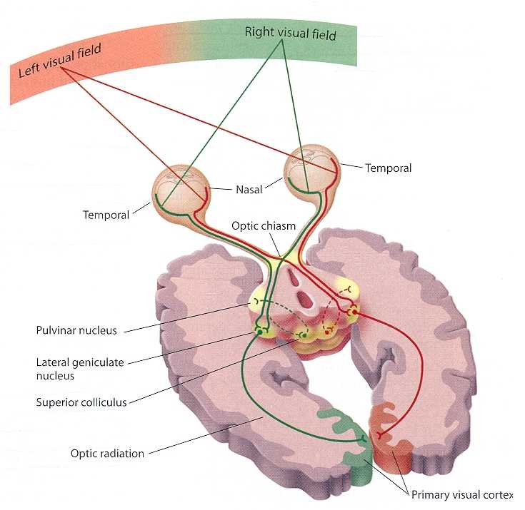
Visual Pathway
Photoreceptors:
Rods & Cones of the retina
Three neurons pathway
1st order neurons:
Bipolar cells of retina
2nd order neurons:
Ganglion cells of retina.
Their axons form the optic nerve
3rd order neurons:
Neurons in the lateral geniculate body.
Their axons terminate in primary visual cortex.

Slide 19
Optic Nerve
Axons of retinal ganglion cells converge at the optic disc and pass as the optic nerve.
Then the nerve passes posteromedially in the orbit.
Then exits through the optic canal to enter the middle cranial fossa to form the optic chiasma.

Slide 20
Optic Chiasma
Fibers from the nasal (medial) half of retina decussate in the chiasm and join uncrossed fibers from the temporal (lateral) half of the retina to form the optic tract.
The decussation of nerve fibers in the chiasm resulting in the right optic tract conveys impulses from the left visual field and vice versa.
The partial crossing of optic nerve fibers in the optic chiasma is a requirement for binocular vision.
Which retinal fibres are present in the left optic tract?????????

Slide 21
Optic Tracts
Fibers in the optic tracts:
Mainly terminate in the (LGB), lateral geniculate body of the thalamus (3rd order neuron).
A few fibers terminate in pretectal area and superior colliculus.
These fibers are related to light reflexes.

Slide 22
From the lateral geniculate nucleus (third-order neuron), thalamocortical fibres project through the retrolenticular part of the posterior limb of the internal capsule as the optic radiation, which terminates in the primary visual cortex of the occipital lobe.
The primary visual cortex is located predominantly on the medial surface of the hemisphere in the region above and below the calcarine sulcus.

Slide 23
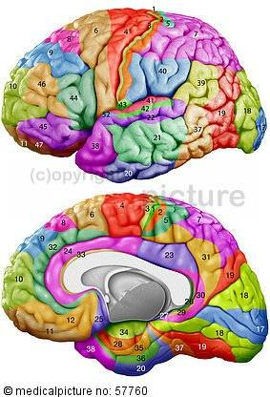
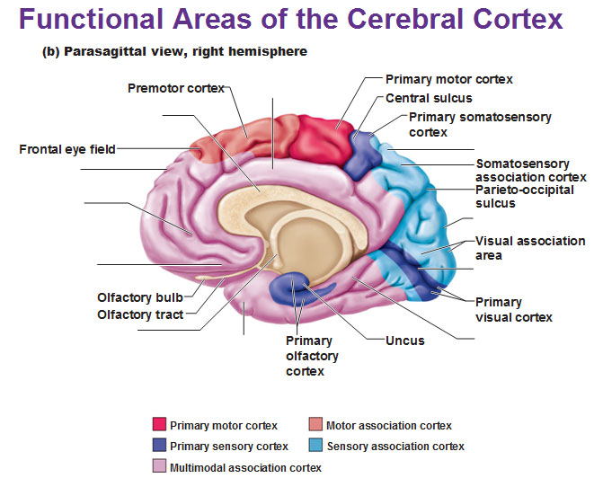
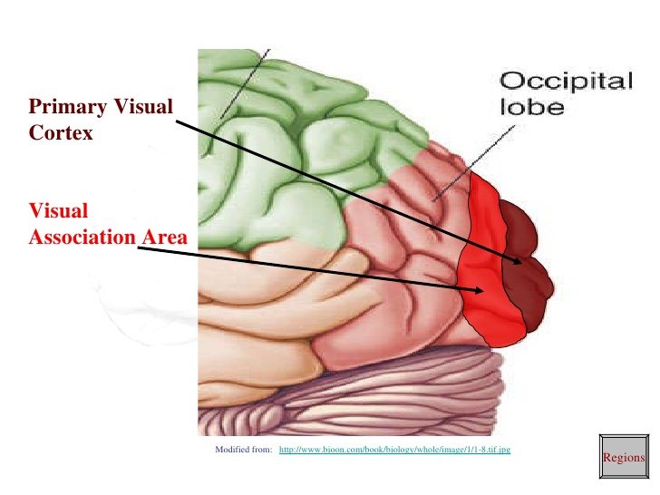
Visual Cortex
The primary visual cortex (area 17 of Brodmann's) occupies the upper and lower lips of the calcarine sulcus on the medial surface of the cerebral hemisphere.
The visual association cortex is extensive, including the whole of the occipital lobe, the adjacent posterior part of the parietal lobe. This cortex is involved in interpretation and recognition of objects and perception of color, depth, motion, and other aspects of vision.

Slide 24
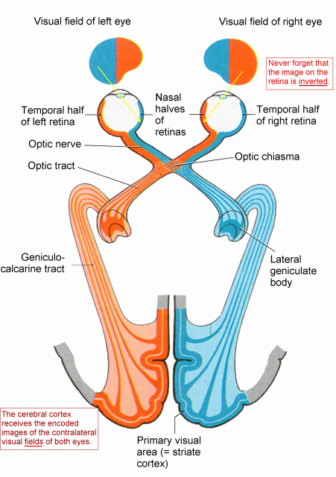
Visual field deficits
Disease of the eyeball (cataract, intraocular haemorrhage, retinal detachment) and disease of the optic nerve (multiple sclerosis and optic nerve tumors) lead to : loss of vision in the affected eye (monocular blindness).
Compression of the optic chiasm by an adjacent pituitary tumour leads to : bitemporal hemianopia.
Vascular and neoplastic lesions of the optic tract, optic radiation or occipital cortex produce : contralateral homonymous hemianopia.

Slide 25
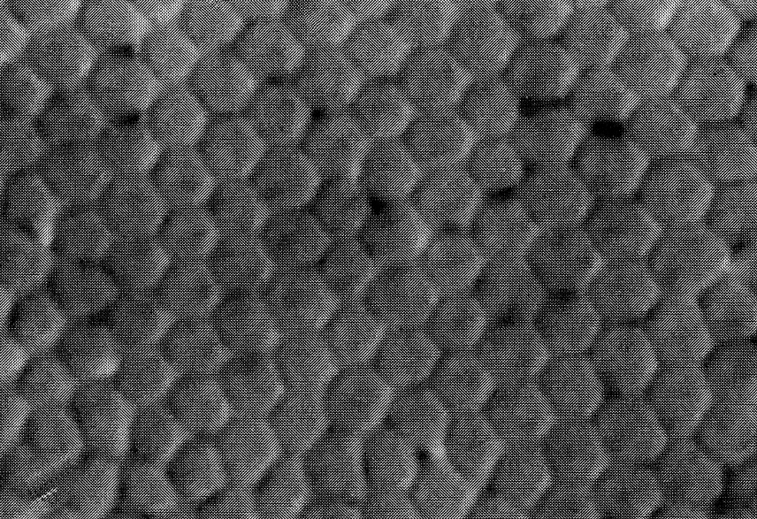
THANK YOU

Slide 26
FOR YOU Visual field deficits
A person may not be able to see objects on their left or right sides of visual fields (homonymous hemianopsia) if the optic tract or radiation or visual cortex affected.
or may have difficulty seeing objects on their outer visual fields (bitemporal hemianopsia) if the optic chiasm is involved.
The pretectal area, or pretectum, is a midbrain structure composed of seven nuclei and comprises part of the subcortical visual system. Pretectal nuclei are bilateral group of highly interconnected nuclei located near the junction of the midbrain and forebrain.

