Slide 1
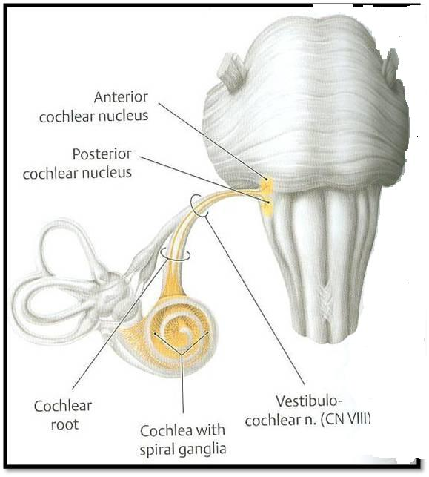
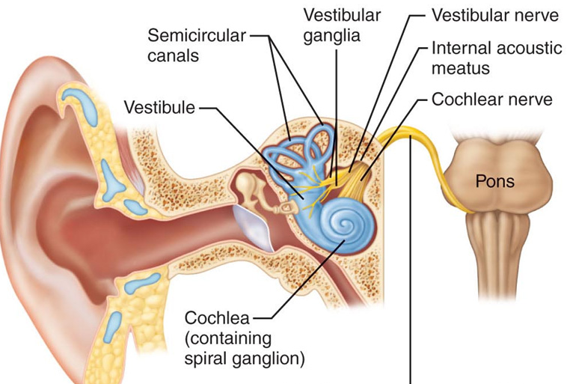
The Vestibulo-cochlear Nerve (Cranial Nerve 8) (Vestibular & Auditory Pathways)
By :
Prof. Ahmed Fathalla
&
Dr. Sanaa AlShaarawy

Slide 2
OBJECTIVES
At the end of the lecture, the students should be able to:
List the nuclei related to vestibular and cochlear nerves in the brain stem.
Describe the type and site of each nucleus.
Describe the vestibular pathways and its main connections.
Describe the auditory pathway and its main connections.

Slide 3
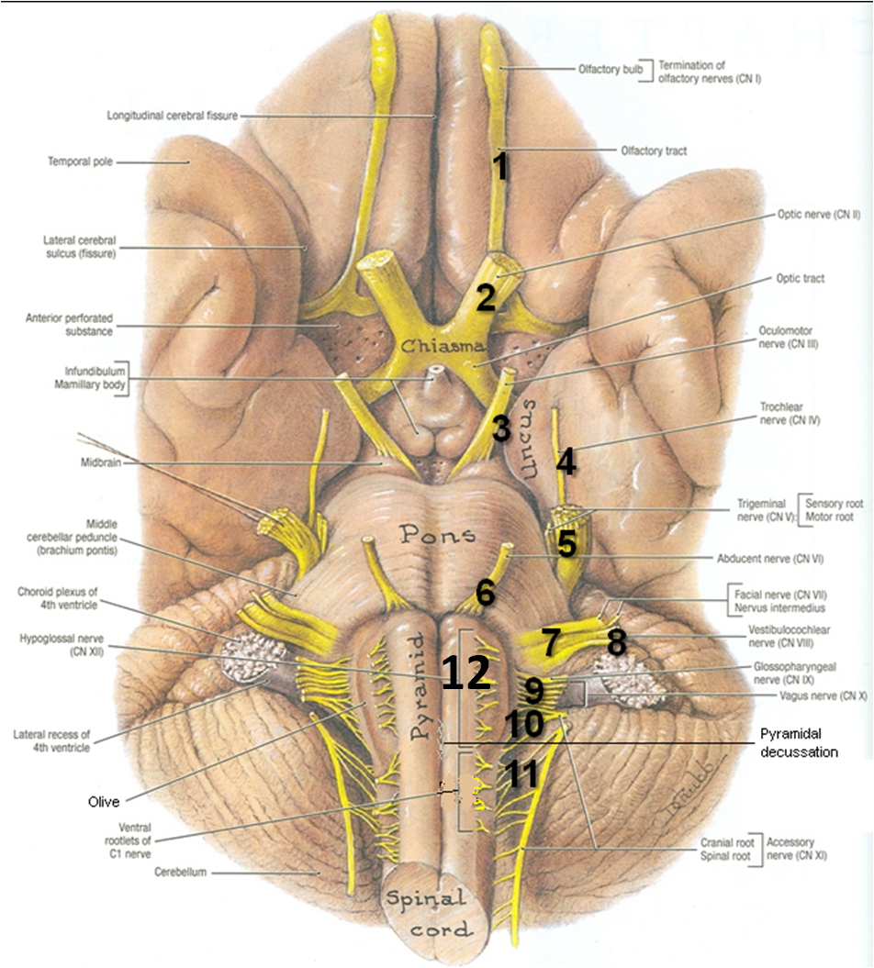
BRAIN – VENTRAL SURFACE
Ponto-medullary
Sulcus (cerebello-pontine angle)

Slide 4
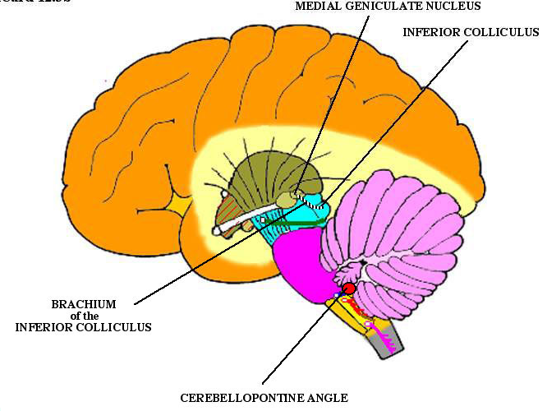
Vestibulo-Cochlear Nerve
Type: Special sensory (SSA)
Conveys impulses from inner ear to nervous system.
Components:
Vestibular part: conveys impulses associated with body posture ,balance and
coordination of head & eye
movements.
Cochlear part: conveys impulses associated with hearing.
Vestibular & cochlear parts leave the ventral surface of brain stem through the pontomedullary sulcus ‘at crebellopontine angle’ (lateral to facial nerve), run laterally in posterior cranial fossa and enter the internal acoustic meatus along with 7th nerve.

Slide 5
Vestibular Nerve
The cell bodies (1st order neurons) are located in the vestibular ganglion within the internal auditory meatus.
The Peripheral processes (vestibular nerve fibers) make dendritic contact with hair cells of the membranous labyrinth (inner ear).
The central processes (form the vestibular nerve) ‘’Efferent Fibres’’ :
Mostly end up in the lateral, medial, inferior and superior vestibular nuclei (2nd order neurons) of the rostral medulla, located beneath the lateral part of the floor of 4th ventricle
Some fibers go to the cerebellum through the inferior cerebellar peduncle
Vestibular nuclei belong to special somatic afferent column in brain stem.
2
1

Slide 6
Other Efferents from the vestibular nuclei project to other regions for the control of posture, maintenance of equilibrium, co-ordination of head & eye movements and the conscious awareness of vestibular stimulation .
The efferents from the vestibular nuclei project:
To ipsilateral flocculonodular lobe of cerebellum (vestibulo-cerebellar tract) (For Balance) through inferior cerebellar peduncle.
Bilaterally to ventral posterior nucleus of thalamus, which in turn project to the cerebral cortex ( For conscious awareness).
Bilaterally to motor nuclei of cranial nerves (vestibulo-ocular tract) through medial longitudinal fasciculus (For coordination of head and eye movements).
To Motor neurons of the spinal cord as lateral (ipsilateral) directly & medial vestibulospinal (bilateral) tracts through MLF (for control the posture ).
2
1
3
4

Slide 7
Medial Longitudinal Fasciculus
Extends through out the brain stem and formed of both descending & ascending fibers
Projects bilaterally
Has two components:
The ascending component (vestibulo-ocular) establishes connections with the nuclei of the Occulomotor, Trochlear & Abducent nerves (motor nuclei for extraoccular muscles) for coordination of head & eye movements.
The descending component extends into the spinal cord as the medial vestibulospinal tract, for control the body posture.

Slide 8
Vestibulospinal Tracts
Vestibulospinal fibers influence the activity of spinal motor neurons concerned with the control of body posture and balance
Two tracts: lateral & medial.
Lateral arises from lateral vestibular (Deiter’s) nucleus, descends ipsilaterally
Medial is the descending part of the medial longitudinal fasciculus, projects bilaterally.
Lateral

Slide 9
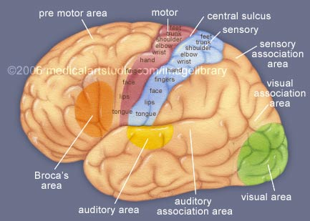
Vestibular Cortex
Located in the lower part of postcentral gyrus (head area).
Responsible for conscious awareness of vestibular sensation.

Slide 10
Auditory Pathway
It is a multisynaptic pathway
There are several locations between medulla and the thalamus where axons may synapse and not all the fibers behave in the same manner.
Representation of cochlea is bilateral at all levels above cochlear nuclei, so Hearing is bilaterally represented.

Slide 11
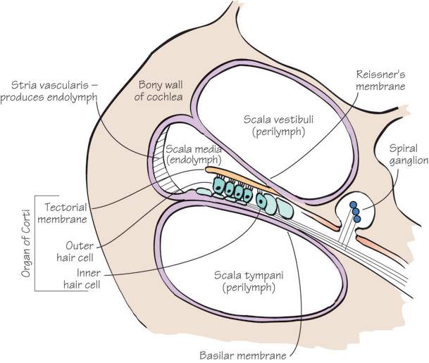
Cochlear (Auditory) Nerve
The cell bodies (1st order neurons) are located in the spiral ganglion within the cochlea ( organ of Corti in inner ear).
The Peripheral processes make dendritic contact with hair cells of the organ of Corti within the cochlear duct of inner ear.
The central processes (cochlear nerve fibers) terminate in the dorsal and ventral cochlear nuclei (2nd order neurons), which lie close to the inferior cerebellar peduncle (ICP) in open rostral medulla.
Cochlear nuclei belong to special somatic afferent column in brain stem.
ICP
ICP

Slide 12
AUDITORY PATHWAY
From the cochlear nuclei, 2nd order neurons, fibres ascend into the pons, where:
Most fibers cross the midline in trapezoid body (1) and terminate in the nucleus of trapezoid body or in the contralateral superior olivary nucleus (2)
Some fibers run ipsilaterally and terminate in the superior olivary nucleus (2).
From the superior olivary nuclei, ascending fibers comprise the lateral lemniscus (3) containg both crossed (mainly) and direct (few) cochlear fibres, which runs through tegmentum of pons and terminate in the inferior colliculus (4) of the mdibrain (3rd order neurones).
4
4
3
5
3
2
2
1

Slide 13
AUDITORY PATHWAY
Some axons within lateral lemniscus terminate in small nucleus of the lateral lemniscus (5)
The inferior colliculi project to medial geniculate nuclei (4th order neurones) of thalamus (6)
The axons originating from the medial geniculate nucleus (auditory radiation) pass through sublenticular part of the internal capsule to the primary auditory cortex (Brodmann’s areas 41, 42) located in the dorsal surface of the superior temporal gyrus (Heschl’s gyrus) (7)
7
Auditory radiation
7
6
6
4
4
5
5
3
3
2
2
1

Slide 14
AUDITORY PATHWAY
The region surrounding the primary auditory cortex is known as the auditory association cortex or Wernick’s area (Brodmann’s areas 22)
Wernick’s area is related to recognition and processing of language by the brain

Slide 15
Other Functions of some nuclei :
Superior olivary nucleus sends olivocochlear fibers to end in organ of Corti through the vestibulocochlear nerve. These fibers are inhibitory in function and serve to modulate transmission of sound to the cochlear nerve.
Superior olivary nucleus & the nucleus of the lateral lemniscus establish reflex connections with motor neurons of trigeminal and facial motor nuclei mediating contraction of tensor tympani and stapedius muscles as They reduce the amount of sound that gets into the inner ear in response to loud noise
Inferior colliculi establish reflex connections with motor neurons in the cervical spinal segments (via tectospinal tract) for the movement of head and neck in response to visual stimulation.

Slide 16
Clinical Notes
Lesion of vestibulocochlear nerve produces deafness (disturbnce of cochlear nerve functions),/ tinnitis, vertigo, dizziness, nausea, nystagmus, loss of balance and ataxia (disturbnce of vestibular nerve functions).
Acoustic neuroma: a benign tumour of 8th nerve leads to compression of the nerve leading to attacks of dizziness, and profound deafness and ataxia
Rostral to the cochlear nuclei The representation of cochlea is essentially bilateral at all levels.
So, Lesions anywhere along the pathway usually have no obvious effect on hearing, producing weakness of hearing in both ears but mostly in the opposite ear.
Complete Deafness of the affected ear is essentially only caused by damage to the middle ear , cochlea, or auditory nerve.

Slide 17
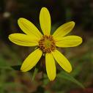
Thank U & Good Luck

Slide 18
SUMMARY
Ganglia related to vestibulocochlear nerve are located in the inner ear.
Vestibular & cochlear nerves pass through internal auditory meatus to cranial cavity, then enter pons at pontocerebellar angle, lateral to facial nerve.
Cochlear & vestibular nuclei are of the special somatic afferent type (receiving special afferent sensation, hearing & equilibrium from inner ear), and are located in pons & medulla.

Slide 19
SUMMARY
Inferior colliculi, medial geniculate nucleus and finally auditory cortex are stations in cochlear pathway.
Hearing is bilaterally represented.
Vestibular nuclei are connected to: spinal cord (directly or through medial longitudinal fasciculus), to flocculo-nodular lobe of cerebellum and to vestibular area of cerebral cortex.

Slide 20
QUESTION 1
The third order neurones of auditory pathway are found in:
Mid brain.
Thalamus.
Pons.
Cerebral cortex.

Slide 21
QUESTION 2
Regarding the vestibular pathway:
The vestibular ganglion is located in the middle ear.
The vestibular nuclei are located in the midbrain.
The vestibular nuclei are connected to the cerebellum.
The vestibulospinal tracts are located in the lateral white column of spinal cord.

Slide 22
Q For You
Q1
Lesion of the cochlea or cochlear nerve of right ear leads to ?????
(Complete deafness of the right ear).
Q2
Lesion in the right lateral lemniscus or right hearing centre leads to ???
(Weakness of hearing in both ears, but the weakness is more in the opposite left ear).

