Slide 1
THE CEREBELLUM & ITS RELEVANT CONNECTIONS
Dr. Sanaa Alshaarawy
Associate Professor of Anatomy
Prof. Ahmed Fathalla Ibrahim
Prfessor of Anatomy

Slide 2
OBJECTIVES
At the end of the lecture, students should:
Describe the External features of the cerebellum (lobes, fissures).
Describe briefly the Internal structure of the cerebellum.
List the name of Cerebellar Nuclei.
Relate the Anatomical to the Functional Subdivisions of the cerebellum.
Describe the Important connections of each subdivision.
Describe briefly the Main Effects in case of lesion of the cerebellum.

Slide 3
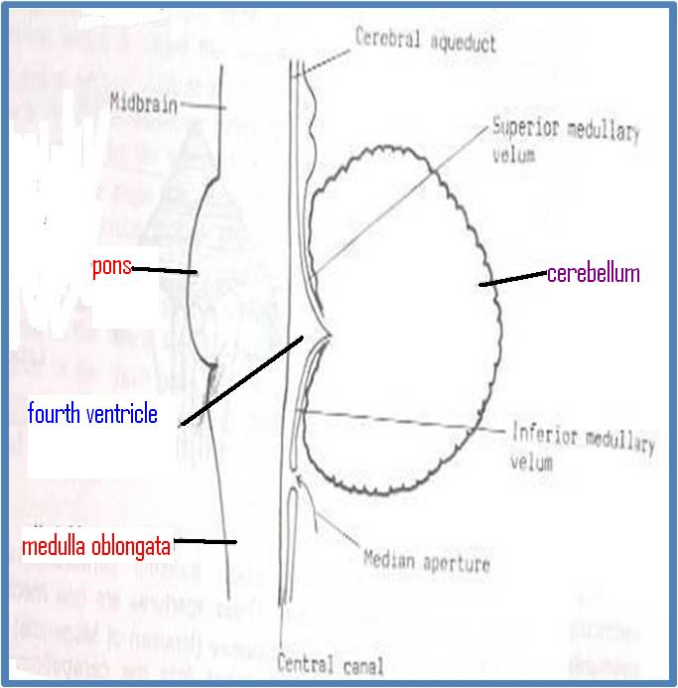
CEREBELLUM
ORIGIN :
From Hindbrain.
Position :
lies behind Pons & Medulla Separated from them by Fourth ventricle.

Slide 4
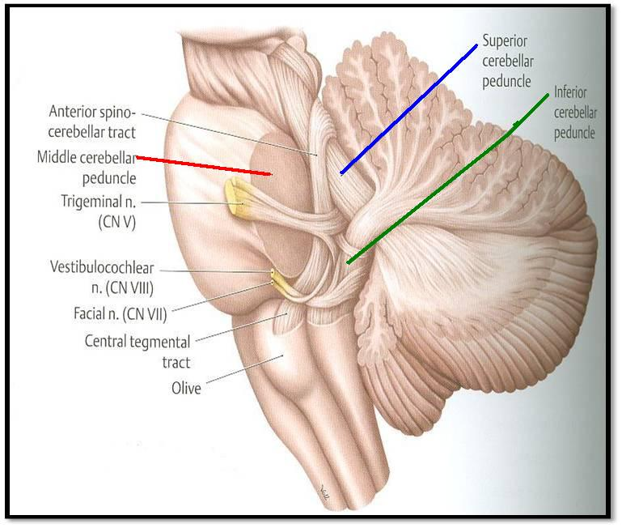
THE CEREBELLUM
CONNECTION TO BRAIN STEM:
by Inferior, Middle & Superior Cerebellar Peduncles.

Slide 5
EXTERNAL FEATURES
It consists of two Cerebellar Hemispheres joined in midline by the Vermis.
Its surface is highly convoluted forming Folia, separated by Fissures.

Slide 6
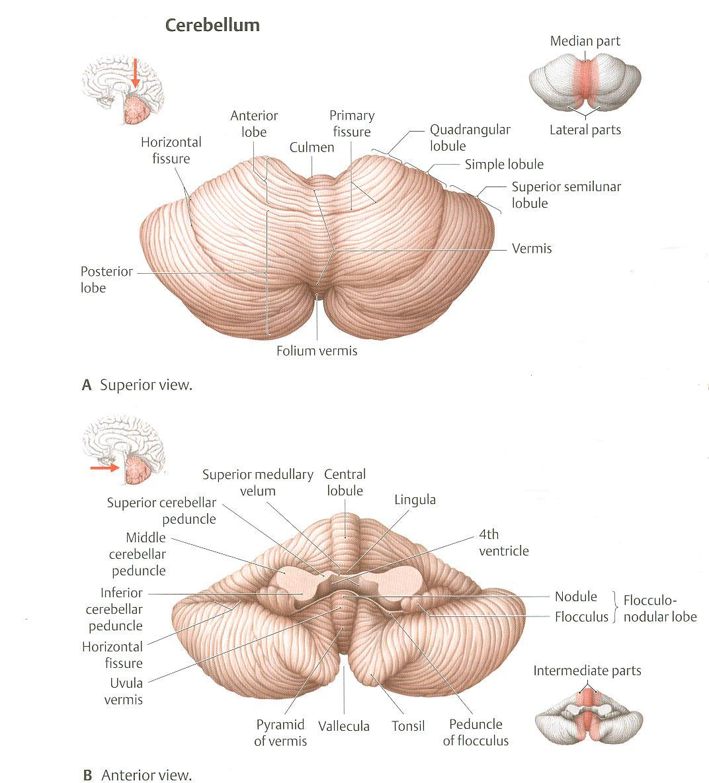
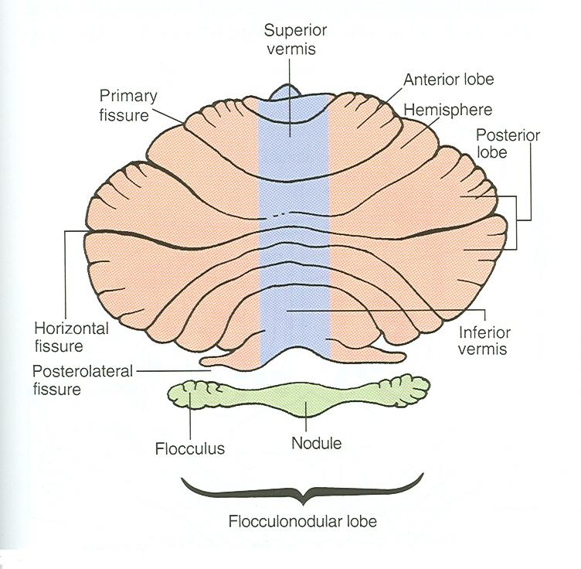
ANATOMICAL SUBDIVISION
Primary Fissure
Superior Surface
Posterolateral = Secondary Fissure
Anterroinferior Surface
Anterior lobe: in front of primary fissure, on the superior surface.
Posterior (middle) lobe: behind primary fissure (Between Primary & Secondary fissures = posterolateral).
Flocculonodular lobe: in front of secondary (Posterolateral) fissure, on the inferior surface .

Slide 7
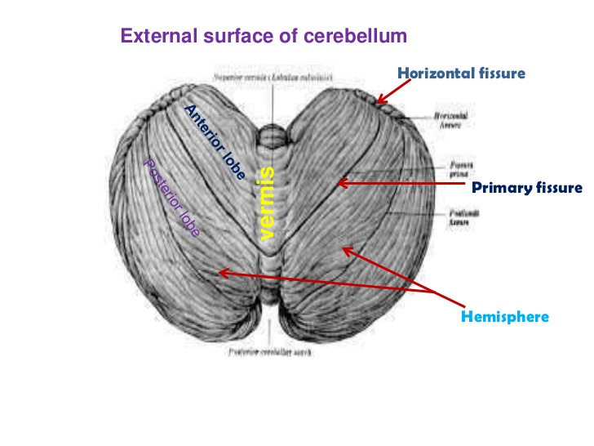
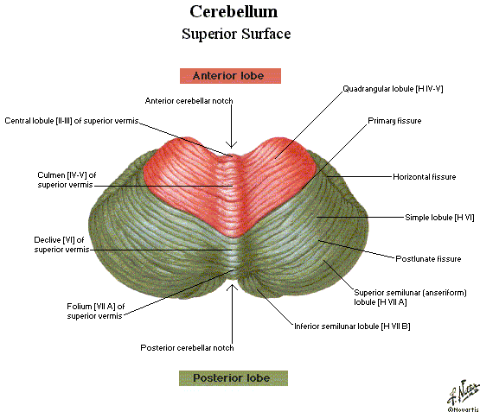
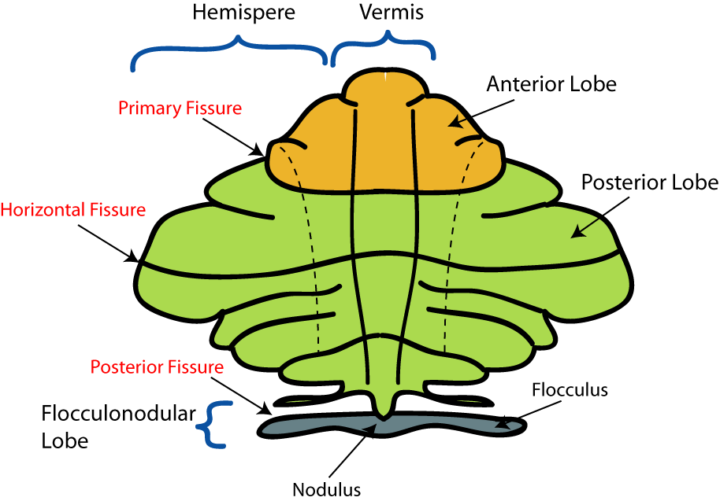
ANATOMICAL SUBDIVISION
Secondary Fissur
Or

Slide 8
CONSTITUENTS (Internal Structure and Nuclei of Cerebellum)
Outer grey matter: cerebellar cortex.
Inner white matter: cerebellar medulla.
Deeply seated nuclei in white matter: from medial to lateral:
Fastigial nucleus.
Globose nucleus.
Emboliform nucleus.
Dentate nucleus: largest one.

Slide 9
CEREBELLAR CORTEX
1
Divided into 3 layers:
Outer molecular layer
Intermediate Purkinje cell layer
Inner granular layer
2
3
1
2
3

Slide 10
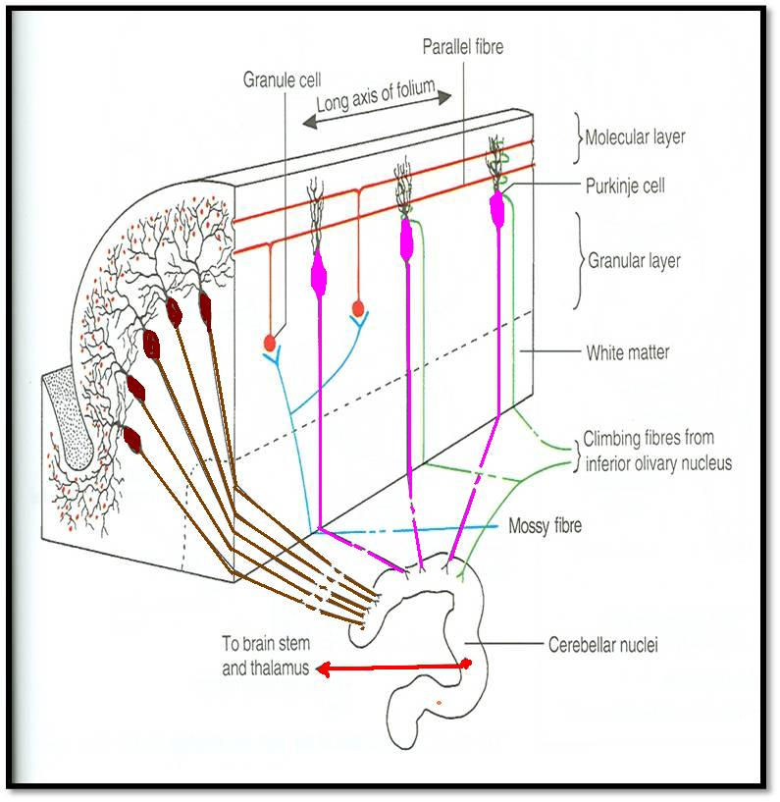
CEREBELLAR MEDULLA
AFFERENT FIBRES:
Climbing fibres: from inferior olivary nucleus, relay to purkinje cells
Mossy fibres: rest of fibres:
From vestibular nuclei
From spinal cord
From pons
They relay to granule cells which in turn relay to purkinje cells.
Finally all afferent fibres passing through the medulla relay to purkinje cells in the cortex.

Slide 11
CEREBELLAR MEDULLA
Axons of Purkinje Cells are the only axons to leave the cortex to medulla :
The great majority of axons do not leave cerebellum & end in deep cerebellar nuclei, specially Dentate nucleus.
Some of axons leave cerebellum as efferent fibres.
Dendato-rubro-thalamic

Slide 12
CEREBELLAR MEDULLA
EFFERENT FIBRES:
Most efferent fibres are axons of deep cerebellar nuclei.
Main Efferents go to nuclei of brainstem& thalamus :
Vestibular nuclei (cerebello-vestibular tract).
Red nucleus (Dendato-rubro-thalamic tract).
Ventral lateral nucleus of thalamus (Dendato-thalamic tract).

Slide 13
FUNCTIONAL SUBDIVISIONS
OF
THE CEREBELLUM

Slide 14
ARCHICEREBELLUM
Vestibular Part of cerebellum: Flocculo-nodular lobe.
Green = Archi-cerebellum, Blue= Paleo-cerebellum. Pink= Neo-cerebellum.

Slide 15
ARCHICEREBELLUM
Nuclei Related: Fastigial
Afferents: from Vestibular nuclei (Vestibulocerebellar fibres),(through ICP)
Efferents cortical (purkinje cell) Fibres project : to Fastigial nucleus, which projects to vestibular nuclei (through ICP) + to Reticular formation
Function: controls body Balance (via vestibulospinal & reticulospinal tracts).
Control of eye movement (via VO Reflex)

Slide 16
PALEOCEREBELLUM
Spinal Part of cerebellum: Vermis & Paravermis
Green = Archi-cerebellum, Blue= Paleo-cerebellum. Pink= Neo-cerebellum.

Slide 17
PALEOCEREBELLUM
Nuclei Related: globose & emboliform
Afferents: from spinal cord (dorsal & ventral spinocerebellar tracts through ICP & SCP, respectively)
Efferents : to globose&embliform nuclei which project to red nucleus (through SCP)
Function: controls posture & muscle tone (via Rubrospinal tract).

Slide 18
NEOCEREBELLUM
Cerebral Part of cerebellum: Rest of Cerebellum.

Slide 19
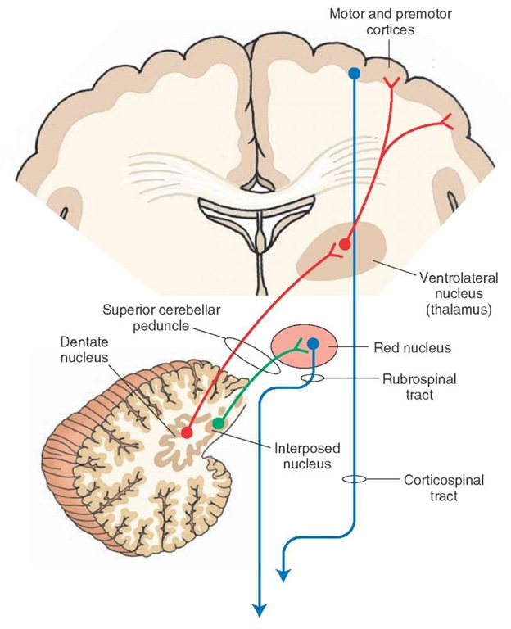
NEOCEREBELLUM
Nuclei Related: Dentate
Afferents: from Pons (Pontocerebellar fibres) (through MCP)
Efferents: to Red nucleus but mostly to Ventral Lateral Nucleus of Thalamus (through SCP) then to motor cortex
Function: coordination of voluntary movements (via descending Corticospinal & corticobulbar tracts or Rubrospinal tract).

Slide 20
CEREBELLAR LESIONS
MIDLINE LESION: Loss of postural control.
UNILATERAL LESION: “Cerebellar ataxia” causes ipsilateral :
Incoordination of arm: intention tremors (on performing voluntary movements)
Incoordination of leg: unsteady gait
Incoordination of eye movements: nystagmus
Slowness of speech: dysarthria (difficulty of speech).

Slide 21
THANK YOU

Slide 22
SUMMARY
Anatomically, the cerebellum is divided into: anterior, posterior & flocculonodular lobes.
Developmentally & functionally, it is divided into: archi- paleo- & neocerebellum.
Archicerebellum (flocculonodular lobe) is the oldest part of cerebellum, related to fastigial nucleus, connected to vestibular nuclei & concerning for control of body balance.

Slide 23
SUMMARY
Paleocerebellum (vermis & paravermis) is related to globose & emboliform nuclei, connected to spinal cord & red nucleus & concerned with regulation of posture & muscle tone.
Neocerebellum (most of human cerebellum) is related to dentate nucleus, connected to pons, thalamus. Its final destination is to motor cortex. It is concerned with coordination of voluntary movements.
Cerebellar lesions lead to ipsilateral incoordination (ataxia).

Slide 24
QUESTION 1
Which one of the following nuclei is related to neocerebellum?
Fastigeal nucleus
Dentate nucleus
Globose nucleus
Emboliform nucleus

Slide 25
QUESTION 2
To which part of the CNS the flocculonodular lobe send its efferent fibers?
Red nucleus
Pons
Vestibular nuclei
Motor cortex

Slide 26
The largest nucleus in the cerebellum can be seen by naked eye is :
a. Fastigial nucleus.
b. Globose nucleus.
c. Dentate nucleus.
d. Emboliform nucleus.
2. Which part in cerebellum is concerned with coordination of movement ?
a. Vermis.
b. Paravermis.
c. Folocculonodular lobe.
e. Neocerebellum.
3. Which nucleus contributes in the balance function of cerebellum ?
a. Dentate nucleus.
b. Fastigial nucleus.
d. Globose nucleuse.
e. Emboliform.

