Slide 1
CEREBRAL BLOOD CIRCULATION
DR JAMILA EL MEDANY

Slide 2
OBJECTIVES
At the end of the lecture, students should be able to:
List the cerebral arteries.
Describe the cerebral arterial supply regarding the origin, distribution and branches.
Describe the arterial Circle of Willis .
Describe the cerebral venous drainage and its termination.
Describe arterial & venous vascular disorders and their clinical manifestations.

Slide 3
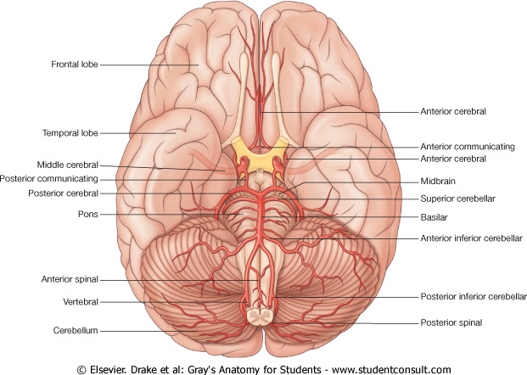
CEREBRAL ARTERIAL SUPPLY
It is composed of two arterial systems:
A. Carotid System
B. Vertebro Basilar System
A
B

Slide 4
CAROTID SYSTEM
It is composed of:
Internal carotid artery and its branches:
Anterior cerebral artery&
Middle cerebral artery

Slide 5
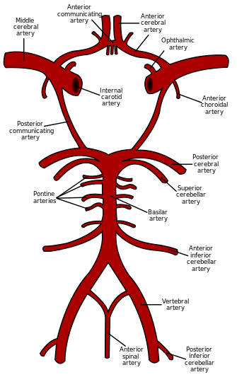
VERTEBRO BASILAR SYSTEM
The two Vertebral arteries ( from Subclavian artery) unite to form Basilar artery.
It divides at the upper border of the pons into two Posterior Cerebral arteries.

Slide 6
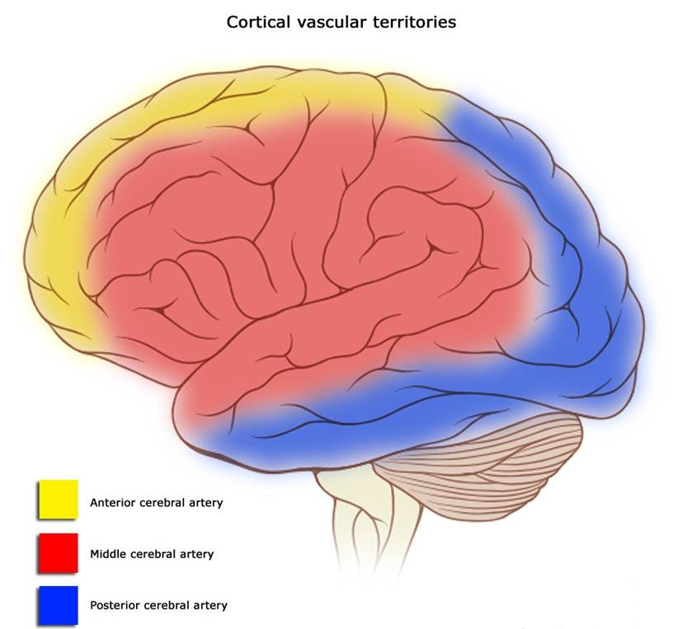
Distribution of the cerebral arteries on the superolateral surface of the cerebral H

Slide 7
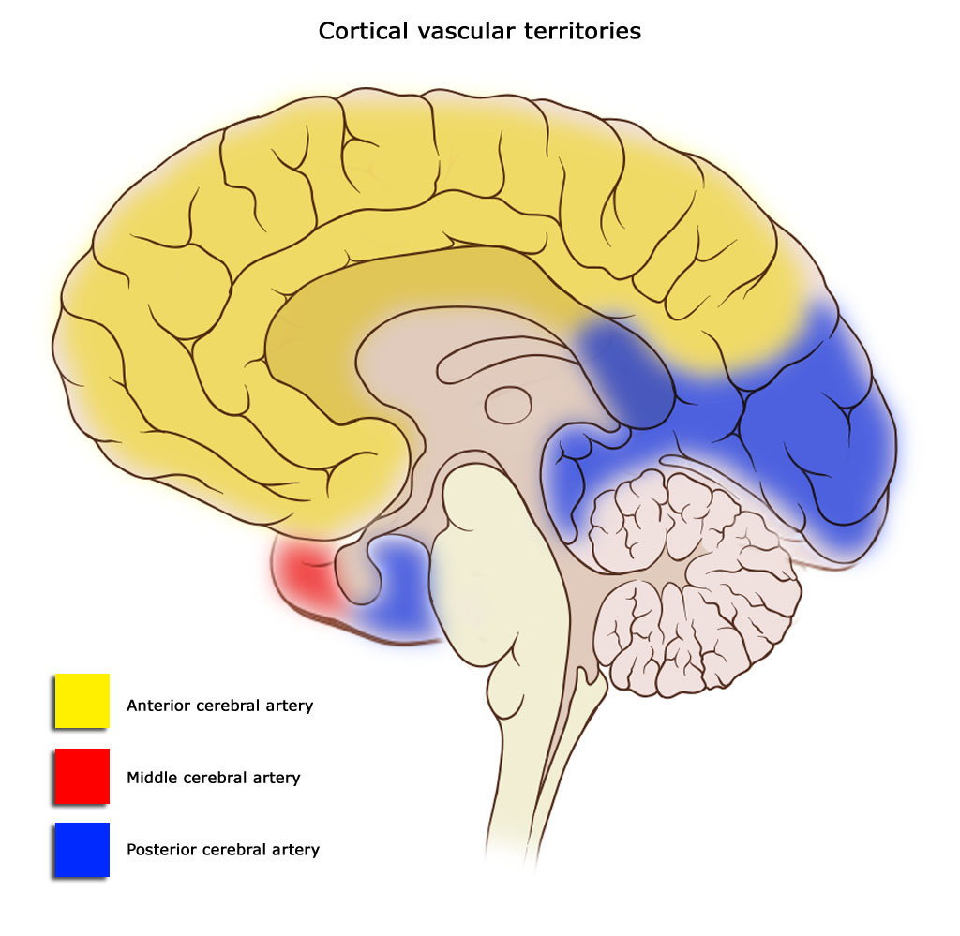
Distribution of the cerebral arteries on the medial surface of the cerebral H

Slide 8
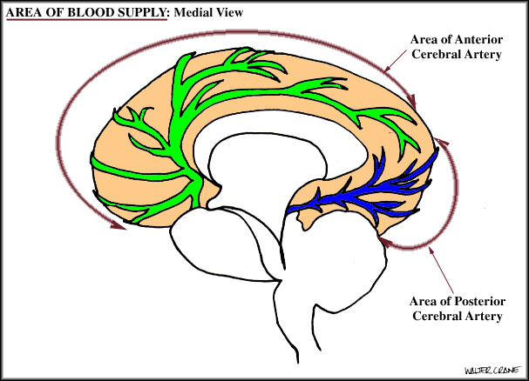
Anterior Cerebral Artery
Supplies : orbital and medial surfaces of the frontal and parietal lobes
A narrow part on the superolateral surface.

Slide 9
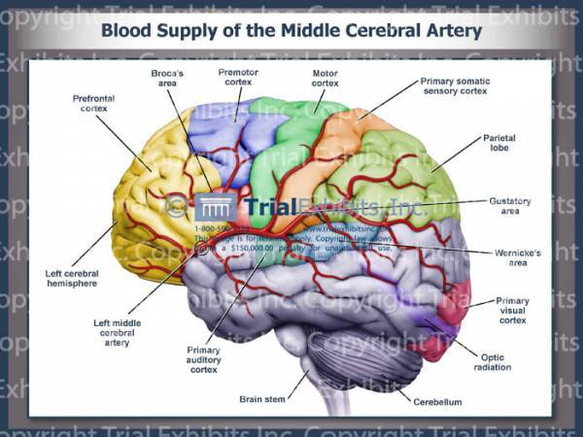
Middle Cerebral Artery
Supplies entire Superolateral surface:
Somatosensory Cortex
Motor Cortex
Language areas:
Broca's Area
Wernicke’s Area)
Auditory areas:
Primary auditory area
Auditory association (Heschl’s Gyrus

Slide 10
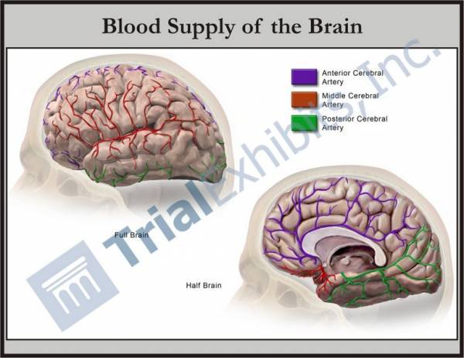
Posterior Cerebral Artery
Supplies:
Anterior and inferior parts of temporal lobe, Uncus, Inferior temporal gyrus,
Inferior and Medial parts of Occipital lobe (visual areas)

Slide 11
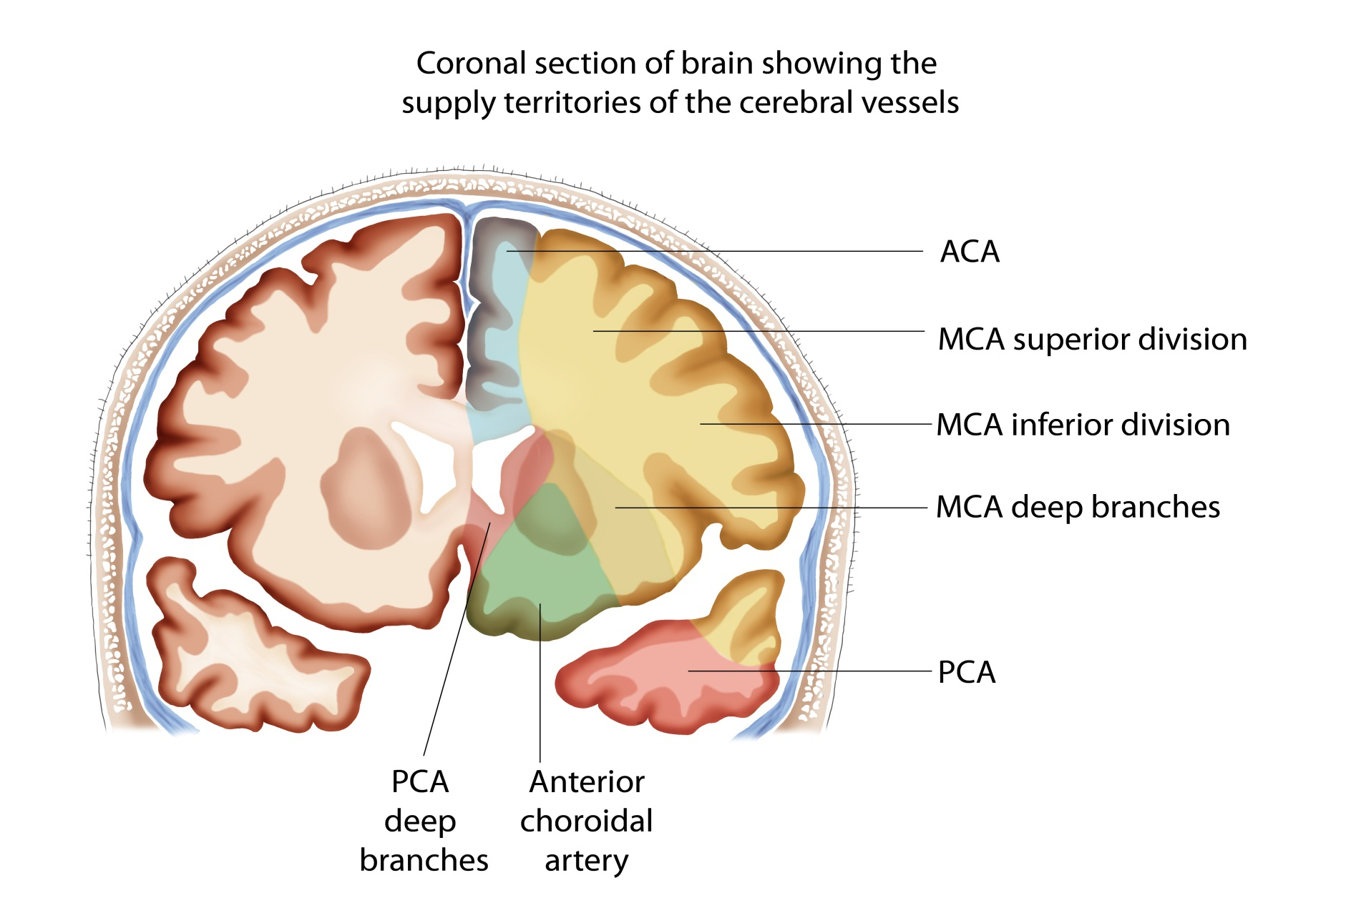

Slide 12
Circulus Arteriosus
(of Willis)
It joins the Carotid & Vertebrobasilar systems

Slide 13
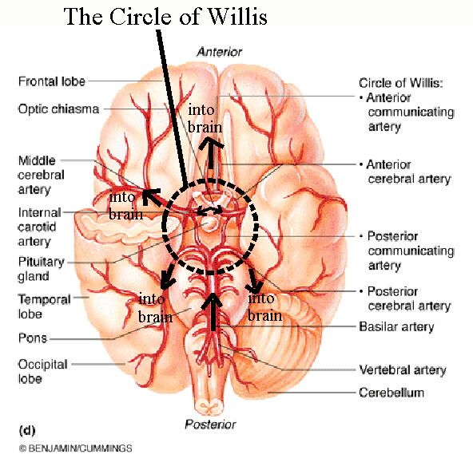
located on the base of the brain
It encircles:
Optic Chiasma, Hypothalamus Pituitary gland Midbrain.

Slide 14
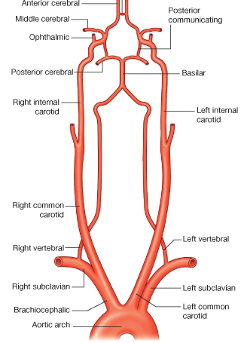
Composed of:
2 Anterior cerebral arteries
2 Internal carotid arteries
2 Posterior cerebral arteries
2 Posterior communicating arteries
1 Anterior communicating artery

Slide 15
Branches:
Perforating arteries (Anterior& Posterior):
Numerous small vessels that penetrate the surface of the brain through the anterior and posterior perforating substances.
APA supply:
Large part of Basal Ganglia,
Optic chiasma,
Internal capsule & Hypothalamus
PPA supply:
Ventral portion of Midbrain, parts of Subthalamus and Hypothalamus

Slide 16
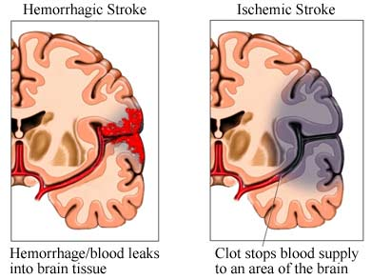
Arterial Disorders
A. Stroke (Sudden occlusion
of the blood supply):
It can be:
1. Hemorrhagic
2. Ischemaic
B. Aneurysm
C. Angioma
B

Slide 17
EFFECT OF OCCLUSION of Cerebral arteries
ACA
MCA
PCA

Slide 18
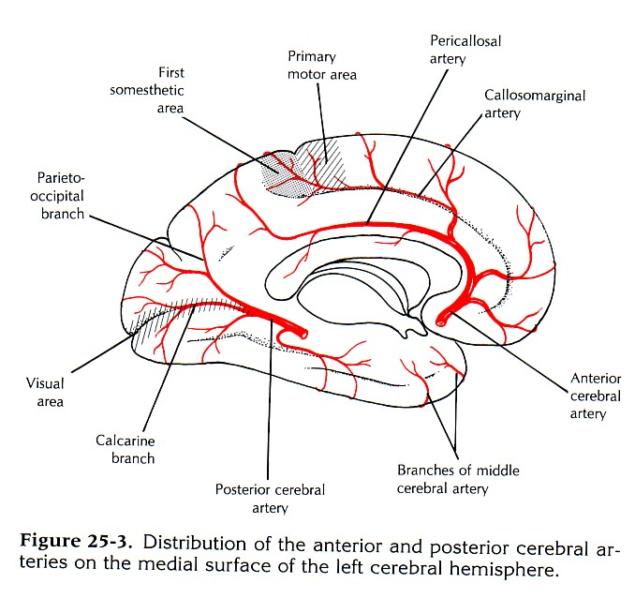
ACA
1. Motor & sensory disturbances in the contralateral distal leg
2. Difficulty in the Prefrontal lobe functions:
Cognitive thinking, Judgment,
Motor initiation and
Self monitoring

Slide 19
MCA
1. Contralateral weakness of:
Face, Arm & Hand (more than leg)
2.Contralateral sensory loss of:
Face, Arm & Hand (more than leg)
3. Visual field cut (damage to optic radiation)
4. Aphasia (language disturbances )
Broca's: production
Wernicke's: comprehension

Slide 20
PCA
1. Visual disturbances
Contralateral homonymous hemianopia
In Bilateral lesions: Cortical Blindness
patients unaware they cannot see (Anton's syndrome)
2. Memory impairment
If the temporal lobe is affected

Slide 21
Cerebral Venous Drainage
Cortical Veins:
(A) Superficial
found in the Subarchnoid space Drain the cortical surfaces
(B) Deep veins:
Drain the deeper structures
These veins are thin walled and devoid of valves.
They ultimately drain into the
Dural Venous Sinuses

Slide 22
Superficial Cortical Veins
1. Superior cerebral veins (6 to 12)
Drain lateral surface of brain above the lateral sulcus
Terminate mainly into the Superior Sagittal sinus, and partly into Superficial middle cerebral vein.
2. Inferior cerebral veins:
Run below the lateral sulcus
Drain the lateral surface of the temporal lobe
Terminate partly into superficial middle cerebral vein & partly into Transverse sinus.

Slide 23
3.Superficial middle cerebral vein:
Runs along the lateral sulcus
Terminates into the Cavernous sinus
It is connected posteriorly through Superior & Inferior anastomotic veins to Superior Sagittal & Transverse sinuses.

Slide 24
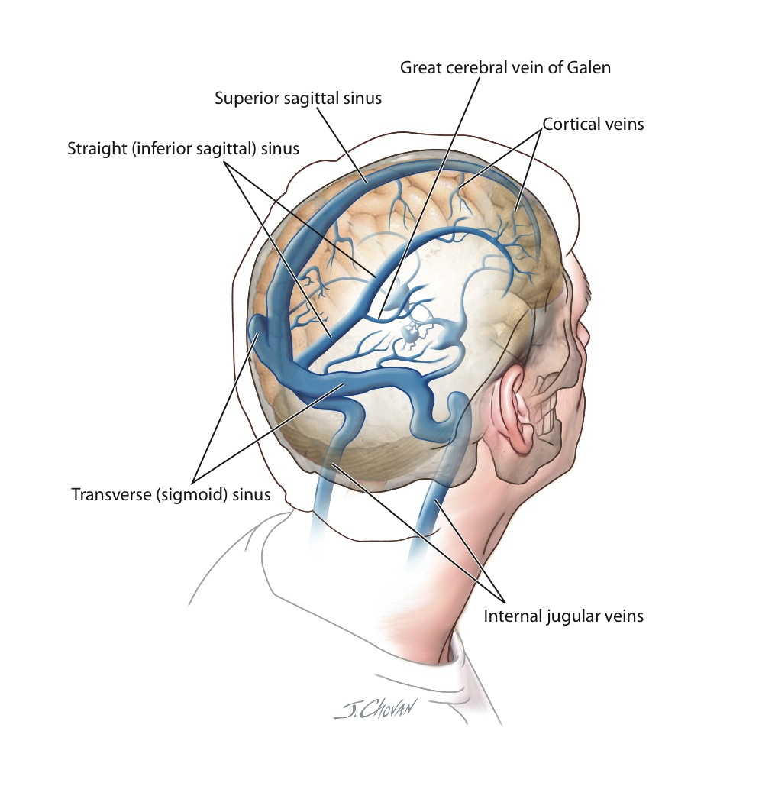
Deep Cerebral Veins
Drain the internal structures (basal ganglia, internal capsule, thalamus)
They merge to form two Internal Cerebral Veins.
The two veins unite in the midline to form the Great Cerebral vein.
This short vessel joins the Inferior Sagittal sinus to form the Straight S

Slide 25
Dural Venous Sinuses
Paired
Single
Transverse.
Sigmoid.
Cavernous.
Petrosal (Sup & Inf)
Superior sagittal.
Inferior sagittal.
Straight.
Occipital.
Blood flows from transverse &sigmoid sinuses into IJV

Slide 26
Venous Disorders
Infarcation.
Sinus thrombosis:
(SSS thrombosis) can complicates ear infection .
Cavernous S thrombosis (as a complication of infection in the dangerous area of the face)
Obstruction of venous drainage of the brain leads to Cerebral edema and raised ICP

Slide 27
Thank You & Good Luck

