Slide 1
CEREBRUM
Dr. Jamila EL Medany

Slide 2
Objectives
At the end of the lecture, the student should be able to:
List the parts of the cerebral hemisphere (cortex, medulla, basal nuclei, lateral ventricle).
Describe the subdivision of a cerebral hemisphere into lobes.
List the important sulci and gyri of each lobe.
Describe different types of fibers in cerebral medulla (association, projection and commissural) and give example of each type.

Slide 3
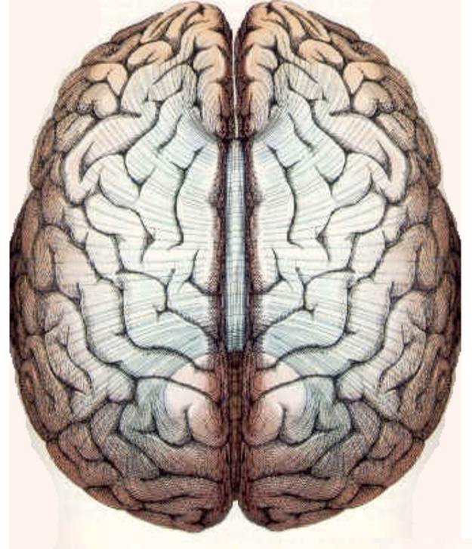
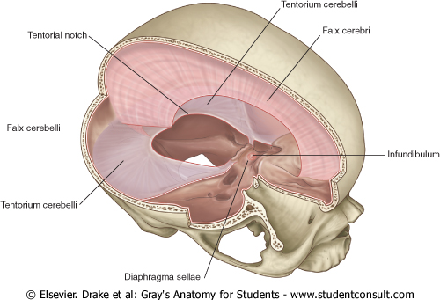
Cerebrum
Corpus callosum
Largest part of the forebrain.
Divided into two halves, the (cerebral hemipheres), which are separated by a deep median longitudinal fissure which lodges the falx cerebri.
In the depth of the fissure, the hemispheres are connected by a bundle of fibers called the corpus callosum.
Left hemisphere
Right hemisphere
Median longitudinal fissure

Slide 4
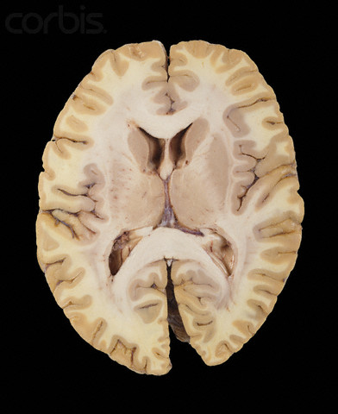
Structure of Cerebrum
Cortex
Basal ganglia
Cerebral cortex: Superficial layer of grey matter
Medulla (White matter) : Deeper to the cortex, contains axons to and from the cells of the cortex
Basal ganglia: Number of nuclear masses buried within the white matter
Lateral ventricle: The cavity of hemisphere
WM
WM
Lateral ventricle

Slide 5
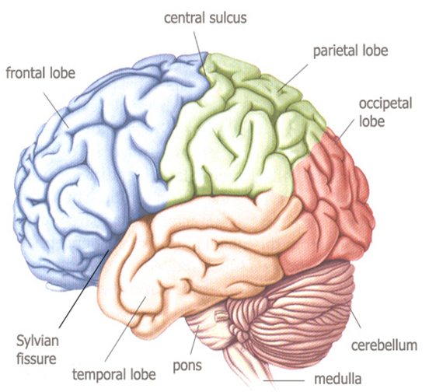
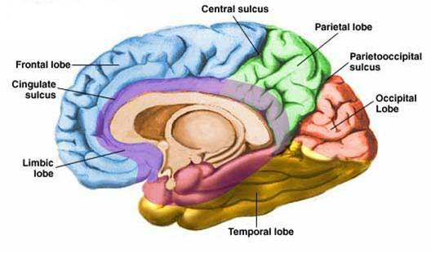
Surfaces(3)
Superolateral
Medial
Inferior (tentorial)

Slide 6
Lobes of Cerebrum
The superficial layer of grey matter is highly convoluted to form a complex pattern of ridges (gyri) and grooves (sulci). This arrangement maximizes the surface area of the cerebral cortex (about 70% is hidden within the depths of sulci).
Three sulci, consistent in position, named central, lateral (sylvian) & parieto-occipital, divide each hemisphere into FOUR lobes: Frontal, Parietal, Temporal & Occipital (named after overlying bones) Functionally each hemisphere contains a ‘limbic lobe’ on the medial surface.
S
g

Slide 7
Function of Lobes
reception and evaluation of sensory information
motor function, motivation, aggression, smell and mood
visual processing
emotions, memory storage & Linking conscious intellectual functions with the unconscious autonomic functions,
smell, hearing, memory and abstract thought

Slide 8
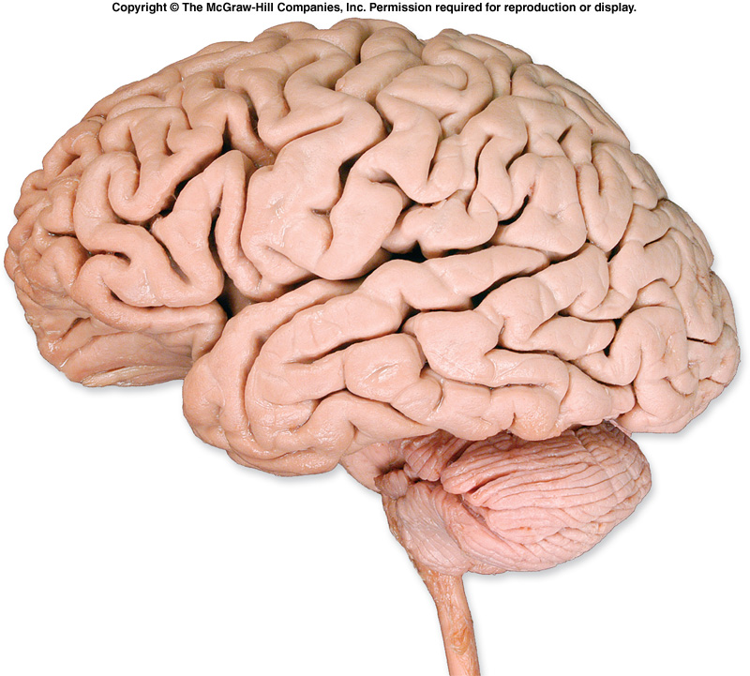
Frontal lobe:
Precentral gyrus.
Superior & inferior frontal sulci divide the lobe into superior, middle & inferior frontal gyri.
Parietal lobe:
Postcentral gyrus.
Intraparietal sulcus divide the lobe into superior & inferior parietal lobules.
Precentral gyrus
Postcentral gyrus
sfs
Superior parietal lobule
ifs
Inferior parietal lobule
Intraparietal sulcus
Superior , middle & inferior frontal gyri
MAIN GYRI IN SUPEROLATERAL SURFACE

Slide 9
Superior, middle & inferior temporal gyri
Temporal lobe:
Superior & inferior temporal sulci giving rise to superior, middle & inferior temporal gyri.
Insula: the gyrus in the depth of lateral sulcus, covered by parts of frontal, parietal & temporal lobes called the opercula (removed in lower picture.).
sts
its
insula

Slide 10
Medial Surface
Sulci: Parietooccipital, Calcarine, Cingulate
Gyri: Cingulate, Parahippocampal

Slide 11
Brodmann’s Map
Brodmann produced a numbered, cytological map of cerebral cortex based upon its regional histological characteristics.
Subdivisions with similar cellular and laminar structure are called 'areas'
Brodmann's numbering of these cortical locations has become one of the standard ways to identify brain areas.

Slide 12
Functional Areas of the Cerebral Cortex

Slide 13
Frontal Lobe
Premotor cortex: Located in the region immediately anterior to the precentral gyrus (Brodmann’s area 6).
Primary motor cortex: Located in precentral gyrus (Brodmann area 4).
Prefrontal cortex: Extensive region of the frontal lobe anterior to premotor area.
Broca’s (motor speech) area: Located in the inferior frontal gyrus of the dominant hemisphere, usually left (Brodmann’s area 44 & 45).
Frontal eye field: Located in the middle frontal gyrus immediately in front of motor cortex (Brodmann’s area 8).

Slide 14
Parietal lobe
Primary somatosensory cortex: located in postcentral gyrus (Brodmann’s area 1, 2, 3).
Parietal association cortex: located posterior to primary somatosensory cortex.
Occipital lobe
Primary visual cortex: located on the medial surface of the hemisphere, in the gyri surrounding the calcarine sulcus (Brodmann’s area 17).
Visual association cortex: located around the primary visual cortex. Area 19

Slide 15
Temporal Lobe
Primary auditory cortex: located in the superior surface of the superior temporal gyrus (Brodmann’s area 41, 42)
Auditory association cortex: located immediately around the primary auditory cortex (also includes Wernick’s area)
Parahippocampal gyrus: located in the inferomedial part of temporal lobe. Deep to this gyrus lies the hippocampus and the amygdala, which are parts of limbic system

Slide 17
Language AreaS
Organized around the lateral Sulcus.
Broca’s area: concerned with expressive aspects of language.
Wernick’s area: responsible for comprehension of the spoken words.
Angular gyrus & Supramarginal gyrus: nearby regions of temporal lobe and parietal lobe o fthe inferior parietal lobule) are important in naming, reading, writing, and calculation.

Slide 18
Hemispheric Dominance
The localization of Speech centers & Mathematical ability is the criterion for defining the dominant cerebral hemisphere.
In 96% of normal right-handed individuals and 70% of normal left-handed individuals, the Left hemisphere contains the language centers. These are Left Hemisphere Dominant.
Cerebral dominance becomes established during the first few years after birth.
Verbal Memory
Shape Memory
Hemispheres communicate via the corpus callosum

Slide 19
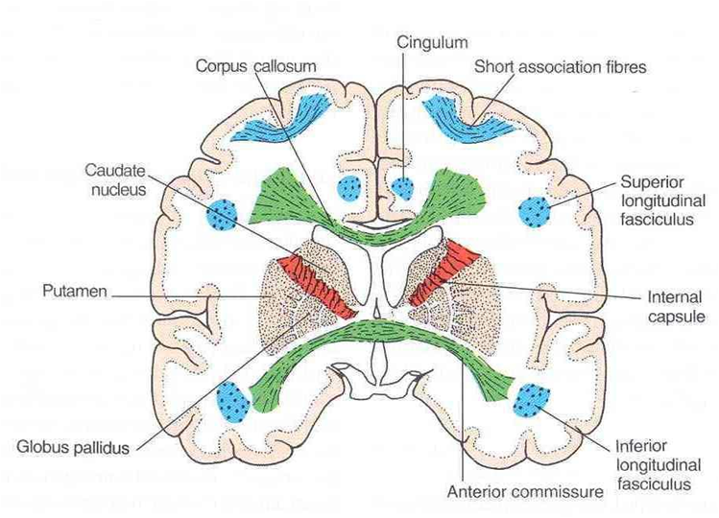
White Matter
Underlies the cortex, contains nerve fibers, neuroglia cells and blood vessels.
The nerve fibers originate, terminate or sometimes both, within the cortex.
Depending on their origin & termination, these nerve fibers are classified into three types: Association, Projection & Commissural
Association fibers: Unite different parts of the same hemisphere, are of two types: long & short
Commissural fibers: Connect the corresponding regions of the two hemispheres
Projection fibers: Consist of afferent and efferent fibers of the cerebral cortex

Slide 20
Thank U & Good Luck

