Slide 1
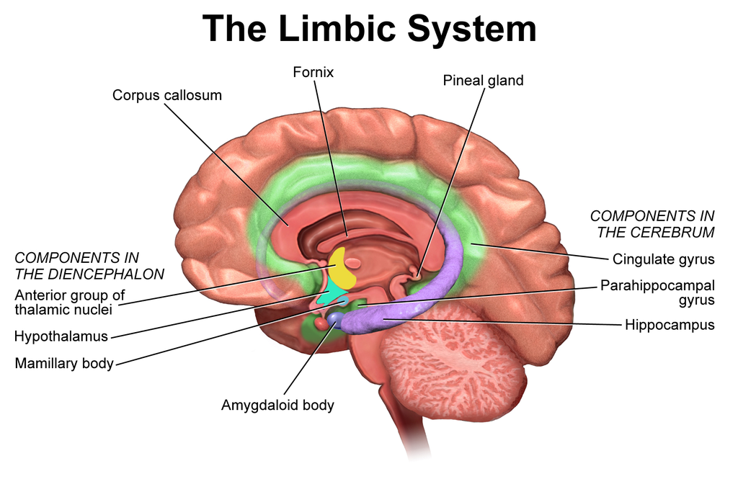
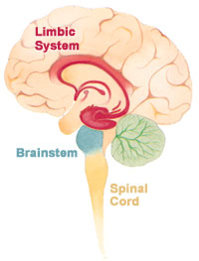
Thalamus
&
Limbic System
Prof. Saeed Abuel Makarem & Dr.Sanaa Alshaarawy

Slide 2
Objectives
By the end of the lecture, you should be able to:
Describe the anatomy and main functions of the thalamus.
Name and identify different nuclei of the thalamus.
Describe the main connections and functions of thalamic nuclei.
Name and identify different parts of the limbic system.
Describe main functions of the limbic system.
Describe the effects of lesions of the limbic system.

Slide 3
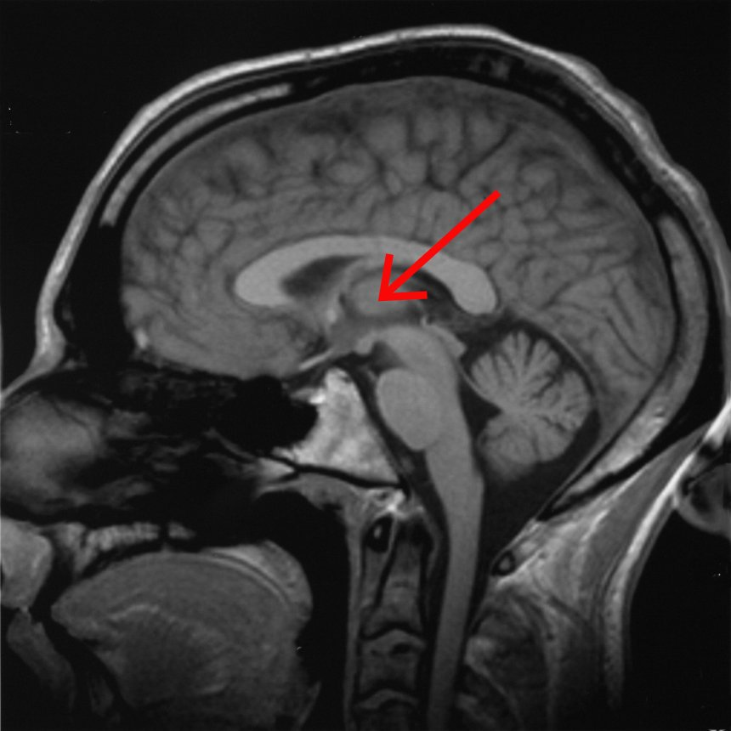
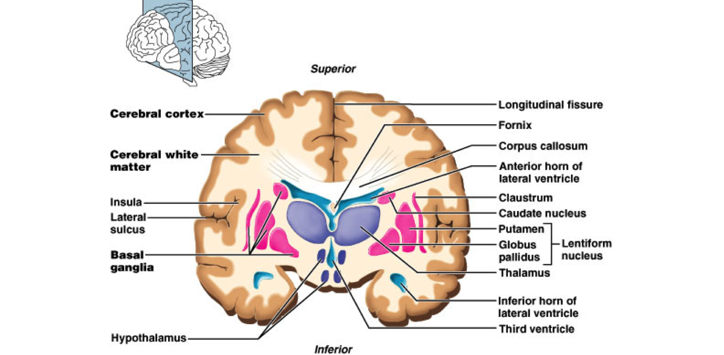
Thalamus
It is the largest nuclear mass of the whole body.
It is the largest part of the diencephalon
It is formed of
two oval masses of grey matter.
It is the gateway to the cortex.
Together with the hypothalamus they form the lateral wall of the 3rd ventricle.
THALAMUS
Corpus callosum
Midbrain
PONS

Slide 4
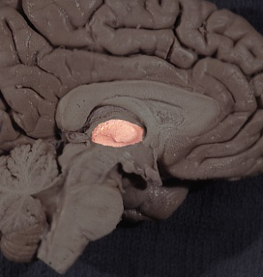
It sends the received information to the cerebral cortex from diverse brain regions.
Axons from every sensory system (except olfaction) synapse in the thalamus as the last relay site 'last pit stop' before the information reaches the cerebral cortex.
There are some thalamic nuclei that receive input from:
Cerebellar nuclei,
Basal ganglia- and
Limbic-related brain regions.
Thalamus

Slide 5
It has 4 surfaces & 2 ends.
Surfaces
Lateral:(L)
Posterior limb of the internal capsule
Medial:
The 3rd ventricle
It is connected to the thalamus of the opposite side by the interthalamic connexus, (adhesion) or Massa intermedia.
Superior: (s)
Lateral ventricle and fornix.
Inferior: (I)
Hypothalamus, anteriorly & Subthalamus posteriorly.
Relations
S
L
I
Coronal section

Slide 6
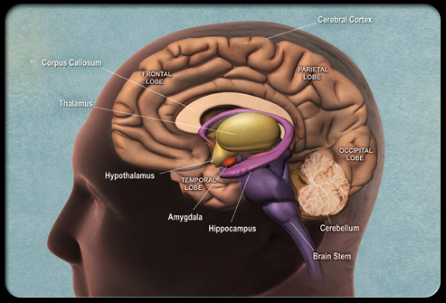
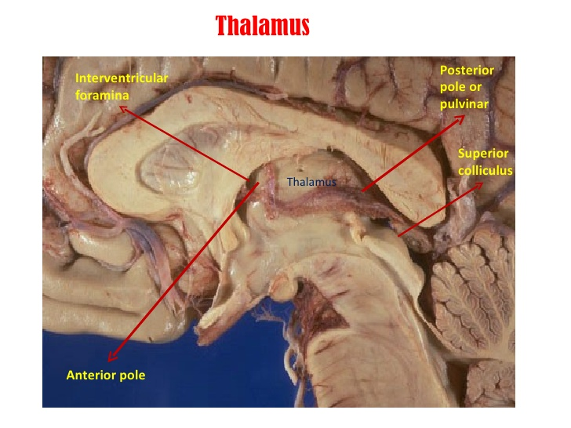
Anterior end:
Forms a projection, called the anterior tubercle.
It lies just behind the interventricular foramen.
Posterior end: Broad
Forms a projection called Pulvinar which lies above the superior colliculus and the lateral & medial Geniculate bodies.

Slide 7
Internal Structure
White matter:
External medullary lamina:
Covers the lateral surface.
It consists of thalamocortical & corticothalamic fibers.
Internal medullary lamina:
Bundle of Y- shaped myelinated (afferent & efferent) fibers.
It divides the thalamus into: anterior , medial, lateral nuclear groups.
Each of these groups is subdivided into a number of named nuclei.

Slide 8
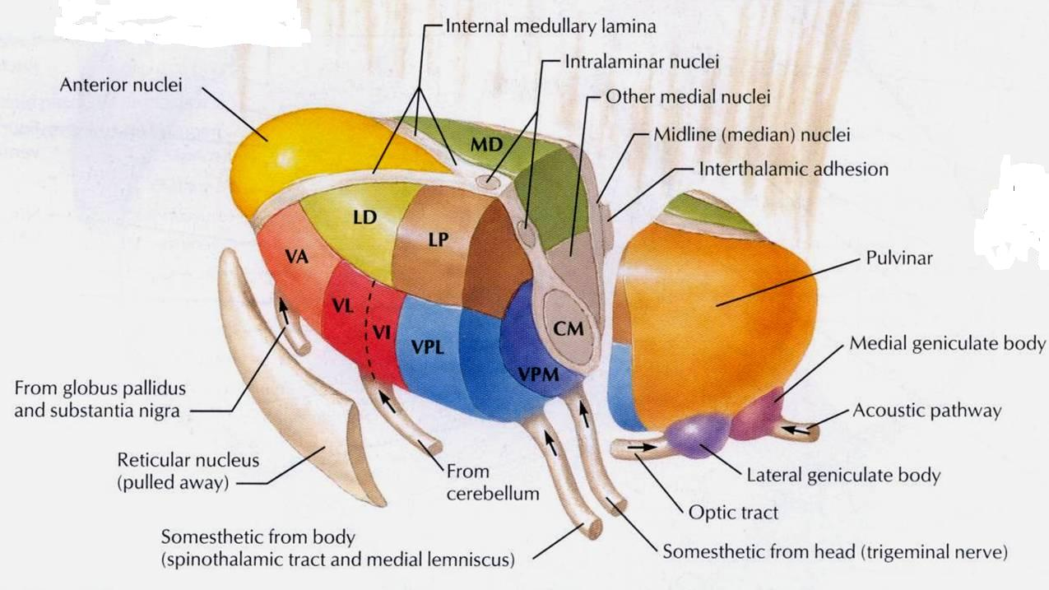
It is divided into: Dorsal & Ventral tiers
Dorsal tier:
which contains:
Lateral Dorsal (LD)&
Lateral Posterior (LP)
Pulvinar.
Ventral tier,
which contains :
Ventral Anterior (VA)
Ventral Lateral (VL)
Ventral Intermediate (VI)
Ventral Posterior (VP) (PLVNT, PMVNT)
Lateral & Medial Geniculate nuclei.
Lateral Nuclear Group

Slide 9
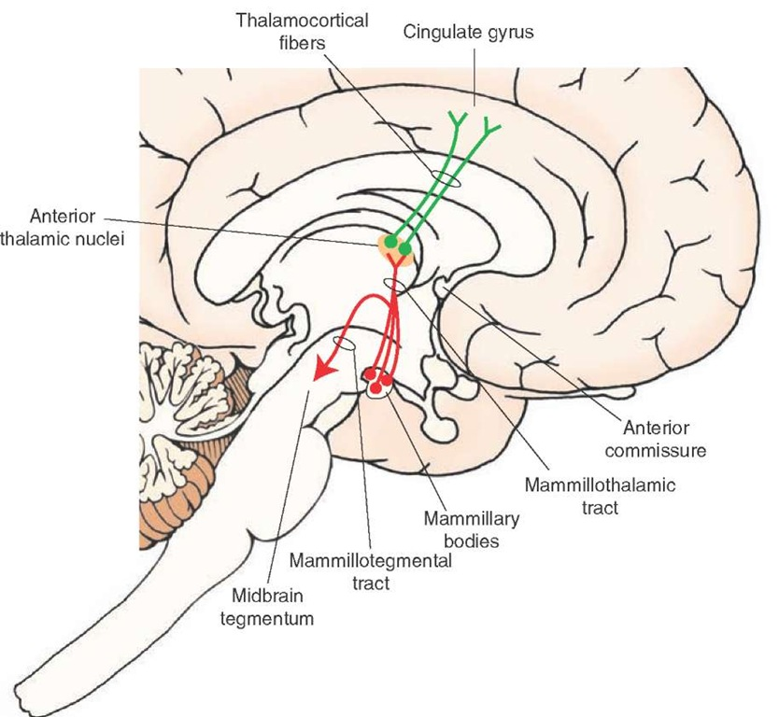
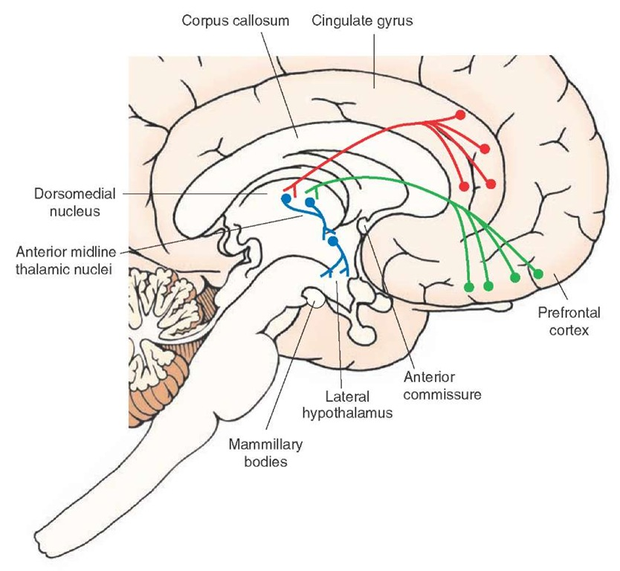
Projection of thalamic nuclei
Anterior Thalamic Nuclei
Afferent: Mammillary body.
Efferent: Cingulate gyrus, (limbic system)
-------------------------------
Medial Nuclei
Afferent: Hypothalamus.
Efferent: Prefrontal cortex & Frontal.

Slide 10
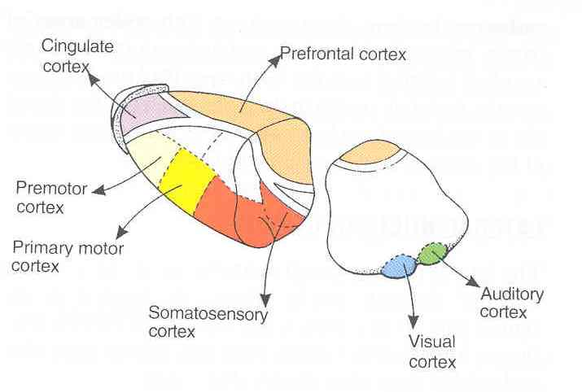
Projection of thalamic nuclei
Ventral Anterior Nucleus
Afferent: Globus pallidus body.
Efferent: Premotor cortex.
-------------------------------
Ventral Lateral Nucleus
Afferent: Dentate Nucleus
Efferent: primary motor cortex.
Input of Ventral Thalamic Nuclei
MD
Output of thalamic nuclei

Slide 11
Projection of thalamic nuclei
Ventral Posterior Lateral Nucleus
Afferent: Medial and spinal leminsci.
Efferent: Sensory cortex.
-------------------------------
Ventral Posterior Medial Nucleus
Afferent: Trigeminal Leminiscus
Efferent: Sensory cortex.
Input of Ventral Thalamic Nuclei
Output of thalamic nuclei

Slide 12
Projection of thalamic nuclei
Input of Ventral Thalamic Nuclei
Lateral geniculate body :
Afferent : optic tract.
Efferent : visual cortex
Medial geniculate body :
Afferent : lateral lemniscus.
Efferent : auditory cortex.
Output of thalamic nuclei

Slide 13
Mammillary Body
Hypothalamus
Input & Output of thalamic nuclei
Globus pallidus and Substantia Nigra
Lateral Leminiscus
Medial & Spinal Leminsci
Trigeminal Leminiscus
Dentate Nucleus
Optic Tract

Slide 14
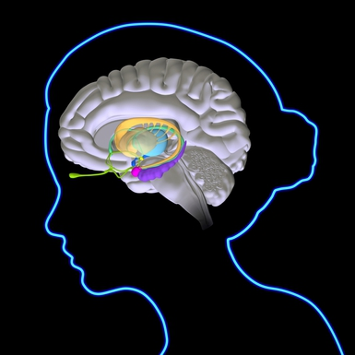
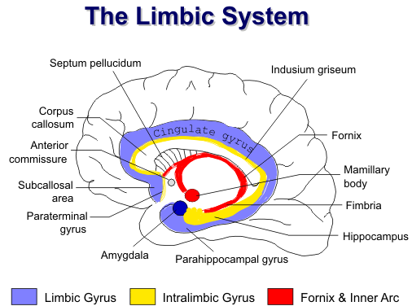
LIMBIC SYSTEM
The term "limbic" is from the Latin word Limbus, for "border" or "edge".
It separates the medial surface of the cerebral cortex from the diencephalon
It consists of a number of cortical & subcortical structures with looped connections that all project to the hypothalamus (particularly mammilary bodies).

Slide 15
WHAT IS THE FUNCTION OF THE LIMBIC SYSTEM?
It control a variety of functions including:
Emotions:
Emotional responses
Behaviour & Mood (happy, cry, laugh, sad, afraid, aggression, depression)
Motivation.
Memory.
Visceral & Motor responses involved in (sex, pleasure, hunger, and reproduction).
Olfaction.
Pleasure
sensation
OLFACTION
MEMORY

Slide 16
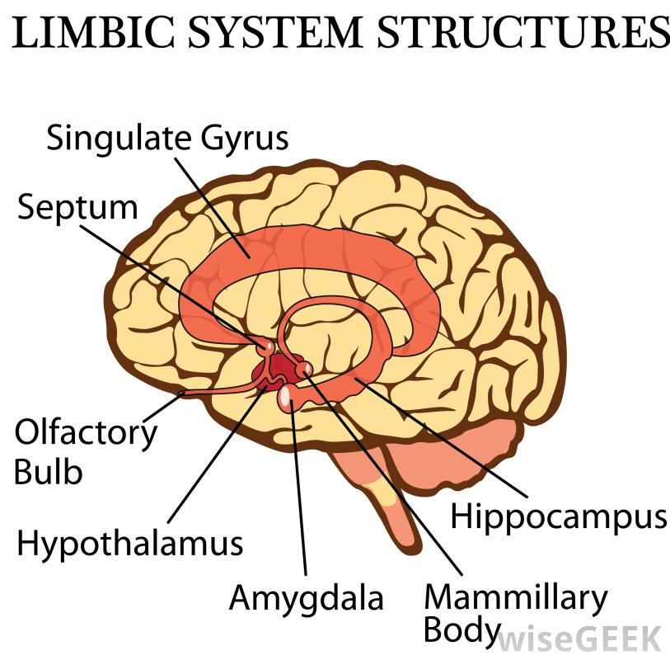
The limbic system is composed of four main structures:
1. Limbic cortex (Lobe).
2. Hippocampus
3. Amygdala,&
4. Septal area.
These structures form connections between the hypothalamus, thalamus and cerebral cortex.
The hippocampus is important in memory and learning, while the limbic system itself is important in the control of the emotional responses.
The limbic system is a set of brain structures including

Slide 17
CORTICAL STRUCTURES
Limbic lobe.
Hippocampal formation.
Septal areas.
Prefrontal area (Olfactory cortex).

Slide 18
LIMBIC LOBE
C-shaped ring of grey matter on the medial side of each cerebral hemisphere, surrounding the corpus callosum.
It includes:
Subcallosal area
Cingulate gyrus
Isthmus
Parahippocampal gyrus and the
Uncus.

Slide 19
HIPPOCAMPUS
It is a limbic system structure that is involved in:
Formation,
Organization, and
Storing of memories.
It is important in forming new memories and connecting emotions and senses, such as smell and sound, to memories.
It is a horseshoe paired structure, one in each cerebral hemisphere.
It acts as a memory indexer by sending memories to the appropriate part of the cerebral hemisphere for long-term storage and retrieving them when necessary.

Slide 20
HIPPOCAMPUS
Site:
It is a scrolled (infolding) inferomedial part of temporal lobe.
Function:
Memory (file new memories as they occur).
The hippocampus & its connections are necessary for consolidation of new short-term memories.

Slide 21
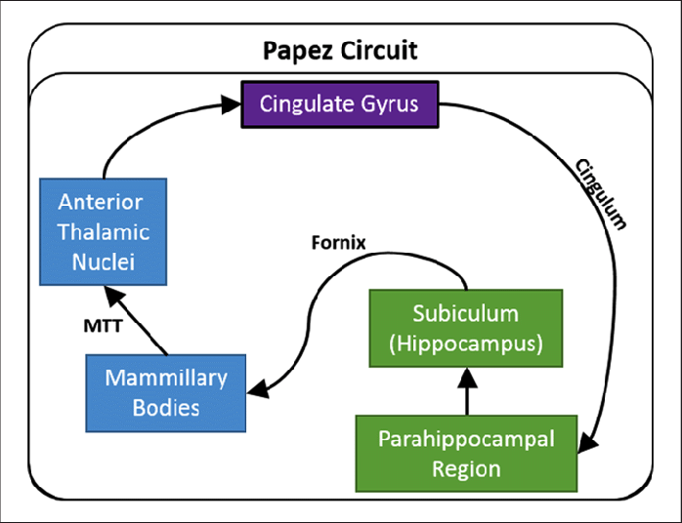
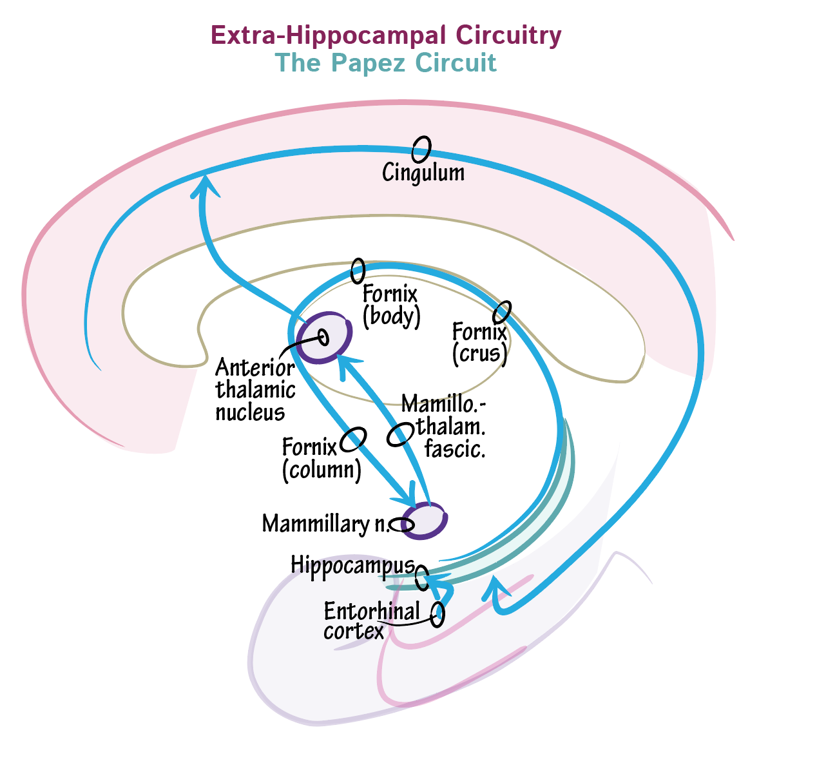
HIPPOCAMPUS
Its principal efferent pathway is called the:
FORNIX:
It is C-shaped group of fibers connecting the hippocampus with mammillary body and then to the anterior nuclei of thalamus.
It consists of:
2 Fimbria,
2 Crus,
1 Body &
2 Column.
The Fornix is an important component of PAPEZ CIRCUIT (based on connecting the hypothalamus with limbic lobe to control emotions )

Slide 22
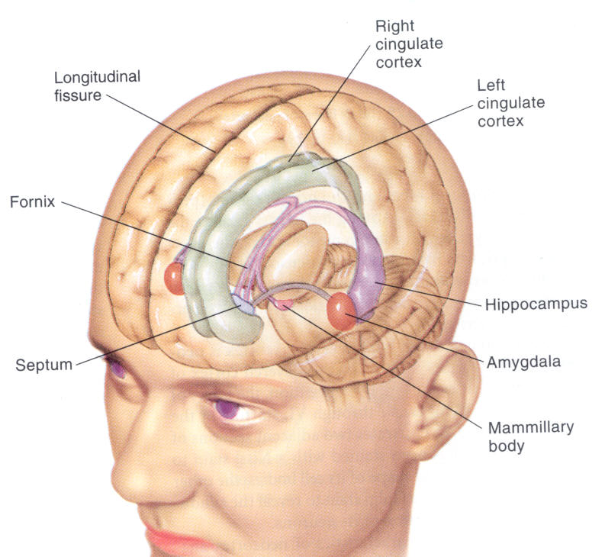
AMYGDALA
Site:
almond shaped mass of nuclei that
lies near the temporal pole, deep within the temporal lobes ,close to the tail of the caudate nucleus.
Function:
It is involved in
Emotions :
FEAR,
Anger ; aggression &
Hormonal secretions.

Slide 23
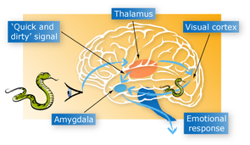
CONNECTIONS OF AMYGDALA
Inputs:
Association areas of visual, auditory & somatosensory cortices.
Outputs:
Hypothalamus &
Autonomic nuclei in the brain stem,
Lesion:
Lack of emotional responses & docility.

Slide 24
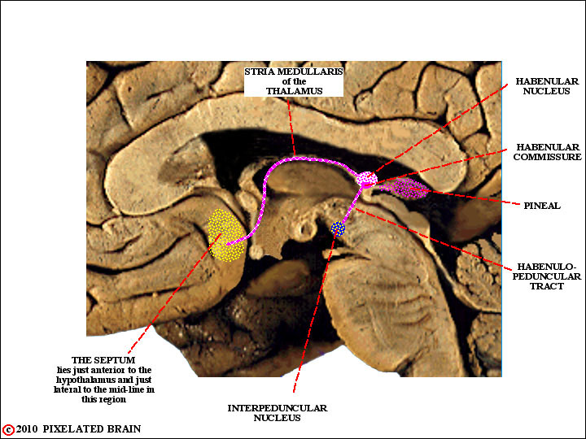
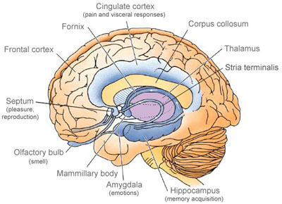
Septal nuclei
Site:
Located anterior to the interventricular septum (septum pellucidum).
Main connections:
It sends projections:
To Hypothalamus
To Habenular nuclei
Function:
It is the pleasure zone.

Slide 25
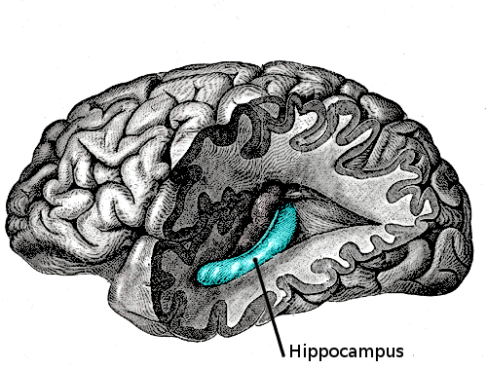
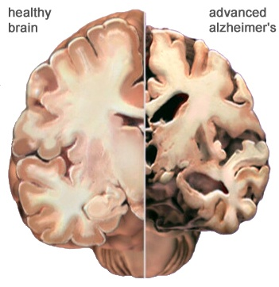
Lesions associated with limbic lobe disorders
Korsakoff’s psychosis : Korsakoff syndrome is a chronic memory disorder caused by severe deficiency of thiamine (vitamin B-1) & alcoholic intoxication.
Inability to remember recent events and long-term memory gaps
(Retrograde = loss of retained old memories occurred before the injury & (anterograde amnesia= inability to gain new memories).
Temporal lobe epilepsy
The hippocampus is a common focus site in epilepsy, and can be damaged through chronic seizures.
It is sometimes damaged in diseases such as herpes encephalitis,
Alzheimer’s disease: hippocampus is one of the first brain areas to show damage in Alzheimer's disease.Anterograde amnesia —the inability to form and retain new memmories. .
Schizophrenia. (mental disorder with inappropriate actions and feelings).

Slide 26
THANK YOU

