Slide 1
Meninges ,ventricles & CSF
Dr.Sanaa Al-Shaarawy
Dr. Essam Eldin Salama

Slide 2
OBJECTIVES
By the end of the lecture the student should be able to:
Describe the cerebral meninges & list the main dural folds.
Describe the spinal meninges & locate the level of the termination of each of them.
Describe the importance of the subarachnoid space.
List the Ventricular system of the CNS and locate the site of each of them.
Describe the formation, circulation, drainage, and functions of the CSF.
Know some clinical point about the CSF

Slide 3
MENINGES
The brain and spinal cord are invested by three concentric membranes ;
The outermost layer is the dura matter.
The middle layer is the arachnoid matter.
The innermost layer is the pia matter.

Slide 4
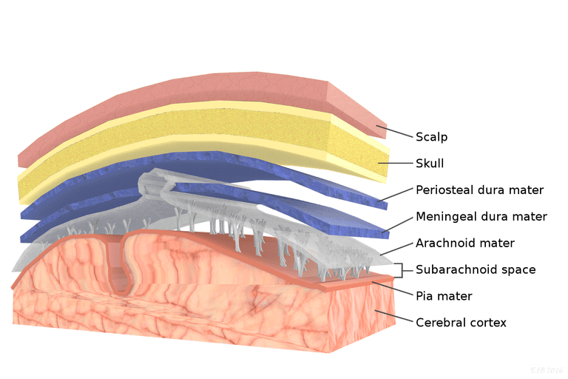
DURA MATER
The cranial dura is a two layered tough, fibrous thick membrane that surrounds the brain.
It is formed of two layers; periosteal and meningeal.
The periosteal layer is attached to the skull.
The meningeal layer is folded forming the dural folds : falx cerebri, and tentorium cerebelli.
Sensory innervation of the dura is mostly from : meningeal branches of the trigeminal and vagus nerves & C1 to C3(upper cervical Ns.).

Slide 5
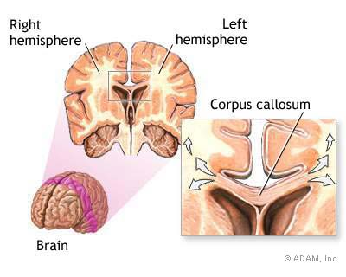
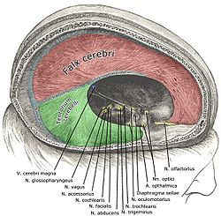
DURA MATER Folds
Two large reflection of dura extend into the cranial cavity :
1.The falx cerebri, In the midline,
It is a vertical sickle-shaped sheet of dura, extends from the cranial roof into the great longitudinal fissure between the two cerebral hemispheres.
It has an attached border adherent to the skull.
And a free border lies above the corpus callosum.

Slide 6
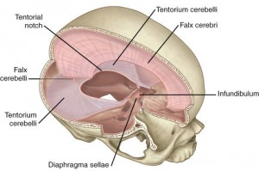
DURA MATER Folds
2. A horizontal shelf of dura, The tentorium cerebelli,
It lies between the posterior part of the cerebral hemispheres and the cerebellum.
It has a free border that encircles the midbrain.
In the middle line it is continous above with the falx cerebri.

Slide 7
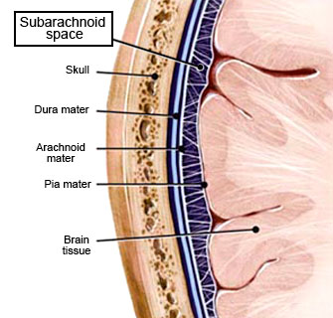
Arachnoid Mater& Pia Mater
The arachnoid mater is a soft, translucent membrane loosely envelops the brain.
The arachnoid mater is separated from the dura by a narrow subdural space.
The pia mater is the innermost, thin, delicate & highly vascular membrane that is closely adherent to the gyri and fitted into the sulci.
Between the pia and arachnoid mater lies the subarachnoid space which contains; fibrous trabechulae, main blood vessels and CSF.

Slide 8
Subarachnoid Space
It is varied in depth forming; subarachnoid cisterns ;
The cisterna magna, or cerebllomedullary cistern which lies between the inferior surface of the cerebellum and the back of the medulla.
At this cistern CSF flows out of the 4th ventricle via the 2 lateral aperatures and median aperature.

Slide 9
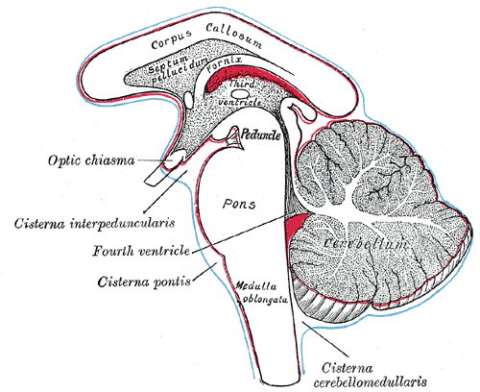
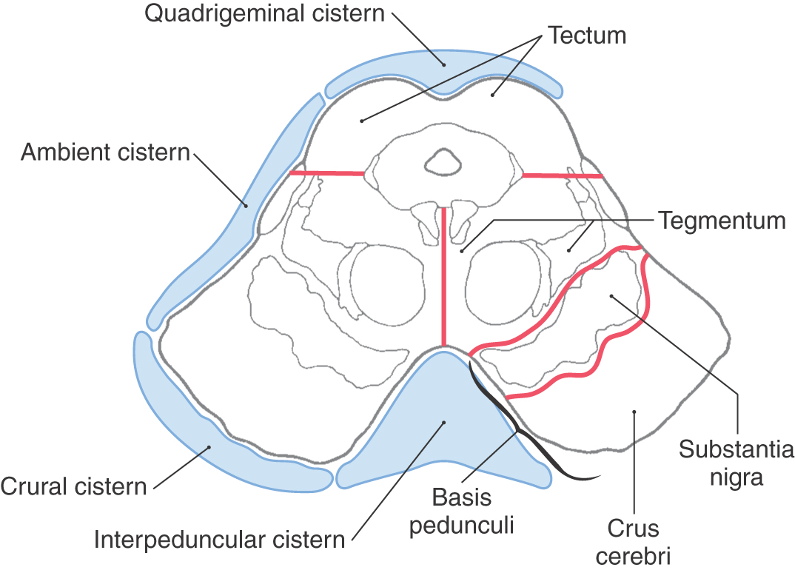
Subarachnoid Space
2. The interpeduncular cistern, which is located at the base of the brain, where the arachnoid spans between the two cerebral peduncles of midbrain.
This cistern contains the optic chiasma & circulus arteriosus of Wills.

Slide 10
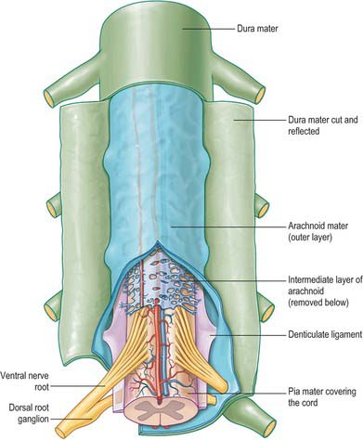
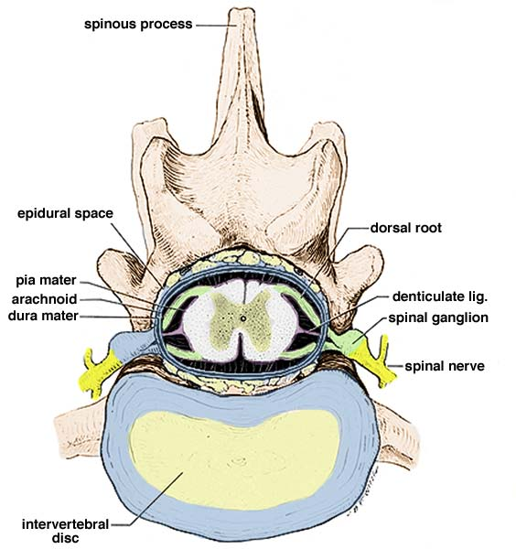
Spinal meninges
The spinal cord, is invested by three meningeal coverings: pia mater, arachnoid mater and dura mater.
The dura matter; The outer covering; is a thick, tough fibrous membrane.
It envelopes the cord loosely.
It is separated from arachnoid matter by the subdural space, and from the bony wall of the vertebral canal by the epidural space.
The arachnoid matter is a translucent membrane lies between the pia and dura,
Between arachnoid and pia lies the subarachnoid space contains CSF.
The pia matter; The innermost covering, is a delicate fibrous membrane closely envelops the cord and nerve roots.
It is attached through the arachnoid to the dura by the denticulate ligament.

Slide 11
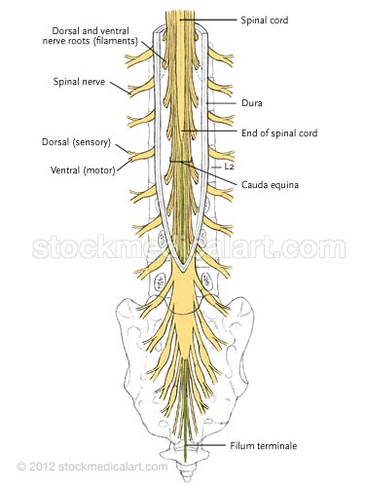
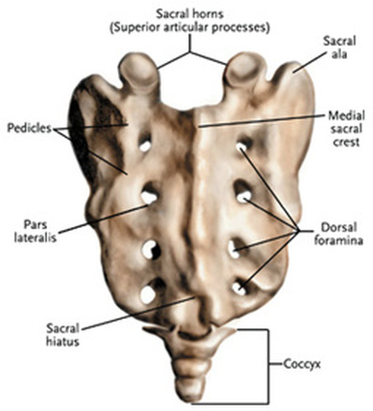
Spinal meninges
The spinal cord terminates at level L1-L2, while
The dura and arachnoid and, subarachnoid space, continue caudally to S2.
The pia extends downwards forming the filum terminale which pierces the arachnoid and dural sacs and passes through the sacral hiatus to be attached to the back of the coccyx.
S2

Slide 12
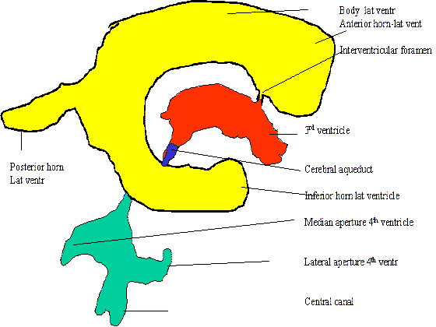
VENTRICULAR SYSTEM
Interconnecting channels within the CNS.
In the spinal cord; represented by the central canal.
Within the brain; a system of ventricles is found.
The central canal of the spinal cord is continuous upwards to the forth ventricle.
On each side of the forth ventricle laterally, lateral recess extend to open into lateral aperture (foramen of Luscka), central defect in its roof (foramen of Magendie)

Slide 13
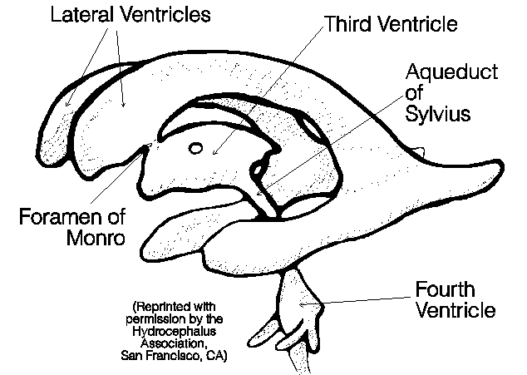
VENTRICULAR SYSTEM
The forth ventricle is continuous up with the cerebral aqueduct, that opens in the third ventricle.
The third ventricle is continuous with the lateral ventricle through the interventricular foramen (foramen of Monro).

Slide 14
CEREBROSPINAL FLUID
Present in the ventricular system, together with the cranial and spinal subarachnoid spaces.
It is colourless clear fluid containing little protein and few cells.
It is about 150 ml.
It acts as a cushion for the brain from sudden movements of the head.

Slide 15
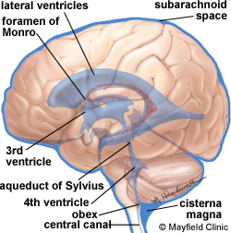
CEREBROSPINAL FLUID
It is produced by the choroid plexus, which is located in the lateral, third & fourth ventricles.
From lateral ventricle it flows: through the interventricular foramen into the 3rd ventricle and, by way of the cerebral aqueduct, into the 4th ventricle.

Slide 16
CEREBROSPINAL FLUID
It leaves the ventricular system through the three apertures of the 4th ventricle (median foramen of Magindi & 2 lateral foraminae of Leushka), to enters the subarachnoid space.

Slide 17
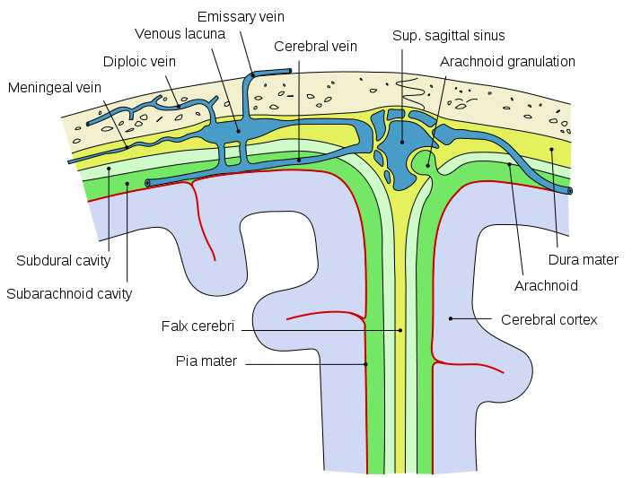
CEREBROSPINAL FLUID
reabsorbed finally into the venous system along
arachnoid villi, and
arachnoid granulation that project into the dural venous sinuses , mainly superior saggital sinus.

Slide 18
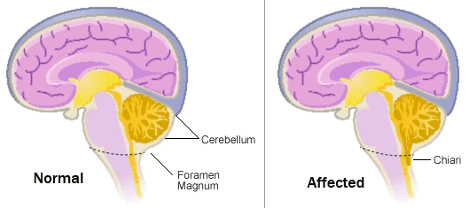
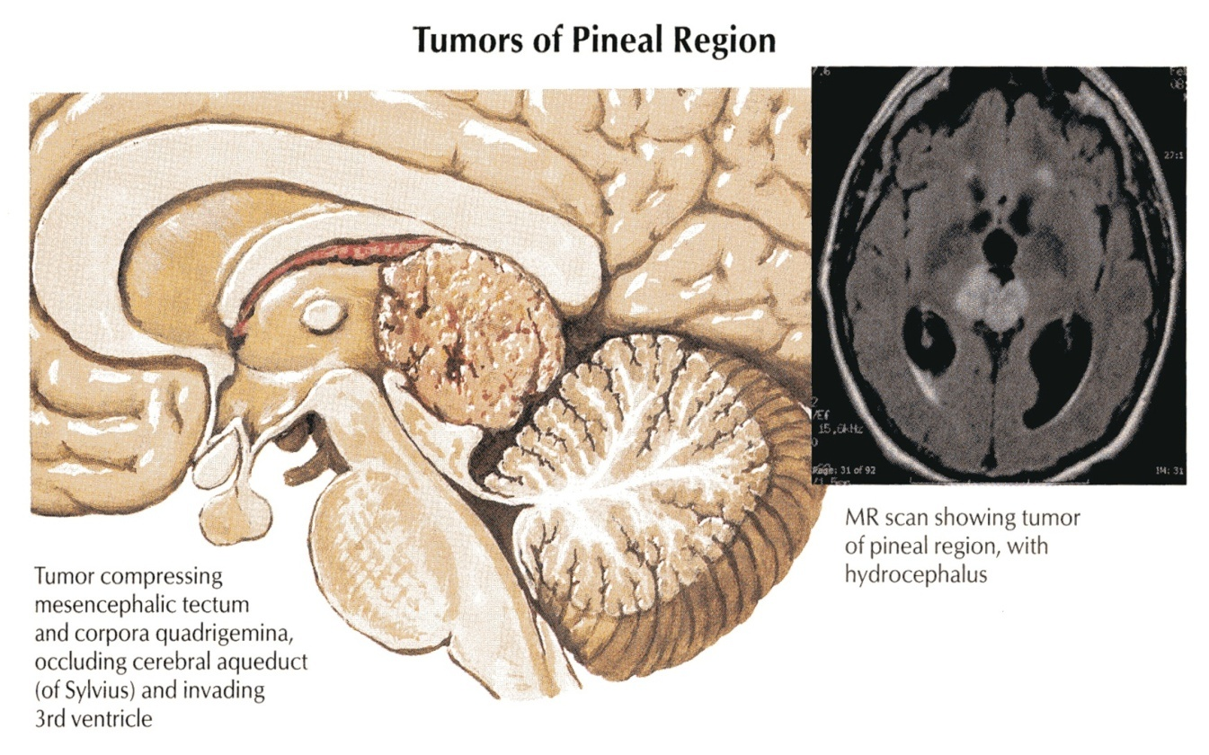
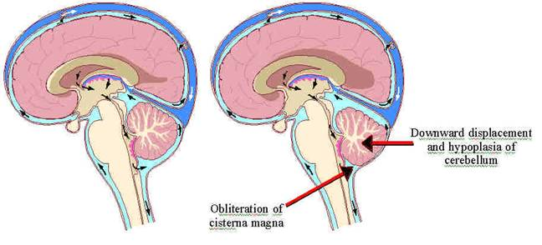
CEREBROSPINAL FLUID clinical point
The obstruction of the flow of CSF leads to a rise in fluid pressure causing swelling of the ventricles (hydrocephalus).
Causes :
Congenital : ( Arnold-Chiari malformation).
Acquired :
Stenosis of the cerebral aqueduct by tumor of pineal region.
Obstruction of the interventricular foramina secondary to tumors, hemorrhages or infections such as meningitis

Slide 19
CEREBROSPINAL FLUID clinical point
Decompression of the dilated ventricles is achieved by inserting a shunt connecting the ventricles to the jugular vein or the abdominal peritoneum.

Slide 20
Thank U & Good Luck

Slide 21
Summary
The brain & spinal cord are covered by 3 layers of meninges : dura, arachnoid & pia mater.
The important dural folds inside the brain are the falax cerebri & tentorium cerebelli.
CSF is produced by the choroid plexuses of the ventricles of the brain : lateral ,3rd & 4th ventricles.
CSF circulates in the subarachnoid space.
CSF is drained into the dural venous sinuses principally superior saggital sinus.
The subarachnoid space in the spinal cord terminates at the 2nd sacral vertebra.
Obstruction of the flow of CSF as in tumors of the brain leads to hydrocephalus.

