Slide 1
Anatomy of the Spinal Cord
DR JAMILA EL MEDANY

Slide 2
OBJECTIVES
At the end of the lecture, the students should be able to:
Describe the external anatomy of the spinal cord.
Describe the internal anatomy of the spinal cord.
Describe the spinal nerves: formation, branches and distribution via plexuses.
Define ‘Dermatome’ and describe its significance.
Describe the meninges of the spinal cord.
Define a reflex and reflex arc. Describe the components of the reflex arc.

Slide 3
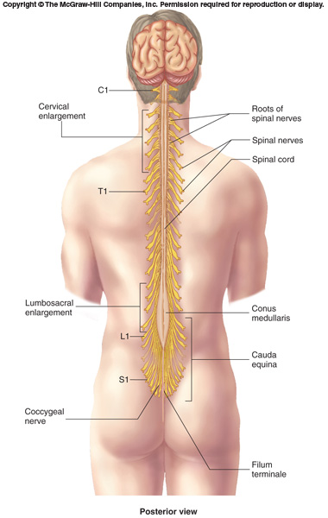
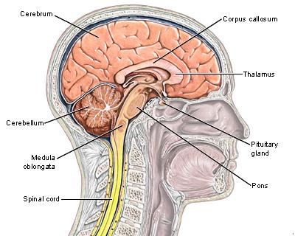
Spinal Cord
An Elongated, almost Cylindrical structure, about the thickness of the little finger.
It is suspended in the vertebral canal & surrounded by the meninges and cerebrospinal fluid (CSF).
In adults, its Length is approximately 45 cm
Extends from foramen magnum to L1-L2
(In children it extends to L3)
Continuous above with the medulla oblongata.
The tapered inferior end forms Conus Medullaris, which is connected to the coccyx by a non-neuronal cord called Filum Terminale.
Gives rise to 31 pairs of spinal nerves

Slide 4
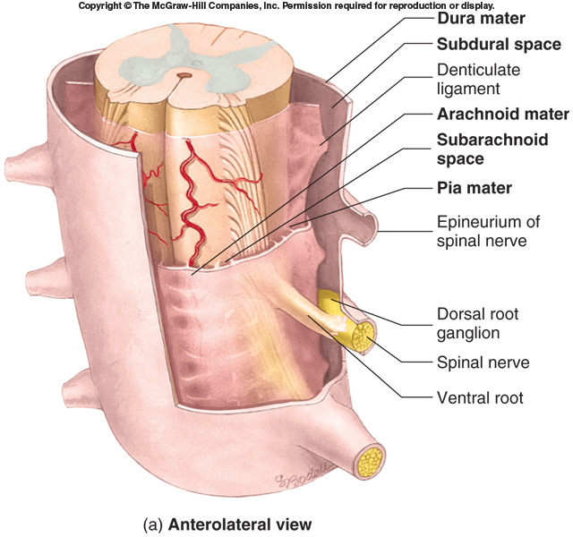
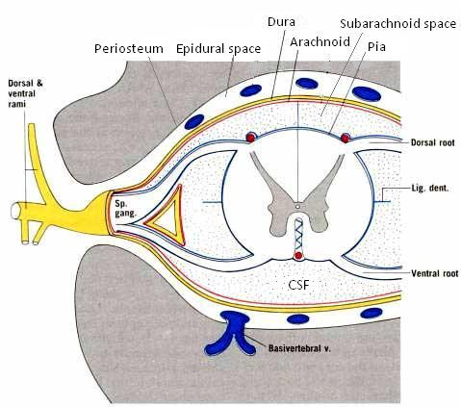
Spinal Meninges
Three connective tissue membranes surround spinal cord and brain
Dura mater: tough outer layer, continuous with epineurium of the spinal nerves
Arachnoid mater: thin membrane deeper to dura mater
Pia mater: delicate membrane bound tightly to surface of brain and spinal cord and carries blood vessels.
Forms the filum terminale, which anchors spinal cord to coccyx and the denticulate ligaments that attach the spinal cord to the dura mater
Spaces
Epidural: Contains blood vessels, areolar connective tissue and fat.
Subdural: a potential cavity between the dura and arachnoid mater, contains a small volume of serous fluid.
Subarachnoid: Contains cerebrospinal fluid (CSF) and blood vessels
P
A
D

Slide 5
The spinal cord is a Segmented structure, has
Cervical
Thoracic
Lumbar
Sacral segments
Not uniform in diameter,
Has two enlargements:
Cervical enlargement: supplies upper limbs
Lumbosacral enlargement: supplies lower limbs
The bundle of spinal nerves extending inferiorly from lumbosacral enlargement and conus medullaris surround the filum terminale and form cauda equina (because of its resemblance to a horse's tail

Slide 6
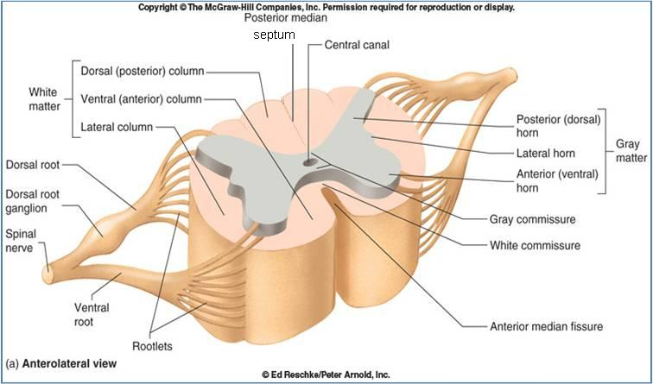
Cross Section of Spinal Cord
The spinal cord is:
Incompletely divided into two equal parts,
anteriorly by a short, shallow median fissure and
posteriorly by a deep narrow septum, the posterior median septum.
Composed of grey matter in the centre surrounded by white matter
*
*
*
The arrangement of grey matter resembles the shape of the letter H, having two posterior, two anterior and two lateral horns/columns

Slide 7
Central canal
A cerebrospinal-filled space that runs longitudinally through the entire length of the spinal cord.
Lined by ependyma (ciliated columnar epithelium)
Continuous with the ventricular system of the brain
Superiorly opens into the 4th ventricle
Inferiorly in the conus medullaris, it expands into the fusiform terminal ventricle and terminates below at the root of filum terminale

Slide 8
Commissures of the Spinal Cord
Grey commissure:
A transverse bridge of grey matter connecting the anterior and posterior gray horns on each side
Is pierced by the central canal that divides it into anterior and posterior parts
White Commissure:
Lies ventral to the gray commissure
Mainly contains decussating nerve fibers
White commissure
grey commissure

Slide 9
Grey matter
Consists of nerve cell bodies and their processes, neuroglia, and blood vessels
The nerve cells are multipolar and are of three main categories:
Sensory neurons (Tract cells), which receive impulses from the periphery of the body and whose axons constitute the ascending fasciculi of the white matter, are located in the Dorsal horns.
Lower motor neurons, which transmit impulses to the skeletal muscles, are located in the ventral horns (similar neurons in the lateral horn are the preganglionic neurons of the autonomic system)
Interneurons (connector neurons): linking sensory and motor neurons, at the same or different levels, which form spinal reflex arcs.

Slide 10
Neuronal Architecture of Spinal Grey Matter
Cells of the same type are clustered into groups, which occur in long columns
In transverse section, these columns appear as layers, especially within the dorsal horn
These layers are called the Laminae of Rexed, that are numbered consecutively by Roman numerals, starting from the tip of the dorsal horn and moving ventrally into the ventral horn

Slide 11
Nerve Cell Groups in Dorsal Horn
4 main groups
Substantia gelatinosa
Nucleus proprius
Nucleus dorsalis (Clark’s column, nucleus thoracis)
Visceral afferent nucleus
1
2
4
3

Slide 12
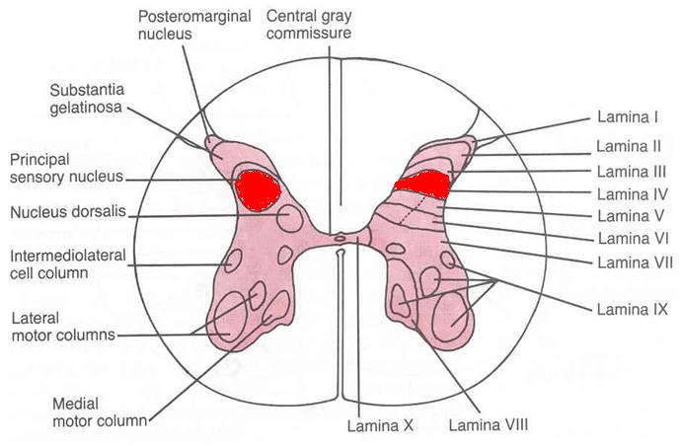
Substantia Gelatinosa
Rexed Laminae II
Located at the apex of the posterior horn
Composed of large neurons
Extends throughout the length of spinal cord
Afferents: dorsal root fibers concerned with pain, temperature.
Nucleus Proprius (nucleus centralis)
Rexed Lamina IV
Located anterior to substantia gelatinosa
Composed of large neurons
Extends throughout the length of spinal cord
Afferents: dorsal root fibers concerned with half of crude touch.

Slide 13
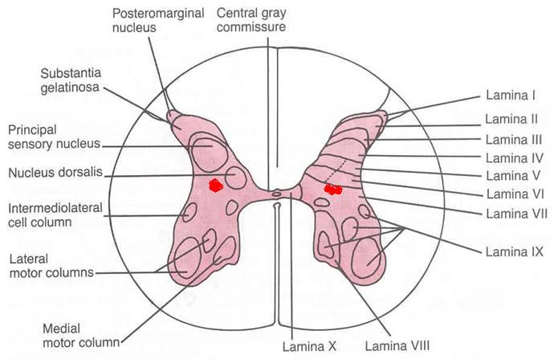
Nucleus Dorsalis (Clark’s column, Nucleus thoracis)
Rexed Lamina VII
Located at the base of dorsal horn
Composed mostly of large neurons
Extends from C8 to L3-4 segments
Associated with proprioceptive endings
Afferents: dorsal root fibers concerned with information from muscle spindles and tendon organs.
Visceral Afferent Nucleus
Rexed Lamina VII
Located lateral to nucleus dorsalis
Composed mostly of medium size neurons
Extends from T1 to L3 segments
Afferents: Visceral afferents

Slide 14
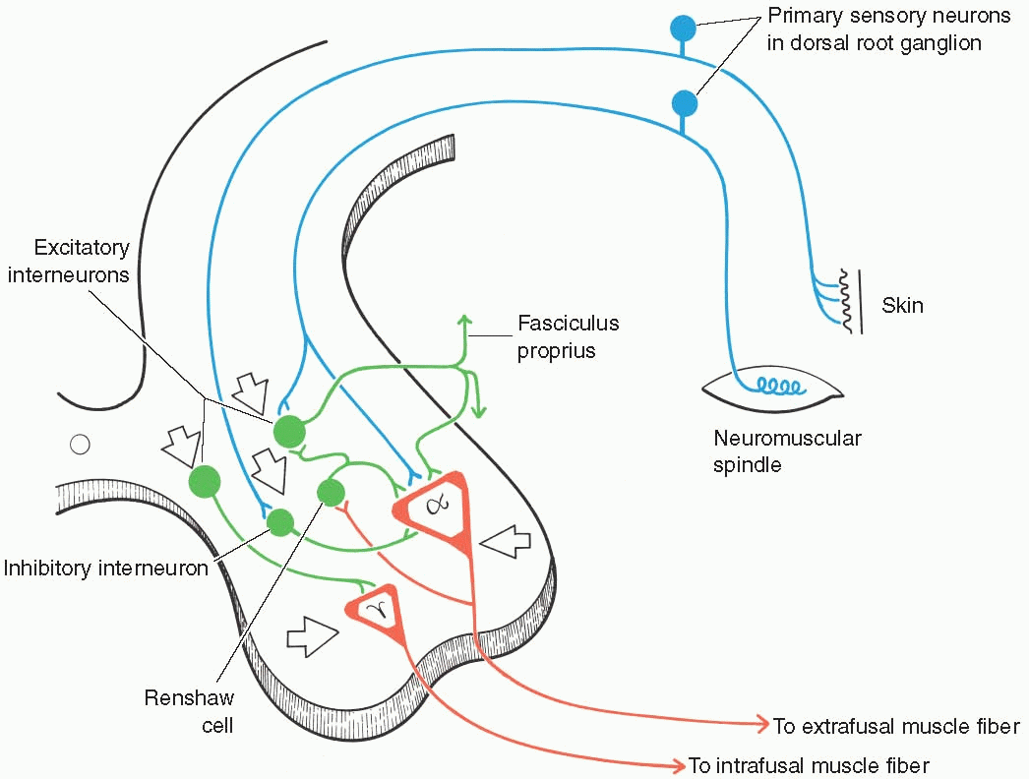
Nerve Cell Groups in Ventral Horn
The ventral horns contain:
Motor neurons, also called lower motor neurons.
Interneurons, the (Renshaw cells), whose branched axons form inhibitory synaptic junctions on motor neurons

Slide 15
Types of Motor Neurons in Ventral Horn
Large multipolar cells
Numerous
Axons pass out in the ventral roots of spinal nerves as alpha efferents
Innervate extrafusal muscle fibers
Smaller multipolar cells
Less numerous
Axons pass out in the ventral roots of spinal nerves as gamma efferents
Innervate intrafusal muscle fibers of neuromuscular spindles
Both alpha and gamma motor neurons are under the influence of descending pathways (upper motor neurons) from brain

Slide 16
Organization of Motor Neurons in Ventral Horn
Motor neurons are organized in 3 groups:
Medial:
present in most segments
Innervate muscles of Neck and Trunk (including intercostal and abdominal muscles)
Central:
smallest,
present in some segments: cervical (phrenic C3-5, spinal accessory C1-6) and lumbosacral (L2-S1) Lateral:
present in cervical and lumbosacral segments
innervates muscles of the Limbs
Neurons supplying flexor muscles are located dorsal to neurons for extensor muscles

Slide 17
Nerve Cell Groups in Lateral Horn
Small column composed of small neurons extend from:
T1 to L2-3 segments, give rise to pre-ganglionic sympathetic fibers
S2-4 segments, give rise to preganglionic parasympathetic fibers

Slide 18
White Matter
Consists of mixture of nerve fibers, neuroglia and blood vessels. White color is due to high proportion of myelinated nerve fibers
Arranged in columns/funiculi; anterior, posterior and lateral.
The nerve fibers are arranged as bundles, running vertically through the cord. A group of nerve fibers (axons) that share a common origin, termination and function form a tract or fasciculus
Tracts are often named according to their points of origin and destination, e.g. spinothalamic, corticospinal.
Depending on their function, the spinal tracts are divided into Ascending and Descending tracts

Slide 19
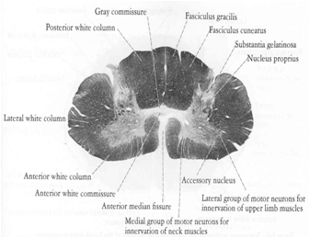
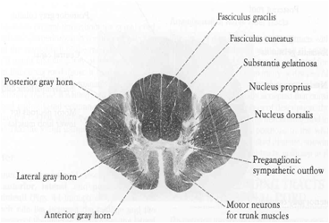
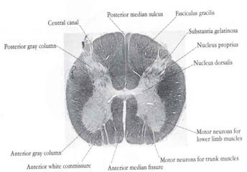
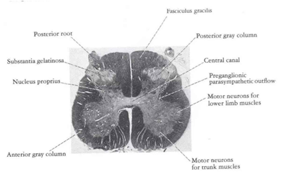
Regional Differences
Although the general pattern of gray matter is the same throughout spinal cord, regional differences are apparent in transverse sections
The amount of white matter increases in a caudal-to-cranial direction because fibers are added to ascending tracts
The gray matter is increased in volume in cervical & lumbosacral enlargements for innervation of upper & lower limbs
The lateral horn is characteristics of thoracic and upper lumbar segments
Cervical
Thoracic
Lumbar
Sacral

Slide 20
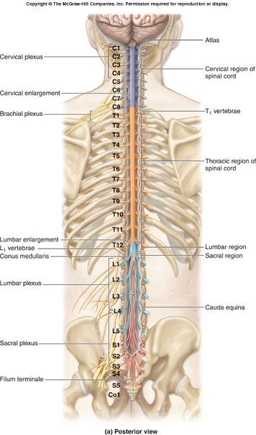
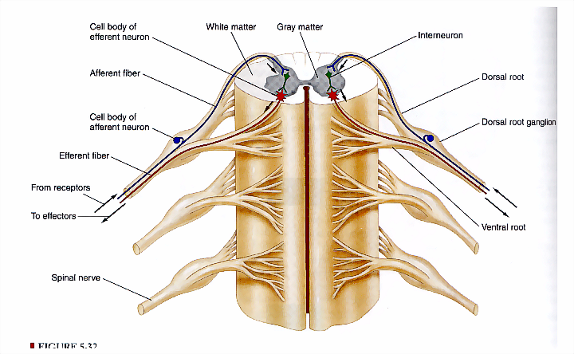
Spinal Nerves
Thirty-one pairs of spinal nerves
First pair exit vertebral column between skull and atlas, last four pair exit via the sacral foramina and others exit through intervertebral foramina
Eight pair cervical, twelve pair thoracic, five pair lumbar, five pair sacral, one pair coccygeal
Each spinal nerve arises as rootlets which then combine to form dorsal (posterior) purely sensory & ventral (anterior) purely motor Roots.
Two roots merge laterally and form the spinal nerve.
Dorsal (posterior) root has a ganglion (dorsal root/sensory ganglion) that contains the cell bodies of the sensory neurons
Each spinal nerve then divides into a MIXED smaller dorsal and a larger ventral Ramus

Slide 21
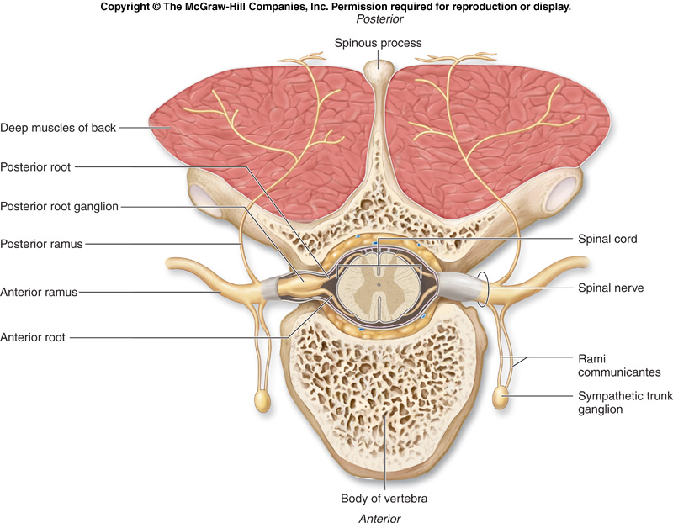
Branches of Spinal Nerves
Dorsal Rami
Innervate:
Deep muscles of the trunk responsible for movements of the vertebral column
Skin near the midline of the back.
Ventral Rami:
In the thoracic region form Intercostal nerves that innervate the intercostal muscles and the skin over the thorax
Remaining ventral rami form five plexuses:
C1 - C4= Cervical plexus
C5 - T1= Brachial plexus
L1 - L4= Lumbar plexus
L4 - S4= Sacral plexus
S5 & Co= Coccygeal plexus
The spinal nerves are connected to sympathetic chain of ganglia by communicating rami

Slide 22
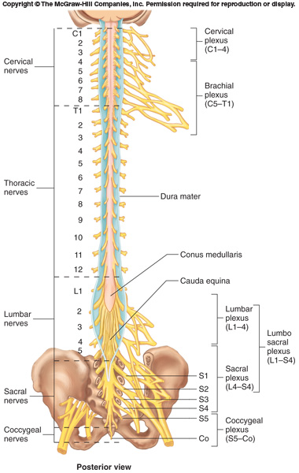

Slide 23
Dermatomes
‘Dermatome’ is a segment of skin supplied by a specific segment of the spinal cord (segmental spinal nerve)
Cutaneous areas supplied by adjacent spinal nerves overlap. There is therefore little or no sensory loss after interruption of a single spinal nerve or dorsal root
Notes:
Al examination

Slide 24
Reflex & Reflex Arc
A reflex is a rapid, involuntary, predictable response brought by a sensory stimulus
The neural pathway mediating the reflex actions is called reflex arc.

Slide 25
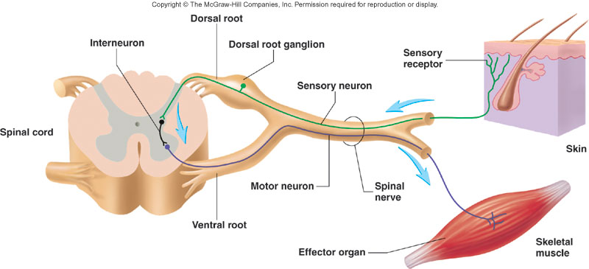
Components of a Reflex Arc
Action potentials produced in
Sensory receptor
Sensory neuron
Effector organ which responds with a reflex
Motor neuron
Interneuron

Slide 26
Variety of Reflexes
Some integrated within spinal cord; some within brain
Some involve excitatory neurons yielding a response; some involve inhibitory neurons that prevent an action
Higher brain centers can influence, suppress, or exaggerate reflex responses

Slide 27
Thank You

