Slide 1
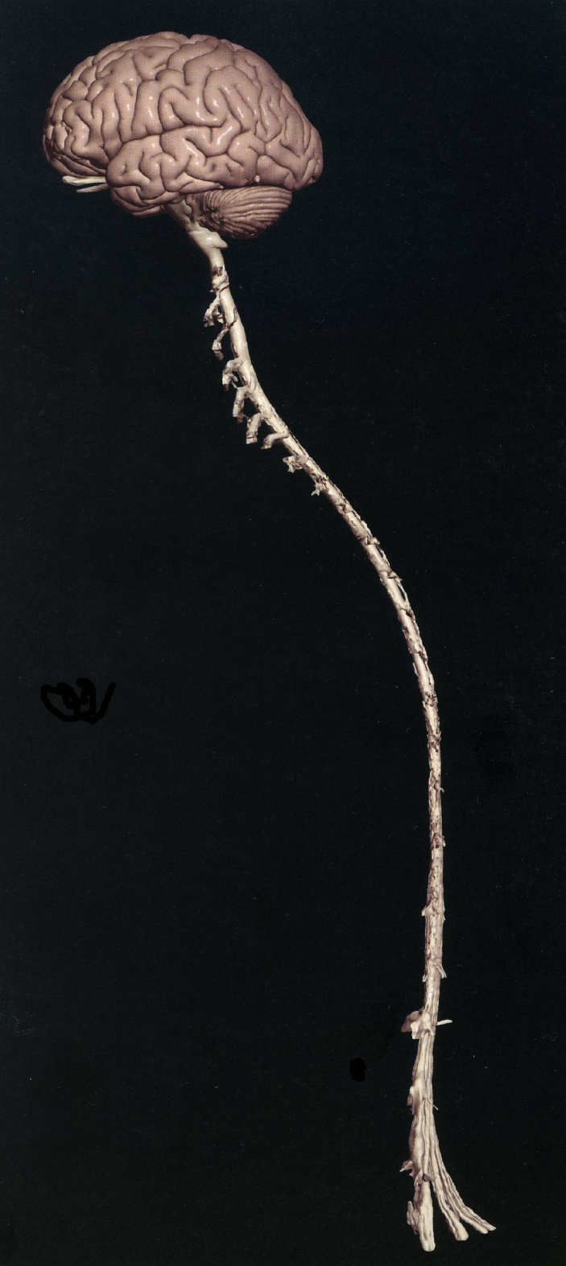
SENSORY (ASCENDING) SPINAL TRACTS
Dr. Jamila Dr. Essam Eldin
El-Medany Salama

Slide 2
OBJECTIVES
By the end of the lecture, the student will be able to:
Define the meaning of a tract.
Distinguish between the different types of tracts.
Locate the position of each tract.
Describe the sensory pathway.
Identify the different sensory spinal tracts and their functions.
Identify the course of each of these tracts.
Know some associated lesions regarding the main tracts.

Slide 3
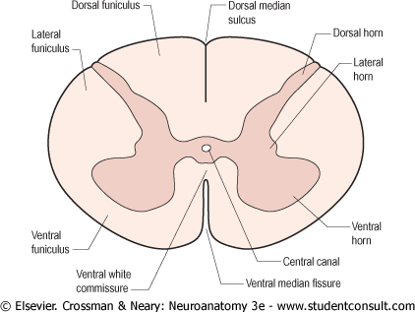
The grey matter of the spinal cord is completely surrounded by the white matter
The White matter of the spinal cord consists of Ascending and Descending Nerve Fibers.
It is divided into Dorsal, Lateral & Ventral Columns or Funiculi.

Slide 4
WHITE MATTER TRACTS
Bundles or fasciculi of fibers that occupy more or less definite positions in the white matter.
They have the same Origin,
Termination and
carry the same Function.

Slide 5
CLASSIFICATION OF WHITE MATTER TRACTS
They are classified into:
1- Short Tracts; intersegmental or propriospinal).
Fibers occupy narrow band immediately peripheral to the grey matter (fasciculus proprius).
They interconnect adjacent or distant spinal segments
And Permit intersegmental coordination

Slide 6
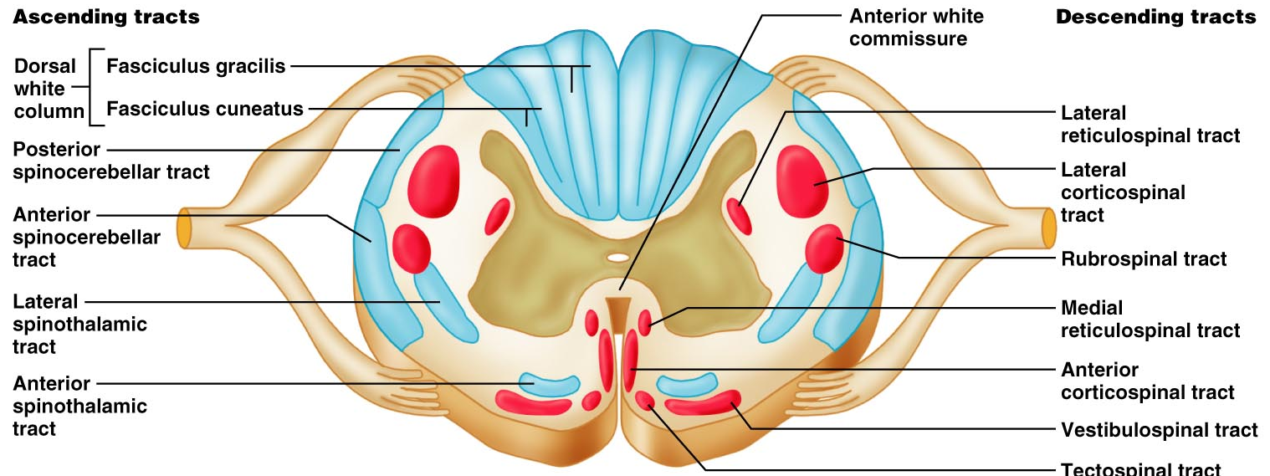
2-Long Tracts:
(a) Ascending (sensory or afferent). (b) Descending (motor or efferent). They serve to join the brain to the spinal cord.

Slide 7
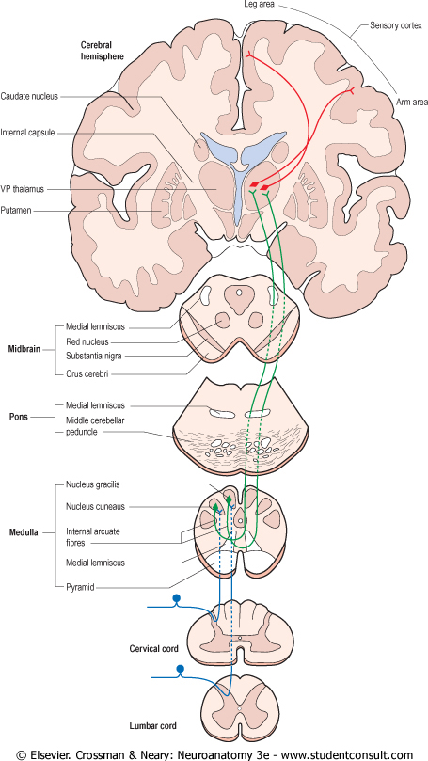
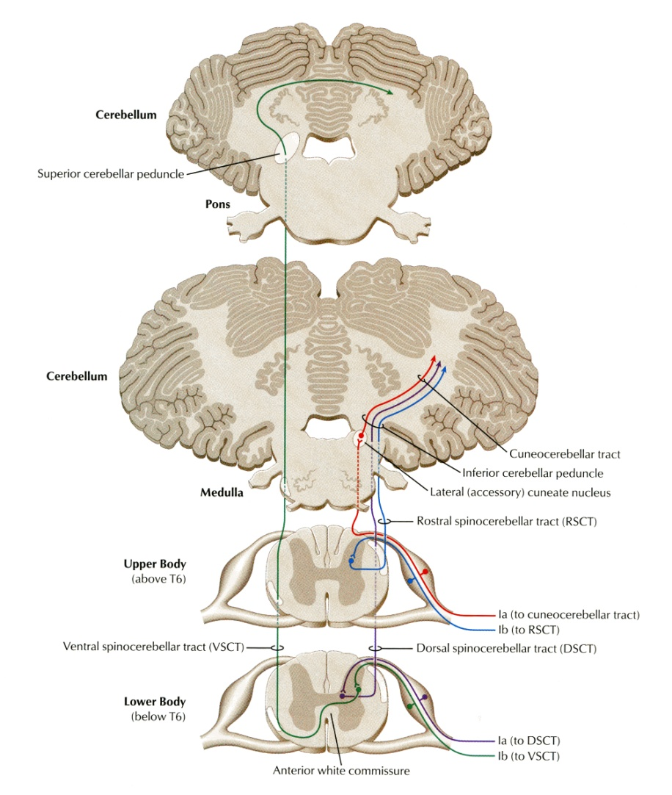
Ascending Tracts;
Carry impulses from pain, thermal, tactile, muscle and joint receptors to the brain.
Some of this information eventually reaches a conscious level (at the cerebral cortex),
while some is destined for subconscious centers (e.g at the cerebellum).

Slide 8
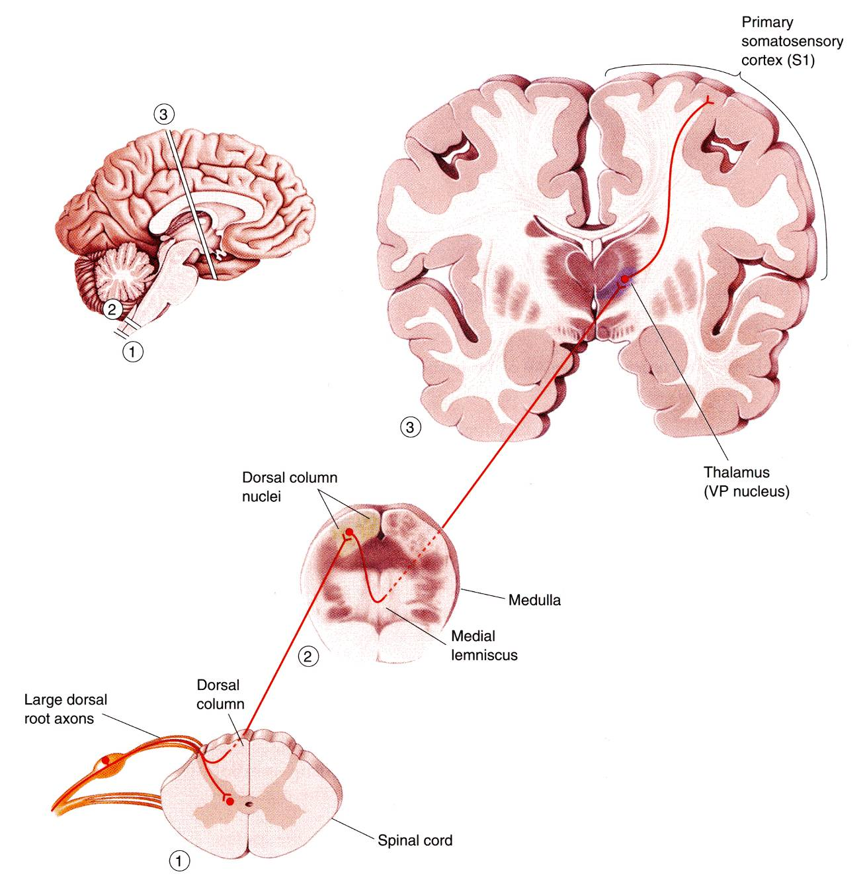
Pathways that carry information to a conscious level share certain common characteristics:
There is a sequence of Three Neurones between the peripheral receptors and the cerebral cortex.

Slide 9
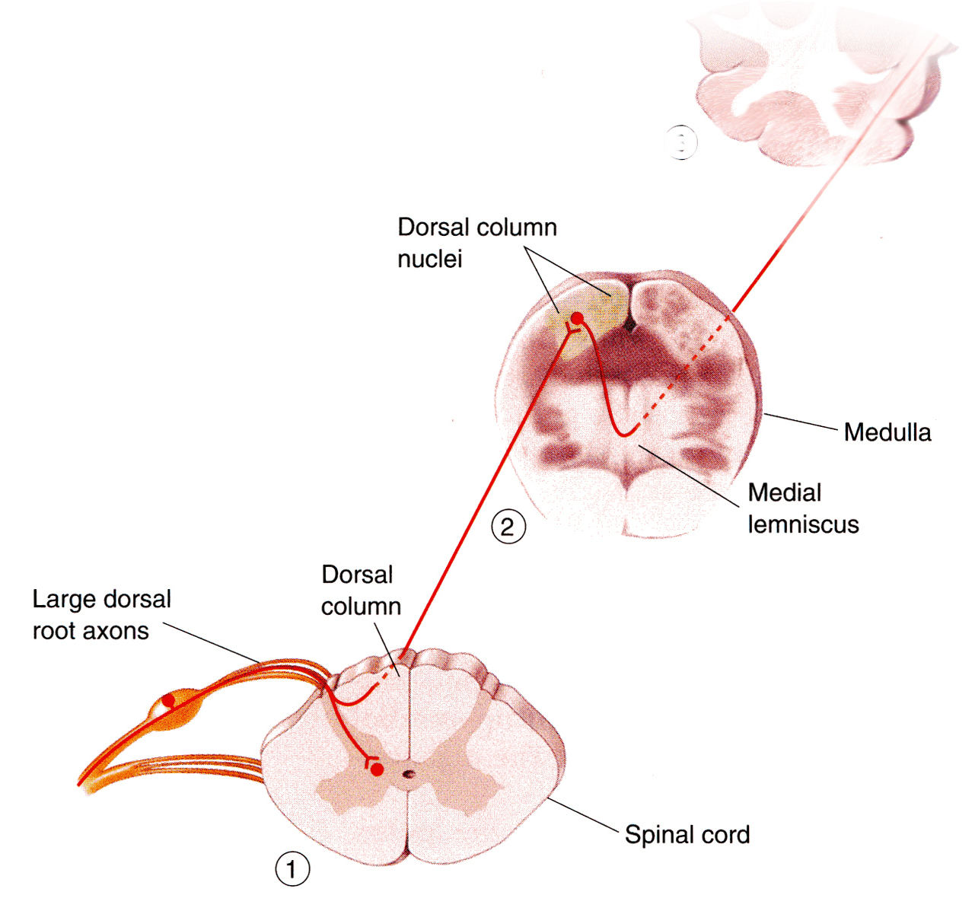
The axons of the first-order neurone or primary afferent neurone) enters the spinal cord through the dorsal root of a spinal nerve and its cell body lies in the dorsal root ganglion.
The main fiber remains on the ipsilateral side of the cord and terminates in synaptic contact with the second neurone which lies either in the spinal grey matter or in the medulla oblongata of the brain stem.

Slide 10
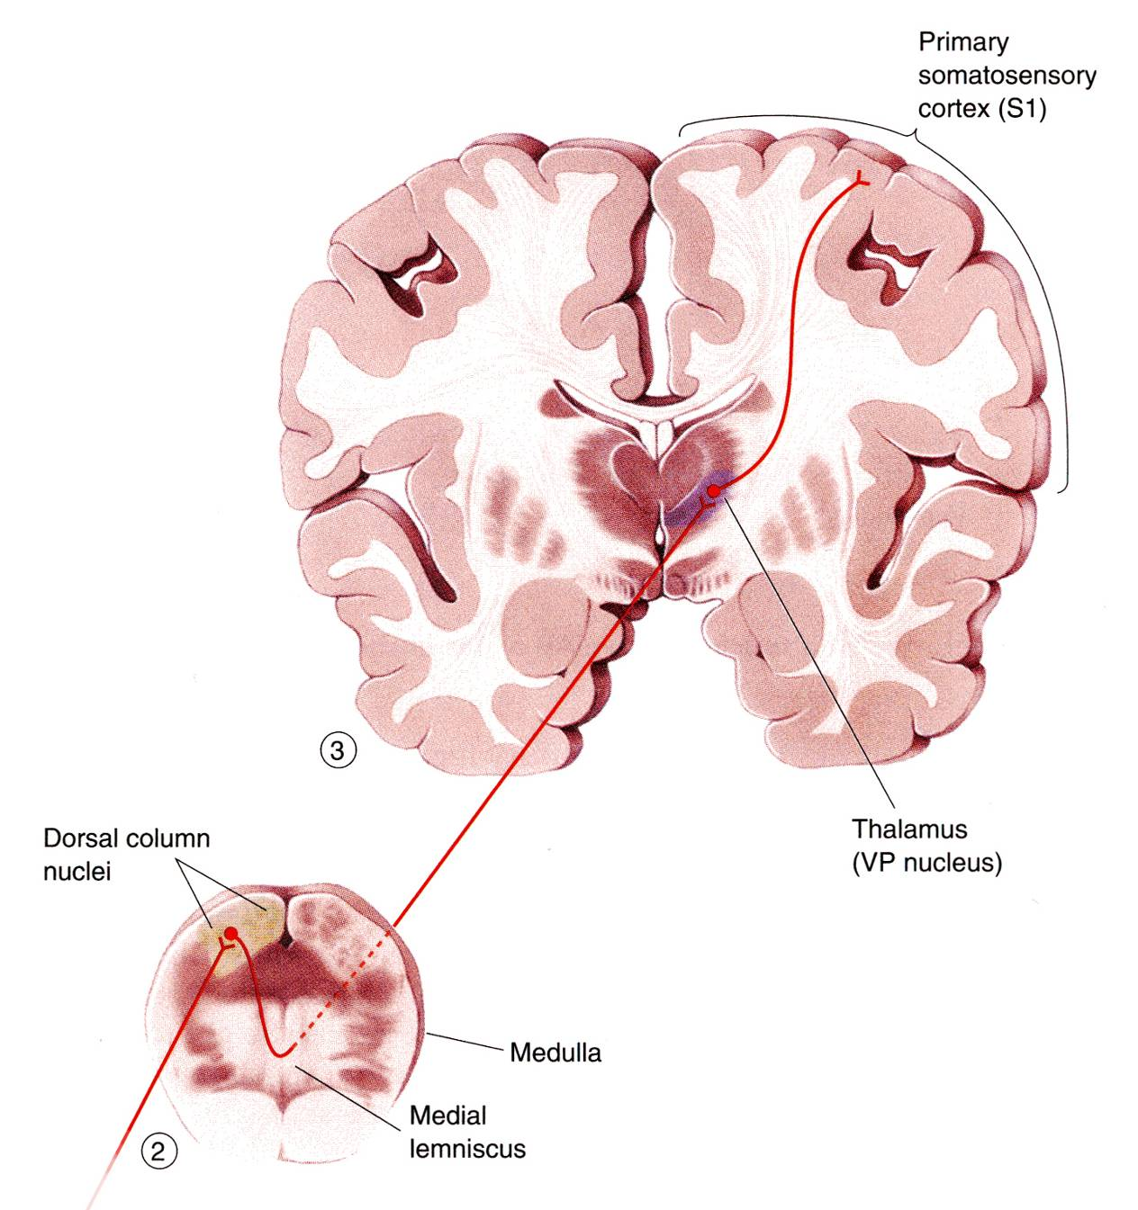
The axon of the second order neurone crosses over (decussates) to the opposite side of the CNS and ascends to the thalamus, where it terminates.
The third-order neurone has its cell body in the thalamus.
Its axon passes to the somatosensory cortex of the parietal lobe of the cerebral hemisphere.

Slide 11
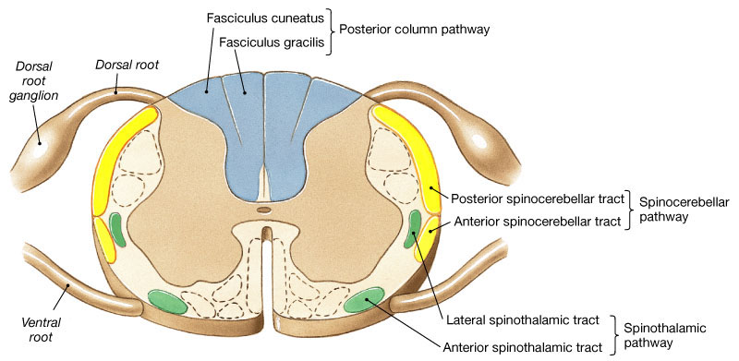
Three major pathways carry sensory information:
Dorsal (Posterior )column (Gracile & Cuneate fasciculi)
Anterolateral pathway (Spinothalamic)
Spinocerebellar pathway

Slide 12
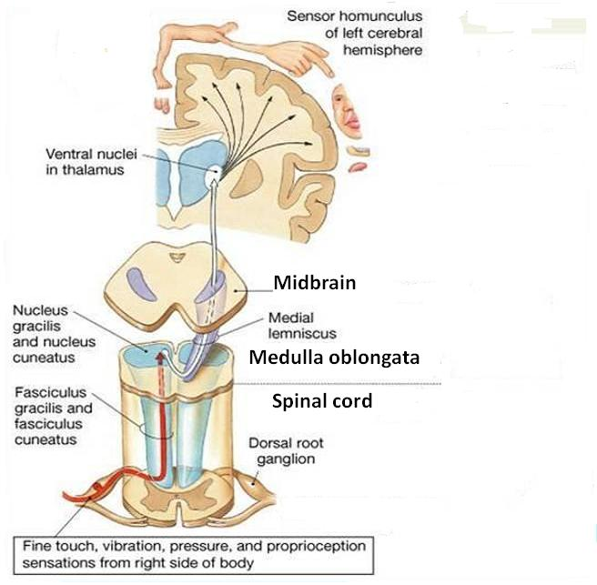
Dorsal Column
Contains two tracts; Fasciculus Gracilis (FG) & Fasciculus Cuneatus (FC)
Carry impulses concerned with proprioception (movement and joint position) , discriminative touch & the other half of the crude touch from ipsilateral side of the body
Contain the axons of primary afferent neurons that have entered cord through dorsal roots of spinal nerves
Fasciculus Gracilis contains fibers that are received at sacral, lumbar and lower thoracic levels,
Fasciculus Cuneatus contains fibers that are received at upper thoracic and cervical levels

Slide 13
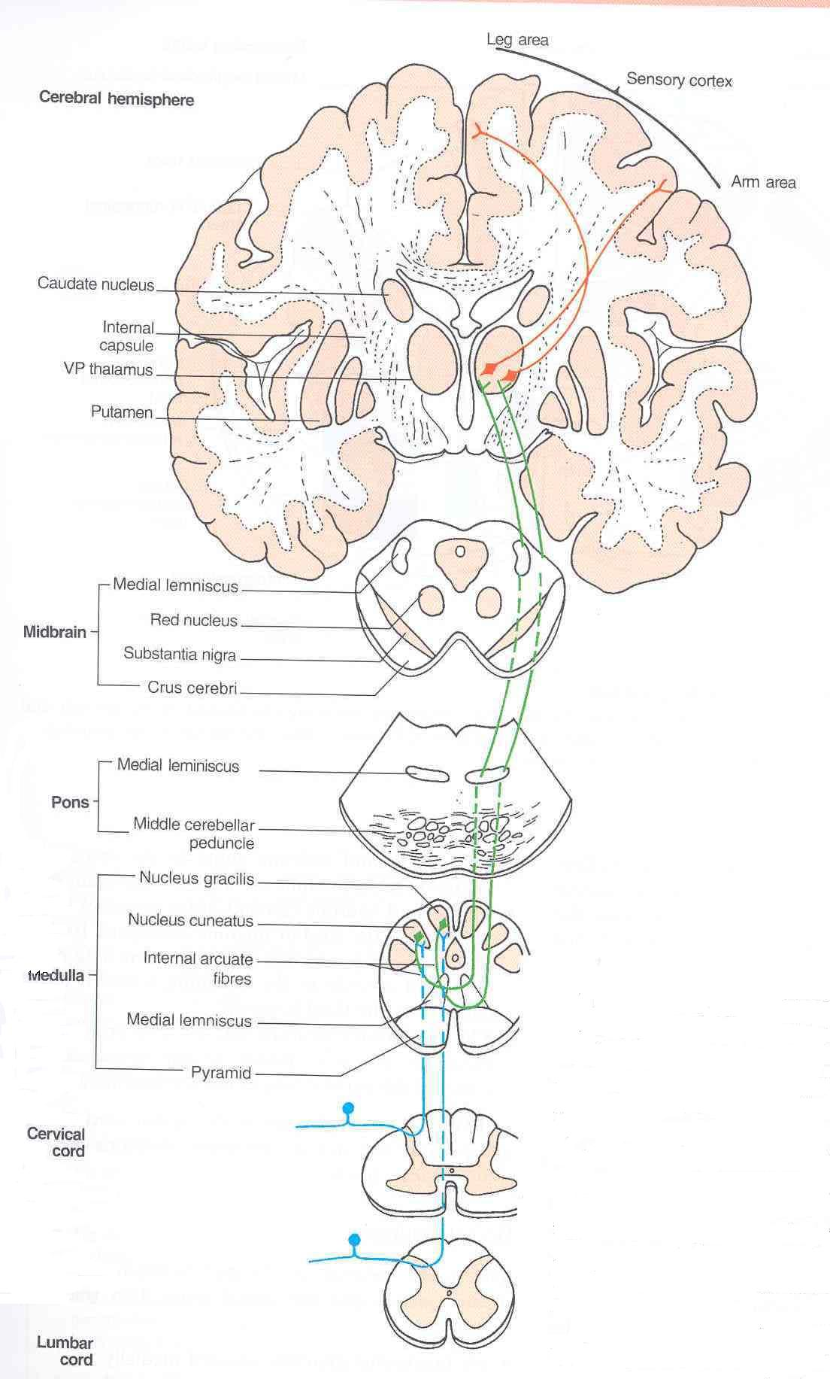
Dorsal Column
Fibers ascend without interruption where they terminate upon 2nd order neurons in nucleus gracilis and nucleus cuneatus.
The axons of the 2nd order neurons decussate in the medulla as internal arcuate fibers. and ascend through the brain stem as Medial Lemniscus.
The medial lemniscus terminates in the ventral posterior nucleus of the thalamus (3rd order neurons),
which project to the somatosensory cortex (thalamocortical fibers)

Slide 14
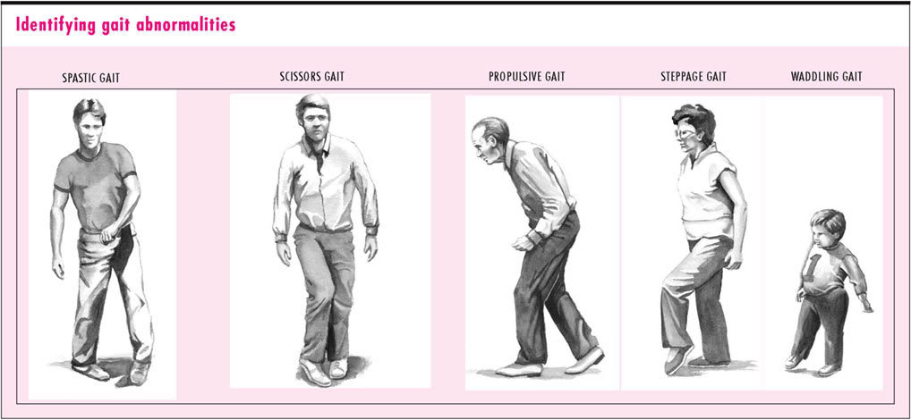
Tabes Dorsalis
A late manifestation of syphilitic infection on the CNS.
Affects the lumbosacral dorsal spinal roots and dorsal columns of the spinal cord.
Leads to loss of proprioception which is manifested by a high Step Page and unsteady gait (Sensory Ataxia)

Slide 15
Subacute Combined Degeneration of the spinal cord
A systemic disease results from B12 deficiency
It produces Sensory Ataxia
Lateral columns are also affected (combined) causing weak and spastic limbs
It is completely recovered by proper treatment with B12

Slide 16
Multiple Sclerosis
An immune disease affects specifically fasciculus Cuneatus of the cervical region. Leads to loss of proprioception in hands and fingers (Asteriognosis)

Slide 17
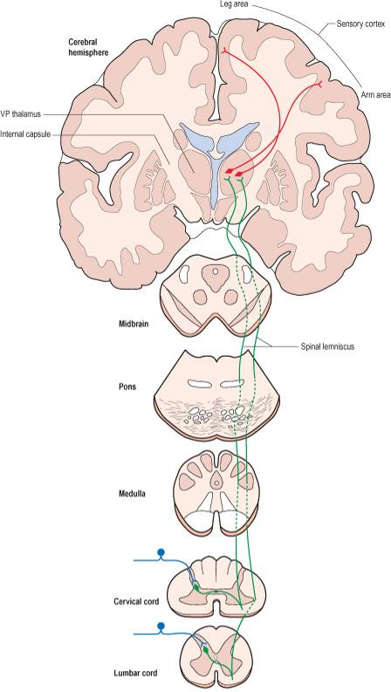
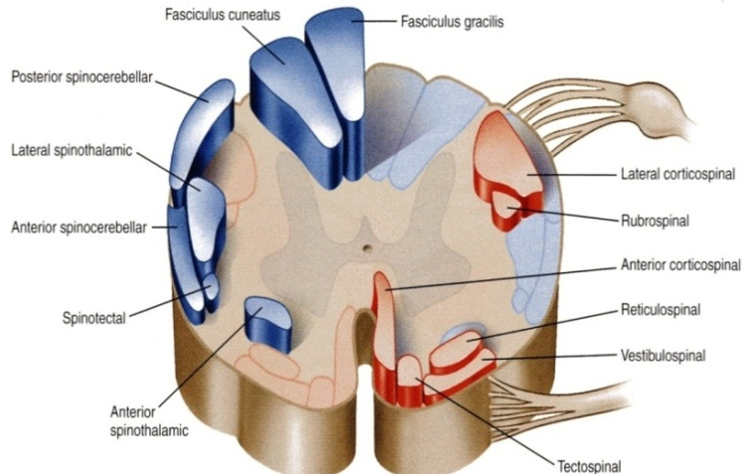
Spinothalamic Tracts
The spinothalamic tracts contain axons of second-order neurones, the cell bodies of which lie in the contralateral dorsal horn.
Located lateral and ventral to the ventral horn.
Carry impulses concerned with; pain and thermal sensations (Lateral tract) and ½ Non- Discriminative touch and pressure (Anterior tract), from the contralateral side.
In brain stem, the two tracts constitute the Spinal Lemniscus.
Information is sent to the primary sensory cortex on the opposite side of the body.

Slide 18
Lateral Spinothalamic Tract
Function:
Carries pain & Temperature to thalamus and sensory area of the cerebral cortex.
Neurones: 3 Neurones
Neurone I: Small cells in the dorsal root ganglia.
Neurone II: Cells of substantia gelatinosa of Rolandi in the posterior horn.
Neurone III: Cells of (VP) nucleus of the thalamus.

Slide 19
Anterior Spinothalamic Tract
Function:
Carries 1/2 crude touch (non discriminative) & pressure to thalamus and sensory cortex.
Neurones: 3 Neurones
Neurone I:
Medium sized cells in the dorsal root ganglia.
Neurone II:
Cells of main sensory nucleus or
(nucleus proprius).
Fibers arising from Substantia Gelatinosa & Nucleus Proprius decussate in the Anterior White Commissar
Neurone III:
Cells of VP nucleus of thalamus.
.

Slide 20
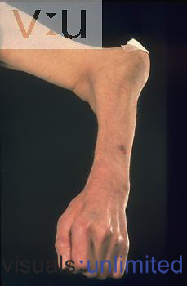
Spinothalamic Tracts Lesion
It is selectively damaged in Syringomyelia
The central canal becomes enlarged forming a cavity compressing the adjacent nerve fibres
Fibres serving pain and temperature are damaged as they decussate in the ventral white commissure close to the central canal causing selective loss of pain and temperature in the upper limbs (dissociate sensory loss)
Light touch and proprioceptive sensations are retained
Joints of the limbs become disorganized without discomfort (Charcot's joint)

Slide 21
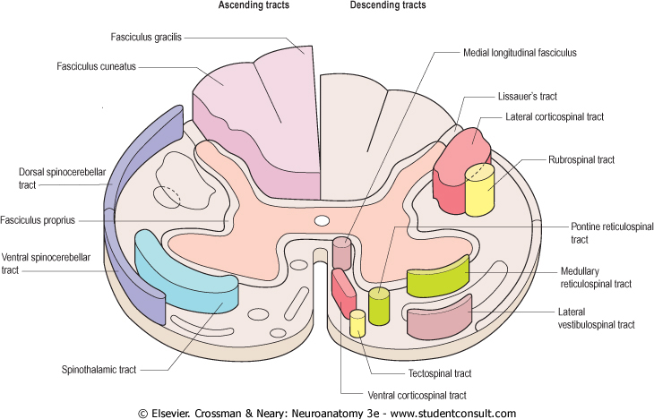
Spinocerebellar Tracts
The Spinocerebellar system consists of a sequence of only two neurons;
Neurone I:Large cells of dorsal root ganglia.
Neurone II: cells of the nucleus dorsalis; Clark's nucleus (column) .
Two tracts: Dorsal &Ventral
Located near the dorsolateral and ventrolateral surfaces of the cord
Contain axons of the second order neurons
Carry information derived from muscle spindles, Golgi tendon and tactile receptors to the cerebellum for the control of posture and coordination of movements

Slide 22
Posterior Spinocerebellar Tract
Present only above level L3
The cell bodies of 2nd order neuron lie in Clark’s column
Axons of 2nd order neuron terminate ipsilaterally (uncrossed) in the cerebellar cortex by entering through the inferior cerebellar peduncle.
Posterior spinocerebellar tract convey sensory information to the same side of the cerebellum

Slide 23
Ventral (Anterior)Spinocerebellar Tract
The cell bodies of 2nd order neuron lie in base of the dorsal horn of the lumbosacral segments
Axons of 2nd order neuron cross to opposite side, ascend as far as the midbrain, and then make a sharp turn caudally (the fibers cross the midline for the second time) and enter the superior cerebellar peduncle to terminate in the cerebellar cortex
So Ventral spinocerebellar tract conveys sensory information to the same side of the cerebellum

Slide 24
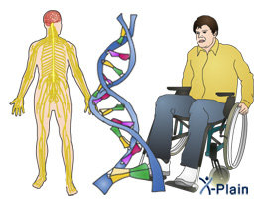
Lesion of the Spinocerebellar Tracts
Friedrichs ataxia
An inherited degenerated disease
Affecting the spinocerebellar tracts
Leading to incoordination of arms, intense tremor, wide base reeling gait ataxia
It begins in child hood
Wheelchair is bound by 20 years of age

Slide 25
Spinotectal Tract
Ascends in the anterolateral part, in close association with spinothalamic system.
Primary afferents reach dorsal horn through dorsal roots and terminate on 2nd order neurons
The cell bodies of 2nd order neuron lie in base of the dorsal horn.
Axons of 2nd order neuron cross to opposite side, and project to the periaquiductal gray matter and superior colliculus in the midbrain.
Involved in reflexive turning of the head and eyes toward a point of cutaneous stimulation.

Slide 26
Spino - olivary Tract
Indirect spinocerebellar pathway (spino-olivo-cerebellar)
Impulses from the spinal cord are relayed to the cerebellum via inferior olivary nucleus.
Conveys sensory information to the cerebellum.
Fibers arise at all levels of the spinal cord.
Contribute to movement coordination associated primarily with balance.

Slide 27
Spinoreticular Tract
Originates in the dorsal horn, and ascend in the ventrolateral region of the cord
Contains uncrossed fibers that end in medullary reticular formation & both
crossed & uncrossed fibers that terminate in pontine reticular formation, finally to the thalamus; that activate the cerebral cortex
Forms part of the ascending reticular activating system.
Involved in perception of dull aching (slow pain)

Slide 28
Thank you

