Slide 1
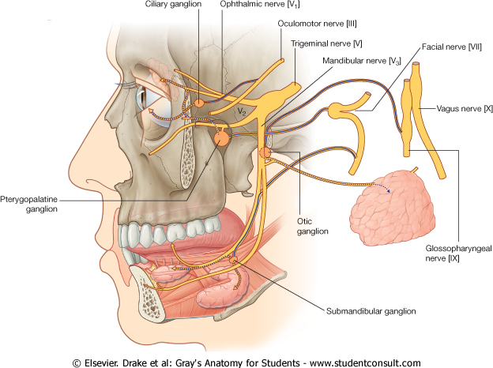
NERVE SUPPLY OF FACE
5TH & 7TH CRANIAL NERVES
By :
Prof Saeed Abuel Makarem
& Dr.Sanaa Alshaarawi

Slide 2
OBJECTIVES
By the end of the lecture, students shouldbe able to:
List the nuclei of the deep origin of the trigeminal and facial nerves in the brain stem.
Describe the type and site of each nucleus.
Describe the superficial attachment of trigeminal and facial nerves to the brain stem.
Describe the main course and distribution of trigeminal and facial nerves in the face.
Describe the main motor & sensory manifestation in case of lesion of the trigeminal & facial nerves.

Slide 3
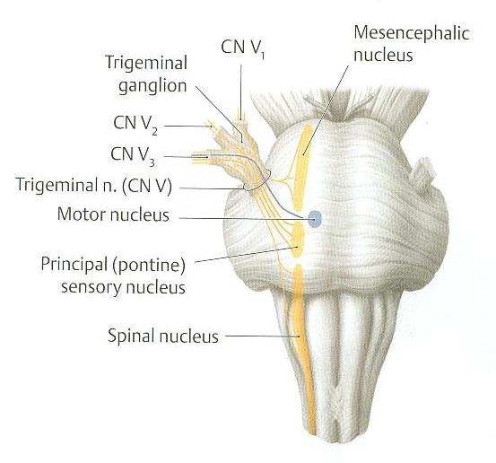
TRIGEMINAL NERVE
Type:
Mixed
(sensory & motor).
Fibers:
General somatic afferent:
Carrying general sensations from face.
2. Special visceral efferent:
Supplying muscles developed from the 1st pharyngeal arch, (8 muscles).

Slide 4
TRIGEMINAL NERVE NUCLEI(Deep origin)
3 sensory + 1 Motor

Slide 5
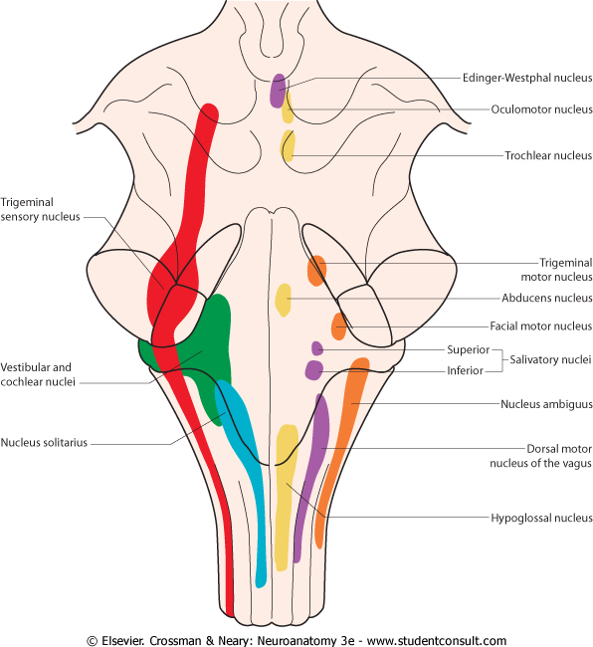
TRIGEMINAL NERVE NUCLEI
Four nuclei: (3 sensory + 1 Motor).
General somatic afferent:
Mesencephalic nucleus (midbrain &pons): receives proprioceptive fibers from muscles of mastication.
Principal (main) sensory nucleus (pons): receives touch fibers from face & scalp
Spinal nucleus (pons, medulla & upper 2-3 cervical segments of spinal cord): receives pain & temperature sensations from face & scalp.
Special visceral efferent:
4. Motor nucleus (pons): supplies:
Four Muscles of mastication (temporalis, masseter, medial & lateral pterygoid).
Other four muscles (Anterior belly of digastric, mylohyoid, tensor palati & tensor tympani).

Slide 6
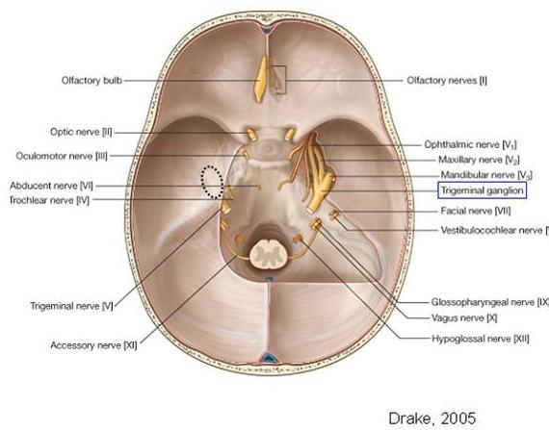
TRIGEMINAL GANGLION
Site:
Occupies a depression in the middle cranial fossa.
Importance: Contains cell bodies :
Whose dendrites carry sensations from the face.
Whose axons form the sensory root of trigeminal nerve.

Slide 7
TRIGEMINAL NERVE
Emerges from the middle of the ventral surface of the pons by 2 roots (Large Lateral sensory root & small medial motor root).
Divides into 3 divisions (dendrites of trigeminal ganglion):
Ophthalmic.
Maxillary.
Mandibular.
Axons of cells of motor nucleus join only the mandibular division.

Slide 8
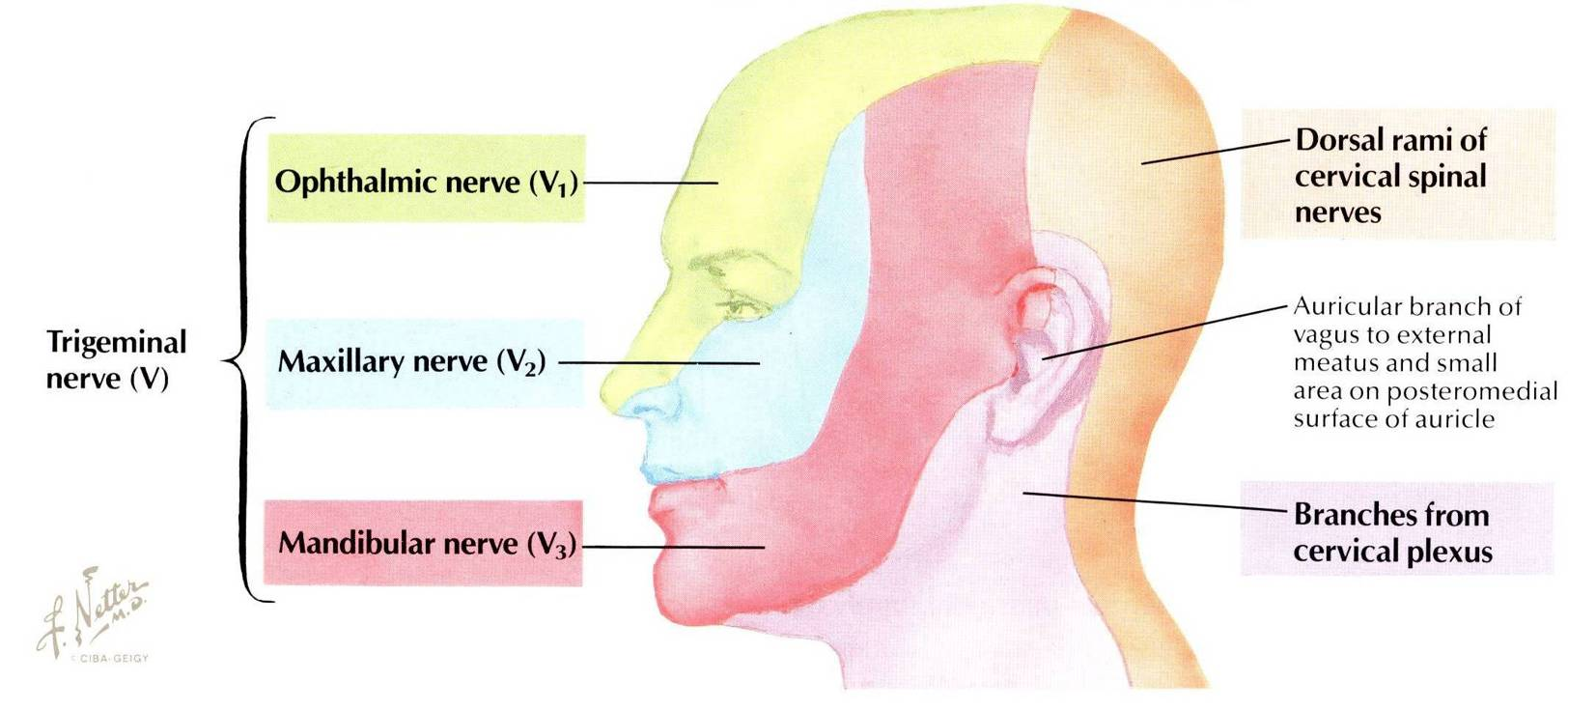

Slide 9
OPHTHALMIC (PURE SENSORY)
Divides into 3 branches:
Frontal, Lacrimal & Nasociliary which pass through superior orbital fissure to the orbit
Frontal: supplies skin of face & scalp.
Lacrimal: supplies skin of face & lacrimal gland.
Nasociliary: supplies skin of face, nasal cavity & eyeball.
1
2
3

Slide 10
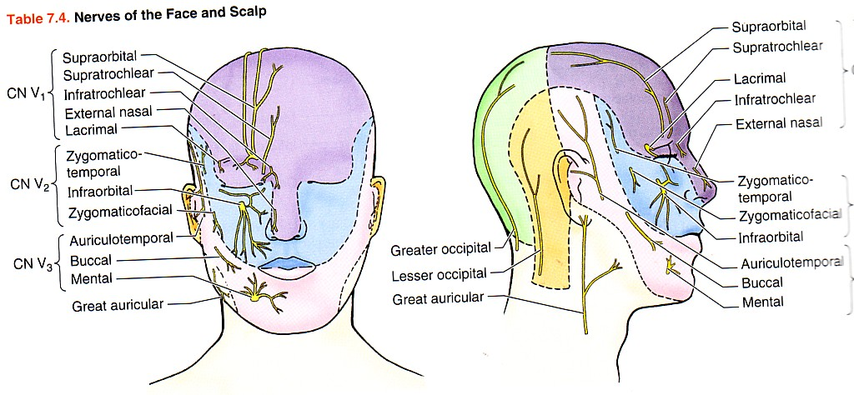
MAXILLARY (PURE SENSORY)
Supplies:
Upper teeth, gums &
maxillary air sinus
(posterior, middle & anterior superior alveolar nerves).
Face: (zygomaticofacial & infraorbital nerves).

Slide 11
MANDIBULAR (MIXED)
SENSORY BRANCHES:
Lingual: receives
General sensations from anterior 2/3 the of tongue.
2. Inferior alveolar: supplies
Lower teeth, gums & face.
Buccal: supplies
Face (cheek on upper jaw)
4. Auriculotemporal: supplies
auricle, temple, parotid gland & TMJ.
MOTOR BRANCHES:
to 8 muscles (4 muscles of mastication & other 4 muscles).
4
3
1
2

Slide 12
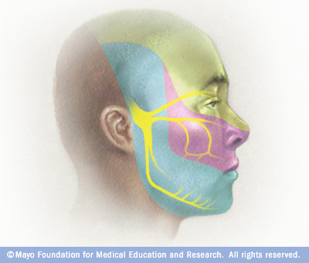
Trigeminal Neuralgia
Compression, degeneration or inflammation of the 5th cranial nerve may result in a condition called trigeminal neuralgia or tic douloureux (spasmodic contraction of the muscles in the face)
This condition is characterized by recurring episodes of intense stabbing excruciating pain radiating from the angle of the jaw along a branches of the trigeminal nerve.
Usually involves maxillary & mandibular branches, rarely in the ophthalmic division.

Slide 13
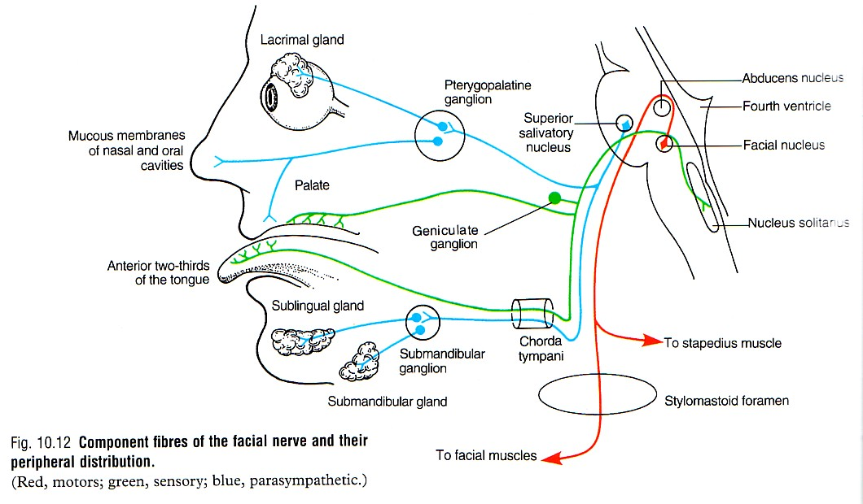
FACIAL NERVE
Type: Mixed ( Motor, special sensory, parasympathetic).
Fibers:
Special visceral afferent: carrying taste sensation from anterior 2/3 of the tongue.
Special visceral efferent: supplying muscles developed from the 2nd pharyngeal arch.
General visceral efferent: supplying parasympathetic secretory fibers to submandibular, sublingual, lacrimal, nasal & palatine glands.
Parasymp.
taste sensation
motor

Slide 14
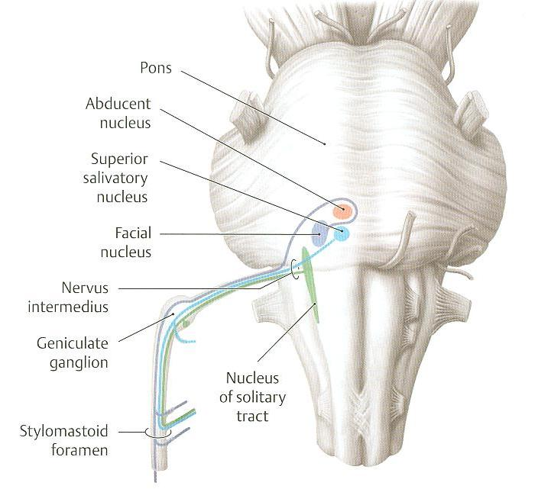
FACIAL NERVE NUCLEI
3 Nuclei :
Special visceral afferent: (nucleus solitarius): receives taste from the anterior 2/3 of tongue.
Special visceral efferent: motor nucleus of facial nerve: supplies: muscles of face, posterior belly of digastric, stylohyoid, platysma, stapedius, and occipitofrontalis.
General visceral efferent: superior salivatory nucleus: sends preganglionic parasympathetic secretory fibers to sublingual, submandibular, lacrimal, nasal & palatine glands.
2
3
1

Slide 15
COURSE OF FACIAL NERVE
Emerges from the cerebellopontine angle by 2 roots:
Medial motor root: contains motor fibers.
Lateral root (nervous intermedius): contains parasympathetic & taste fibers.

Slide 16
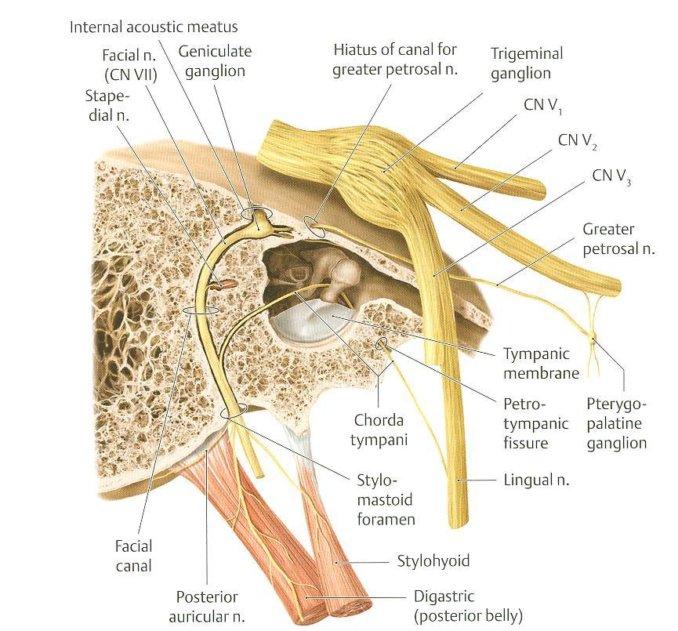
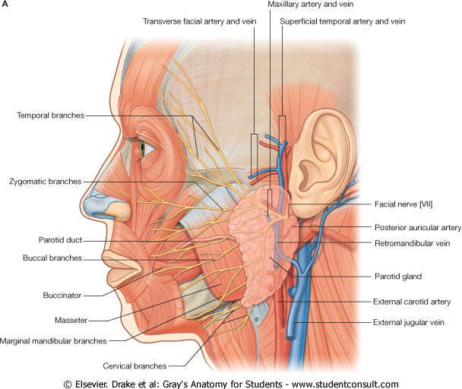
COURSE OF FACIAL NERVE
Passes through internal auditory meatus to inner ear where it runs in facial canal.
Emerges from the stylomastoid foramen & enters the parotid gland where it ends.

Slide 17
BRANCHES OF FACIAL NERVE
In facial canal:
Greater petrosal nerve: carries preganglionic parasympathetic fibers to lacrimal, nasal & palatine glands.
Chorda tympani: carries: a) preganglionic parasympathetic fibers to submandibular & sublingual glands.
b) taste fibers from anterior 2/3 of tongue.
3. Nerve to stapedius. control the amplitude of sound waves from the external environment to the inner ear.
N.B.: Geniculate ganglion: contains cell bodies of neurones ; its fibres carrying taste sensations from anterior 2/3 of tongue; ending in solitary nucleus in M.O .
Lies in internal acoustic meatus.
3
1
2

Slide 18
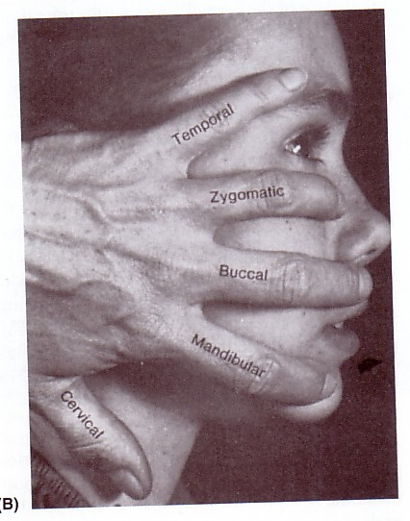
BRANCHES OF FACIAL NERVE
Just as it emerges from the stylomastoid foramen it gives:
Posterior auricular: to occipitofrontalis muscle.
Muscular branches to posterior belly of digastric & stylohyoid.
Inside parotid gland: gives 5 terminal motor branches:
Temporal,
Zygomatic,
Buccal,
Mandibular &
Cervical…. To the muscles of the face.

Slide 19
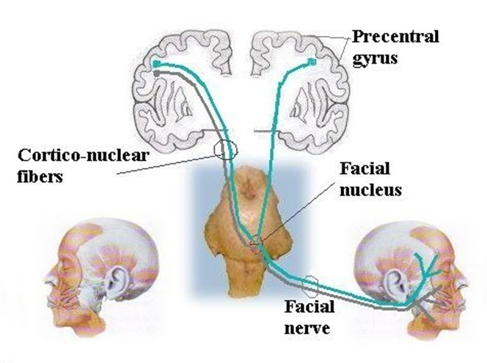
Bell’s Palsy
Damage of the facial nerve results in paralysis of muscles of facial expressions : Facial (Bell’s) palsy; lower motor neuron lesion (whole face affected)
NB. In upper motor neuron lesion (upper face is intact) .
Face is distorted:
Drooping of lower eyelid,
Sagging of mouth angle,
Dribbling of saliva,
Loss of facial expressions,
Loss of chewing,
Loss of blowing,
Loss of sucking,
Unable to show teeth or close the eye on that side.

Slide 20
THANK YOU & BEST LUCK

Slide 21
SUMMARY
Both trigeminal & facial nerves are mixed.
Nuclei of trigeminal nerve are found in midbrain, pons & medulla. They are of the general somatic afferent & special visceral efferent types.
The trigeminal nerve emerges from the pons and divides into: ophthalmic, maxillary & mandibular divisions that receive sensory supply from the face (with an exception of a small area over ramus of mandible by great auricular nerve C2,3).
All motor fibers are included in the mandibular division & supply muscles of mastication.

Slide 22
SUMMARY
Nuclei of facial nerve are found in pons. They are of the special visceral afferent & efferent types, as well as general visceral efferent type.
The facial nerve emerges from the cerebellopontine angle, gives motor fibers to muscles of facial expression, secretory fibers to submandibular, sublingual, lacrimal, nasal & palatine glands & receives taste fibers from anterior 2/3 of tongue.

Slide 23
Lower Motor Neuron Lesion
For the Students
Results from injury of facial nerve fibres in internal acoustic meatus;in the middle ear;in the facial canal or in parotid gland.
Manifested by complete paralysis of facial muscles on the same side of lesion.
Upper Motor Neuron Lesion
This occurs after injury to the pyramidal tract (corticonuclear) above facial nucleus...
Leads to paralysis of facial muscles of lower ½ of face of opposite side but the upper ½ of the face intact because :
Ms.of lower ½ of face receive pyramidal fibres from opposite cerebral cortex only,
While Ms..of upper ½ of face receive pyramidal fibres from both cerebral hemispheres (Bilateral represented).

Slide 24
TEST YOUR SELF !
Stimulation of which of the following nerves could lead to salivation and lacrimation?:
Facial.
Glossopharyngeal.
Trigeminal.
Vagus.
Lesion of mandibular nerve may result in:
Loss of sensation of skin over the nose.
Loss of lacrimation.
Loss of sensory supply of upper teeth.
Loss of general sensations of anterior 2/3 of tongue.

