Slide 1
Development of Spinal Cord & Vertebral Column
Dr. Sanaa Alshaarawi
&
Prof. Ahmed Fathalla

Slide 2
OBJECTIVES
At the end of the lecture, students should be able to:
Describe the development of the spinal cord from the neural tube.
List the layers of the spinal cord and its contents.
List subdivisions of mantle & marginal zones.
List meningeal layers and describe positional changes of spinal cord.
Describe development of vertebral column from sclerotomic portion of paraxial mesoderm.
Describe chondrification & ossification stages in vertebral development.
Describe spina bifida and its types.

Slide 3
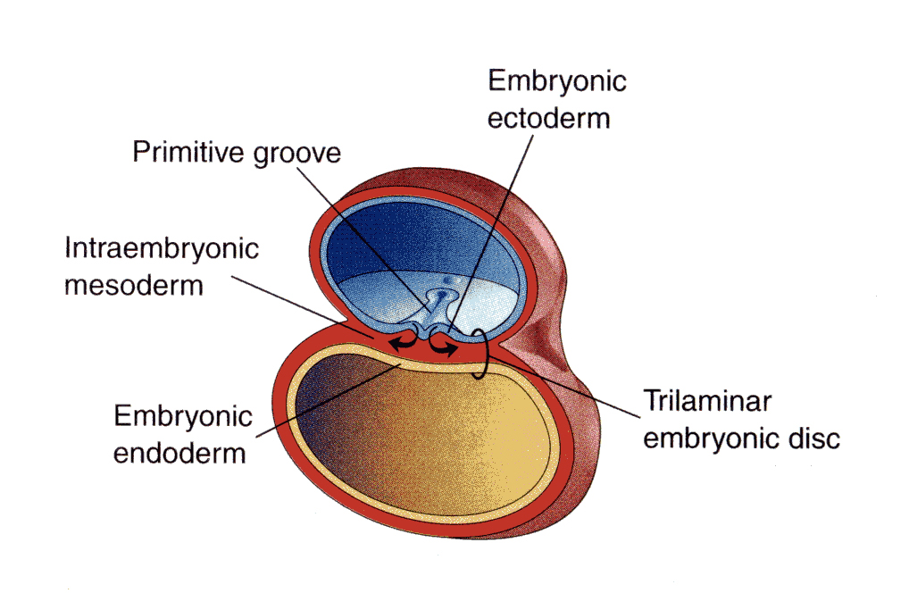
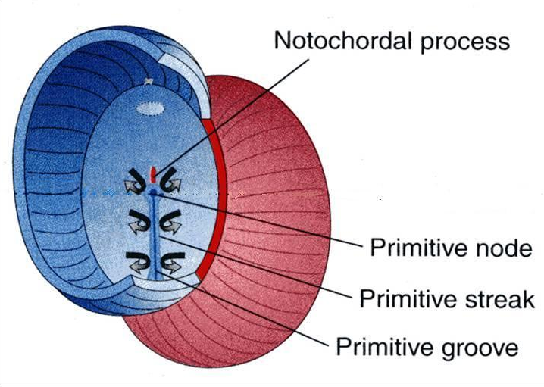
The Three Germ Layers
Ectoderm
Mesoderm
Endoderm
Amniotic
cavity
Notochord stimulates neural tube formation which in turn stimulates development of the vertebral column.
Yolk sac
The Neural Tube is a derivative of the ectoderm

Slide 4
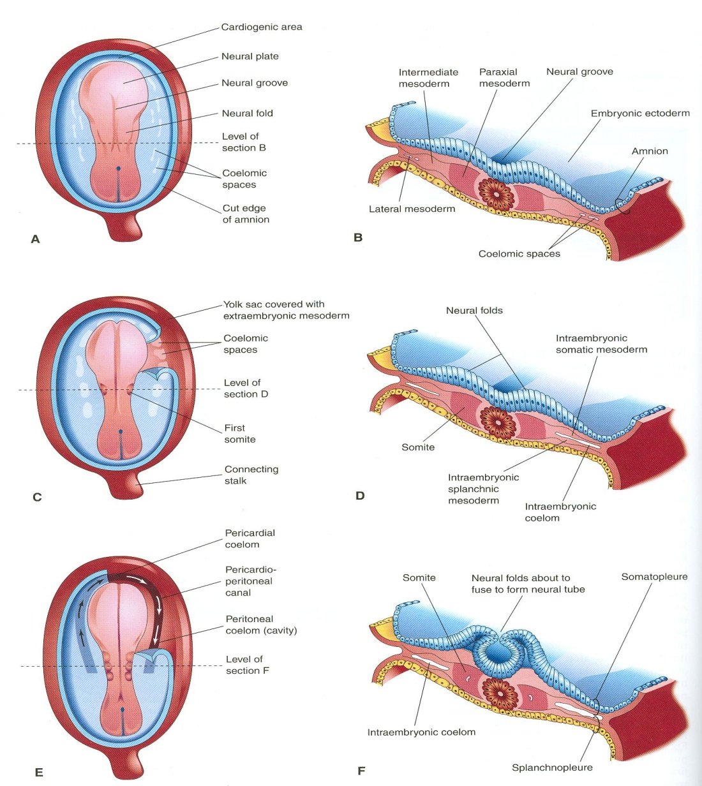
Development of Neural Tube
Ectodermal cells dorsal to notochord thicken to form the neural plate.
A longitudinal groove, neural groove, develops in the neural plate.
The margins of the neural plate (neural folds) approach to each other and fuse to form the neural tube.

Slide 5
Development of the Spinal Cord
The spinal cord develops from the caudal 2/3 of the neural tube

Slide 6
Layers of the spinal cord :
The cells of the neural tube are arranged in three layers :
An inner ventricular zone of undifferentiated cells
A middle mantle zone of cell bodies of neurons (future grey matter)
An outer marginal zone of nerve fibers or axons of neurons (future white matter)

Slide 7
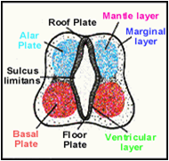
Mantle Layer of Spinal Cord
Neurons of mantle layer (future grey matter) differentiate into :
A dorsal alar plate (future dorsal horn): containing sensory neurons
A ventral basal plate (future ventral horn): containing motor neurons
The 2 areas are separated by a longitudinal groove (sulcus limitans).

Slide 8
Dorsal median septum
Central canal
Ventral median fissure
Proliferation and bulging of both alar & basal plates result in:
Formation of dorsal median septum
Formation of ventral median fissure
Narrowing of the lumen of the neural tube to form a small central canal

Slide 9
Marginal Layer of Spinal cord
Dorsal
funiculus
Lateral
funiculus
Ventral
funiculus
The marginal layer (future white matter) increases in size due to addition of ascending, descending & intersegmental nerve fibers & is divided into : dorsal, lateral and ventral funiculi
Myelination of nerve fibers starts at 4th month & continues during the 1st postnatal year. Motor fibers myelinate before sensory fibers. So, After a nerve injury, both motor and sensory axons have the ability to regenerate and, given a proper pathway.

Slide 10
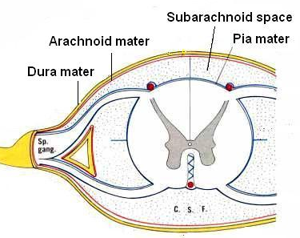
Meninges
These are 3 membranes covering the neural tube:
Outer thick dura mater: MESODERMAL in origin
Middle arachnoid mater & Inner thin pia mater are ECTODERMAL in origin
A cavity appears between the arachnoid & the pia mater (subarachnoid space) & becomes filled with cerebrospinal fluid (CSF).

Slide 11
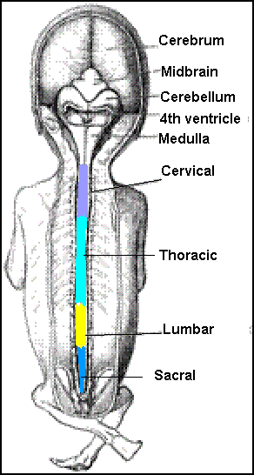
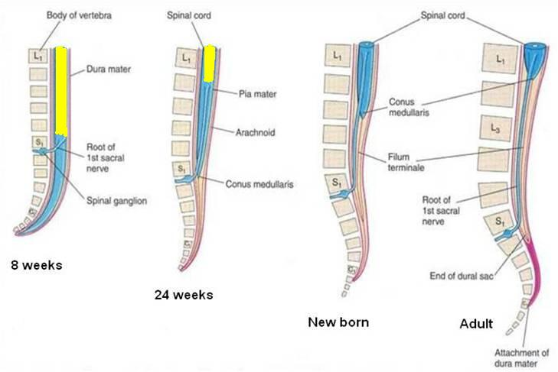
Positional Changes of Spinal Cord
Initially, the spinal cord occupies the whole length of the vertebral canal.
As a result a faster growth of vertebral column, the caudal end of spinal cord (conus medullaris) shifts gradually to a higher level.
L2
L3

Slide 12
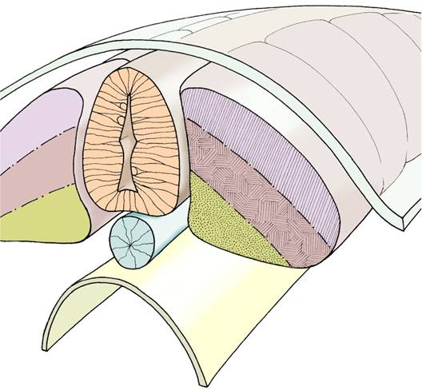
Development of the Vertebral Column
The vertebral column develops from the ventromedial parts (sclerotomes) of the somites
The somites develop from the para-axial mesoderm.

Slide 13
Intraembryonic Mesoderm
Located between Ectoderm & Endoderm EXCEPT in the central axis of embryo where NOTOCHORD is found.
Differentiates into 3 parts:
Paraxial mesoderm
Intermediate mesoderm
Lateral mesoderm
Paraxial mesoderm divides into segments called ‘somites’.
Each somite divides into 3 parts:
Dermatome
Myotome
Sclerotome
NT
1
2
3
N
Gut
somites

Slide 14
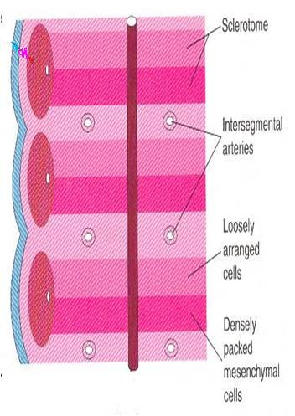
Formation of Body of Vertebra
At 4th week, each sclerotome becomes subvidided into two parts :
an cranial part, consisting of loosely arranged cells
a caudal part, of more condensed tissue.

Slide 15
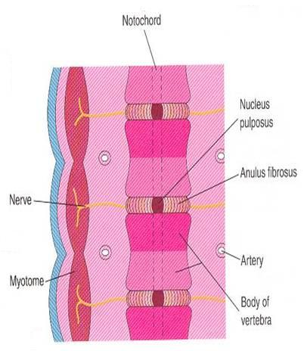
Formation of Body of Vertebra
The caudal part of each somite fuses with the cranial part of the consecutive somite, around the notochord to form the body of the vertebra, called the centrum.
Thus each centrum develops from 2 adjacent sclerotomes

Slide 16
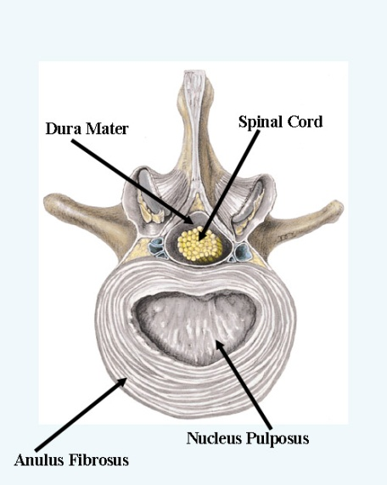
Fate of Notochord
In the region of the bodies of vertebrae: It degenerates
Between bodies of vertebrae: It forms the central part, ’nucleus pulposus’ of the intervertebral discs
Annulus fibrosus of the intervertebral discs is formed by the mesoderm surrounding the notochord.

Slide 17
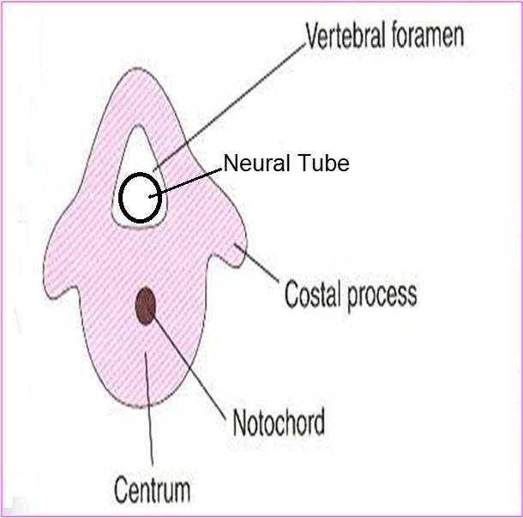
The fused sclerotomes grow dorsally around the neural tube and form the vertebral (neural) arch.
Ventrolaterally, costal processes develop that give rise to ribs in thoracic region.
Vertebral Arch

Slide 18
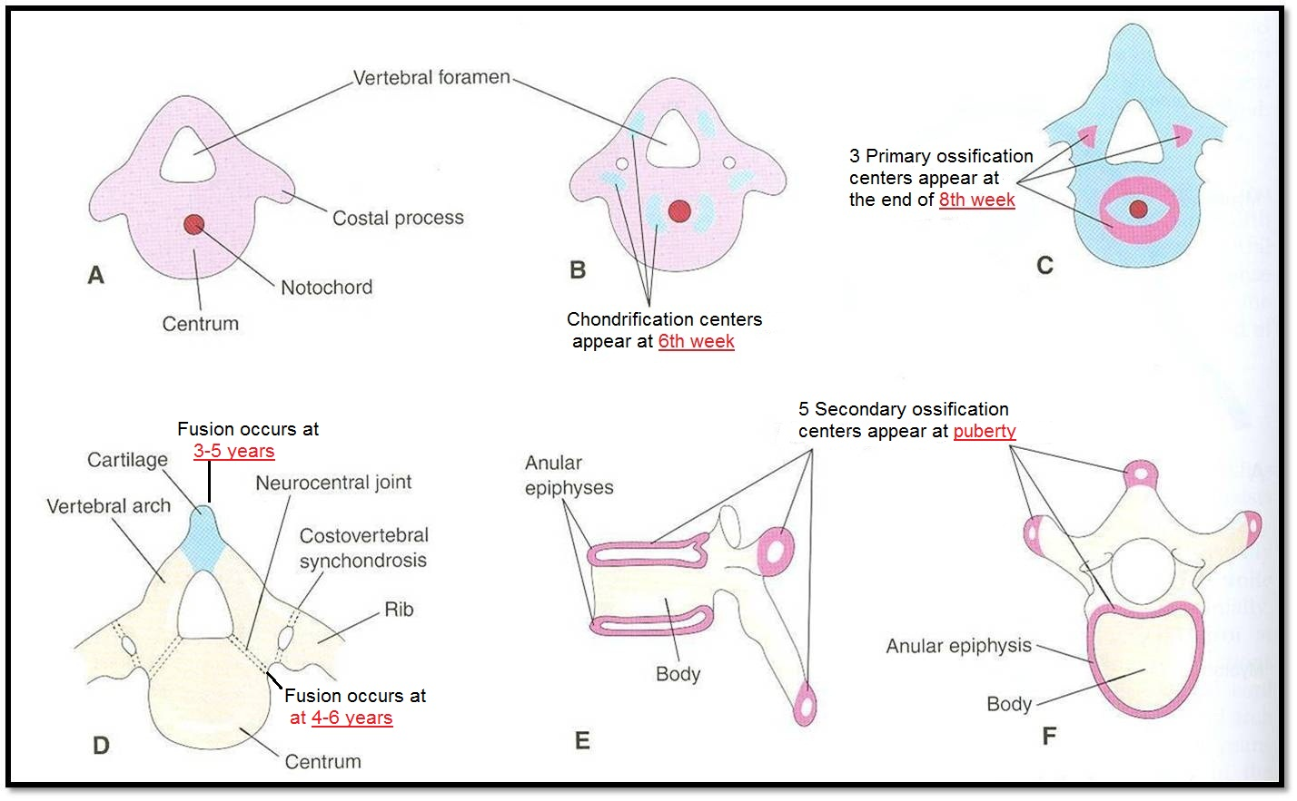
Vertebral Development
Primary Ossification Stage
Mesenchymal Stage
Chondrification Stage
Fusion of 2 V.arches
Stage of Secondary Ossification
Stage of Fusion
All centers unite around 25 years

Slide 19
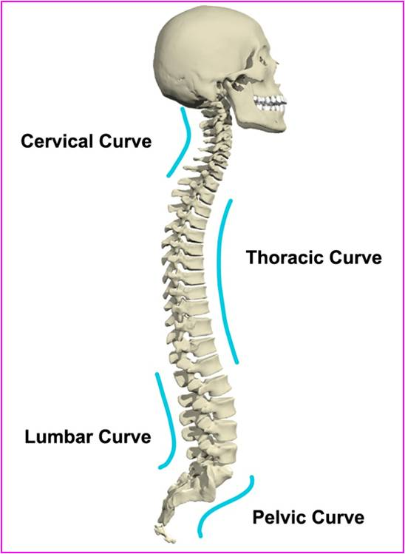
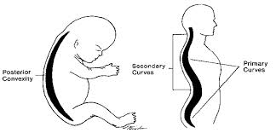
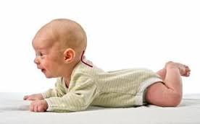
Curvatures of Vertebral Column
Primary curvatures (concave anterior) : develop prenatally
Thoracic
Pelvic or Sacral
Secondary curvatures (convex anterior) : develop postnatally
Cervical: as a result of lifting the head
Lumbar: as a result of walking

Slide 20
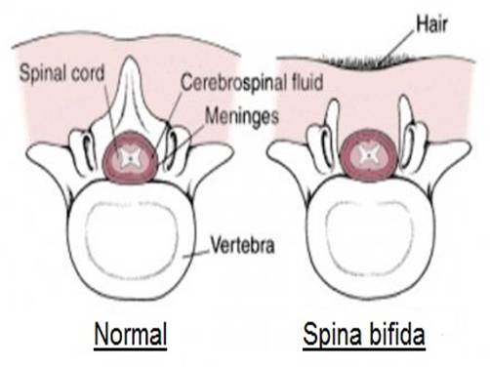
Spina Bifida
Cause: Failure of fusion of the halves of vertebral arches
Incidence: 0.04-0.15%
Sex: more frequent in females
Types:
Spina bifida occulta (20%)
Spin bifida cystica (80%)

Slide 21
Spina Bifida Occulta
The closed type
Only one vertebra is affected
No clinical symptoms
Skin overlying it is intact.
Sometimes covered by a tuft of hair.
Usually does not involve underlying neural tissue.

Slide 22
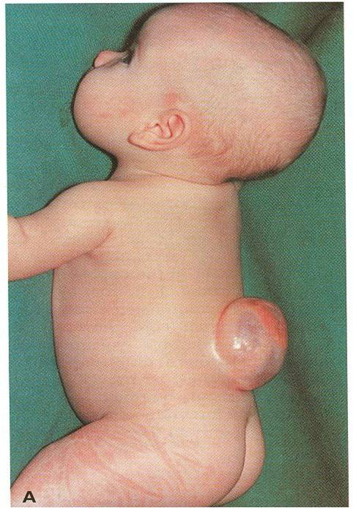
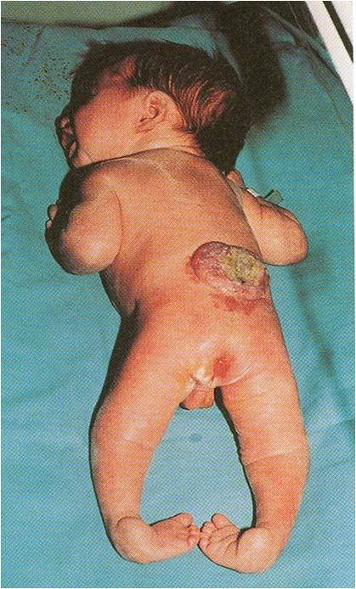
Spina Bifida Cystica
The open type
Cystica is the most severe and complex form of spina bifida. It usually involves serious neurological problems. A portion of the nerves and the spinal cord are exposed outside the body
Neurological symptoms are present
Subdivided into:
Spina bifida with meningocoele: protrusion of sac containing meninges & cerebrospinal fluid
Spina bifida with meningomyelocoele: protrusion of sac containing meninges with spinal cord and/or nerve roots
Spina bifida with myeloschisis : spinal cord is open due to failure of neural folds to develop.
1
with meningocoele
with meningomyelocoele
with myeloschisis
3
2

Slide 23
Spina bifida with meningocoele
Spina bifida occulta
Spina bifida with meningomyelocoele
Spina bifida with myeloschisis

Slide 24
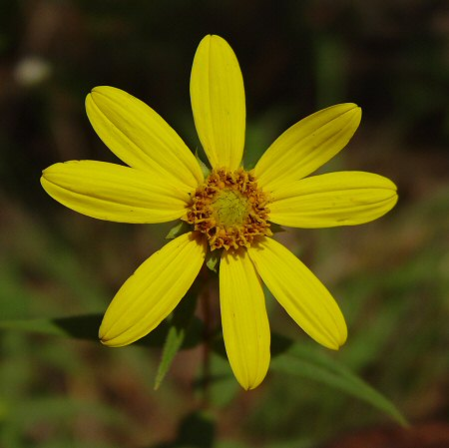
Thank You & Good Luck

