Slide 1
DEVELOPMENT
of
CEREBRUM & CEREBELLUM
By Dr.Sanaa Alshaarawy

Slide 2
OBJECTIVES
By the end of the lecture the student should be able to:
Describe the formation of the neural tube.
List the 3 brain vesicles and their derivatives.
Describe the brain flexures.
Describe briefly the development of the cerebrum.
Describe briefly the development of the cerebellum.

Slide 3
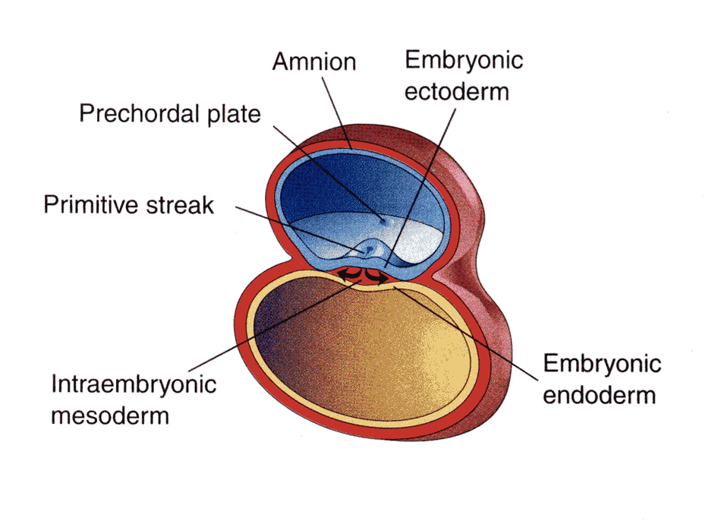
INTRODUCTION
By the beginning of the 3rd week of development, three germ cell layers become established, Ectoderm, Mesoderm and Endoderm.

Slide 4
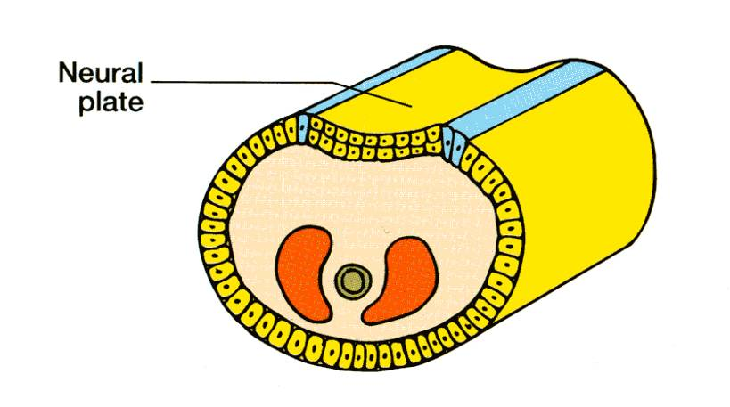
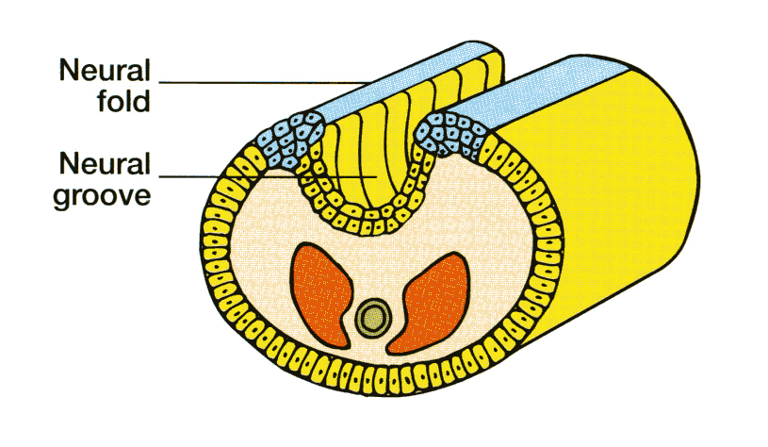
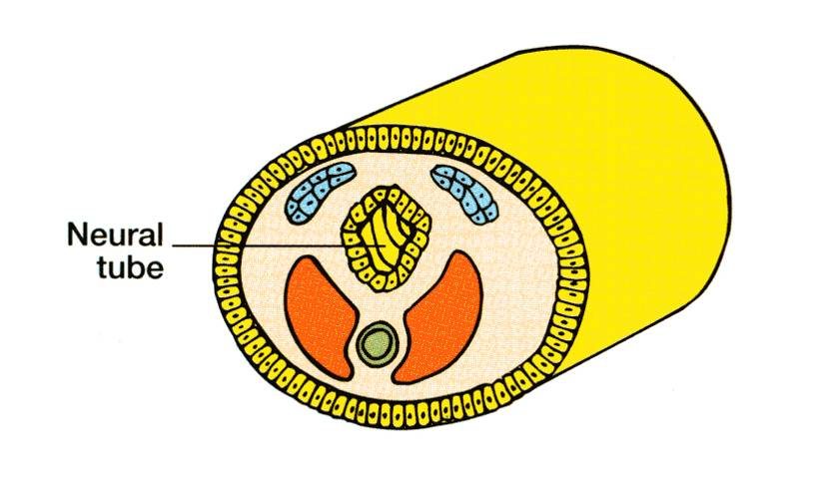
EARLY DEVELOPMENT
During the middle of the 3rd week, the dorsal midline ectoderm undergoes thickening to form the neural plate (neuroectoderm).
The margins of the plate become elevated, forming neural folds.
So a longitudinal, midline depression, called the neural groove is formed.
The 2 neural folds then fuse together, thus sealing the neural groove and creating the neural tube.

Slide 5
Neural Tube Development Three-vesicles stage (End of 4th Week)
Formation of the neural tube is completed by the middle of the fourth week.
By the end of the 4th week,
Its upper end dilates & shows 3 primary vesicles:
Prosencephalon,
Mesencephalon, &
Rhombencephalon.
By the end of 4th week

Slide 6
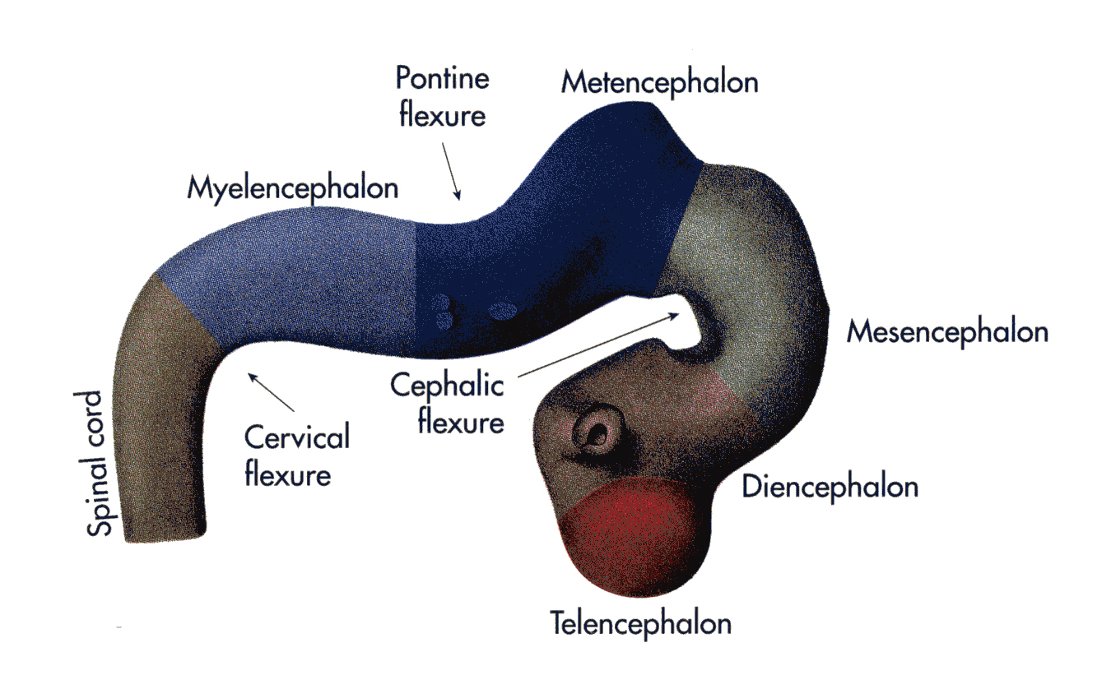
By the 5th week further differentiation distinguishes five 2ry brain vesicles from the primary vesicles :
The prosencephalon divides into the two telencephalon and one diencephalon and
The Rhombencephalon divides into metencephalon and myelencephalon.

Slide 7
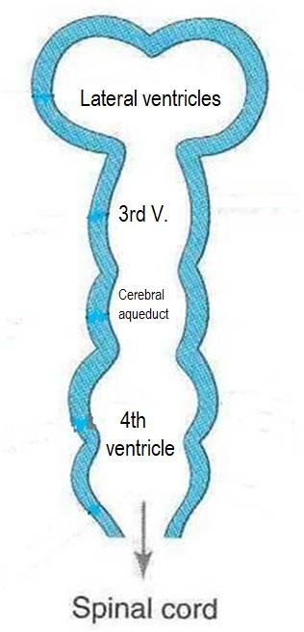
Neural Tube Development Five-vesicles stage (5th week)
Telencephalon
Diencephalon
Mesencephalon
Metencephalon
Myelencephalon

Slide 8
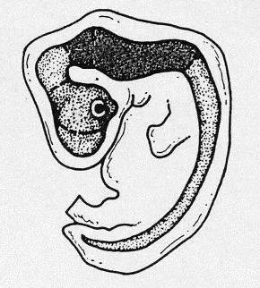
Brain Flexures
By the 4th week:
The neural tube grows rapidly and bends ventrally, producing two flexures:
Midbrain flexure: between the prosencephalon & the mesencephalon (midbrain)
Cervical flexure:
Between the hind brain & the spinal cord.
Mesencephalon
Rhobencephalon(hindbrain)
Prosencephalon
Later Pontine flexure appears in the hindbrain, in the opposite direction, resulting in thinning of the roof of the hindbrain.

Slide 10
Development of the Cerebrum
The cerebrum develops from the Telencephalon

Slide 11
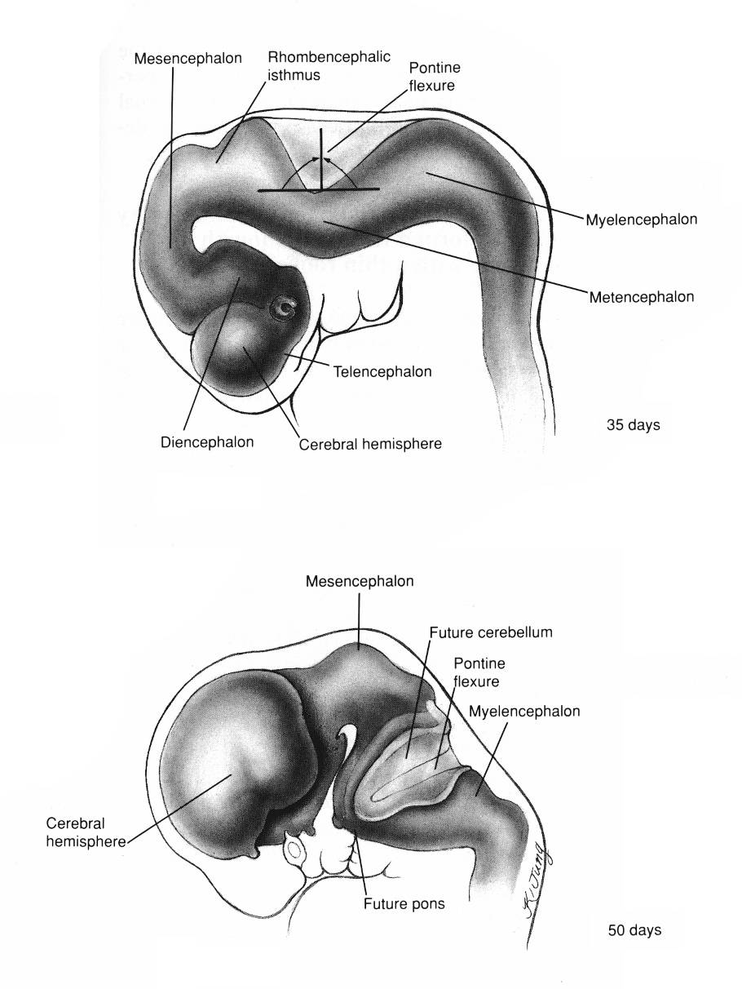
Development of the Cerebrum
The cerebral hemispheres first appear on the day 32 of pregnancy as a pair of bubble-like outgrowths of the Telencephalon.
By 16 weeks, the rapidly growing hemispheres are oval and have expanded back to cover the diencephalon.

Slide 12
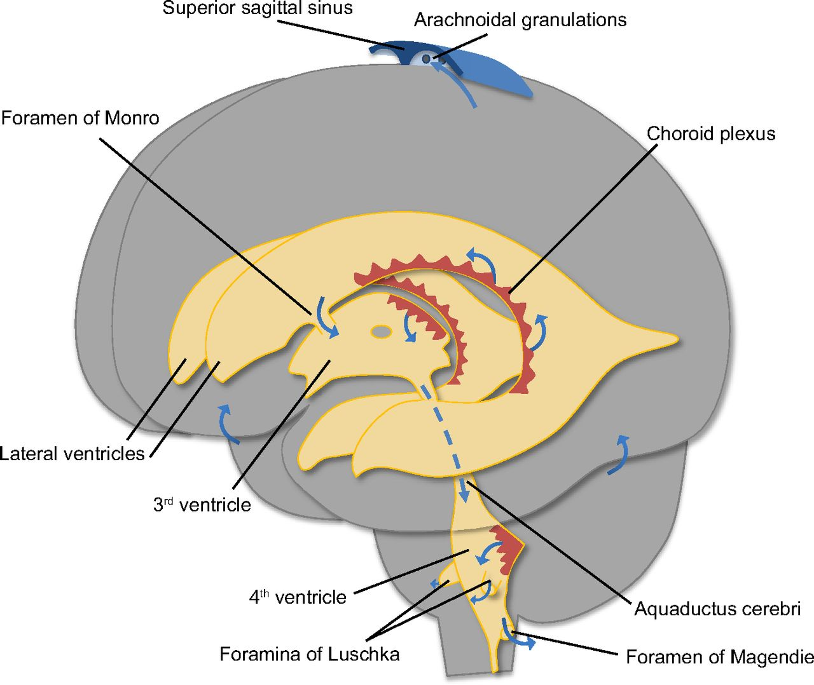
Differentiation of Forebrain Vesicle (prosencephalon)
The (prosencephalon) or the forebrain vesicle differentiates into a:
Median part, (diencephalon),
Two lateral cerebral vesicles or (telencephalic vesicles.)
The lumen gives the 2 lateral ventricles and the 3rd ventricle.
Both cavities communicating with each other through a wide interventricular foramen.
The cerebral hemispheres expand in all directions.
Its medial wall becomes thin, flat and it is the site of development of choroid plexus in the lateral ventricle.

Slide 13
Development of the Cerebrum
The wall of the telencephalon is formed of 3 layers :
Ependymal (lining the cavity of the lateral ventricle).
Mantel; nerve cells forming the grey matter.
Marginal; nerve fibers forming the white matter.

Slide 14
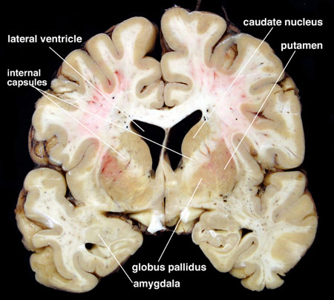
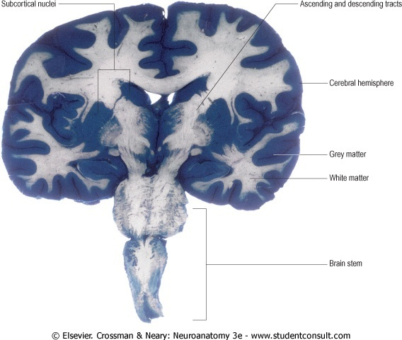
As development proceeds, the following changes occur:
Most of the nerve cells in mantel layer migrate to the marginal layer forming the cerebral cortex.
Some cells do not migrate and remains to form the basal ganglia.

Slide 15
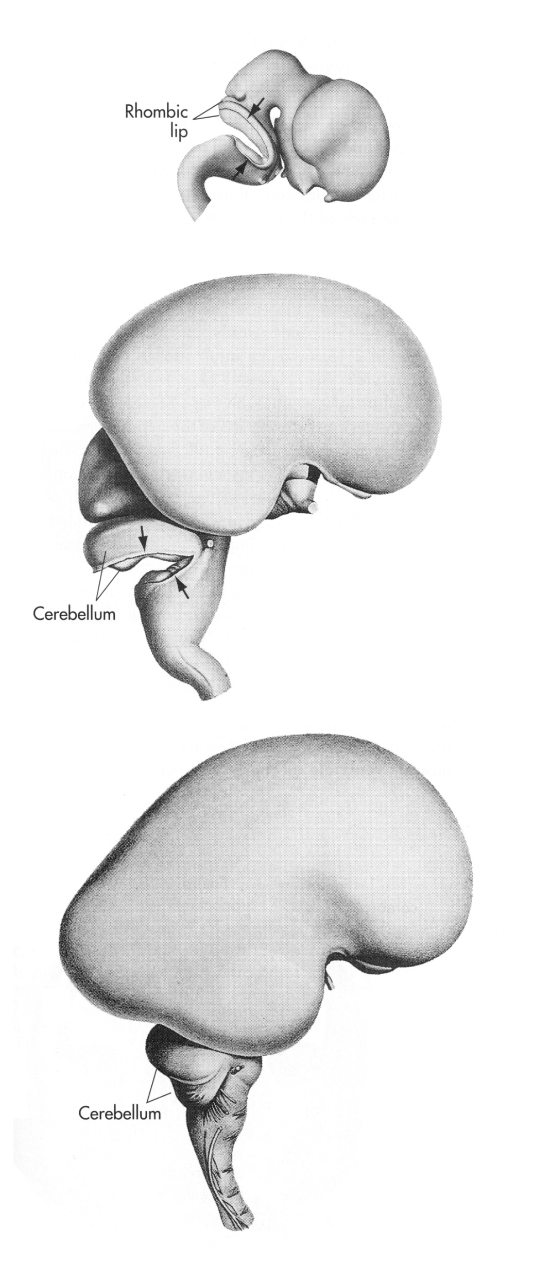
By the end of the 3rd month the surfaces of the cerebral hemispheres are smooth.
By the 4th month the grey matter grows faster than the white matter, so, the cortex becomes folded into gyri separated by sulci ; The gyri and sulci effectively increase the surface area of the brain.
The detailed pattern of gyri & sulci varies somewhat from individual to individual.
3rd month
4th month

Slide 16
Corpus striatum:
It is the basal ganglia nuclei in the cerebral hemisphere
It appears in 6th week in the floor of each cerebral hemisphere.
As the cerebral cortex differentiates and the fibers passing to and from it, they pass through the corpus striatum,
The corpus striatum now divides into caudate nucleus & lentiform nucleus.
This fiber pathway forms the internal capsule.

Slide 17
Further expansion of cerebral hemisphere gives C-shape appearance to the hemisphere itself as well as its cavity (lateral ventricle).
Also the caudate nucleus elongates and assumes the shape of the lateral ventricle and remains related to it.

Slide 18
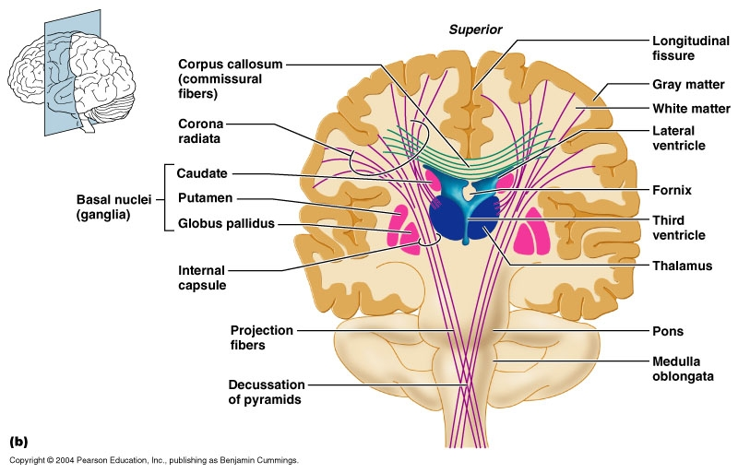
Development of the Cerebral Commissures
As the cerebral cortex develops, group of fibers, (commissures), connect the corresponding regions of the cortex.
These are:
Lamina terminalis.
Optic chiasma.
Anterior commissure.
Posterior commissure.
Hippocampal commissure.
Habenular commissure.
Corpus callosum (is a major commissural fibres that connect the two cerebral hemispheres).

Slide 19
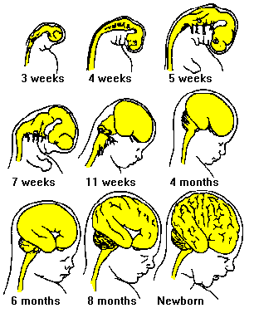
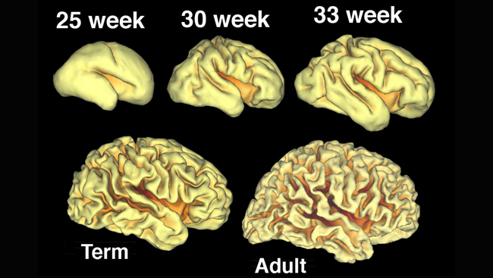
Development of Insula & lateral fissure
The cortex covering the surface of the corpus striatum: grows relatively slower than the other cortices, so it is overgrown by the rest of the hemisphere and lies in the depth of the lateral sulcus. This is called the insula.
So, the insular lobe is a portion of cerebral cortex that has invaginated to lie deep within the lateral sulcus.

Slide 20
Development of the Cerebellum
It develops from the dorsal part of the Metencephalon
metencephalon
myelencephalon

Slide 21
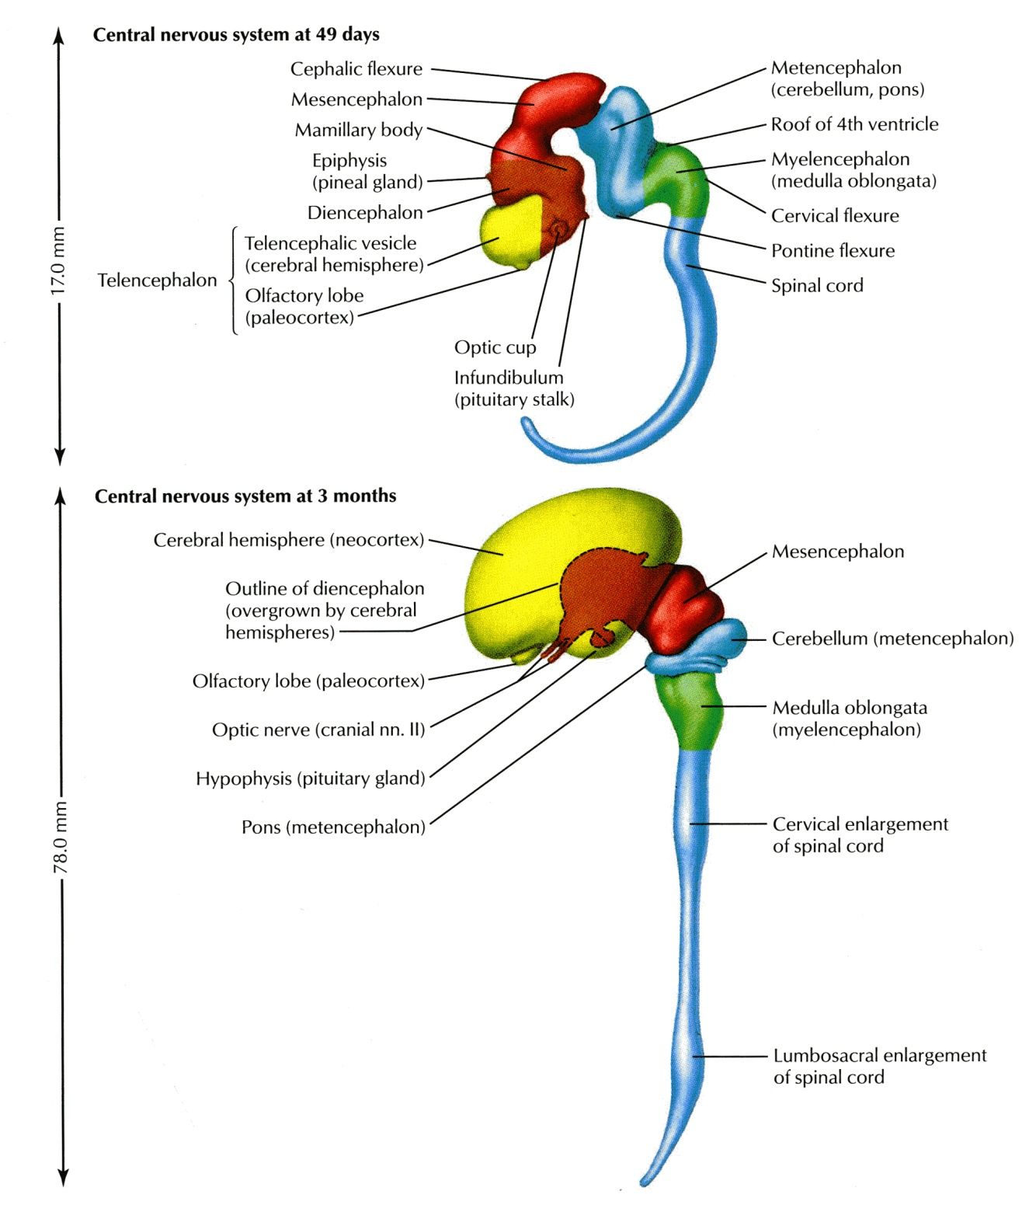
The metencephalon develops into the pons and overlying cerebellum.

Slide 22
Development of the Cerebellum
Pontine flexure results in:
Moving the alar plates of the neural tube laterally then pending medially.
Stretching and thinning of the roof plate.
Widening of the cavity to form the 4th ventricle.
Alar plate

Slide 23
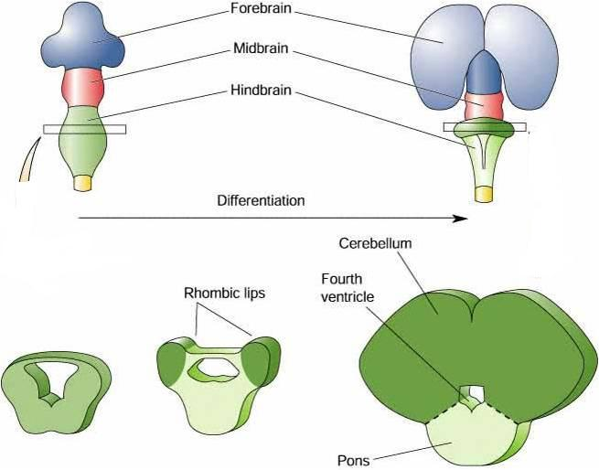
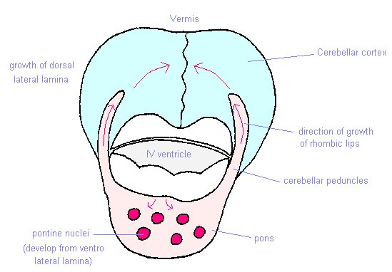
Metencephalon: Changes in Alar plates
The dorsal parts of alar plate thicken to form Rhombic lips, that will give rise to the cerebellum.
Some neuroblasts migrate from the mantle layer to the marginal layer to form the cerebellar cortex.
Others remains in the mantel layer and give rise to the cerebellar nuclei.
The cerebellar peduncles develop later as the axons of these cerebellar nuclei and grow out to reach the brain stem.
Alar plate

Slide 24
The surface of the cerebellum
As the cerebellar hemispheres develops; they undergo a complicated process of transverse folding to form closely packed, leaf-like transverse gyri called folia.
These processes of fissure formation and foliation continue throughout embryonic, fetal, and postnatal life, and they vastly increase the surface area of the cerebellar cortex.
35 d
50 d
90 d
150 d

Slide 25
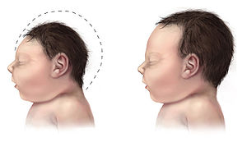
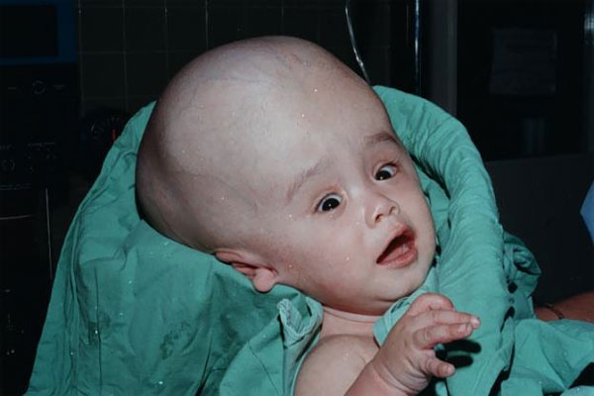
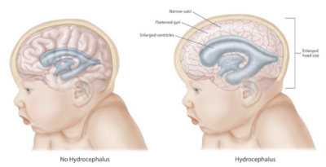
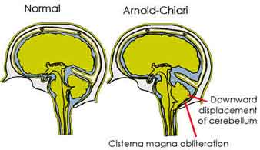
Congenital Anomalies of The Brain
Mental retardation.
Seizures (changes in electrical activity).
Cerebral palsy.
Cranium bifidum with or without meningocele & meningoencephalocele.
Agenesis of corpus callosum.
Microcephaly (abnormal smallness of the head, a congenital condition associated with incomplete brain development).
Hydrocephalus :
Arnold-Chiari malformation (herniated part of cerebellum through the foramen magnum leading to CSF obstruction ,so hydrocephalus results), also in aqueductal stenosis and in brain tumours.
Anencephaly.
Microcephaly
Normal
Hydrocephalus

Slide 26
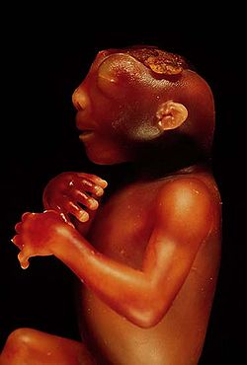
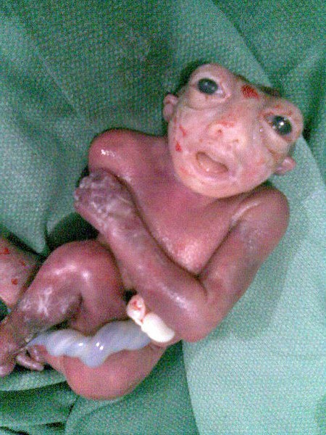
ANENCEPHALY
In anencephaly, the brain and skull are minute and the infant does not usually survive.

Slide 27
THANK YOU

