Slide 1
Nervous System
Practical pictures

Slide 2
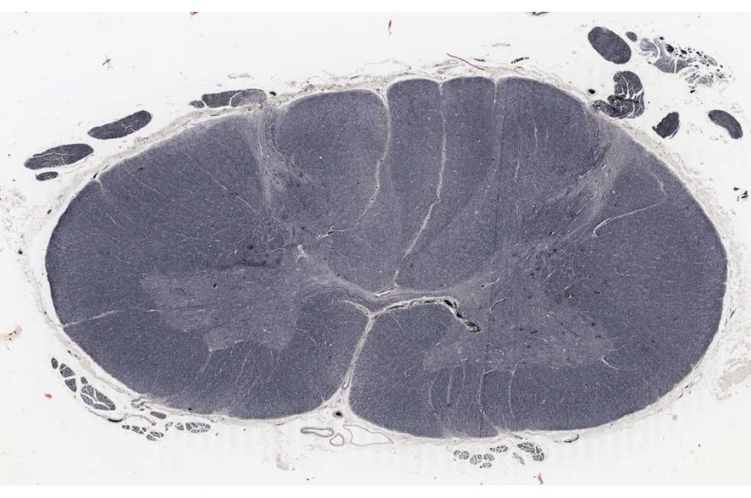
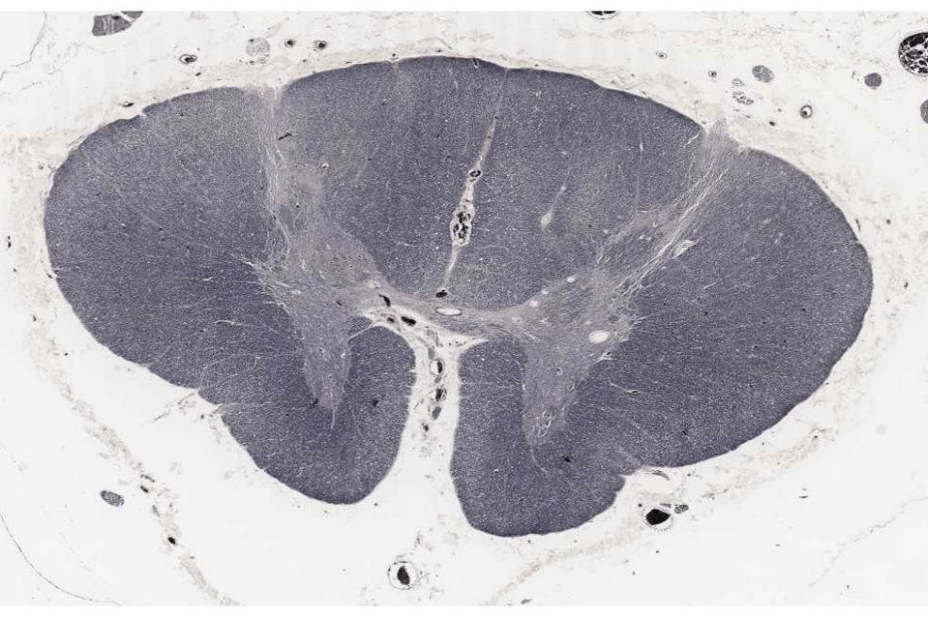
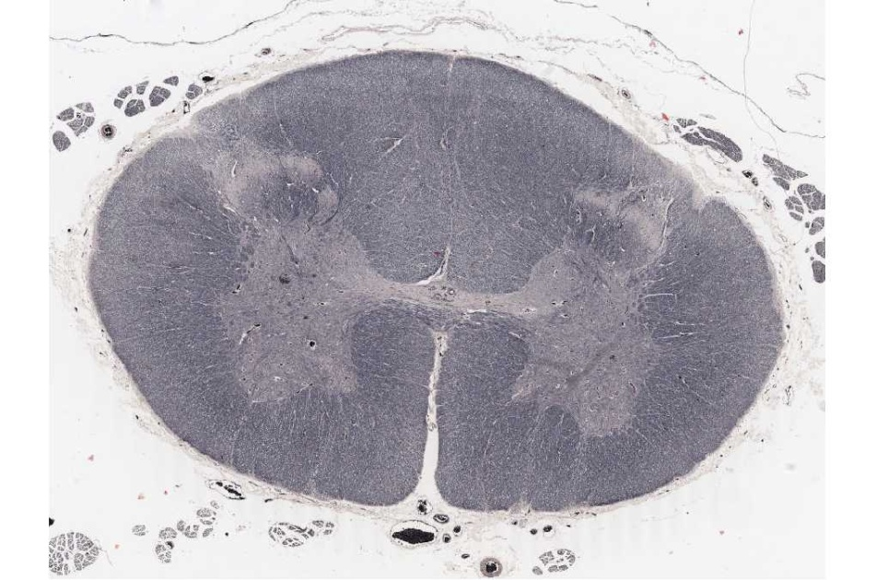
Cervical Spinal Cord
Thoracic Spinal Cord
Lumbar Spinal Cord

Slide 4
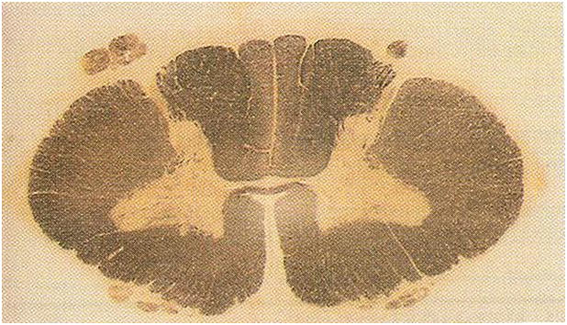
Cervical Spinal Cord

Slide 5
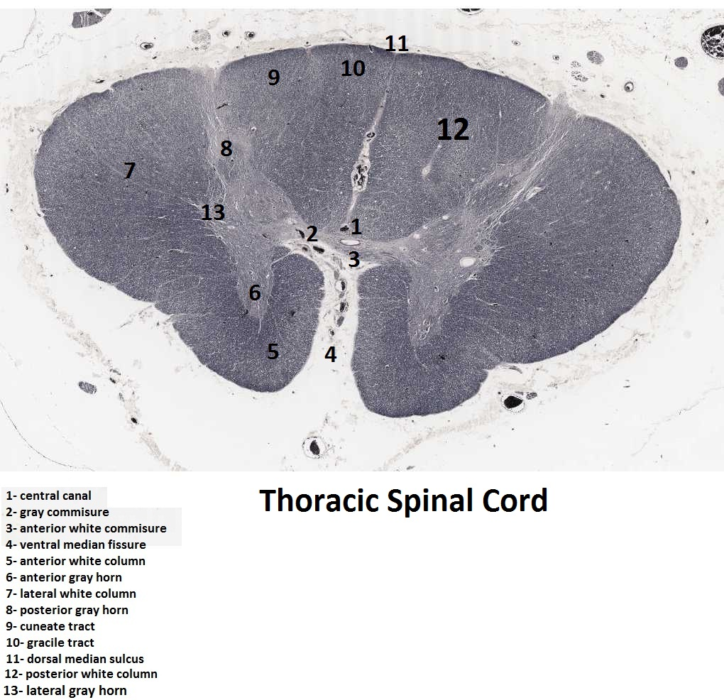

Slide 6
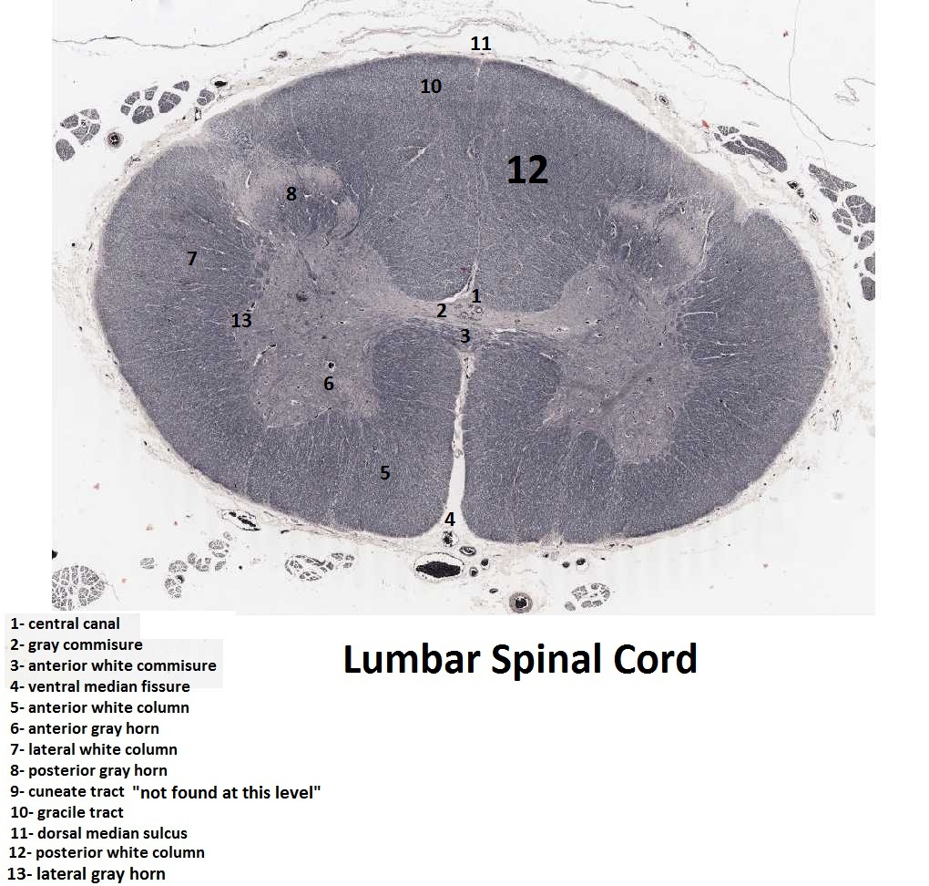

Slide 7
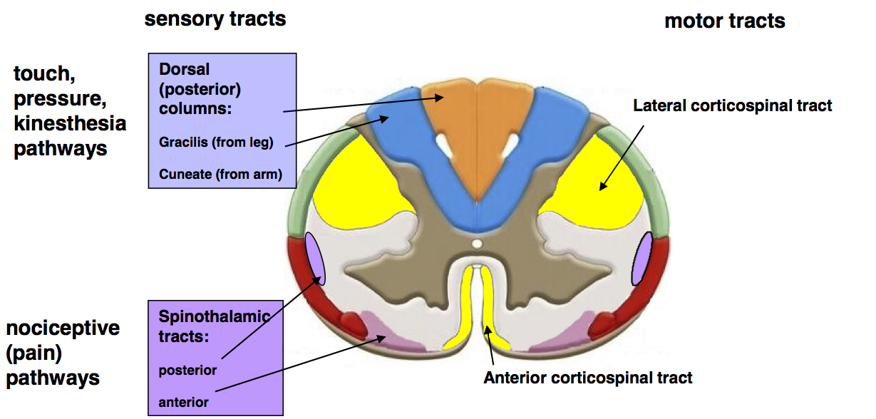
Cervical spinal cord: some tracts.

Slide 8
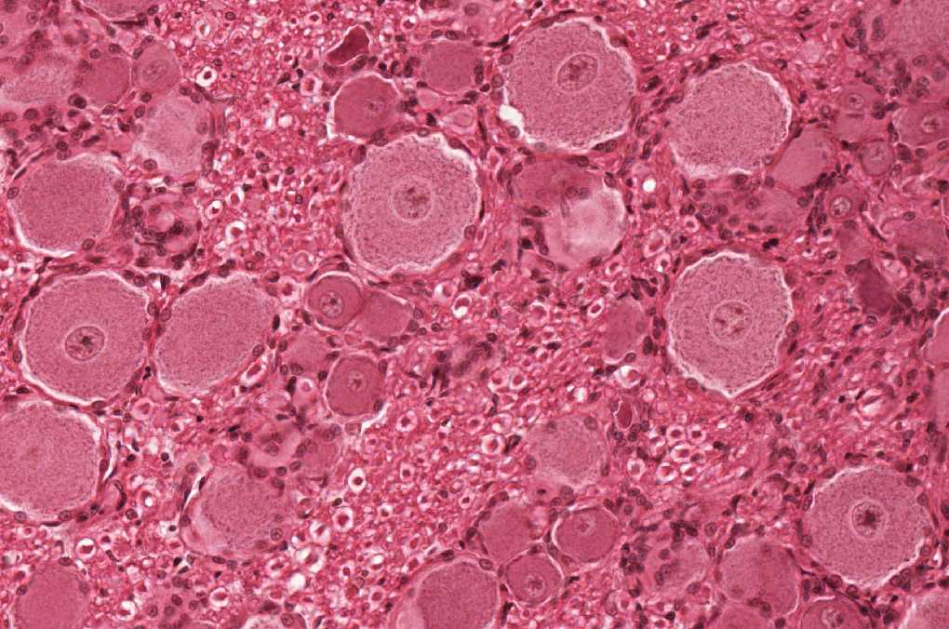
Unipolar neurons (in spinal ganglion)

Slide 9
Unipolar neurons (in spinal ganglion) (diagram)

Slide 10
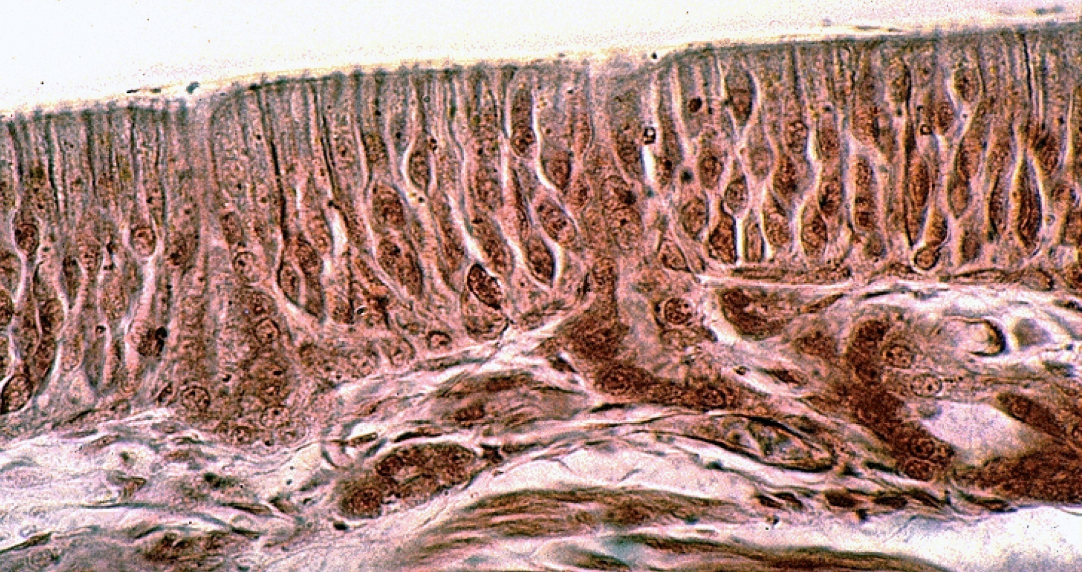
Bipolar neurons (in olfactory epithelium)

Slide 11
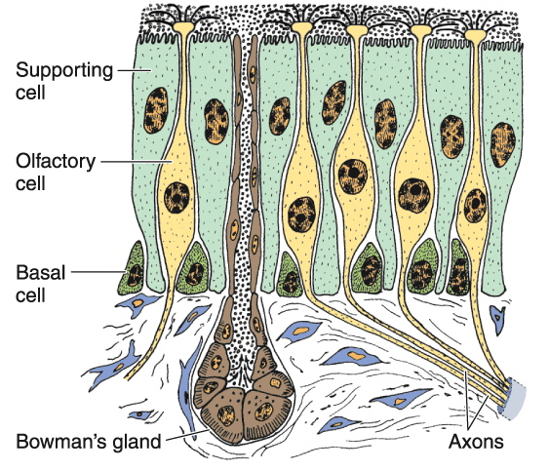
Bipolar neurons (in olfactory epithelium) (diagram)

Slide 12
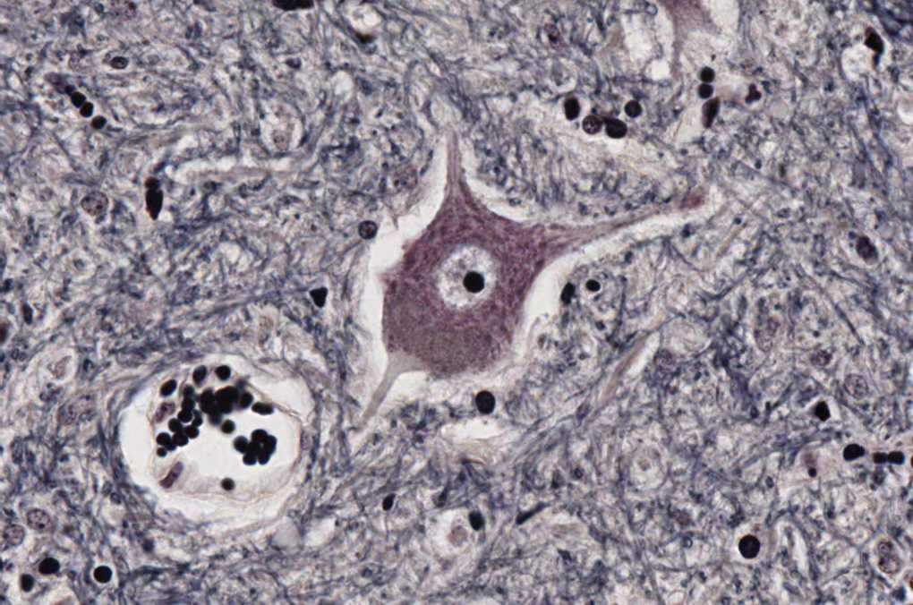
Multipolar stellate neuron (anterior horn cells of the spinal cord)

Slide 13
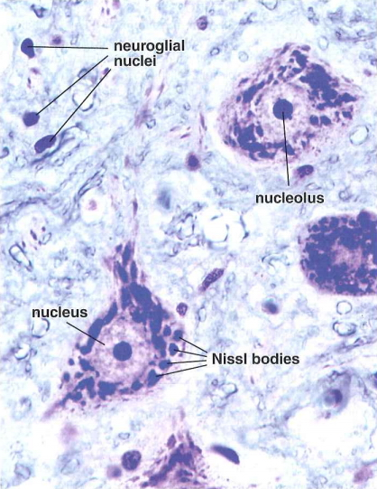
Multipolar stellate neurons (anterior horn cells of the spinal cord) and structure of the cell body of the neuron (nucleus, nucleolus, Nissl bodies)

Slide 14
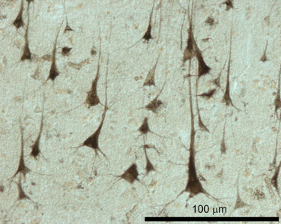
Multipolar pyramidal neurons (in cerebrum)

Slide 15
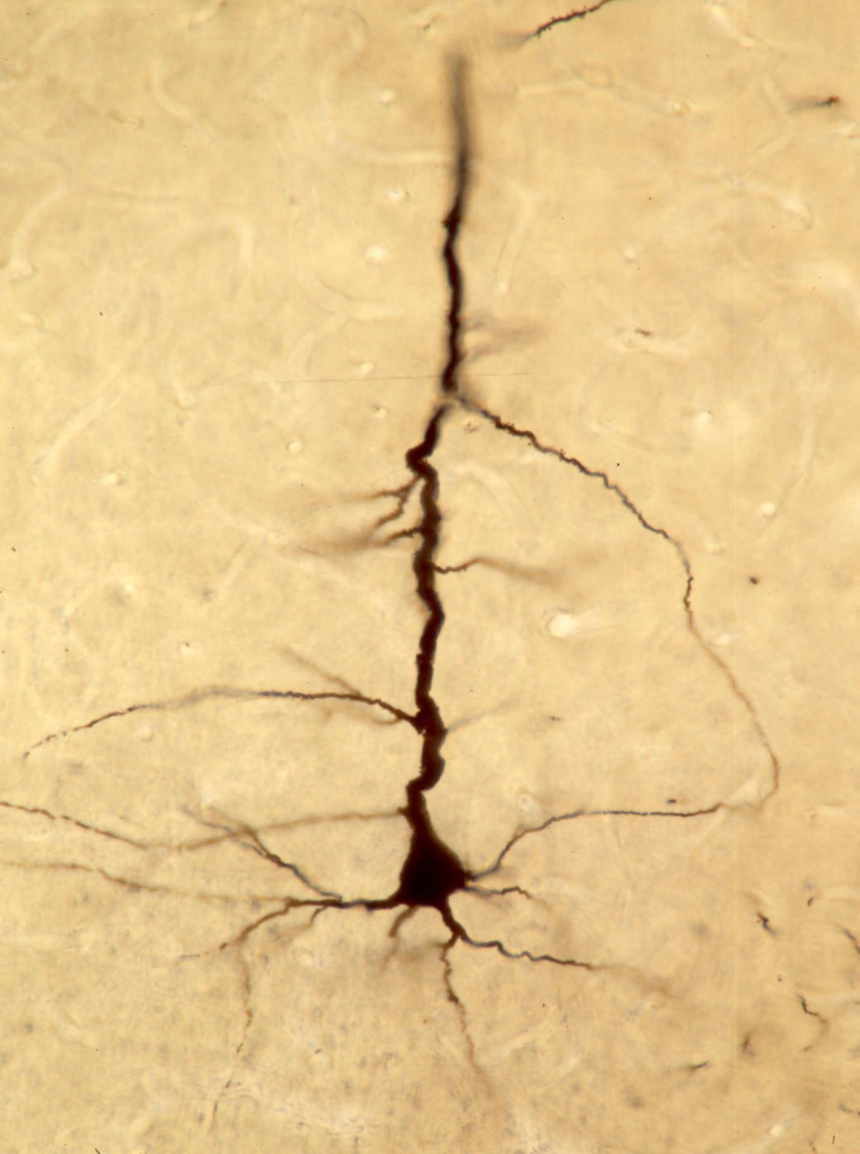
Multipolar pyramidal neuron (in cerebrum)

Slide 16
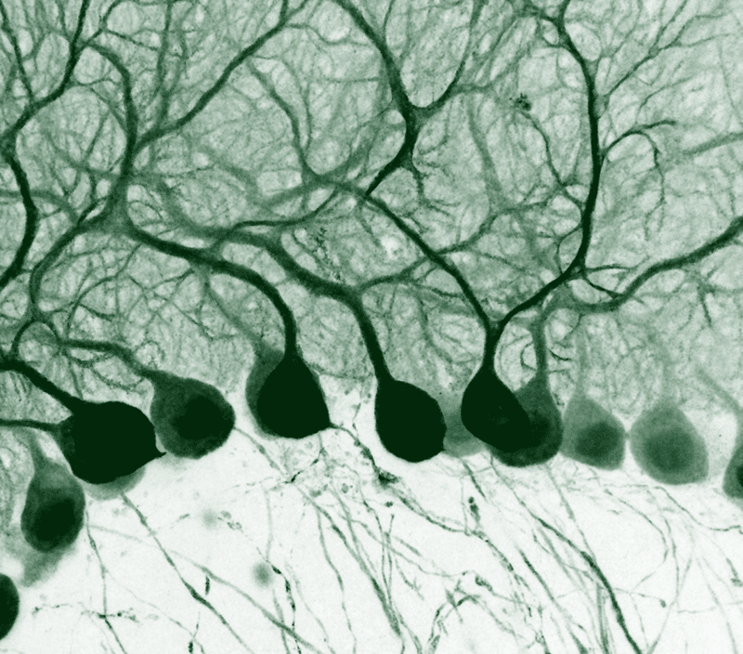
Multipolar pyriform neurons (Purkinje cells of cerebellum)

Slide 17
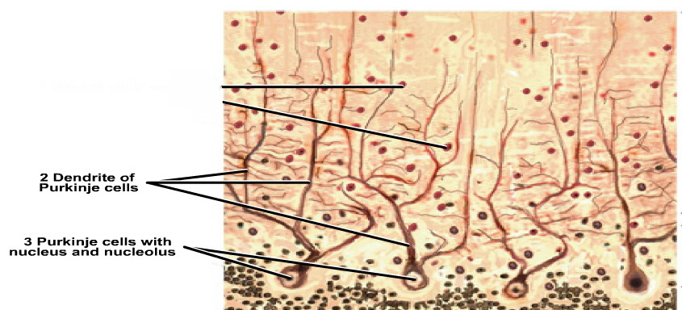
Multipolar pyriform neurons (Purkinje cells of cerebellum)

