Slide 1
CELLULAR INJURY IN THE NERVOUS SYSTEM
Dr. Maria A. Arafah
Assistant Professor – Department of Pathology
http://fac.ksu.edu.sa/mariaarafah/courses

Slide 2
Objectives
The student should:
Understand the role of the different constituents of Central nervous system (CNS) cells in the disease status.
Understand the “injury” concept.
Explain the basic pathological descriptive terms used in CNS cellular injury.
Correlate the different patterns of cellular injury with some important clinical examples.
Understand the concept of reaction of neurons, astrocytes and other glial cells to injury.
Recognize the axonal injury in both CNS and Peripheral nervous system as well as the consequences and the pathological findings.

Slide 3
Introduction
The principal functional unit of the CNS is the neuron.
The CNS contains other cells, such as astrocytes and oligodendrocytes, which make up the glia.
Mature neurons are incapable of cell division, so destruction of even a small number of neurons essential for a specific function may leave the individual with a neurologic deficit.
Acute injuries typically result in breakdown of the blood-brain barrier and variable degrees of cerebral edema.

Slide 4
Patterns of Injury
In response to injury, a number of changes occur in neurons and their processes (axons and dendrites), examples include:
Red neurons
Intracellular inclusions
Dystrophic neurites
Spheroids
Chromatolysis

Slide 5
Neuronal Injury
Red neurons:
Within 12 hours of an irreversible hypoxic-ischemic insult, neuronal injury becomes evident on routine H&E:
Shrinkage of the cell body
Pyknosis of the nucleus
Disappearance of the nucleolus
Loss of Nissl substance
Intense eosinophilia of the cytoplasm (“red neurons”)

Slide 6
Red Neurons

Slide 7
Neuronal Injury
Intracellular inclusions:
Many neurodegenerative diseases are associated with specific intracellular inclusions.
These are nuclear or cytoplasmic aggregates of stainable substances, usually proteins.
Examples include:
Negri bodies in rabies
Lewy bodies in Parkinson disease
Tangles in Alzheimer disease

Slide 8
Intracellular Inclusions
Negri body
Lewy body
Notes:
Negri bodies are eosinophilic sharply outlined pathognomonic inclusion bodies found in the cytoplasm of certain nerve cells containing the virus of rabies, especially in pyramidal cells.
Lewy bodies are aggregates of abnormal proteins that develop inside nerve cells.

Slide 9
Neuronal Injury
Dystrophic neurites:
A neurite refers to any projection from the cell body of a neuron.
In some neurodegenerative diseases, neuronal processes become thickened and tortuous; these are termed dystrophic neurites.

Slide 10
Dystrophic Neurites

Slide 11
Axonal Injury
Injured axons undergo swelling (called spheroids) and show disruption of axonal transport.
Axonal injury also leads to the following features:
Cellular body enlargement and rounding
Peripheral displacement of the nucleus
Enlargement of the nucleolus
Peripheral dispersion of Nissl substance (central chromatolysis).

Slide 12
Central chromatolysis

Slide 13
Axonal Injury
Evidence of injury can be highlighted by silver staining or immunohistochemistry for axonally transported proteins such as amyloid precursor protein.
Immunostains with antibodies to Beta Amyloid Precursor Protein (BAPP) can detect the axonal lesions in 2-3 hours after the injury (diffuse axonal injury).

Slide 14
Beta Amyloid Precursor Protein

Slide 15
Diffuse Axonal Injury
As many as 50% of patients who develop coma shortly after a trauma, even without cerebral contusions, are believed to have white matter damage and diffuse axonal injury.
The movement of one region of the brain relative to another is thought to lead to the disruption of axonal integrity and function.
Diffuse axonal injury is characterized by the wide but often asymmetric distribution of axonal swellings that appears within hours of the injury and may persists for much longer.
These are best demonstrated with silver stains or by immunohistochemistry for proteins within axons.

Slide 16
Cerebral Edema
Cerebral edema is the accumulation of excess fluid within the brain parenchyma.
There are two types, which often occur together, particularly after generalized injury:
Vasogenic edema
Cytotoxic edema

Slide 17
Vasogenic Edema
It occurs when the integrity of the normal blood-brain barrier is disrupted, allowing fluid to shift from the vascular compartment into the extracellular spaces of the brain.
Vasogenic edema can be localized (e.g., the result of increased vascular permeability due to inflammation or in tumors) or generalized.

Slide 18
Cytotoxic Edema
It is an increase in intracellular fluid secondary to neuronal and glial cell injury, as might follow generalized hypoxic or ischemic insult or exposure to certain toxins.

Slide 19
Glial Cells in Injury
Astrocytes are the principal cells responsible for repair and scar formation in the brain, a process termed gliosis.
In response to injury:
Astrocytes undergo both hypertrophy and hyperplasia
The nucleus enlarges and becomes vesicular
The nucleolus becomes prominent
The cytoplasm expands and takes on a bright pink hue, and the cell extends multiple stout, ramifying processes (called gemistocytic astrocytes)
In long-standing gliosis, the cytoplasm of reactive astrocytes shrinks in size, and the cellular processes become more tightly interwoven (fibrillary astrocytes).

Slide 20
Glial Cells in Injury
Gemistocytic astrocytes
Fibrillary astrocytes

Slide 21
Glial Cells in Injury
There is minimal extracellular matrix deposition in CNS injury.
Unlike repair after injury elsewhere in the body, fibroblasts participate in healing after brain injury only to a limited extent (usually after penetrating brain trauma or around abscesses).

Slide 22
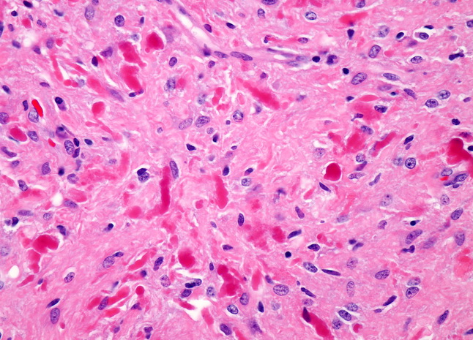
Glial Cells in Injury
Rosenthal fibers are thick, elongated, brightly eosinophilic protein aggregates found in astrocytic processes in chronic gliosis and in some low-grade gliomas.

Slide 23
Glial Cells in Injury
Oligodendrocytes, which produce myelin, exhibit a limited spectrum of specific morphologic changes in response to various injuries.
In progressive multifocal leukoencephalopathy, viral inclusions can be seen in oligodendrocytes, with a smudgy, homogeneous-appearing enlarged nucleus.

Slide 24
Progressive Multifocal Leukoencephalopathy
Notes:
PML is a rare and usually fatal viral disease characterized by progressive damage or/and inflammation of the brain’s white matter at multiple location. It is an opportunistive infection caused by the polyomavirus JC virus.

Slide 25
Glial Cells in Injury
Ependymal cells line the ventricular system and the central canal of the spinal cord.
Certain pathogens, particularly cytomegalovirus, can produce extensive ependymal injury, with typical viral inclusions.

Slide 26
Glial Cells in Injury
Microglial cells are long-lived cells derived from the embryonic yolk sac that function as the resident phagocytes of the CNS.
When activated by tissue injury, infection, or trauma, they proliferate and become more prominent histologically.
Microglial cells take on the appearance of activated macrophages in areas of demyelination, organizing infarct, or hemorrhage; in other settings such as infections, they develop elongated nuclei (rod cells). Aggregates of elongated microglial cells at sites of tissue injury are termed microglial nodules.
Similar collections can be found congregating around and phagocytosing injured neurons (neuronophagia).

Slide 27
Glial Cells in Injury
Microglial nodules
Neuronophagia

Slide 28
Peripheral Nerve Injury
Most peripheral neuropathies can be subclassified as either axonal or demyelinating, even though some diseases exhibit mixed features.

Slide 29
Axonal Neuropathies
They are caused by insults that directly injure the axon.
The entire distal portion of an affected axon degenerates.
Axonal degeneration is associated with secondary myelin loss a process sometimes referred to as Wallerian degeneration. Regeneration takes place through axonal regrowth and subsequent remyelination of the distal axon.
The morphologic hallmark of axonal neuropathies is a decrease in the density of axons, which in electrophysiologic studies correlates with a decrease in the strength of amplitude of nerve impulses.

Slide 30
Segmental Demyelination
They are characterized by damage to Schwan cells or myeline with axonal sparing resulting in abnormally show nerve conduction velocities.
Demyelination typically occurs in individual myelin internodes randomly; this process is termed segmental demyelination
Morphologically, demyelinating neuropathies show a relatively normal density of axons and features of segmental demyelination and repair >> recognized by the presence of axons with abnormally thin myelin sheaths and short internodes.

Slide 31
Axonal Neuropathies

Slide 32
Homework
Define Corpora amylacea.
Where and when they are deposited in the CNS?

Slide 33
Reference
Kumar V, Abbas AK, Aster JC. Robbins Basic Pathology. 10th ed. Elsevier; 2017. Philadelphia, PA.

Slide 34
End of Lecture
Thank You

