Slide 1
CNS Tumors
Dr. Maria A. Arafah
Assistant Professor – Department of Pathology
http://fac.ksu.edu.sa/mariaarafah/courses

Slide 2
Objectives
Upon completion of this lecture, students should be able to:
Appreciate how the anatomy of the skull and the spinal column influences the prognosis of both benign and malignant primary CNS tumors.
List the principal clinicopathological features of some of the main types of tumors that can arise within the central and the peripheral nervous systems.

Slide 3
Introduction
The annual incidence of CNS tumors ranges from 10 to 17 per 100,000 individuals for intracranial tumors and 1 to 2 per 100,000 individuals for intraspinal tumors.
About one half to three-fourths are primary tumors, and the rest are metastatic.

Slide 4
Introduction
Tumors of the CNS make up a larger proportion of childhood cancers, accounting for as many of 20% of all pediatric tumors.
Childhood CNS tumors differ from those in adults in both histologic subtype and location.
In childhood, tumors are likely to arise in the posterior fossa, whereas tumors in adults are mostly supratentorial.

Slide 5
Introduction
Tumors of the nervous system have unique characteristics:
These tumors do not have morphologically evident premalignant or in situ stages comparable to those of carcinomas.
Even low-grade lesions may infiltrate large regions of the brain, leading to serious clinical deficits, inability to be resected, and poor prognosis.
The anatomic site of the neoplasm can influence outcome independent of histologic classification due to local effects (e.g., a benign meningioma may cause cardiorespiratory arrest from compression of the medulla).
Even the most highly malignant gliomas rarely spread outside of the CNS.

Slide 6
Introduction
Symptoms of CNS tumors include:
Seizures, headaches, vague symptoms
Focal neurologic deficits related to the anatomic site of involvement
The rate of growth may correlate with the history and duration of symptoms.

Slide 7
Introduction
CNS tumors may arise from:
cells of the coverings (meningiomas)
cells intrinsic to the brain (gliomas, neuronal tumors, choroid plexus tumors)
other cell populations within the skull (primary CNS lymphoma, germ-cell tumors)
Tumor from elsewhere in the body spreading to the CNS (metastases)

Slide 8
Gliomas
Astrocytomas
Oligodendrogliomas
Ependymomas

Slide 9
Astrocytomas
Pilocytic (Grade I):
Children and young adults
Commonly cerebellum
Relatively benign
Fibrillary:
4th to 6th decade
Commonly cerebral hemisphere
Variable grades:
Diffuse astrocytoma (Grade II)
Anaplstic astrocytoma (Grade III)
Glioblastoma (Grade IV)

Slide 10
Pilocytic Astrocytoma
Cystic with a mural nodule
Well circumscribed
"hairlike“=pilocytic processes that are GFAP positive
Rosenthal fibers & hyaline granular bodies are often present
Necrosis and mitoses are typically absent

Slide 11
Pilocytic Astrocytoma
Radiology
Microscopy

Slide 12
Astrocytomas
Well differentiated “diffuse astrocytoma” (WHO grade II):
Static or progress slowly (mean survival of more than 5 years)
Moderate cellularity
Variable nuclear pleomorphism
Anaplstiac astrocytoma (WHO grade III):
More cellular
Greater nuclear pelomrophism
Mitosis
Glioblastoma (WHO grade IV):
With treatment, the mean survival is of 8-10 months
All the features of anaplastic astrocytoma, plus necrosis and/or vascular or endothelial cell proliferation

Slide 13
Diffuse Astrocytomas
Macroscopy
Microscopy
Note that diffuse astrocytoma are poorly demarcated

Slide 14
Glioblastoma Multiforme
Macroscopy
Microscopy

Slide 15
Astrocytomas
Mutations that alter the enzymatic activity of two isoforms of the metabolic enzyme isocitrate dehydrogenase (IDH1 and IDH2) are common in lower-grade astrocytomas.
Primary glioblastomas are characterized by amplification of the epidermal growth factor receptor (EGFR ) gene.
Secondary glioblastomas share p53 mutations that characterizes low-grade gliomas.

Slide 16
Oligodendroglioma
The most common genetic findings are loss of heterozygosity for chromosomes 1p and 19q.
4th and 5th decades
Cerebral hemispheres, with a predilection for the white matter
Better prognosis than astrocytomas (5 to 10 years with treatment)
The prognosis of the anaplastic type is worse than the conventional type.

Slide 17
Oligodendroglioma
In oligodendroglioma tumor cells have round nuclei, often with a cytoplasmic halo
Blood vessels in the background are thin and can form an interlacing pattern
→ What additional features are needed for anaplastic oligodendroglioma?

Slide 18
Ependymoma
They occur in the first two decades of life.
They most often arise next to the ependyma-lined ventricular system, including the central canal of the spinal cord.
They typically occur near the fourth ventricle.
In adults, the spinal cord is their most common location.

Slide 19
Ependymoma
Tumor cells may form round or elongated structures (rosettes, canals) more frequently present are perivascular pseudorosettes in which tumor cells are arranged around vessels with an intervening zone containing thin ependymal processes.
Anaplastic ependymomas show increased cell density, high mitotic rates, necrosis and less evident ependymal differentiation

Slide 20
Meningioma
They are often low grade tumors of adults.
They originate from the meningothelial cell of the arachnoid
Although most meningiomas are easily separable from underlying brain, some tumors infiltrate the brain.
The presence of brain invasion is associated with increased risk of recurrence.

Slide 21
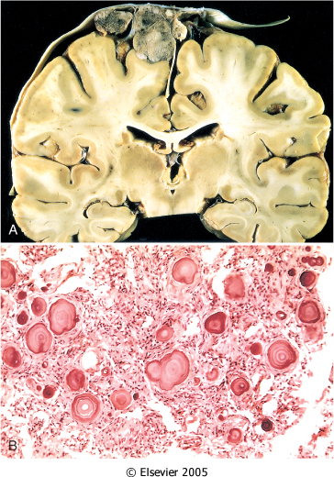
Meningioma
A, A parasagittal multilobular meningioma attached to the dura with compression of the underlying brain.
B, Meningioma with a whorled pattern of cell growth and psammoma bodies.

Slide 22
Meningioma
Main subtypes (grade I):
Meningothelial
Fibroblastic
Transitional
Psammomatous
Secretory
Also note:
Atypical meningiomas (grade II)
Anaplastic (malignant) meningiomas (grade III)

Slide 23
Medulloblastoma
They occur in children and exclusively in the cerebellum.
Neuronal and glial markers may be expressed, but the tumor is often largely undifferentiated.
The tumor is highly malignant, and the prognosis for untreated patients is dismal; however, it is exquisitely radiosensitive.
With total excision and radiation, the 5-year survival rate may be as high as 75%.

Slide 24
Medulloblastoma
Macroscopy
Microscopy
The tumor is extremely cellular, with sheets of anaplastic ("small blue") cells with little cytoplasm and hyperchromatic nuclei; mitoses are abundant

Slide 25
Schwannoma
Benign
In the CNS, they are often encountered within the cranial vault in the cerebellopontine angle, where they are attached to the vestibular branch of the eighth nerve, causing tinnitus and hearing loss.
They are attached to the nerve but can be separated from it
Sporadic schwannomas are associated with mutations in the NF2 gene, however bilateral acoustic schwannoma is associated with NF2 syndrome.

Slide 26
Schwannoma
Biphasic pattern
Verocay Bodies

Slide 27
Schwannoma
Microscopically:
Biphasic pattern: cellular Antoni A pattern and a less cellular Antoni B pattern.
Nuclear-free zones of processes that lie between the regions of nuclear palisading and termed Verocay bodies

Slide 28
Neurofibroma
Neurofibromas are benign tumors of peripheral nerves and they cannot be separated from the nerve trunk (in comparison to shcwannomas)
Examples include: cutaneous neurofibroms or in peripheral nerve solitary neurofibroma.
These arise sporadically or in association with type 1 neurofibromatosis.
Plexiform neurofibromas, mostly arise in individuals with NF1 syndrome with a potential malignant transformation.

Slide 29
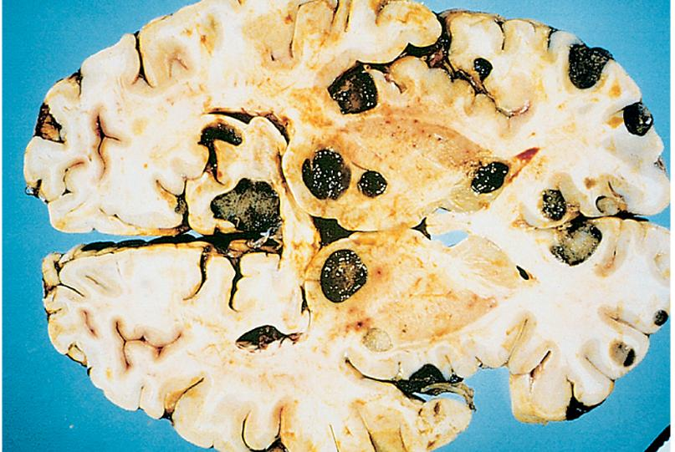
Metastatic Tumors
About half to three-quarters of brain tumors are primary tumors, and the rest are metastatic.
Lung, breast, skin (melanoma), kidney, and gastrointestinal tract are the most common primary sites for metastases.
The metastatic deposits are usually
sharply demarcated with a surrounding edema.

Slide 30
Homework !
Describe the inheritance pattern and the main features of:
Type 1 Neurofibromatosis
Type 2 Neurofibromatosis
Which one of these two syndromes, has a propensity for the neurofibromas to undergo malignant transformation at a higher rate than that observed for comparable tumors in the general population?
Notes:
NF1 is an autosomal dominant disorder caused by mutations in the tumor suppressor neurofibromin, encoded on the long arm of chromosome 17. Symptoms include neurofibromas, malignant peripheral nerve sheath tumors, “optic gliomas,” and other glial tumors. In addition, patients with NF1 exhibit learning disabilities, seizures, skeletal abnormalities, vascular abnormalities with arterial stenoses, pigmented nodules of the iris (Lisch nodules), and pigmented skin lesions (axillary freckling and café-au-lait spots) in various degrees.
NF2 is an autosomal dominant disorder and patients are at risk of developing multiple schwannomas, meningiomas, and ependymomas. The presence of bilateral vestibular schwannomasis a hallmark of NF2; despite the name, neurofibromas are not found in NF2 patients. Affected patients carry a dominant loss of function mutation of the merlin gene on chromosome 22.

Slide 31
Reference
Kumar V, Abbas AK, Aster JC. Robbins Basic Pathology. 10th ed. Elsevier; 2017. Philadelphia, PA.

Slide 32
End of Lecture
Thank You

