Slide 1
Multiple Sclerosis
Dr. Maria A. Arafah
Assistant Professor – Department of Pathology
http://fac.ksu.edu.sa/mariaarafah/courses

Slide 2
Objectives
The student should:
Appreciate the critical role of myelin in maintaining the integrity of the CNS system.
Understand the pathogenesis and the clinic-pathological features of multiple sclerosis as the classical and the commonest example of CNS demyelinating diseases.

Slide 3
Introduction
Myelin consists of multiple layers of the specialized plasma membrane of oligodendrocytes in the CNS with most of the cytoplasm excluded.
Myelin is an electrical insulator that allows rapid propagation of neural impulses.
Although myelinated axons are present in all areas of the brain, they are the dominant component in the white matter; therefore, most diseases of myelin are primarily white matter disorders.

Slide 4
Introduction
An oligodendrocyte extends its processes toward many different axons and wraps a segment of roughly a few hundred microns of an axon.
Each of these segments is called an internode, and the gaps between internodes are known as nodes of Ranvier.

Slide 5
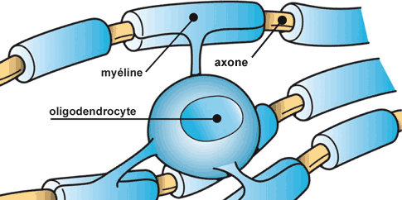
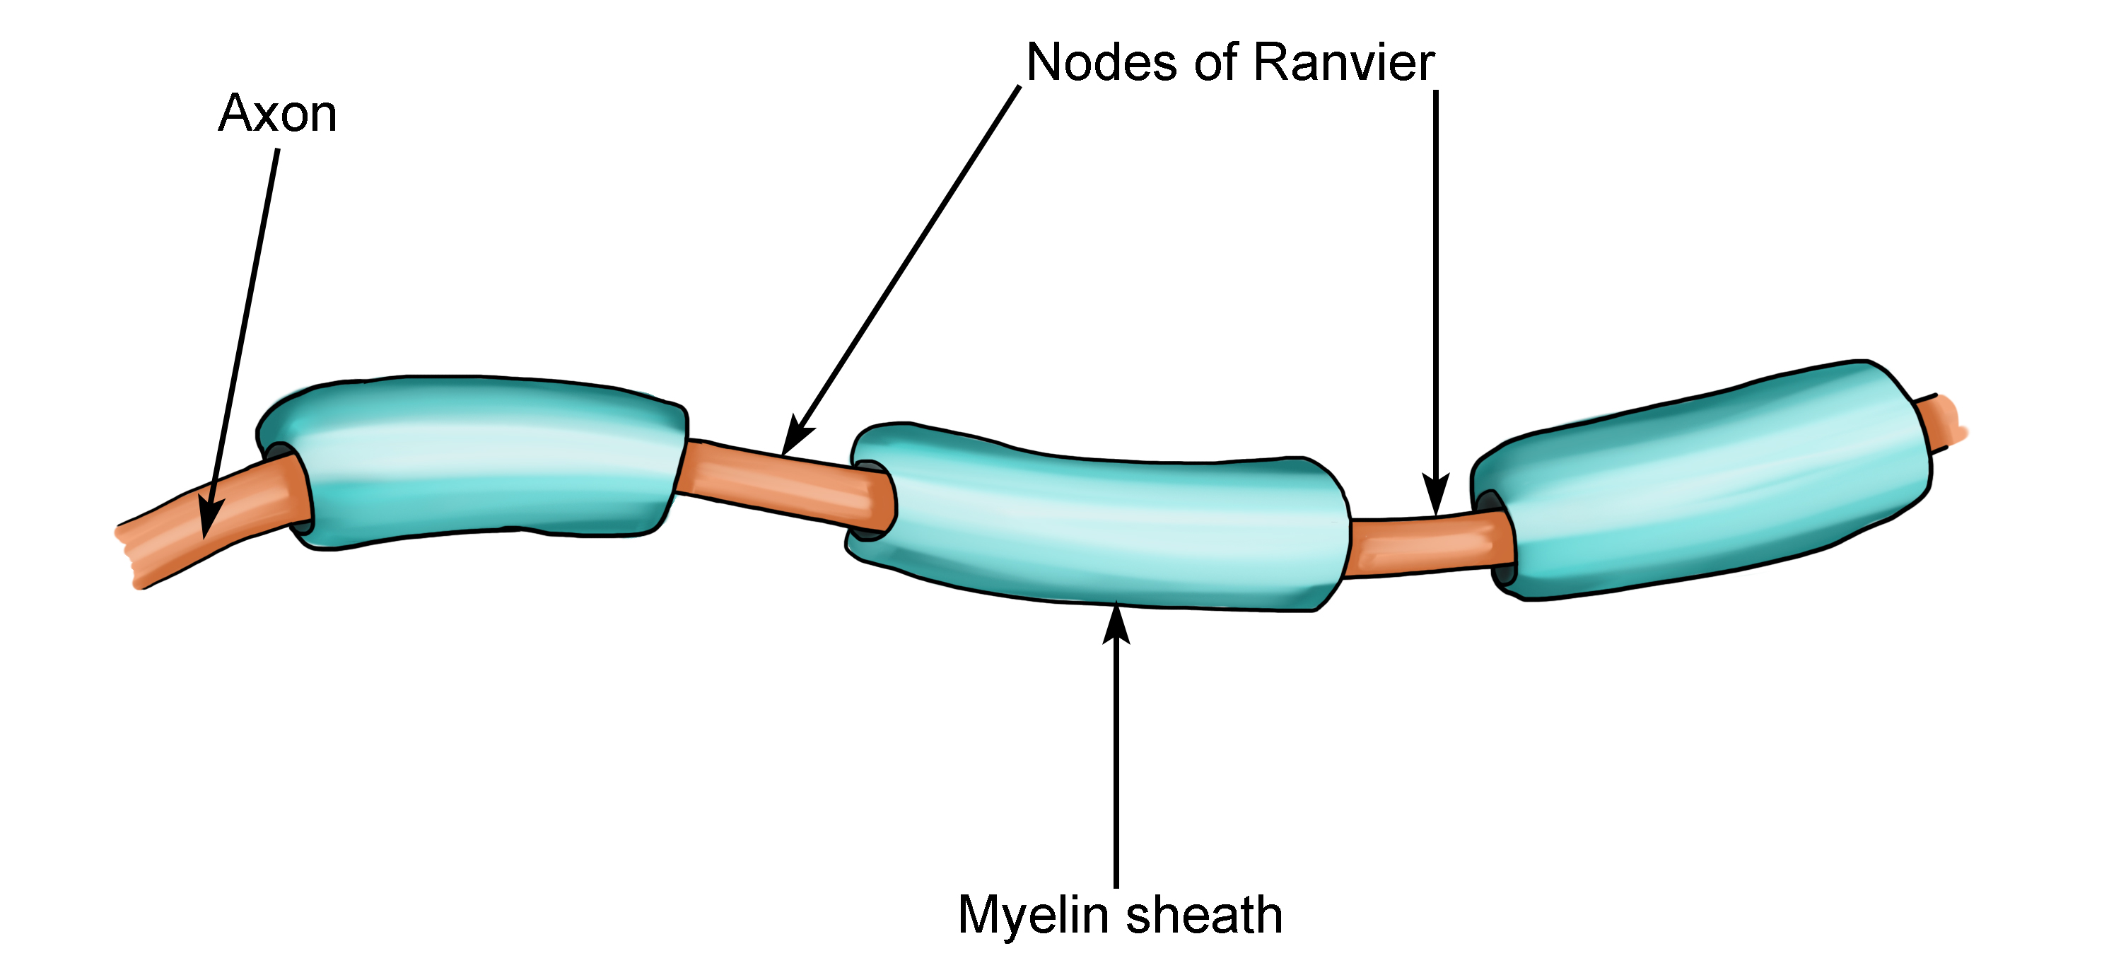

Slide 6
Introduction
The myelin in peripheral nerves is similar to the myelin in the CNS but:
peripheral myelin is made by Schwann cells, not oligodendrocytes.
Each cell in the peripheral nerve contributes to only one internode, while in the CNS, many internodes comes from a single oligodendrocyte.
The specialized proteins and lipids are also different
Most diseases of CNS myelin do not significantly involve the peripheral nerves, and vice versa.

Slide 7
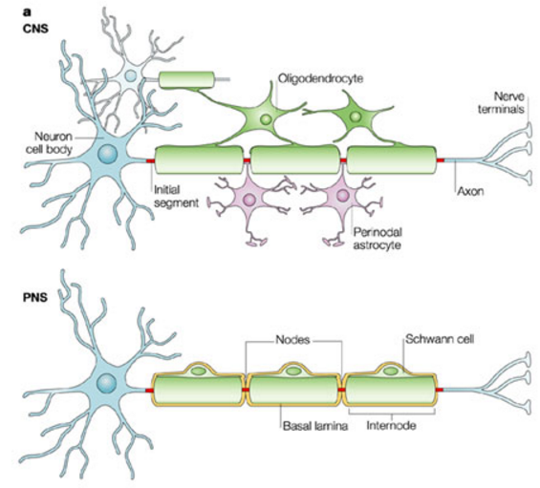

Slide 8
Introduction
The natural history of demyelinating diseases is determined, in part, by the limited capacity of the CNS to regenerate normal myelin and by the degree of secondary damage to axons that occurs as the disease runs its course.

Slide 9
Classification of Demyelinating Diseases
A. Demyelinating disease of the CNS:
They are acquired conditions characterized by a preferential damage to previously normal myelin.
They commonly result from an immune-mediated injury, viral infections to oligodendrocytes (as in progressive multifocal leukoencephalopathy), drugs and other toxic agents.

Slide 10
Classification of Demyelinating Diseases
B. Dysmyelinating diseases of the CNS (leukodystrophies).
Myelin is not formed properly or has abnormal turnover kinetics.
They are associated with mutations affecting the proteins required for the formation of normal myelin or mutations that affect the synthesis or degradation of myelin lipids.

Slide 11
Multiple Sclerosis
MS is an autoimmune demyelinating disorder characterized by distinct episodes of neurologic deficits, separated in time, attributable to white matter lesions that are separated in space.
The most common demyelinating disorders (prevalence of 1 per 1000 persons in the United States and Europe).

Slide 12
Multiple Sclerosis
The disease becomes clinically apparent at any age, although an onset in childhood or after the age 50 years is relatively rare.
Women are affected twice as often as men
In most individuals with MS the illness shows a relapsing and remitting episodes of neurologic deficits. The frequency of relapses tends to decrease during the course of the illness, but there is a steady neurologic deterioration in a subset of patients.

Slide 13
Pathogenesis of MS
The lesions of MS are caused by an autoimmune response directed against components of the myelin sheath. As in other autoimmune diseases, the development of MS is related to genetic susceptibility and largely undefined environmental triggers.
The incidence of MS is 15-fold higher when the disease is present in a first-degree relative and roughly 150-fold higher with an affected monozygotic twin.

Slide 14
Pathogenesis of MS
A significant fraction of the genetic risk for MS is attributable to HLA-DR variants, the DR2 allele being the one that most significantly increases the risk for developing MS.
The available evidence indicates that the disease is initiated by TH1 and TH17 T cells that react against myelin antigens and secrete cytokines.

Slide 15
Pathogenesis of MS
Experimental autoimmune encephalomyelitis is an animal model of MS in which demyelination and inflammation occur after immunization of animals with myelin proteins.
In this model, the lesions are caused by a T cell-mediated delayed type hypersensitivity reaction to myelin proteins, and the same immune mechanism is thought to be central to the pathogenesis of MS.

Slide 16
Pathogenesis of MS
While MS is characterized by the presence of demyelination out of proportion to axonal loss, some injury to axons does occur.
Toxic effects of lymphocytes, macrophages, and their secreted molecules have been implicated in initiating the process of axonal injury, sometimes even leading to neuronal death.

Slide 17
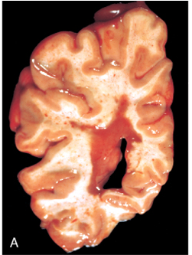
Morphology of MS
MS is a white matter disease.
The affected areas show multiple,
well-circumscribed, slightly depressed, glassy,
gray-tan, irregularly shaped lesions, termed
plaques.
They occur beside the ventricles and they are
frequent in the optic nerves and chiasm, brain stem,
ascending and descending fiber tracts, cerebellum
and spinal cord.

Slide 18
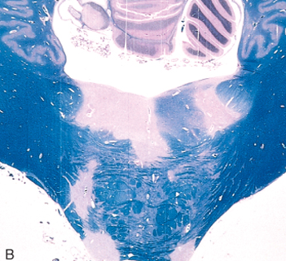
Morphology of MS
The lesions have sharply defined borders at the microscopic level.

Slide 19
Morphology of MS
In an active plaque, there is evidence of ongoing myelin breakdown with abundant macrophages containing myelin debris.
Loss of myelin and variable loss of oligodendrocytes.
Lymphocytes, plasma cells and macrophages are present, mostly as perivascular cuffs.
Axons are relatively preserved, although they may be reduced in number.

Slide 20
Morphology of MS
When plaques become quiescent (inactive plaques), the inflammation mostly disappears, leaving behind little to no myelin.
Loss of oligodendrocytes and secondary axonal injuries.
Astrocytic proliferation and gliosis are prominent (astrogliosis).

Slide 21
Morphology of MS
This is a myelin stain (luxol fast blue/PAS) of an early lesion.
The lesion is centered around a small vein which is surrounded by inflammatory cells.

Slide 22
Morphology of MS
H&E stained section from a patient with a long-standing MS.
An old (inactive) lesion is centered around a vein with very little inflammation.
Loss of myelin can be seen even without special stains (it is lighter pink than the normal white matter around it).

Slide 23
Morphology of MS
An MS plaque showing a pale plaque almost devoid of myelin.
There is a decrease in oligodendrocytes and in acrease in the astrocytic nuclei which is characteristic of old MS lesions.

Slide 24
Clinical Features of MS
The course of MS is variable.
MS lesions can occur anywhere in the CNS inducing a wide range of clinical manifestations.
Commonly there are multiple episodes of new symptoms (relapses) followed by episodes of recovery (remissions). Typically, the recovery is not complete.
The consequence of this pattern of relapsing-remitting disease is a gradual, often stepwise, accumulation of increasing neurologic deficits.

Slide 25
Clinical Features of MS
Certain patterns of neurologic symptoms and signs are commonly observed:
Unilateral visual impairment occurring over the course of a few days is a frequent initial manifestation of MS (due to involvement of the optic nerve “optic neuritis”). When this occurs as the first event, only a minority (10% to 50%) go on to develop full-blown MS.
Involvement of the brain stem produces cranial nerve signs and ataxia, and can disrupt conjugate eye movements.
Spinal cord lesions give rise to motor and sensory impairment of trunk and limbs, spasticity, and difficulties with the voluntary control of the bladder function.

Slide 26
Clinical Features of MS
Changes in the cognitive function can be present, but are often much milder than the other findings.
In any given patient, it is hard to predict when the next relapse will occur; most current treatments aim at decreasing the rate and severity of relapses rather than recovering lost function.

Slide 27
Radiological Findings
Lesions on MRI appear as bright yellow spots.

Slide 28
Laboratory Findings
It shows mildly elevated protein levels with an increased proportion of γ-globulin (IgG) on electrophoresis.
In one-third of cases there is moderate pleocytosis (abnormal increase in the amount of lymphocytes in the CSF).
When the immunoglobulin is examined further, most MS patients show oligoclonal bands, representing antibodies directed against a variety of antigenic targets.
These antibodies constitute a marker for disease activity.

Slide 29
Reference
Kumar V, Abbas AK, Aster JC. Robbins Basic Pathology. 10th ed. Elsevier; 2017. Philadelphia, PA.

Slide 30
End of Lecture
Thank You

