Slide 1
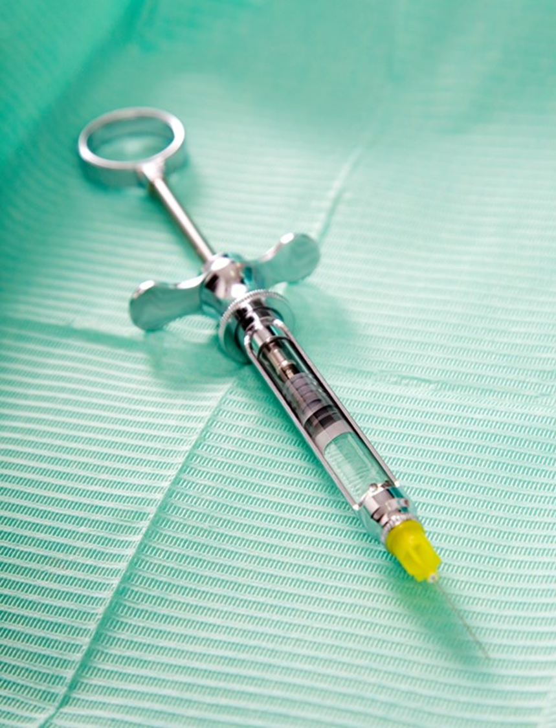
General anesthetics

Slide 2
Introduction
Drugs used to induce loss of pain sensation, loss of consciousness, skeletal muscle relaxation, analgesia, amnesia and inhibitions of undesirable autonomic reflexes.
10/9/2018
Prof. Hanan Hagar

Slide 3
Types of Anesthesia
General anesthesia
Local anesthesia
10/9/2018
Prof. Hanan Hagar

Slide 4
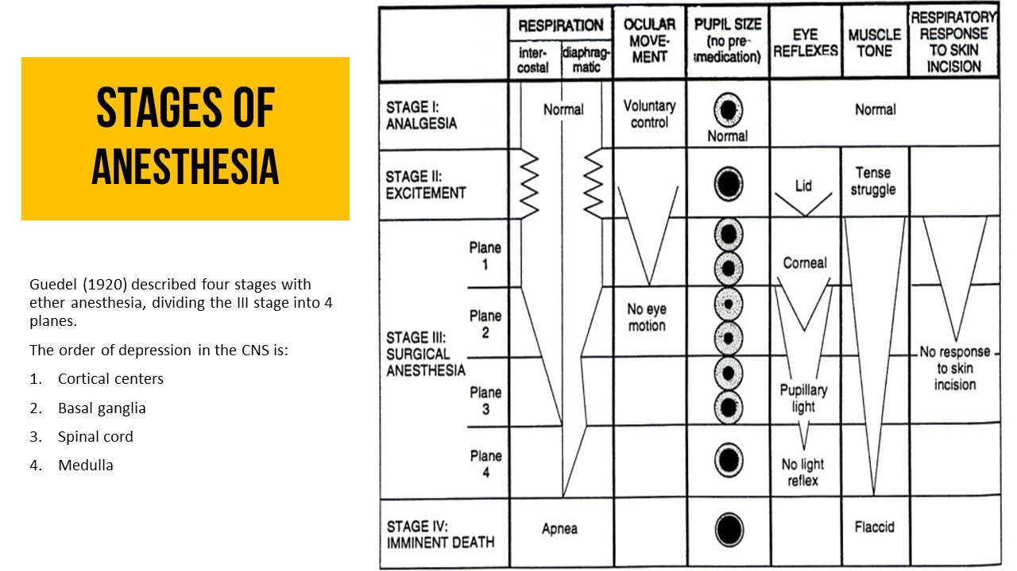
Stages of anesthesia
Stage I (analgesia)
Loss of pain sensation.
The patient is conscious and conversational.
Stage II (Excitement)
Increased respiratory rate.
Increased, irregular blood pressure.
Patient may experience delirium & violent behavior.
Eye dilated & reactive.

Slide 5
Stages of anesthesia
Stage III (Surgical anesthesia)
- Regular respiration & relaxation of Sk. muscles.
- Eye reflexes decrease until the pupil is fixed.
Stage IV (coma and death)
- Medullary paralysis.
Severe depression of vasomotor
Depression of respiratory centers.
Death may occur.

Slide 6
Stages of anesthesia
The III stage is divided into 4 planes.
The order of depression in the CNS is:
Cortical centers
Basal ganglia
Spinal cord
Medulla
10/9/2018
Prof. Hanan Hagar

Slide 7
Stages of anesthesia

Slide 8
Character s of an Ideal anesthetic drug
Smooth and rapid induction.
Rapid recovery.
Wide safety margin.
Minimal side effects.
10/9/2018

Slide 9
Ideal General Anesthesia
Loss of pain sensation unconsciousness
‘Amnesia-hypnosis’
Analgesia
‘Loss of sensory and autonomic reflexes’
Need for muscle relaxation
10/9/2018

Slide 10
Balanced Anaesthesia
Is the use of more than one drug in combination to fulfil the patient needs.
Beneficial effects
Adverse effects

Slide 11
How we can obtain balanced anesthesia
Balanced anesthesia is achieved by a combination of
I.V and inhaled anesthesia and Pre-anaesthetic medications

Slide 12
Pre-anesthetic medication
Calm the patient, relieve pain
Protect against undesirable effects of the subsequently administered anesthetics or the surgical procedure.
Facilitate smooth induction of anaesthesia
Lowered the dose of anaesthetic required
Prof. Hanan Hagar
10/9/2018

Slide 13
Pre - anaesthetic medication
Opiates: induce analgesia e.g. morphine
Anticholinergics: prevent secretion of fluids into the respiratory tract e.g. hyoscine
Sedatives & anxiolytics: relieve anxiety. e.g. diazepam
Antihistaminics: allergic reactions. e.g. diphenhydramine
Antiemetics : post surgical N&V. e.g. metoclopramide, prochlorperazine
H2-receptor blockers: reduce gastric acidity e.g. ranitidine
Thiopental: smooth induction
Prof. Hanan Hagar
10/9/2018

Slide 14
Adjuncts to general anaesthetics
Pre-anesthetic medication.
Neuromuscular blocking agents
e.g. succinylcholine, vecuronium, atracurium
Facilitate intubation
Suppress muscle tone.
Prof. Hanan Hagar
10/9/2018

Slide 15
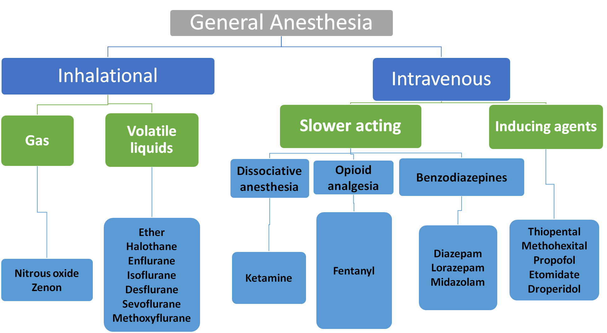
General Anesthesia
Inhalational
Gas
Volatile liquids
Intravenous
Slower acting
Nitrous oxide
Zenon
Ether
Halothane
Enflurane
Isoflurane
Desflurane
Sevoflurane
Methoxyflurane
Dissociative anesthesia
Opioid analgesia
Benzodiazepines
Thiopental
Methohexital
Propofol
Etomidate
Droperidol
Ketamine
Fentanyl
Diazepam
Lorazepam
Midazolam
Inducing agents

Slide 16
General Anesthesia
Inhalational
Gas
Volatile liquids
Intravenous
Slower acting
Nitrous oxide
Zenon
Ether
Halothane
Enflurane
Isoflurane
Desflurane
Sevoflurane
Methoxyflurane
Dissociative anesthesia
Opiod analgesia
Benzodiazepines
Thiopentone sod.
Methohexitone sod.
Propofol
Etomidate
Droperidol
Ketamine
Fentanyl
Diazepam
Lorazepam
Midazolam
Inducing agents

Slide 17
Mechanism of action of general anaesthetics
Disruption of the function of ionic channels
Disruption of lipids associated with ionic channels
Receptors
Inhibitory : GABA A, glycine
Excitatory : nAch, NMDA

Slide 18
Mechanism of action of general anaesthetics
Enhance the action of GABA _{A} and glycine on receptors leading to greater entrance of chloride ion hyperpolarization thus decrease neuronal excitability.
10/9/2018
Prof. Hanan Hagar

Slide 19
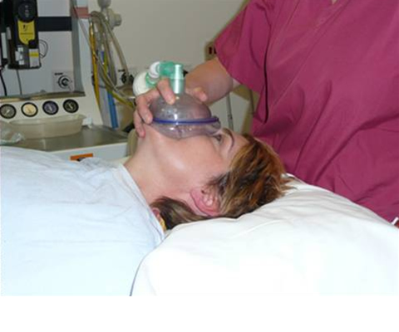
Inhalation anesthetics
Are halogenated hydrocarbons
End with suffix “flurane”
Methoxyflurane
Halothane
Enflurane
Isoflurane
Desflurane
Sevoflurane
Nitrous oxide
Prof. Hanan Hagar
10/9/2018

Slide 20
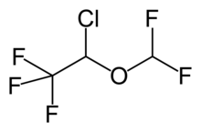
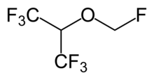
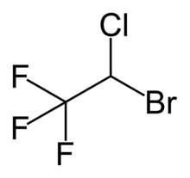
Structures
Inhalational
Sevoflurane
Halothane
Isoflurane

Slide 21
Pharmacokinetics of Inhalation anesthetics
Rate of induction
Depth of anesthesia and recovery.
Prof. Hanan Hagar
10/9/2018

Slide 22
Inhalation anesthetics
Induction
Time elapsed between onset of administration of anesthetic and
development of effective surgical anesthesia.
Maintenance
Time during which the patient is surgically anesthetized.
Recovery
The time from discontinuation of anesthetic drug until consciousness is regained.
Prof. Hanan Hagar
10/9/2018

Slide 23
Pharmacokinetics of Inhalation anesthetics
Factors controlling induction & recovery
The anesthetic concentration in the inspired air: (Direct).
Blood solubility: Blood: gas partition coefficient (Inverse relation).
Rate and depth of ventilation (Direct).
Prof. Hanan Hagar
10/9/2018

Slide 24
Drugs Solubility Induction & Recovery
(Blood : gas partition coefficient )
Methoxyflurane 12 Slow
Halothane 2.3 Slow
Enflurane 1.8 Medium
Isoflurane 1.4 Medium
Sevoflurane 0.69 Rapid
Desflurane 0.42 poor & Rapid
Nitrous Oxide 0.47 Rapid

Slide 25
Minimum alveolar concentration (MAC)
It is the concentration of inhalation anesthetic that produce immobility in 50 % patients in response to surgical incision.
Potency of anesthetic agents.
Oil: gas partition coefficient (Direct with potency).
The lower the MAC value the more potent the drug.
Decreased by CNS depressants, old people.
Increased by CNS stimulants.

Slide 26
Drugs MAC POTENCY
Methoxyflurane 0.16
Halothane 0.75
Isoflurane 1.4
Enflurane 1.7
Sevoflurane 2
Desflurane 6-7
Nitrous oxide >100
Prof. Hanan Hagar
10/9/2018

Slide 27
POTENCY & INDUCTION & VELOCITY
Drugs
Methoxyflurane: The most potent, low MAC value, slow induction& recovery
Halothane: Potent, slow induction & recovery (pleasant odor)
Enflurane: less potent, medium induction & recovery (pungent odor)
Isoflurane: less potent, medium induction & recovery
Sevoflurane : less potent, rapid induction & recovery (better smell)
Desflurane: Rapid induction & rapid recovery (pungent odor)
Nitrous oxide: The least potent, high MAC value, rapid induction & recovery
Prof. Hanan Hagar
10/9/2018

Slide 28
Pharmacological actions of inhalation anesthetics
CNS
- ↓ metabolic rate.
- ↑ ICP (due to cerebral vasodilatation) # in head injuries.
Dose -dependent EEG changes (Enflurane).
CVS
- Hypotension
- Bradycardia Except (Isoflurane & Desflurane ).
- Myocardial depression (Halothane – Enflurane).
Sensitize heart to catecholamines (Halothane)
Prof. Hanan Hagar
10/9/2018

Slide 29
Pharmacological actions of inhalation anesthetics
Respiratory
- All respiratory depressants
Airway irritation (Desflurane-Enflurane)
Liver
- Decrease hepatic flow
- Hepatotoxicity (Only halothane)
Uterus & Skeletal Muscles
Uterine relaxation
Nitrous oxide has minimal relaxant effect (labor).
All are skeletal muscle relaxants.
Prof. Hanan Hagar
10/9/2018

Slide 30
Halothane
Potent anesthetic, slow induction and recovery
Weak analgesic, weak skeletal muscle relaxant.
Metabolized to toxic metabolites (trifluroethanol) hepatotoxic.
CVS depression
Hypotension, bradycardia (vagomimetic action)
↓ Myocardial contractility, ↓ Cardiac output
Adverse Effects
Hepatotoxicity (repeated use).
Malignant hyperthermia.
Cardiac arrhythmias.
Sensitizes heart to action of catechalamines → arrhythmias.

Slide 31
Enflurane
Less potent than halothane.
Better muscle relaxation, Better analgesic properties.
is metabolized to fluoride (8%), excreted in the kidney
More rapid induction and recovery than halothane.
Disadvantages
Pungent (Less induction -Not for pediatrics).
CNS stimulation (Epilepsy-like seizure- abnormal EEG).
Contraindication
patients with seizure disorders.
Not for renal failures.

Slide 32
Isoflurane (Forane)
Potent anesthetic, rapid induction & recovery
Stable compound (2%).
Low biotransformation (Less fluoride).
No nephrotoxicity - No hepatotoxicity.
Good analgesic action.
No sensitization of the heart.
No cardiac arrythmias.
Disadvantages
Pungent (Not for pediatrics).

Slide 33
Desflurane
Pungent odor (irritation - Cough)
Rapid induction & fast recovery (Low solubility).
Less potent than halothane.
Less metabolized (0.05 %).
Low boiling point (special equipment).

Slide 34
Sevoflurane
Better smell
Less potent than halothane
Rapid onset and recovery (Low solubility)
Less metabolized (3- 5% fluoride)
Little effect on HR
No airway irritation (preferable for children)

Slide 35
Nitrous Oxide (N2O)
Potent analgesic.
Weak anesthetic (Low potency, combined).
Rapid induction & Recovery (Low solubility).
No muscle relaxation, No respiratory depression.
Not hepatotoxic, minimal CVS adverse effects.
Adverse Effects
Diffusion Hypoxia: (respiratory diseases).
Nausea and vomiting.
Inactivation of B 12 ⎯→ megaloblastic anemia.
Bone marrow depression-Leukopenia (chronic use).
Abortion - Congenital anomalies

Slide 36
Therapeutic Uses
Outpatient anesthesia (Dental procedures).
Balanced anesthesia.
Neuroleptanalgesia.
Delivery
Contraindications
1. Pregnancy.
2. Pernicious anemia.
3. Immunosuppression.

Slide 37
Inhalation anesthetics
Characters | Anesthetic drugs
For veterinary use only | Methoxyflurane
Non irritant - Potent anesthetic, Weak analgesic. Can be used in children | Halothane
Stable compound (2%), Low biotransformation (Less fluoride). No nephrotoxicity - No hepatotoxicity. | Isoflurane
is metabolized to fluoride (8%) Contraindicated in patients with seizure disorders. Not for renal failures. | Enflurane
Less metabolized (0.05 %), low boiling point (special equipment) | Desflurane
Better smell, little effect on HR, No airway irritation (children) | Sevoflurane
Potent analgesics, Minimal CVS adverse effects, contraindicated in pregnancy | Nitrous oxide

Slide 38
Side effects of inhalation anesthetics
Side effects | Anesthetic drugs
Slow induction, nephrotoxicity | Methoxyflurane
Slow induction and recovery (??????). Sensitization of heart to catecholamines Hepatotoxicity, Malignant hyperthermia | Halothane
Pungent odor, Airway irritation | Desflurane
Pungent (less induction -Not for pediatrics). Airway irritation CNS stimulation (Epilepsy-like seizure- abnormal EEG). | Enflurane
Weak anesthetic (low potency, combined). Diffusion hypoxia, Nausea and vomiting. Inactivation of B 12 ⎯→ megaloblastic anemia, congenital anomalies | Nitrous oxide

Slide 39
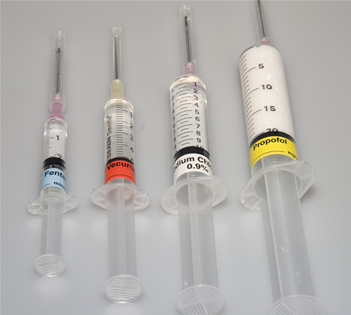
General Anesthesia
Intravenous
Slower acting
Dissociative anesthesia
Opioid analgesia
Benzodiazepines
Thiopental
Methohexital
Propofol
Etomidate
Droperidol
Ketamine
Fentanyl
Diazepam
Lorazepam
Midazolam
Inducing agents

Slide 40
Intravenous anesthetics
Ultra short acting barbiturates e.g. thiopental, methohexital
Benzodiazepines (diazepam, lorazepam, midazolam)
Opioids (fentanyl)
Ketamine
Propofol
Etomidate
Prof. Hanan Hagar
10/9/2018

Slide 41
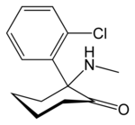
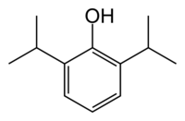
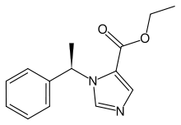
Structures
Intravenous
Etomidate
Ketamine
Propofol

Slide 42
Intravenous anesthetics
NO need for special equipments.
Rapid induction & recovery EXCEPT benzodiazepines
Injected slowly (rapid induction).
Recovery is due to redistribution from CNS.
Analgesic activity: Opioids & ketamine
Amnesic action: benzodiazepines & ketamine.
Can be used alone in short operation & Outpatients anesthesia.
Prof. Hanan Hagar
10/9/2018

Slide 43
Character s of intravenous anaesthetic drugS
Drug | Induction and recovery
Thiopental | Fast onset, slow recovery, hangover
Etomidate | Fast onset, fairly fast recovery, less hangover
Propofol | Fast onset, rapidly metabolized, very fast recovery
Ketamine | Slow onset, Dissociative anesthesia Produces good analgesia and amnesia.
Fentanyl | Slow onset
Midazolam | Slower onset than other agents, has amnesic effect

Slide 44
Ultrashort acting barbiturates
e.g. Thiopental, Methohexital
Rapid onset of action 1 min (high lipid solubility).
Ultra short duration of action 15 - 20 min
Metabolized slowly by the liver (slow recovery)
Potent anesthetic.
CNS: ↓ ICP (Used in head injuries).
CVS collapse & respiratory depression, precipitate porphyria attack, hypersensitivity reaction.
Used for induction in major surgery and alone in minor surgery.

Slide 45
Propofol
Hypnotic (Non Barbiturate).
Rapid onset, short duration of action, Faster recovery than thiopental
Rapidly metabolized in liver (10 times - Elimination ½ = 30 – 60 min).
Decreases ↓ ICP
Has Antiemetic action.
Side Effects
Hypotension (↓PVR).
Excitation (involuntary movements), Pain at site of injection
Expensive, Clinical infections due to bacterial contamination
Prof. Hanan Hagar
10/9/2018

Slide 46
Benzodiazepines
e.g. Midazolam, Diazepam , Lorazepam
No pain, have anxiolytic and amnesic action
Slow induction & recovery.
Cause respiratory depression.
Used in induction of general anesthesia.
Alone in minor procedure (endoscopy).
In balanced anesthesia (Midazolam).
Prof. Hanan Hagar
10/9/2018

Slide 47
Etomidate
Ultrashort acting hypnotic (Non Barbiturates).
Rapid onset of action, short duration of action.
Rapidly metabolized in liver (less hangover).
Minimal CVS and respiratory depressant effects.
Involuntary movements during induction (diazepam).
Postoperative nausea & vomiting.
Pain at sit of injection.
Adrenal suppression
Prof. Hanan Hagar
10/9/2018

Slide 48
ketamine
Dissociative anesthesia (Analgesic activity, amnesic action, immobility, complete separation from the surrounding environment).
Rapid onset of action, short duration, is given IV, IM (Children).
↑ BP & cardiac output (↑central sympathetic activity).
↑ Increases plasma catecholamine levels, ↑ ICP
Potent bronchodilator (asthmatics).
Used in (hypovolemic, shock & elderly) patients.
Post operative hallucination vivid dreams & disorientation &illusions
Risk of hypertension & cerebral hemorrhage, ↑ ICP
Prof. Hanan Hagar
10/9/2018

Slide 49
Opiate drugs
Fentanyl, Alfentanil, Sufentanil, Remifentanil
Rapid onset, Short duration of action, Potent analgesia.
Uses
Neuroleptanalgesia (Fentanyl + Droperidol ).
Neuroleptanesthesia (Fentanyl+Droperidol+ nitrous oxide).
Side Effects
Respiratory depression, bronchospasm (wooden rigidity).
Hypotension, nausea & vomiting
Prof. Hanan Hagar
10/9/2018

Slide 50
Contraindication
1. Head injuries.
2. Pregnancy.
3. Bronchial asthma.
4. Chronic obstructive lung diseases.
5. Hypovolemic shock (Large dose only).
Prof. Hanan Hagar
10/9/2018

Slide 51
Neuroleptanalgesia
A state of analgesia, sedation and muscle relaxation without loss of consciousness.
used for diagnostic procedures that require cooperation of the patient.
Innovar (Fentanyl + Droperidol ).
Contraindicated in parkinsonism.
Neuroleptanesthesia
A combination of (Fentanyl + Droperidol + nitrous oxide).
Prof. Hanan Hagar
10/9/2018

Slide 52
EFFECTS OF INTRAVENOUS DRUGS ON CVS SYSTEM
Drug | Systemic BP | Heart rate
Propofol Thiopental | ↓ | ↓
Etomidate | No change or slight ↓ | No change
Ketamine | ↑ | ↑
Prof. Hanan Hagar
10/9/2018

Slide 53
Side effects of intravenous anaesthetic drug
Drug | Main side effects
Thiopental | CVS collapse and respiratory depression (Laryngospasm, bronchospasm), porphyria
Etomidate | Adrenocortical suppression, Excitatory effects during induction pain at site of injection, Post-operative NV
Propofol | CVS and respiratory depression, Excitation (involuntary movements) Pain at injection site, expensive.
Ketamine | Psychotomimetic effects following recovery (vivid dreams, hallucination) Postoperative nausea, vomiting，salivation Risk of hypertension and cerebral hemorrhage
Midazolam | Slow induction & recovery Minimal CVS and respiratory depression
Opioids Fentanyl | Respiratory depression, Bronchospasm (wooden rigidity). Hypotension, Nausea & vomiting, Increase in ICP, Urinary retention. Prolongation of labor & fetal distress.

Slide 54
Contraindication of intravenous anaesthetic drugs
Drug | Contraindications
Thiopental | Porphyria, severe hypotension (hypovolemic & shock patient) Chronic obstructive lung disease.
Propofol | CVS and respiratory depression
Fentanyl | Head injuries, Pregnancy, Bronchial asthma, Chronic obstructive lung diseases. Hypovolemic shock (Large dose only).
Ketamine | CV diseases (hypertension-stroke). Head injuries.
Midazolam | Respiratory patients

Slide 55
Thank you

