Slide 1
Pathophysiology of Epilepsy

Slide 2
Seizures
Epilepsy

Slide 3
Definition
Seizure (Convulsion)
Clinical manifestation of synchronised electrical discharges of neurons
Seizures are symptoms of a disturbance in brain function , which can be due to epilepsy or other causes
A seizure is a sudden surge in electrical activity in the brain that causes an alteration in sensation, behavior, or consciousness

Slide 4
Epilepsy
Present when 2 or more unprovoked seizures occur at an interval greater than 24 hours apart
Sudden recurrent episodes of sensory disturbance
Loss of consciousness, or convulsions
Associated with abnormal electrical activity in the brain

Slide 5
Abnormal , excessive electrical discharge of a group of neurons within the brain.
When a person has recurrent ( 2 or more) , unprovoked seizures → “ epileptic “.
Hence seizures can be a symptom of epilepsy

Slide 6
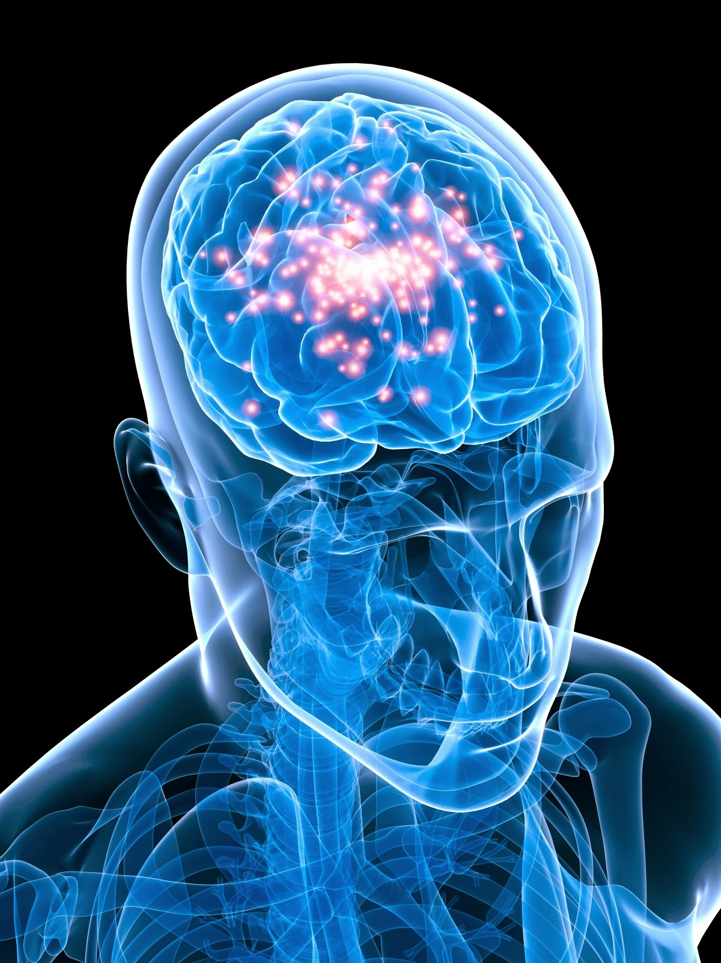
Definition
Provoked seizures
Seizures induced by somatic disorders originating outside the brain
E.g. fever, infection, syncope, head trauma, hypoxia, toxins, cardiac arrhythmias

Slide 7
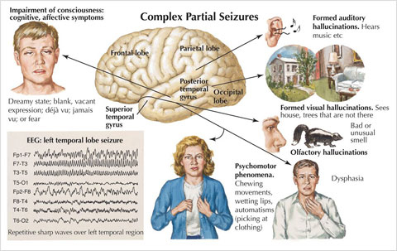

Slide 8
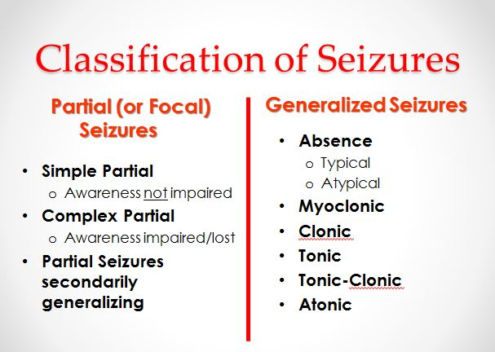
Seizures
Partial
or
Generalized

Slide 9
Focal / Partial seizures → their onset ( start) is limited to part of the cerebral hemisphere
Generalized seizures → those that involve the cerebral cortex diffusely ( whole of it ) from the beginning (generalized seizures)

Slide 10
partial seizures
a. Simple partial seizures
manifest
motor, somatosensory, and psychomotor symptoms
without impairment of consciousness
b. Complex partial seizures
manifest
impairment of consciousness with or without simple partial symptoms

Slide 11
Generalized seizures
Manifest a loss of consciousness
Concvulsive or non-convculsive
(1) Generalized tonic-clonic seizures
(Grand Mal epileptic seizure )
(2) Absence seizures
(Petit mal epileptic seizures)

Slide 12
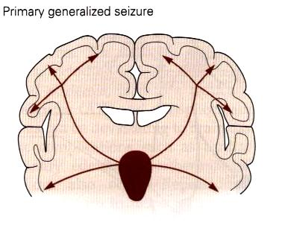
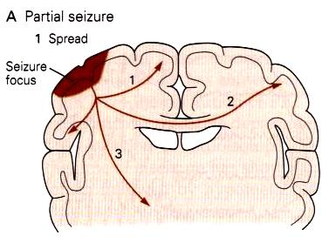
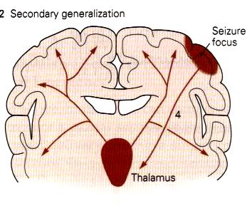

Slide 13
The onset of a seizures:
Small group of abnormal neurons undergo
Prolonged depolarizations
Rapid firing of repeated action potentials
Spread to adjacent neurons or neurons with which they are connected into the process.

Slide 14
Generalized
1- Generalized tonic-clonic (grand mal) seizure
+/- aura
(peculiar sensation or dizziness; then sudden onset of seizure with loss of consciousness)
Tonic phase : Rigid muscle contraction in which clenched jaw and hands; eyes open with pupils dilated; lasts 30 to 60 seconds
Clonic phase: Rhythmic, jerky contraction and relaxation of all muscles in with incontinence and frothing at the lips; may bite tongue or cheek, lasts several minutes.
Postictal state: Sleeping or dazed for up to several hours.

Slide 15
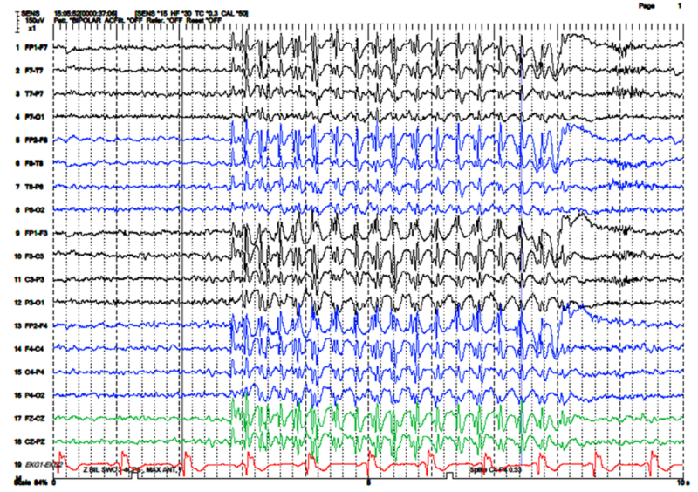

Slide 16
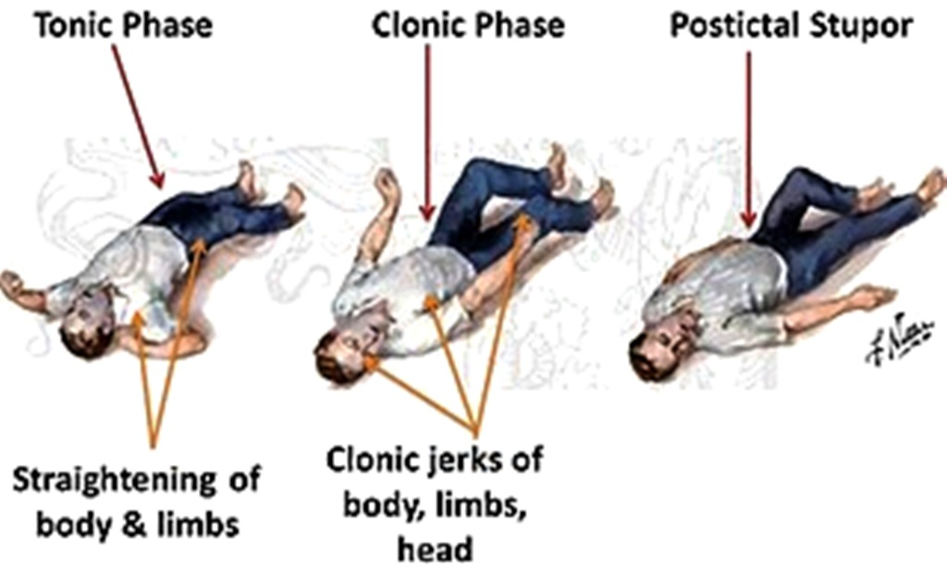
A clinical seizure occurs when the electrical discharges of a large number of cells become abnormally linked together, creating a storm of electrical activity in the brain.
Seizures may then spread to involve adjacent areas of the brain or through established anatomic pathways to other distant areas.

Slide 17
2. Absence ( petit mal) seizure
a. Loss of contact with environment for 5 to 30 seconds.
b. Appears to be day dreaming or may roll eyes, nod head, move hands, or smack lips.
c. Resumes activity and is not aware of seizure.

Slide 18
The clinical manifestations of a seizure reflect the area of the brain from which the seizure begins (i.e., seizure focus) and the spread of the electrical discharge.

Slide 19
Clinical manifestations accompanying a seizure are numerous and varied, including →
(1) indescribable bodily sensations,
(2) "pins and needles" sensations,
(3) smells or sounds,
(4) fear or depression,
(5) hallucinations,
(6) momentary jerks or head nods,
(7) staring with loss of awareness, and
(8) Convulsions → i.e., involuntary muscle contractions) lasting seconds to minutes.

Slide 21
Aetiology of seizures
Epileptic
Idiopathic (70-80%)
Cerebral tumor
Neurodegenerative disorders
Secondary to
Cerebral damage: e.g. congenital infections, intraventricular hemorrhage
Cerebral dysgenesis/malformation: e.g. hydrocephalus

Slide 22
Aetiology of seizures
Non-epileptic
Febrile convulsions
Metabolic
Hypoglycemia
HypoCa, HypoMg, HyperNa, HypoNa
Head trauma
Meningitis
Encephalitis
Poisons/toxins

Slide 23
Pathophysiology of Epilepsy ( at molecular level)
Cortical cell membrane level
Instability of the nerve cell membrane → Polarization abnormalities (excessive polarization ,hypopolarization , or lapses in repolarization), allowing the cell to be more susceptible to activation → Hypersensitive neurons with lowered thresholds for firing and firing excessively , related to →

Slide 24
(1) Excess of Excaitatory ( acetylecholine- or Glutamate –related activity )
(2) Decreased inhibitory ( GABA –related activity)
Together and/or (2) above → leading to instability of cell-membrane & lowered threshold for exciatation → excessive polarization, hypopolarization allowing the cell to be more susceptible to activation spontaneously or by any ionic imbalances in the immediate chemical environment of neurons

Slide 26
Electroencephalogram ( EEG)
EEG ›››› diagnosis, classifying seizures ›››› therapeutic decisions
spikes or sharp waves (Epileptiform EEG patterns)
Focal epileptiform discharges indicate focal epilepsy
Generalized epileptiform activity indicates a generalized form of epilepsy.

Slide 27
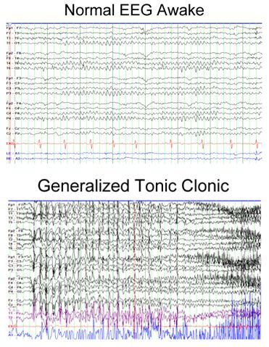
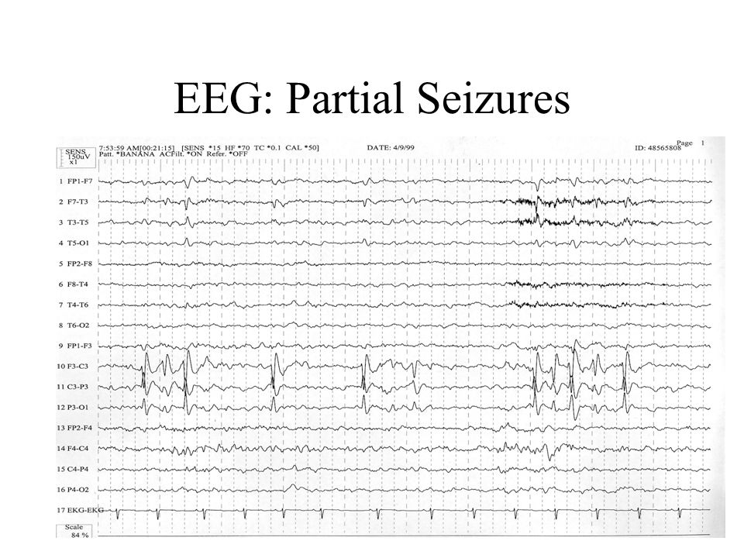

Slide 28
Some types linked to genes
(run in families)
Genetic abnormalities ›››› increasing a person's susceptibility to seizures that are triggered by an environmental factor
Several types of epilepsy have now been linked to defective genes for ion channels, the "gates" that control the flow of ions in to and out of cells and that regulate neuron signaling.

Slide 29
Pathophysiology
Genetic factors
At least 20 %
Some examples
Benign neonatal convulsions--20q and 8q
Juvenile myoclonic epilepsy--6p
Progressive myoclonic epilepsy--21q22.3

