Slide 1
Brachial & Lumbosacral Plexuses
Prof. Saeed Abuel Makarem.

Slide 2
Objectives
By the end of this lecture, you should be able to :
Describe the formation of brachial plexus (site, roots)
List the main branches of brachial plexus.
Describe the formation of lumbosacral plexus (site, roots)
List the main branches of lumbosacral plexus.
Describe some important applied Anatomy related to the brachial & lumbosacral plexuses.

Slide 3
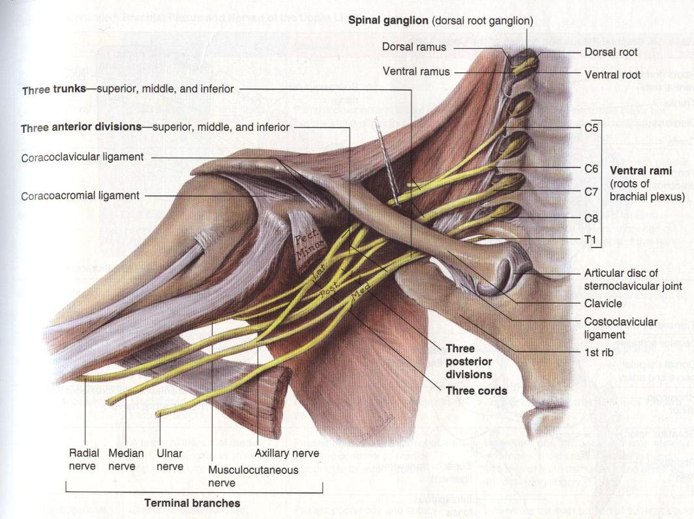
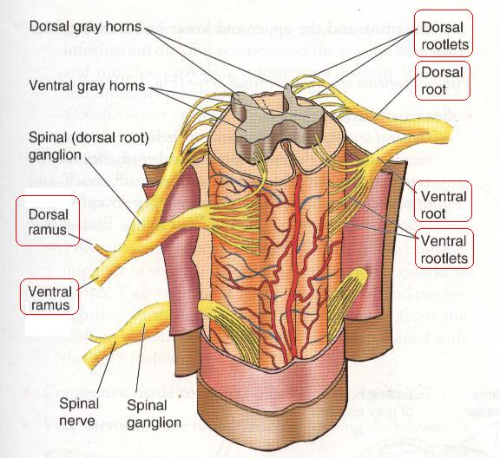
Formation of Brachial Plexus
It is formed within the posterior triangle of the neck.
It is formed by the union of the anterior rami of cervical 5th ,6th ,7th ,8th & 1st thoracic spinal nerves.

Slide 4
Stages of the plexus
The plexus is divided into 5 stages:
Roots.
Trunks.
Divisions.
Cords.
Branches.

Slide 5
Brachial Plexus
Long Thoracic (C5,6,7)
Dorsal Scapular(C5)
Nerve to Subclavius(C5,6)
upper
trunk
Suprascapular(C5,6)
Roots
lateral Cord
(2LM)
C5
C6
middle
trunk
C7
lower
trunk
C8
posterior Cord
(ULTRA)
T1
medial Cord
(4MU)
Anterior divisions
Posterior divisions

Slide 6
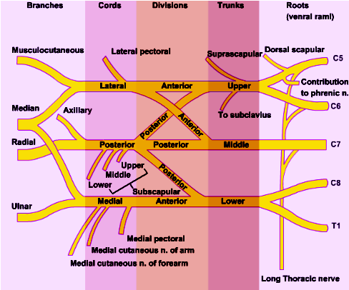
The Plexus can be divided into 5 stages:
Roots: in the posterior∆ of the neck.
Trunks: in the posterior∆ of the neck.
Divisions: behind the clavicle.
Cords: in the axilla.
Branches: in the axilla.
The first 2 stages lie in the posterior triangle, while the last 2 sages lie in the axilla.

Slide 7
Branches from Roots
1. Nerve to rhomboids (dorsal scapular nerve) C5.
2. Long thoracic nerve C5, 6 & 7.
Branches from Trunk
Nerve to Subclavius.
Suprascapular nerve, (supplies supraspinatus & infraspinatus).

Slide 8
Branches of Cords
Lateral Cord
(2LM)
.Lateral pectoral nerve.
.Lateral root of median nerve.
.Musculocutaneous nerve.
C5
C6
C7
C8
T1
Posterior Cord
(ULTRA)
.Upper subscapular n
.Lower subscapular n
.Thoracodorsal n
.Radial n
.Axillary n
Medial cord
(4MU)
.Medial pectoral n.
.Medial root to median n.
.Medial cutaneous n of arm.
.Medial cutaneous n of forearm.
.Ulnar n.

Slide 9
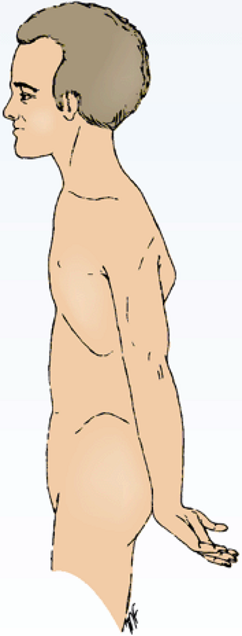
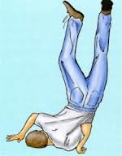
Brachial Plexus Injuries
Upper Lesions of the Brachial Plexus
Upper Trunk C5,6 (Erb-Duchenne Palsy ”waiter's tip position”.
Resulting from traumatic injury to the upper part of the brachial plexus resulting from excessive displacement of the head to the opposite side and depression of the shoulder on the same side (a blow or fall on shoulder or obstructed Labour).
The position of the upper limb in this condition has been compared to that of a porter or waiter hinting for a tip or policeman’s tip hand.
The arm hangs by the side and is rotated medially. The forearm is extended and pronated.
Erb-Duchenne’s paralysis due to injury of Upper Trunk of Brachial Plexus.

Slide 10
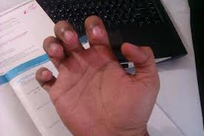
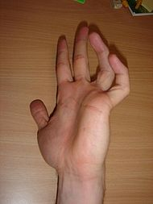
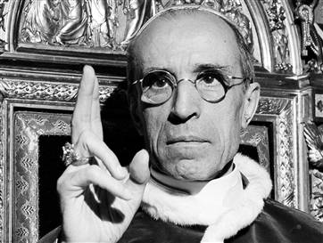
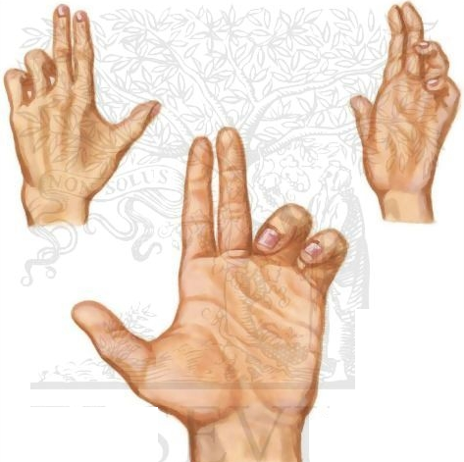
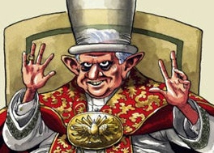
Brachial Plexus Injuries
Lower Lesions of the Brachial Plexus, (Klumpke Palsy)/LowerTrunk (C8,T1)Lesion .
Lower lesions of the brachial plexus are usually traction injuries caused by a person falling from a height clutching at an object to save himself.
The first thoracic nerve is usually torn.
The nerve fibers from this segment run in the ulnar and median nerves to supply all the small muscles of the hand. The hand has a clawed appearance due to ulnar nerve injury
Claw Hand
Claw Hand
Hand of Benediction or Pop’s Blessings (APE HAND) will result from median nerve injury.

Slide 11
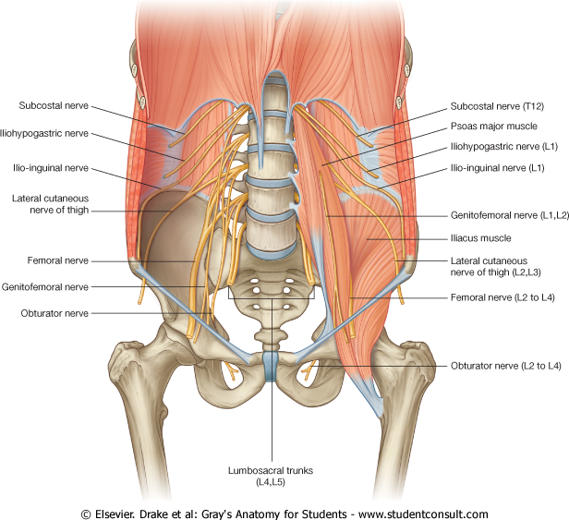
LUMBAR PLEXUS
Formation:
By ventral rami of upper 4 lumbar nerves (L1, 2, 3 and most of L4).
Site:
Within the substance of psoas major muscle.
Main branches:
Iliohypogastric & ilioinguinal (L1):
to anterior abdominal wall.
Obturator (L2,L3 & L4):
to medial compartment of the
thigh
Femoral (L2,L3 & L4):
to anterior compartment of the thigh

Slide 12
FEMORAL NERVE
Origin:
A branch from lumbar plexus (L2,3,4).
Course:
Descends lateral to psoas major.
Enters the thigh behind the middle of the inguinal ligament.
Passes lateral to femoral artery outside the femoral sheath.
It divides into anterior & posterior divisions.

Slide 13
FEMORAL NERVE INJURY
Motor effect:
Wasting of quadriceps femoris.
Loss of extension of knee.
Weak flexion of hip (psoas major is intact).
Sensory effect:
Loss of sensation over antero-medial aspect of thigh & medial side of leg & foot (areas supplied by the femoral nerve).

Slide 14
SACRAL PLEXUS
Formation:
By ventral rami of a part of L4 & whole L5 (lumbosacral trunk) + S1, 2, 3 and most of the S4.
Site:
In front of piriformis muscle.

Slide 15
SACRAL PLEXUS
Main branches:
Pelvic splanchnic nerve preganglionic parasympathetic to pelvic viscera & hindgut.
Pudendal nerve
to perineum.
Sciatic nerve
to lower limb.

Slide 16
SCIATIC NERVE The largest nerve of the body
Origin:
from sacral plexus (L4, 5, S1, 2, & 3).
Course:
Leaves the pelvis through greater sciatic foramen, below piriformis.
Passes in the gluteal region midway between ischial tuberosity & greater trochanter.
Then it passes to the posterior compartment of thigh.
Divides into:
Tibial nerve.
Common peroneal (fibular) nerve.
Ischial tuberosity

Slide 17
TIBIAL NERVE
Course:
Descends through popliteal fossa to posterior compartment of leg, accompanied with posterior tibial vessels.
Passes deep to the flexor retinaculum to reach the sole of foot where it divides into 2 terminal branches:
Medial planter nerve.
Lateral Planter nerve.

Slide 18
COMMON PERONEAL (FIBULAR) NERVE
Course:
Leaves popliteal fossa & turns around the lateral aspect of neck of fibula (Dangerous position).
Then divides into 2 terminal branches:
Superficial peroneal: descends into lateral compartment of leg.
Deep peroneal: descends into anterior compartment of leg.

Slide 19
SUMMARY
The lumbar plexus is formed by ventral rami of L1,2,3 and most of L4, in substance of psoas major muscle
The sacral plexus is formed by ventral rami of a part of L4 & whole L5 (lumbosacral trunk) plus the S1,2,3 and most of S4, in front of piriformis muscle.
The femoral nerve, a branch of lumbar plexus (L2,3,4).
Its injury will lead to weak flexion of hip & loss of extension of knee as well as loss of sensation of skin of anteromedial aspects of the thigh, medial side of knee, leg and foot
The sciatic nerve is a branch of sacral plexus (L4,5, S1,2,3)
Its injury will affect the flexion of knee, extension of hip, all movements of leg & foot, as well as loss of sensation of skin of leg & foot (except areas supplied by saphenous branch of femoral nerve)

Slide 20
Thank you
And
Good Luck

Slide 21
1. Lesion of the upper trunk of the brachial plexus leads to :
Klumpke palsy.
Erb-Duchenne palsy
Drop wrist & hand.
Ape hand.
2. Which one of the following nerves is a branch of posterior cord of brachial plexus?
Ulnar
Radial
Median
Musclocutanous

Slide 22
QUESTION 3
The femoral nerve supplies:
Extensors of hip.
Skin of dorsum of foot.
Hamstrings.
Extensors of knee

Slide 23
QUESTION 4
Injury of common peroneal nerve leads to:
Loss of dorsiflexion of ankle
Loss of inversion of foot
Loss of extension of knee
Loss of flexion of toes

