Slide 1
Microbiology of Middle Ear Infections
Dr Ali M Somily

Slide 2
Objectives
Recognize the definition and classification of otitis media
Define the epidemiology of otitis media
identify the pathogenesis and risk factors
List the major symptoms and signs in the clinical presentation and major etiological agents
identify the method of diagnosis and management of otitis media

Slide 3
Definitions
Middle ear is the area between the tympanic membrane and the inner ear including the Eustachian tube.
Otitis media (OM) is inflammation of the middle ear.

Slide 4
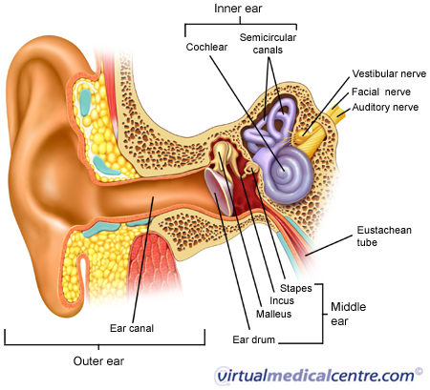
Anatomy of the Middle Ear

Slide 5
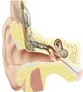
OM-Classification
Acute OM
Secretory ( Serous) OM
Chronic OM

Slide 6
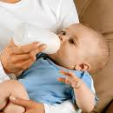
OM- Epidemiology
Most common in infants 6 to 18 months of age (2/3 of cases). Improves with age, why ?
The Eustachian Tube which vents the middle ear to the nasopharynx , is horizontal in infants, difficult to drain naturally, its surface is cartilage ,and lymphatic tissue lining is an extension of adenoidal tissue from back of the nose.
Accompanied with viral URTI

Slide 7
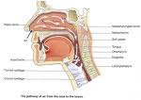
OM-Pathogenesis and Risk Factors
URTI or allergic condition cause edema or inflammation of the tube.
Functions of the tube ( ventilation, protection and clearance ) disturbed.
Oxygen lost leading to negative pressure
Pathogens enter from nasopharynx into middle ear.
Colonization and infection result.

Slide 8
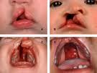
OM- Other risk factors
Anatomic abnormalities
Medical conditions such as Cleft palate ,obstruction due to adenoid or NG tube or malignancy, immune dysfunction.
Exposure to pathogens from day care.
Exposure to smoking.

Slide 9
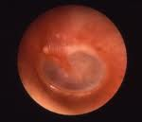
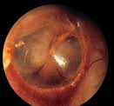
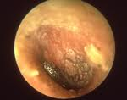
Images of acute OM

Slide 10
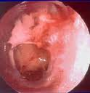
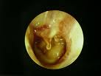
Images of chronic OM

Slide 11
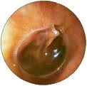
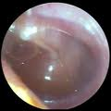
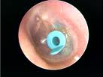
Images of serous OM

Slide 12
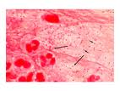
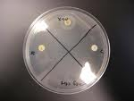
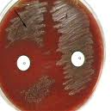
Microbiology of OM

Slide 13
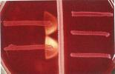
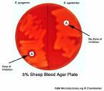
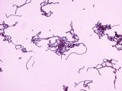
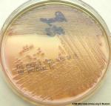
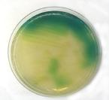
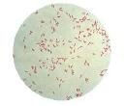
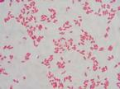
Microbiology of OM-continue

Slide 14
OM-Microbiology-Bacterial Causes
Acute OM
< 3months of age
> 3 months of age
S.pneumoniae,(40%) group B Streptococcus, H.influenzae (non typable) ,Gram negative bacteria and P.aeruginosa
S.pneumoniae, H.influenzae ,others eg, S.pyogenes, Moraxella catarrhalis, S.aureus

Slide 15
OM-Microbiology-cont.
Chronic OM
Serous OM
Mixed flora in 40% of cases
P.aeruginosa, H.influenzae, S.aureus, Proteus species, K.pneumoniae, Moraxella catarrhalis, anaerobic bacteria.
Same as chronic OM, but
Most of the effusions are sterile
Few acute inflammatory cells

Slide 16
OM-Viral causes
RSV -74% of viral isolates
Rhinovirus
Parainfluenza virus
Influenza virus

Slide 17
Clinical presentation
Acute OM
Mostly Bacterial ,often a complication of viral URTI
First 1-2 days:
Fever (39º C), irritability, earache (otalgia)
, muffled nose.
Bulging tympanic membrane ,poor mobility and obstruction by fluid or inflammatory cells on otoscopic examination.

Slide 18
3-8 days:
Pus and ear exudate discharge spontaneously (otorrhea) and pain and fever begin to decrease.
2-4 weeks :
Healing phase, discharge dies up and hearing becomes normal.

Slide 19
Serous OM
Collection of fluid within the middle ear as a result of negative pressure produced by altered eustachian tube function.
Represent a form of chronic OM or allergy-related inflammation
Tends to be chronic , with non –purulent secretions.
Cause hearing deficit.

Slide 20
Chronic OM
Usually result from unresolved acute infection due to in adequate treatment or host factors that perpetuate the inflammatory process.
Result in destruction of middle ear structures and significant risk of permanent hearing loss.

Slide 21
Diagnostic approaches of OM
Clinical examination
Tympanometry ( detect presence of fluid)
Gram stain and culture of aspirated fluid to determine the etiologic agents.

Slide 22
Management of OM
Acute OM requires antimicrobial therapy & careful follow up.
Antimicrobial usually empirical depending on the most likely bacterial pathogens, usually to cove S.pneumonia and H.influenzae.
Drainage of exudate may be required.
Chronic or serous OM need complex management, possibly surgical.

Slide 23
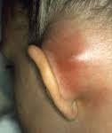
Complications
Extracranial
Intracranial
Hearing loss
Tympanic membrane perforation
Mastoiditis
Cholestatoma
Labyrinthitis
others
Meningitis
Extradural abscess
Sudural empyema
Brain abscess
others

