Slide 1


Drugs used for anxiety and panic disorders
ILOs
Define some types of anxiety disorders
Classify types of drugs used for treatment of anxiety
Discuss the different characteristics of antianxiety drugs

Slide 2
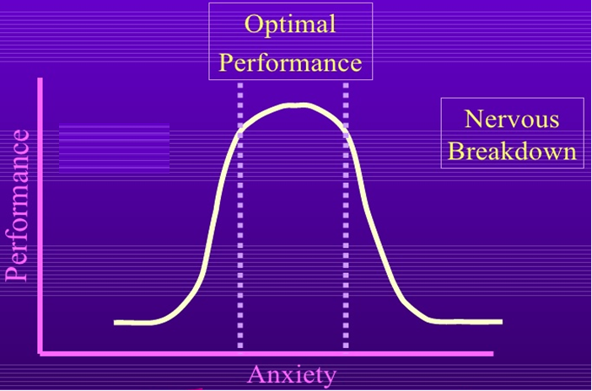
What is anxiety ?
Physical and emotional distress which interferes with normal life.

Slide 3
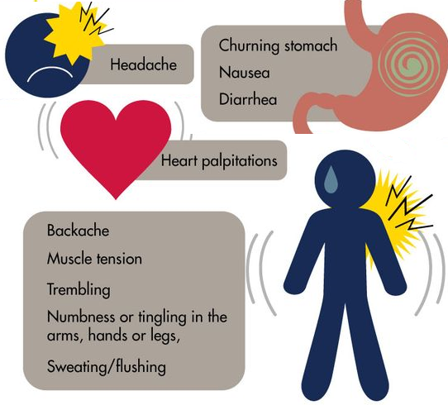
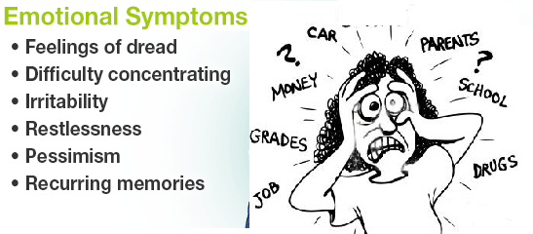
Symtoms of ansiety
1-Somatic
2- Emotional

Slide 4
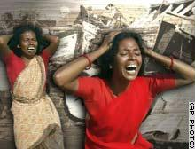
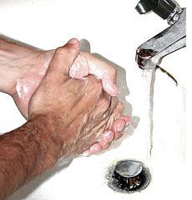
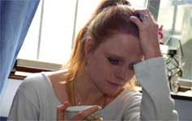
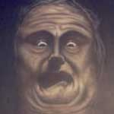
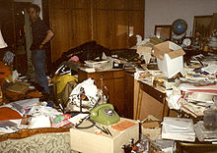
Types of anxiety disorders
1- Generalized anxiety
disorder
2- Panic disorder
4-Post traumatic
stress disorder
3- Phobia
5- Obsessive compulsive
disorder

Slide 5

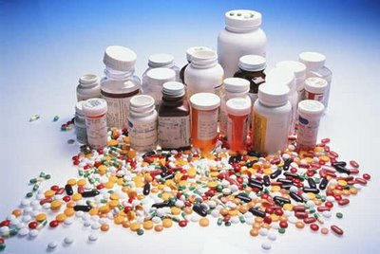
Treatment of anxiety
Psychotherapy
Anxiolytics

Slide 6
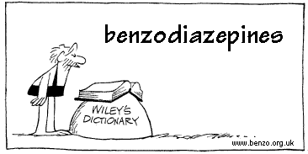

Classification of anxiolytic drugs:
1-Benzodiazepines ( BDZ ).
2-5HT_{1A} agonists.
3-Beta-adrenergic blockers
4-5HT reuptake inhibitors
5-Tricyclic Antidepressants
6-MAO inhibitors

Slide 7
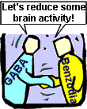
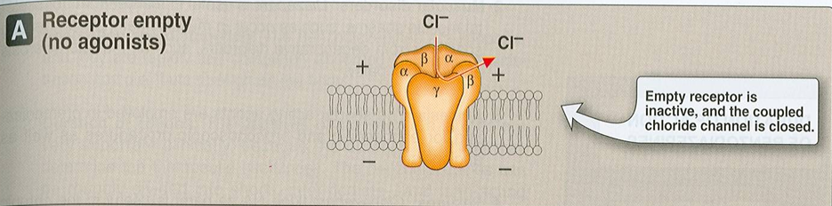
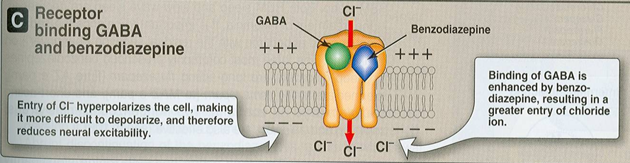
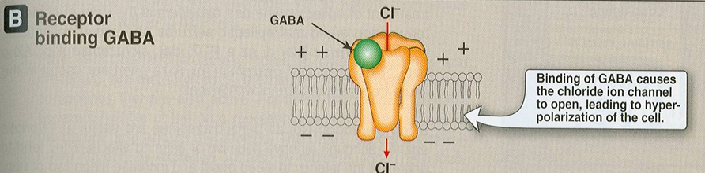
1-Benzodiazepines ( BDZ ).
Mechanism of Action
Benzodiazepines act by binding to BZ
receptors in the brain→ enhance GABA action in the brain

Slide 8
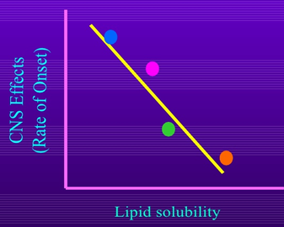
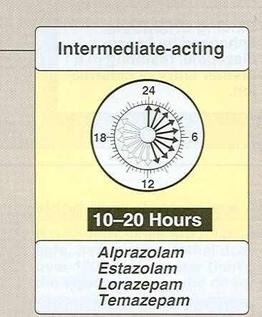
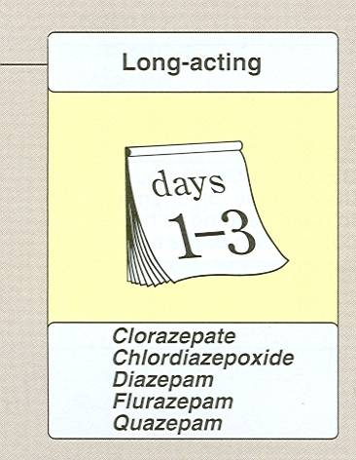
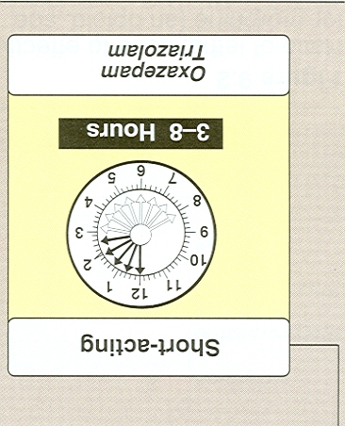
PHARMACOKINETICS
Can be classified according to the duration of action into short, medium & long- acting
Lipid soluble
Well absorbed orally,
Can be given parenterally
Chlordiazepoxide- Diazepam (IV only NOT IM)
Widely distributed
Excreted in milk (neonatal depression).
Cross placental barrier (Fetal depression)

Slide 9
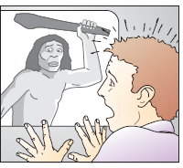
Pharmacological Actions
Anxiolytic action.
Depression of cognitive and
psychomotor function
Sedative & hypnotic actions
Anterograde amnesia
Minimal depressant effects on cardiovascular system & respiratory system
Some have anticonvulsant effect:
  Clonazepam, diazepam.

Slide 10
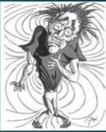
Therapeutic Uses
Anxiety disorders:
Short term relief of severe anxiety
General anxiety disorder
Obsessive compulsive disorder
Panic attack with depression→ Alprazolam (antidepressant effect)
Sleep disorders (Insomnia).
  Triazolam, Lorazepam, Flurazepam
Treatment of epilepsy
Diazepam – Lorazepam

Slide 11
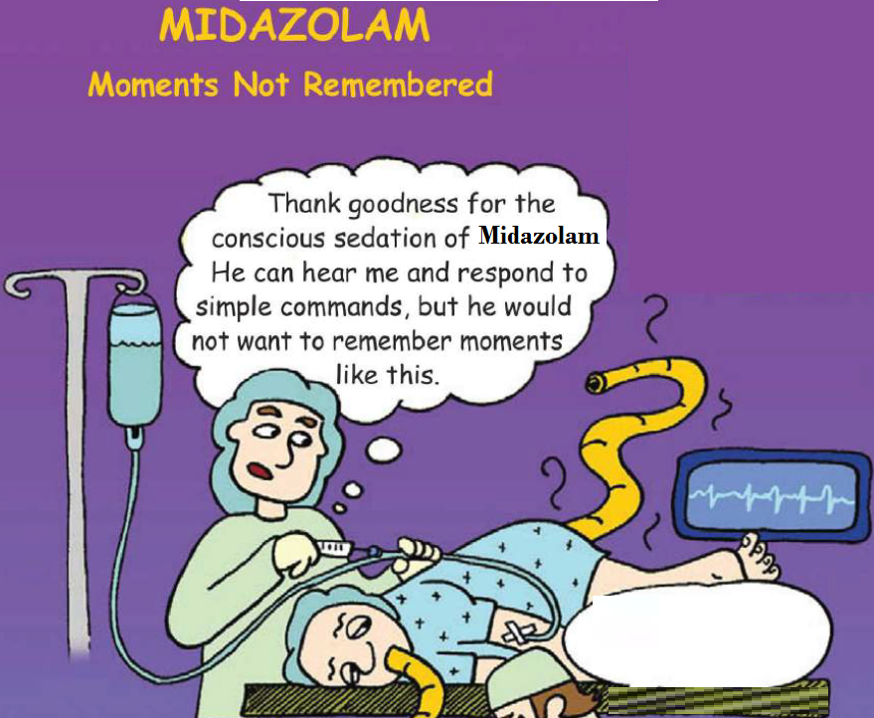
Therapeutic Uses
In anesthesia
Preanesthetic medication (diazepam).
Induction of anesthesia (Midazolam, IV)

Slide 12
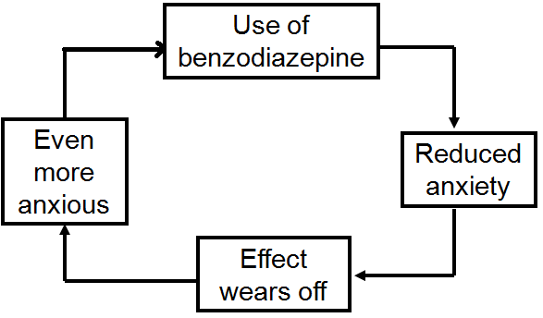
Adverse Effects
Ataxia (motor incoordination)
Cognitive impairment
Hangover: (drowsiness, confusion)
Tolerance & dependence
Risk of withdrawal symptoms(Rebound insomnia, anorexia, anxiety, agitation, tremors and convulsion)

Slide 13
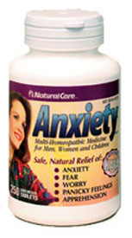

Adverse Effects
Toxic effects: respiratory
cardiovascular depression in large doses.

Slide 14
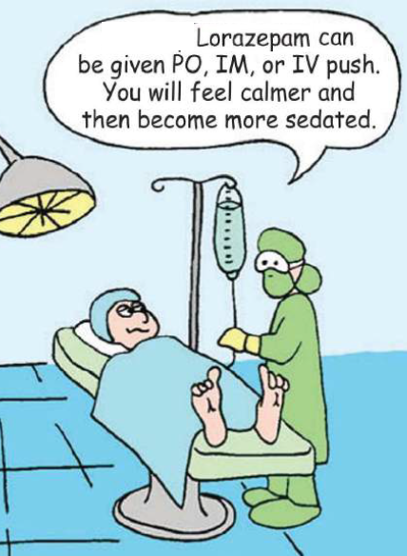
Drug -drug interactions
 | Examples
CNS depressants | Alcohol & Antihistaminics ↑ effect of benzodiazepines
Cytochrome P450 inhibitors | Cimetidine & Erythromycin ↑ t _{½} of benzodiazepines
CYT P450 inducers | Phenytoin & Rifampicin ↓ t _{1/2} of benzodiazepines

Slide 15
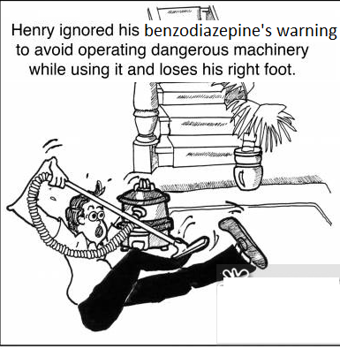
Benzodiazepine antagonist
Flumazenil
Binds competetivly to GABA receptors displacing benzodiazepine
Has a short plasma half life→ repeated dosing
Used in benzodiazepine overdose
Precipitates withdrawal symptoms in benzodiazepine addicts

Slide 16
5HT_{1A} agonists
Buspirone
Acts as a partial agonist at brain 5HT_{1A} receptors, presynapticaly inhibiting 5HT release
Adaptive changes after chronic treatment , reduction in 5HT2 receptors in cortex
Weak dopapamine D2 action , but not antipsychotic

Slide 17
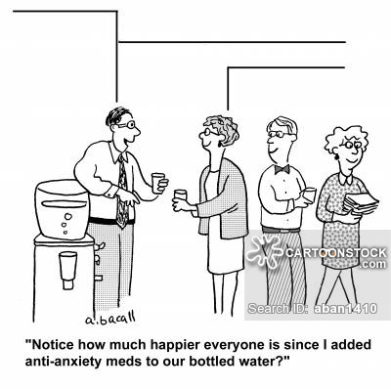
5HT_{1A} agonists
Buspirone
Rapidly absorbed orally.
t½ : (2 – 4 h).
Undergoes extensive hepatic metabolism, some of the metabolites are active
Liver dysfunction → ↓ its clearance

Slide 18
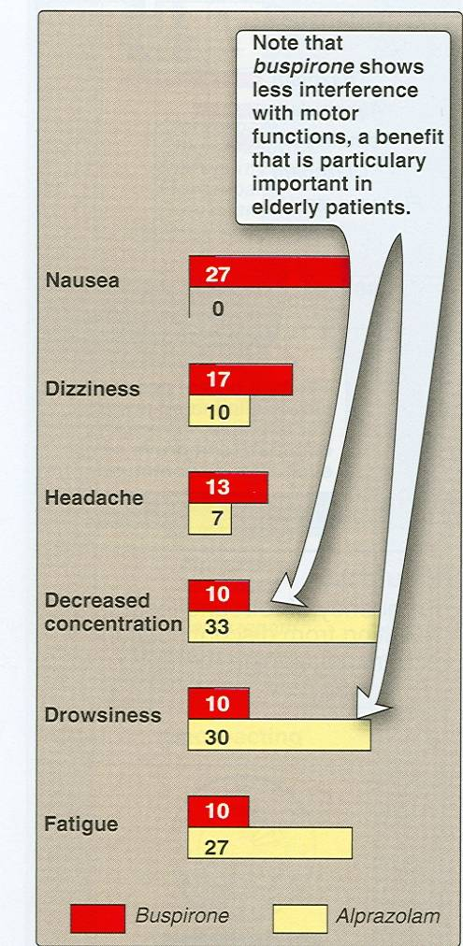
Pharmacodynamic effects
Only anxiolytic
No hypnotic effect.
Not muscle relaxant.
Not anticonvulsant
No potentiation of
Other CNS depressants
No withdrawal signs
Minimal psychomotor &
Cognitive dysfunctions.
Does not affect
driving skills
Minimal risk of dependence

Slide 19
clinical uses
As anxiolytic in mild anxiety & generalized anxiety disorders.

Slide 20
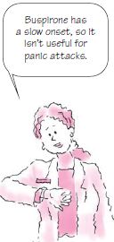
Disadvantages of buspirone
Slow onset of action (delayed effect)
Not effective in severe anxiety/panic disorder
GIT upset, dizziness, drowsiness
Drug Interactions with CYT P450 inducers and inhibitors

Slide 21
Inhibitors of CYP450 3A4 , verapamil, diltiazem→↑ buspirone level
Rifampin cause 10 fold ↓ buspirone level
Increase blood pressure in people taking MAOi
Dose should be reduced in
Liver disease
Old people
Precautions
-Should be used with precaution in
pregnant women or breast-feeding.
-People over 65.

Slide 22
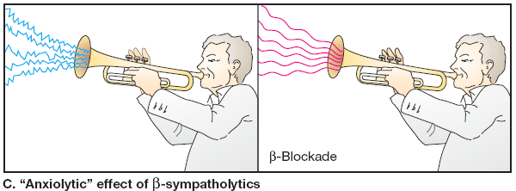
Beta Blockers
Act by blocking peripheral sympathetic system.
Reduce somatic symptoms of anxiety.
Decrease BP & slow HR.
Used in performance anxiety.
Are less effective for other forms of anxiety

Slide 23
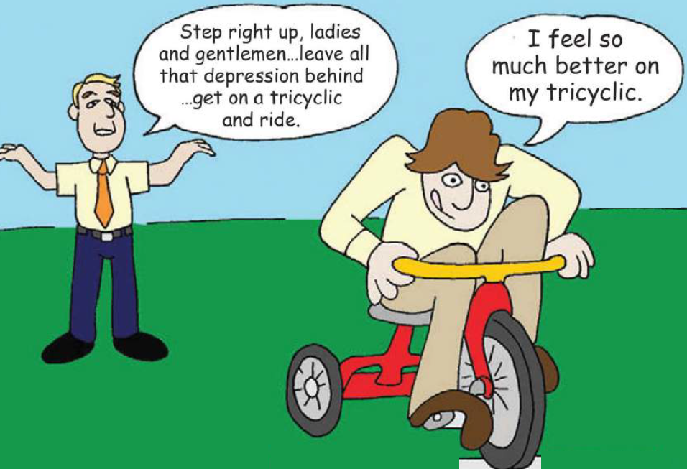
Tricyclic Antidepressants
Doxepin- imipramine – desipramine
Act by reducing uptake of 5HT & NA.
Used for anxiety especially associated with depression.
Effective for panic attacks.
Delayed onset of action (weeks).

Slide 24
ADRS
Atropine like actions (dry mouth-blurred vision).
α-blocking activity (Postural hypotension).
Sexual dysfunction
Weight gain

Slide 25
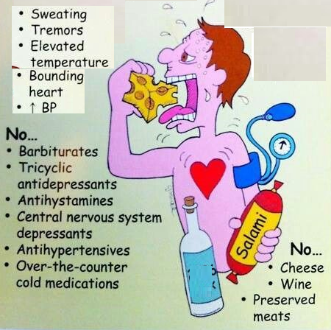
Monoamine oxidase inhibitors (MAOIs)
Phenelzine
Acts by blocking the action of MAO enzymes.
Used for panic attacks and phobia.
Require dietary restriction
Avoid wine, beer, fermented foods and old cheese that contain tyramine.
ADRs
Dry mouth, constipation, diarrhea, restlessness, dizziness.

Slide 26

Selective serotonin reuptake inhibitors (SSRIs)
Fluoxetine
Acts by blocking uptake of 5HT
Orally
Delayed onset of action (weeks).
Long half life
Used for panic disorder – OCD -Generalized anxiety disorders - phobia.

Slide 27
ADRs
Nausea, diarrhea
Weight gain or loss
Sexual dysfunction
Dry mouth
Seizures
Sleep disturbance

Slide 28

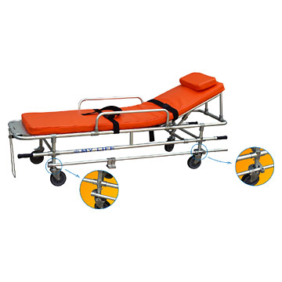
Case
A 22-year-old woman is brought in the emergency department via ambulance because of a suicide attempt. Soon after a “night on the town,” she called her
boyfriend saying that she took a handful of sleeping tablets. On examination, she appears lethargic, but groans and moves all her extremities to painful stimuli.
Her blood pressure is 110/70 mm Hg, heart rate is 80 bp/m, and oxygen saturation is 99 percent. Her pupils are of normal size and reactive to light. Her deep tendon reflexes are normal bilaterally. In the field, she was given an intravenous bolus of dextrose and an ampoule of naloxone without response. Her boyfriend, with whom she had an argument, brings in the bottle of sleeping medication which reads “lorazepam.”

Slide 29
Case
Q1
What is the danger of an overdose
with this class of medication?

Slide 30
Case
Q2
What is the cellular mechanism of action of this class of
medication?

Slide 31
Case
Q3
What pharmacologic agent can be used to treat this patient, and
what is its mechanism of action?

Slide 32
