Slide 1
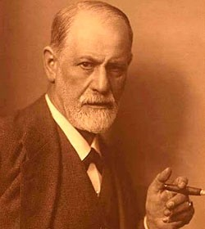
A CASE OF OVERDOSE
Drugs Used In Management Of Pain
His cancer of the jaw was causing him increasingly severe PAIN and agony
Sigmund Freud, the father of psychoanalysis
What effect of morphine caused the death of Sigmund Freud?
Euthenasia
He begged his friend and doctor, Max Schur to relieve him.
His doctor administered increasing doses of MORPHINE that resulted in Freud's death on 23 September 1939

Slide 2
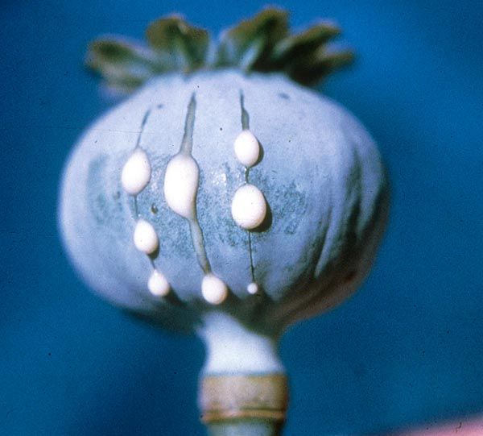
Drugs Used In Management Of Pain
ilos
Categorize the different classes of drugs used to relieve pain
Detail on the mechanism of action, pharmacokinetics and pharmacodynamic effects of morphine and its synthetic derivatives
Hints on the properties and clinical uses of morphine antagonists

Slide 3
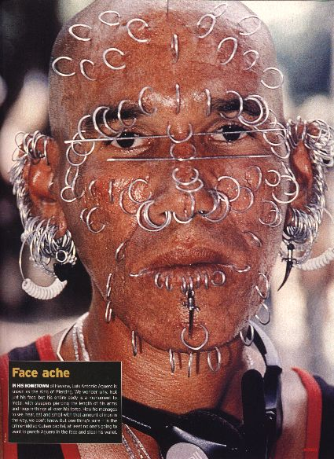
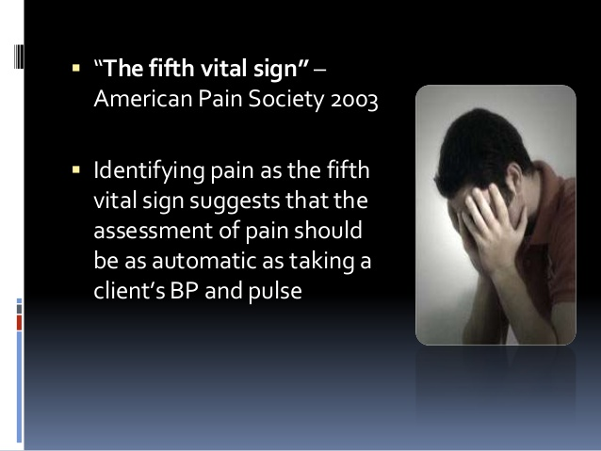
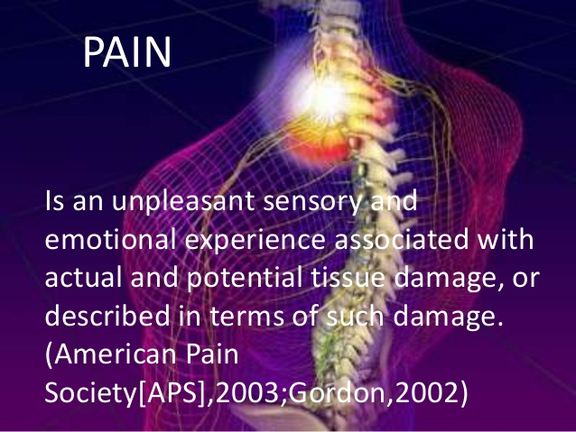
Drugs Used In Management Of Pain
Why should we treat pain?
Pain is a miserable experience
What is pain?
Pain is the most common reason patient seek medical advice
Impairs the patient functional ability & psychological well being
Pain increases sympathetic output
-Increases myocardial oxygen demand
-Increases BP, HR
Pain limits mobility
-Increases risk for DVT/PE

Slide 4
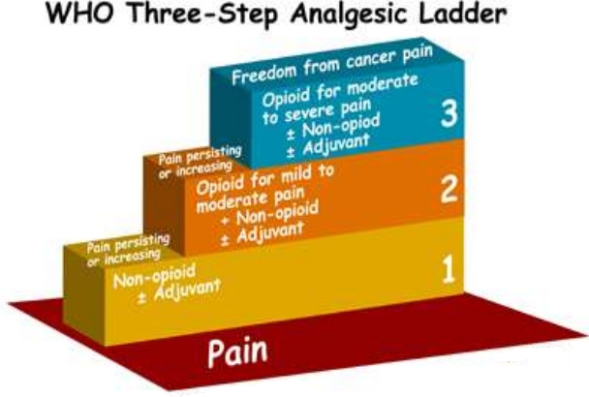
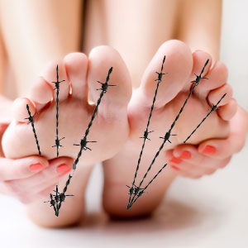
Drugs Used In Management Of Pain
Classes of Drugs Used In Management Of Pain
Side-ffects
NSAIDs
WHO Pain Ladder
Opioids
Analgesia
Adjuvant drugs

Slide 5
NSAIDS
Generally the first class of drugs used for controlling pain
Work at site of tissue injury to prevent the formation of the nociceptive mediators
Can decrease opioid use by ~30% therefore decreasing opioid-related side effects
They neither cause tolerance or dependence
Has a ceilling effect to analgesia

Slide 6
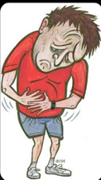
Adjuvant drugs
e.g. Anxiolytics, Neuroleptics,
Antidepressants
Antiepileptics
Primarily indicated for clinical conditions other than pain
May modify the perception of pain
Remove the concomitants of pain such as anxiety, fear, depression

Slide 7

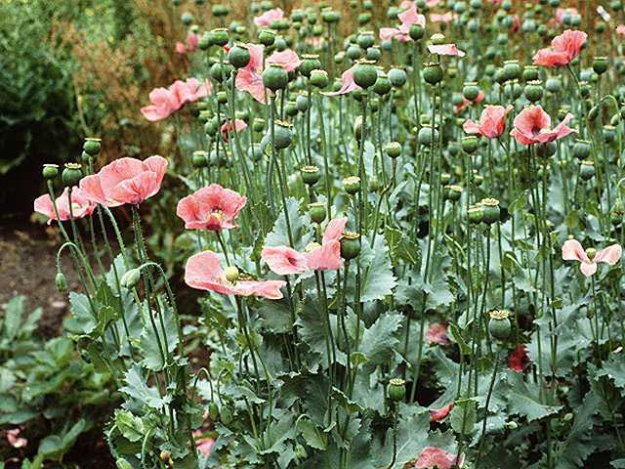
Oioids
Opium is derived from the juice of the opium poppy, Papaver somniferum
The natural products include morphine, codeine,papaverine and thebaine
Opiates are drugs derived from opium and semisynthetic and synthetic derivatives
Opioids refer to opiates and endogenous opioid peptides, e.g.
β− endorphin

Slide 8
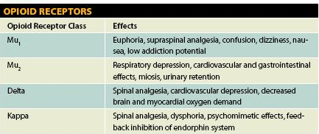
OPIOID RECEPTORS
μ1
μ2
δ
k
ORL-1
Nociceptin receptor
Antagonizes dopamine transport
All of them are typical G-protein coupled receptors

Slide 9
CLASSIFICATION OF OPOIDs
According to their source
According to agonistic/
Antagonistic actions
Natural
Morphine
Semisynthetic
Heroin
According to their specificity of
action on receptors
Agonists; Morphine, Codeine,
Pethidine, Methadone
Synthetic
Pethidine, Methadone
Mixed agonists /antagonists; Pentazocine,
Morphine,codeine, heroin→μ -receptor agonists
Pure antagonist; Nalaxone, Naltraxone,
Pentazocine agonist at k –receptors & antagonist at µ-receptors

Slide 10
Mechanism of action
Binding to presynaptic opioid receptors coupled to Gi  AC & cAMP  voltage-gated Ca²⁺ channels  excitatory transmitter.
Binding to postsynaptic receptors opening of K channels neuronal excitability

Slide 11
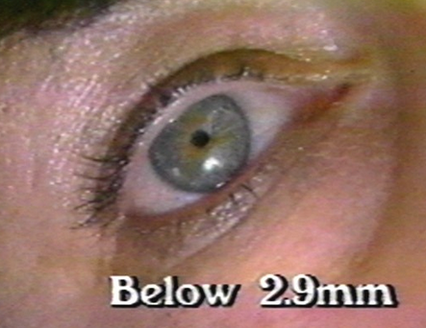
Morphine
Pharmacodynamic Actions
Analgesia [in acute & chronic pain]
Euphoria
Respiratory depression
Depression of cough reflexes
Nausea & vomiting → ↑CRTZ
Pin point pupil
Releases histamine from mast cells
-Effects on GIT:-↑in tone ↓motility →severe constipation
-Contraction of gall bladder +constriction of biliary sphincter →↑pressure in the biliary tract

Slide 12
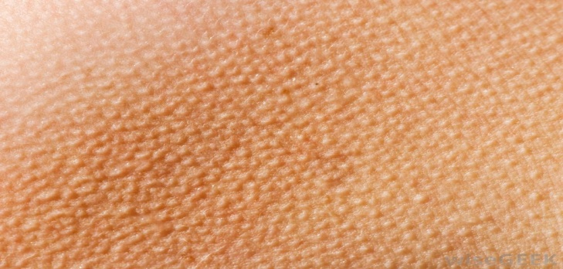
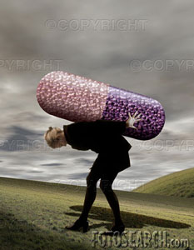
Morphine
TOLERANCE & DEPENDENCE
TOLERANCE
Tolerance occurs rapidly with opioids (with morphine 12–24 hours)
DEPENDENCE
Physical dependence:-
Withdrawal manifestations develops upon stoppage.
Tolerance develops to respiratory depression, analgesia, euphoria and sedation
Lasting for a few days(8-10 days) in form of ↑ body ache, insomnia, diarrhea, goose flesh, lacrimation
Psychological dependence lasting for months / years → craving

Slide 13
Morphine
Pharmacokinetics
t ½ is 2-3h
It is slowly & erratically absorbed orally (bioavailability 20-40%).
-Medically given by SC, IM or IV injection.
Metabolized by conjugation with glucuronic acid
Undergoes enterohepatic recycling,
-crosses BBB
-crosses placenta.

Slide 14
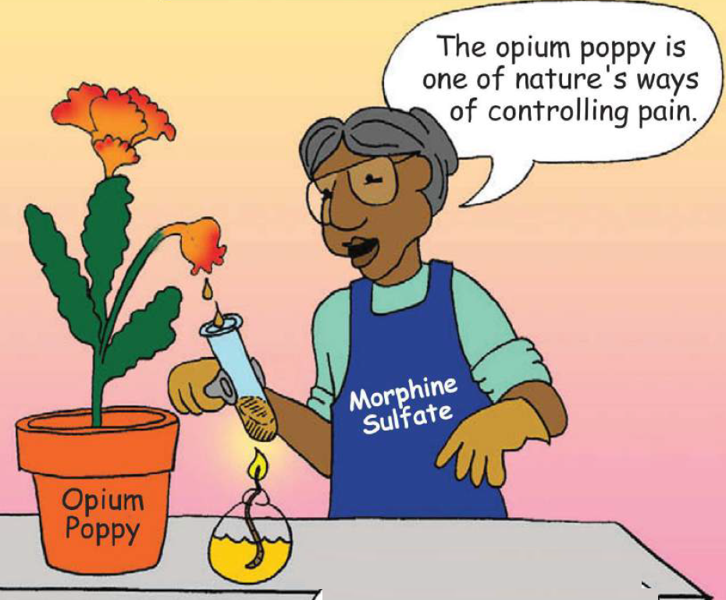
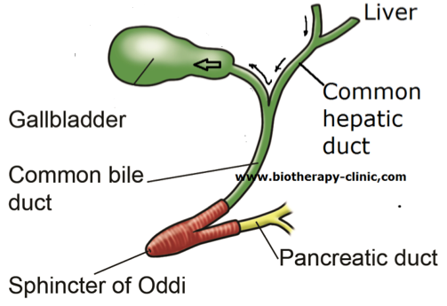
Morphine
Clinical Indications
CONTROL PAIN; cancer pain, severe burns, trauma
Severe visceral pain (not renal/biliary colics, acute pancreatitis )
Acute pulmonary edema
Myocardial ischemia
Non painful coditions e.g. heart failure (to relieve distress)
Preanesthetic medication

Slide 15
Morphine
adrs
constipation
Respiratory depression
itching
C r I n c s
Nausia,vomiting
Constricted pupil
sedation

Slide 16
Morphine
Contrindications
HEAD INJURY
BRONCHIAL ASTHMA or impaired pulmonary function
Biliary colic
Elderly are more sensitive; metabolism, lean body mass &  renal function
With MAOIs
Not given to infants, neonates or during child birth conjugating capacity  accumulate   respiratory

Slide 17
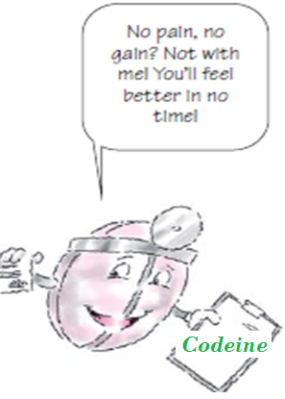
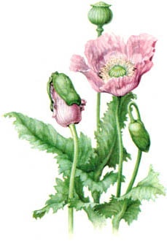
codeine
μ Agonist
Dependence < morphine
Used in mild & moderate pain, cough, diarrhea

Slide 18
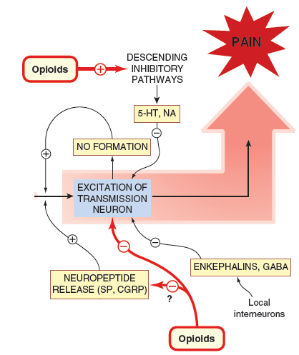
TRAMADOL
Synthetic, μ agonist , less potent than morphine
Indications
Inhibits also NE & 5HT reuptake
ADRs
-Mild - moderate acute & chronic visceral pain
-During labor
Can be given orally; more oral bioavailability
-Seizures (not in epileptics), Nausea , Dry mouth, Dizziness , Sedation
-Less adverse effects on respiratory & C.V.S

Slide 19
Pethidine(mepridine)
Synthetic more effective κ agonist
actions
indications
Less analgesic, constipating , depressant on faetal respiration than morphine
adrs
As in morphine but not in cough & diarrhea
No cough suppressant effect
Tremors, Convulsions, Hyperthermia, Hypotension
Preanaesthetic medication
Has atropine –like action (Smooth muscle relaxant)
Blurred vision, Dry mouth, Urine retention
Used in obstetric analgesia (No  resp.)
Tolerance & Addiction
Used in severe visceral pain; renal & biliary
colics (sm. relaxant)

Slide 20
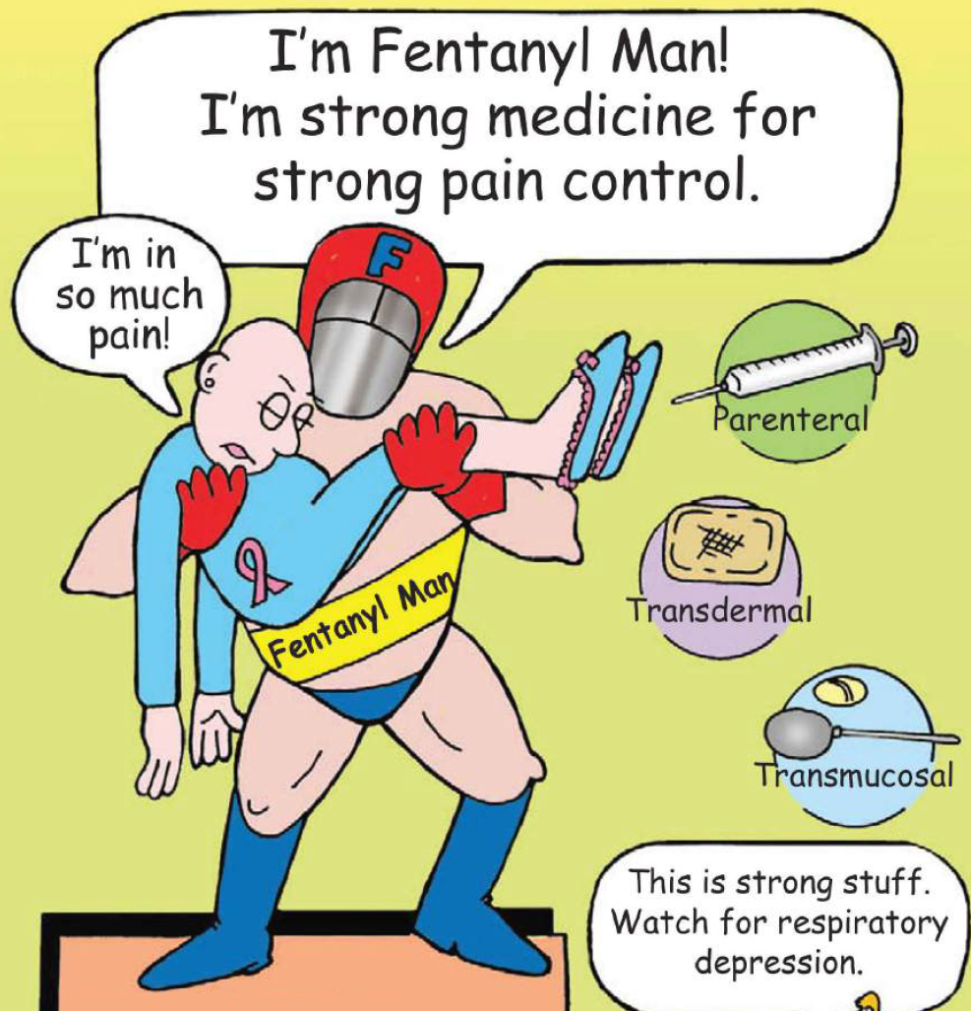

Fentanyl
Synthetic, μ agonist, more potent than pethidine & morphine
Clinical uses
ADRS
Analgesic supplement during anesthesia, (IV or intrathecal)
Respiratory depression (most serious)
CV effects are less.
Bradycardia may still occur
To induce & maintain anesthesia in poor-risk patients [stabilizing heart.]
In combination with droperidol as NEUROLEPTANALGESIA
In cancer pain & severe postoperative pain; (transdermal patch changed every 72 hrs).

Slide 21
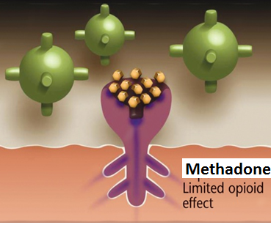
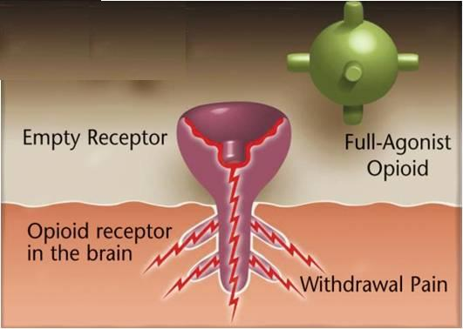
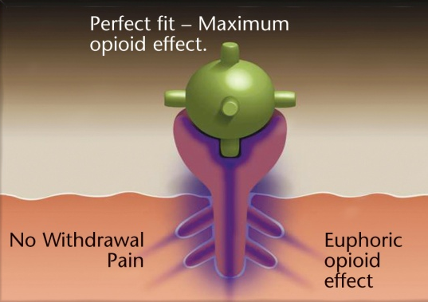
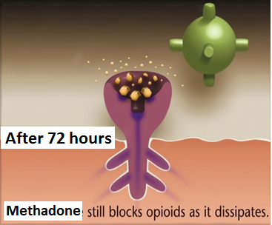
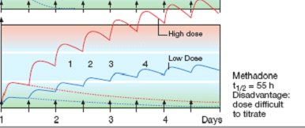
METHADONE
Used to treat opioid withdrawal
Weaker synthetic μ- agonist
In non addicts, it causes tolerance & dependence but not as severe as that of morphine
t½ 55 h
An ADDICT

Slide 22
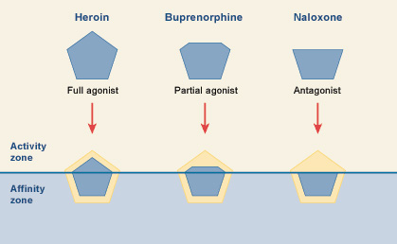
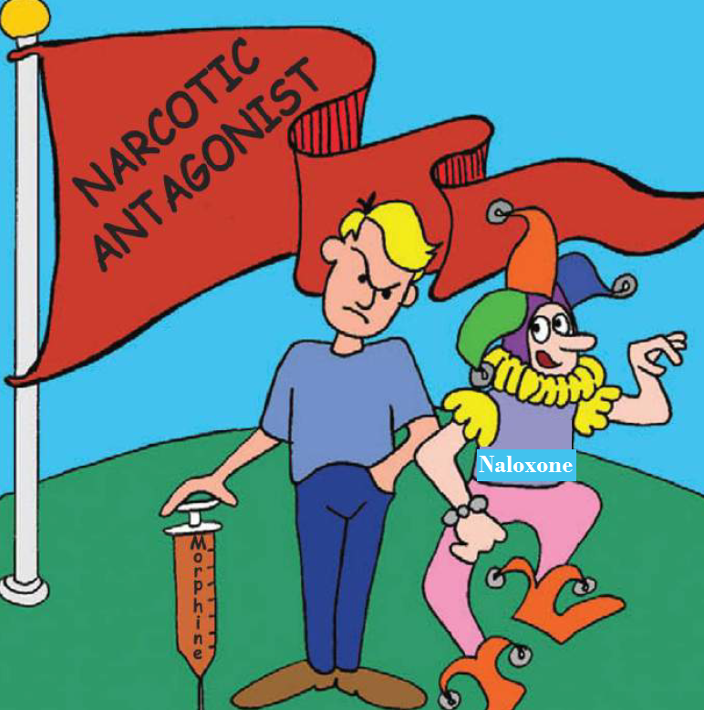
Opioid antagonists
Morphine
Nalorphine
Naloxone

Slide 23
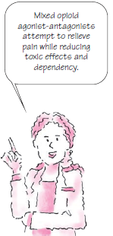
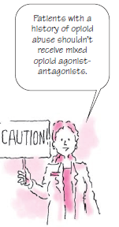
Naloxone
Pure opioid antagonist
Used to treat respiratory depression caused by opioid overdose
To reverse the effect of analgesia on the respiration of the new born baby
Effect lasts only for 2-4 hours
Precipitates withdrawal syndrome in addicts
Naltrexone
Very similar to naloxone but with longer duration of action [t½=10h]

Slide 24
At-121
Experimental analgesic, 100 times more potent than morphine
A bifunctional analgesic , acting as an agonist at both the μ-opioid receptor and the nociceptin receptor
The interaction with the nociceptin receptor blocks the abuse and dependence-related side effects

