Slide 1
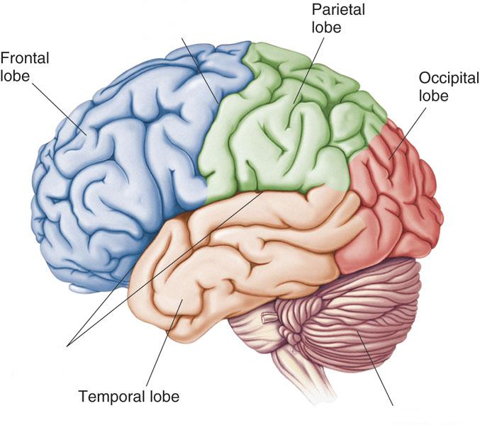
FUNCTIONS OF CEREBRAL
HEMISPHERE
Dr. Salah Elmalik

Slide 2
The Cerebrum
Lobes, the Cerebral Cortex, and Cortical Regions of the Brain

Slide 3
INTRODUCTION
The cerebrum is the largest part of the brain with two hemisphere, linked by commissural fibres of corpus callosum.
Each cerebral hemisphere contains externally
highly convoluted cortex of grey matter and internal mass of white matter or medulla.
The cerebral hemispheres contains motor and sensory areas and the limbic system.

Slide 4
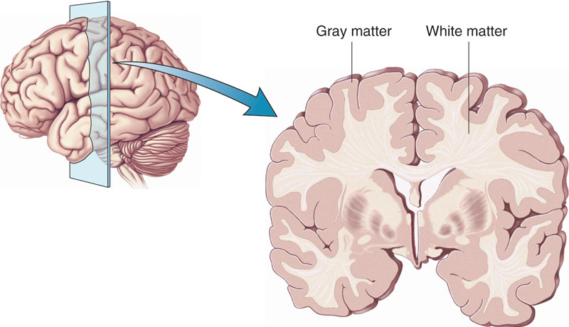
Cerebral Cortex - The outermost layer of gray matter making up the superficial aspect of the cerebrum.
Cerebral Cortex
Cerebral Cortex

Slide 5
Cerebral Cortex
Microscopically the cortex consists of six layers or laminae lying parallel to the surface
From outside to inside the layers are:
I. Molecular layer
II. The external granular layer
III. Layer of pyramidal cell
IV. Internal granular layer
V. large pyramidal cell layer
VI. Layer of fusiform or polymorphic cells.

Slide 6
CEREBRAL CORTEX LAYERS
The incoming sensory signal excites neuronal layer IV first; then the signal spreads toward the surface of the cortex and also toward deeper layers.
2.Layers I and II & III perform most of intracortical association function.
3.The neurons in layers II and III making short horizontal connections with adjacent cortical areas.
4.The neurons in layers V and VI send output signals to brain stem ,spinal cord (V) & thalamus (VI)

Slide 7
There are three main types of functional areas in the cerebral cortex:
Primary Areas:
The primary motor areas have direct connections with specific muscles for causing discrete muscle movements.
The primary sensory areas detect specific sensations—visual, auditory, or somatic—transmitted directly to the brain from peripheral sensory organs.
Association Areas they receive and analyze signals
simultaneously from multiple regions of both the motor
and sensory cortices as well as from subcortical structures.

Slide 8
Association Areas

Slide 9
ASSOCIATION AREAS
These areas receive and analyze signals simultaneously from multiple regions of both the motor and sensory cortices as well as from subcortical structures.
The most important association areas are
(1) Parieto-occipitotemporal association area
(2) prefrontal association area
(3) limbic association area.

Slide 10
PARIETO-OCCIPITOTEMPORAL
ASSOCIATION AREAS
1. Analysis of the Spatial Coordinates of the Body.
2. Language Comprehension.
3. Initial Processing of Visual Language (Reading).
4. Area for Naming Objects.

Slide 11
PARIETO-OCCIPITOTEMPORAL ASSOCIATION AREAS
AREA | SITE | FUNCTION
Analysis of the Spatial Coordinates of the Body. | beginning in the posterior parietal cortex and extending into the superior occipital cortex | computes the coordinates of the visual , auditory, and body surroundings.
Area for Language Comprehension | Wernicke's area, lies behind the primary auditory cortex in the posterior part of the superior gyrus of the temporal lobe | higher intellectual function
Area for Initial Processing of Visual Language (Reading). | angular gyrus area | make meaning out of the visually perceived words (lesion causes Dyslexia or Word Blindness)
Area for Naming Objects. | Lateral portion of anterior occipital lobe & posterior temporal lobe | naming objects.

Slide 13
Prefrontal Association Area
Is the anterior pole of frontal lobe.
It contributes in the following functions:
Planning of complex pattern of movements.
Personality characteristics and social relationship
Production of deep, more abstract and logically sequenced thoughts which enable attainment of goals
Working memory (ability to tie thoughts together in a logical sequence by comparing many bits of information with appropriate stored knowledge and be able to instantly recall this information for future planning)
Lesions in this area lead to change in personality and behavior

Slide 14
Limbic Association Area
Consists of anterior and inner portion of temporal lobe.
Is primarily concerned with emotion , behavior and motivational drive for different tasks most importantly learning.
Lesion of this area may lead to decreased aggression , lack of emotion , hyper sexuality & hyperphagia

Slide 15
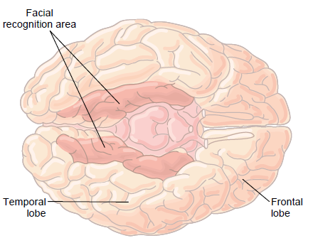
Area of Recognition of Faces
Located on the underside of the brain on the medial occipital and temporal lobes
The occipital portion is contiguous with visual cortex , while the temporal one is closely associated with limbic system
Inability to recognize faces is called prosopagnosia

Slide 16
Lobes of the Brain
Frontal
Parietal
Occipital
Temporal

Slide 17

Lobes of the Brain - Frontal
The Frontal Lobe of the brain is located deep to the Frontal Bone of the skull
It plays an integral role in the following functions:
  -Memory Formation
  Emotions
  Decision Making -Reasoning
  - Personality

Slide 18
Frontal Lobe - Cortical Regions
Primary Motor Cortex (Precentral Gyrus) – Cortical site involved with controlling movements of the body.
Broca’s Area –plan of motor pattern for expressing of individual words. Located on Left Frontal Lobe.
  Broca’s Aphasia – Results in the ability to comprehend speech, but the decreased motor ability (or inability) to speak and form words.
Orbitofrontal Cortex – Site of Frontal Lobotomies
  * Desired Effects:
    - Diminished Rage
    - Decreased Aggression
    - Poor Emotional Responses
* Possible Side Effects:
- Epilepsy
- Poor Emotional Responses
- Perseveration (Uncontrolled, repetitive actions, gestures, or words)
Olfactory Bulb - Cranial Nerve I, Responsible for sensation of Smell

Slide 19
Primary Motor Cortex/ Precentral Gyrus
Broca’s Area
Orbitofrontal Cortex
Olfactory Bulb
Regions

Slide 20
Lobes of the Brain - Parietal Lobe
The Parietal Lobe of the brain is located deep to the Parietal Bone of the skull.
It plays a major role in the following functions/actions:
- Senses and integrates sensation(s)
Spatial awareness and perception
  (Proprioception - Awareness of body/ body parts in space and in relation to each other)

Slide 21
Parietal Lobe - Cortical Regions
Primary Somatosensory Cortex (Postcentral Gyrus) – Site involved with processing of tactile and proprioceptive information.
Somatosensory Association Cortex - Assists with the integration and interpretation of sensations relative to body position and orientation in space.
Primary Gustatory Cortex – Primary site involved with the interpretation of the sensation of Taste.

Slide 22
Parietal Lobe
Parietal lobe is essential for our feeling of touch, warmth/heat , cold, pain , body position and appreciation of shapes of palpated objects .
When damaged , the person loses the ability to recognize shapes of complex objects by palpation (palpation = examination of objects by touch )
& also develops Sensory Inattention on opposite side
(the inability to feel a tactile stimulus when a similar stimulus, presented simultaneously in a homologous area of the body, is perceived)

Slide 23
Primary Somatosensory Cortex/ Postcentral Gyrus
Somatosensory Association Cortex
Primary Gustatory Cortex
Regions

Slide 24
Lobes of the Brain – Occipital Lobe
The Occipital Lobe of the Brain is located deep to the Occipital Bone of the Skull.
Its primary function is the processing, integration, interpretation, etc. of VISION and visual stimuli.

Slide 25
Occipital Lobe – Cortical Regions
Primary Visual Cortex – This is the primary area of the brain responsible for detection of visual stimulie
Visual Association Area – Interprets information acquired through the primary visual cortex.

Slide 26
Primary Visual Cortex
Visual Association Area

Slide 27
Lobes of the Brain – Temporal Lobe
The Temporal Lobes are located on the sides of the brain, deep to the Temporal Bones of the skull.
They play an integral role in the following functions:
  Hearing
  Organization/Comprehension of language
  Information Retrieval (Memory and Memory Formation)

Slide 28
Temporal Lobe – Cortical Regions
Primary Auditory Cortex – Responsible for hearing
Primary Olfactory Cortex – Interprets the sense of smell once it reaches the cortex via the olfactory bulbs. (Not visible on the superficial cortex)
Wernicke’s Area – Language comprehension.
Located on the Left Temporal Lobe (dominant hemisphere).
Understand auditory and visual information and send them to Brocas area

Slide 29
Temporal Lobe
Lesion → may lead to:
- Wernicke’s Aphasia – Language comprehension is inhibited. The individuals have difficulty understanding written and spoken language
Memory impairment
& can be associated with temporal lobe epilepsy

Slide 30
Primary Auditory Cortex
Wernike’s Area
Primary Olfactory Cortex (Deep)
Conducted from Olfactory Bulb
Regions

Slide 31
Click the Region to see its Name

Slide 32
Functional Principles of the Cerebral hemispheres
Each cerebral hemisphere receives sensory information from, and sends motor commands to, the opposite side of body
The 2 hemispheres have somewhat different functions although their structures are alike
Correspondence between a specific function and a specific region of cerebral cortex is not precise
No functional area acts alone; conscious behavior involves the entire cortex

Slide 33
Dominant & Nondominant Hemisphere
Functional differences between left and right hemispheres
In most people, left hemisphere (dominant hemisphere) controls:
  reading, writing, and math, decision-making, logic, speech and language (usually)
Right cerebral hemisphere relates to:
  understanding & interpreting music,
  Non verbal visual Experience
  Spatial relation between the person & their surroundings
  Body language and intonation of peoples voices

Slide 34
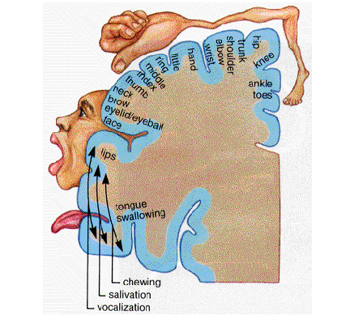
A: Primary Motor Cortex
* This graphic representation of the regions of the Primary Motor Cortex and Primary Sensory Cortex is one example of a HOMUNCULUS:
Homunculus

Slide 35
THANK YOU

