Slide 1
*Pathophysiology of Epilepsy
Dr. Salah Elmalik

Slide 2



*Objectives
*At the end of this lecture the students should be able to:-
Define Epilepsy
Etio-pathology of Epilepsy
Types of Epilepsy
Role of Genetic in Epilepsy
Clinical Features
Role of Electro Physiological tests in the
diagnosis of Epilepsy

Slide 3




* Definition of seizure and Epilepsy
*Seizures are symptoms of a disturbance in brain function , which can be due to epilepsy or other causes
*A seizure is a sudden surge in electrical activity in the brain that causes an alteration in sensation, behavior, or consciousness

Slide 4
*Abnormal , excessive electrical discharge of a group of neurons within the brain.
*When a person has recurrent ( 2 or more) , unprovoked seizures → “ epileptic “.
*Hence seizures can be a symptom of epilepsy .

Slide 5
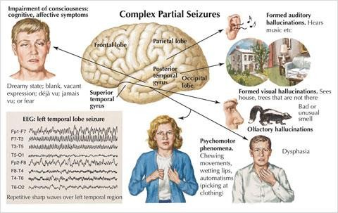


Slide 6
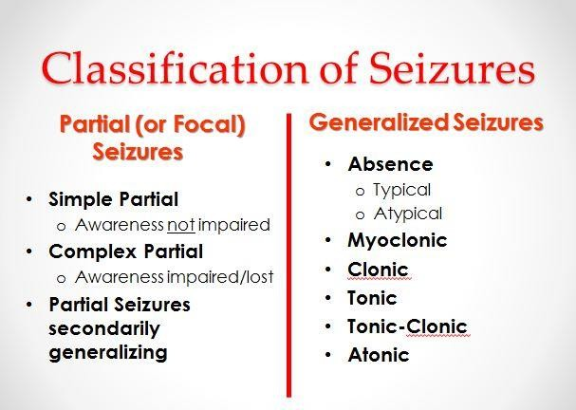
*Seizures
*Partial
* or
*Generalized

Slide 7





*a. Simple partial seizures manifest
motor, somatosensory, and psychomotor symptoms without impairment of consciousness(e.g Jaksonian seizures)
*b. Complex partial seizures impairment of consciousness

Slide 8
Partial psychomotor (temporal lobe) seizure
Epileptic seizures which originate in the temporal lobe of the brain.
The seizures involve sensory changes, for example smelling an unusual odour that is not there, and disturbance of memory.
Visual , auditory , olfactory or visceral hallucinations, déjà vu (over familiatry)
The most common cause is mesial temporal
sclerosis

Slide 9
Jacksonian epilepsy
Focal motor seizures begin in motor areas of cerebral cortex, usually begins with twitching of the thumb or finger , toe or the angle of the mouth.

Slide 10



*c. Generalized seizures
*manifest a loss of consciousness
convulsive or non-convulsive
*Generalized seizures include →
*(1) generalized tonic- clonic seizures(GTC)
*(Grand Mal epileptic seizure )
*(2) Absence seizures (Petit mal epileptic seizures)
GTC are convulsive and Absence are non- convulsive .

Slide 11
Simple partial seizures can progress to complex partial seizures, and complex partial seizures can secondarily become generalized.
Seizures affect all ages. Most cases of epilepsy are identified in childhood, and several seizure types are particular to children.

Slide 12






* Seizure Classification & Clinical Manifestations
Focal / Partial seizures → their onset ( start) is limited to part of the
cerebral hemisphere
Generalized seizures → those that involve the cerebral cortex diffusely ( whole of it ) from the beginning (generalized seizures)

Slide 13
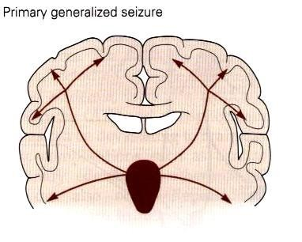
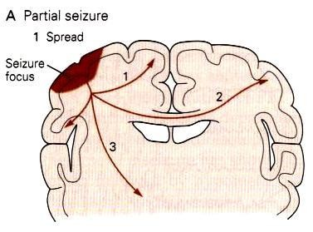
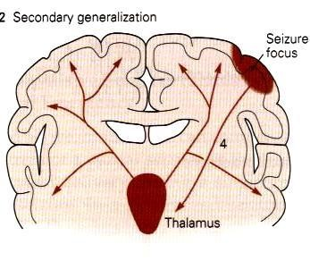

Slide 14
*The onset of a seizures:
Small group of abnormal neurons undergo prolonged depolarizations
-Rapid firing of repeated action potentials
*Spread to adjacent neurons or neurons with which they
are connected into the process.

Slide 15
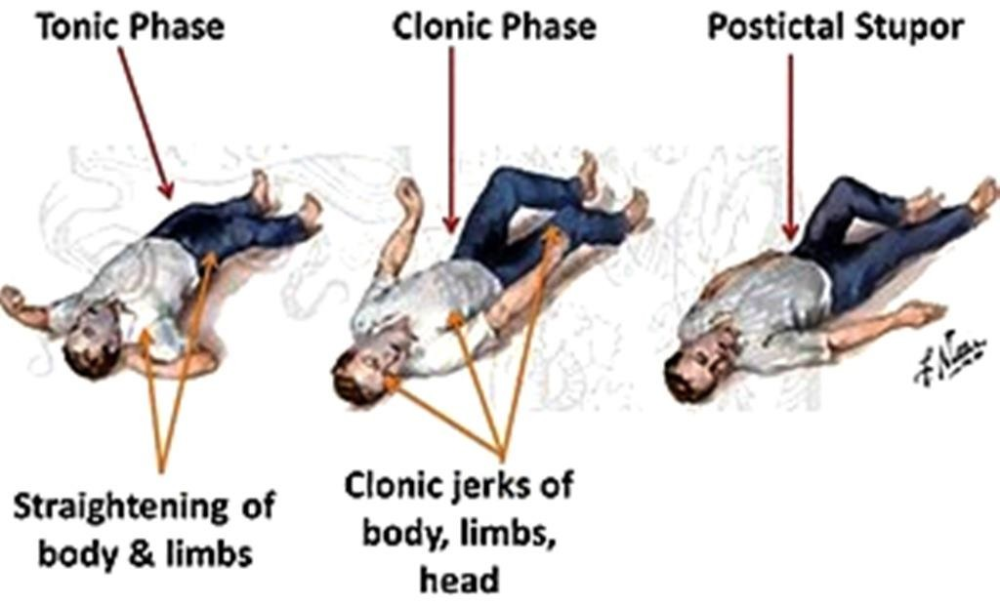
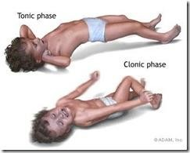
*A clinical seizure occurs when the electrical discharges of a large number of cells become abnormally linked together, creating a storm of electrical activity in the brain.
*Seizures may then spread to involve adjacent areas of the brain or through established anatomic pathways to other distant areas.

Slide 16



























*Generalized
*1- Generalized tonic-clonic (grand mal) seizure
*a. +/- aura
*(peculiar sensation or dizziness; then sudden onset of seizure with
loss of consciousness)
*tonic phase : Rigid muscle contraction in which clenched jaw and hands; eyes open with pupils dilated; lasts 30 to 60 seconds
*clonic phase: Rhythmic, jerky contraction and relaxation of all
muscles in with incontinence and frothing at the lips; may bite tongue or cheek, lasts several minutes.
*postictal state: Sleeping or dazed for up to several hours.

Slide 17




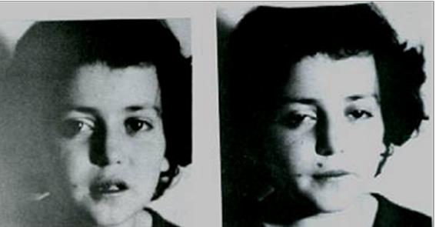
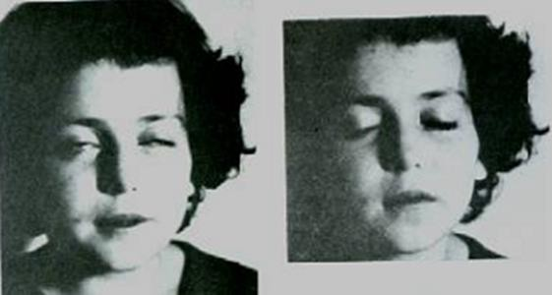
*Generalized
2. Absence ( petit mal) seizure
a. Loss of contact with environment for 5 to 30 seconds.
b. Appears to be day dreaming or may roll eyes, nod head, move hands, or smack lips.
c. Resumes activity and is not aware of seizure.

Slide 18
*Clinical Manifestation of Seizure:
*The clinical manifestations of a seizure reflect the area of the brain from which the seizure begins (i.e., seizure focus) and the spread of the electrical discharge.

Slide 19
* Clinical manifestations accompanying a seizure are numerous and varied, including →
* (1) indescribable bodily sensations,
* (2) "pins and needles" sensations,
* (3) smells or sounds,
* (4) fear or depression,
* (5) hallucinations,
* (6) momentary jerks or head nods,
* (7) staring with loss of awareness, and
* (8) Convulsions → i.e., involuntary muscle contractions) lasting seconds to minutes.

Slide 20


* Pathophysiology of Epilepsy
( at molecular level)
Cortical cell membrane level
Hypersensitive neurons with lowered thresholds for firing and firing excessively , related to →
(1) Excess of Excitatory ( acetylcholine- or Glutamate – related activity )
(2) Decreased inhibitory ( GABA –related activity)
Together and/or (2) above → leading to instability of cell-membrane & lowered threshold for excitation →  excessive polarization, hypopolarization allowing the cell to be more susceptible to activation spontaneously or by any ionic imbalances in the immediate chemical environment of neurons

Slide 21


* Electroencephalogram ( EEG)
EEG is helpful for establishing the diagnosis, classifying
seizures correctly, and making therapeutic decisions
In combination with appropriate clinical findings, epileptiform EEG patterns termed spikes or sharp waves strongly support a diagnosis of epilepsy
EEG in patients with seizures :
focal epileptiform discharges indicate focal epilepsy
generalized epileptiform activity indicates a generalized
form of epilepsy.
Most EEGs are obtained between seizures, and interictal abnormalities alone can never prove or eliminate a diagnosis of epilepsy
Epilepsy can be definitely established only by recording a characteristic ictal discharge during a clinical attack.
3Hz spike-and-wave activity occurs specifically in petit
mal

Slide 22
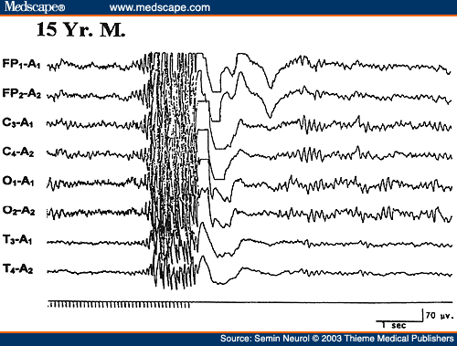

Slide 23




*Genetic & Epilepsy:
*Some types linked to genes (run in families)
*Genetic abnormalities ›››› increasing a person's susceptibility to seizures that are triggered by an environmental factor
*Several types of epilepsy have now been linked to defective genes for ion channels, the "gates" that control the flow of ions in to and out of cells and that regulate neuron signaling.
Example : Lafora's disease, has been linked to a gene that helps to break down carbohydrates.

Slide 24
Thank you

