Slide 1
OSPE
Neuropsychiatry Block
{وَمَنْ يَتَوَكَّلْ عَلَى اللَّهِ فَهُوَ حَسْبُهُ}

Slide 2
Skull
Identify the foramen labelled.
Mention the structure/s passing through the foramen labelled (especially nerves).

Slide 3
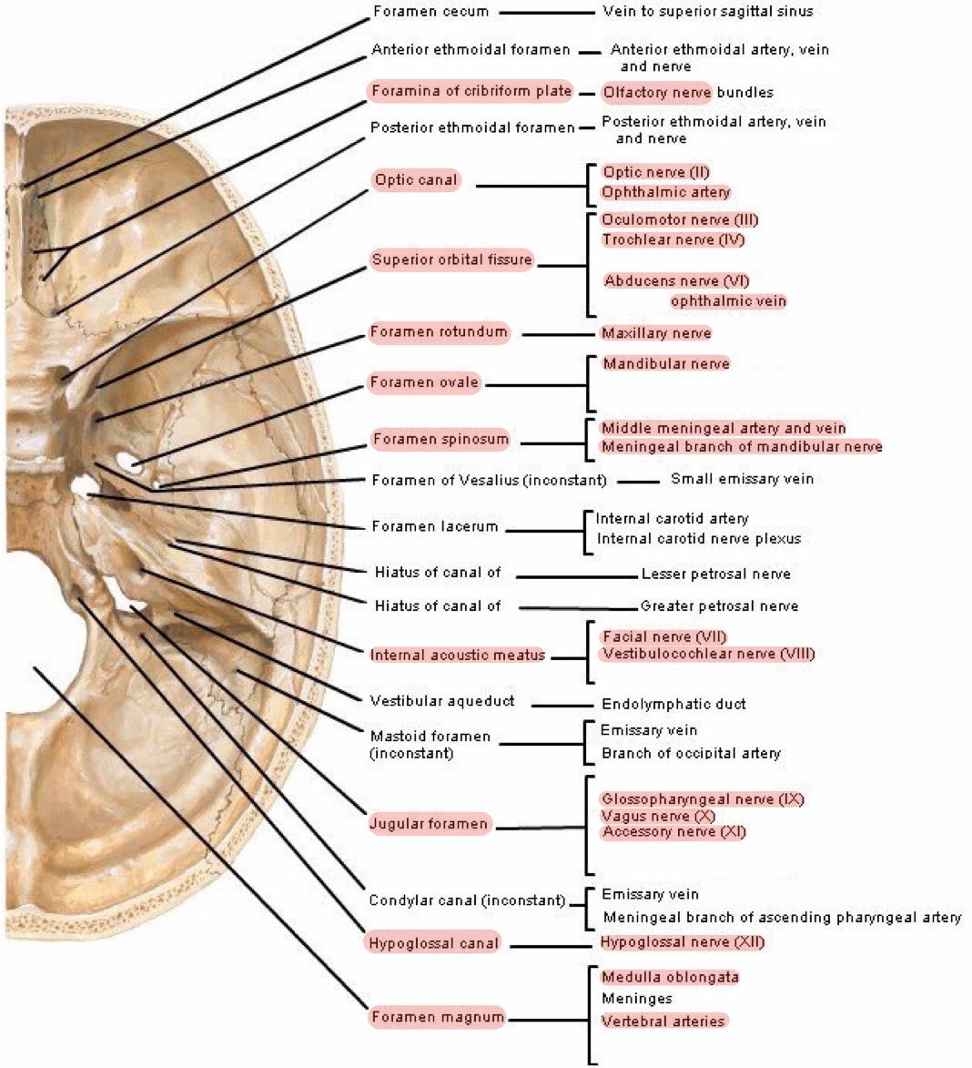
*Any part in posterior cranial fossa other than foramina is transverse sinus
Skull

Slide 4
Upper & Lower Limb
Identify the nerve labelled.
You should know the root value, the motor supply, and the name of lesion for each nerve.

Slide 5
Brachial Plexus (supply UPPER limb)
Site: | In the posterior triangle of the neck
Formation by: | Ventral rami of the C5, C6, C7, C8 & T1 spinal nerves
Stages: | 1- Roots: in the posterior triangle of the neck 2- Trunks: in the posterior triangle of the neck (Upper C5-C6, Meddle C7 & Lower C8-T1) 3- Divisions: behind the clavicle ”cervico axillary trunk” (Anterior & Posterior) 4- Cords: in the axilla (Medial, Lateral & Posterior) 5- Branches: in the axilla
Main branches: | From Roots: 1- C5: Nerve to rhomboids (dorsal scapular nerve) 2- C5,6 &7: Long thoracic nerve (supplies serratus anterior) Lesion=Winging scapula From Trunks (Upper “superior” trunk): C5 & 6: Nerve to subclavius C5 & 6: Suprascapular nerve (supplies supraspinatus & infraspinatus) From Cords (Lateral cord): 2LM Lateral pectoral nerve Lateral root of median nerve Musculocutaneous nerve | From Cords (Posterior cord): ULTRA Upper subscapular nerve Lower subscapular nerve Thoracodorsal nerve. Radial nerve (continuation) Axillary nerve (branch) From Cords (Medial cord): 4MU Medial pectoral nerve Medial root of median nerve Medial cutaneous nerve of arm Medial cutaneous nerve of forearm Ulnar nerve
Lesion | - Lesion of upper trunk C5-C6 (Erb-Duchenne Palsy or waiter's tip position): displacement of the head to the opposite side, depression of the shoulder, arm hangs by the side & rotated medially forearm is extended & pronated - Lesions of Lower trunk C8-T1 (Klumpke Palsy) ,the first thoracic nerve is usually torn The hand has a clawed appearance due to ulnar nerve injury Hand of Benediction or Pope’s Blessings (APE hand) will result from median nerve injury

Slide 6
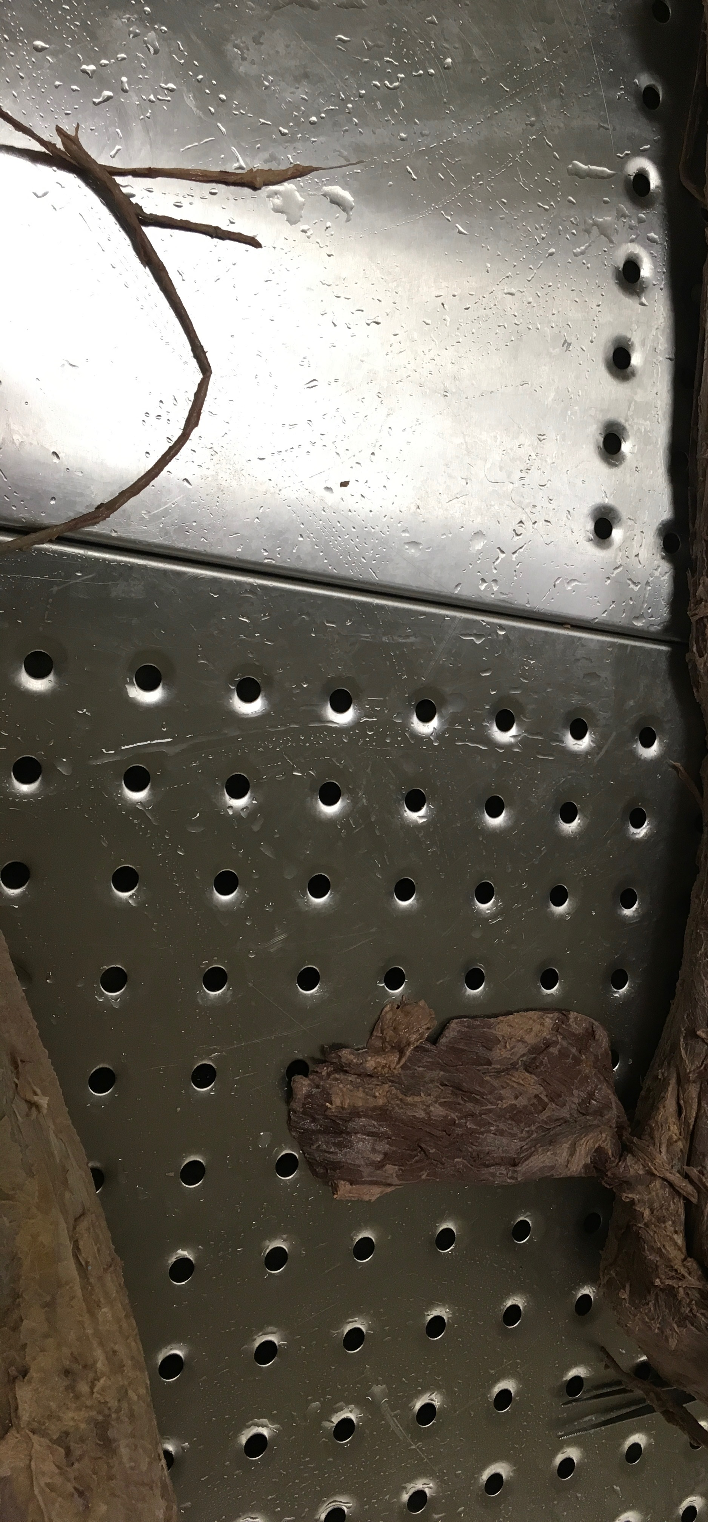
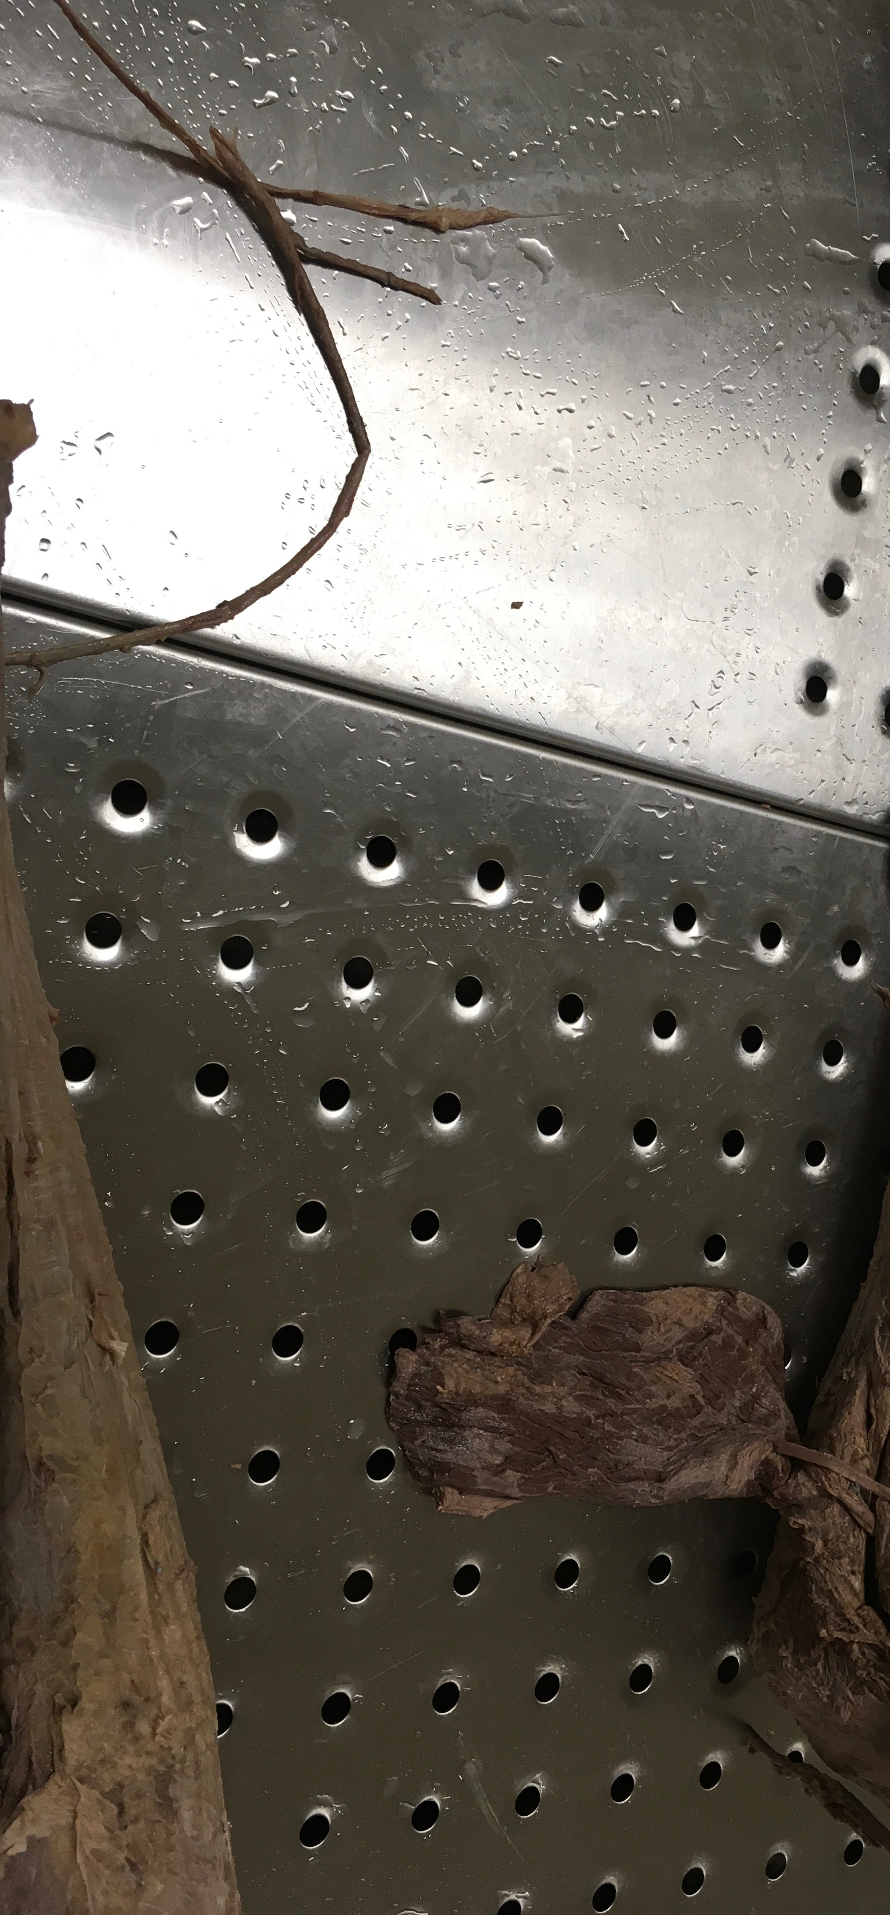
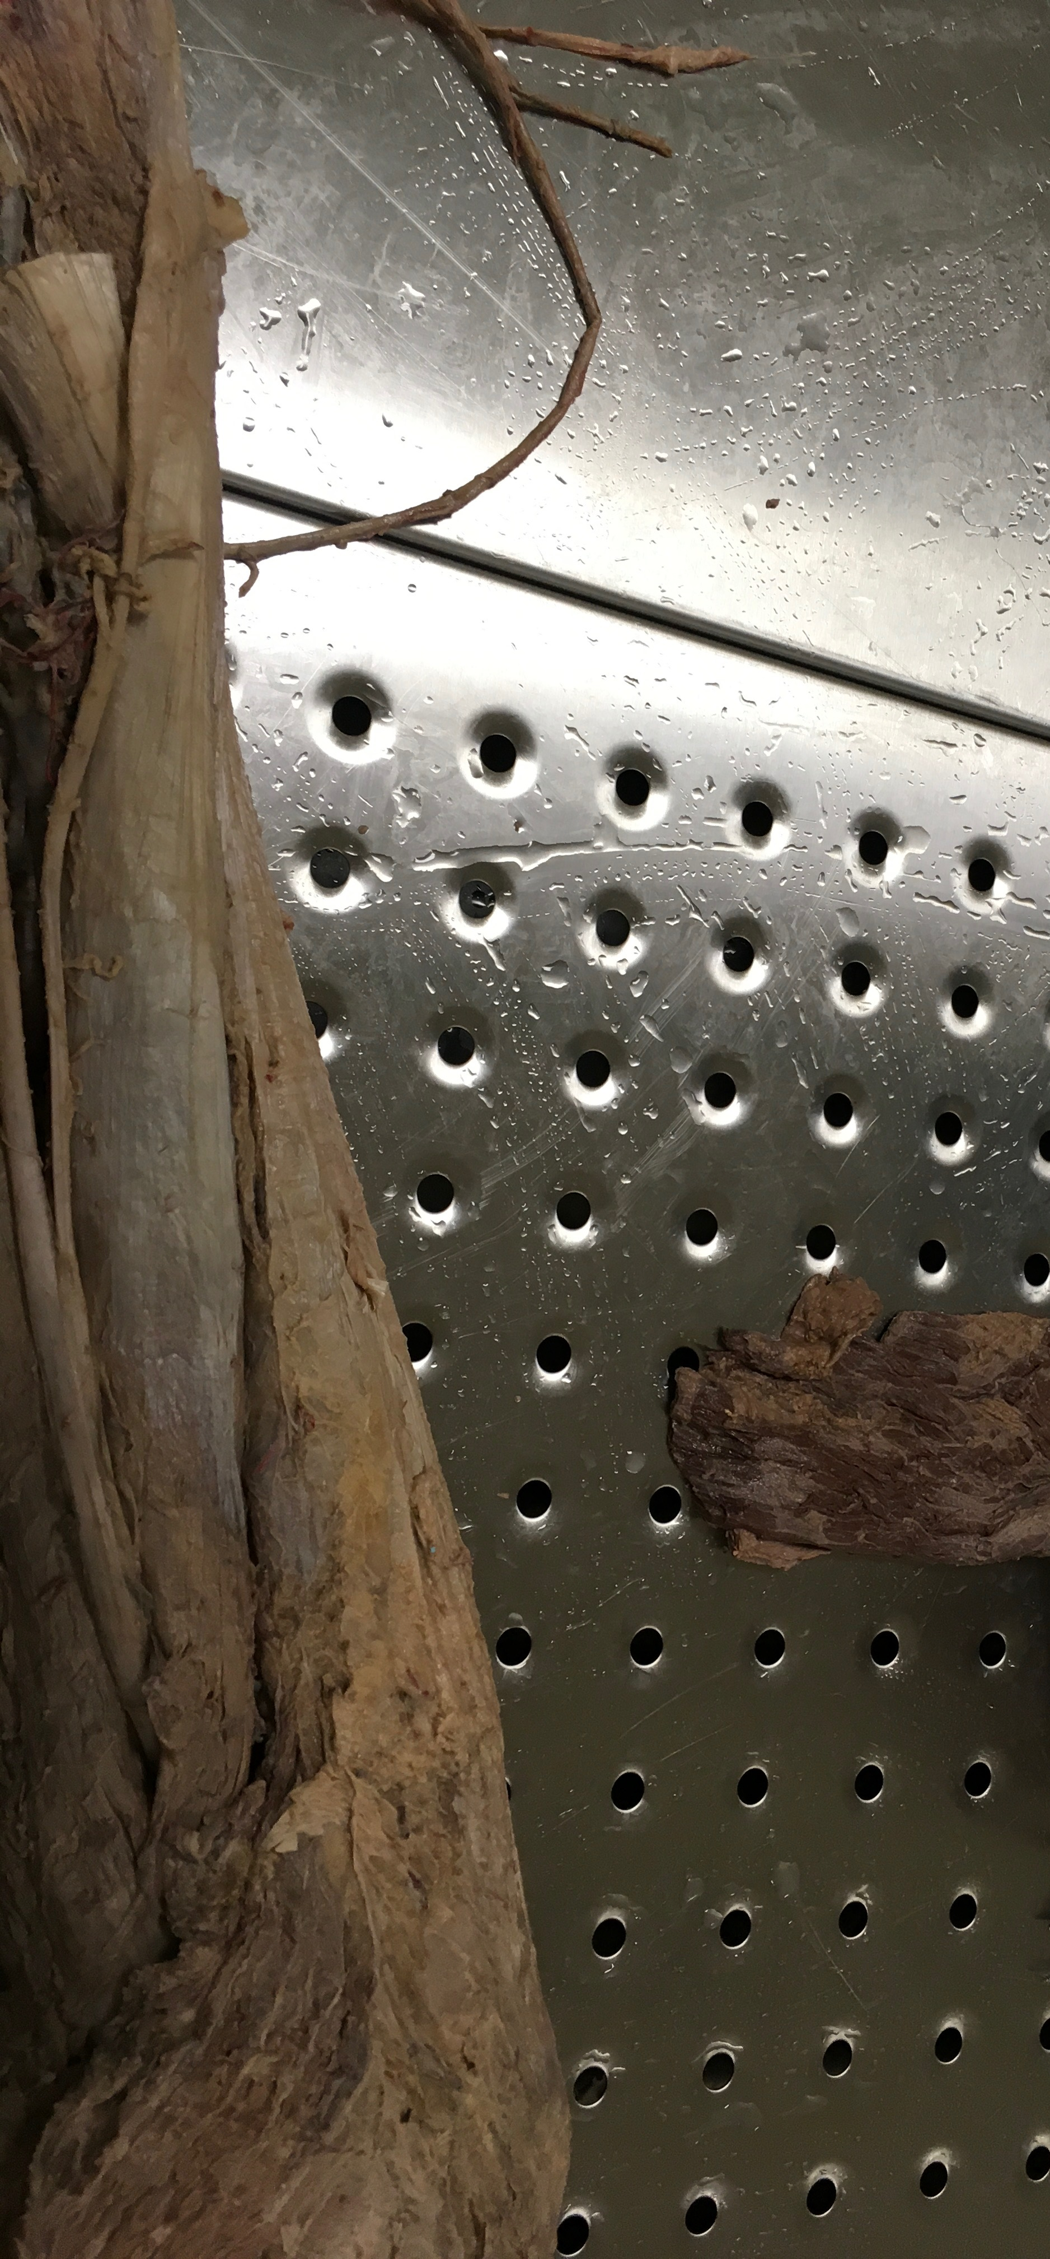
Nerves of the UPPER limbs
Name | Median nerve¹ | Ulnar nerve² | Musculocutaneous nerve³ | Radial nerve | Axillary nerve
Root value | C5-T1 | C8, T1* *Dr. Abu Almakarem said C7-T1 | C5-C7 | C5-T1 | C5,C6
Cords | Medial & lateral cord | Medial cord | Lateral cord | Posterior cord | Posterior
Muscles supplied | Flexor carpi radialis Palmaris longus Pronator teres | Flexor carpi ulnaris Palmar interossei Adductor Pollicis | Coracobrachialis Biceps brachii Brachialis | Triceps Supinator Extensor digitorum | Deltoid Teres minor Triceps (long head)
Lesions | APE hand | Claw hand | Weakness of elbow flexion & foramen supination | Wrist drop | Weak abduction of the shoulder
Picture
Medial
Medial
Medial
Lateral
Lateral
Lateral
1- Median nerve: arises from lateral and medial cords of the brachial plexus (Y shape) then continues in both arm & forearm in the middle side (very obvious)
2- Ulnar nerve: long medial nerve in both arm “may disappears ¾ end of arm” & forearm (directly connected to the little finger)
3- Musculocutaneous nerve: superficial short lateral nerve
Upper limb

Slide 7
 | Lumbar Plexus (supply LOWER limb) | Sacral Plexus (supply LOWER limb & pelvic)
Site: | In the substance of psoas major muscle | In front of piriformis muscle (In pelvic)
Formation by: | Ventral rami of the L1, L2, L3 & most of L4 spinal nerves | Ventral rami of the Part of the L4 & whole L5 (lumbosacral trunk) + S1, S2, S3 & most of the S4 spinal nerves
Main branches: | 1- CIliohypogastric & ilioinguinal nerves (L1): to anterior abdominal wall (sensory branches) 2- Obturator nerve (L2 – L4): to medial compartment (supply Adductor longus & Adductor brevis muscles) 3- Femoral nerve (L2 – L4): to anterior compartment of thigh | 1- Pelvic splanchnic nerve: preganglionic parasympathetic to pelvic viscera & hindgut 2- Pudendal nerve: to perineum 3- Sciatic nerve (L4, L5, S1, S2, & S3) : to lower limb *The largest nerve of the body, Divides into: 1: Tibial “medial” nerve divides into 2 terminal branches: Medial & lateral plantar nerves 2: Common peroneal “lateral” (fibular) nerve divides into: (1) Superficial peroneal or musculocutaneous nerve of leg descends into lateral compartment of leg (motor & sensory) supply: Peroneus longus & Peroneus brevis muscles (2) Deep peroneal or anterior tibial nerve descends into anterior compartment of leg, supply: Extensors hallucis & Extensors digitorum longus muscles
Lesion | (next slide) | - Lesion of Superficial peroneal: loss of foot eversion - Lesion of Deep peroneal: loss of ankle dorsiflexion - Lesion of common peroneal nerve: loss both of foot eversion and loss of ankle dorsiflexion ( talipes equinovarus)

Slide 8
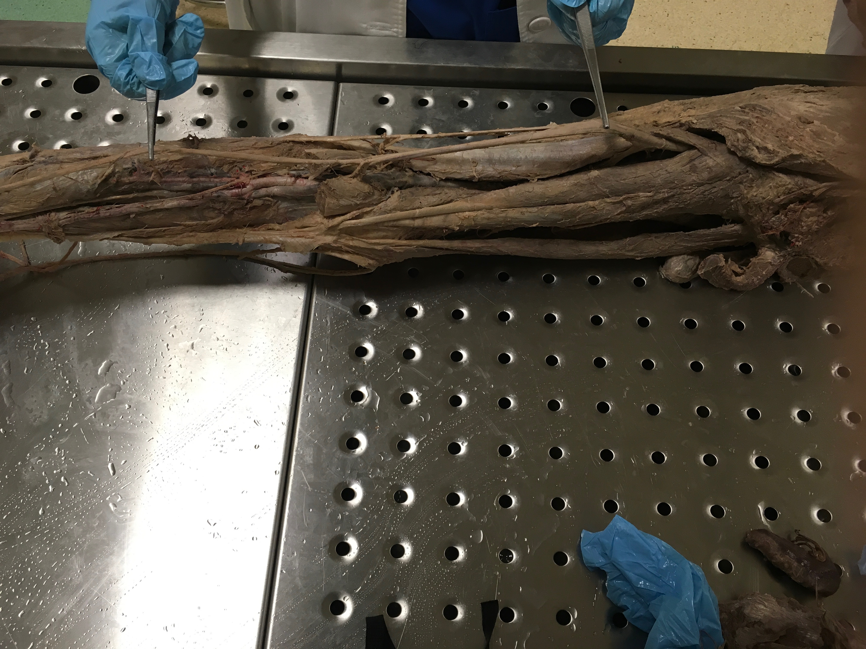
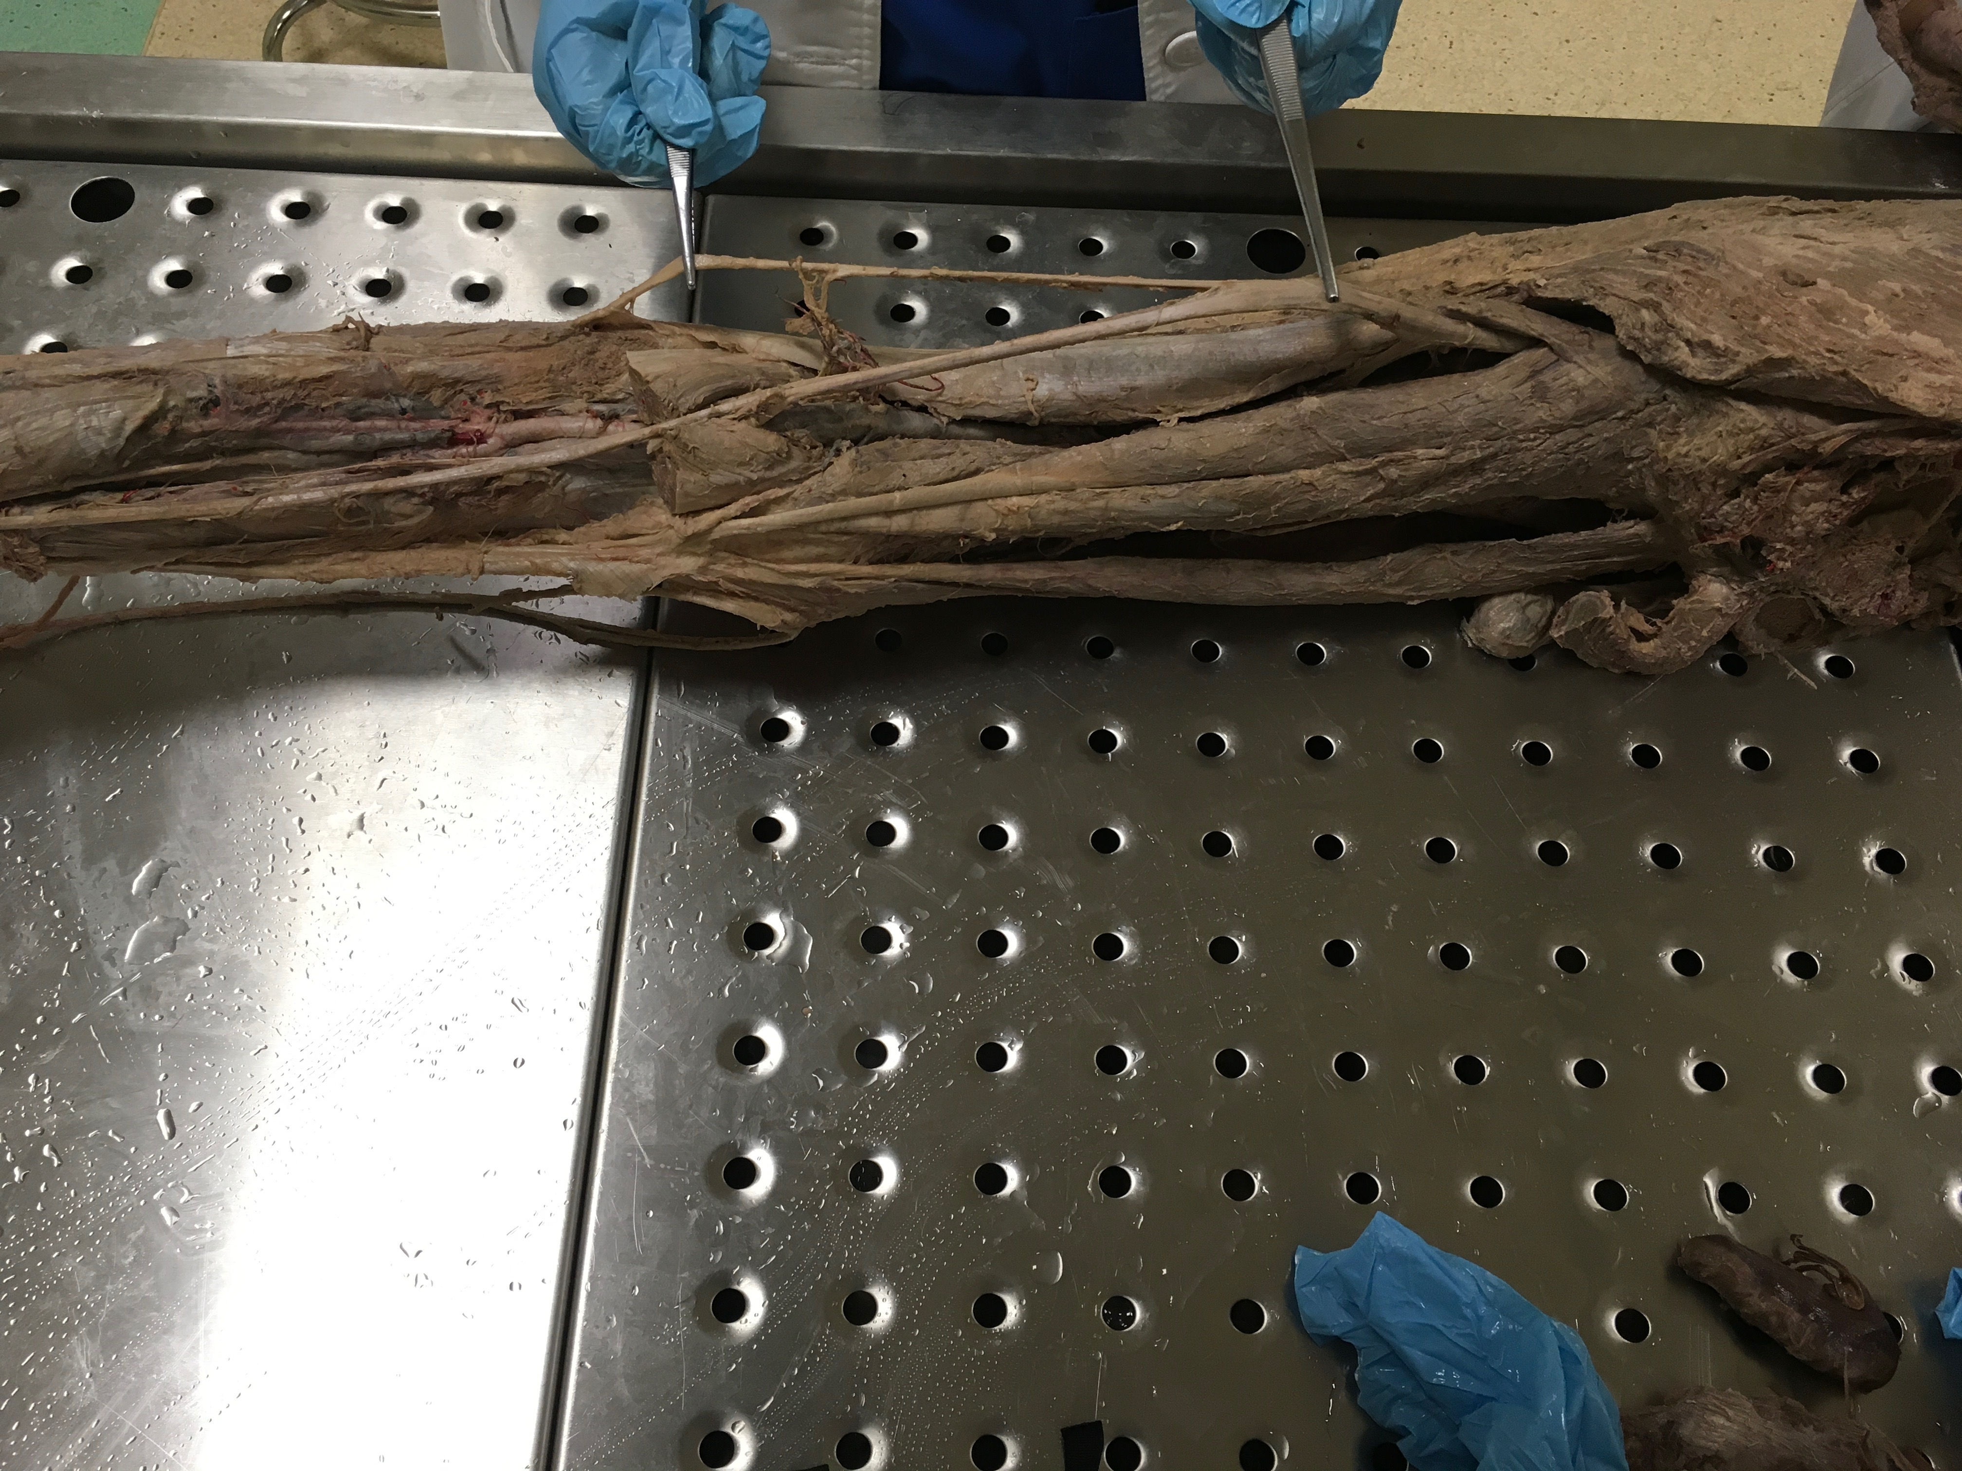
Nerves of the LOWER limbs
 | Anterior part | Posterior part
Name |  | Sciatic nerve | Branches of sciatic nerve
 | Femoral nerve¹ | Sciatic nerve² | Tibial “medial” nerve³ (Continuation) | Common peroneal “lateral” nerve⁴ (Branch)
Root value | L2 – L4 | L4-S3 | L4-S3 | L4-S2
Muscles supplied | Quadriceps femoris Sartorius muscle Pectineus muscle iliacus muscle | Peroneus brevis Peroneus longus Gastrocnemius Soleus | Gastrocnemius Plantaris Soleus | Peroneus brevis Peroneus longus Extensors hallucis
Lesions | Motor effect: Wasting of quadriceps femoris, Loss extension of knee & Weak flexion of hip Sensory effect: loss of sensation of skin over areas supplied antero-medial aspect of thigh & medial side of leg & foot | Motor effect: weak flexion of knee, weak extension of hip, affect all movements of leg & foot (paralysis) & Foot drop Sensory effect: loss of sensation of skin of leg and foot (EXCEPT areas supplied by saphenous branch of femoral nerve)
Picture
Lateral
Sciatic n.
Sciatic n.
Lateral
Medial
Medial
Pelvis
Lower limb
1- Femoral nerve: ONLY nerve from anterior part of LL
2- Sciatic nerve: largest nerve in the posterior part of LL body, Divides into tibial “medial” nerve³ (Continuation) & common peroneal “lateral” nerve⁴ (branch)

Slide 9
Brain Stem
Identify the parts of the brain stem and the cerebellum.
You should know important afferents and efferents of each part.
*Whole brain or brain stem specimen (complete or sagittal section) - with or without cerebellum

Slide 10
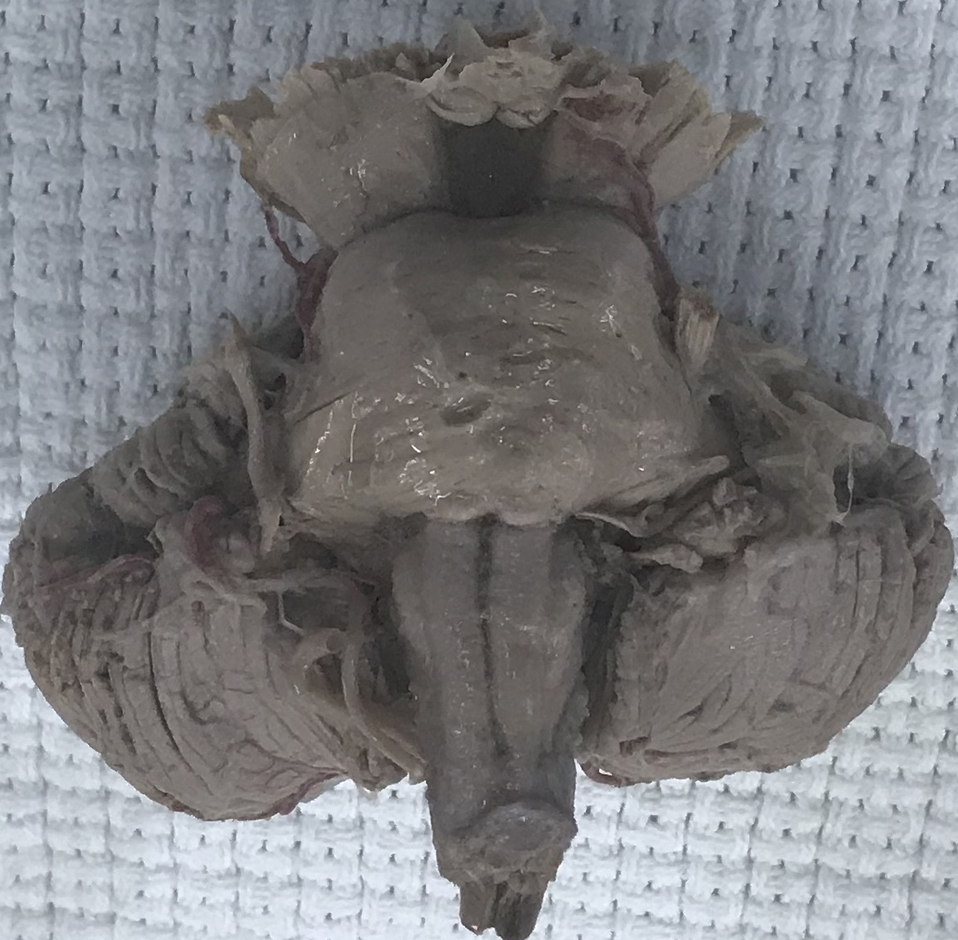
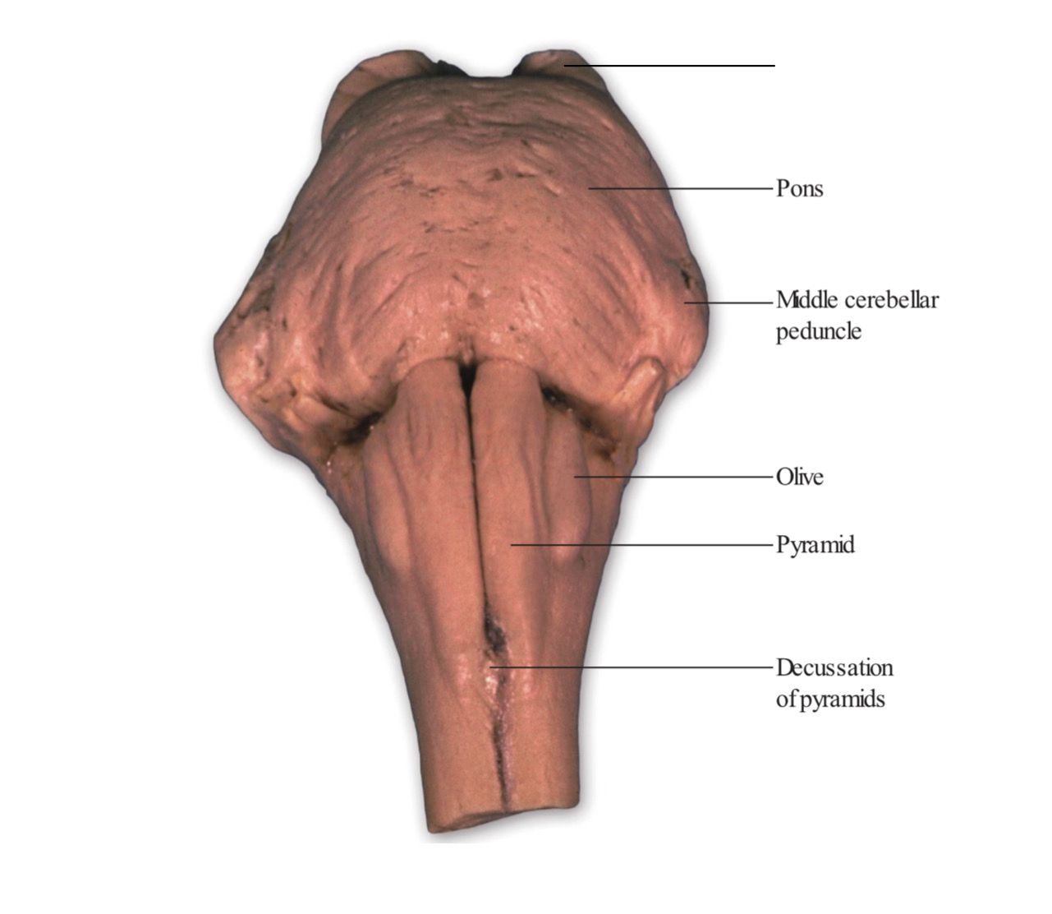
External Structures of Brainstem
*Identify the structures: 1- crus cerebri of mid brain
2- Pons
3- Olive¹ of medulla
4- Pyramid² of medulla
5- (Decussation of pyramid) in medulla
6- Cerebellum
7- basilar groove (sulcus) for basilar artery³ in pons
Crus cerebri
1
2
7
3
4
6
5
*You MUST mention the specific part with name of the structure
especially when the question “identify the elevation” (usually Olive or Pyramid of the medulla)
1-Pyramid produce by corticospinal tract |2- Olive produce by inferior olivary nucleus
3- May the pons contain basilar artery & they will ask about it (its ONLY ARTERY CAN COME)

Slide 11
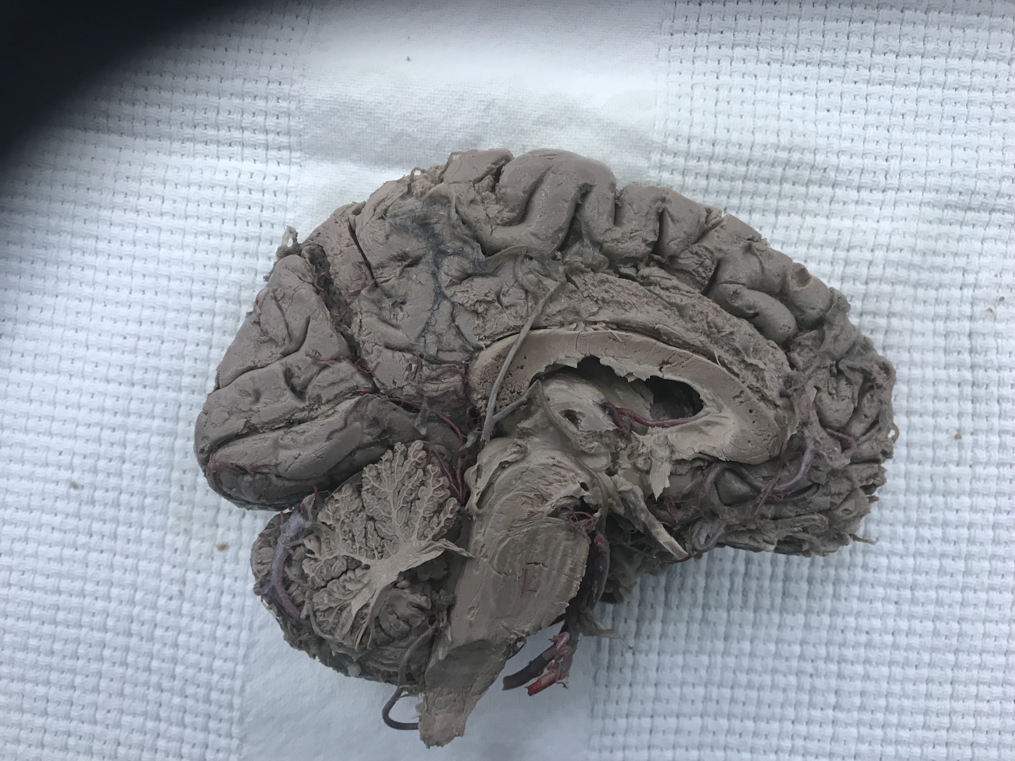
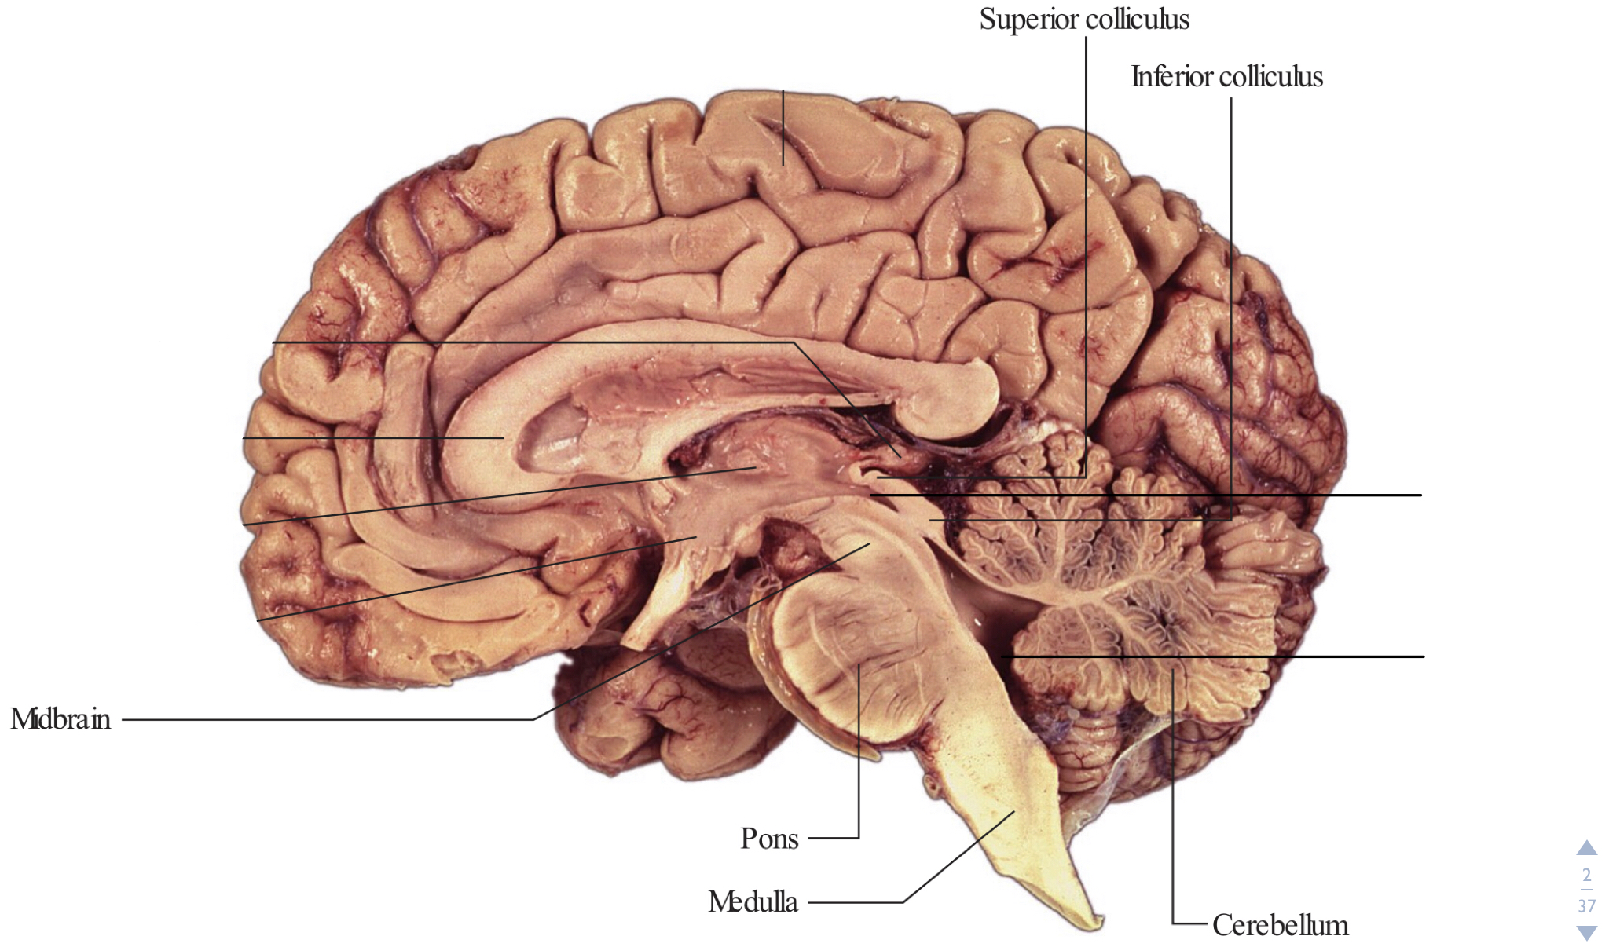
External Structures of Brainstem
*Identify the structures:
1- Mid brain
2- Pons
3- Medulla
4- Cerebellum
5- 4th ventricle
6- Cerebral aqueduct
1
2
1
Cerebral aqueduct
4
3
4
Forth ventricle
5
2
6
5
3
6

Slide 12
Nerves Emerging From Brain Stem
*Mid brain:
3rd CN (Oculomotor nerve)
4th CN (Trochlear nerve) it’s not in the picture because it emerge from the dorsal surface of the mid brain.
*Pons:
5th CN (Trigeminal nerve)
6th CN (Abducent nerve)
7th CN (Facial nerve)
8th CN (Vestibulocochlear nerve)
*Medulla oblongata:
9th CN (Glossopharyngeal nerve)
10th CN (Vagus nerve)
11th CN (Accessory nerve)
12th CN (Hypoglossal nerve)
3rd CN
5th CN
6th CN
7th CN
8th CN
9th CN
10th CN
12th CN
11th CN

Slide 13
Important Afferents & Efferents
Crus cerebri
*Mid brain:
Afferent: Corticorubral tract
Efferent: Rubrospinal tract
*Pons:
Afferent: Corticopontine fibers
Efferent: Pontocerebellar fibers
*Medulla oblongata:
Afferent: Spinoolivary tract
Efferent: Olivospinal tract

Slide 14
Cerebral Hemisphere
Identify the structure labelled.
You should know the name of sulci and gyri, the functions and effects of lesion in important areas, the arterial supply of cerebral hemispheres.
*Whole brain or cerebral hemisphere specimen (complete or sagittal section) and/or plastinated section of brain (horizontal or coronal):

Slide 15
*JUST for illustration

Slide 16
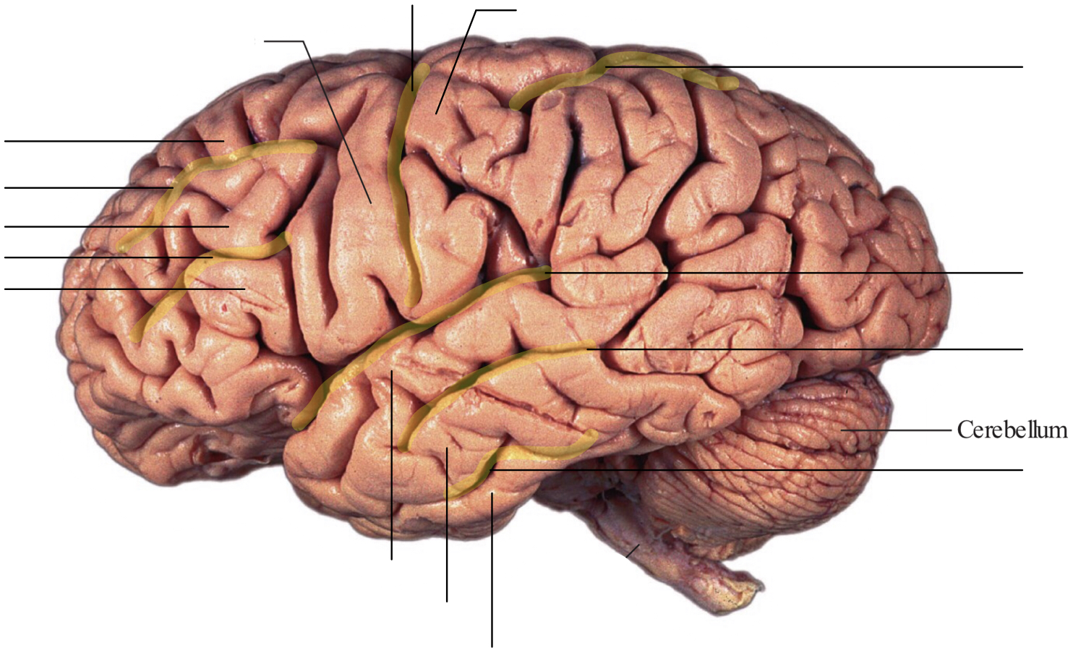
Superolateral Surface
Central sulcus
Postcentral gyrus
Precentral gyrus
Intraparietal sulcus
Superior frontal gyrus
Superior frontal sulcus
Middle frontal gyrus
Inferior frontal sulcus
Lateral sulcus
Inferior frontal gyrus
Superior temporal sulcus
Inferior temporal sulcus
Superior temporal gyrus
Middle temporal gyrus
Inferior temporal gyrus
Anterior & posterior differentiation

Slide 17
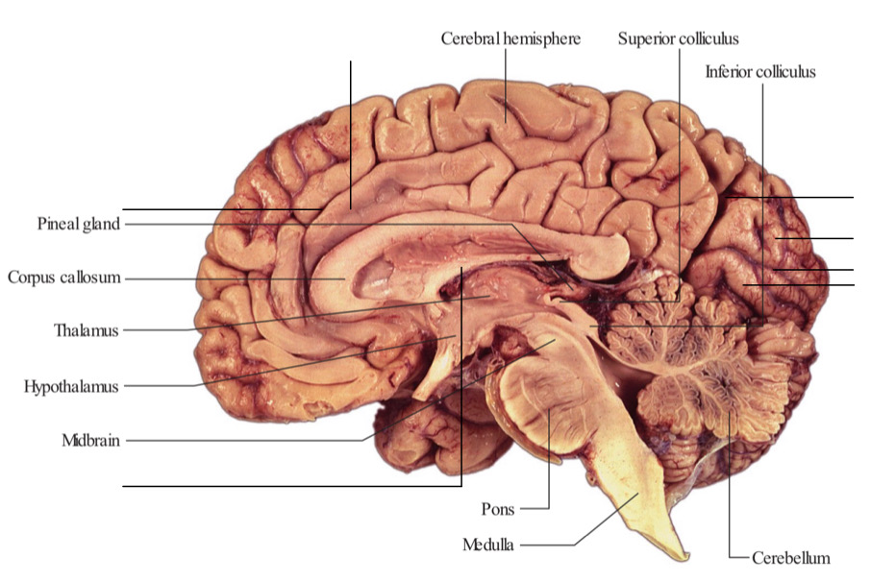
Medial Surface
Cingulate gyrus
Cingulate sulcus
Parietooccipital sulcus
Cuneus
Calcarine sulcus
Lingual gyrus
Fornix

Slide 18
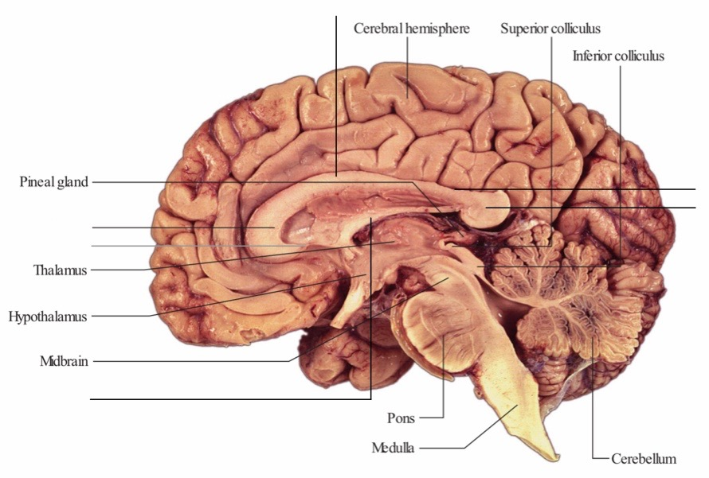
Corpus Callosum
Body/trunk of corpus callosum
Callosal sulcus
Splenium of corpus callosum
Genu of corpus callosum
Rostrum of corpus callosum
Fornix
*Can't ask about Rostrum of corpus callosum because it usually not obvious
Corpus callosum

Slide 19
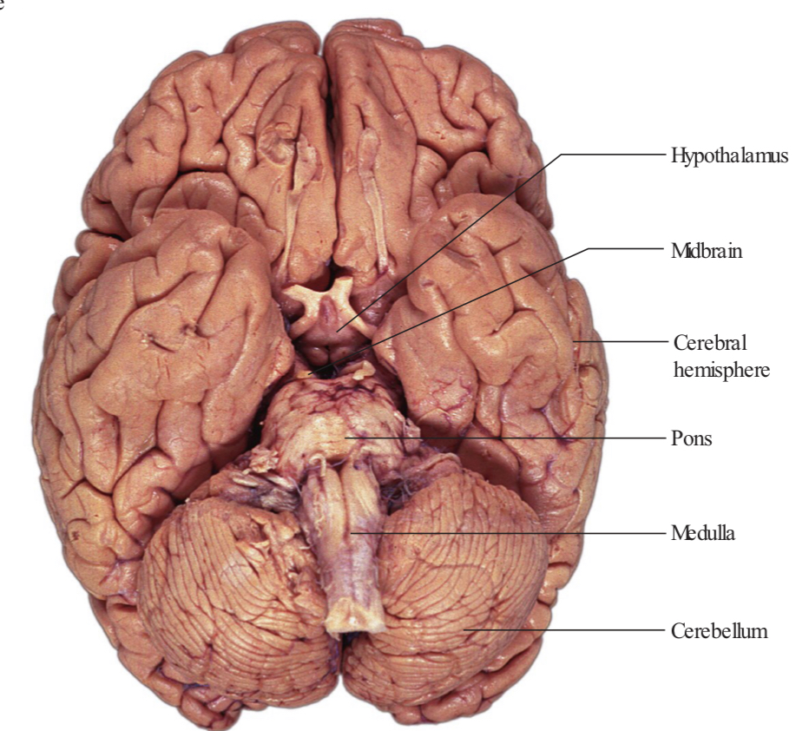
Inferior Surface

Slide 20
Functional Areas
*JUST for illustration

Slide 21
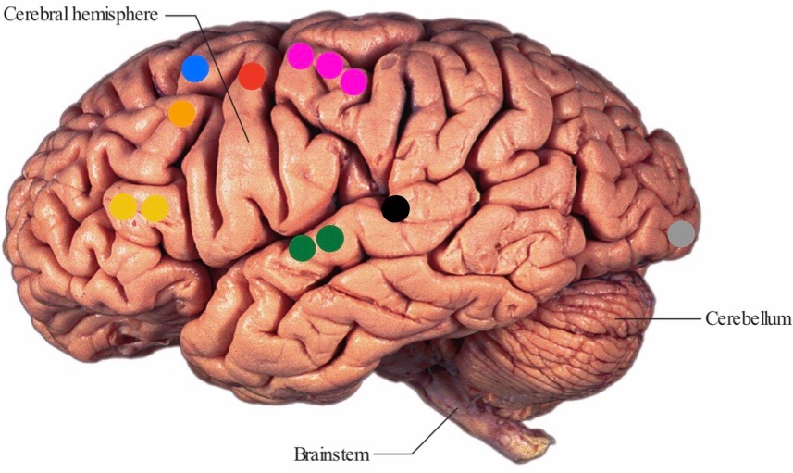
Functional Areas
Frontal lobe
Primary motor cortex (area 4): In precentral gyrus Lesion: Contralateral affect voluntary movement of all body except LL & perineum
Premotor cortex (area 6): Anterior to the precentral gyrus
Frontal eye field (area 8): In front of premotor cortex (area) Lesion: Visual field cut (damage to optic radiation)
Broca’s (motor speech) (area 44 & 45): In inferior frontal gyrus Lesion: Motor Aphasia (Speech production deficits)
Parietal lobe
Primary somatosensory cortex (area 3,1,2): In postcentral gyrus Lesion: Contralateral sensory loss of all body except LL & perineum
Occipital lobe
Primary visual cortex (area 17): In gyri surround the calcarine sulcus Lesion: homonymous hemianopia
Temporal lobe
Primary auditory cortex (area 41, 42) Lesion: Decreasing of hearing (NOT loss) In the superior surface of the superior temporal gyrus
Wernicke’s (area 39,40): end of lateral sulcus Lesion: Sensory Aphasia (comprehension deficits)
*All functional areas supplied by the middle cerebral artery EXPECT primary visual cortex which supply by the posterior cerebral artery

Slide 22
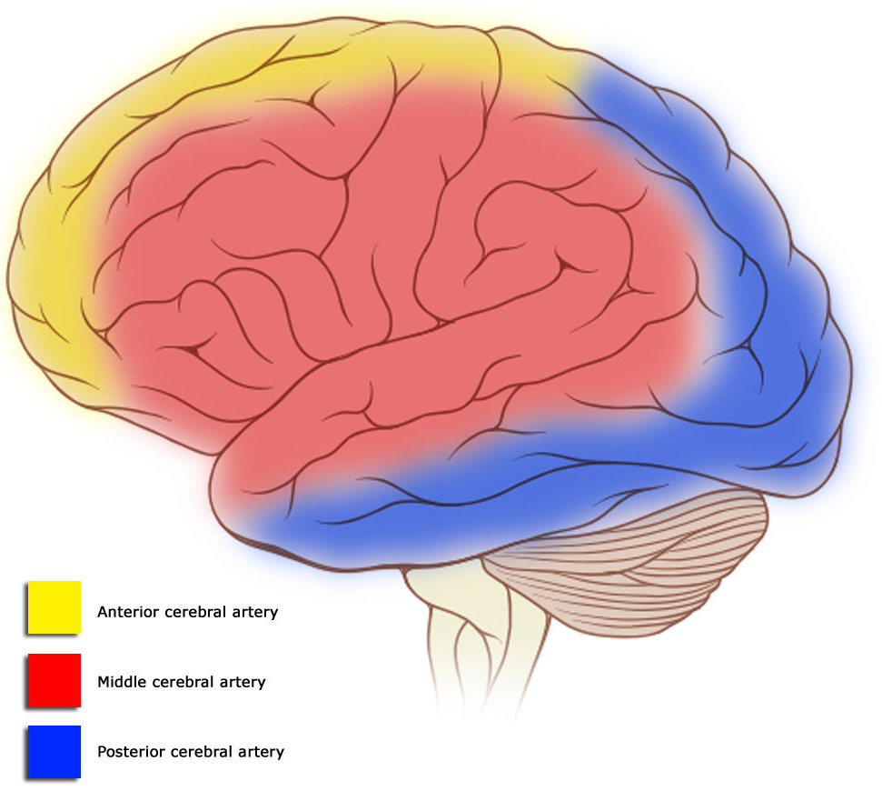
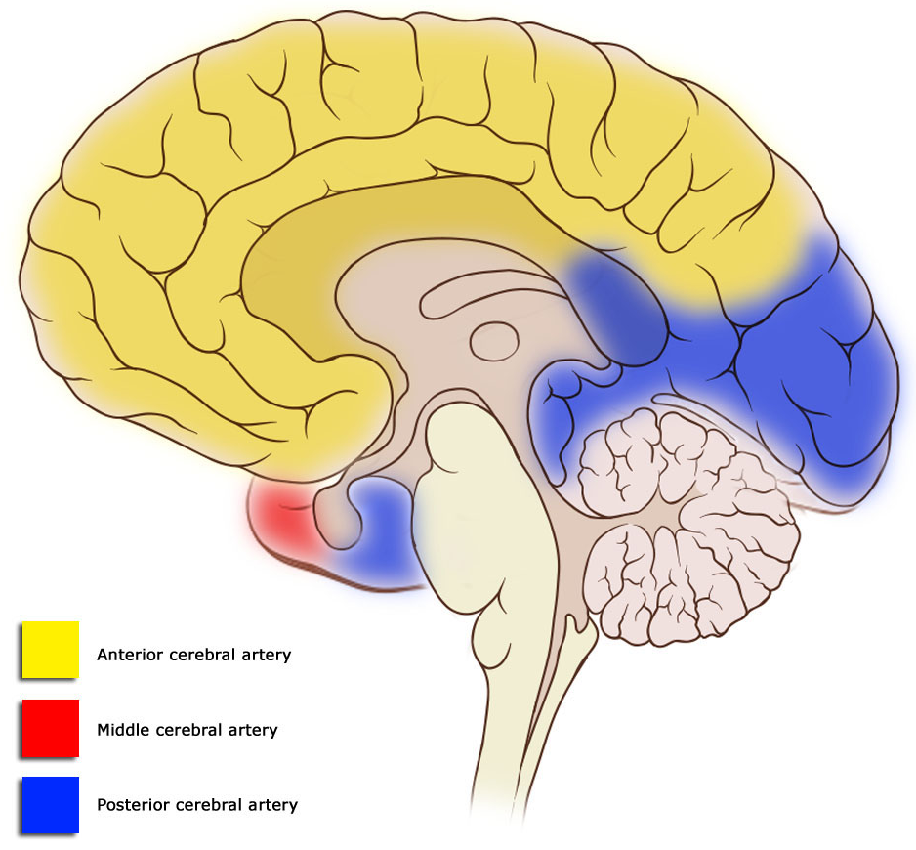
Arterial Supply
*JUST for illustration

Slide 23
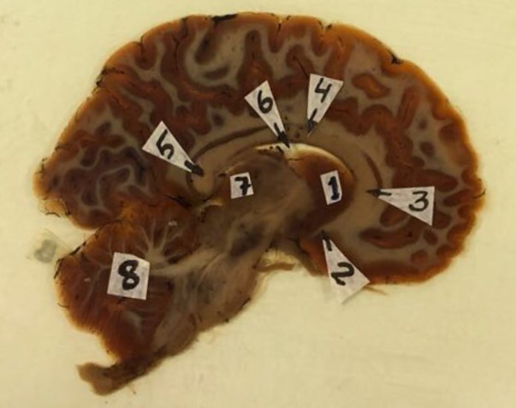
Sagittal Section of Brain
*Identify the structures: 1- Caudate nucleus
2- Rostrum of corpus callosum
3- Genu of corpus callosum
4- Body of corpus callosum
5- Splenium of corpus callosum
6- Lateral ventricle
7- Thalamus
8- Cerebellum

Slide 24
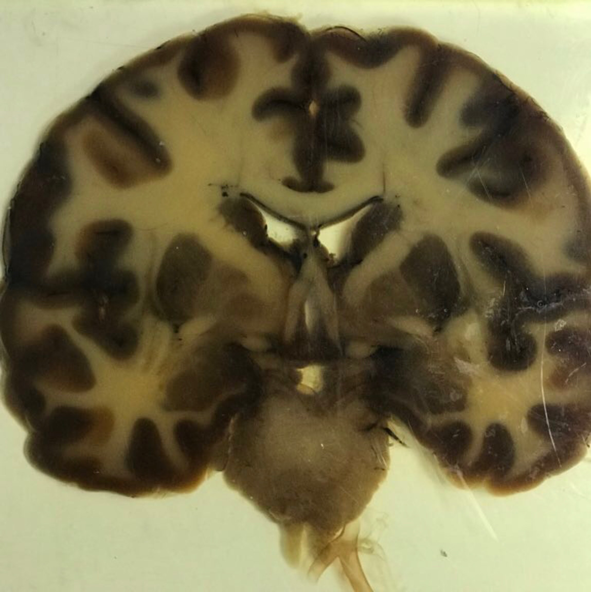
Coronal Section of Brain
*Identify the structures: 1- Caudate nucleus
2- Putamen
3- Globus pallidus
4- Claustrum
5- Lateral fissure (sulcus)
6- Corpus callosum
7- Lateral ventricle
8- 3rd ventricle
9- Fornix
10- Thalamus
11- Internal capsule
Corpus callosum
Caudate nucleus
Lateral sulcus
Claustrum
Putamen
6
1
7
4
11
9
3
2
5
8
10
Globus pallidus
Fornix
Lateral ventricle
*Caudate nucleus lies around lateral ventricle | *Thalamus lies around 3rd ventricle
*In coronal section if the Putamen & Globus pallidus not clear, you have to write lentiform nucleus

Slide 25
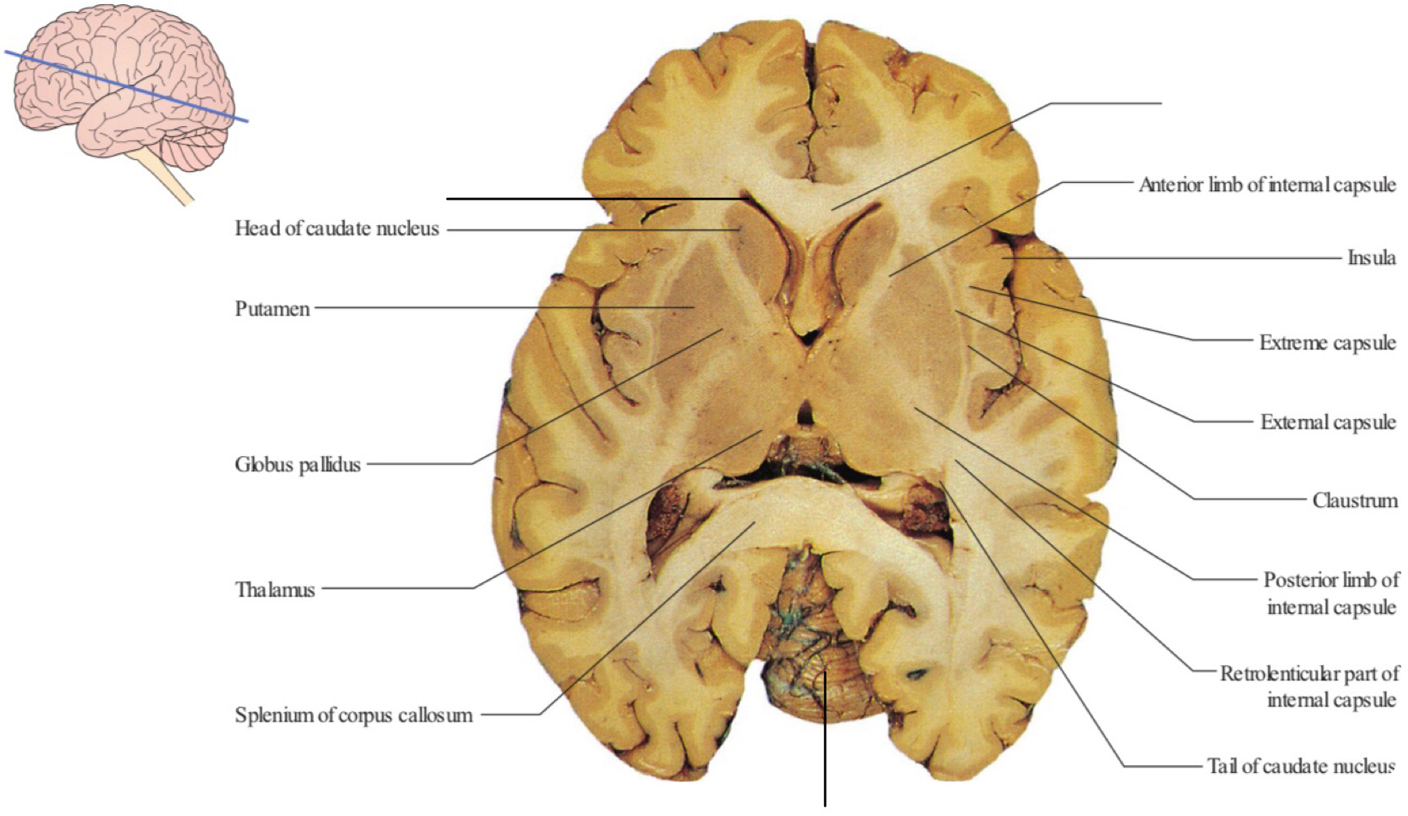
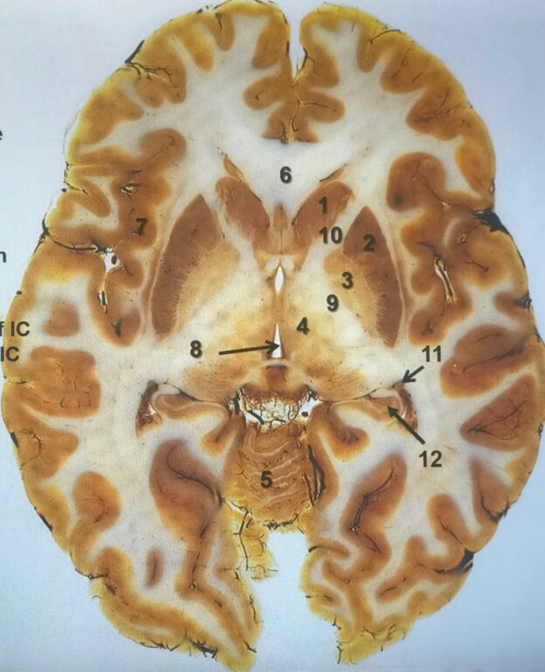
Horizontal Section of Brain
*Identify the structures: 1- Head of caudate nucleus
2- Putamen
3- Globus pallidus
4- Thalamus
5- Cerebellum
6- Corpus callosum
7- Insula
8- 3rd ventricle
9- Posterior limb of internal capsule
10- Anterior limb of internal capsule
11- Tail of caudate nucleus
12- Hippocampus
13- External capsule
14- Claustrum
15- Extreme capsule
Corpus callosum
Anterior horn of lateral ventricle
13
14
15
3rd ventricle
Cerebellum

Slide 26
GOOD LUCK “
Rawan Alharbi & Faisal Alsaif
Twitter.com/Anatomy437
Anatomyteam.437@gmail.com

