Slide 1
OSPE
" اللَّهُمَّ لا سَهْلَ إِلاَّ ما جَعَلْتَهُ سَهْلاً، وأنْتَ تَجْعَلُ الحَزْنَ إذَا شِئْتَ سَهْلاً"
437 Biochemistry Team
leaders : Fatima Balsharaf & MOATH ALHAMOUD
Special thanks for: Razan Alzahrani
Neuropsychiatry block

Slide 2
Exam will include:
اختبار العملي فقط راح يكون حساب معادلة والوحدات والتحويل مهم !
كمية البروتين في CSF واسم الطريقة
الباقي فقط أجزاء من النظري قراءة
هل بتكون في عينات نشتغل عليها مثل ماطبقنا في المعمل ؟ لا
د.سمبل: الأحمر فقط المهم
العينات الصورة هذه من قسم المايكرو تم إضافتها للفهم
دكتور عيسى قال: نفس الكلام بس بالاضافه ان ممكن يجيكم سؤال عن ال Physical examination of CSF الي هو
appearance,color,viscous بالاضافه انه قال ال
normal Range of protein and glucose are .
.important

Slide 3
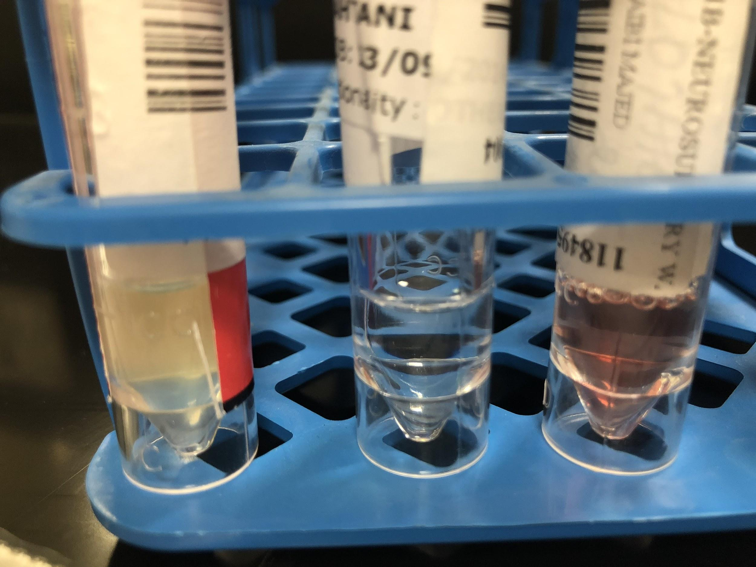
1- Physical Examination
The specimen should be delivered to the laboratory immediately after collection ( 100-150 ml)
Glucose and protein estimations should be performed as soon as possible after drawing the CSF specimen
If testing is to be delayed, the specimen should be frozen at – 200 C.
Parameter | Normal- how will you describe it ? | Abnormal- how will you describe it ?
Turbidity | Clear- normal | Cloudy/ turbid- may indicate the presence of white, or red blood cells, microorganisms, or an increase in protein level
Color | Colorless- normal | Yellow, orange-brown, or red- may indicate the presence of blood
Viscosity | same consistency as water | Thicker CSF may be seen in patients with certain types of cancers or meningitis.
2- Chemical Analysis:
Routinely performed biochemical tests in CSF are: glucose
protein (total and specific)
lactate
lactate dehydrogenase
glutamine and acid-base parameter
● Protein is normally low in CSF: if increased suspect infection, but its decrease is not significant.
● Lactate and lactate dehydrogenase increase in bacterial infection, but not in viral.
● Glutamine increase in CSF due to liver disease

Slide 4
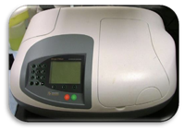
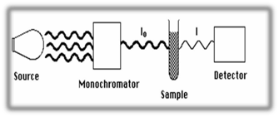
Remember !!
• Before any analysis, the fluid should be centrifuged to avoid contamination by cellular elements.
• CSF is the most precious biological material. Often, only small volumes of CSF are available for analysis due to difficulty in collection; hence handle this with care.
• The specimen may not be pre-tested for micro-organisms ( may contain virulent organisms), so strict safety precautions should be followed.
Just read it !!
CSF Protein Assay
Protein present in the CSF is detected by a series of enzymatic reactions that ultimately form a colored product like kit based on Biuret method.
Biuret reagent when interacts with the peptide bonds in the protein give a blue coloured product.important if they asked you about the method !!
The intensity of the color is proportional the amount of protein in CSF
Color intensity is determined by measuring the absorbance by the colored solution at a wavelength of 546nm
Absorbance is measured by an instrument, spectrophotometer
Extra“ Information”
Most of visible spectrophotometers are composed of:
Light source which works with visible wavelengths (400-700 nm)
Monochromator filter for choosing desired wavelength
Sample holder (cuvette)
Detector
Meter or recorder
Spectrophotometer “
Just read it Except the red is important !!

Slide 5
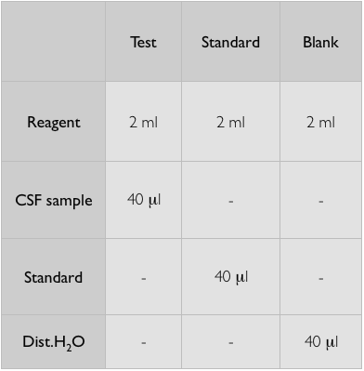
Procedure
1-Mix and incubate for 15 minutes at room temperature 2- Measure absorbance at 546 nm
Don’t memorize the procedure for each tube they will give you already the numbers that have been calculated in centrifuge
Calculation:
Protein concentration (g/L) =
Absorbance of sample ”test”
Conc. of standard (60 mg/dL)
Absorbance of standard
( Important: you must convert from mg/dL to g/L ) , divide on 100
Normal Range Normal reference values for CSF protein: 15 - 45 mg/dL ( 0.1 - 0.4 g/L )
Don’t memorize the range it will be given in the question but the unit is important
They will give you the value of the absorption of sample test tube ( without any unit ) and the standard tube value what will you do ? Just after the division you will multiply it by 60 important to memorize it. then the answer divide it again by 100 the answer must be in unit of g/L
Then if it's in the normal range write normal if it’s not write abnormal whether ( high/ low )

Slide 6
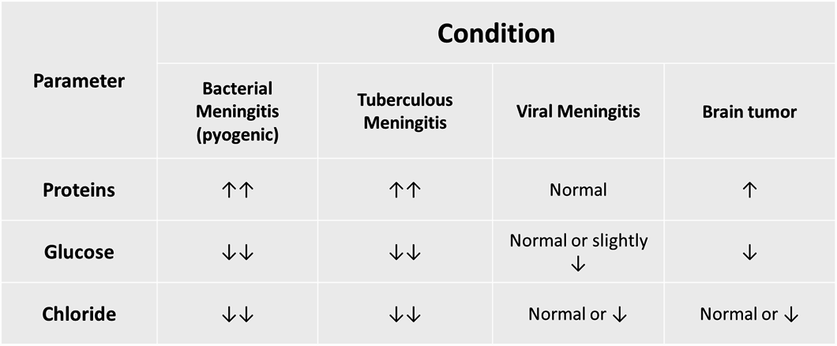
Abnormal findings of CSF in some pathological conditions:
Very Important!!

