Slide 3
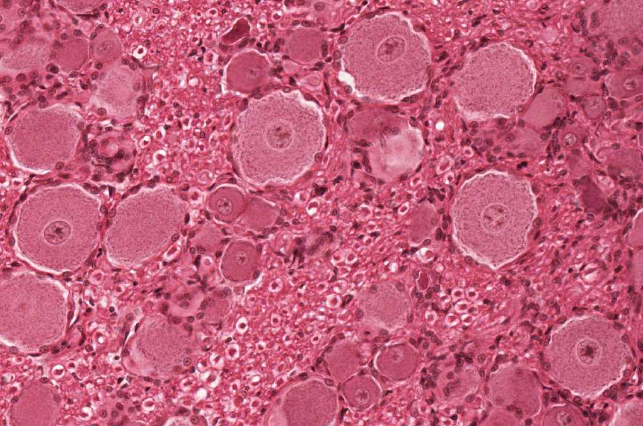
Unipolar/Pseudo-unipolar Neuron
Q1: Identify the structure (type of the neuron)?
Unipolar/Pseudo-unipolar Neuron
Q2: Where is the structure located?
Dorsal root ganglion
Mesencephalic nucleus of the trigeminal nerve
Q3: What are the components that form this structure?
Nucleus
Nucleolus
Nissl bodies
Mitochondria
Cell body
*When the question only Identify you should write the location

Slide 4
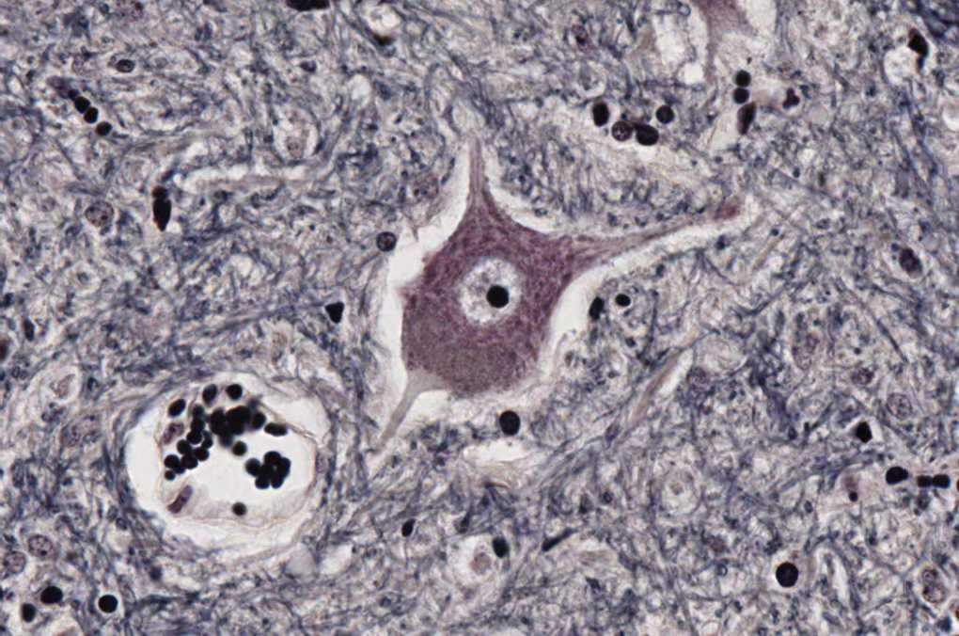
Multipolar Stellate Neuron
Q1: Identify the structure (type of the neuron)?
Multipolar Stellate Neuron
Q2: Where is the structure located?
Anterior horn of the spinal cord
Q3: What are the components that form this structure?
Nucleus
Nucleolus
Nissl bodies
Mitochondria
*When the question only Identify you should write the location

Slide 5
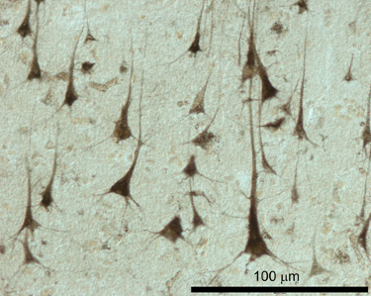
Multipolar Pyramidal Neuron
Q1: Identify the structure (type of the neuron)?
Multipolar Pyramidal Neuron
Q2: Where is the structure located?
Motor area 4 of the cerebral cortex
Q3: What are the components that form this structure?
Nucleus
Nucleolus
Nissl bodies
Mitochondria
*When the question only Identify you should write the location

Slide 6
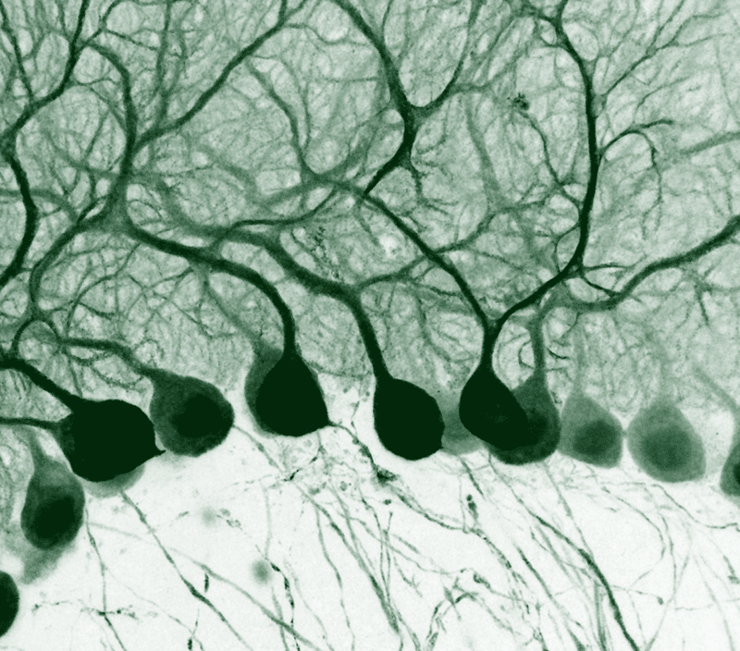
Multipolar Pyriform Neurons
Q1: Identify the structure (type of the neuron)?
Multipolar Pyriform Neurons
Q2: Where is the structure located?
Purkinje cells of cerebellum
Q3: What are the components that form this structure?
Purkinje cells with nucleus
Purkinje cells with nucleolus
Dendrites of Purkinje cells
Nissl bodies
Mitochondria
*When the question only Identify you should write the location
*Microscopic pictures here not important because its not clear

Slide 7
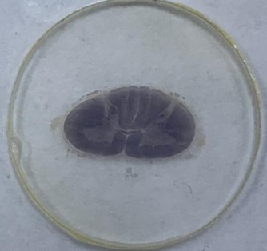
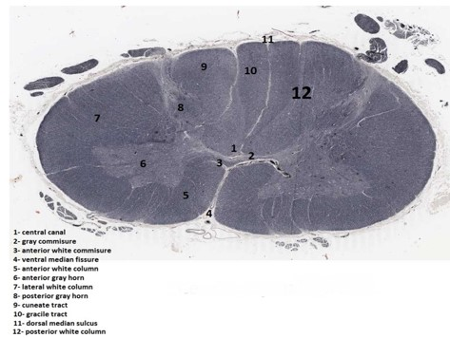
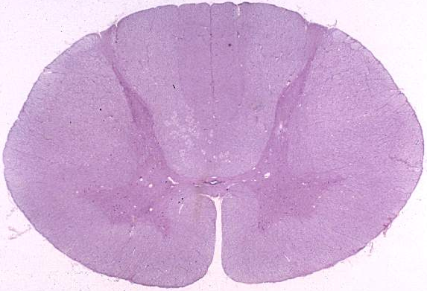
Cervical Spinal Cord
The spinal cord sections won’t be under the microscope, it will be as seen here
Q1: Identify the structure?
Cervical level of Spinal Cord
Q2: Identify labeling:
1- Central canal
2- Grey commissure
3- Ventral white commissure
4- Ventral median fissure
5- Ventral white column
6- Ventral grey horn
7- Lateral white column
8- Dorsal grey horn
9- Cuneate tract
10- Gracile tract
11- Dorsal median sulcus
12- Dorsal white column
Q3: What is the features of the structure?
Oval in shape
Wide ventral horn*
Thin dorsal horn
Not contain lateral horn
Contain both cuneate tract and gracile tract
*Because of brachial plexus

Slide 8
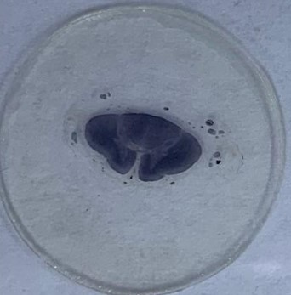
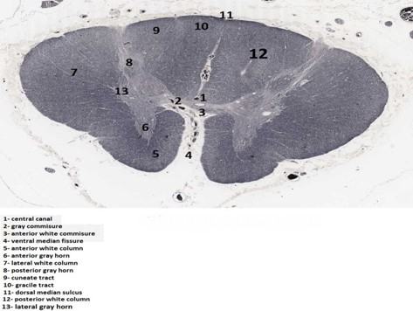
Thoracic Spinal Cord
The spinal cord sections won’t be under the microscope, it will be as seen here
Q1: Identify the structure?
Thoracic level of Spinal Cord
Q2: Identify labeling:
1- Central canal
2- Grey commissure
3- Ventral white commissure
4- Ventral median fissure
5- Ventral white column
6- Ventral grey horn
7- Lateral white column
8- Dorsal grey horn
9- Cuneate tract
10- Gracile tract
11- Dorsal median sulcus
12- Dorsal white column
13- Lateral grey horn
Q3: What is the features of the structure?
Thin ventral horn
Thin Dorsal horn
It contain lateral horn

Slide 9
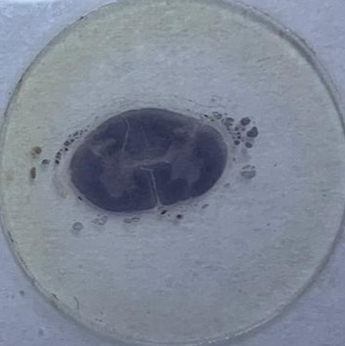
Lumbar Spinal Cord
The spinal cord sections won’t be under the microscope, it will be as seen here
Q1: Identify the structure?
Lumbar level of Spinal Cord
Q2: Identify labeling:
1- Central canal
2- Grey commissure
3- Ventral white commissure
4- Ventral median fissure
5- Ventral white column
6- Ventral grey horn
7- Lateral white column
8- Dorsal grey horn
9- (not found at this level)
10- Gracile tract
11- Dorsal median sulcus
12- Dorsal white column
13- Lateral grey horn
Q3: What is the features of the structure?
Wide ventral horn
Wide Dorsal horn
Not contain Cuneate tract

Slide 10
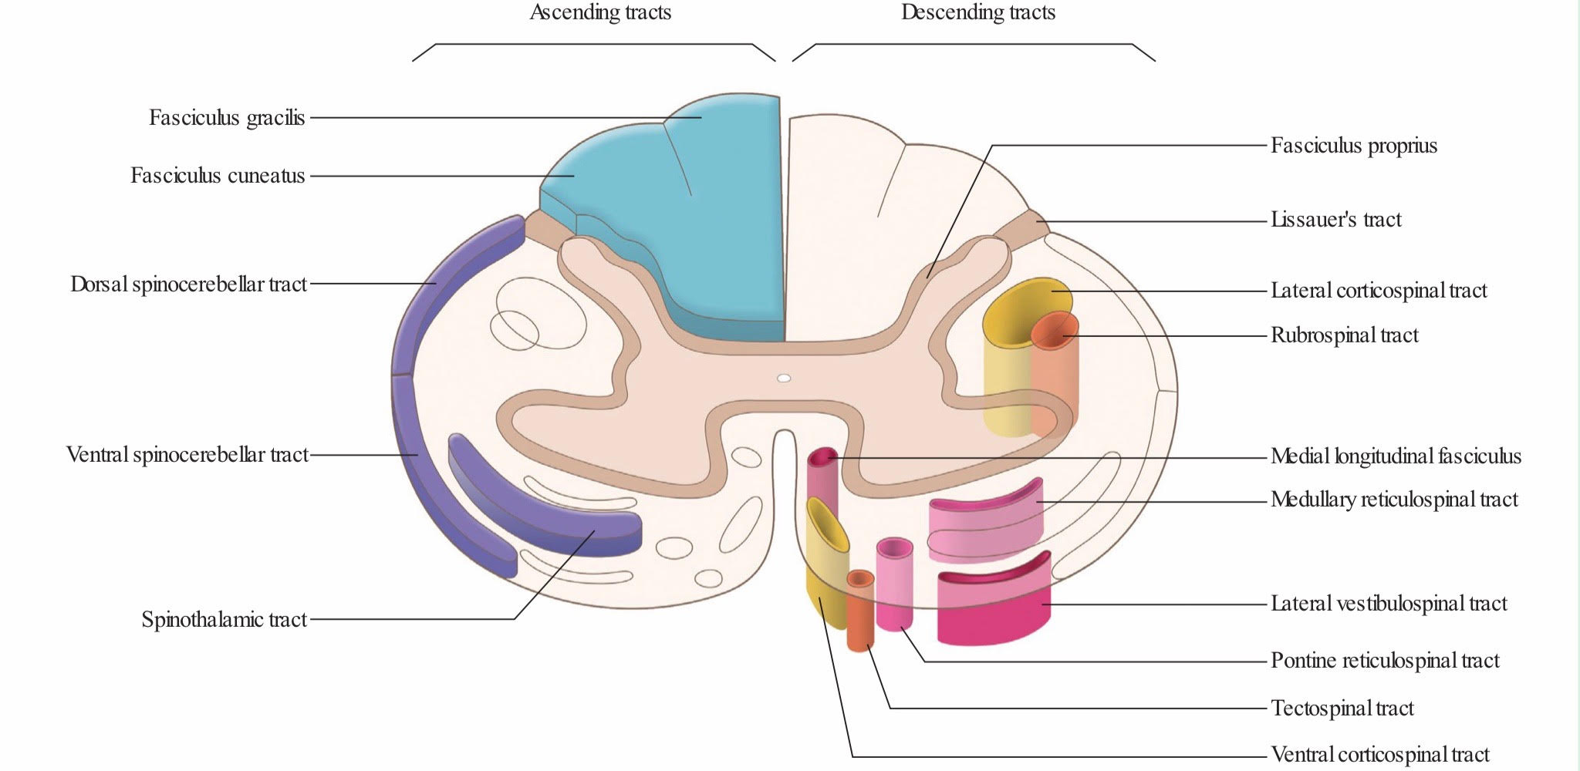
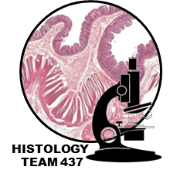
Ascending & Descending Tracts
*Identify the labelled structure & function?
Fasciculus gracilis
Fasciculus cuneatus
*Proprioception (movement & joint position sense)
*Fine touch
Lateral Corticospinal tract
*Voluntary movement
*Discrete movement
*Skilled movement
Lateral spinothalamic tract
*Pain
*Temperature
Ventral spinothalamic tract
Ventral Corticospinal tract
*Pressure
*Crude touch
*Voluntary movement
*Discrete movement
*Skilled movement

