Slide 2
Objectives
At the end of the lecture, students should be able to:
List the parts of the nervous system.
List the function of the nervous system.
Describe the Structural & Functional Organizations.
Define the terms:
Nervous tissue, grey matter, white matter, nucleus, ganglion, tract, nerve.
List the parts of the brain.
List the structures protecting the central nervous system.

Slide 3
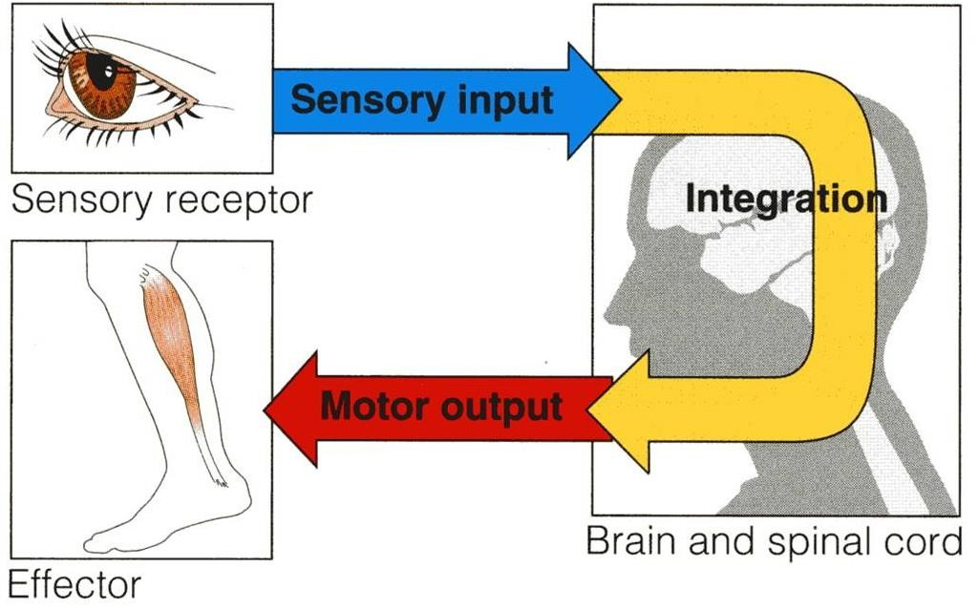




Introduction
How does the nervous system work?
The nervous system has three general functions:
Collection of sensory input:
  Identifies changes occurring inside or outside the body by using sensory receptors. These changes are called stimuli.
Integration:
  Processes, analyzes, and interprets these changes and makes decisions.
Motor output, or response by activating muscles or
glands (effectors).

Slide 4

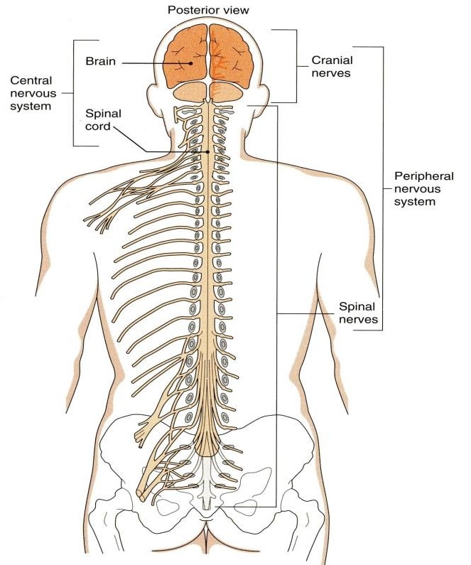
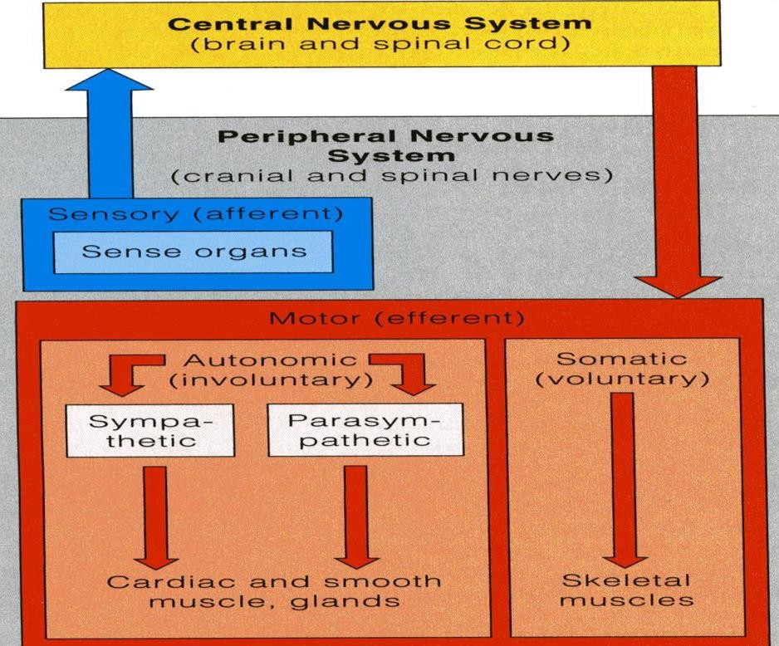
Classification
To remember: SAME
Sensory: Afferent / Motor: Efferent
11:57
Anatomical or Structural classification:
  Central Nervous System
(brain and spinal cord)
  Peripheral Nervous System
(everything coming out of the CNS: cranial and spinal nerves, ganglia, and receptors)
Physiological or Functional classification:
  Sensory division (Afferent) 2-Motor division (Efferent):
    Somatic (voluntary)
    Autonomic (involuntary)

Slide 5
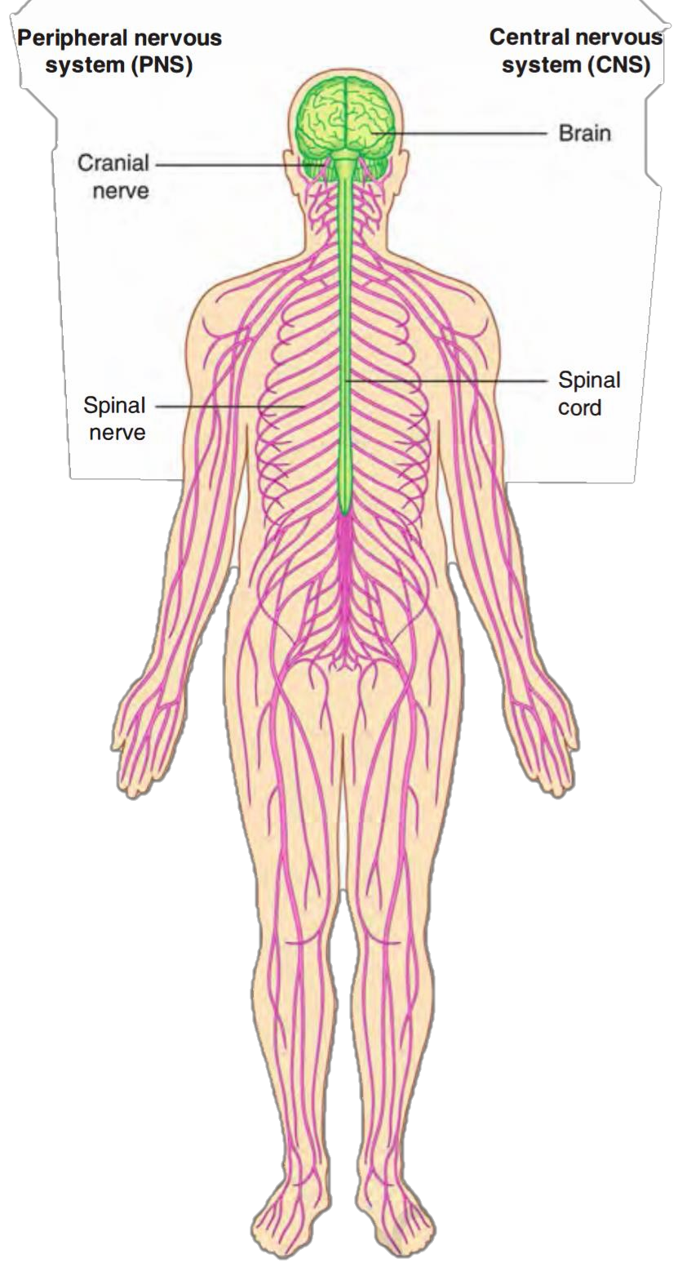
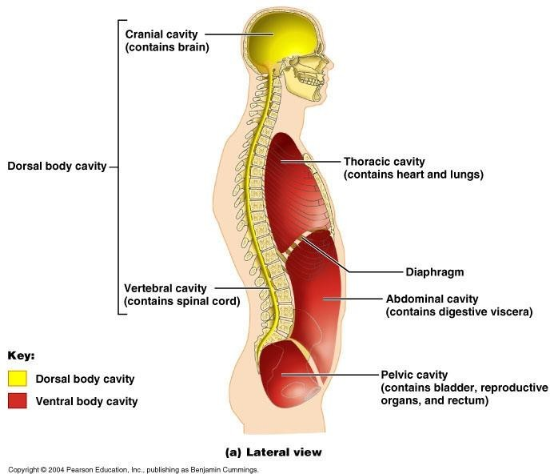
Classification
Structural Organization
Two subdivisions:
Central Nervous System (CNS)
  Consists of Brain & Spinal cord
  Occupies the dorsal body cavity.
  Acts as the integrating and command centers.
Peripheral Nervous System (PNS)
  Consists of nerves, ganglia, receptors.
  It is the part of the nervous system
outside the CNS.
Extra

Slide 6
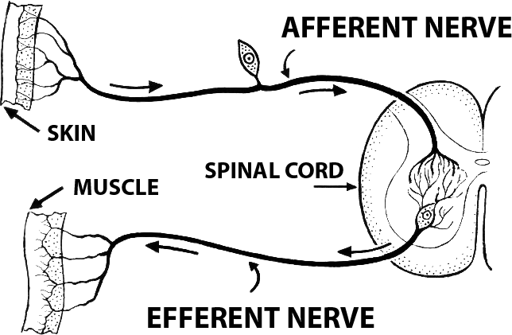
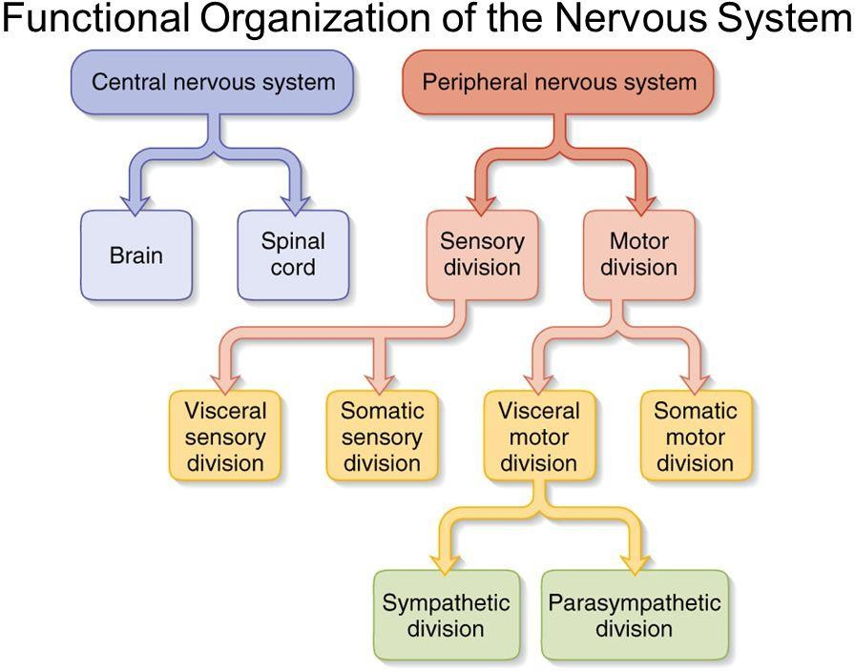
Classification
Functional Organization
Afferent → approach the CNS
Efferent → exit the CNS
Two subdivisions:
Sensory or afferent division:
  Consists of nerve fibers that convey impulses from receptors located in various parts of the body, to the CNS.
Motor or efferent division:
  Consists of nerve fibers that convey impulses from the CNS to the effector organs, muscles and glands.
Both sensory and motor subdivisions are further divided into visceral and somatic (we will focus here on the motor subdivision)
Motor subdivision is divided into:
Somatic division: concerned with skin, skeletal muscles and joints.
Autonomic (visceral) division: concerned with the visceral organs
(sympathetic and parasympathetic).
Extra
(autonomic)
Extra

Slide 7
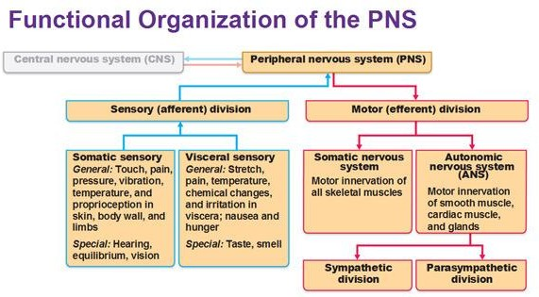
Only on the girl’s slides
Additional picture for more understanding.

Slide 8
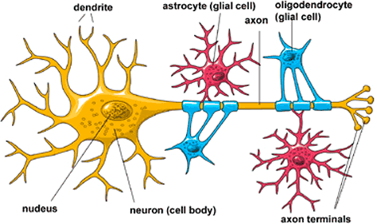
The Nervous System
It is the major controlling, regulatory & communicating system in the body.
It is the center of all mental activity including: Thought, Learning, Behavior and Memory.
Together with the endocrine system, the nervous system is responsible for regulating and maintaining homeostasis. (Nervous System + Endocrine System → Homeostasis)
Nervous system is composed of nervous tissue, which contains two types of cells:
  Nerve cells or neurons (cell bodies)
  Supporting cells or neuroglia (glia). (Supporting bodies)
Nervous system contains millions of neurons that vary in their shape, size, and number of processes.
The nerve cells can't regenerate
Extra
Nervous Tissue

Slide 9
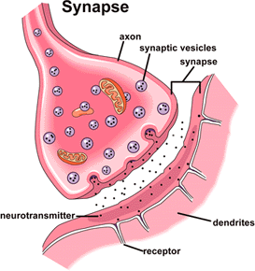
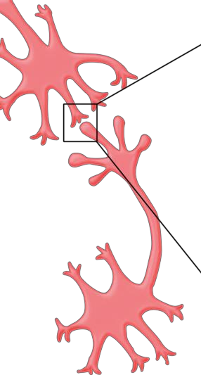
Nervous Tissue
Neurons
What is a neuron?
It is the basic structural (anatomical), functional and embryological unit of the nervous system.
The human nervous system is estimated to contain
about 10¹⁰.
The junction site of two neurons is called a
“synapse or relay”.
In the synapses the membranes of adjacent cells are in close apposition (contiguity=contact, not continuity). They are adjacent to each other and may come into contact but are not continuous with one another. (متلامسة وليست متسلسلة)

Slide 10
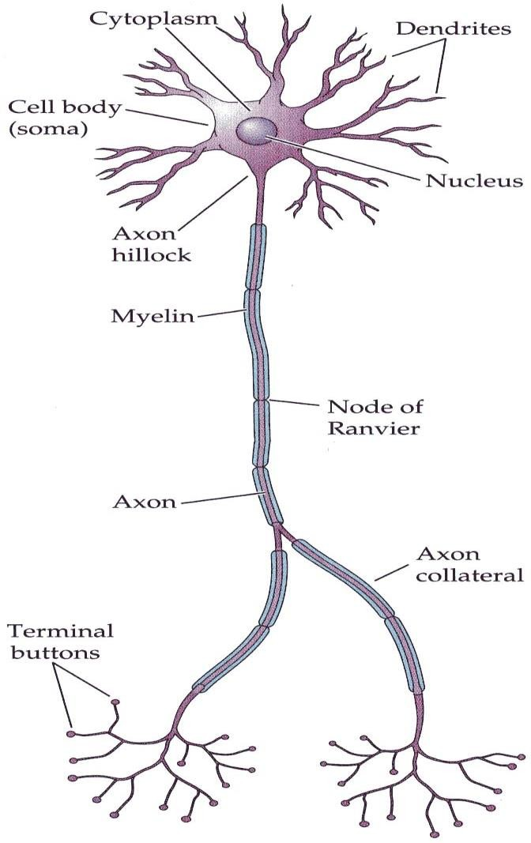
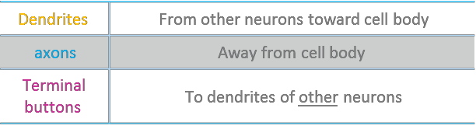
Nervous Tissue
Dendrites
Dendrites are like ears so they receive information.
Axons are like the mouth so they send information.
The neuron has cell body with multiple processes.
Most of the processes of the cell body are short with variable numbers and are receptive in function.
They are known as Dendrites.
One of these processes leaving the cell body is called the axon
which carries information away from the cell body.
Axons are highly variable in length and may divide into several branches or collaterals through which information can be distributed to a number of different destinations.
At the end of the axon, specializations called terminal buttons occur where information is transferred (neurotransmission) to the dendrites of other neurones.

Slide 11
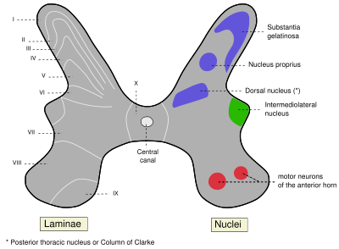
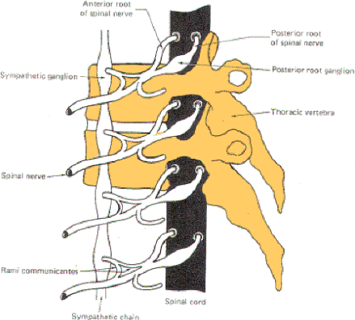
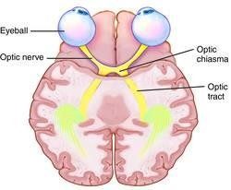
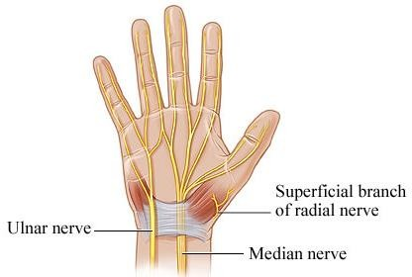
Remember the difference!
Nucleus= A group of neurons within the CNS
Ganglion= A group of neurons outside the CNS
Tract= A group of nerve fibers (axons) within
the CNS
Nerve= A group of nerve fibers (axons) outside
the CNS

Slide 12
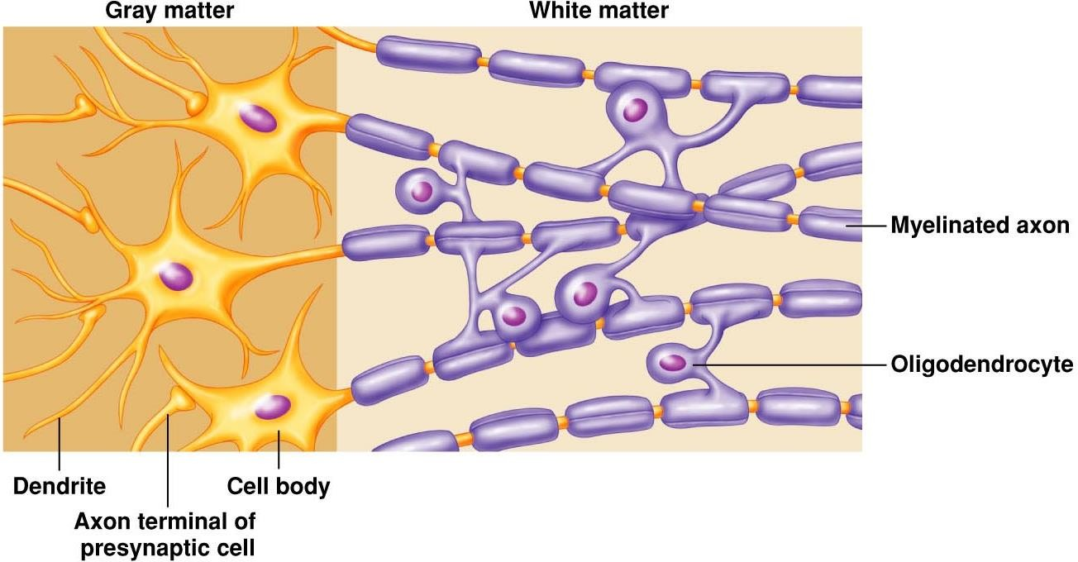
Nervous Tissue
Nervous tissue is organized as:
Grey Matter | White Matter
1. Cell Bodies | No cell bodies in the white matter
2. Processes of the neurons | 1. Processes of the neurons
3. Neuroglia | 2. Neuroglia
4. Blood Vessels | 3. Blood vessels

Slide 13
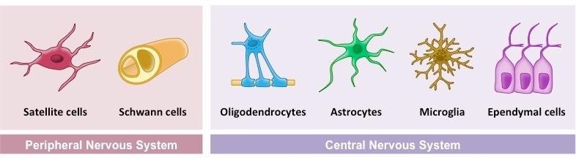
Only on the girl’s slides
Nervous Tissue
Neuroglia (or glia or glial cells)
Neuroglia, or glia cells constitute the other major cellular component of the nervous tissue. “Neuroglia (plural), ganglion (singular)”
It is a specialized connective tissue supporting framework for the nervous
system
Unlike neurones, neuroglia do not have a direct role in information processing but they are essential for the normal functioning of the neurons, they act as supporting and nutrition for neurons
Extra

Slide 14
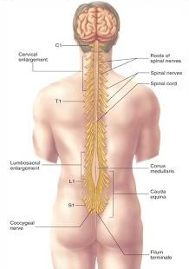
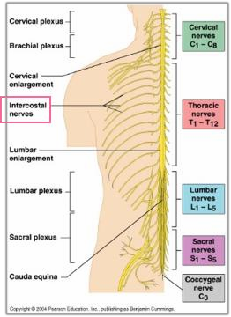
Only on the boy’s slides
Spinal Cord
Elongated almost cylindrical suspended in the vertebral canal, surrounded by the meninges and cerebrospinal fluid. Start from foramen magnum to L1-L2
Approximately 45 cm long in adult and is about the thickness of the little finger.
It extends from the foramen magnum to the upper border of the 2nd lumbar vertebra.
Continuous above with the medulla oblongata.
Its lower end is called conus medullaris*.
Gives rise to 31 pairs of spinal nerves:
  8 Cervical
  12 Thoracic
  5 Lumbar
  5 Sacral
  ONE Coccygeal
*Recall from foundation:
End of spinal cord: conus medullaris.
End of spinal nerves: cauda equina.

Slide 15
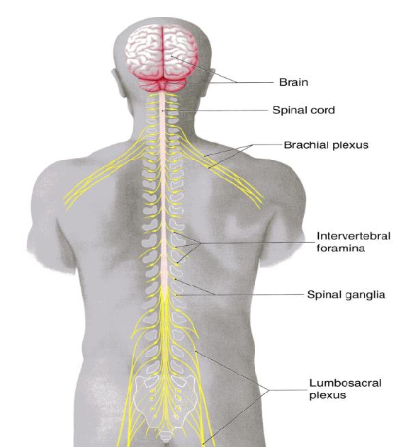
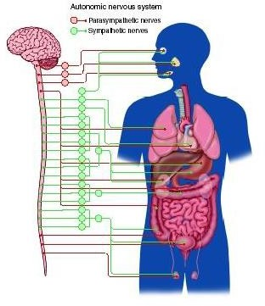
Peripheral Nervous System
Spinal nerves supplying the upper or lower limbs form plexuses e.g brachial or lumbar plexus. (It always coming from the anterior rami)
Nerve cell bodies that are aggregated outside the CNS
are called GANGLIA.
Neurons that detect changes and control the activity of the viscera are collectively referred to as the autonomic nervous system.
Its components are present in both the central and peripheral nervous systems.
The autonomic nervous system innervates:
Smooth muscles
Cardiac muscle
Secretory glands
Autonomic Nervous System

Slide 16
Autonomic Nervous System
It is an important part of the homeostatic mechanisms that control the internal environment of the body with the endocrine system.
The autonomic nervous system is divided into two anatomically and functionally distinct parts:
  Sympathetic: Or Thoracolumbar outflow
  Parasympathetic: Or Craniosacral outflow.
Sympathetic and parasympathetic , divisions are generally have antagonistic effects on the structures that they innervate.
E.g. Sympathetic increases the heart rate, while the parasympathetic decreases the heart rate.

Slide 17
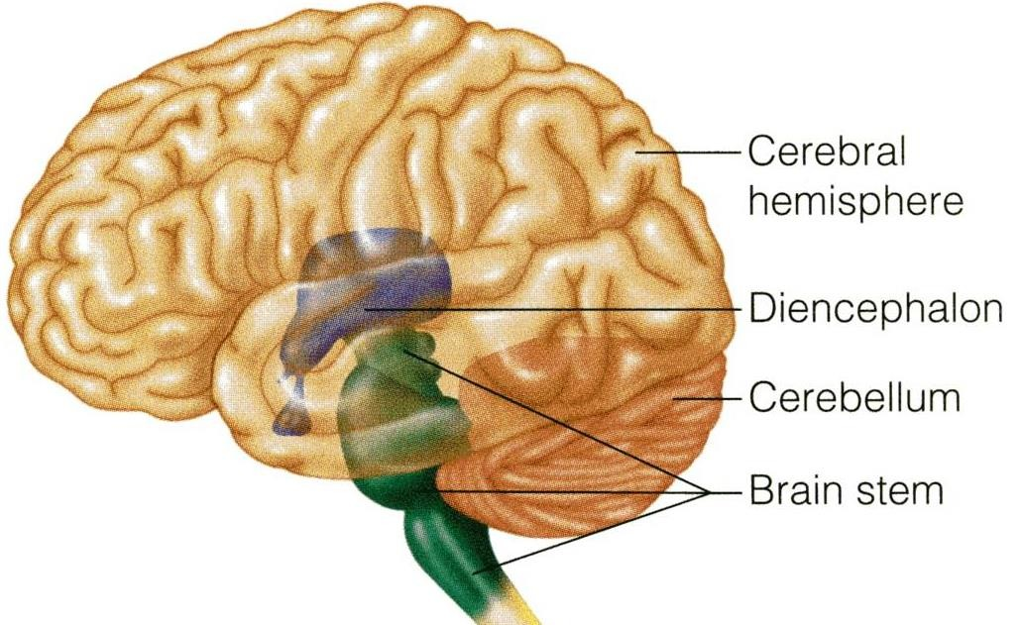
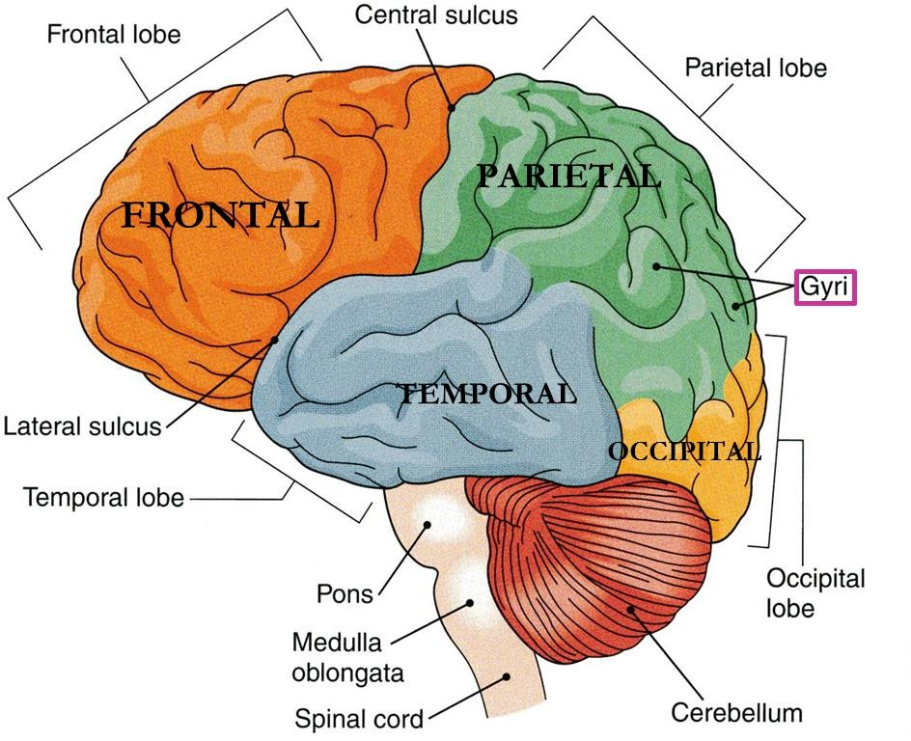

The Brain
The brain is composed of 4 parts:
  Cerebral hemispheres (2 cerebrum)
  Diencephalon
  Brain stem
  Cerebellum
The largest part of the brain.
They have elevations, called gyri (singular: gyrus)
Gyri are separated by depressions called sulci (singular: sulcus).
Each hemisphere is divided into 4 lobes named according to the bone of the skull above.
Lobes are separated by deeper grooves called fissures or sulci.
Example: central sulcus separates the frontal lobe and parietal lobe.
lateral sulcus separates frontal, parietal and temporal lobes
11:57
1. Cerebral Hemisphere

Slide 18
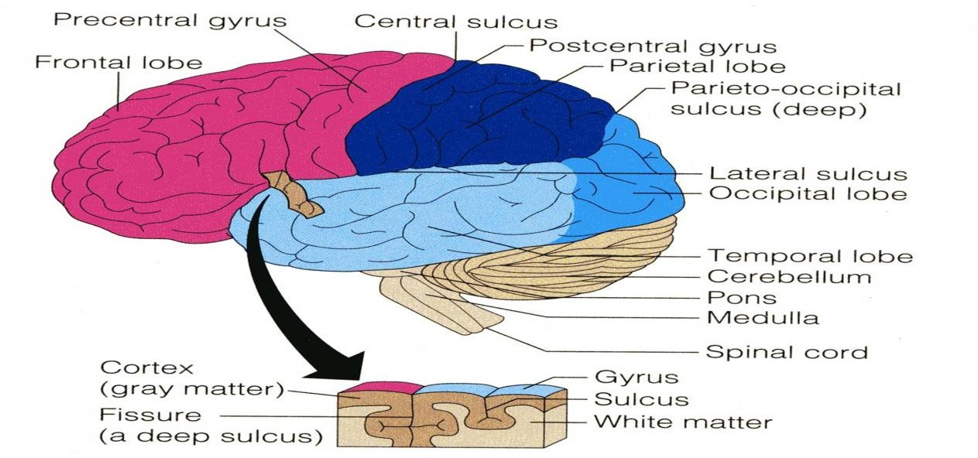
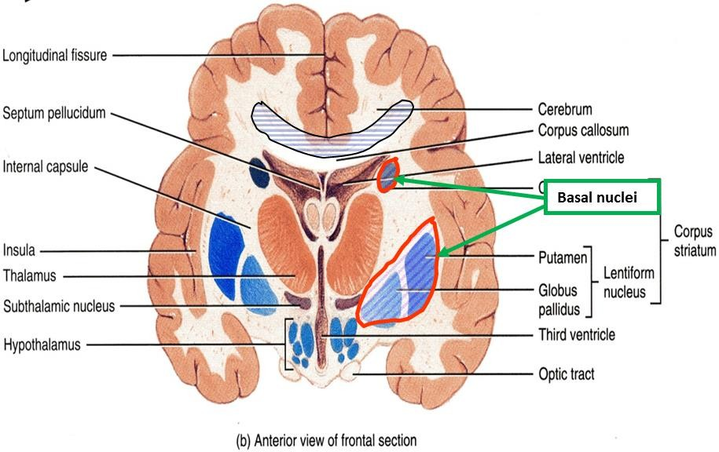
The Brain
1. Cerebral Hemisphere
Tissue of the cerebral hemispheres:
The outer layer is the gray matter or cortex.
Deeper is located the white matter, or medulla, composed of bundles of nerve fibers, carrying impulses to and from the cortex
Basal nuclei are gray matter that are located deep within the white matter. (they are an exception because white matter should only contain fibers)
They help the motor cortex in regulation of
voluntary motor activities.

Slide 19
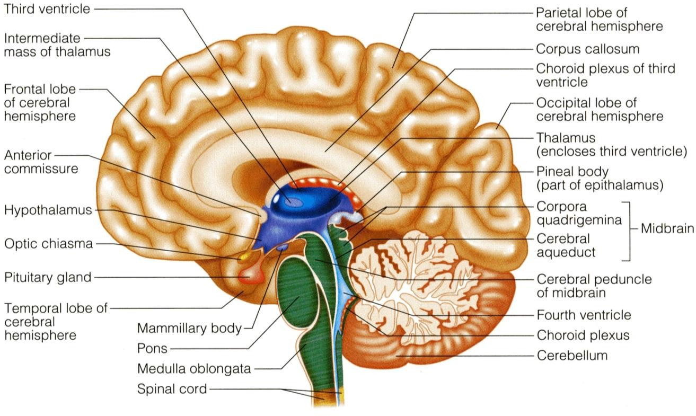

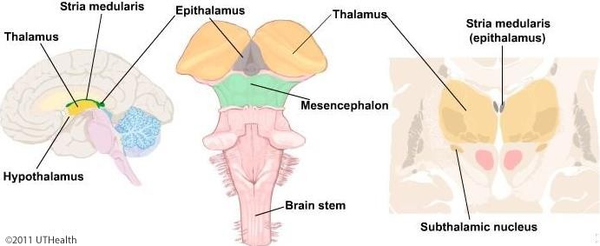
The Brain
2. Diencephalon
The diencephalon is located between the 2 cerebral hemispheres and is linked to them and to the brainstem.
The major structures of the diencephalon are the Thalamus, Hypothalamus, Subthalamus and Epithalamus.
Extra

Slide 20
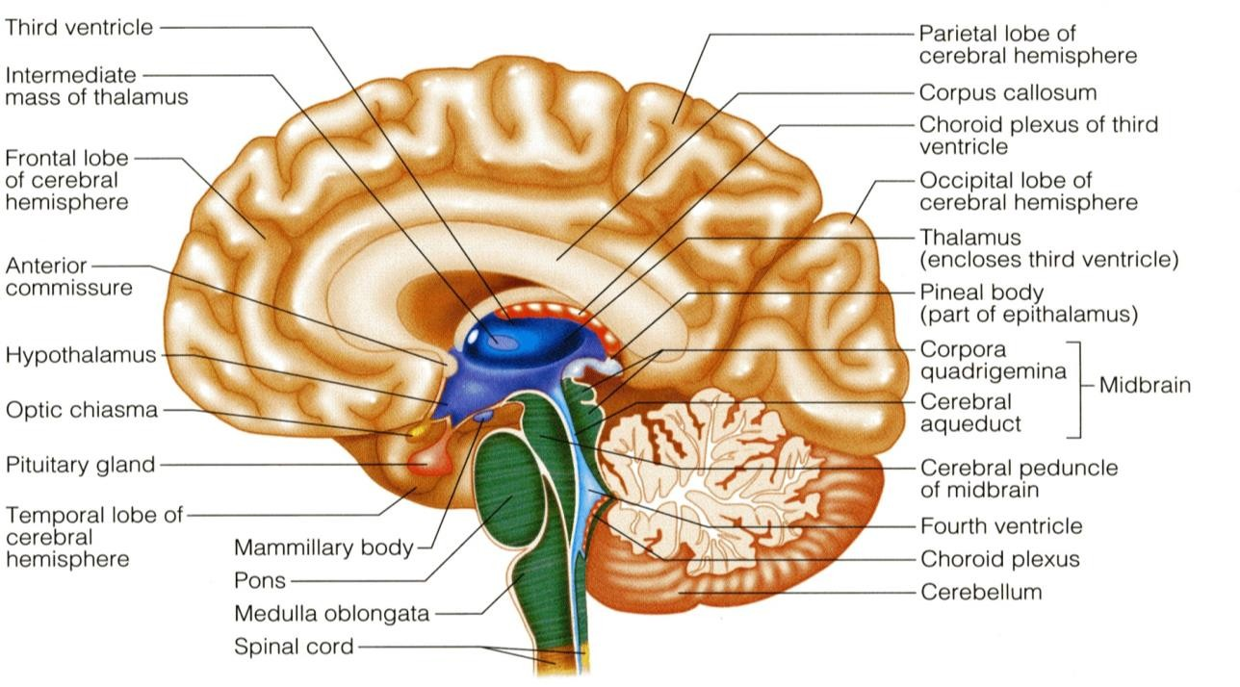
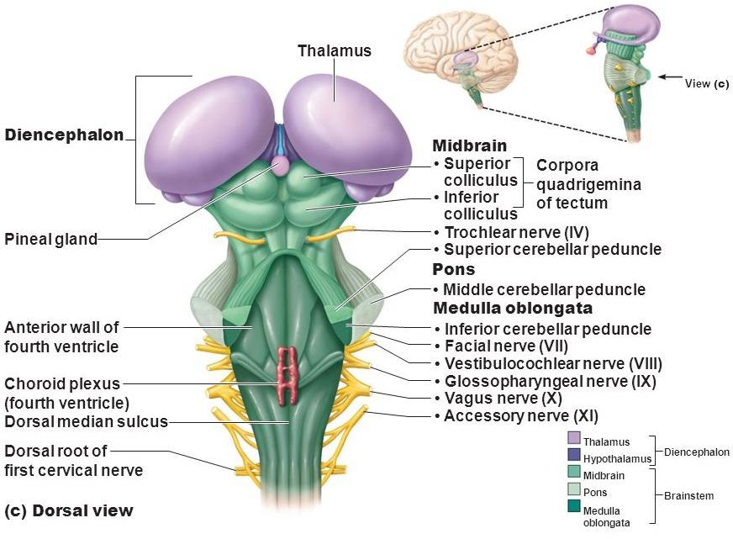
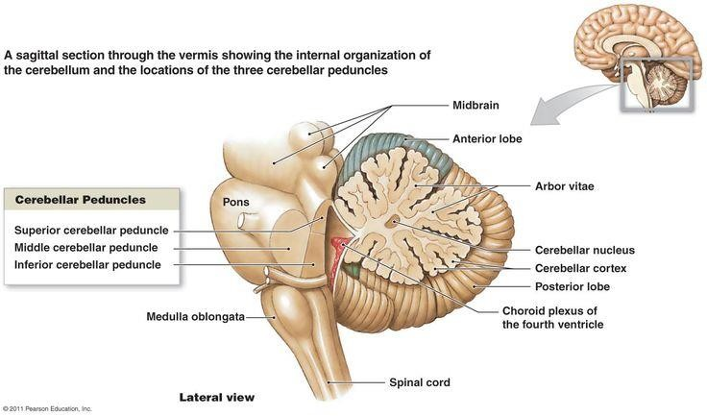
The Brain
3. Brainstem
The brainstem has three parts
midbrain, Pons and medulla oblongata (continues as the spinal cord).
It is connected to the cerebellum with 3 paired peduncles: Superior, middle and inferior.
*Superior peduncle connects midbrain
with cerebellum
Middle peduncle connects pons with cerebellum
Inferior peduncle connects medulla
oblongata with cerebellum
Extra
Extra

Slide 21
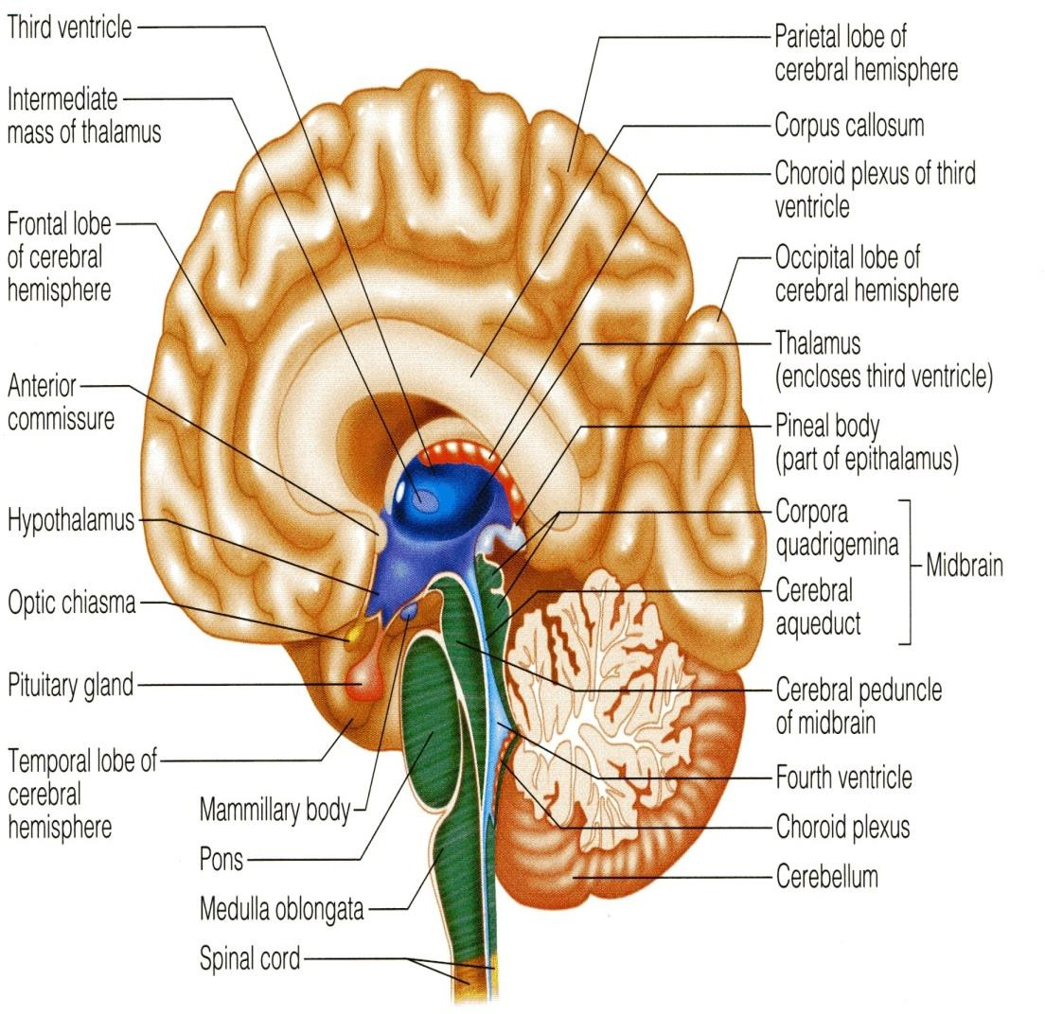

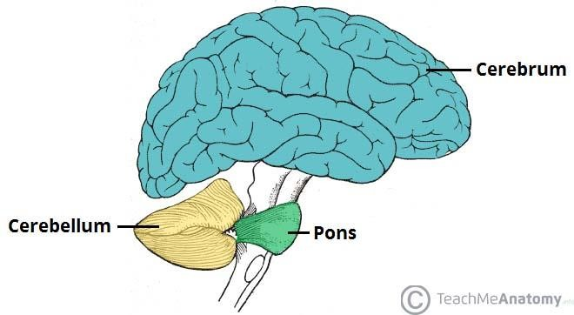
The Brain
4. Cerebellum
Cerebellum has 2 cerebellar hemispheres with convoluted surface.
It has an outer cortex of gray matter
and an inner region of white matter.
It provides precise coordination for body movements and helps maintain equilibrium.
Extra

Slide 22
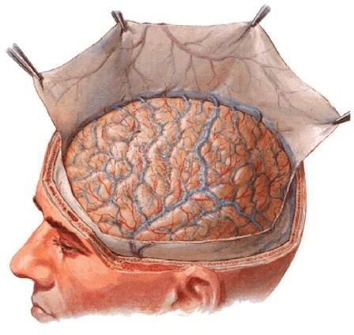
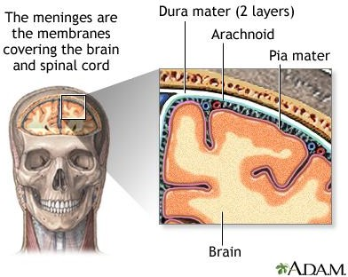
Meninges
There are three connective tissue membranes invest the brain and the spinal cord.
These are from outward to inward are:
  Dura mater. الصلبة
  Arachnoid mater. عنكبوتية
  Pia mater. متلاصقة بشكل مباشر
The space between the arachnoid mater and pia mater is the subarachnoid space for the CSF (cerebrospinal fluid).
Note that is NO subpia space
Dura → Outside Pia → Inside
To remember the order from outside to inside:
Dora Ate Pie
Extra

Slide 23
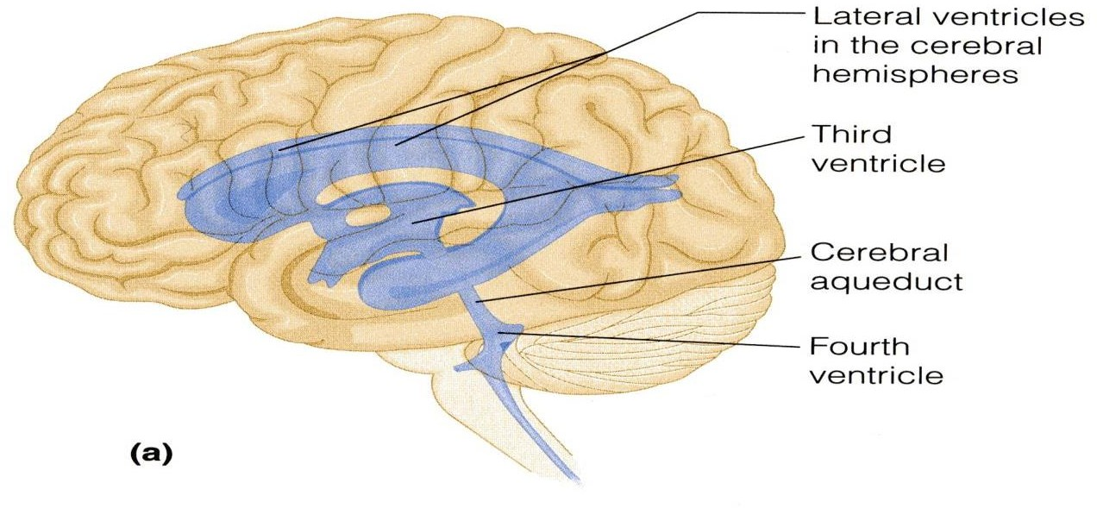
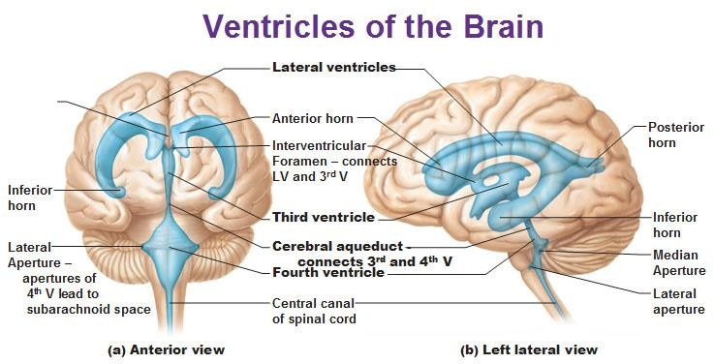
Brain Ventricles
02:02
Brain is bathed by the cerebrospinal fluid (CSF).
Inside the brain, there are 4 ventricles filled
with CSF.
o The 4 ventricles are:
2 lateral ventricles: One in each hemispheres.
3rd ventricle: in the Diencephalon.
4th ventricle: between Pons, Medulla oblongata & Cerebellum.
N.B. Cerebral aqueduct* (within midbrain):
connects the 3rd to the 4th ventricle.
*cerebral aqueduct is also a channel for CSF but is not considered a ventricle.
Interventricular foramen
Extra

Slide 24
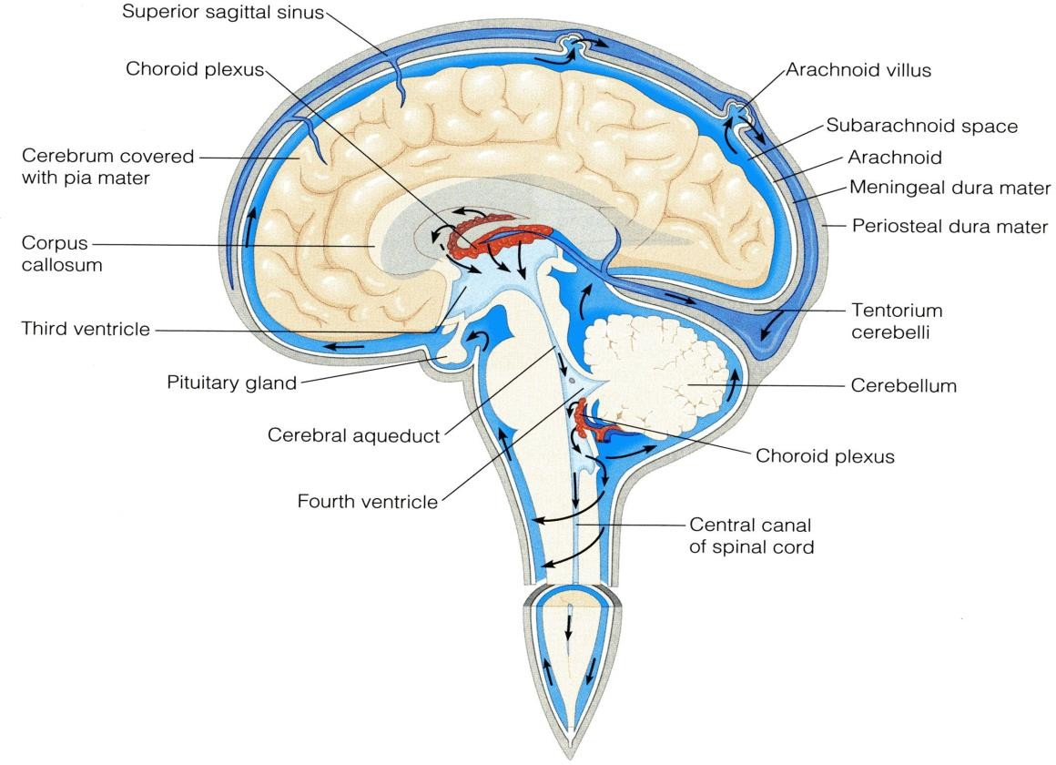
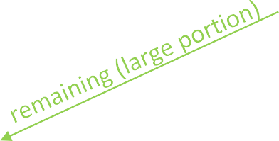
Cerebrospinal Fluid (CSF)
CSF is constantly produced by the choroid plexuses inside the ventricles.
Inside the brain, CSF flows from the lateral ventricles to the 3rd and 4th ventricles*
From the 4th ventricle, a small part of the CSF
flows down in the central canal of the spinal cord.
Most of the CSF drains from the 4th ventricle to distribute in the subarachnoid space around the brain and returns to the dural sinuses through the arachnoids villi.
Arachnoid villi are small protrusions of the arachnoid.
Villi absorb cerebrospinal fluid and return it finally to the dural venous circulation.
CSF is important to absorbed hits
Lateral ventricle → 3rd ventricle → 4th ventricle → central canal (small
portion)
Subarachnoid space → through arachnoid villi → dural venous sinuses

Slide 25
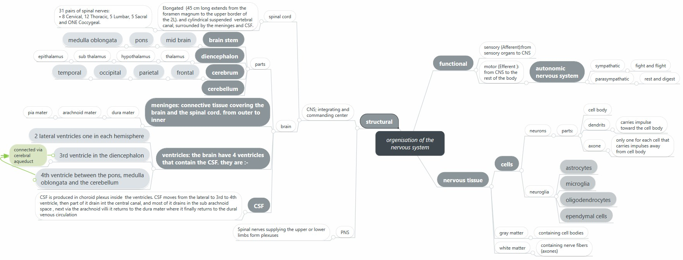
Summary

Slide 26
(1) CSF is constantly produced by?
A) Cerebral Aqueduct B) Choroid Plexuses
C) Diencephalon D) Brachial plexuses
(2) What is the final drainage of CSF?
A) Arachnoids Villi B) Subarachnoid Space
C) Dural Sinuses D) Choroid plexuses
(3) The 3rd ventricle lies in?
A) Cerebral hemisphere B) Diencephalon
C) Cerebellum D) Brain stem
(4) Autonomic nervous system is present in?
A) Central nervous system B) peripheral nervous system C) A&B D) Non of them
(5) Which one of the following is related to the nucleus?
A) Neurons outside the CNS
B) Neurons inside the CNS
C) Nerve fibers within the CNS D) Nerve fibers outside the CNS.
(6) What is the functional unit of nervous tissue?
A) Neuron B) Neuroglia
C) Nephron D) Non of them
(7) Which component is NOT found in white matter?
A) Cell body B) Blood vessels
C) Processes of the neuron D) Neuroglia
(8) Which one in NOT innervated by ANS?
A) Skeletal muscle B) Smooth muscle
C) cardiac muscle D) secretary glands
(9) The meninges layers from outward to inward?
A) Pia mater , arachnoid mater , dura mater
B) Arachnoid mater , pia mater , dura mater
C) Dura mater , arachnoid mater , pia mater
D) Arachnoid mater , dura mater , pia mater
(10) connects the 3rd to the 4th ventricle?
A) Arachnoid villi B) Cerebral aqueduct
C) Central canal D) Choroid plexuses

Slide 27
Answers
(1) B (6) A
(2) C (7) A
(3) B (8) A
(4) C (9) C
(5) B (10) B

Slide 28
(1) How does the cerebrospinal fluid circulate?
Cerebrospinal fluid (CSF) is produced in the choroid plexus of the lateral ventricles to the 3rd ventricle then 4th ventricle via cerebral aqueduct. Part of CSF then circulates down in the central canal of the spinal cord. But most of the CSF drains from the 4th ventricle to distribute in the subarachnoid space around the brain and returns to the dural sinuses through the arachnoids villi
(2) What does peripheral nervous system consist of?
Consists of nerves, ganglia, receptors.
(3) What are the three layers of the meninges from outward to inward? Which layer of the meninges contains the cerebrospinal fluid?
Dura mater.
Arachnoid mater.
Pia mater.
Cerebrospinal fluid is located in the subarachnoid space between the arachnoid mater and the pia mater.

