Slide 1


Slide 2
Objectives
At the end of the lecture, students should be able to:
Describe the structures forming the walls of the nasal cavity.
List the main structures draining into the lateral wall of the nasal cavity.
Differentiate between the respiratory and olfactory regions of the nasal cavity.
List the main sensory and blood supply of the nose.
Describe the olfactory pathway.

Slide 3
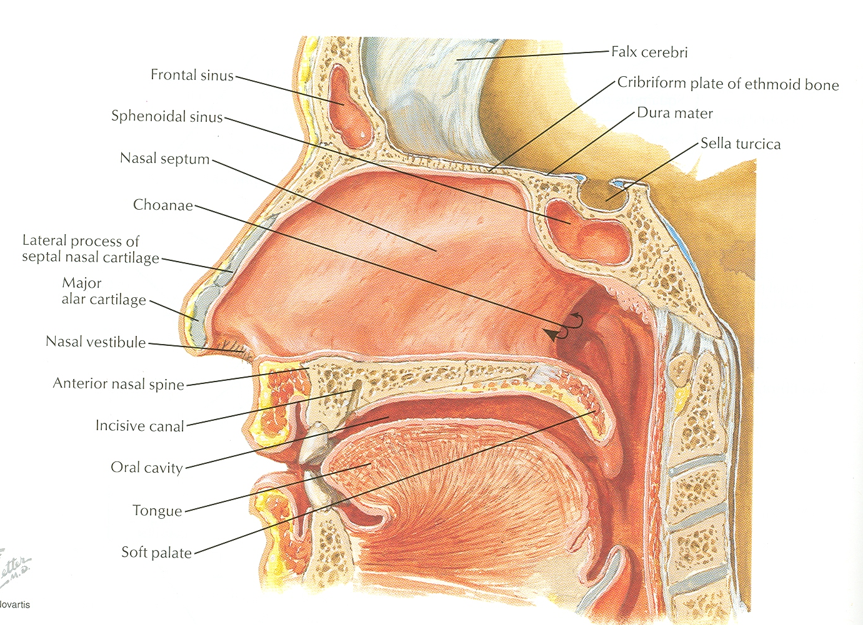
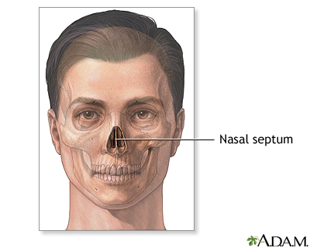
Nasal Cavity
The external (anterior ) nares or nostrils lead to the nasal cavity.
Formed above by bony skeleton, and below by plates of hyaline cartilage.
It is a large air filled space above and behind the nose in the middle of the face.
It extends (begins) from nostrils anteriorly to the choanae posteriorly.
Each cavity is the continuation of one of the two nostrils.
It communicates with the nasopharynx posteriorly.
Divided into right and left parts by the nasal septum (medial wall).
Each part has:
Roof
Floor
Lateral and
Medial walls.
Extra

Slide 4
*Only in Boys slides
The Nose
Functions:
-Olfaction (smell)
-Respiration (breathing)
-Warming inspired air (submucous venous plexues)
-Filtration of dust
-Humidification of the inspired air (mucous)
-Reception of secretions from the paranasal sinuses and nasolacrimal duct
Divisions:
1-Vestibule region:
• It is the area surrounding the external opening to the nasal cavity.
• Lined by modified skin, provided with hairs, and sebaceous glands, to filter the incoming air.
• exocrine glands in the skin that secrete an oily or waxy matter called sebum to lubricate and waterproof the skin and hair.
2-Respiratory region:
• The largest region.
• Lined with mucous that is continuous with that of Nasal Sinuses, Lacrimal sac, Conjunctiva,
and Nasopharynx.
3-Olfactory region:
• Located at the apex of the nasal cavity.
• It is lined by olfactory cells with olfactory receptors.

Slide 5
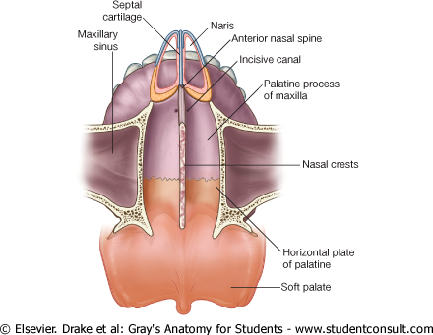
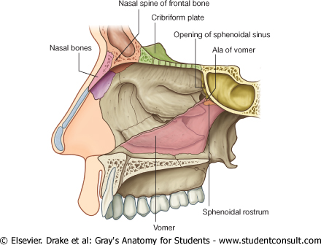
Nasal Cavity
1. Floor
Formed by:
Nasal (upper) surface of the hard (bony) palate:
Palatine process of maxilla (anteriorly)
Horizontal plate of the palatine bone (posterior)y”
2. Roof (narrow, sloping)
Formed by:
Body of sphenoid (posteriorly)
Cribriform plate of ethmoid (in the middle)
Frontal, and nasal bones (Anteriorly)

Slide 6
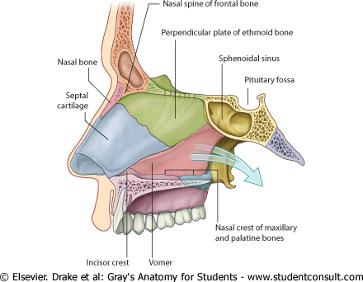
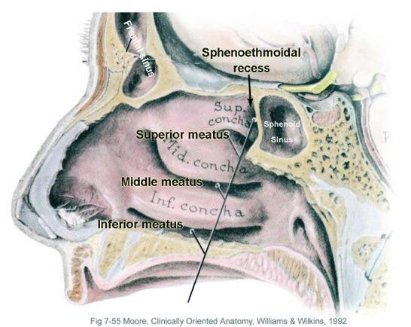
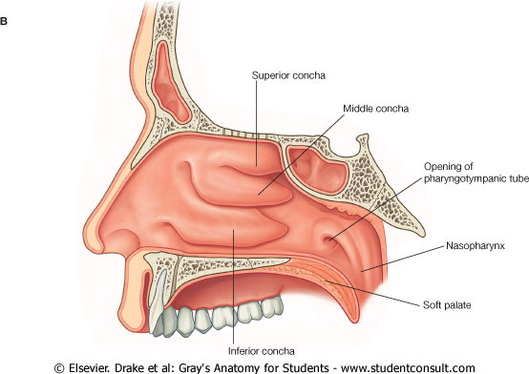
Nasal Cavity
3. Medial Wall
The nasal septum :
Vertical or perpendicular plate of
ethmoid.(superior)
Septal cartilage.(most anterior)
Vomer.(inferior)
Extra
4. Lateral Wall
Marked by Three projections (Nasal Conchae):
Superior, middle, and inferior(biggest)
The space below each concha is called Meatus.
Superior, middle, and inferior meatus.
The space (fossa) above the superior concha is
the Sphenoethmoidal recess.

Slide 7
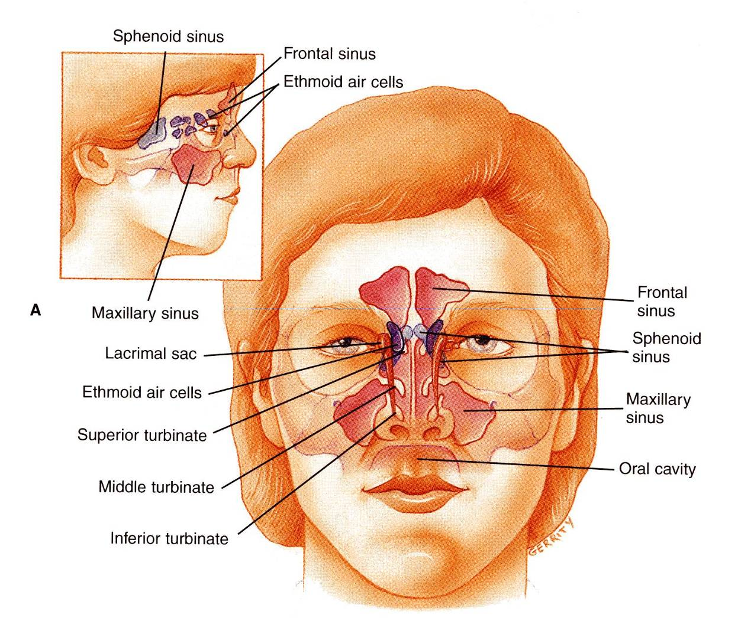
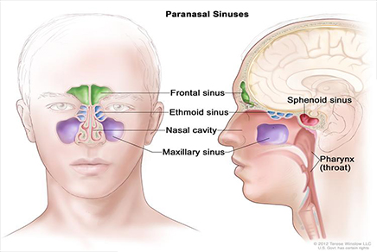
sinuses
secretion
obstruction
اذا صار فيه يتجمع ال داخل ال ويسبب صداع وتغيير بالصوت
Nasal Cavity
Paranasal Sinuses
They are cavities that are named according to the bones within which the sinuses located:
  Maxilla
  Frontal bone
  Sphenoid bone
  Ethmoid bone divided into anterior, middle, and posterior
They are:
  Lined with respiratory epithelium (ciliated pseudostratified columnar epithelium)(mucoperiosteal).
  Group of four paired air-filled spaces
  Communicate with the nasal cavity.
  Open in the lateral wall of the nasal cavity
  Functions:
  Lighten the skull weight
  Amplify the sound as we speak.
  Resonance of voice.
  Drainage secretion into the lateral wall
Extra
Provides a buffer against facial trauma.
Insulating sensitive structures like dental roots and eyes from rapid temperature change in the nasal cavity.
Humidifying and heating of inhaled air because of slow air turnover in this region.

Slide 8
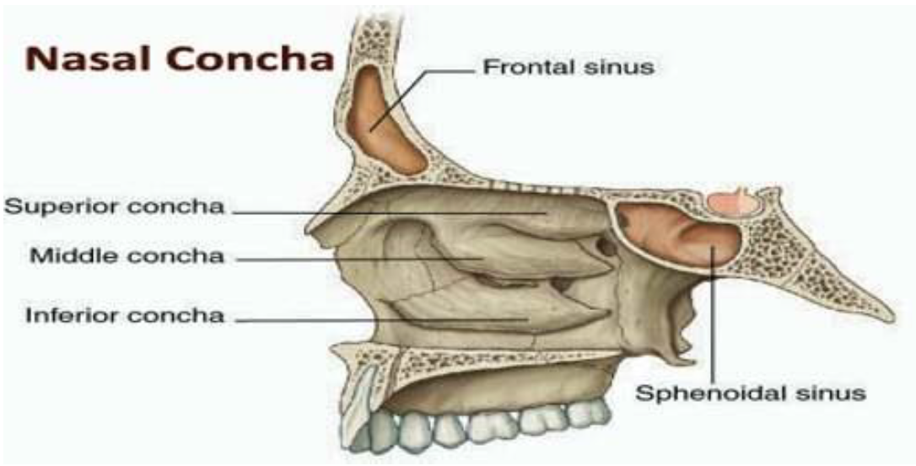
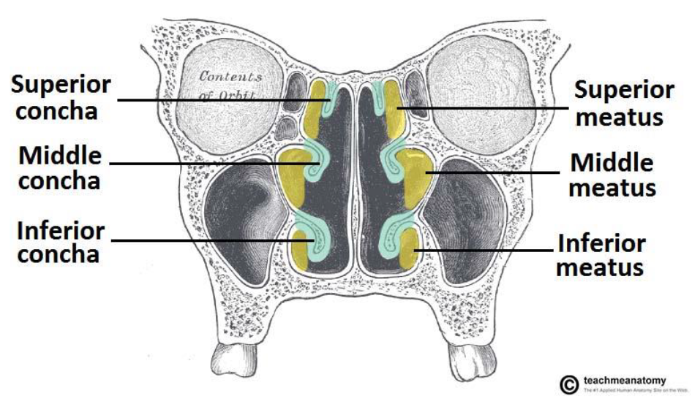
*Only in Boys slides
Nasal Cavity
Nasal conchae
Projecting out of the lateral walls of the nasal cavity are curved shelves of bone.
They project into the nasal cavity, creating four pathways for the air to flow.
These pathways are called meatuses:
-Inferior meatus: lies between the inferior concha and floor of the nasal cavity.
-Middle meatus: lies between the inferior and middle concha.
-Superior meatus: lies between the middle and superior concha.
-Spheno-ethmoidal recess: lies superiorly and posteriorly to the superior concha.
The function of the conchae is to increase the surface
area of the nasal cavity to increase the amount of inspired air that can come
into contact with the cavity walls.
They also disrupt the fast flow of the air, making it slow;
So that the air spends longer in the nasal cavity, so that it can
be humidified.

Slide 9
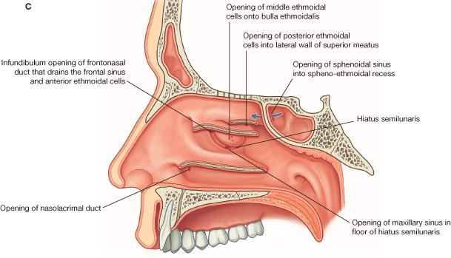
Nasal Cavity
Sinuses Opening in Lateral Wall
Spheno-ethmoidal recess | receives the opening of sphenoidal air sinus
Superior meatus | receives the opening of posterior ethmoidal sinus.
Middle meatus | receives the openings of (1) maxillary, (2) frontal, & (3) anterior , (4) middle ethmoidal sinuses. contains bulla ethmoidalis*, hiatus semilunaris**, Infundibulum***
Inferior meatus | receives the opening of nasolacrimal duct. اذا الدموع زادة عن حاجة العين تروح هنا
N.B: all sinuses open into the middle meatus EXCEPT:
Sphenoidal sinus : in sphenoethmoidal recess.
Posterior ethmoidal sinus : in superior meatus.
*Receives opening of (4) *** Receives opening of (2) and (3)
**Receives opening of (1)

Slide 10
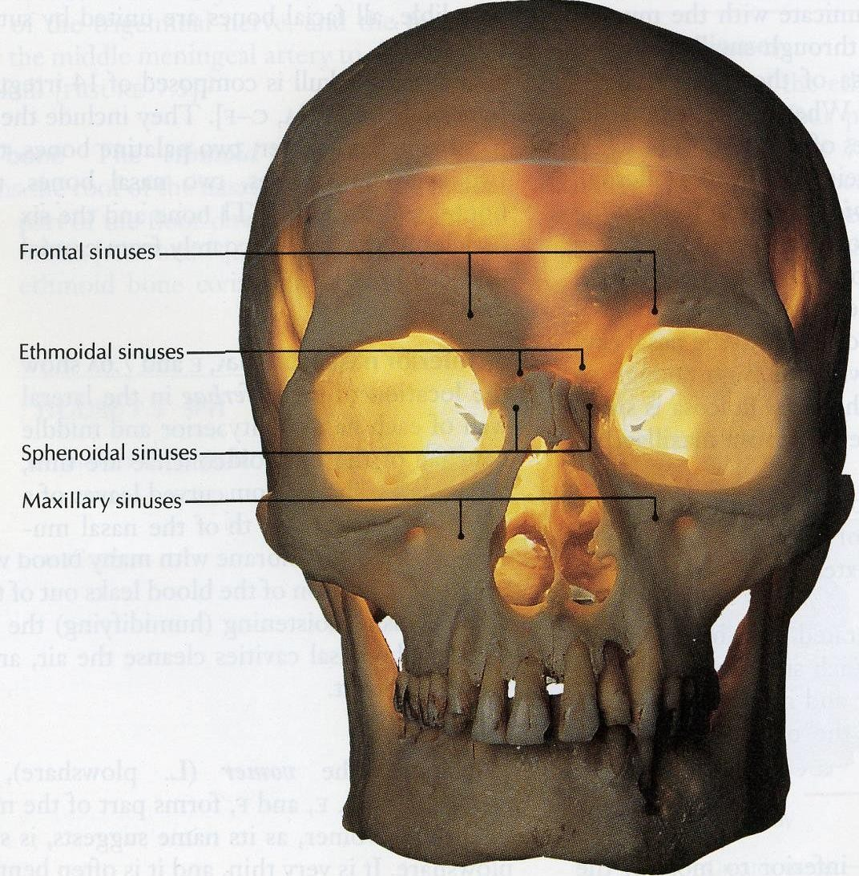
Nasal Cavity
Mucosa
The mucosa or mucous membrane is a type of tissue that lines the nasal cavity, and it is usually moist tissues that are bathed by secretions such as in the nose.
The mucosal lining of these (paranasal) sinuses is continuous with that in the nose and the throat.
So infection in this area tends to migrate into the sinuses causing sinusitis.
When the sinuses are obstructed they cause headaches.
The nose has 2 functions: respiration and smell, so accordingly there are two types of mucosa in the nasal cavity:
1. Respiratory mucosa
2. Olfactory mucosa

Slide 11
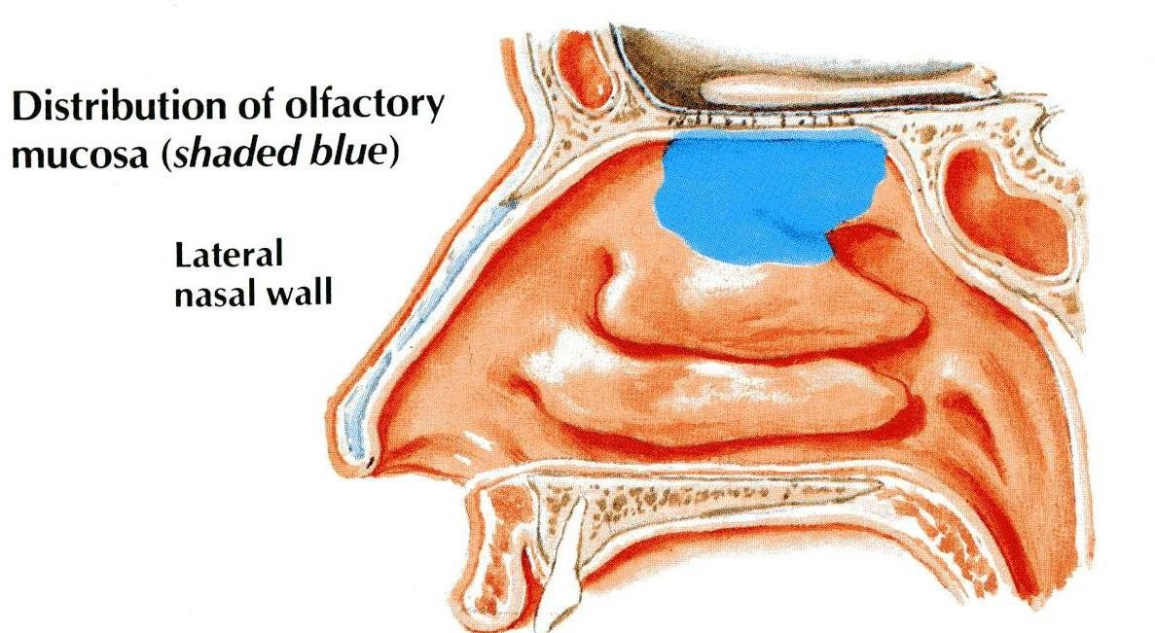
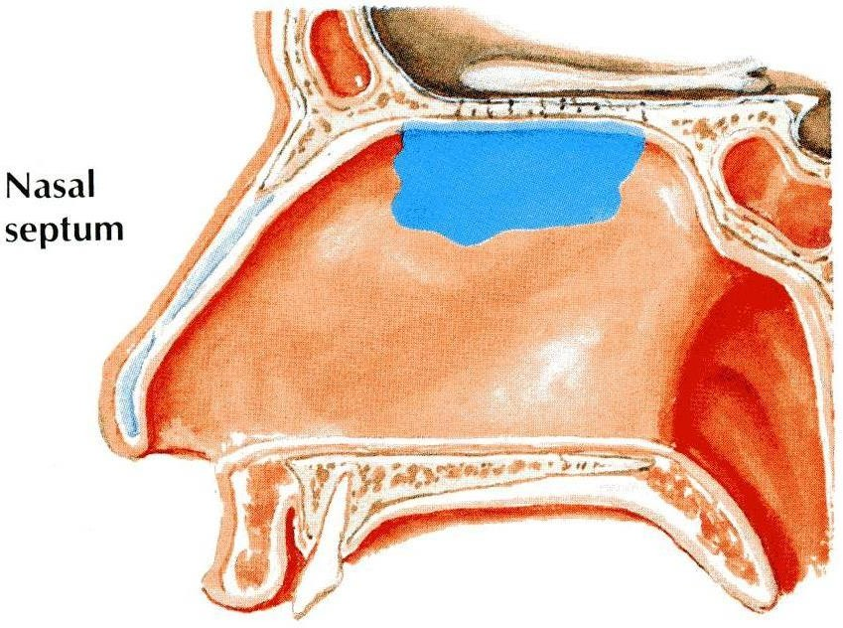
Nasal Cavity
Olfactory Mucosa
  It is made up by olfactory epithelium.
  It is delicate and contains olfactory nerve cells.
It is present in the upper part of nasal cavity:
Roof
On the lateral wall, it lines the upper surface of the superior concha and the sphenoethmoidal recess.
On the medial wall, it lines the superior part of the nasal septum.

Slide 12
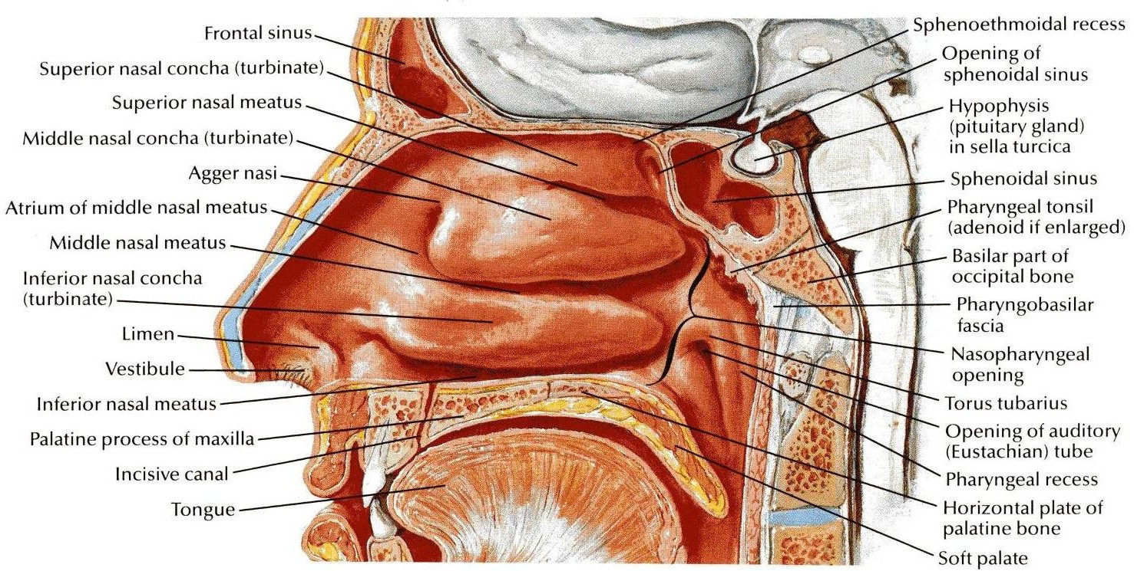
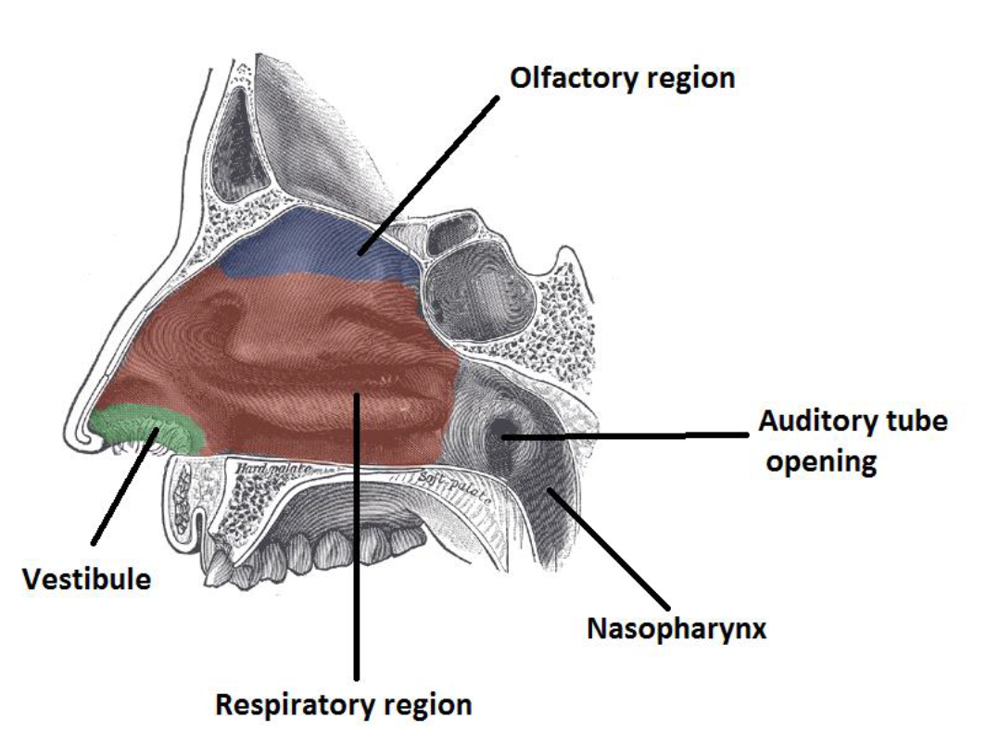
Nasal Cavity
Respiratory Mucosa
Vestibule: it is the only part of the nasal cavity which is lined by skin ( also contains hair)
It is thick, ciliated, highly vascular and contains mucous glands & goblet cells
It lines the lower part of the nasal cavity (from skin of vestibule* to the superior concha).
It functions to moisten, clean and warm the inspired air.
The air is moistened by the secretion of numerous serous glands.
It is cleaned by the removal of the dust particles by the ciliary action of the columnar ciliated epithelium that covers the mucosa.
The air is warmed by a submucous venous plexus.
The vestibule is lined by skin.

Slide 13
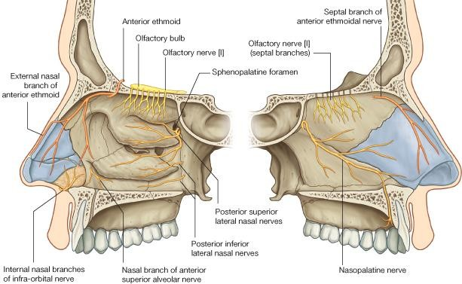
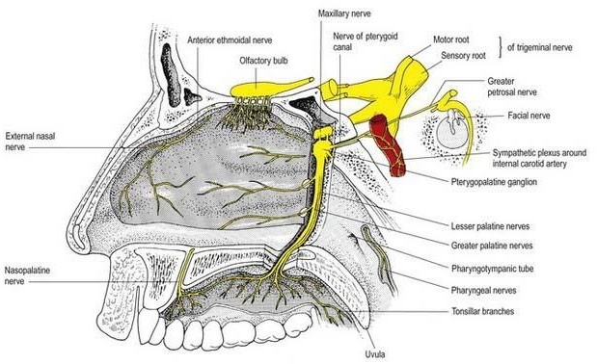
Nasal Cavity
Nerve Supply
Innervation to the external skin of the nose is supplied by the trigeminal nerve.
The nerves of General Sensation are derived from the Ophthalmic & Maxillary divisions of trigeminal nerve.
The anterior part is supplied by: Anterior Ethmoidal branch of nasociliary(another name is external nasal) nerve. (the septum and lateral wall)
The posterior part is supplied by branches of the pterygopalatine ganglion*:
1- Nasopalatine (the septum and lateral wall)
2- Nasal
3- Palatine
* The sensory root of the pterygopalatine ganglion is from the maxillary nerve.
Extra

Slide 14
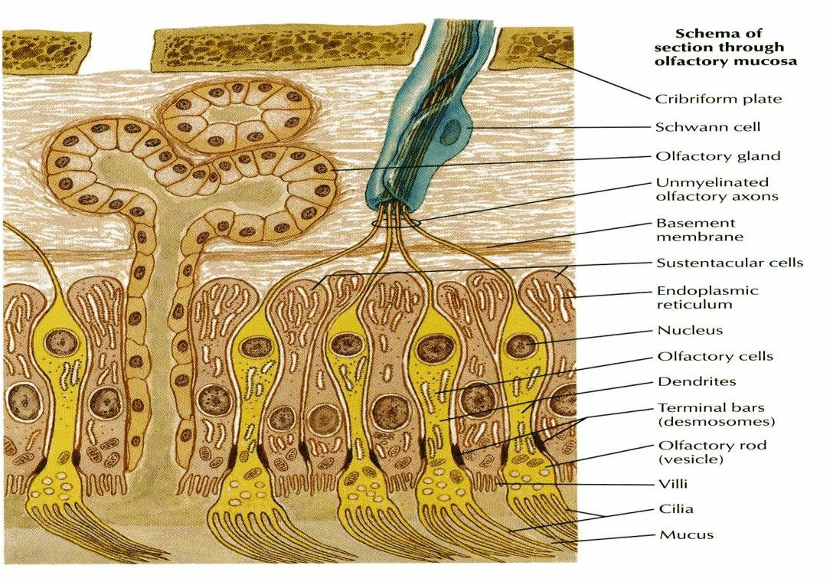
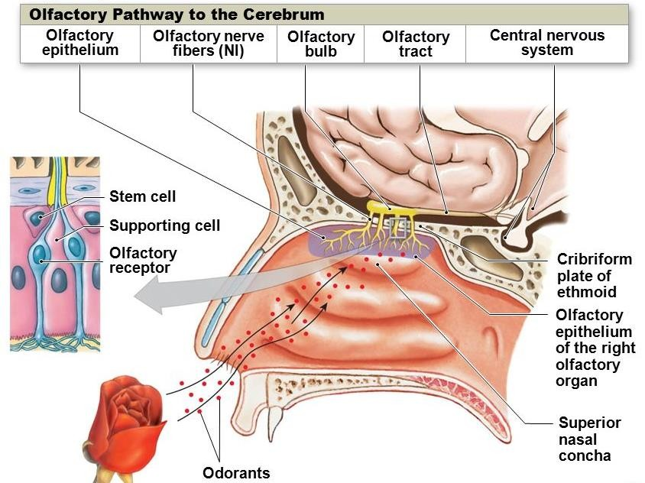
Nasal Cavity
Nerve Supply
The nerve of special sensation is the olfactory nerve.
It gives the ability of the nose to smell. This is carried out by the olfactory nerves (Cr. I)
Olfactory pathway:
1st neuron:
Olfactory receptors are specialized, ciliated nerve cells that lie in the olfactory epithelium.
The axons of these bipolar cells 12-20 fibers form the true olfactory nerve fibers.
Which passes through the cribriform plate of ethmoid.
They join the olfactory bulb
Extra

Slide 15
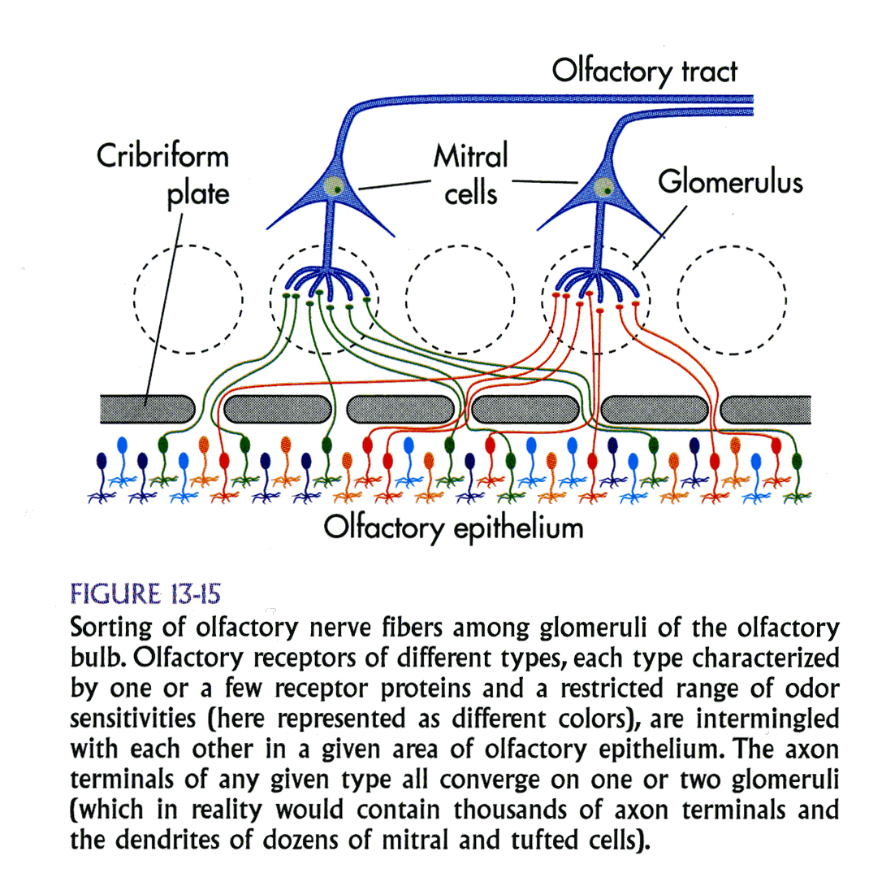
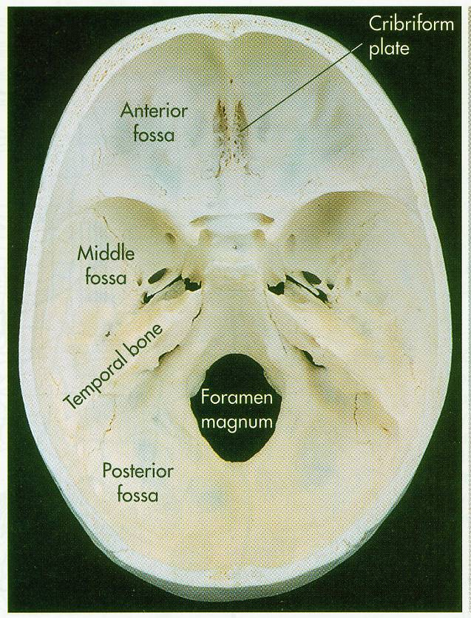
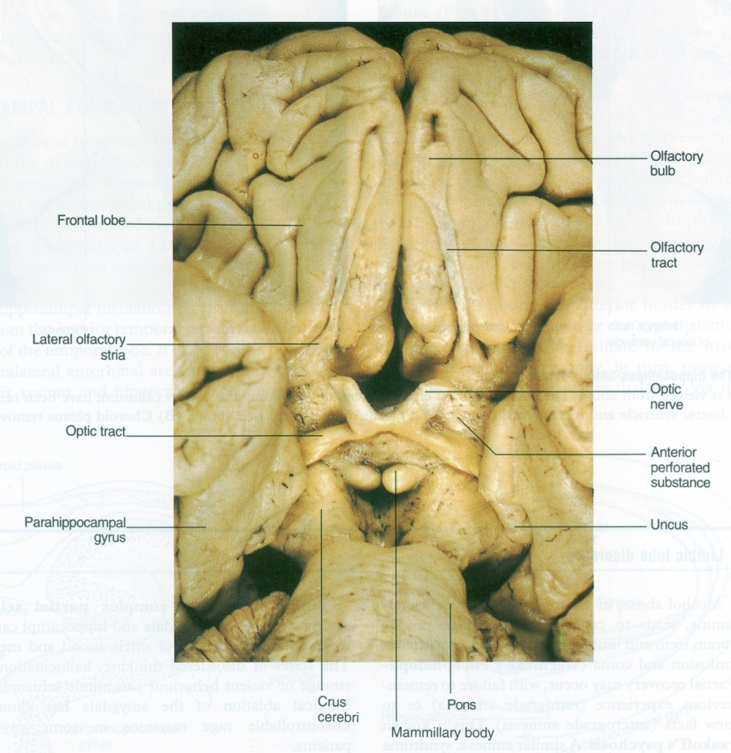
Nasal Cavity
Nerve Supply
Preliminary processing of olfactory information is within the olfactory bulb, which contains interneurons and large Mitral cells(2nd order neuron) ; axons from the latter leave the bulb to form the olfactory tract. (smell is the only sense that does not go to the thalamus) from 2nd neuron to cerebral cortex.

Slide 16
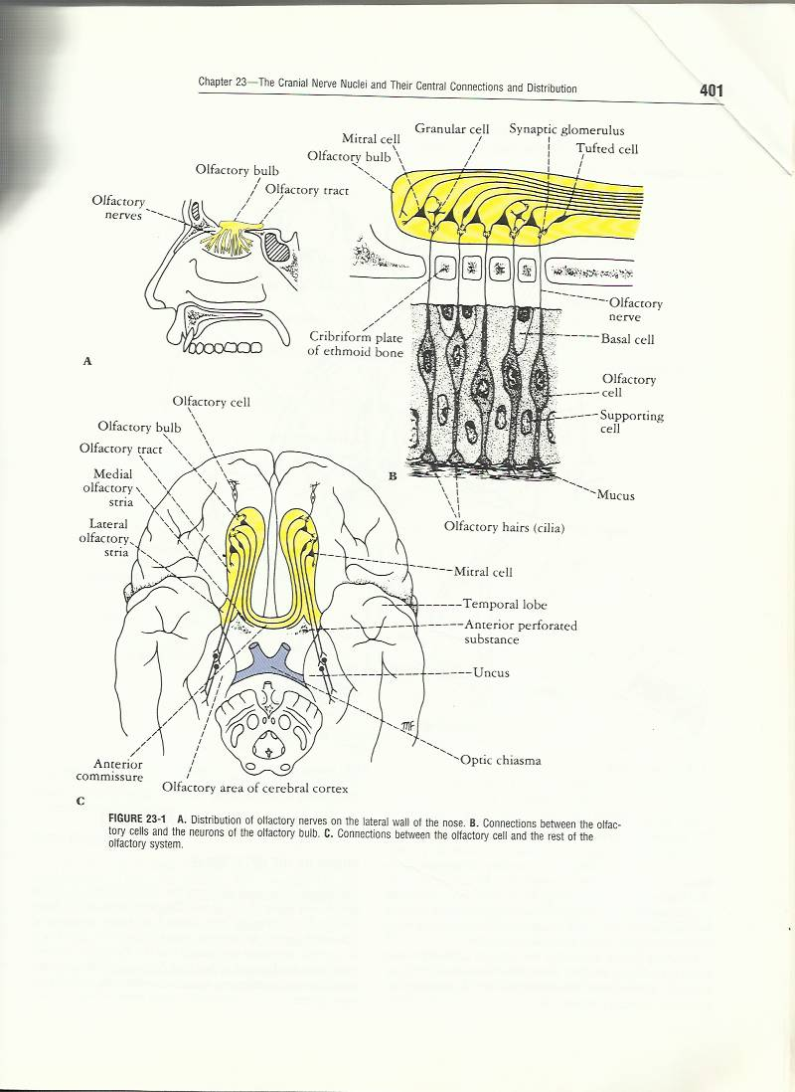
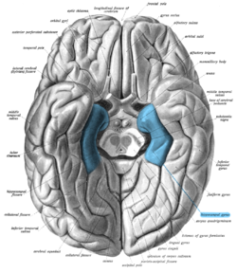
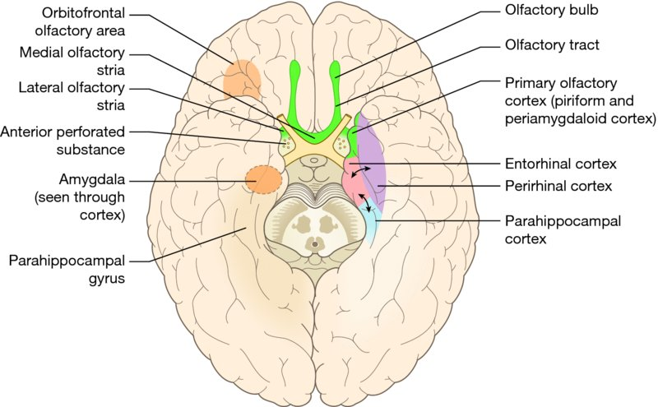
Nasal Cavity
Nerve Supply
2nd neuron:
It is formed by the Mitral cells of olfactory bulb.
The axons of these cells form the olfactory tract.
tract divides into 2 roots (lateral and medial) at the anterior perforated substance:
1- Lateral root:(direct to area in the same side)
Carries olfactory fibers to end in cortex of the Uncus & adjacent part of Hippocampal gyrus (center of smell).
Extra
Extra

Slide 17
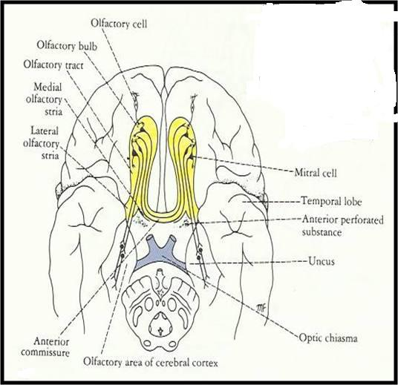
Nasal Cavity
Nerve Supply
2- Medial root:(direct to area in the opposite side)
crosses midline through anterior commissure and joins the uncrossed lateral root of opposite side.
It connects olfactory centers of 2 cerebral hemispheres.
So each olfactory center receives smell sensation from both halves of nasal cavity.
NB. Olfactory pathway is the only sensory pathway which reaches the cerebral cortex without passing through the Thalamus.
*Note: The lateral root goes to the same side while the medial root crosses to the opposite side.

Slide 18
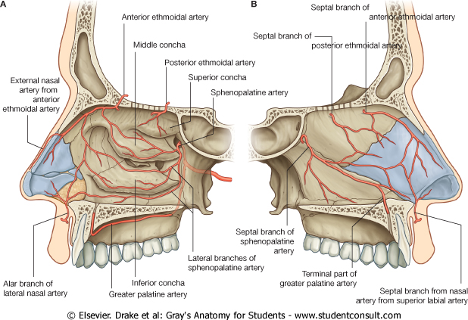
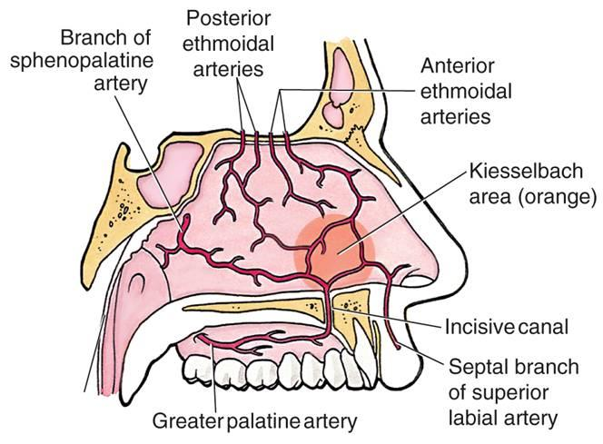
Nasal Cavity
Arterial Supply (from both external and internal carotid arteries)
Sphenopalatine artery (branch of maxillary). (external carotid)
Anterior and Posterior Ethmoidal (branch of ophthalmic). (internal carotid)
Superior labial (branch of facial).(external carotid)
Greater palatine artery (Branch of maxillary)
Lateral nasal artery (Branch of facial)
Applied anatomy :
The most common site for epistaxis (nosebleed) is at the anterior & inferior part of nasal septum
(Little’s area) because of the rich arterial anastomosis
Remember:
Nerve supply → nasopalatine
Arterial supply → sphenopalatine
Extra

Slide 19
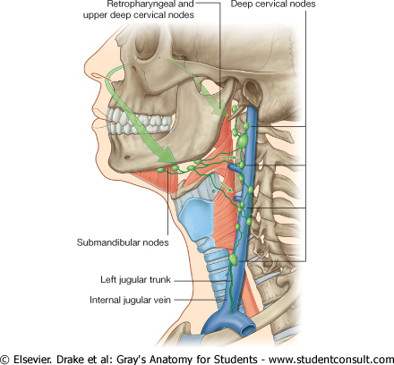
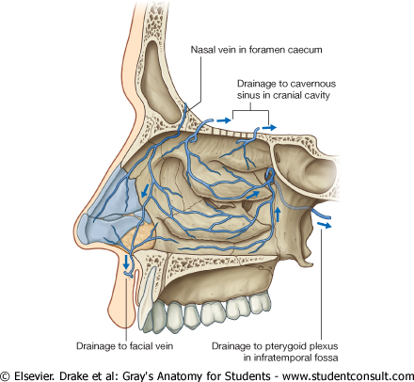
Nasal Cavity
Venous Drainage
Lymphatic Drainage
Venous plexus in the submucosa formed by veins accompanying the arteries
They drain into cavernous sinus(Facial vein)* & pterygoid venous plexus.
To Submandibular
Upper deep cervical nodes.
*The internal carotid artery and abducens nerve are present in the cavernous sinus
Blood passes according to pressure
Can transmit infection from nasal cavity to cavernous sinus
The emissary vein directly opens into the cavernous sinus. The vein is special because it is
valve-less, so blood can pass in 2 directions

Slide 20
*Only in Boys slides
Clinical significances
NOSEBLEED:
- It is common case due to rich blood supply of the node.
- Most likely occur in anterior third of nasal cavity.
-Cause could be local due to trauma or systemic due to hypertension.
DISEASES OF THE NASAL CAVITY INCLUDE:
- Viral
- Bacterial
- Fungal infections
- Nasal cavity tumours
- Inflammations of the nasal mucosa
Inflammation:
▪ The paranasal sinuses are joined to the nasal cavity via small orifices called ostia.
These become blocked easily by allergic inflammation, or by swelling in the nasal lining
that occurs with a cold. If this happens, normal drainage of mucus within the sinuses is disrupted,
and sinusitis may occur.
▪ Because the maxillary posterior teeth are close to the maxillary sinus, this can also cause clinical problems
if any disease processes are present, such as an infection in any of these teeth.

Slide 21
*Only in Boys slides
Clinical significances
Deviated Septum:
▪ Occurs when the thin wall (nasal septum) between the nasal passages is displaced to one side.
▪ In many people, the nasal septum is displaced or deviated making one nasal passage smaller.
▪ When a deviated septum is severe, it can block one side of the nose and reduce airflow, causing difficulty breathing.
▪ Nasal obstruction can occur from a deviated nasal septum, from swelling of the tissues lining the nose, or from both.
▪ Treatment of nasal obstruction may include medications to reduce the swelling or nasal dilators that help open the nasal passages.
▪ To correct a deviated septum, surgery is necessary.
Cancer:
▪ Malignancies of the paranasal sinuses comprise approximately 0.2%of all malignancies.
▪ About 80% of these malignancies arise in the maxillary sinus.
▪ They most often occur in the age group between 40 and 70 years.
▪ Carcinomas are more frequent than sarcomas.
▪ Tumours of the sphenoid and frontal sinuses are extremely rare.

Slide 22
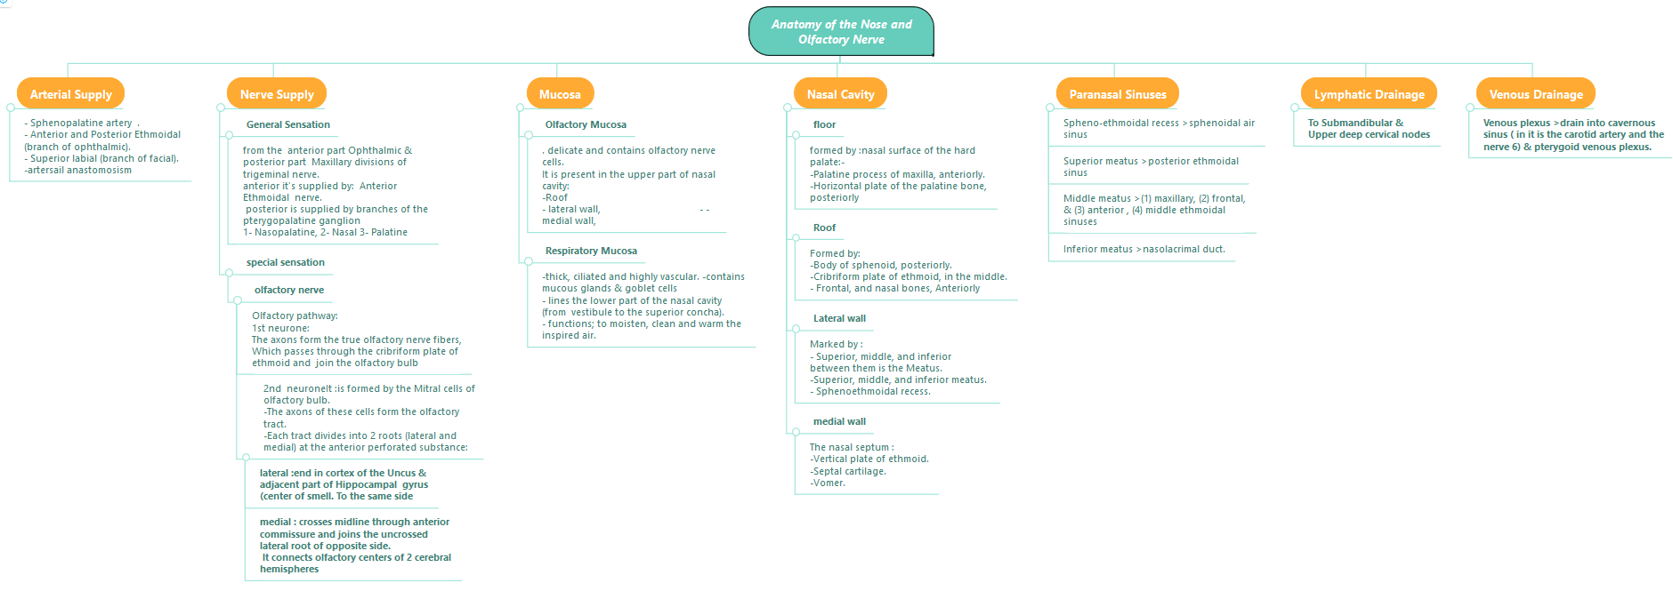
Summary

Slide 23
(1) Anterior nasal floor is composed of?
A) Horizontal plate of the palatine bone B) Palatine process of maxilla
C) Vomer
D) Inferior meats
(2) Paranasal Sinuses are lined with?
A) serous membrane B) Cutaneous membrane
C) Mucoperiosteum D) Non of them
(3) Which sinus doesn't open into the middle meatus?
A) Maxillary B) Sphenoidal sinus
C) Frontal D) Middle ethmoidal
(4) Olfactory Mucosa in nasal cavity is present in?
A) Upper part B) Lower part
C) Right part D) Left part
(5) Posterior part of nasal cavity is innervated by all of the following except?
A) Anterior Ethmoidal B) Nasopalatine
C) Pterygopalatine ganglion D) Palatine
(6) Which root of 2nd neuron (mitral cells) joins the opposite side?
A) Medial root B) Lateral root
C) Upper root D) Lower root
(7) First order neurons are present in?
A) Olfactory epithelium B) Olfactory bulb
C) Olfactory tract D) Non of them
(8) What is the most common site for epistaxis (nosebleed)?
A) Anterior & inferior part of nasal septum
B) Posterior part of nasal septum
C) Floor of nasal cavity
D) Lateral wall of nasal cavity
(9) ?
A) B)
C) D)
(10) ?
A)
B)
C)
D)

Slide 24
Answers
(1) B (6) A
(2) C (7) .
(3) B (8) A
(4) A (9) .
(5) A (10) .

Slide 25
(1) What are the functions of the paranasal sinuses?
Lighten the skull weight
amplify the sound as we speak
(2) Describe how respiratory mucosa moisten, clean, and warm)?
The air is moistened by the secretion of numerous serous glands.
It is cleaned by the removal of the dust particles by the ciliary action of the columnar ciliated epithelium
that covers the mucosa. The air is warmed by a submucous venous plexus.
(3) Mention the innervation of nasal cavity?
The anterior part is supplied by Anterior Ethmoidal nerve (a branch of the ophthalmic nerve).
The posterior part is supplied by branches of pterygopalatine ganglion (a branch of maxillary nerve): Nasopalatine, Nasal, and Palatine.
Both ophthalmic and maxillary are branches of trigeminal nerve.

