Slide 2
Objectives
At the end of the lecture, students should be able to:
Describe the External features of the cerebellum (lobes, fissures).
Describe briefly the Internal structure of the cerebellum.
List the name of Cerebellar Nuclei.
Relate the Anatomical to the Functional Subdivisions of the cerebellum.
Describe the Important connections of each subdivision.
Describe briefly the Main Effects in case of lesion of the cerebellum.

Slide 3
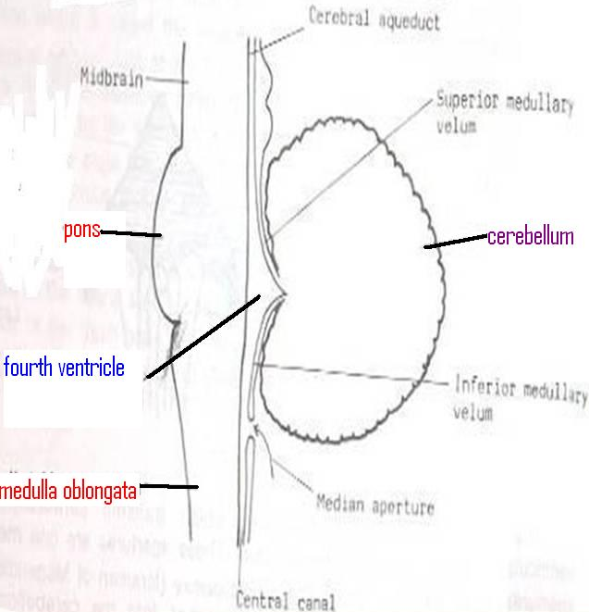
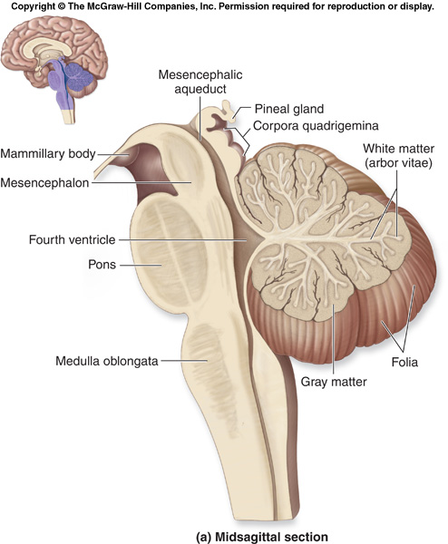
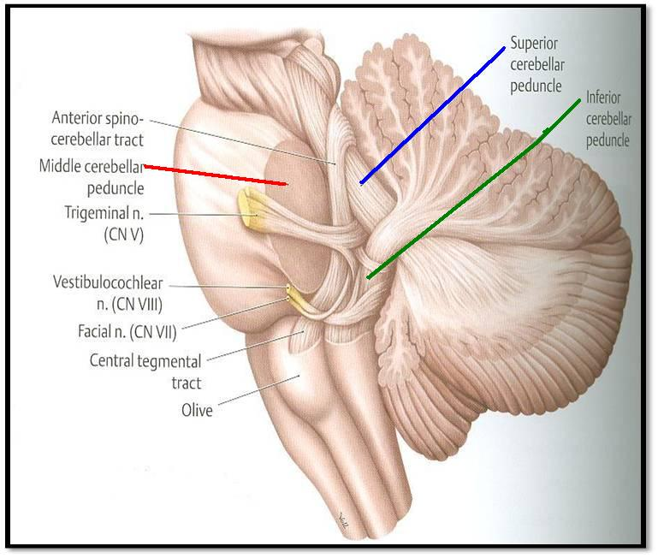
Cerebellum
Origin: from Hindbrain.
Position: lies behind Pons & Medulla Separated from them by Fourth ventricle.
Connection: to the brainstem by Inferior, Middle & Superior Cerebellar Peduncles.
Playlist
(medulla)
(pons)
(midbrain)
Extra

Slide 4
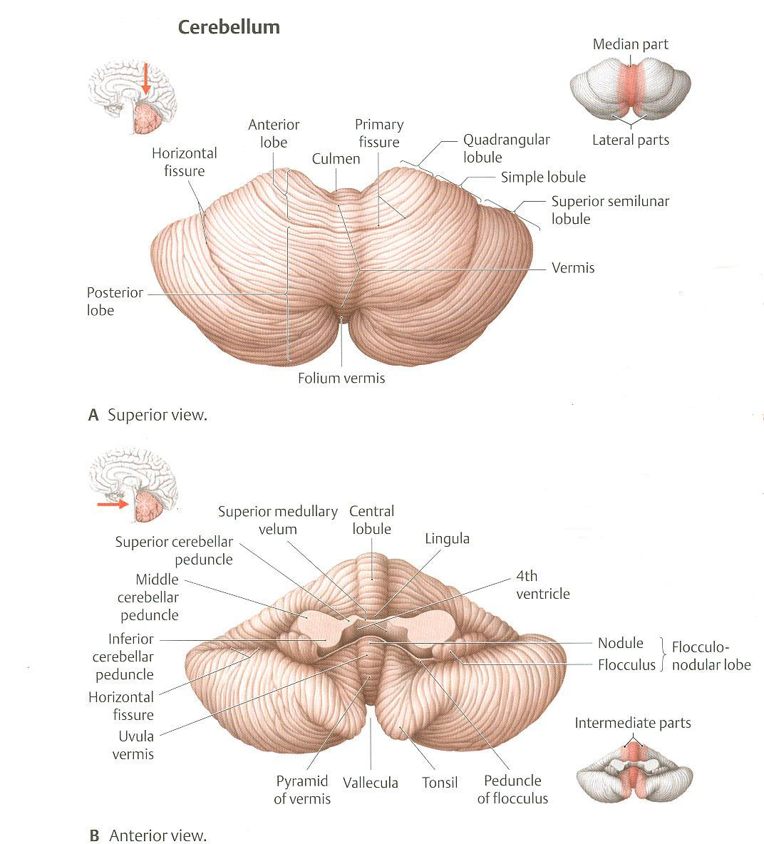
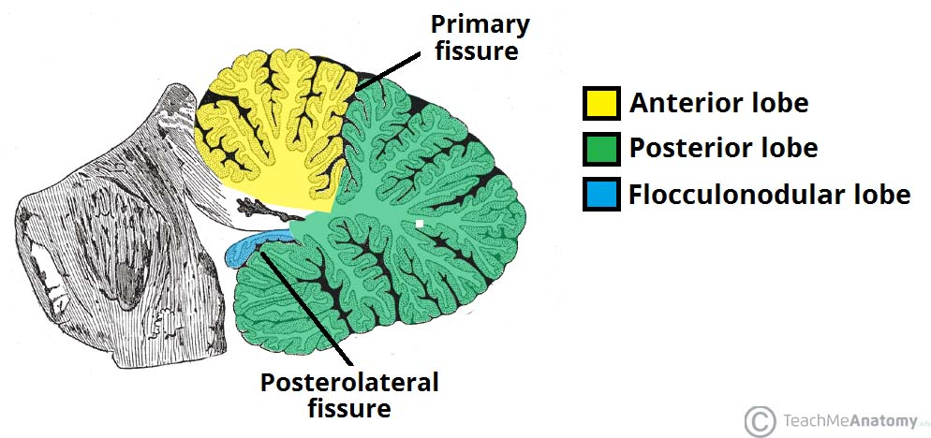
Cerebellum has 3 fissures:
2 main (primary) fissures (related to lobes): primary and secondary (posterolateral)
Horizontal fissure (largest/deepest) and not related to lobes
Cerebellum
External Features
It consists of two Cerebellar Hemispheres joined in midline by the Vermis. and paravermis (intermediate zone) is between vermis and hemisphere
Its surface is highly convoluted forming Folia (like gyri), separated by Fissures (like sulci).
Superior vermis
inferior vermis
Anatomical Subdivision
Anterior lobe: in front of primary fissure, on the superior surface.
Posterior (middle) lobe: behind primary fissure (Between Primary & Secondary/posterolateral fissures).
Flocculonodular lobe: in front of secondary (Posterolateral) fissure, on the inferior surface .
Extra

Slide 5
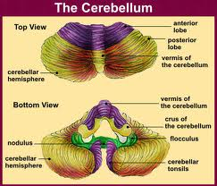
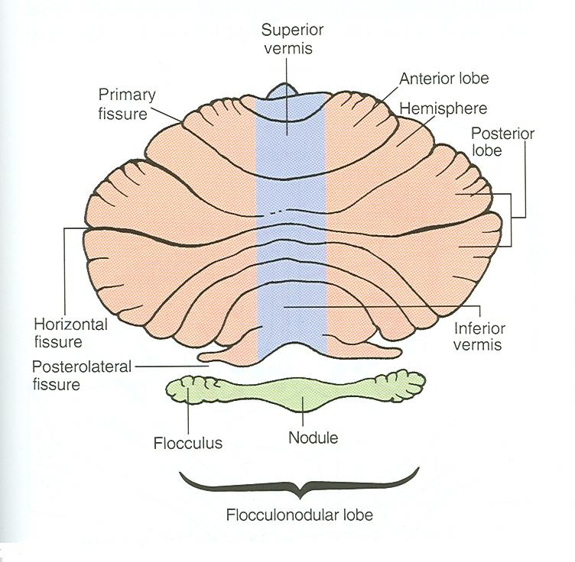
Cerebellum
Anatomical Subdivision
Primary Fissure
Superior Surface
Posterolateral = Secondary Fissure
Anterroinferior Surface

Slide 6
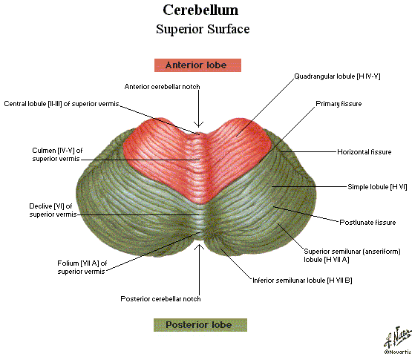
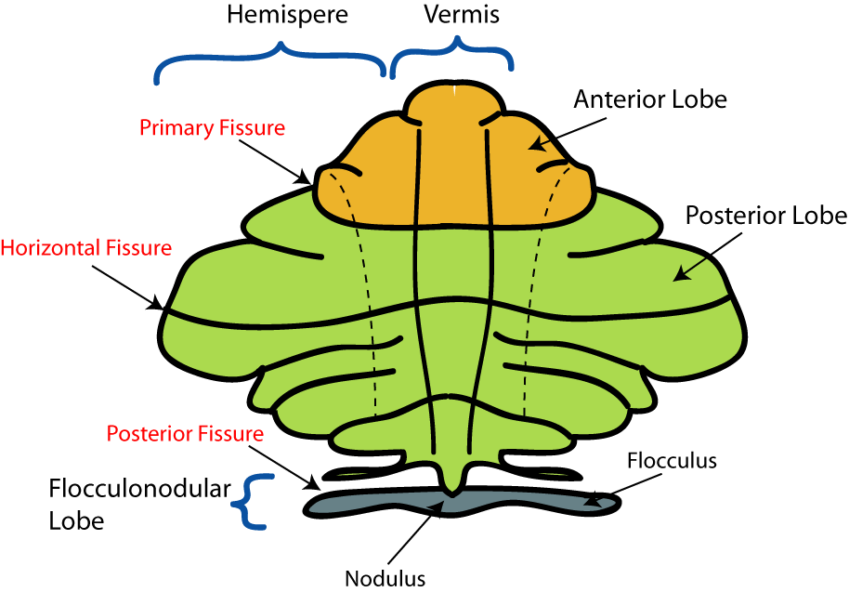
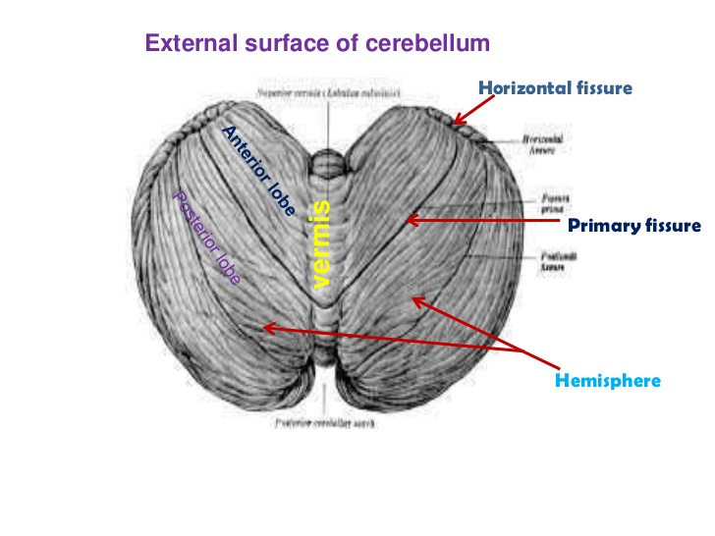
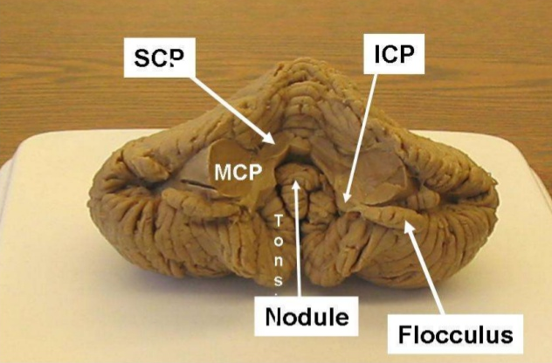

Slide 7
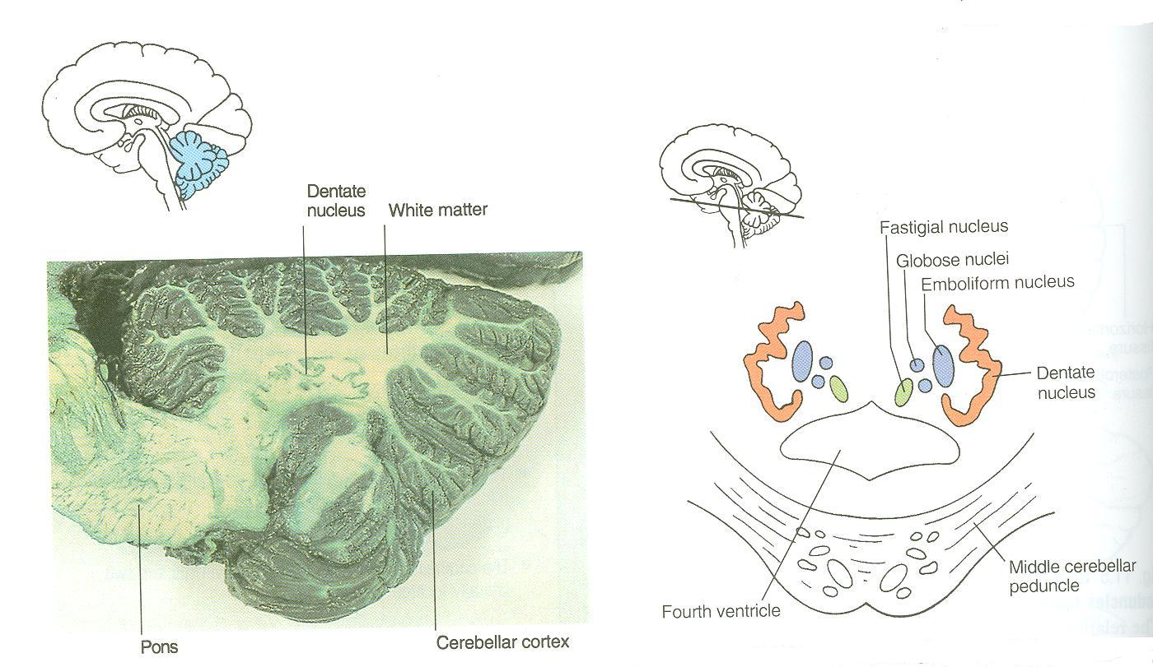
Cerebellum
Constituents (Internal Structure and Nuclei of Cerebellum)
Outer grey matter: cerebellar cortex
Inner white matter: cerebellar medulla
Deeply seated nuclei in white matter: from medial to lateral:
Fastigial nucleus: smallest one(most medial)
Globose nucleus.
Emboliform nucleus.
Dentate nucleus: largest one.
They have related functions
Extra

Slide 8
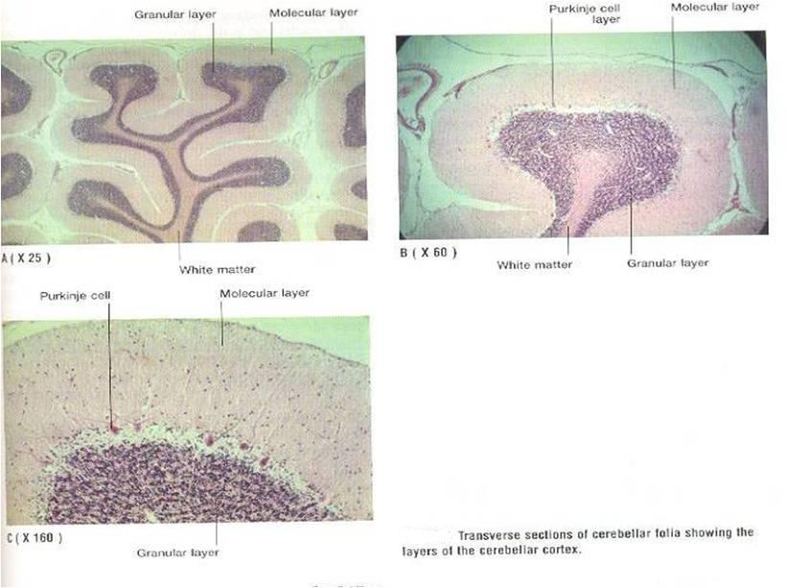
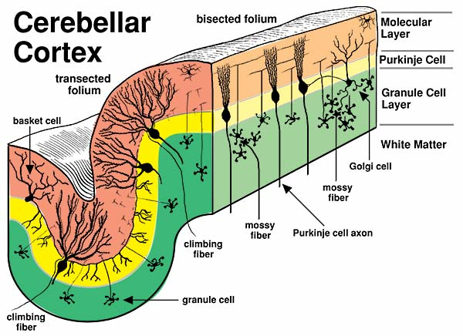
Cerebellum
Cerebellar Cortex
The cerebellar cortex is divided into 3 layers:
Outer molecular layer
Intermediate Purkinje cell layer
Inner granular layer
Extra

Slide 9
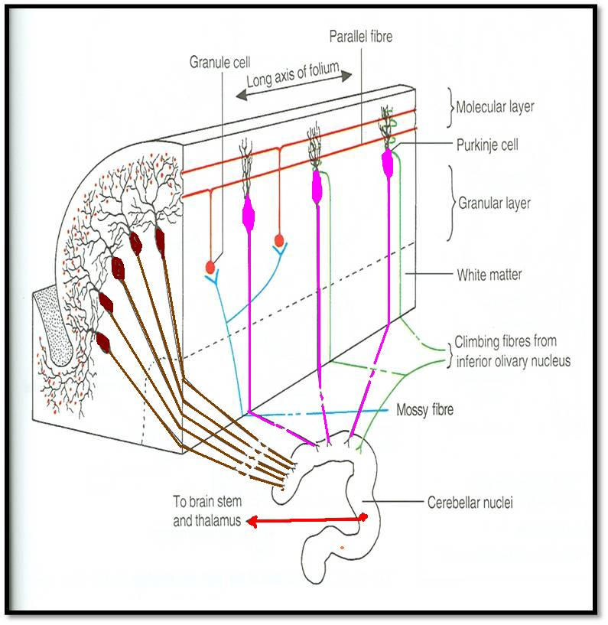
Cerebellum
Cerebellar Medulla
Climbing fibers:
from inferior olivary nucleus, relay to purkinje cells
Afferent fibers:
Fibers coming into the cerebellum They are of two types:
mossy and climbing
Extra
Mossy fibers: rest of fibers:
From vestibular nuclei
From spinal cord
From pons recall : corticopontocerebellar
They relay to granule cells which in turn relay to purkinje cells.
Finally all afferent fibers passing through the medulla relay to purkinje cells in the cortex.

Slide 10
Cerebellum
Cerebellar Medulla
Axons of Purkinje Cells are the only axons to leave the cortex to medulla:
The great majority of axons do not leave cerebellum & end in deep cerebellar nuclei, specially Dentate nucleus.
Some of axons (of deep cerebellar nuclei) leave cerebellum as efferent fibers.
Note that the axons of purkinje cells have to go to the cerebellar nucleus
Dendato-rubro-thalamic
Efferent Fibers:
Most of efferent fibers are axons of deep cerebellar nuclei.
Main Efferents go to: (brainstem/thalamus)
Vestibular nuclei (cerebello-vestibular tract).
Red nucleus (Dendato-rubro-thalamic tract).indirect
Ventral lateral nucleus of thalamus (Dendato-thalamic tract).direct
Extra

Slide 11
Cerebellum
Functional Subdivisions
Cerebellum is divided according to function into 3 parts:
Archicerebellum
Paleocerebellum spinocerebellar
Neocerebellum
Vestibular Part of cerebellum: Flocculonodular lobe.
Spinal Part of cerebellum:
Vermis & Paravermis
Cerebral Part of cerebellum:
Rest of Cerebellum.
Archi = old
In all animals ( primitive cerebellum)

Slide 12
Cerebellum
Functional Subdivisions
SCP = superior cerebellar peduncle
MCP = middle cerebellar peduncle
ICP = inferior cerebellar peduncle
 | Archicerebellum | Paleocerebellum | Neocerebellum
Nuclei Related | Fastigial | Globose & Emboliform | Dentate
Afferents | from Vestibular nuclei (Vestibulocerebellar fibres), (through ICP) | from spinal cord (dorsal spinocerebellar tracts through ICP & ventral spinocerebellar tract through SCP) | from Pons (Pontocerebellar fibres) (through MCP)
Efferents | cortical (purkinje cell) Fibres project : to Fastigial nucleus, which projects to vestibular nuclei (through ICP) + to Reticular formation | to globose & embliform nuclei which project to red nucleus (through SCP) | to Red nucleus but mostly to Ventral Lateral Nucleus of Thalamus (through SCP) then to motor cortex
Function | 1. controls body Balance (via vestibulospinal & reticulospinal tracts). 2. Control of eye movement (via VO vestibulo-ocular reflex) | controls posture & muscle tone (via Rubrospinal tract). | coordination of voluntary movements (via descending corticospinal & corticobulbar tracts or rubrospinal tract).

Slide 13
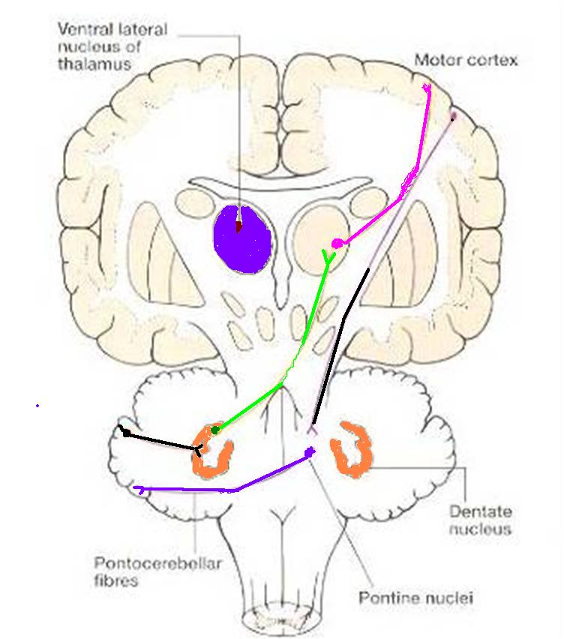
Only on the girl’s slides

Slide 14
*In the PowerPoint presentation this slide is animated.
Only on the boy’s slides
Archicerebellum
Paleocerebellum
Neocerebellum
Purkinge cells of vermis & paravermis
Purkinge cells of rest of cerebellum
Purkinge cells of flocculonodular lobe
Dentate nucleus
ICP
Globose & emboliform
nuclei
Fastigeal nucleus
Red nucleus &
Ventral lateral nucleus
of thalamus
ICP
MCP
SCP
ICP
SCP
Vestibular nuclei
Spinal cord
Red nucleus
Pons
Motor cortex
Balance
Posture
& Muscle Tone
Coordination
Of Voluntary Movements

Slide 15
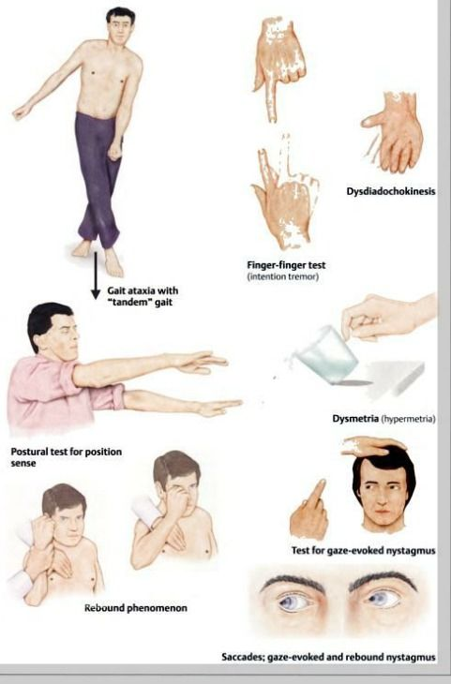
Cerebellum
Cerebellar Lesions
MIDLINE LESION: Loss of postural control.
UNILATERAL LESION: “Cerebellar ataxia” causes ipsilateral:
Incoordination of arm: intention (not resting tremors as Parkinson's disease) tremors (on performing voluntary movements)
Incoordination of leg: unsteady gait
Incoordination of eye movements: nystagmus
Slowness of speech: dysarthria (difficulty of speech)
Extra

Slide 16
Cerebellum function:
It acts like the maestro, and the muscles are like the musicians, and the cerebral order is like the note.
So it coordinates the movement, just like when the maestro leads the musicians.
And to do that it has to get information from spinal cord and the cerebrum.
Summary
Anatomically, the cerebellum is divided into:
anterior, posterior & flocculonodular lobes.
Developmentally & functionally, it is divided into:
archi- paleo- & neocerebellum.
Archicerebellum (flocculonodular lobe) is the oldest part of cerebellum, related to fastigial nucleus, connected to vestibular nuclei & concerning for control of body balance.
Paleocerebellum (vermis & paravermis) is related to globose & emboliform nuclei, connected to spinal cord & red nucleus & concerned with regulation of posture & muscle tone.
Neocerebellum (most of human cerebellum) is related to dentate nucleus, connected to pons, thalamus. Its final destination is to motor cortex. It is concerned with coordination of voluntary movements.
Cerebellar lesions lead to ipsilateral incoordination (ataxia).

Slide 17
Characteristics | Cerebellum
Origin | From hindbrain
Position | Lies behind the pons and medulla, separated from them by 4th ventricle
External structures | Consists of two cerebellar hemispheres joined in the midline by vermis | Its surface is highly convoluted forming folia, separated by fissures
Internal structures | Outer grey matter: cerebellar cortex Inner white matter: cerebellar medulla | Deep seated nuclei in white matter: (from medial to lateral) Fastigial nnucles Globose nucleus Emboliform nucleus Dentate nucleus
Anatomical subdivisions | Anterior lobe: In front of primary fissure | Posterior (middle) lobe: Between primary and secondary (postero-lateral) fissures | Flocculonodular lobe: In front of secondary fissure

Slide 18
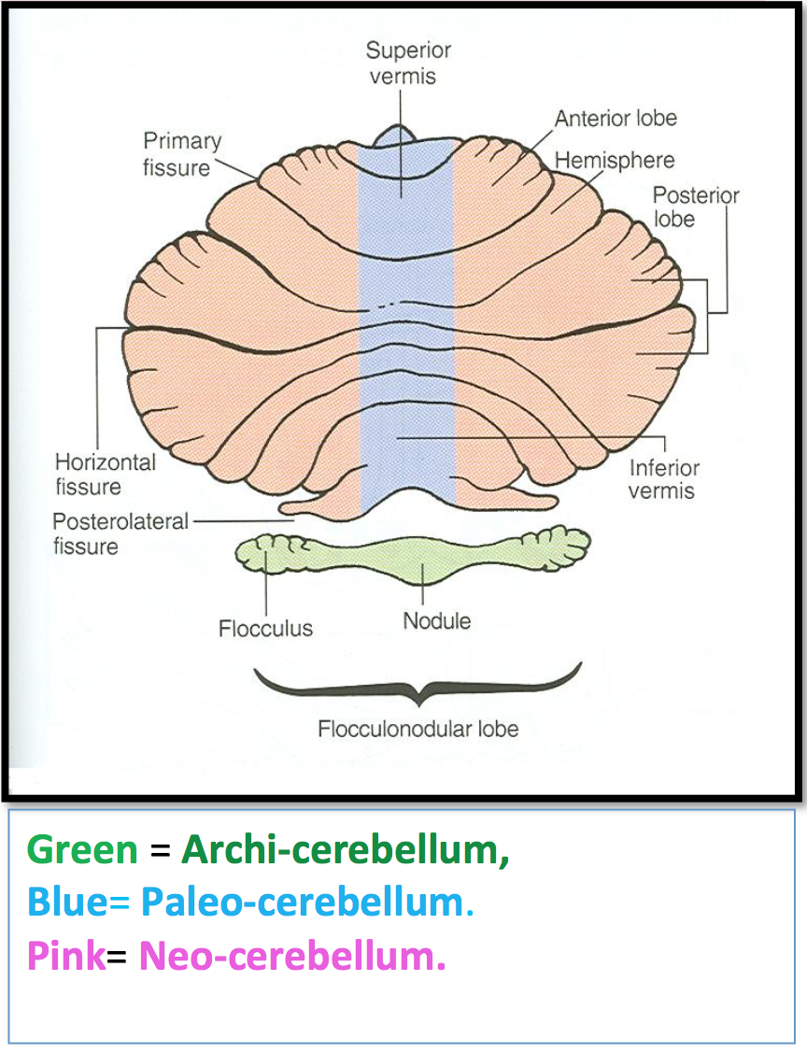
Characteristics | Cerebellum
Functional subdivisions | Archicerebellum: Fastigial nucleus relation Afferent: from vestibular nuclei (vesttibulocerebellar fibers) through ICP Efferent: cortical (purkinje cell) fibers project to fastigial which project to vestibular nuclei + reticular formation Function: Control body balance and eye movement | Paleocerebellum: Globose and emboliform nuclei relation Afferent: from spinal cord (dorsal and ventral spinocerebellar tracts through ICP and SCP respectively) Efferent: to globose and emboliform nuclei which projects to red nucleus (through SCP) Function: Control posture and muscle tone | Neocerebellum: Dentate nucleus relation Afferent: from pons (pontocerebellar tract) through MCP Efferent: to red nucleus but mostly to ventral lateral nucleus of thalamus through SCP then to motor cortex Function: Coordination of voluntary movements
Cerebellar lesions
MIDLINE LESION: Loss of postural control. UNILATERAL LESION: “Cerebellar ataxia” causes ipsilateral : Incoordination of arm: intention tremors (on performing voluntary movements) Incoordination of leg: unsteady gait Incoordination of eye movements: nystagmus Slowness of speech: dysarthria (difficulty of speech).

Slide 19
(1) ______ Climbing and mossy fibers relay to ______?
A) Afferent, Inner granular layer B) Efferent, Inner granular layer
C) Afferent, purkinje cells
D) Efferent, purkinje cells
(2) To which of the following do main efferent go to?
A) Red nucleus B) Ventral posterior nucleus of thalamus
C) Globose nucleus D) Emboliform nucleus
(3) The nuclei related to paleocerebellum are?
A) Globose & Dentate B) Emboliform & Fastigial
C) Dentate & Fastigial D) Globose & Emboliform
(4) The cerebellum originates from the dorsal aspect of the brain stem and overlies the ______ ventricle?
A) Lateral ventricle B) Midline ventricle
C) Third ventricle D) Fourth ventricle
(5) Neocerebellum coordinate voluntary movements via?
A) Vestibulospinal & reticulospinal tracts
B) Descending corticospinal & corticobulbar tracts
C) Descending corticospinal & reticulospinal tracts
D) Vestibulospinal & corticobulbar tracts
(6) Archicerebellum controls?
A) Body Balance B) Posture
C) Memory and speech D) All of the above
(7) Damage to the cerebellum does not cause disorders of?
Movement B) Equilibrium
C) Motor learning D) Posture
(8) ?
A) B)
C) D)
(9) ?
A) B)
C) D)
(10) ?
A)
B)
C)
D)

Slide 20
Answers
(1) C (6) B (2) B (7) A (3) D (8) . (4) D (9) . (5) B (10) .

Slide 21
(1) List the effects of unilateral cerebellar lesion?
Intention Tremors
Unsteady Gait
Nystagmus
Dysarthria
(2) Name the three layers of the Cerebellum's cortex?
Molecular
Purkinje
Granular
(3) Damage to the cerebellum results in effects on which side of the body?
ipsilateral

