Slide 2
Objectives
At the end of the lecture, students should be able to:
List the parts of the cerebral hemisphere (cortex, medulla, basal nuclei, lateral ventricle).
Describe the subdivision of a cerebral hemisphere into lobes.
List the important sulci and gyri of each lobe.
Describe different types of fibers in cerebral medulla (association, projection and commissural) and give example of each type.

Slide 3
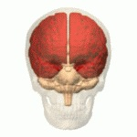
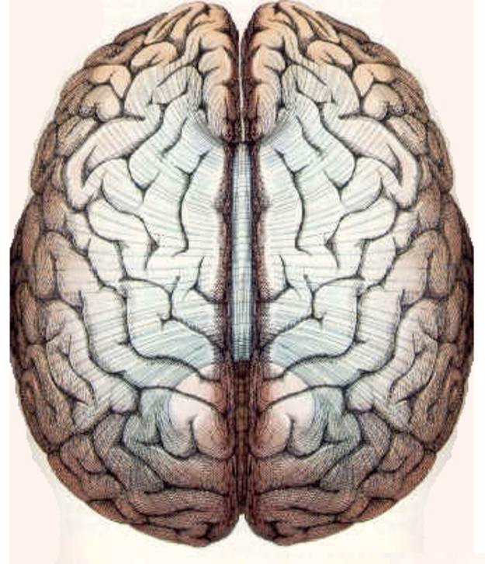
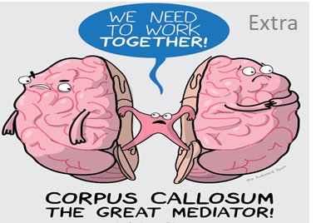
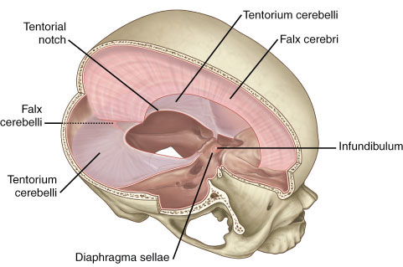
Cerebrum
Extra
Corpus callosum
Largest part of the forebrain. ( makes up 2/3rd weight off all brain)
(recall: the forebrain gives the cerebral hemispheres and the diencephalon)
Divided into two halves, the cerebral hemispheres (right and left), which are separated by a deep median longitudinal fissure which lodges the falx cerebri*(fold of dura matter)
In the depth of the fissure, the hemispheres (left & right) are connected by a bundle of fibers (of white matter) called the corpus callosum (it's example of commissural fibers).
Left hemisphere
Right hemisphere
*It is a large, crescent-shaped fold of meningeal layer of dura mater that descends vertically in the longitudinal fissure between the cerebral hemispheres
Median longitudinal fissure
Extra
Extra

Slide 4
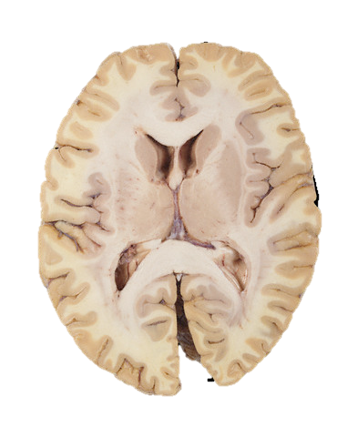
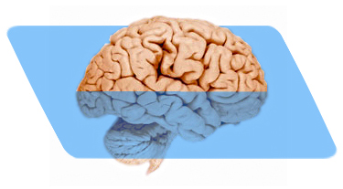
Cerebrum
Cerebral Hemispheres
Buried within the white matter lie a number of nuclear masses (caudate, putamen, globus pallidus) collectively known as the basal ganglia. (nerve cells)
The structure of cerebral hemipheres includes:
Cerebral medulla: Deeper to the cortex, axons running to and from the cells of the cortex form an extensive mass of white matter (WM).
WM
Contains synapses (50 trillion)
WM
The cavity of hemisphere is called the lateral ventricle.
Superficial (outer) layer of grey matter, the cerebral cortex.

Slide 5
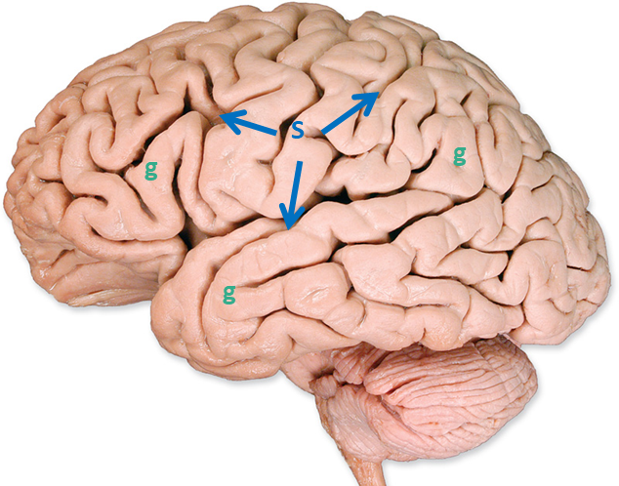
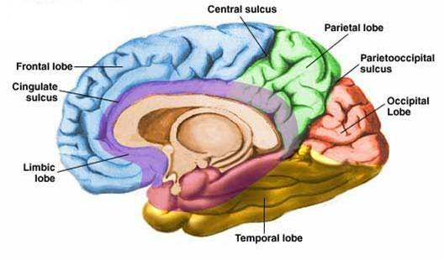
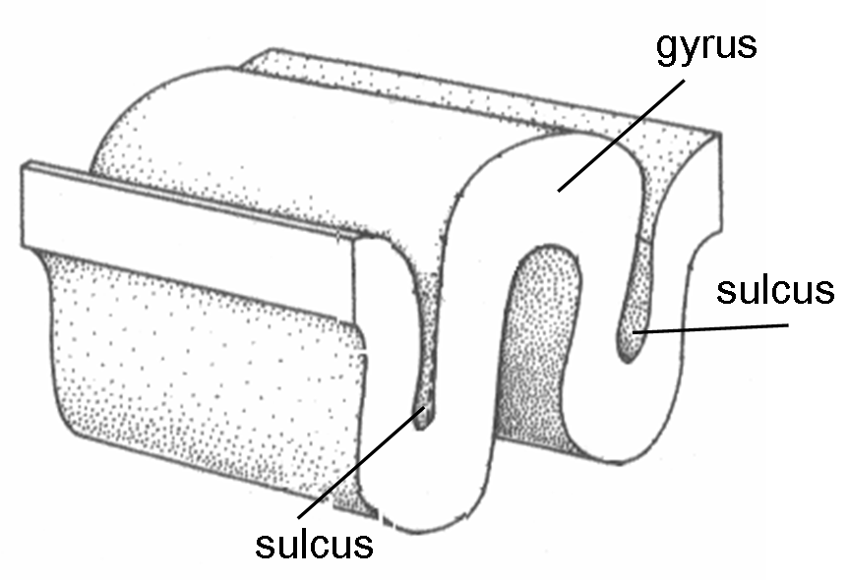
Cerebrum
Surfaces
The superficial layer of grey matter is highly convoluted* to form a complex pattern of ridges (gyri) and grooves (sulci). Gyri (plural) gyrus (singular) | Sucli (plural) sulcus (singular)
This arrangement maximize the surface area of the cerebral cortex (about 70% is hidden within the depths of sulci).
Each hemisphere has 3 surfaces: Superiolateral, Medial, and Inferior.
The inferior has two parts: tentorial** and orbital
*highly convoluted : increase surface area = increase nerve cells = more active)
**It's cover by tentorium (fold of dura matter forming a portion between cerebrum & cerebellum)
Medial
Superiolateral
Inferior
Extra

Slide 6
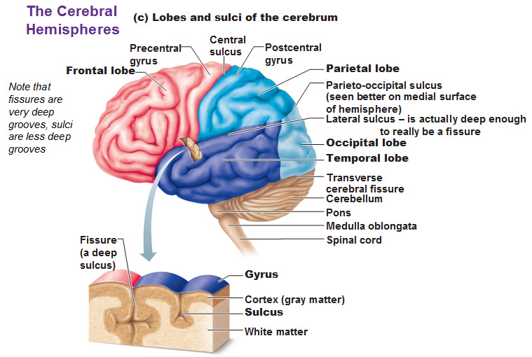
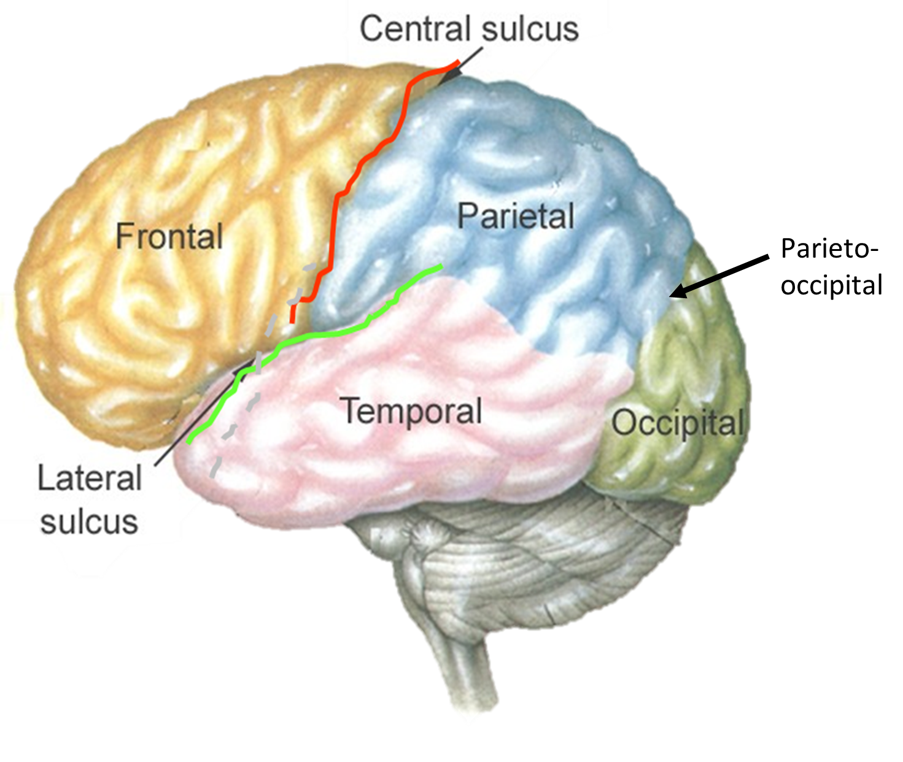
*not everyone has the same gyri and sulci in their brain. If we view different brains we might not find the same sulci/gyri present in both. But the these 3 sulci (central, lateral, & parieto-ociptal) are found in almost everyone
central | Separates frontal+parietal
lateral | Seperates frontal+parietal+temporal
parieto-occipital | Seperates parietal+occipital
Cerebrum
Lobes
Three sulci, consistent in their position* (central, lateral (sylvian) & parieto-occipital) are used to divide each hemisphere into the four lobes.
Each hemisphere is divide into FOUR lobes (named after overlying bones): Frontal, Parietal, Temporal, and Occipital. (pool : is the tip of lobe, Parietal lobe don’t have pool)
- Anatomically (positions) we have 4 lobes - Physiologically (Functionally) we have 5 lobes
Lobes | Function
Frontal | motivation, motor function, smell, mood and aggression (personality and emotion)
Parietal | reception and evaluation of sensory information via thalamus protection from dangerous
Temporal | smell, hearing, memory and abstract thought
Occipital** | visual processing
Extra
**Occulus means eye in latin so occipital = vision

Slide 7
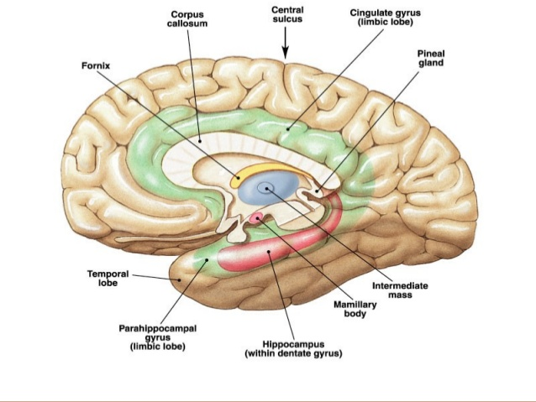
Cerebrum
Lobes
Functionally each hemisphere contains a ‘limbic lobe’ on the medial surface.
It responsible for:
Establishing emotional states
Linking conscious intellectual functions with the unconscious autonomic functions
Facilitating memory storage.
- Anatomically (positions) we have 4 lobes: Frontal, Parietal, Temporal & Occipital - Physiologically (Functionally) we have 5 lobes: Frontal, Parietal, Temporal, Occipital & limbic
Extra

Slide 8
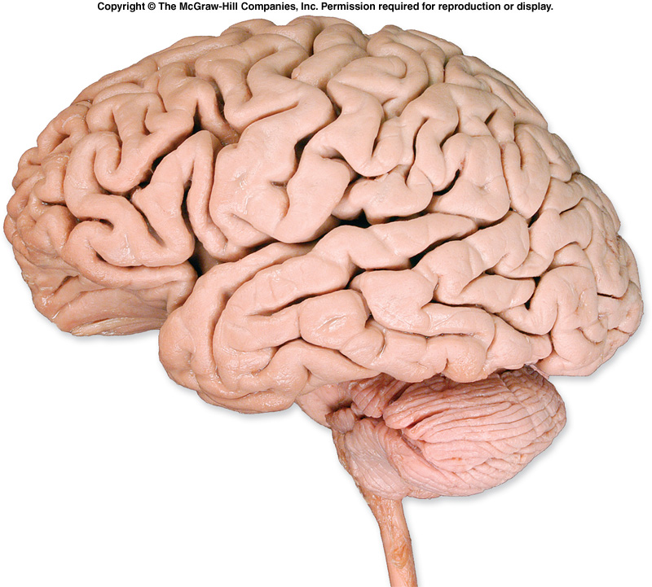
Cerebrum
Lobes
IMPORTANT (OSPE & mcqs) - Name of lobs - Gyrus of each lobe
- Functional area
Superior , middle & inferior frontal gyri
Precentral gyrus
Postcentral gyrus
Main gyri in superolateral surface:
Frontal Lobe*
Gyri | Precentral gyrus (motor area)
Sulci | Superior frontal sulci Inferior frontal sulci
 | (divide lobe into) superior, (middle & inferior)** frontal gyri
*In front of central sulcus & above the lateral sulcus
***Between the central & lateral & parietooccipital sulcus
sfs
ifs
Parietal Lobe***
Gyri | Postcentral gyrus (sensory area)
Sulci | Intraparietal sulcus
 | dividing the lobe into superior & inferior parietal lobules.
Inferior parietal lobule
Superior parietal lobule
Intraparietal sulcus
**more important than superior frontal gyri

Slide 9
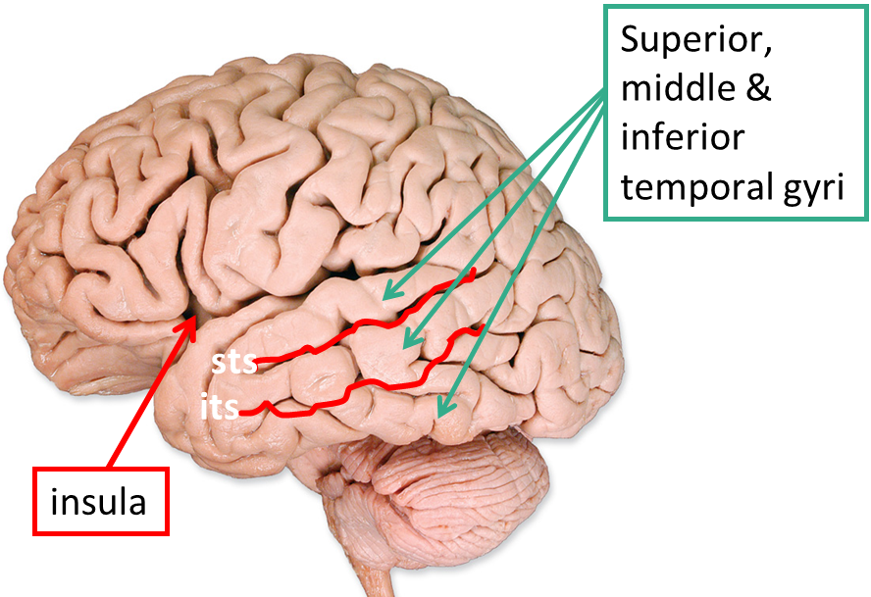
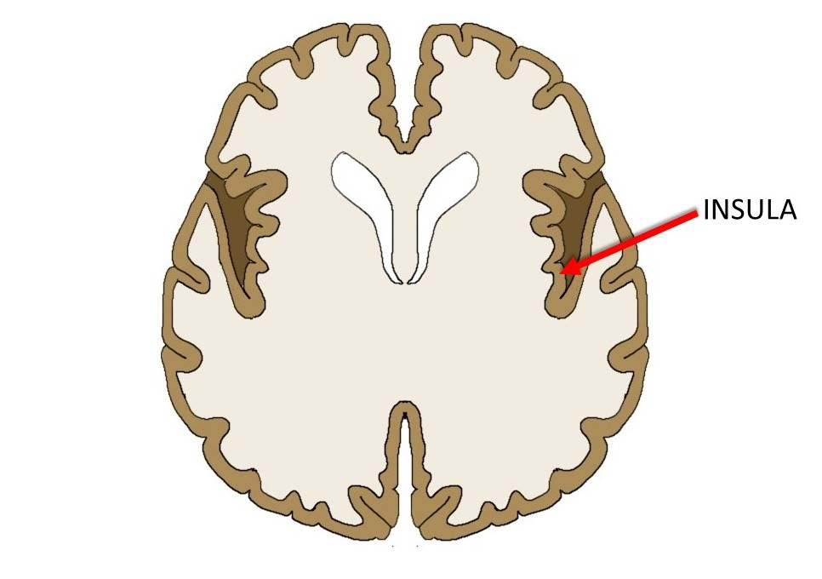
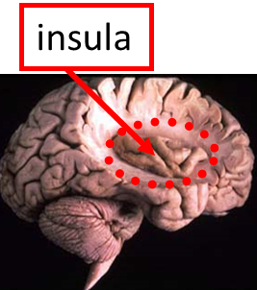
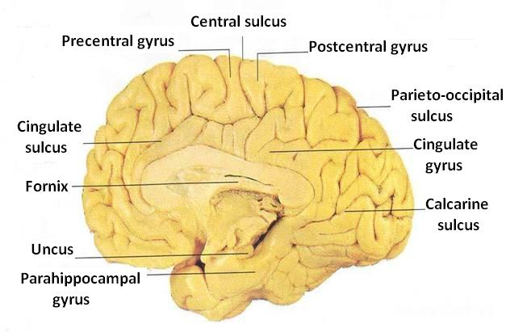
Cerebrum
Lobes
*Under the lateral sulcus & between it & the parietooccipital lobe
Temporal lobe*
Gyri | Superior, middle & inferior temporal gyri
Sulci | Superior & inferior temporal sulci giving rise to superior, middle & inferior temporal gyri.
Insula*** | the gyri in the depth of lateral fissure/sulcus**, covered by parts of frontal, parietal & temporal lobes called the opercula (removed in lower pic so we can see the insula)
Extra
***The insula is grey matter in the Lateral sulcus and has a cover formed of temporal frontal and parietal lobes which we call opercula (parts from the 3 lobes)
(normal cerebral cortex but inside)
Medial Surface
Gyri | Cingulate Parahippocampal
Sulci | Parietooccipital Calcarine divide into: Precalcarine & Postcalcarine Cingulate
**Fissure and sulcus both mean groove. But fissure is deeper
Note: Form y shape

Slide 10
Broadmann’s Map
05:25
Brodmann produced a numbered, cytological map of cerebral cortex based upon its regional histological characteristics.
The basis of Brodmann's cortical localization is its subdivision into 'areas' with similar cellular and laminar structure.
Brodmann's numbering of these cortical locations has become one of the standard ways in which clinicians identify brain areas.
*In the spinal cord the grey matter was divided into rexed laminae. Here broadmanns map is similar but in the cerebral hemispheres

Slide 11
Functional Areas of the Cerebral Cortex
“Each primary cortex has association cortex”
Frontal Lobe
1-Primary motor cortex | Located in precentral gyrus | Brodman’s area 4 | allows conscious control of skilled voluntary (gross) movement (controls skeletal muscles)
2-Premotor cortex: | Located in the region immediately anterior to the precentral gyrus | Brodmann’s area 6 | Controls learned, repetitious, or patterned motor skills, typing, playing a musical instrument. Coordinates simultaneous or sequential actions. Involved in the planning of movements.
3-Prefrontal cortex: | Extensive region of the frontal lobe anterior to premotor area. |  | Involved with intellect, cognition, recall, and personality. Necessary for judgement, reasoning, persistence, and conscience. Also related to mood. Closely linked to limbic system (emotional part of brain)
4-Broca’s (motor speech) area: (in the premotor area) | Located in the inferior frontal gyrus of the dominant hemisphere, usually left | Brodmann’s area 44 & 45 | A motor speech area that directs muscles of the tongue. Is active as one prepares to speak.
5-Frontal eye field: | Located in the middle frontal gyrus immediately in front of premotor cortex | Brodmann’s area 8
Only on the boy’s slides

Slide 12
2
1
6
7
3
8
4
9
5

Slide 13
Functional Areas of the Cerebral Cortex
“Each primary cortex has association cortex”
Only on the boy’s slides
Parietal lobe
6-Primary somatosensory cortex | located in postcentral gyrus | Brodmann’s area 1, 2, 3 | Involved with conscious awareness of general somatic senses Receives information from the skin and skeletal muscles Exhibits spatial discrimination Precisely locates a stimulus
7-Parietal association cortex | located posterior to primary somatosensory cortex. |  | Integrates sensory information Forms comprehensive understanding of the stimulus Determines size, texture, and relationship of parts.
زي المترجم
Occipital lobe .
8-Primary visual cortex | located on the medial surface of the hemisphere, in the gyri surrounding the calcarine* sulcus | Brodmann’s area 17 | Receives visual information from the retinas - If we have injury in this area we cannot see any thing
9-Visual association cortex | located around the primary visual cortex | Brodmann’s area 19 | Interprets visual stimuli (color, form, & movement) - If we have injury in this area we can see, but we . . don’t know what we say
*Especially postcalcarine

Slide 14
Functional Areas of the Cerebral Cortex
“Each primary cortex has association cortex”
Only on the boy’s slides
Temporal Lobe
Primary auditory cortex | located in the superior surface of the superior temporal gyrus | Brodmann’s area 41, 42 | Receives information related to pitch, rhythm, and loudness
Auditory association cortex | located immediately around the primary auditory cortex (also includes Wernick’s area) Located posterior to the primary auditory cortex |  | Stores memories of sounds and permits perception of sounds Involved in recognizing and understanding speech Lies in the center of Wernicke’s area
Auditory is always associated with speech (I need to hear so I can speak)
Parahippocampal gyrus:
located in the inferomedial part of temporal lobe.
Deep to this gyrus lies the hippocampus and the amygdala, which are parts of limbic system
Hippocampus = seahorse/حصان البحر

Slide 15
The body is represented upside down
Upper part is toes and leg and as we go down the brain we reach the body and hands and face and finally the larynx.
Representation of the body is according to precise function not size so a lot of space (largest area) is for fingers tongue, hand, face and larynx, while the trunk has a small area.

Slide 16
Language Area
Organized around the lateral fissure.
(1) Broca’s area: concerned with expressive aspects of language.
Motor: so if there is a lesion he cannot speak
(2) Wernick’s area: responsible for comprehension of the spoken words.
Wernick = supramarginal
Nearby regions of temporal lobe and parietal lobe “(3) angular gyrus & (4) supramarginal gyrus” of the inferior parietal lobule) are important in naming, reading, writing, and calculation.
Extra
*Injury to (angular gyrus & supramarginal gyrus) doesn’t cause the loss of ability to talk, it only affect reading, writing, naming and calculation.
Extra

Slide 17
Hemispheric Dominance
Left
علمي (math science etc)
Right
أدبي (art music etc)
The localization of speech centers & mathematical ability (Calculation and language) is the criterion for defining the dominant cerebral hemisphere.*
In 96% of normal right-handed individuals and 70% of normal left-handed individuals, the left hemisphere contains the language centers. These are left hemisphere dominant.
Cerebral dominance becomes established during the first few years after birth.
Verbal Memory
Shape Memory
*When child starts talking and language centres are formed then the dominance will occur
*these centres are present in both sides but more active in one side.
Example: in left dominance the broca’s area that is active is in left (we have it in the right but inactive)
The right will become active if there is injury to left but will take time. So after the injury the person cannot talk but after time the right side becomes active and he can talk again.
Hemispheres communicate via the corpus callosum

Slide 18
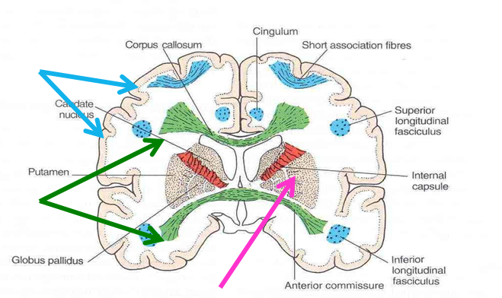
White Matter
*Similar areas in the same lobe (short) but from different lobes (long)
Underlies the cortex
Contains: 1. Nerve fibers 2. Neuroglia cells 3.Blood vessels.
The nerve fibers originate, terminate or sometimes both, within the cortex.
Depending on their origin & termination, these nerve fibers are classified into three types:
1. Association fibers: *
Unite different parts of the same hemisphere (within it self)
2. Commissural fibers: **
Connect the corresponding regions of the two hemispheres
3. Projection fibers: Consisting of: (connect cerebral cotrex with spinal cord)
Afferent fibers conveying impulses to the cerebral cortex.
Efferent fibers conveying impulses away from the cortex.
**Same area but in two hemispheres. Example corpus callosum which will help the two hemispheres act in harmony

Slide 19
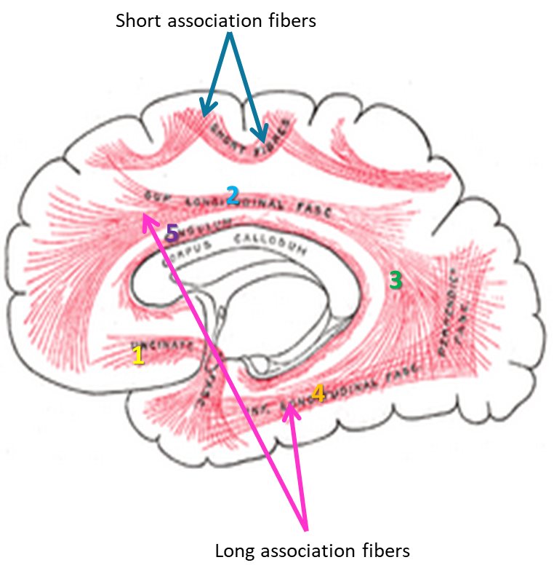
Only on the boy’s slides
White Matter
1. Association Fibers
Unite different parts of the same hemisphere.
Are of two kinds:
Those connecting adjacent gyri, short association fibers
Those connecting more distant parts, long association fibers.
Long Association Fibers
1. Uncinate fasciculus | connects frontal to temporal lobe.
2. Superior longitudinal fasciculus | connects the frontal, occipital, parietal, and temporal lobes
3. Arcuate fasciculus | connect gyri in frontal to temporal lobes
4. Inferior longitudinal fasciculus | connects occipital to temporal pole
5. Cingulum | connects frontal & parietal lobes to the para-hippocampal gyrus and adjacent temporal gyri

Slide 20
This slide is Extra

Slide 21
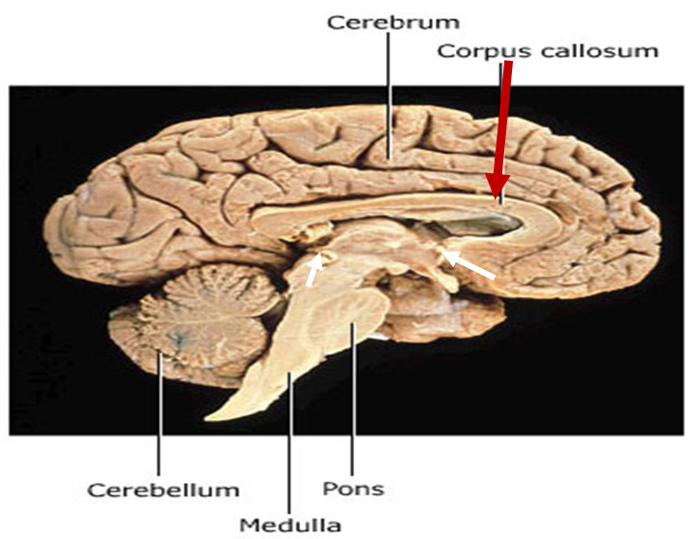
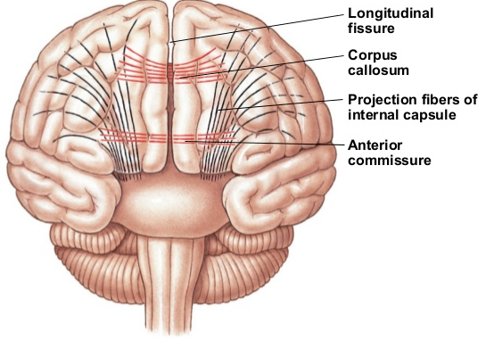
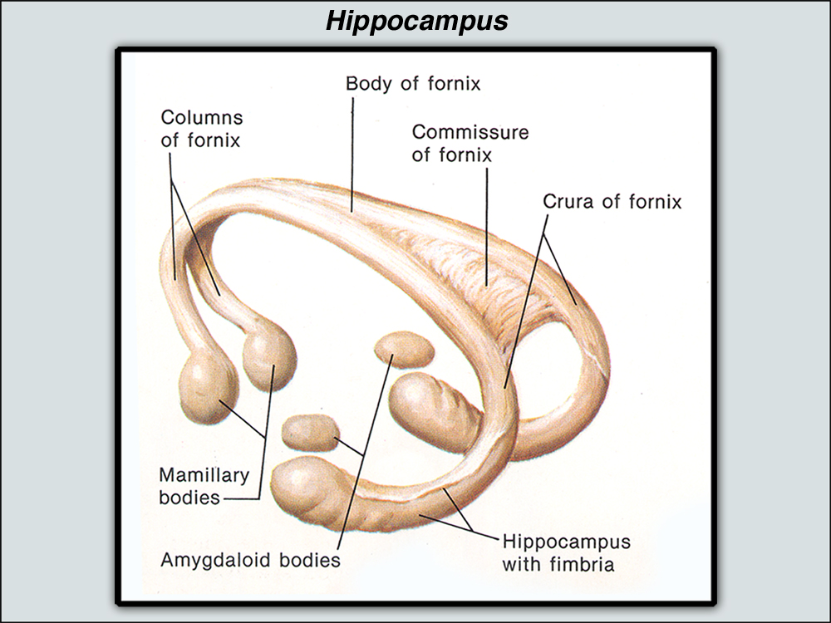
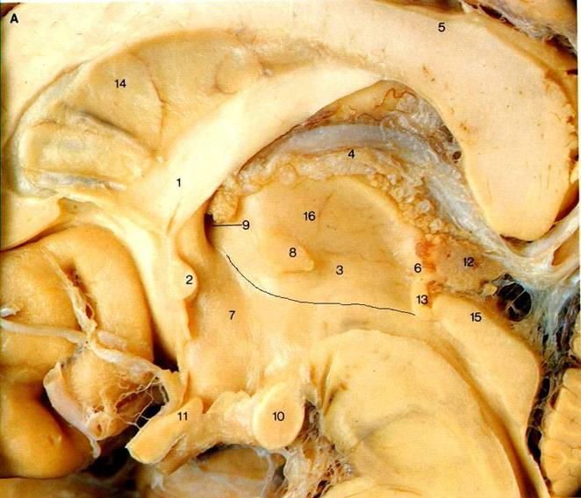
Only on the boy’s slides
White Matter
2. Commissural Fibers
Connect the corresponding regions of the two hemispheres.
Include:
Corpus callosum.
Anterior commissure.
Hippocampal commissure (commissure of fornix).
Posterior commissure.
Anterior commissure: connects the inferior and middle temporal gyri & the olfactory regions of the two hemispheres
Extra
Posterior Commissure: connects the left and right midbrain Important in the bilateral pupillary reflex
Hippocampal Commissure: connect the two hippocampi with each other

Slide 22
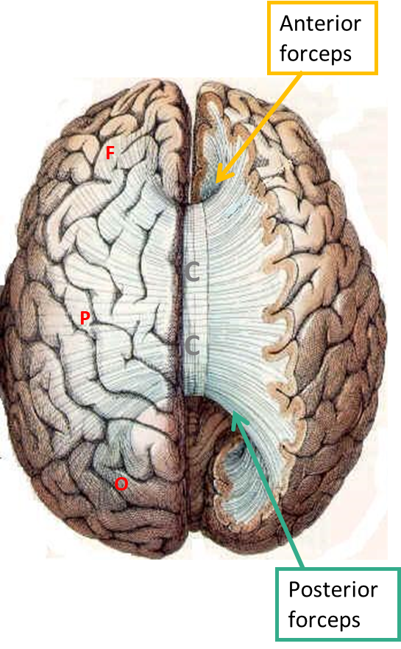
Only on the boy’s slides
White Matter
2. Commissural Fibers
Corpus Callosum
Connects the corresponding regions of the two hemispheres except the temporal lobes, that are connected by anterior commissure.
It is shorter craniocaudally than is the hemisphere.
The callosal fibers linking the frontal poles, curve forward forming anterior forceps (forceps minor).
The callosal fibers linking the occipital poles, curve backward forming posterior forceps (forceps major).

Slide 23
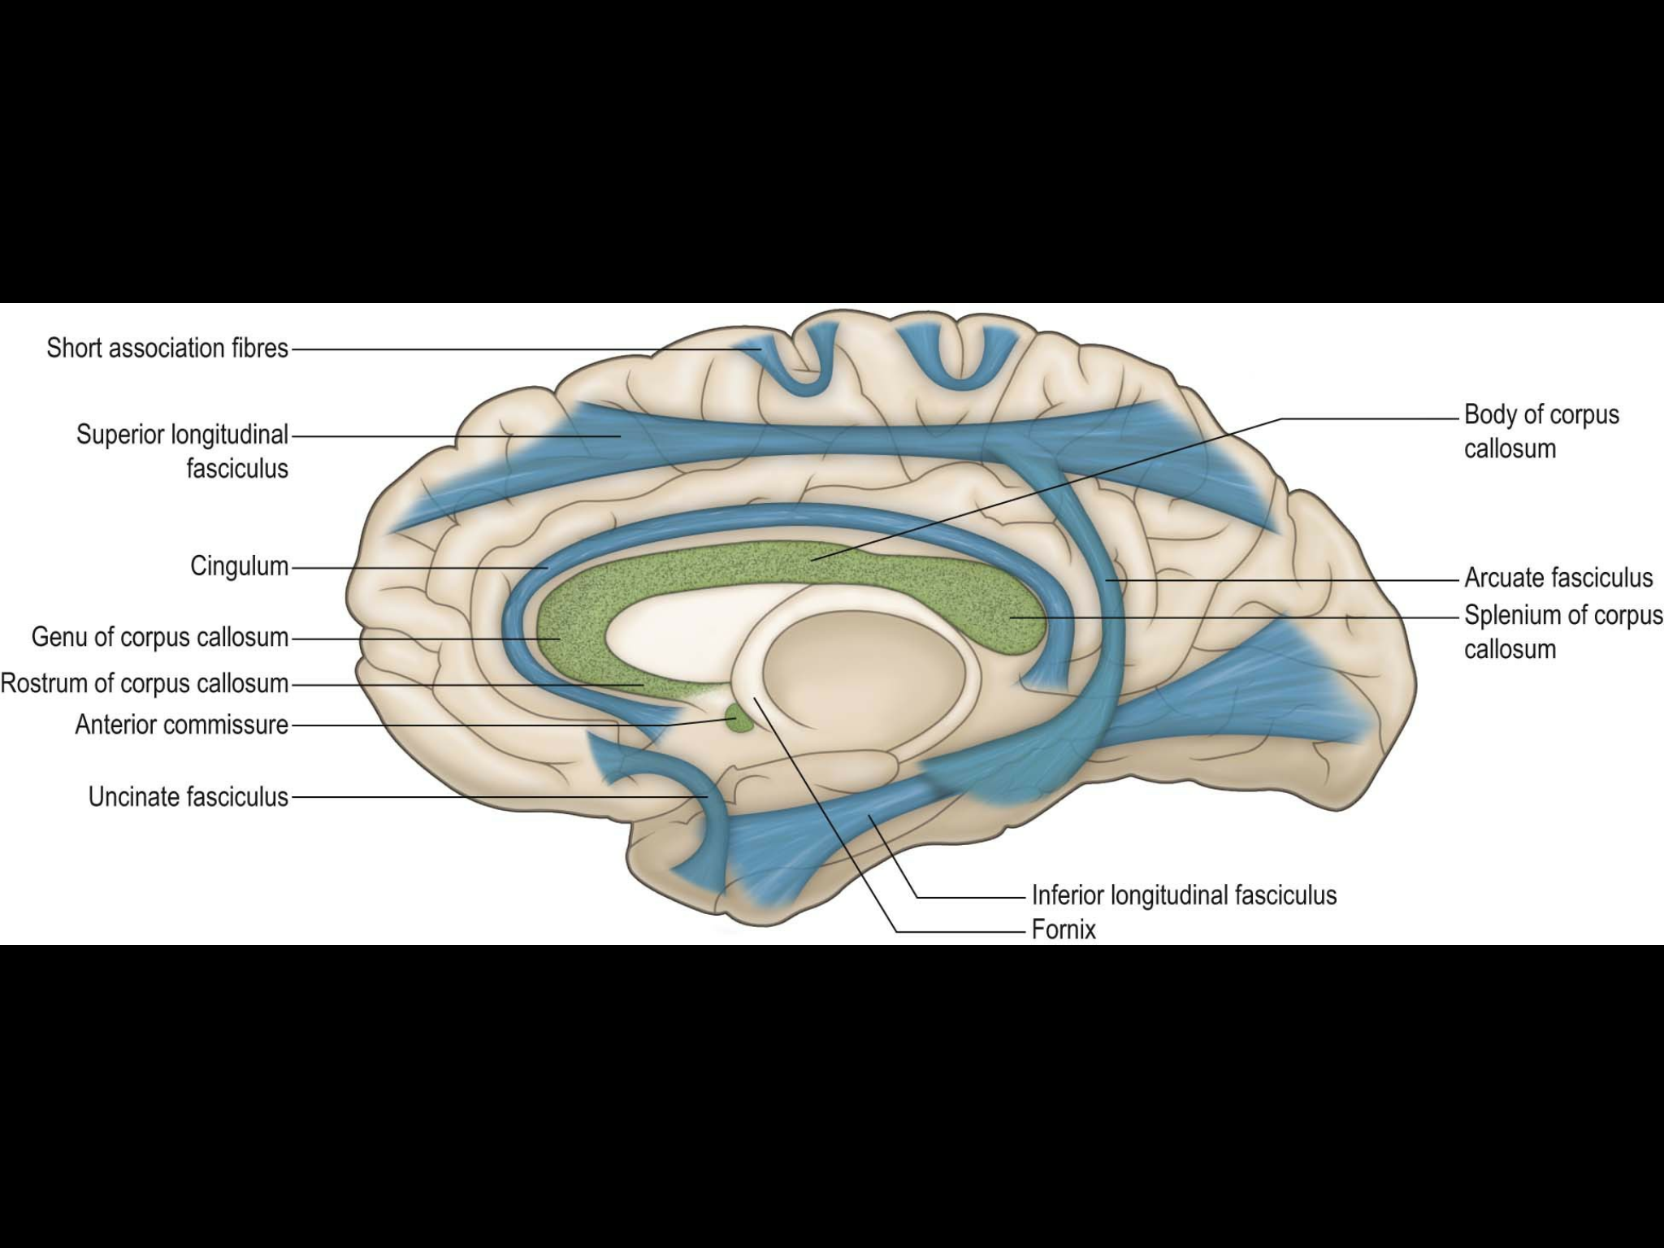
Only on the boy’s slides
White Matter
2. Commissural Fibers
Body
Parts of Corpus Callosum:
Body
Splenium
Genu
Rostrum
Genu
Splenium
Rostrum
Extra
Extra

Slide 24
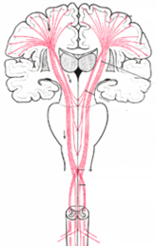
Only on the boy’s slides
White Matter
3. Projection Fibers
Consist of:
Afferent fibers conveying impulses to the cerebral cortex.
Efferent fibers conveying impulses away from the cortex.
Deeper to the cortex, these fibers are arranged radially as the corona radiata.
Then the fibers converge downward, form internal capsule, between thalamus and basal ganglia.
Continue in the crus cerebri of the midbrain, basilar part of pons, & pyramid of medulla oblongata.
corona radiata
Internal capsule
crus cerebri
pyramidal decussation

Slide 25
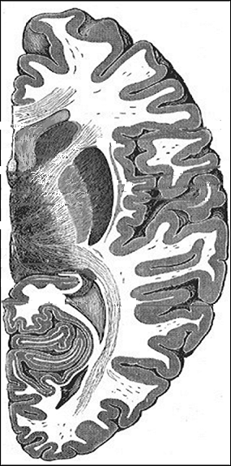
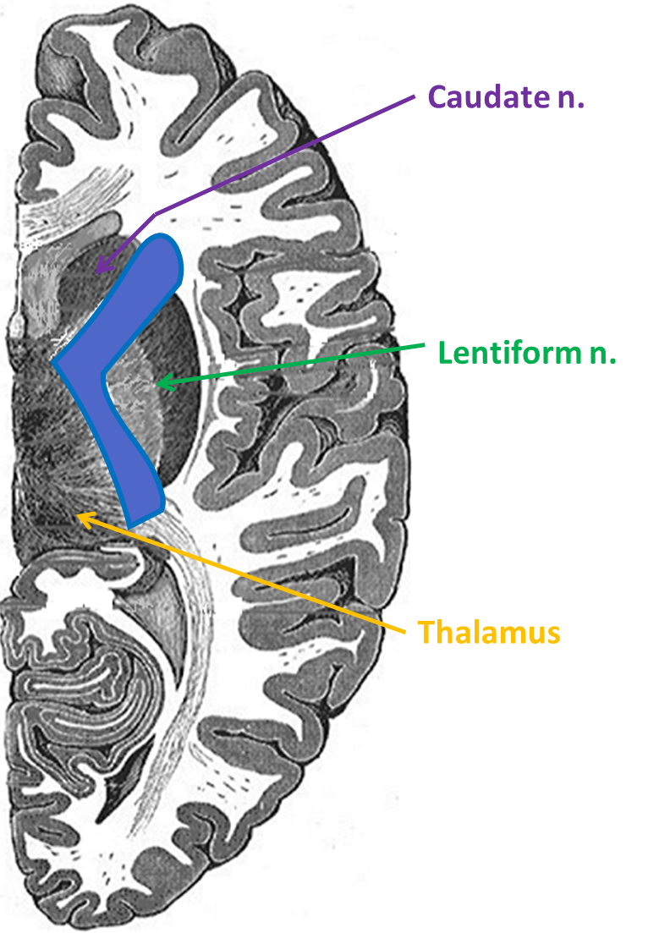
Only on the boy’s slides
White Matter
3. Projection Fibers
Internal Capsule
Bundle of projection fibers, passes through the interval between the thalamus and the basal ganglia (caudate & lentiform* nuclei)
Has 5 parts:
Anterior limb: Thalamocortical & Frontopontine fibers
Genu: Corticobulbar fibers
Posterior limb: Corticospinal, Corticobulbar & Thalamocortical fibers.
Retrolenticular part: Geniculocalcarine fibers
Sublenticular part: Geniculo-temporal fibers.
C
1
2
L
3
T
4
*Putamen and globus pallidus nuclei are collectively known as Lentiform nuclei

Slide 26
Summary
Lobe | Gyri | Sulci
Frontal | Precentral gyrus Superior frontal gyrus Middle frontal gyrus Inferior frontal gyrus | Superior frontal sulci Inferior frontal sulci
Parietal | 1. Postcentral gyrus | 1. Intraparietal sulcus
Temporal | Insula Superior temporal gyrus Middle temporal gyrus Inferior temporal gyrus | Superior temporal sulci Inferior temporal sulci
Medial Surface | Cingulate Parahippocampal | Parietooccipital Calcarine Cingulate
Broadmann’s Areas
1 | Primary somatosensory cortex
2
3
4 | Primary motor cortex
6 | Premotor cortex
8 | Frontal eye field
17 | Primary visual cortex
19 | Visual association cortex
41 | Primary auditory cortex
42
44 | Broca’s area
45

Slide 27
(1) which of the following is not one of the surfaces of the cerebrum?
A) Superiolatral B) Medial
C) Posterior D) Inferior
(2) Which lobe is responsible for smell, hearing and memory?
A) Frontal B) Temporal
C) Occipital D) Parietal
(3) Where is frontal eye field?
C) Occipital D) Parietal
A) Frontal B) Temporal
(4) When is cerebral dominance becomes established?
A) Before birth B) First few years after birth
C) At puberty D) Mid 40s
(5) Which nerve fiber type connect corresponding regions of different hemisphere?
A) Association B) Commissural
C) Projection D) Non of them
(6) Superficial layer of cerebral cortex consist of?
A) Grey matter B) White matter
C) Both A & B D) Non of them
(7) Corpus collosum is example of?
A) Efferent projection fiber B) Commissural fiber
C) Afferent projection fiber D) Association fiber
(8) Brodman's area 4 is related to?
A) Primary motor cortex B) Primary visual cortex C) Primary motor cortex D) Primary visual cortex
(9) Parahippocampal gyrus located in the inferomedial part of?
A) Frontal lobe B) Parietal lobe
C) Occipital lobe D) Temporal lobe
(10) Which of them regions concerned with expressive aspects of language?
A) Broca’s area B) Wernick’s area
C) Angular gyrus D) Supramarginal gyrus

Slide 28
Answers
(1) C (6) A (2) B (7) B (3) A (8) C (4) B (9) D (5) B (10) A

Slide 29
(1) What is the function of afferent projection fibers?
Afferent fibers convey impulses to the cerebral cortex
(2) Name the 4 Commissural Fibers?
Corpus callosum.
Anterior commissure.
Hippocampal commissure (commissure of fornix).
Posterior commissure.

