Slide 2
Objectives
At the end of the lecture, students should be able to:
Define “basal ganglia” and enumerate its components.
Enumerate parts of “Corpus Striatum” and their important relations.
Describe the structure of Caudate and Lentiform (Putamen & Globus Pallidus) nuclei.
Differentiate between striatum & paleostriatum in terms of connections.
State briefly functions & dysfunctions of Corpus Striatum.

Slide 3
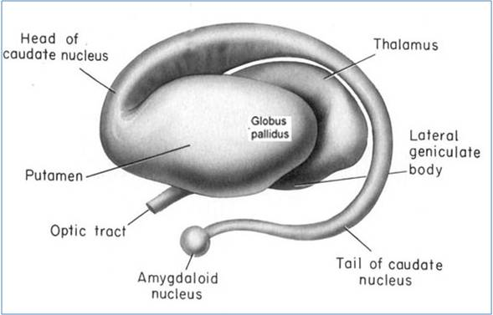
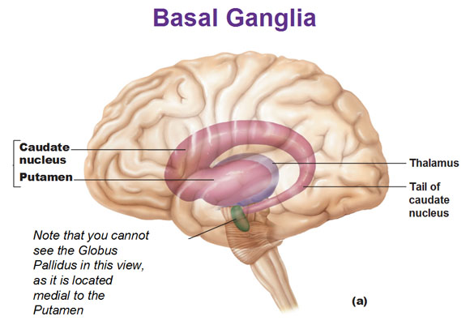
أشياء اكد عليها الدكتور:
-Striatum: caudate +putamen(because it’s functionally connected)(it is the major input).
-corpus striatum: caudate + lentiform(the reason of this naming that there is grey matter connection).
-the space between (caudate and lentiform is the internal capsule).
-the degermation will happen to the connection between the striatum and the source of connection.
Basal Ganglia
02:00
1
BASAL GANGLIA (NUCLEI) : group of nerve cells deeply situated in cerebral hemispheres
Components:
2
1. Caudate Nucleus
Lentiform Nucleus:
divided into Putamen & Globus Pallidus
3
(Lateral) (medial)
Caudate & Lentiform nuclei are functionally related to each other & called “Corpus striatum”: Part of extrapyramidal motor system, principally involved in the control of posture and movements (primarily by inhibiting unwanted motor functions)
Amygdaloid Nucleus
(function is different: part of limbic system) is only embryologically related to Corpus Striatum

Slide 4
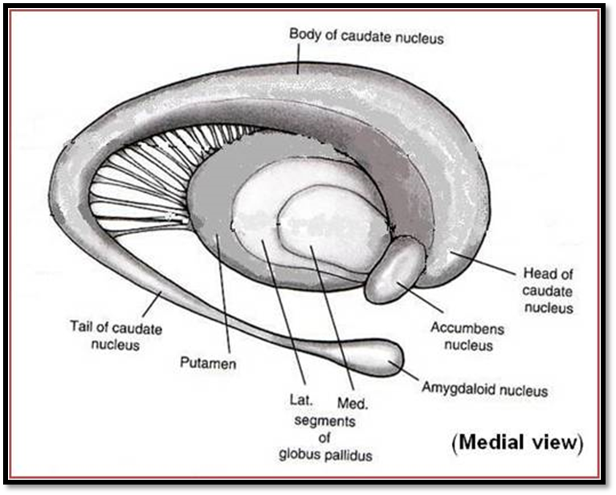
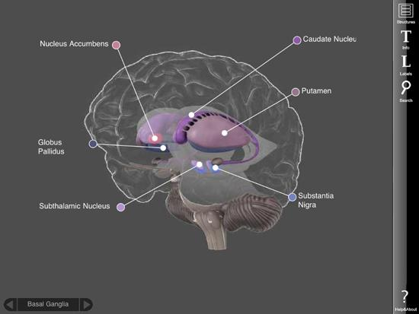
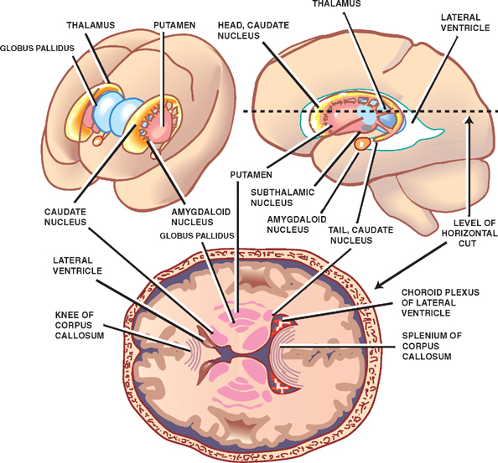
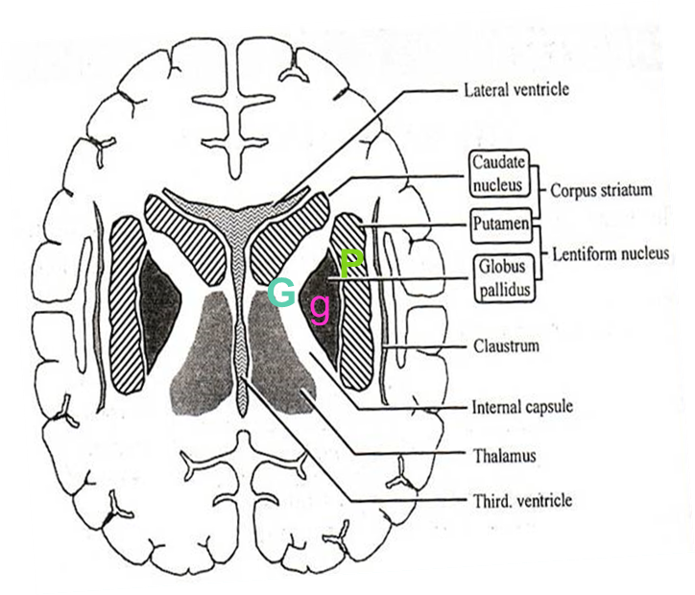
Corpus Striatum
Nomenclature
Bands of grey matter pass from lentiform nucleus across the internal capsule to the caudate nucleus, giving the striated appearance hence, the name corpus striatum.
Shape:
Three sided, wedge-shaped mass of grey matter, with a convex outer surface and an apex which lies against the genu of the internal capsule (g) genu is a latin word for "knee“.
Division: divided into
Larger darker lateral portion called putamen (p)
Smaller, lighter medial portion called globus pallidus (g)
Extra
Extra
Lentiform Nucleus
في الصورة طالع العكس بس تجاهلوها الصح هو المكتوب هنا

Slide 5
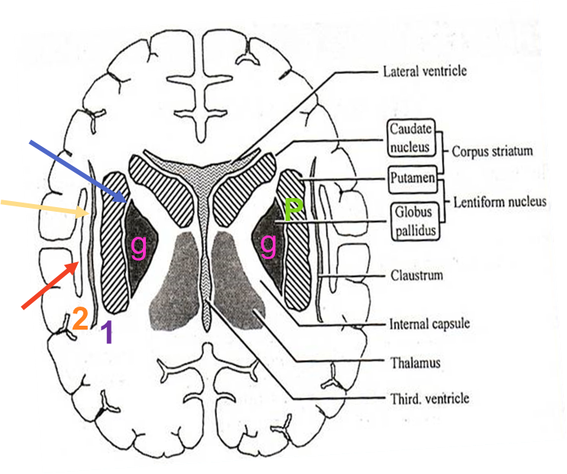
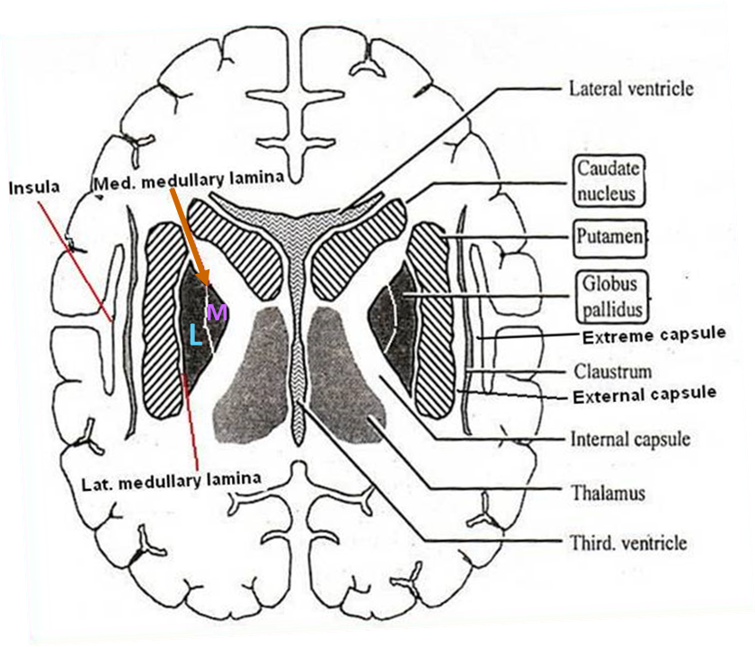
Corpus Striatum
Lentiform Nucleus
Putamen
Separated from globus pallidus (g) by a thin sheath of nerve fibers, the lateral medullary lamina
The white matter lateral to putamen is divided, by a sheath of grey matter, the claustrum into two layers:
external capsule (1) between the putamen and claustrum.
extreme capsule (2) between the claustrum and the insula
We saw 3 capsules: internal, external, and extreme. All are white matter.
Globus Pallidus
Consists of two divisions, the lateral (L) & the medial (M) segments, separated by a thin sheath of nerve fibers, the medial medullary lamina.
The medial segment is similar, in terms of cytology and connections with the pars reticulata of substantia nigra

Slide 6
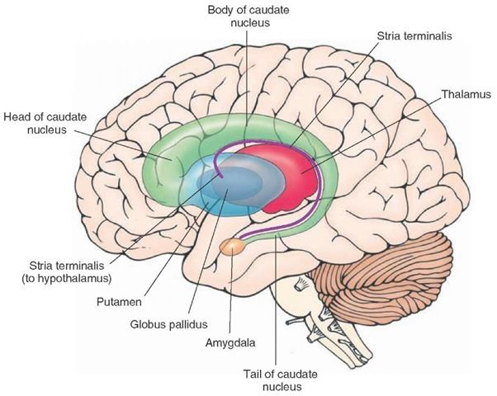
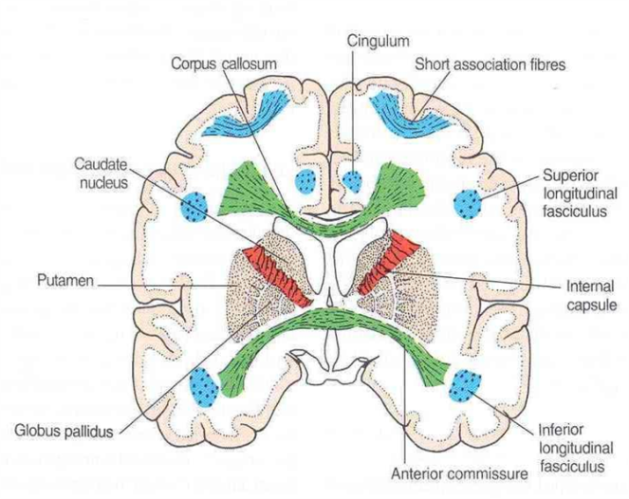
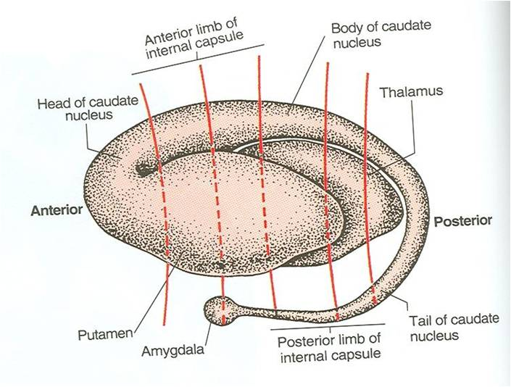
Corpus Striatum
Caudate Nucleus
Shape: C-shaped mass of grey matter
Components: head, body & tail
Looks like comma:
Head:
Rounded in shape
Lies anterior to thalamus (in frontal lobe)
Completely separated from the putamen by the internal capsule except rostrally where it is continuous with the putamen
Extra
Body:
Long & narrow
Extends above thalamus (in parietal lobe)
3. Tail:
Long & tapering
Descends, below thalamus, into temporal lobe
Continuous with Amygdaloid Nucleus (part of limbic system)

Slide 7
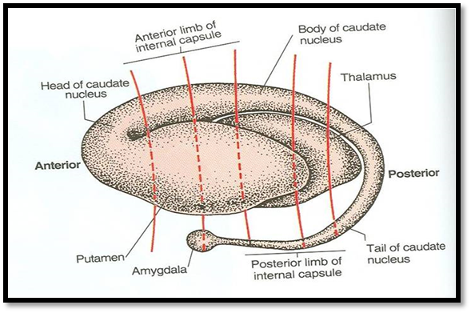
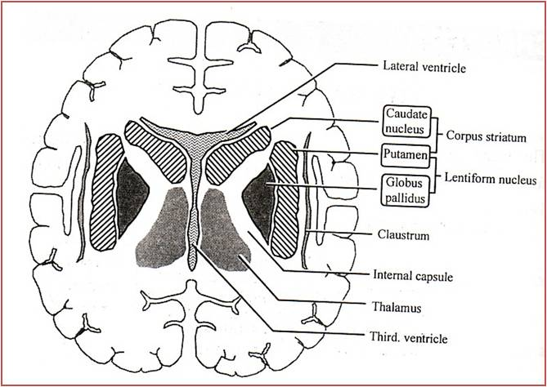
Corpus Striatum
Important relations
01:55
Head of Caudate Nucleus:
Anterior to thalamus
Medial to Lentiform & separated from it by anterior limb of internal capsule (A)
Lentiform Nucleus:
Lateral to thalamus & separated from it by posterior limb of internal capsule (P)
Extra
A
P

Slide 8
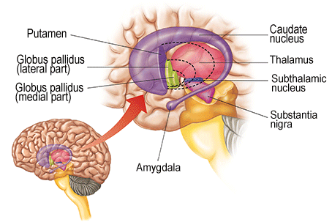
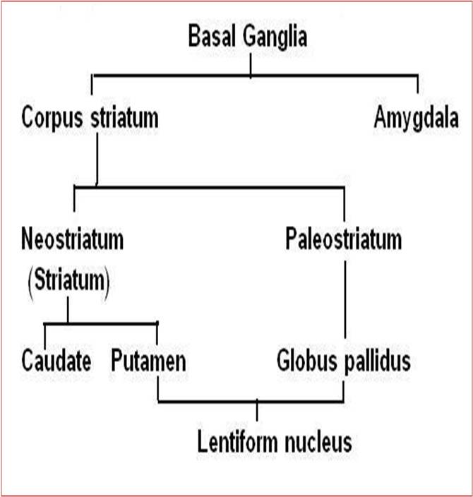
1- The input to striatum is from:
-cortex
-thalamus
-substantial nigra
-midbrain
2- Striatum projects to:
-Globus pallidus
-substantia nigra
IMPORTANT
Corpus Striatum
Putamen is more closely related to Caudate nucleus (regarding development, function & connections) and together constitute the neostriatum or striatum.
The globus pallidus is the oldest part of corpus striatum and is called paleostriatum or pallidum.
Same thing

Slide 9
IMPORTANT
Corpus Striatum
Striatum (Caudate & Putamen)
“The input portion of Corpus striatum”
Paleostriatum (Globus Pallidus)
“The output portion of corpus striatum:
medial segment of G.P. + Pars Reticulata of S.N.*”
*Substantia Nigra is divided into Pars Compacta and Pars Reticulata
(which is structurally similar to the medial segment of globus pallidus)
Cerebral Cortex (premotor area 6)
Substantia Nigra
(Pars Reticulata)
Thalamus
(Ventral lateral, Ventral anterior, centromedian)
Thalamus (intralaminar nuclei)
Striatum
Globus Pallidus
Medial Segment
thalamic fasciculus
Substantia Nigra
(Pars Compacta)
Subthalamic Nuclei
Globus Pallidus
Lateral Segment
AFEERENT (input)
EFEERENT (output)
Subthalamic fasciculus

Slide 10
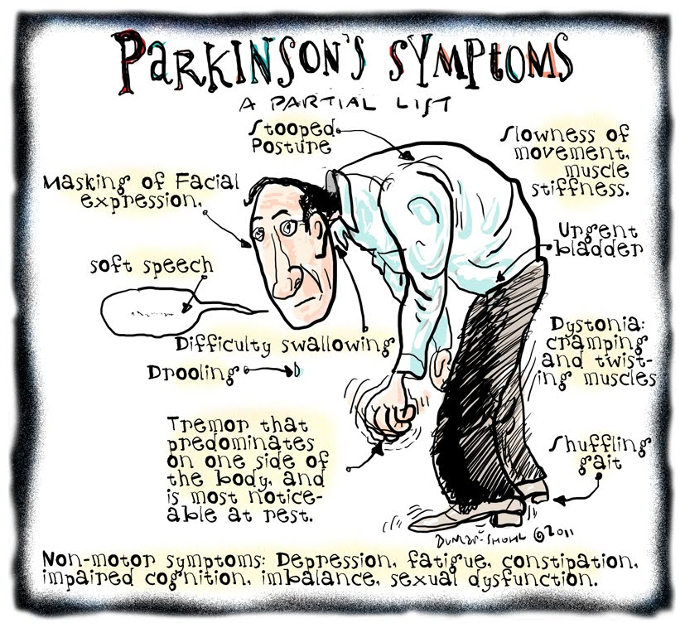
Static tremor: in basal ganglia dysfunction (like Parkinson), while he is setting, but with movement it disappears.
Intension tremor: tremor with movement (with cerebellar injury).
Corpus Striatum
Function
The corpus striatum assists in regulation of voluntary movement and learning of motor skills.
Their function is to facilitate behavior and movement that are required and appropriate, and inhibit unwanted or inappropriate movement.
Dysfunction = Parkinsonism
Its dysfunction does NOT cause paralysis, sensory loss or ataxia
Its dysfunction leads to:
Abnormal motor control: emergence of abnormal,
involuntary movements (dyskinesias)
Alteration in muscle tone: hypertonia/hypotonia
Soft speech, slow steps, tremor at rest
Stooped posture
Nonmotor symptoms: depression, constipation, fatigue.
*Mohammed Ali, the famous boxer, had parkinsonism.

Slide 11
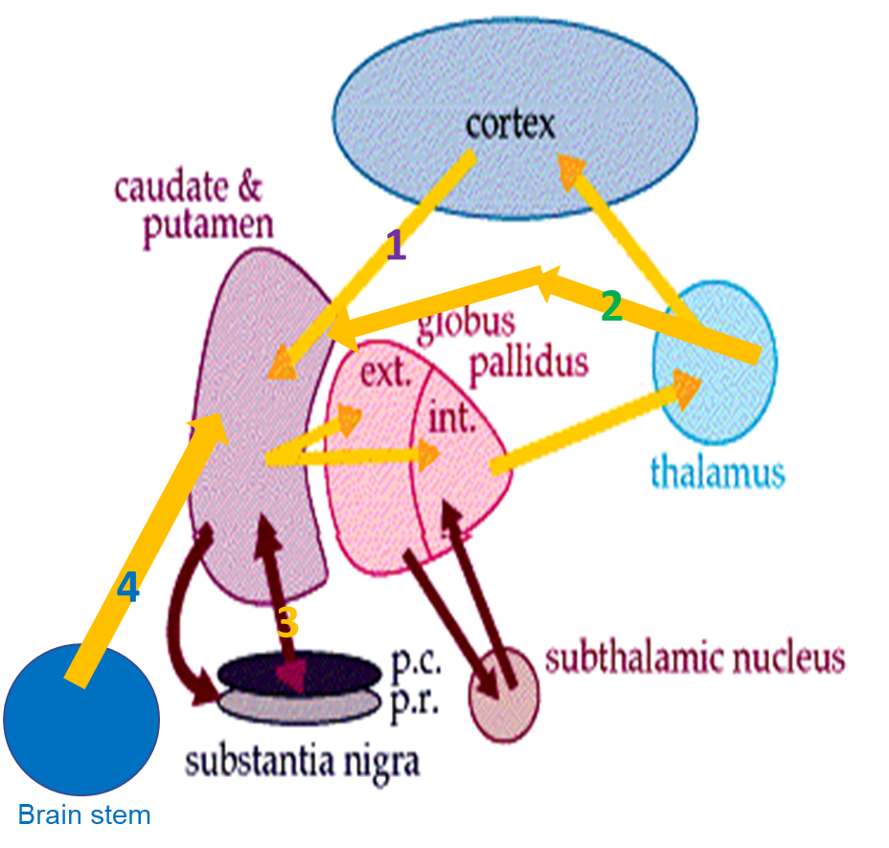
Only on the boy’s slides
Connection Of Corpus Striatum
*الدكتور قال انه السلايدات هذه لزيادة الايضاح فقط و السلايدات المتوافقة مع البنات هي المعتمدة
Afferent Fibers (input)
1- Corticostriate Fibers: From all parts of cerebral cortex (mostly from sensory- motor cortex) axons pass To caudate nucleus and putamen. Glutamate is the neurotransmitter of this fibers.
2-Thalamostriate Fibers : From intralaminar nuclei of thalamus axons pass To caudate nucleus and putamen.
3- Nigrostriate Fibers : Axons from Substantia nigra of midbrain pass To caudate nucleus and putamen. Neurotransmitter is Dopamine. (the problem with Parkinson's is here)
4- Brain stem Strial Fibers (raphe nucleus) : Ascending fibers from brain stem End in caudate nucleus & putamen. Serotonin is the neurotransmitter.
It is believed that the last 2 groups are inhibitory in function

Slide 12
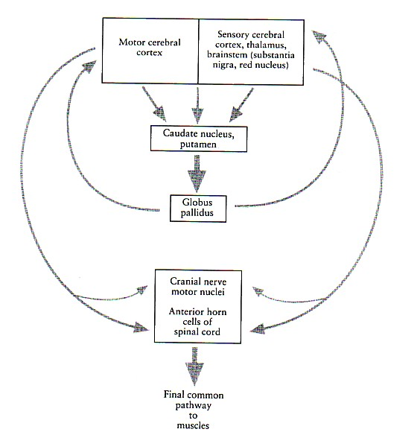
Only on the boy’s slides
Connection Of Corpus Striatum
*الدكتور قال انه السلايدات هذه لزيادة الايضاح فقط و السلايدات المتوافقة مع البنات هي المعتمدة
Efferent Fibers (Output)
1-Striatopallidal fibers: These fibers pass from corpus striatum (caudate nucleus & putamen) To globus pallidus. Gamma-aminobutyric acid (GABA) is the neurotransmitter.
2-Striatonigral fibers: These fibers pass from caudate nucleus & putamen To Substantia nigra. Some fibers use GABA as a neurotransmitter, and others use substance p.

Slide 13
Only on the boy’s slides
Functions of Basal Ganglia
*الدكتور قال انه السلايدات هذه لزيادة الايضاح فقط و السلايدات المتوافقة مع البنات هي المعتمدة
Control of movements
Planning and programming of movements
Cognition
Basically the activity of basal nuclei begins by information received from sensory cortex, thalamus, substantia nigra, and red nucleus, according to thoughts of mind.
These information is integrated within corpus striatum and channeled within globus pallidus and outflow back to motor areas of cerebral cortex, and other motor areas in brain stem.
Thus the basal nuclei can control muscular movement through its effect on cerebral cortex
So basal nuclei assist in regulation of voluntary movement and learning of motor skills.
Functions of basal ganglia:
Design of plans, which convert thoughts and ideas into motor actions: to produce a coordinated organized purposeful movement. e.g. dressing.
Determining the timing and scale of movement: to what extent the movement will be fast, and how long it will last.
Storage of motor programs of familiar motor actions: e.g. signature.

Slide 14
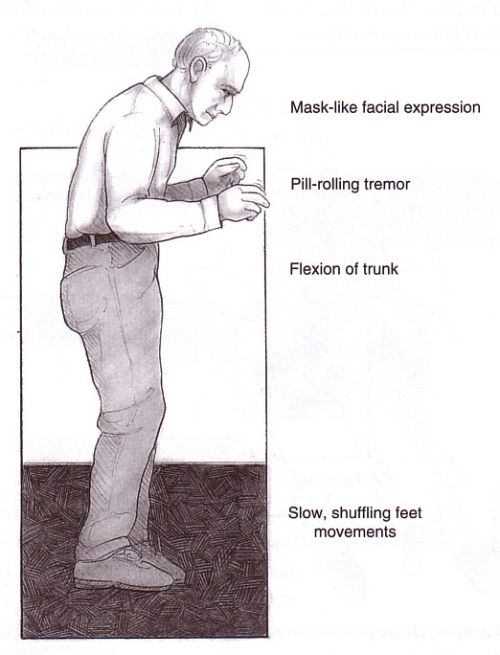
Only on the boy’s slides
Parkinsonism (Parkinson’s disease, paralysis Agitans)
*الدكتور قال انه السلايدات هذه لزيادة الايضاح فقط و السلايدات المتوافقة مع البنات هي المعتمدة
Described by James Parkinson
Lesion: Neuronal degeneration* in substantia nigra leading to reduction of dopamine within corpus striatum.
Features:
1- Tremors: Pill-rolling, involuntary, rhythmic, oscillating movements. It occurs during waking time during rest, it is called static tremors.
2- Rigidity: It occurs in both flexors, and extensors, but more in flexors giving flexion attitude. It is called lead pipe rigidity.
3- Akinesia: it means lack of movement; Absence of swinging arm during walking, mask face, low- volume slow monotonous speech, and shuffling gait (يجر رجله).
Four cardinal symptoms:
1. Tremor & Rigidity 2. Akinesia & Bradykinesia
3. Postural Changes 4. Speech Changes
أعراض المرض لا تظهر إلا بعد ما يحصل:
Degeneration of dopaminergic nigrostriatal
Neurons (60-80 %).
Methyl-Phenyl-Tetrahydro-Pyridine (MPTP).
The oxidant MPP+ is toxic to SN.

Slide 15
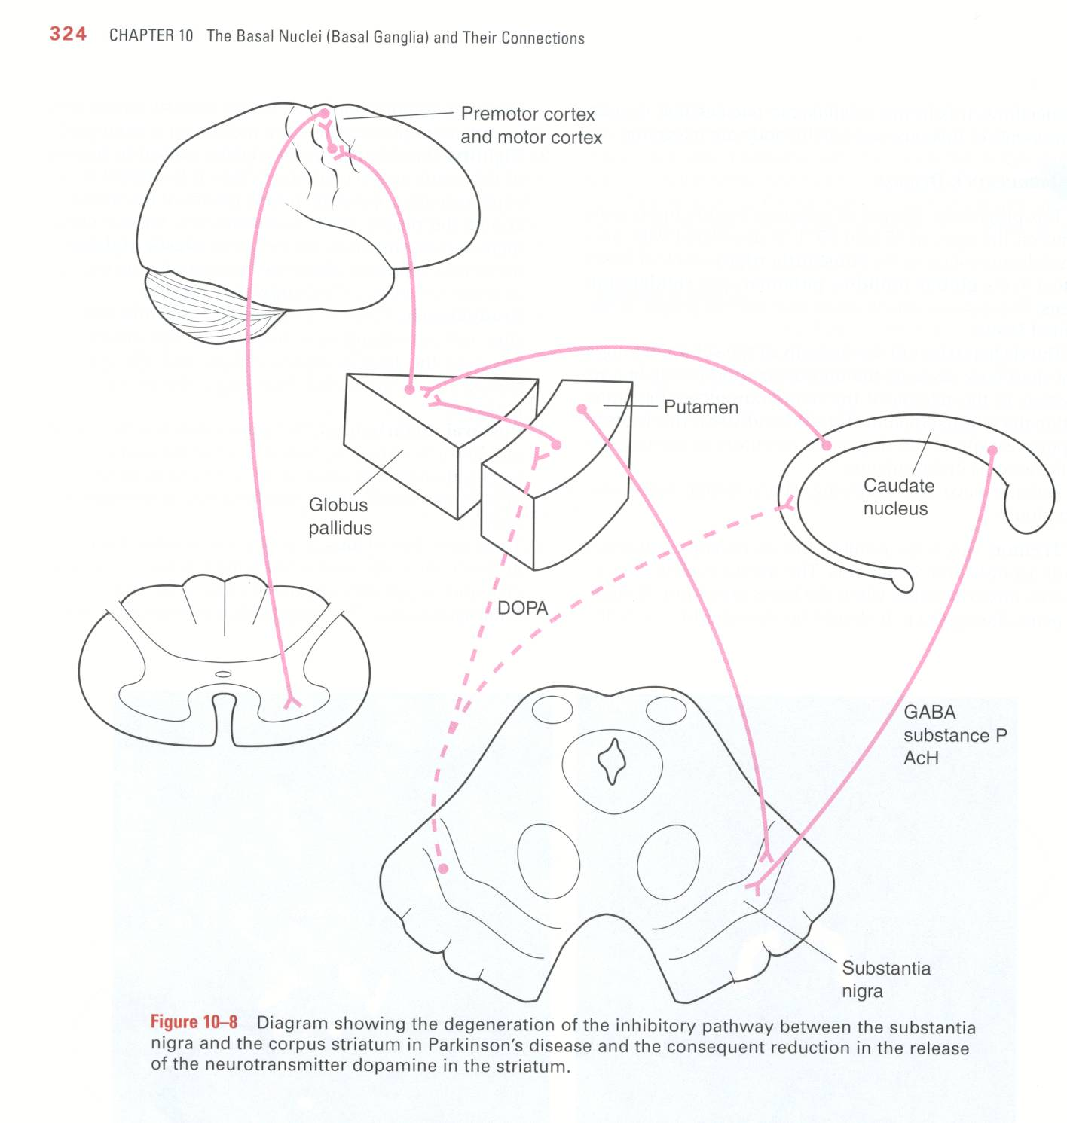
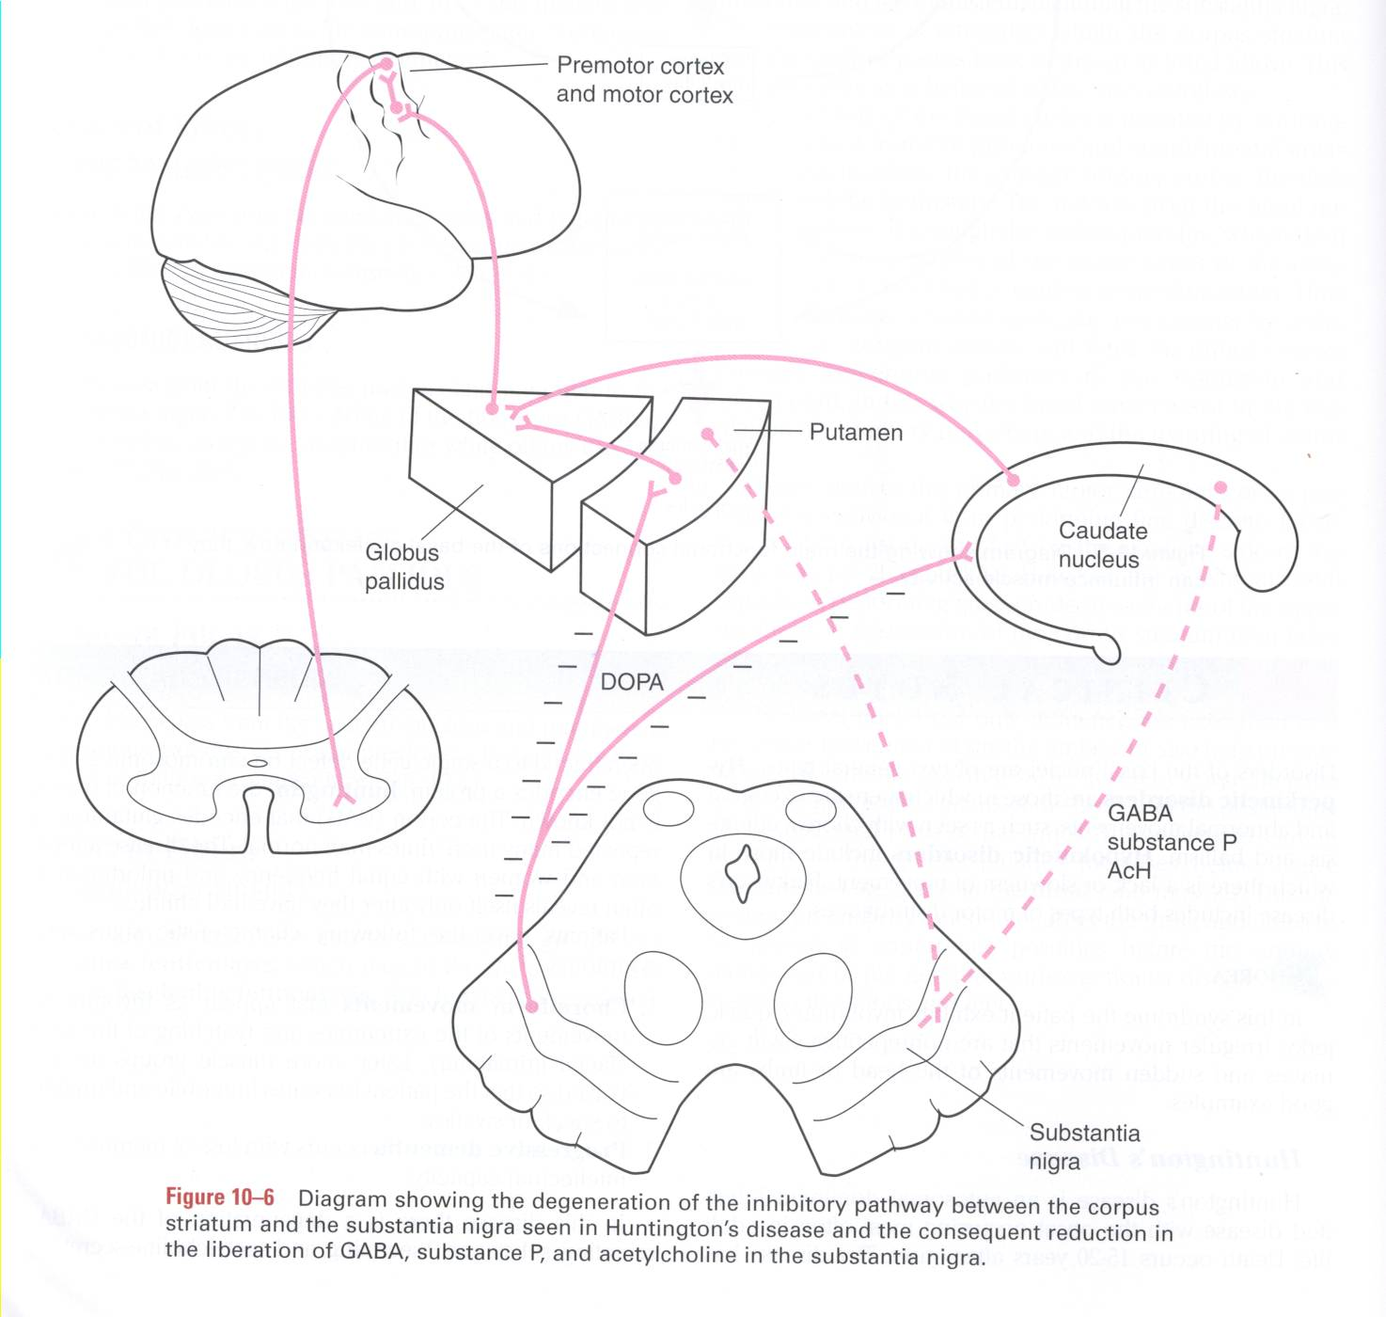
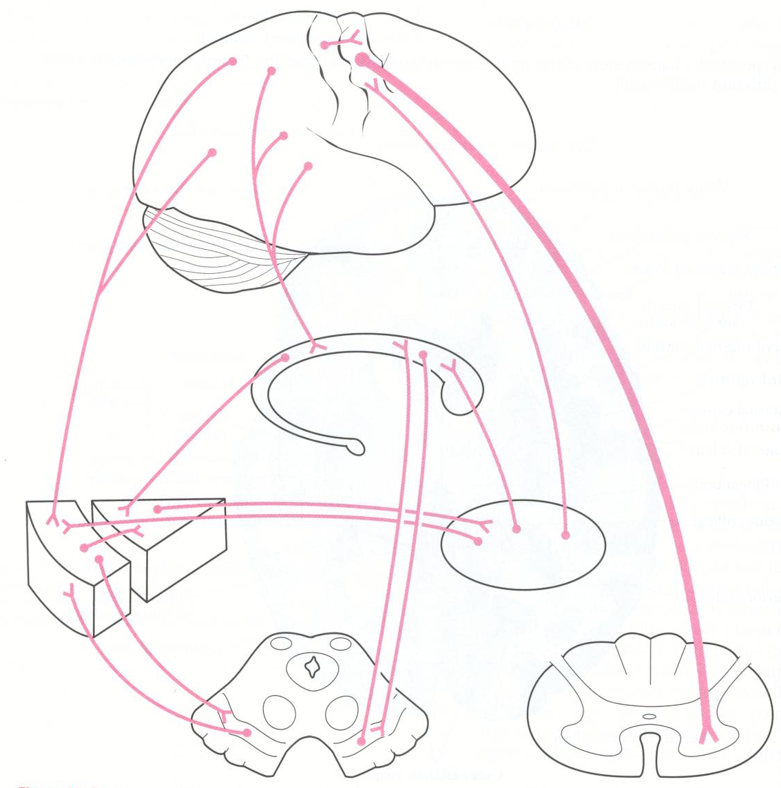
Main Connections between Cortex, basal Nuclei, Thalamic Nuclei Brainstem & Spinal Cord These are the normal connections. Any degeneration will lead to
Huntington’s Disease: degeneration of inhibitory pathway between corpus striatum & Substantia nigra
Parkinson’s Disease: degeneration of inhibitory pathways between Substantia Nigra & corpus striatum
Important:
Parkinsonism: degermation of the pathway between substantial nigra and striatum
Huntington’s: the opposite
Only on the boy’s slides
*الدكتور قال انه السلايدات هذه لزيادة الايضاح فقط و السلايدات المتوافقة مع البنات هي المعتمدة

Slide 16
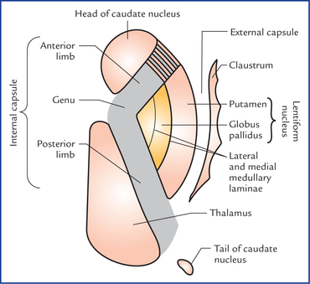
Summary
Basal Ganglia
Corpus Striatum |  |  | Amygdaloid
Caudate | Lentiform
 | Putamen | Globus Pallidus
Neostriatum |  | Paleostriatum
Structure | Separates
Claustrum | Extreme capsule | External capsule
Lateral medullary lamina | Putamen | Globus pallidus
Medial medullary lamina | Lateral segment of globus pallidus | Medial segment of globus pallidus
Anterior limb of internal capsule | Lentiform | Caudate (head)
Posterior limb of internal capsule | Lentiform | Thalamus

Slide 17
Corpus striatum are primarily concerned with control of posture & movement.
The striatum is the input region of corpus striatum,
while the medial segment of globus pallidus & pars reticulata of substantia nigra are the output portion.
Afferent fibers of striatum come from:
cerebral cortex.
intralaminar nucleus of thalamus.
pars compacta of substantia nigra.
Afferent fibers of both lateral & medial segments of globus pallidus come from:
1. Striatum 2. Subthalamic nucleus.
Efferent fibers of medial segment is directed to
ventral lateral,
ventral anterior &
centromedian nucleus of thalamus.
Efferent fibers of lateral segment is directed to subthalamic nucleus.
Efferent fibers of striatum is directed to
globus pallidus.
pars reticulata of substantia nigra.

Slide 18
(1) What is the caudate nucleus shaped like?
A) C-shaped mass of white matter
B) C-shaped mass of grey matter
C) G-shaped mass of grey matter
D) None are correct
(2) The Lentiform Nucleus is related to the thalamus?
A) Medially B) Superior to the thalamus
C) laterally D) Inferior to
(3) The two division of the globus pallidus are seperated by?
A) The medial medullary lamina
B) The lateral medullary lamina
C) Insula
D) Lateral ventricle
(4) What part of the caudate nucleus is continues with the amygdaloid nucleus?
A) Body B) Head
C) A and b D) Tail
(5) What does the dysfunction of the corpus straitum lead to?
A) Paralysis B) Hypertonia
C) Ataxia D) Sensory loss
(6) Corpus striatum is ?
A) Lentifrom and Caudate B) Caudate and glopus pallidus
C) Caudate and putamen D) Putamen and glopus Pallidus
6) Striatum is ?
A) Lentifrom and Caudate B) Caudate and glopus pallidus
C) Caudate and putamen D) Putamen and glopus Pallidus
(8) The major input for basal ganglia goes to ?
A) Lentifrom and Caudate B) Caudate and glopus pallidus
C) Caudate and putamen D) Glopus Pallidus
(8) One of the major output for basal ganglia is?
A) Lentifrom and Caudate B) Caudate and glopus pallidus
C) Caudate and putamen D) Glopus Pallidus
(10) Pallidum is ?
A) Lentifrom and Caudate B) Caudate and glopus pallidus
C) Caudate and putamen D) Glopus Pallidus

Slide 19
Answers
(1) B (6) A (2) C (7) C (3) A (8) C (4) D (9) D (5) B (10) D

Slide 20
(1) What are the components of the basal ganglia?
Caudate Nucleus
Lentiform Nucleus
Amygdaloid Nucleus
(2) What is the oldest part of corpus striatum?
The globus pallidus

