Slide 2
Objectives
At the end of the lecture, students should be able to:
Describe the anatomy and main functions of the thalamus.
Name and identify different nuclei of the thalamus.
Describe the main connections and functions of thalamic nuclei.
Name and identify different parts of the limbic system.
Describe main functions of the limbic system.
Describe the effects of lesions of the limbic system.

Slide 3

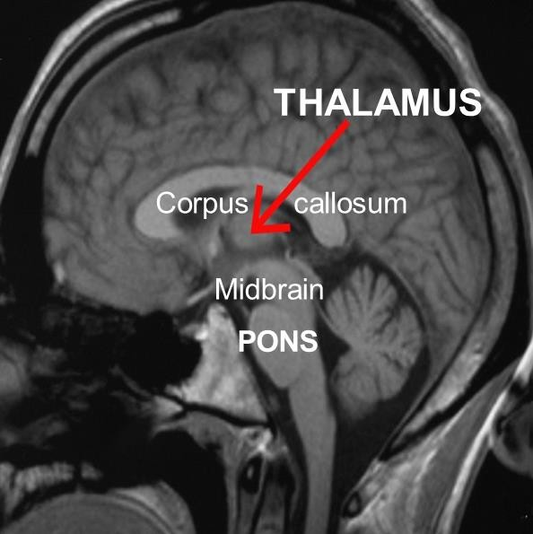

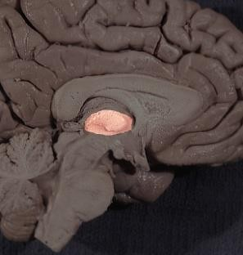
Thalamus
02:04
It is the largest nuclear mass of the whole body.
It is the largest part of the diencephalon
It is formed of: two oval masses of grey matter.
It is the gateway to the cortex.(the last station for sensory fibers before it project to the cortex)
Resemble a small hen.
Together with the hypothalamus they form the lateral wall of the 3rd ventricle.
The thalamus sends received information to the cerebral cortex from different brain regions.
Axons from every sensory system (except olfaction) synapse in the thalamus as the last relay site 'last pit stop' before the information reaches the cerebral cortex.
There are some thalamic nuclei that receive input from:
  Cerebellar nuclei
  Basal ganglia
  Limbic-related brain regions

Slide 4
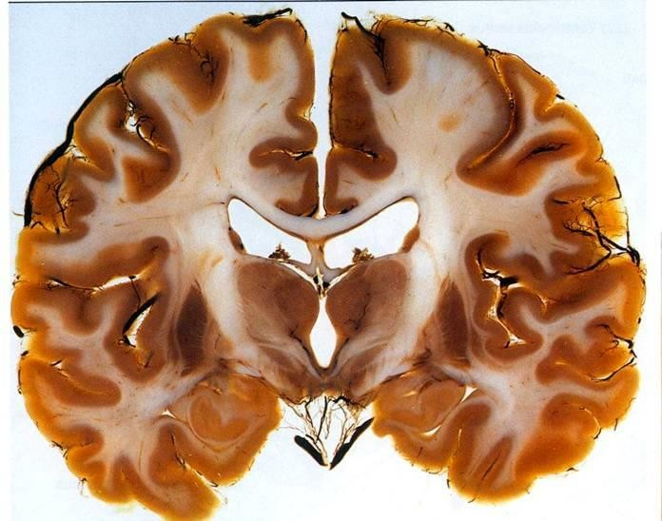
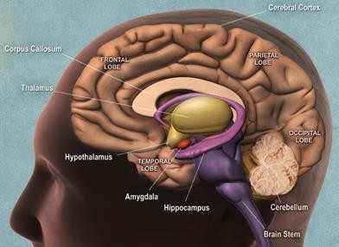





Thalamus
Relations
S
L T
_{I} 3
Relation = surfaces
It has 4 surfaces & 2 ends.
Surfaces:
Superior: (S)
Lateral ventricle & fornix.
Inferior: (I)
Hypothalamus, anteriorly & Subthalamus posteriorly.
Superior: (S)
Lateral ventricle & fornix.
Ends:
Anterior end:
Forms a projection, called the anterior tubercle. It
lies just behind the interventricular foramen*.
Medial: (3)
The 3rd ventricle
In some people it is connected to the thalamus of the opposite side by the interthalamic connexus, (adhesion) or Massa intermedia which crosses through the 3rd ventricle
Lateral:(L)
Posterior limb of the internal capsule
Posterior end: (Broad عريض)
Forms a projection called Pulvinar which lies above the superior colliculus and the lateral & medial Geniculate bodies.
*the foramen between the lateral ventricle and the 3^{ed} ventricle.| another name foramina monro

Slide 5
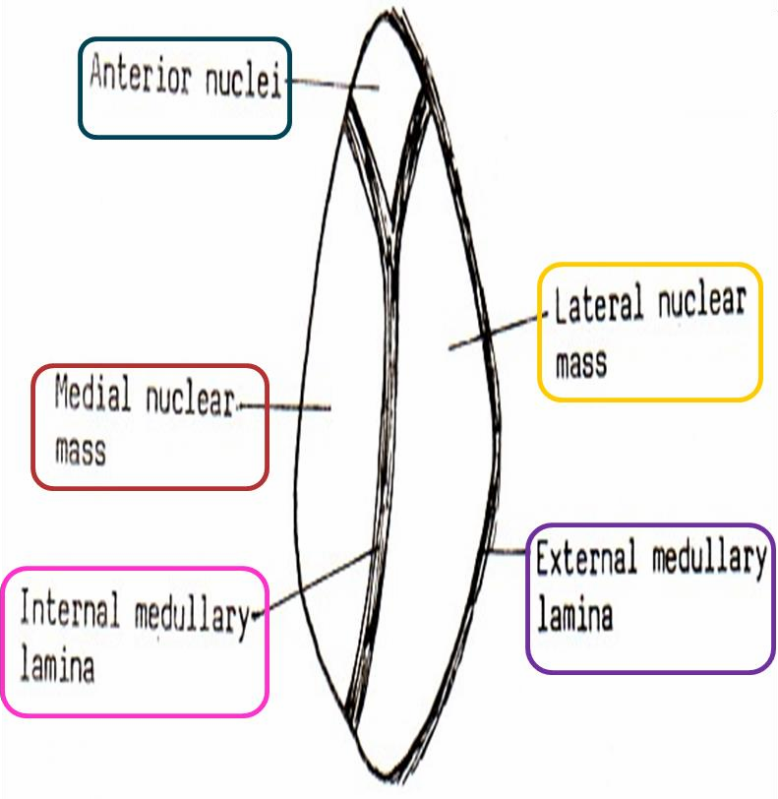
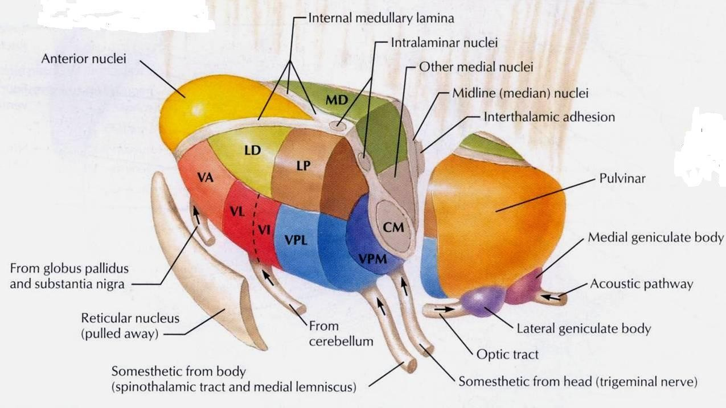
Thalamus
Internal Structure
White matter:
External medullary lamina: Lamina or fiber
  Covers the lateral surface.
  It consists of thalamocortical & corticothalamic fibers.
Internal medullary lamina:
  Bundle of Y- shaped myelinated (afferent & efferent) fibers.
  It divides the thalamus into 3 nuclear groups: anterior*, medial & lateral.
  Each of these group is subdivided into a number of named nuclei.
*Has a relation with limbic system

Slide 6
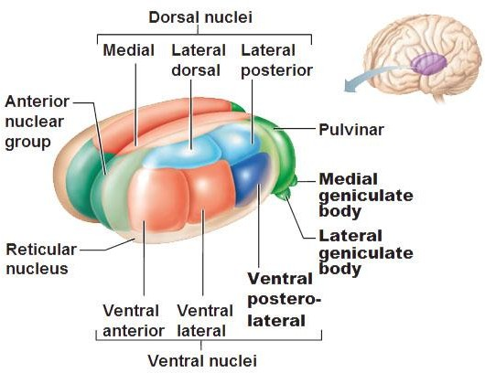
IMPORTANT
Thalamus
Lateral Nuclear Group
Extra
Lateral Nuclear Group is divided into: Dorsal & Ventral tiers
Dorsal Tier | Ventral Tier
1. Lateral Dorsal (LD) | 1. Ventral Anterior (VA)
 | 2. Ventral Lateral (VL)
2. Lateral Posterior (LP) | 3. Ventral Intermediate (VI)
 | 4. Ventral Posterior (VP) (lateral: PLVNT & medial: PMVNT)
3. Pulvinar | 5. Medial geniculate nuclei
 | 6. Lateral geniculate nuclei
tier = group
VL and VI are the same (have the same function)

Slide 7
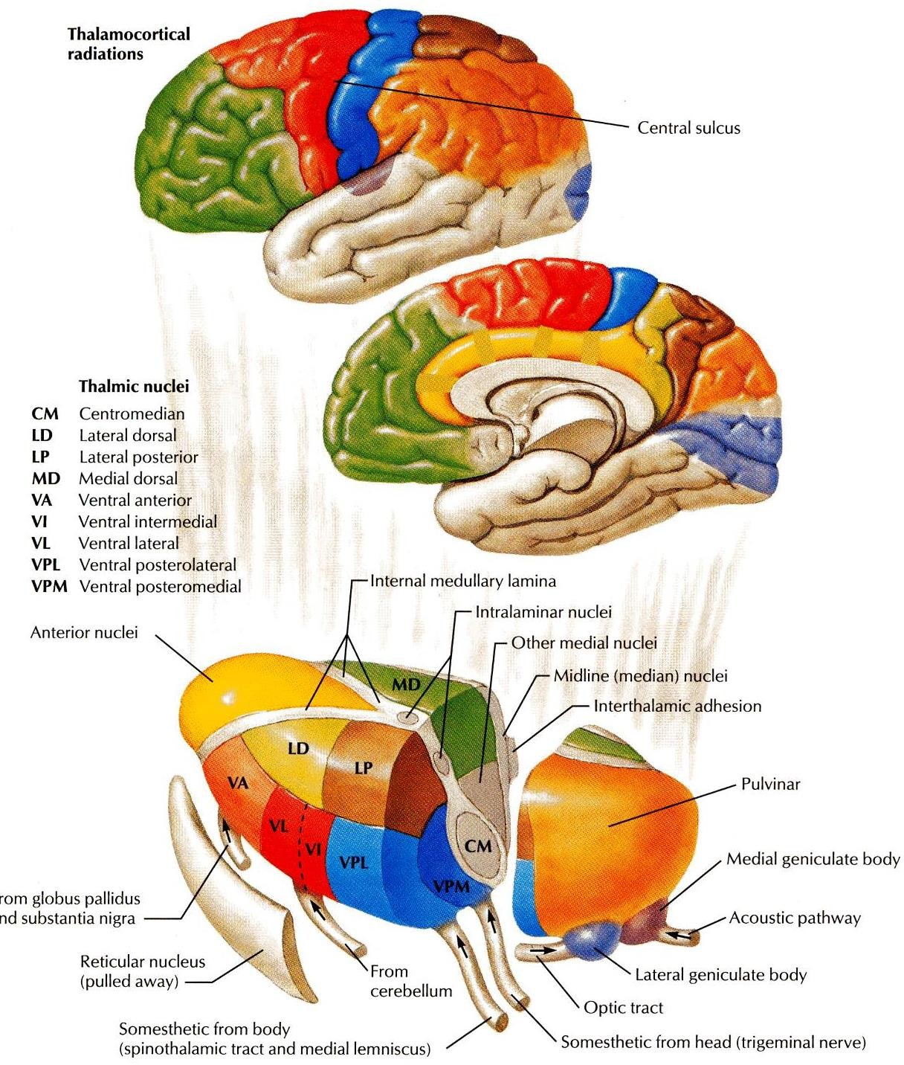
IMPORTANT
Thalamus
Projection of Nuclei
 | Afferent | Efferent
Anterior Thalamic Nucleus | Mammillary body Which is part from hypothalamus | Cingulate gyrus (part of limbic system)
Medial Nucleus | Hypothalamus | Frontal cortex & Prefrontal cortex
Ventral Anterior Nucleus | Globus pallidus body and substania nigra | Premotor cortex In frontal lobe
Ventral Lateral Nucleus & VI | Dentate Nucleus From cerebellum | Primary Motor Cortex In frontal lobe in precentral gyrus
Ventral Posterior Lateral Nucleus | Medial and Spinal lemnisci* | Sensory Cortex Postcentral gyrus in partial lobe
Ventral Posterior Medial Nucleus | Trigeminal Leminiscus | Sensory Cortex
Lateral Geniculate Nucleus | Optic tract | Visual Cortex In occipital lobe
Medial Geniculate Nucleus | Lateral Leminiscus | Auditory Cortex In superior temporal lobe
*Medial lemniscus: from dorsal column | Spinal lemniscus: from spinothalamic

Slide 8
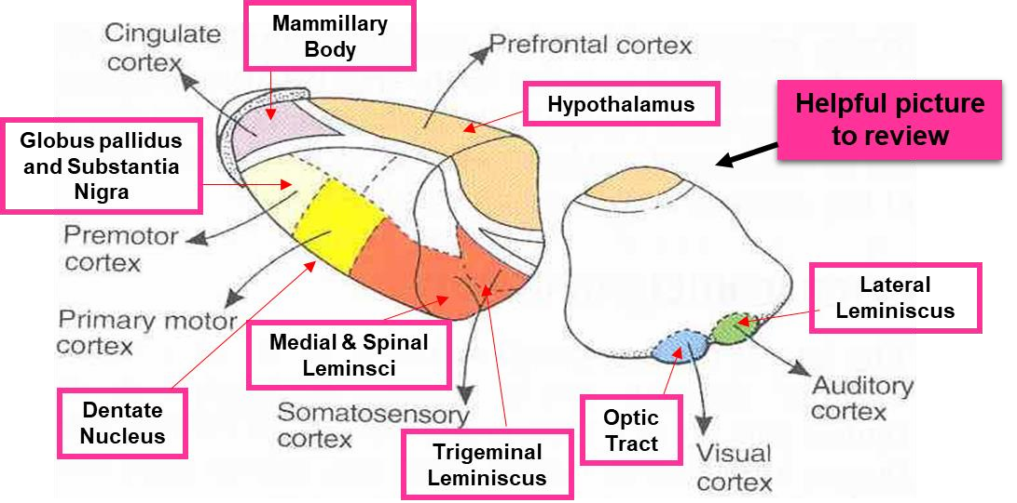
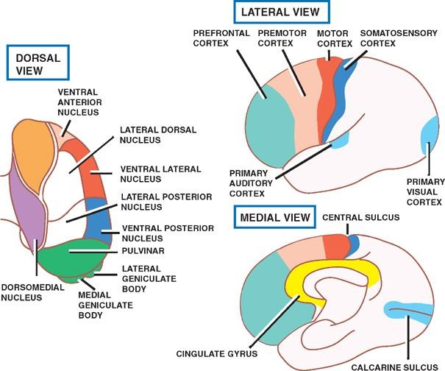
IMPORTANT

Slide 9
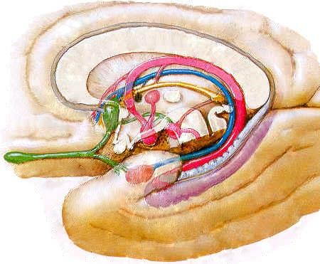
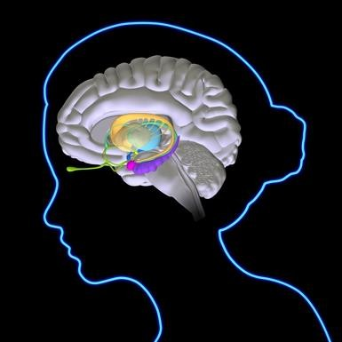
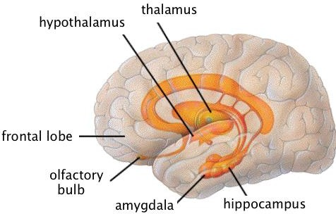
Limbic System
01:5
The term "limbic" is from the Latin word Limbus, for "border" or "edge".
It separates the medial surface of the cerebral cortex from the diencephalon
It consists of a number of cortical & subcortical structures with looped connections then all project to the hypothalamus (particularly mammillary bodies). By fornix
Only on the girl’s slides
Extra

Slide 10
Limbic System
What is the function of the limbic system?
It controls a variety of functions including:
Emotions
Emotional
responses
Behavior & Mood (happy, cry, laugh, sad, afraid, aggression, depression)
Motivation
Memory
Visceral & Motor responses involved in (sex, pleasure, hunger, and reproduction).
Olfaction
These are the general functions of the limbic system but certain parts are more responsible for certain things,
ex: hippocampus and memory

Slide 11
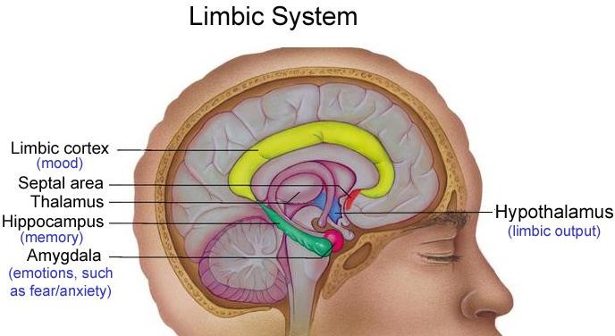
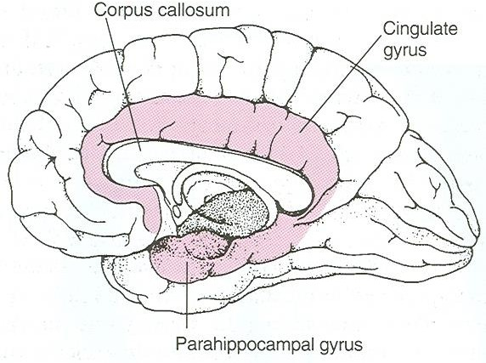
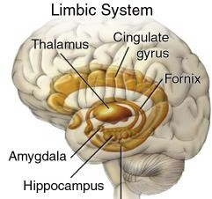
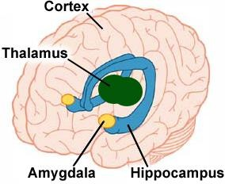
Limbic System
The limbic system is composed of four main structures:
  Limbic cortex (lobe)
  Amygdala.
  Hippocampus (As RAM o computer)
  Septal area.
These structures form connections between the limbic system and the hypothalamus, thalamus and cerebral cortex.
The hippocampus is important in memory and learning, while the limbic system itself is important in the control of the emotional responses.
Extra
Extra

Slide 12
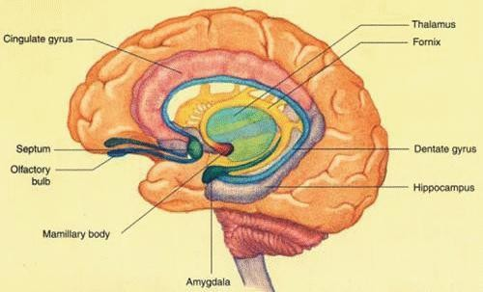

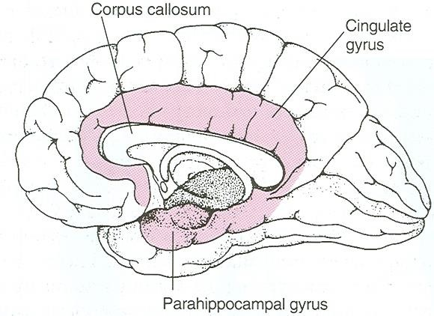
Limbic System
Limbic lobe.
Hippocampal formation.
Septal areas (Fornix, connecting the hippocampus with mammillary bodies and septal nuclei).
Prefrontal area (olfactory cortex).
CORTICAL STRUCTURES
Note: Subcortical structures are like amygdala and hypothalamus
Limbic Lobe
C-shaped ring of grey matter on the medial side of each cerebral hemisphere, surrounding the corpus
callosum.
It includes:
  Subcallosal area
  Cingulate gyrus
  Isthmus
  Parahippocampal gyrus
  Uncus. (olfactory center)

Slide 13
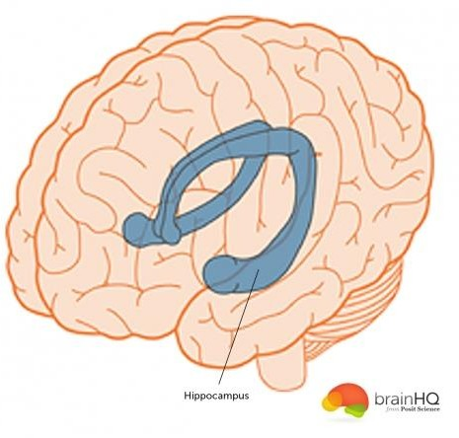
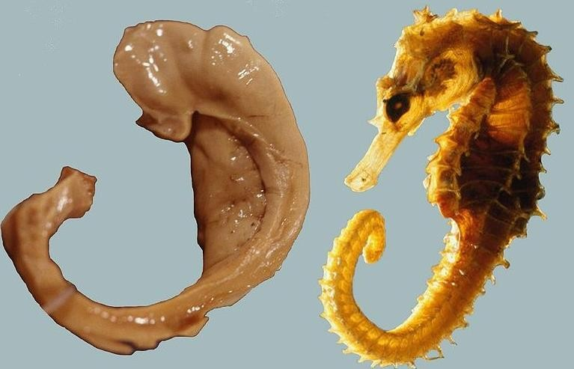
Hippocampus
02:00
It is a limbic system structure that is involved in: FOS
  Formation,
  Organization, and
  Storage of memories.
It is important in forming new memories and connecting emotions and senses, such as smell and sound, to memories.
It is a horseshoe paired structure, one in each cerebral hemisphere.
It acts as a memory indexer by sending memories to the appropriate part of the cerebral hemisphere for long-term storage and retrieving them when necessary.
Extra
The hippocampus got its name
because it looks like a seahorse
Extra:
A patient once had his hippocampus removed as a treatment for seizures.
After the surgery the seizures stopped but the patient was not able retain or make any new memories. To learn more about this patient:
https://bigpictureeducation.com/brain-case-study-patient-hm https://www.youtube.com/watch?v=KkaXNvzE4pk

Slide 14
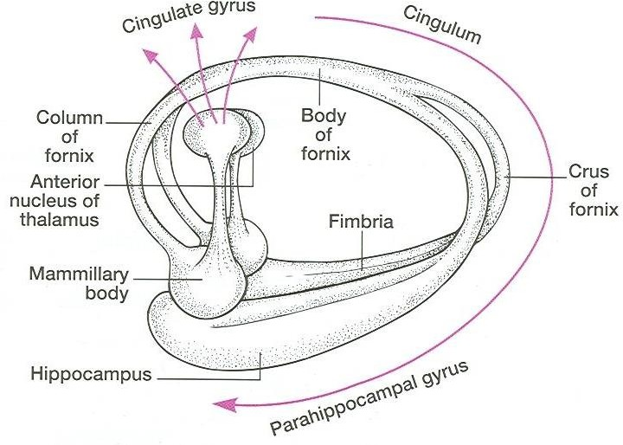
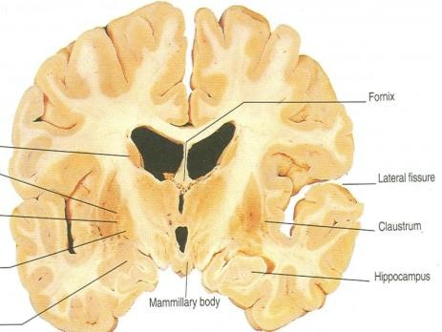
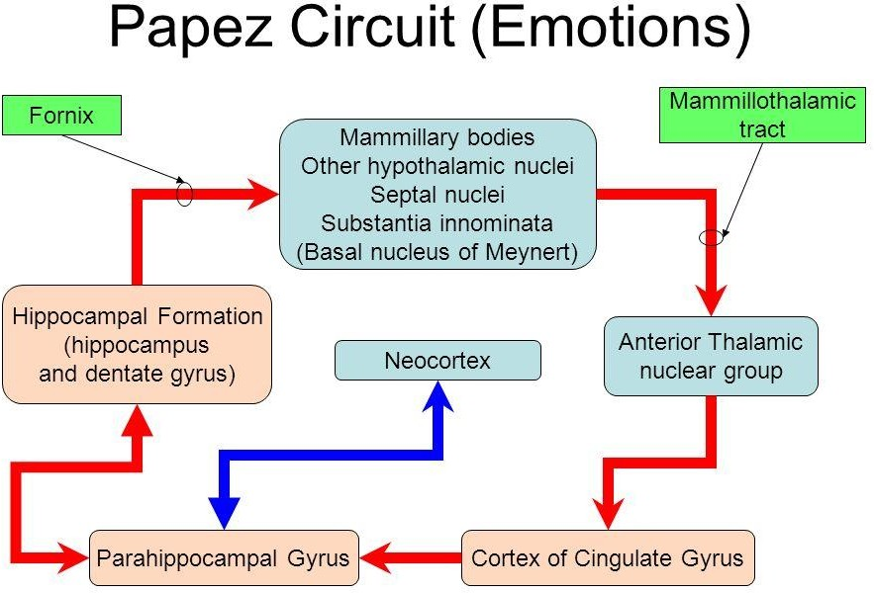
Hippocampus
Site:
It is a scrolled (infolding) structure in the inferomedial part of the temporal lobe.
FUNCTION:
Memory (file new memories as they occur).
The hippocampus & its connections are necessary for
consolidation of new short-term memories.
Its principal efferent pathway is called the Fornix.
Fornix:
  It is C-shaped group of fibers connecting the hippocampus with mammillary body & then to the anterior nuclei of the thalamus
  it consists of:
2 Fimbria, 2 Crus, 1 Body & 2 Column.
  The Fornix is an important component of PAPEZ CIRCUIT (based on connecting the hypothalamus with limbic lobe to control emotions ).
IMPORTANT

Slide 15
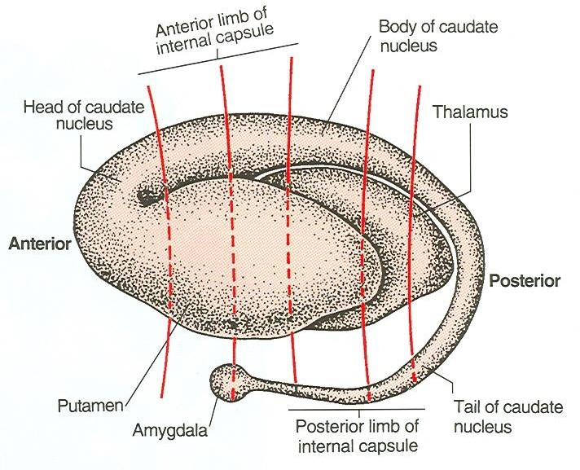
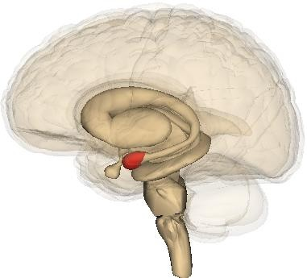
Amygdala
02:01
Site:
almond shaped mass of nuclei that lies near (deep within) the
temporal pole, close to the tail of the caudate nucleus.
Function:
It is involved in
Emotions
FEAR
Anger & (aggression)
Hormonal secretions
Lesion: Lack of emotional responses* & docility “سهل الانقياد”
Connections of Amygdala
INPUTS:
Association areas of visual, auditory
& somatosensory cortices.
OUTPUTS:
Hypothalamus &
Autonomic nuclei in the brain stem,
*Specifically fear and anger

Slide 16
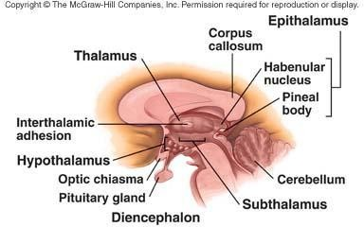
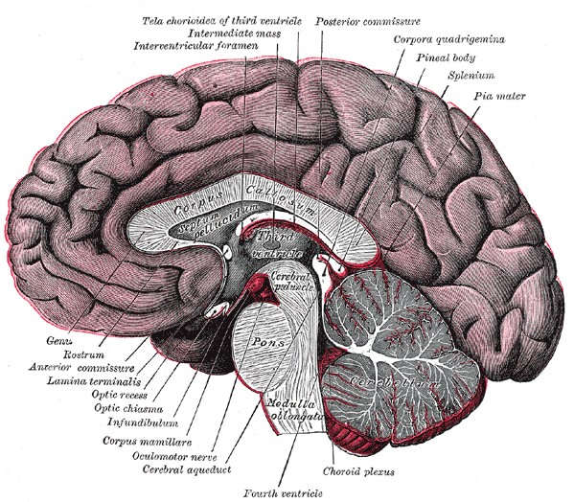
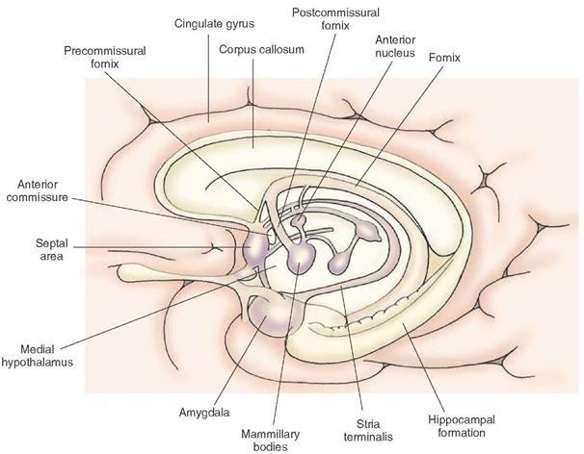
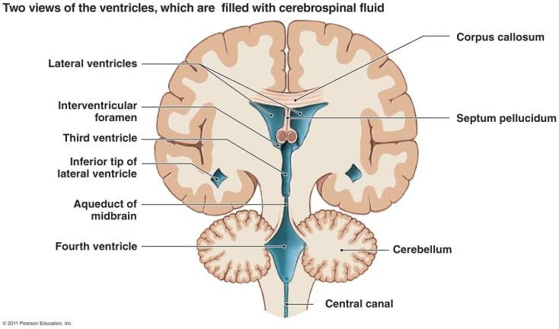
Septal Nuclei
Site:
Located anterior to the interventricular septum (septum pellucidum)
Main Connections: it send projection to:
  To Hypothalamus
  To Habenular nuclei*
Function:
It is the pleasure zone.
*located behind the thalamus
Extra
Extra
Extra

Slide 17
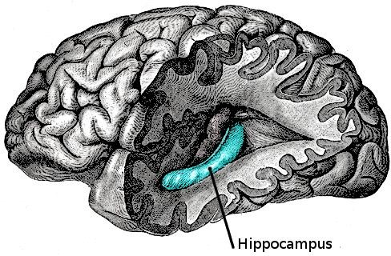
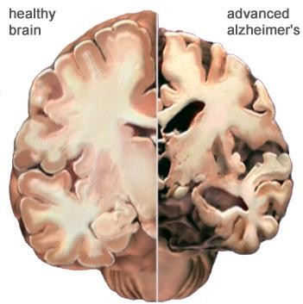
Lesions Associated with Limbic Lobe Disorders
Korsakoff’s psychosis
  Korsakoff syndrome is a chronic memory disorder caused by severe
deficiency of thiamine (vitamin B-1) & alcoholic intoxication.
  (Retrograde = loss of new memories at the time of lesion with loss
  of retained old memories occurred before the injury & anterograde amnesia = inability to gain new memories)
Temporal lobe epilepsy
  The hippocampus is a common focus site in epilepsy, and can be damaged through chronic seizures.
  It is sometimes damaged in diseases such as herpes (virus) encephalitis.
Alzheimer’s disease:
  The hippocampus is one of the first brain areas to show damage in Alzheimer's disease. (anterograde)
Schizophrenia:
  mental disorder with inappropriate actions and feelings.
Anterograde amnesia
  the inability to form and retain new memories.

Slide 18
Summary
Thalamic Internal structures
Thalamic Relations
Superior surface-> lateral ventricle, fornix Inferior surface-> hypothalamus, subthalamus Medial surface-> 3rd ventricle
Lateral surface-> internal capsule Anterior end-> anterior tubercle
Posterior end-> pulvinar, superior colliculus, geniculate bodies
 External medullary lamina -> consists of thalamocortical & corticothalamic fibers.
 Internal medullary lamina -> divides the thalamus into anterior , medial & lateral nuclear groups.
Thalamus & limbic system
The limbic system
Composed of : limbic cortex , amygdala ,
hippocampus & septal area.
Memories -> Hippocampus Fear & Anger -> Amygdala
Hormonal secretions -> Amygdala Pleasure -> Septal Area
Thalamic Lateral nuclear group
 Ventral tier -> lateral dorsal , lateral posterior & pulvinar.
 Dorsal tier -> ventral anterior , ventral lateral , ventral intermediate , ventral posterior (medial & lateral) , medial geniculate nucleus , lateral geniculate nucleus.

Slide 19
(1) Which one of these is NOT cortical structure?
A) Limbic lobe. B) Hippocampal formation
C) Septal areas D) Amygdala
(2) Which one of these is a function of the limbic system?
A) Memory B) Speech
C) Behavior D) A and c
(3) what is true about the amygdala?
A) Almond shaped mass
B) Lies far away from the temporal pole
C) Close to the tail of the caudate nucleus
D) A and c
(4) What is anterograde amnesia?
A) The inability to make new memories
B) The inability to retain old memories
C) Both a and b
D) None of the above
(5) Which of the following is a part of the dorsal tier of the lateral nuclear group?
A) Ventral Intermediate B) Ventral Posterior
C) Medial geniculate nuclei D) Lateral posterior
(6) Which area is responsible for pleasure?
A) Amygdala B) Septal area
C) Hippocampus D) Limbic cortex
(7) Syndrome is caused by severe deficiency of ?
A) Vitamin B1 B) Vitamin A
C) Vitamin B12 D) Irons
(8) FORNIX concects?
A) Mammillary body with cingulate gyrus
B) Mammillary body with fimbria
C) Hippocampus with fimbria
D) Hippocampus with mammillary
(9) The efferent of the ventral anterior nucleus goes to ?
A) Somatosensory area B) Premotor cortex
C) Sensory cortex D) Auditory cortex
(10) Pulvinar lies above the?
A) Superior colliculus B) Inferior colliculus
C) The 3rd ventricle D) Hypothalamus

Slide 20
Answers
(1) D (6) B
(2) D (7) A
(3) D (8) D
(4) A (9) B
(5) D (10) A

Slide 21
Limbic system is composed of four main structures mention 3 only?
Limbic cortex
Amygdala.
Hippocampus
(2) The limbic lobe includes 5 parts, mention 2?
Subcallosal area
Cingulate gyrus
(3) The amygdala has four functions mention them all?
FEAR
Emotions
Anger
Hormonal secretions

