Slide 1


Slide 2
Objectives
At the end of the lecture, the students should be able to:
Describe the external anatomy of the spinal cord.
Describe the internal anatomy of the spinal cord.
Describe the spinal nerves: formation, branches and distribution via plexuses.
Define ‘Dermatome’ and describe its significance.
Describe the meninges of the spinal cord.
Define a reflex and reflex arc, and describe the components of the reflex arc.
The first 4 slides of the boys lecture were not included since they are a review of the first lecture.

Slide 3
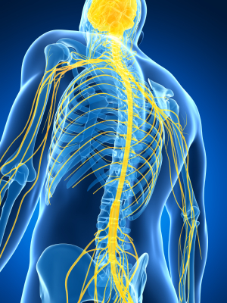
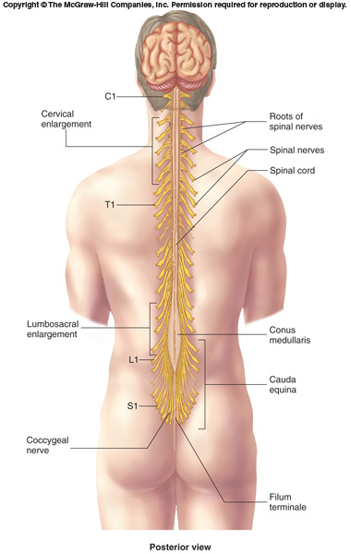
Spinal Cord
The main pathway for information connecting the brain and peripheral nervous system.
An elongated, almost cylindrical structure, about the thickness of the little finger.
It is suspended in the vertebral canal & surrounded by the meninges and cerebrospinal fluid (CSF).
In adults, its Length is approximately 45 cm.
The primary function of spinal cord is a transmission of neural signals between the brain and the rest of the body.
Sensory
Motor
Local reflexes

Slide 4
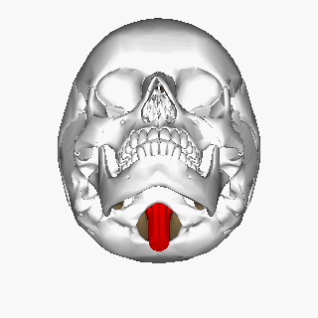
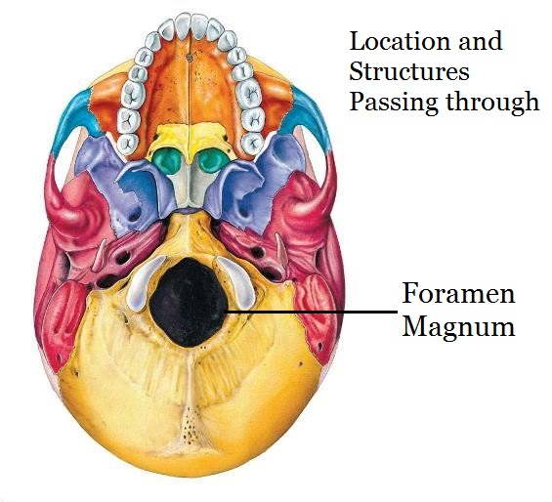
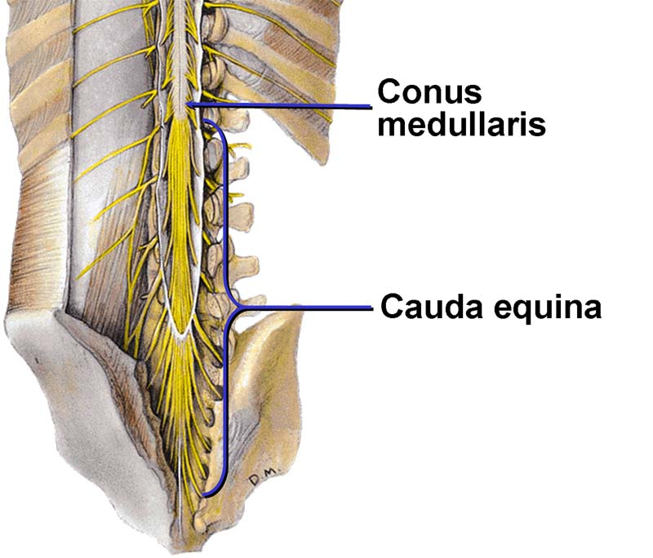
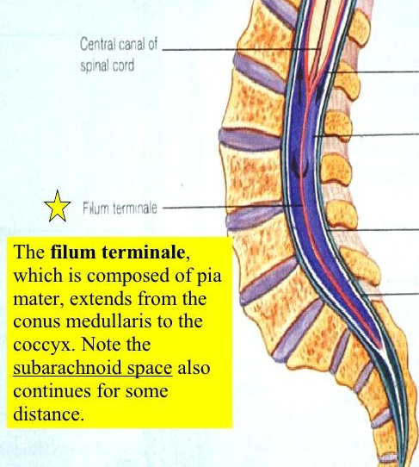
Spinal Cord
Extends from foramen magnum to L1-L2 (intervertebral disc). (boys slides: until second lumbar vertebra L2)
In children it extends to L3 because their vertebral column is smaller/shorter.
Continuous above with the medulla oblongata.
The tapered inferior end forms conus medullaris*, which is connected to the coccyx by a non-neuronal cord called filum terminale (its not considered a part of the spinal cord.).
Gives rise to 31 pairs of spinal nerves.
Extra
*cone like ((مخروطي
(its enlarged because it supplies the lower limbs and it is the place anestheics are injected during child birth).
Extra

Slide 5

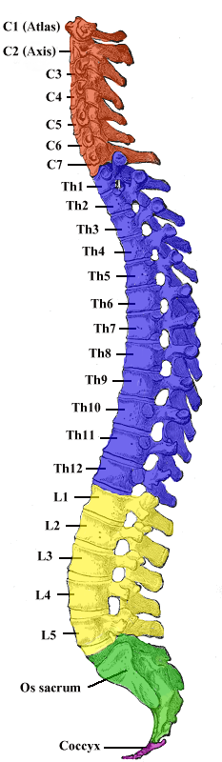
Spinal Cord
07:22
The spinal cord is a Segmented structure, has
  8 Cervical
  12 Thoracic
  5 Lumbar
  5 Sacral
  1 Coccygeal segments
Not uniform in diameter, (not the same diameter throughout)
Has two enlargements:
  Cervical enlargement: supplies upper limbs
  Lumbosacral enlargement: supplies lower limbs
The bundle of spinal nerves extending inferiorly from lumbosacral enlargement and conus medullaris surround the filum terminale and form cauda equina (because of its resemblance to a horse's tail)
The enlargements to supply the needs of upper and lower limbs
*Recall:
End of spinal cord: conus medullaris.
End of spinal nerves: cauda equina.

Slide 6
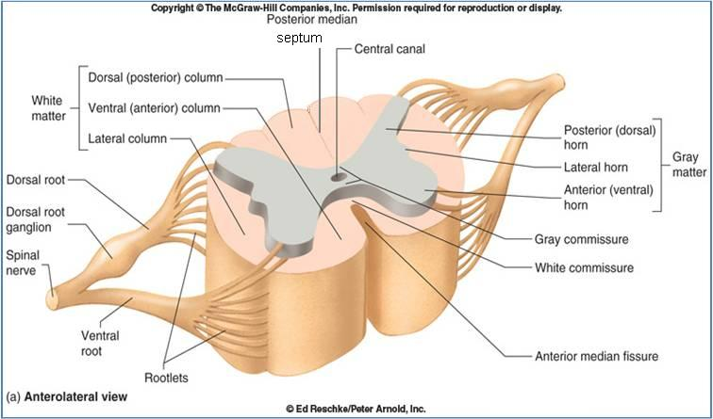
Spinal Cord
Cross Section
You can know the orientation by:
1- dorsal root ganglion
2- anterior median fissure
Fissure > sulcus
Ventral = Anterior
Dorsal = Posterior
The spinal cord is incompletely divided into two equal parts,
anteriorly by a short, shallow median fissure (thicker) and
posteriorly by a deep narrow septum, the posterior median septum (sulcus).
Composed of grey matter in the centre surrounded by white matter supported by neuroglia.*
The arrangement of grey matter resembles the shape of the letter H, having two posterior, two anterior and two lateral horns/columns. (not all grey matter has lateral horns)
*
*
*
Commissures: connections between left and right halves
  Gray with central canal in the center
  White (both will be discussed later)
Roots: spinal nerves arise as rootlets then combine to form roots: Dorsal (posterior) root has a ganglion and Ventral (anterior). Two roots merge laterally and form the spinal nerve.
*Don’t be confused:
 | The brain | Spinal cord
Cortex “outer layer” | Gray matter | White matter
Medulla “inner layer” | White matter | Gray matter

Slide 7
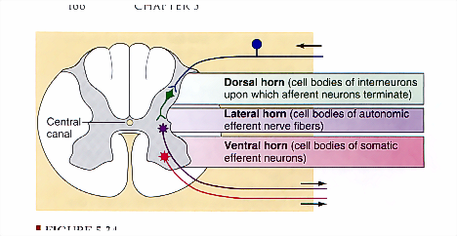
Grey Matter
07:46
Consists of (1) nerve cell bodies and their processes, (2) neuroglia, and (3) blood vessels
The nerve cells are multipolar and are of three main categories:
Sensory neurons (Tract cells), which receive impulses from the periphery of the body and whose axons constitute the ascending fasciculi of the white matter, are located in the Dorsal horns.
Lower motor neurons, which transmit impulses to the skeletal muscles, are located in the ventral horns (similar neurons in the lateral horn are the preganglionic neurons of the autonomic system)
Interneurons (connector neurons): linking sensory and motor neurons, at the same or different levels, which form spinal reflex arcs. (only in spinal cord not brain)
Ventral = Anterior
Dorsal = Posterior

Slide 8
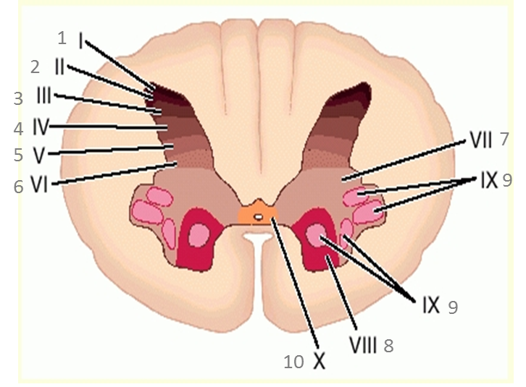
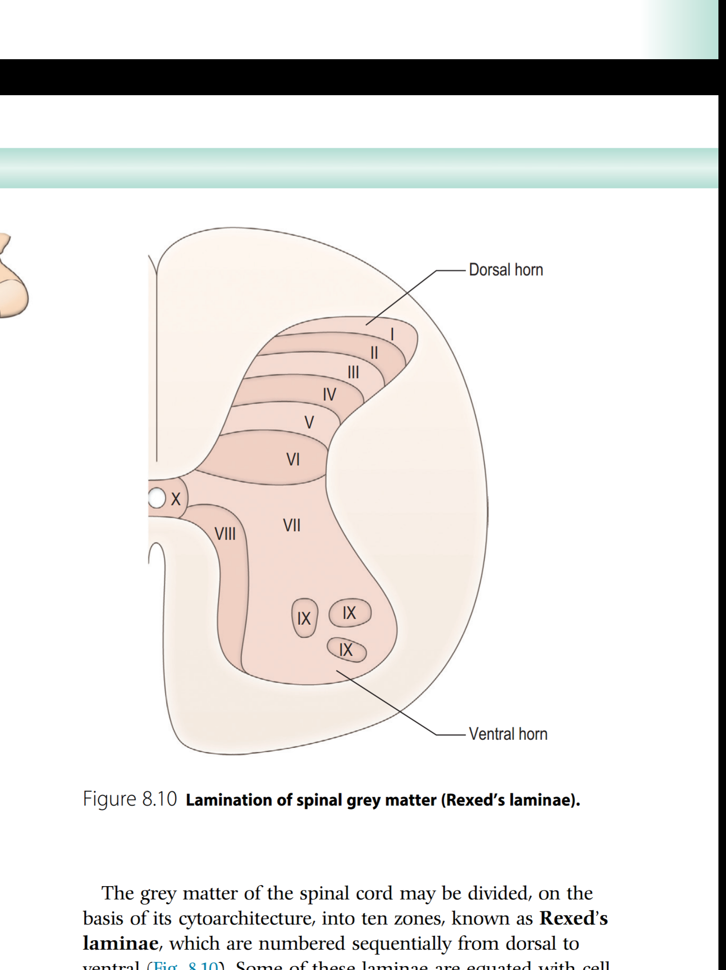
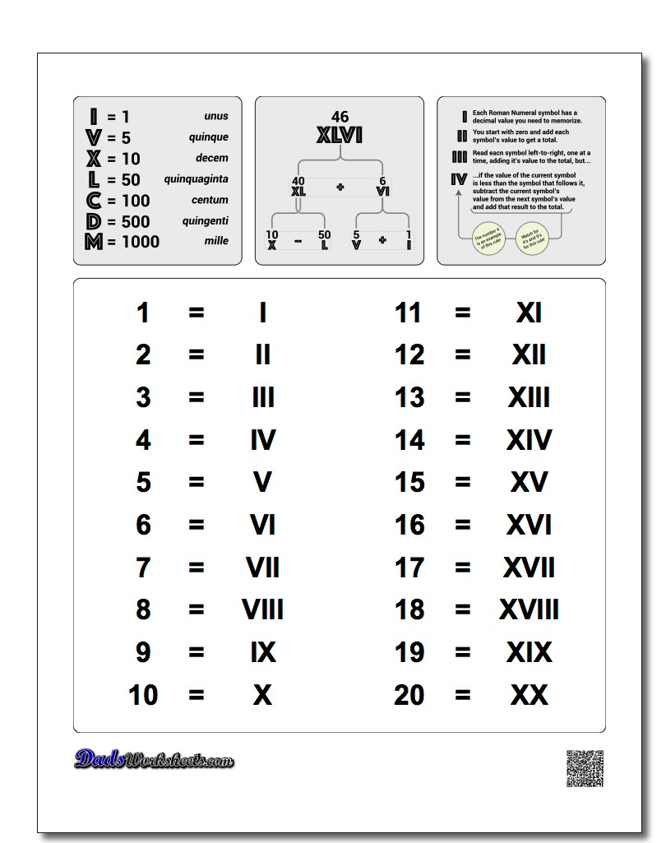
Spinal Grey Matter
Neuronal Architecture
Dorsal horn: 1 → 7
Ventral horn: 8, 9
Central horn: 10
Cells of the same type are clustered into groups, which occur in long columns
In transverse section, these columns appear as layers, especially within the dorsal horn
These layers are called the Laminae of Rexed, that are numbered consecutively by Roman numerals, starting from the tip of the dorsal horn and moving ventrally into the ventral horn.
The rexed laminae comprise a system of ten layers of grey matter (I-X), identified in the early 1950s by a Swedish neuroscientist.
Extra
Extra

Slide 9
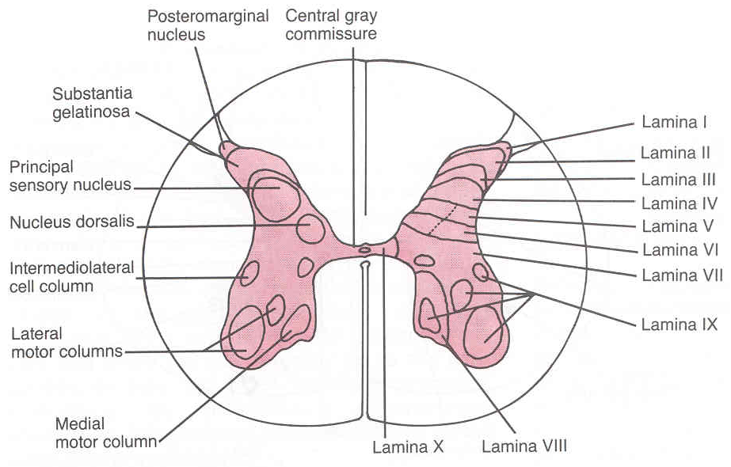
Dorsal Horn
Nerve Cell Groups
5 main groups
Substantia gelatinosa
Nucleus proprius
Nucleus dorsalis (Clark’s column, nucleus thoracis)
Visceral afferent nucleus
Marginal zone (posterior marginals)*
1
2
4
3
* Only in boys slides

Slide 10
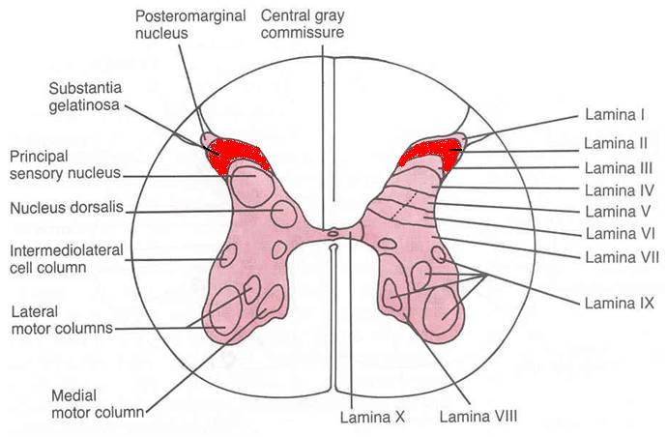
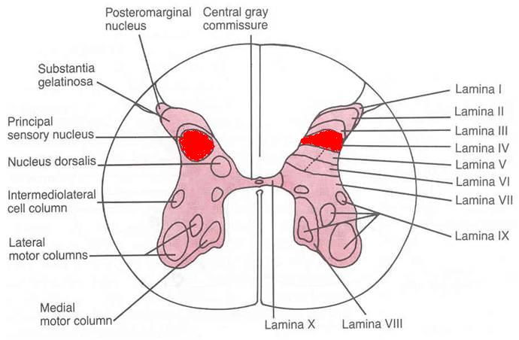
Dorsal Horn
Nerve Cell Groups
The doctor said: you should know the correspondence of each lamina.
For example, lamina 2 corresponds to substatia gelationsa
Marginal zone (posterior marginals)
Rexed Laminae | Location | Composed of | Extends | Afferents
I (1) | At the tip of dorsal horn | - | - | Important for relaying pain and temperature sensation to the brain.
Substantia Gelatinosa
Rexed Laminae | Location | Composed of | Extends | Afferents
II (2) | apex of the posterior/ dorsal horn | large neurons | throughout the length of spinal cord | dorsal root fibers concerned with pain, temperature and crude touch
Nucleus Proprius
Rexed Laminae | Location | Composed of | Extends | Afferents
IV (4) | anterior to substantia gelatinosa/ located in the neck of dorsal horn | large neurons | throughout the length of spinal cord | dorsal root fibers concerned with fine touch (senses of position & movement (proprioception) and two point discrimiation & vibration) *
*There is variation in this point between boys and girls slides, This is the correct information according to Snell’s Clinical Neuroanatomy

Slide 11
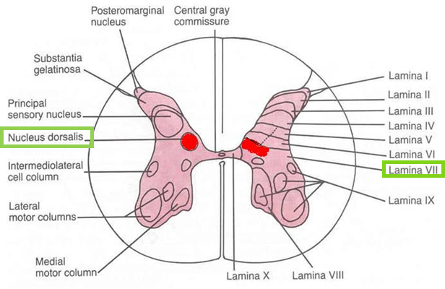
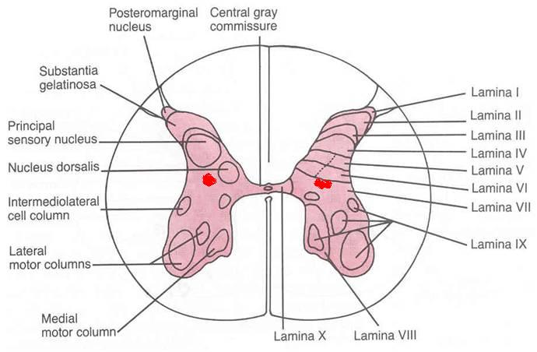
Dorsal Horn
Nerve Cell Groups
Nucleus Dorsalis (Clark’s column, Nucleus thoracis)
Rexed Laminae | Location | Composed of | Extends | Afferents
VII (7) | base of dorsal horn/ the most dorso-medial nuclei | mostly large neurons | from C8 to L3-4 segments | dorsal root fibers concerned with information from muscle spindles and tendon organs.
*Associated with proprioceptive endings
*Relays unconscious proprioceptive information to brain
Visceral Afferent Nucleus
Rexed Laminae | Location | Composed of | Extends | Afferents
VII (7) | lateral to nucleus dorsalis | mostly of medium size neurons | from T1 to L3 segments | Visceral afferents

Slide 12
Only in boys slides
Rexed laminae
*The doctor noted that we only required to know the location of each nucleus in previous slide in which lamina
❑ Lamina I:
o tip of the dorsal horn
o cells respond to noxious or thermal stimuli
o sends information to the brain by the contralateral spinothalamic tract
o corresponds to the marginal zone
❑ Lamina II:
o Involved in sensation of noxious and non-noxious stimuli, and modulating sensory input to contribute to the brain’s interpretation of incoming signals as painful, or not.
o Sends information to Lamina III and IV
o Corresponds to substantia gelatinosa.
❑ Lamina III:
o Involved in proprioception and sensation of light touch.
o Cells in this layer connects with cells in layers IV, V and VI.
o Partially corresponds to nucleus proprius
❑ Lamina IV:
o Involved in non-noxious sensory information relay and processing.
o Cells connect with those in lamina II
o Partially corresponds to nucleus proprius
❑ Lamina V:
o Relays sensory, including nociceptive (potentially painful), information to the brain via the contralateral and spinothalamic tracts
o Receives descending information from the brain via the corticospinal and rubrospinal tracts.
❑ Lamina VI:
o Contains many small interneurons involved in spinal reflexes
o Receives sensory information from muscle spindles (involved in proprioception).
o Sends information to the brain via ipsilateral spinocerebellar pathways
❑ Lamina VII:
o Large, heterogenous zone that varies through the length of the spinal cord.
o Receives information from Lamina II to VI, and from viscera
o Relays motor information to the viscera
o Gives rise to cells involved in the autonomic system.
o Dorsal nucleus of Clarke is part of Lamina VII
❑ Lamina VIII:
o Varies depending on spinal cord level, but is most prominent in cervical and lumbar enlargements.
o Cells are involved in modulating motor output to skeletal muscle.
❑ Lamina IX:
o Size and shape varies between spinal cord levels.
o Distinct groups of motor neurons that innervate skeletal muscle.
❑ Lamina X:
o Surrounds the central canal – the grey commissure.
o Axons decussate (cross over) from one side of the spinal cord to the other.

Slide 13
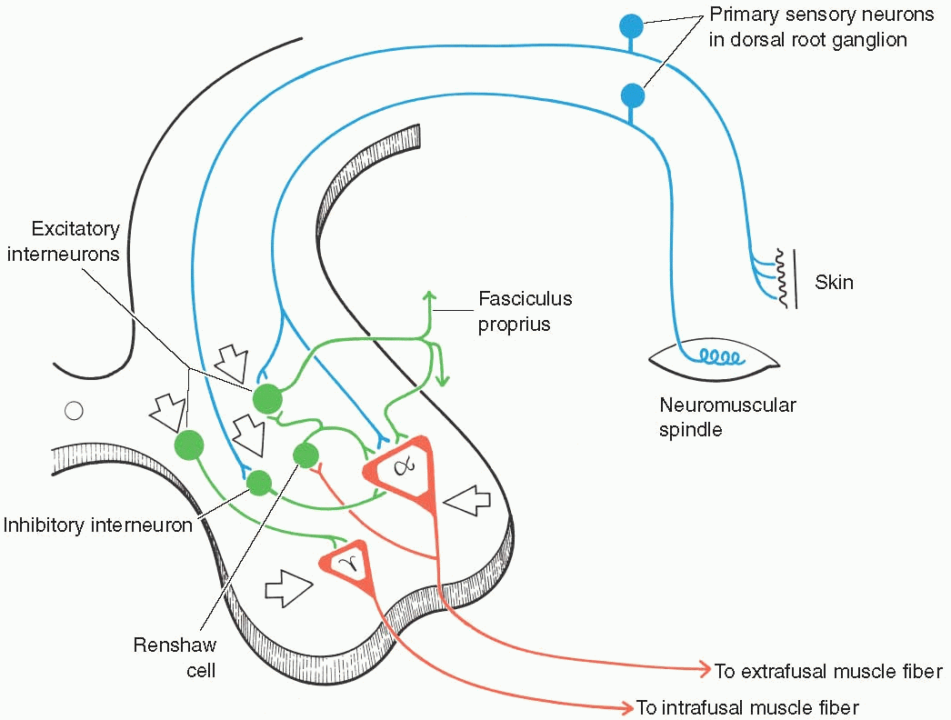
Ventral Horn
Nerve Cell Groups
The ventral horns contain:
Motor neurons, also called lower motor neurons (the upper motor neurons are in the brain).
Interneurons, the (Renshaw cells), whose branched axons form inhibitory synaptic junctions on motor neurons

Slide 14
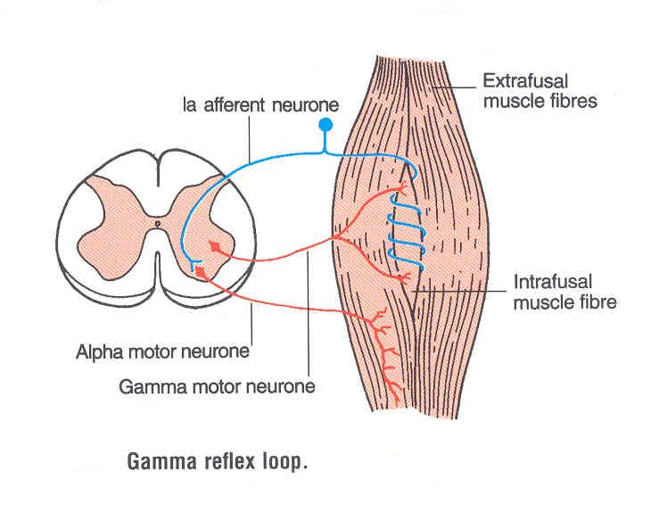
Ventral Horn
1. Motor Neurons
There are two types of motor neurons in ventral horn:
Large multipolar cells
  Numerous
  Axons pass out in the ventral roots of spinal nerves as alpha efferents
  Innervate extrafusal muscle fibers
Smaller multipolar cells
  Less numerous
  Axons pass out in the ventral roots of spinal nerves as gamma efferents
  Innervate intrafusal muscle fibers of neuromuscular spindles
Both alpha and gamma motor neurons are under the influence of descending pathways (upper motor neurons) from brain.

Slide 15
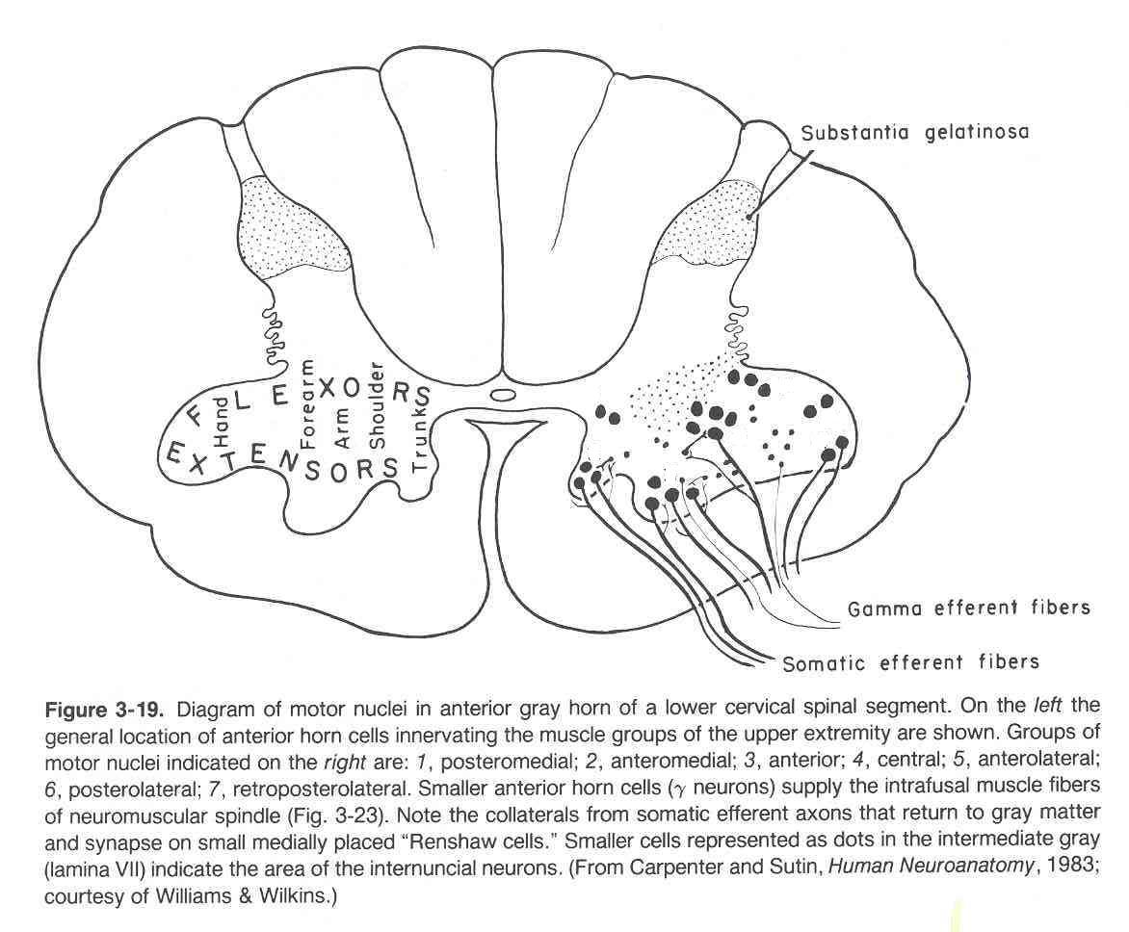
Ventral Horn
1. Motor Neurons
In the the ventral horn motor neurons are organized in 3 groups:
Medial | Central | Lateral
present in most segments | present in some segments: cervical (phrenic C3-5, spinal accessory C1-6) and lumbosacral (L2-S1) | present in cervical and lumbosacral segments
Innervate muscles of Neck and Trunk (including intercostal and abdominal muscles) | smallest | innervates muscles of the Limbs
Neurons supplying flexor muscles are located dorsal to neurons for extensor muscles.

Slide 16
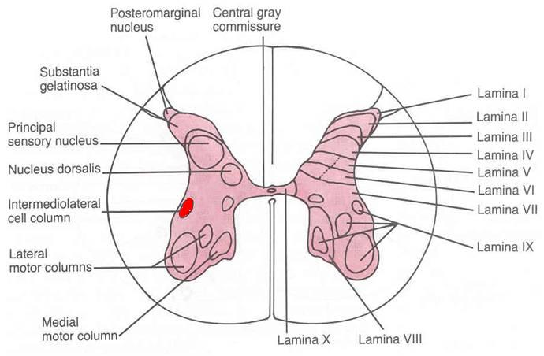
Lateral Horn
Nerve Cell Groups
Small column composed of small neurons extend from:
T1 to L2-3 segments, give rise to pre-ganglionic sympathetic fibers (thoracolumbar).
S2-4 segments, give rise to preganglionic parasympathetic fibers (craniosacral).
Interomediolateral Nucleus(IMN):
Located in the intermediate column and lateral horn.
Relays sensory information from viscera to the brain , and autonomic signals from the brain to the visceral organs.

Slide 17
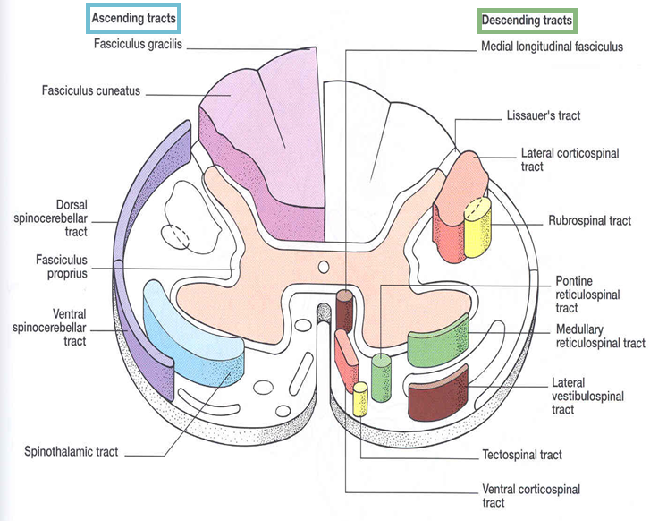
White Matter
09:14
Consists of mixture of nerve fibers, neuroglia and blood vessels.
White color is due to high proportion of myelinated nerve fibers.
Arranged in columns/funiculi; anterior, posterior and lateral.
The nerve fibers are arranged as bundles, running vertically through the cord. A group of nerve fibers (axons) that share a common origin, termination and function form a tract or fasciculus.
These tracts are formed by (1) sensory nerve fibers ascending to the brain, (2) motor nerve fibers descending from the brain and (3) fibers of connector neurons.
Depending on their function, the spinal tracts are divided into ascending and descending tracts.
Tracts are often named according to their points of origin and destination, e.g. spinothalamic, corticospinal.
Funiculi:a bodily structure suggesting a cord; especially : a bundle of nerve fibers
Fasciculus: a small or slender bundle (as of nerve fibers)

Slide 18
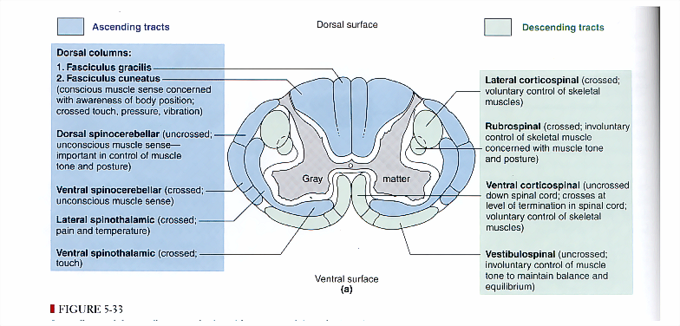

Slide 19
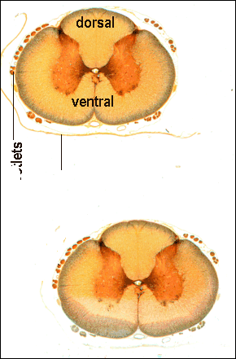
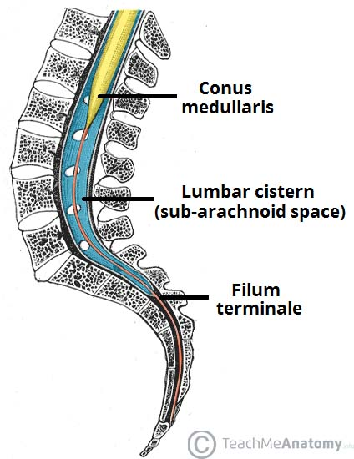
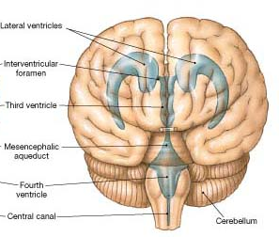
Central Canal
The central canal is a cerebrospinal-filled space that runs longitudinally through the entire length of the spinal cord.
Lined by ependyma (ciliated columnar epithelium) (important)
Continuous with the ventricular system of the brain
Superiorly opens into the 4th ventricle
Inferiorly in the conus medullaris, it expands into the fusiform terminal ventricle and terminates below at the root of filum terminale.
Extra
(important)
Extra
Extra

Slide 20
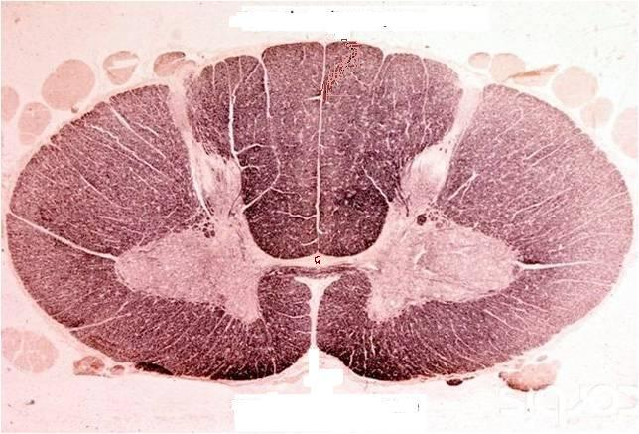
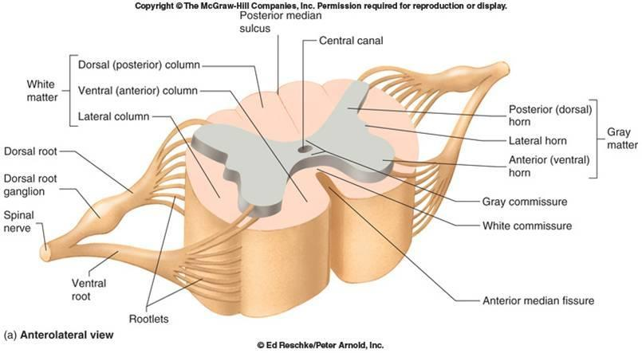
Spinal Cord
Commissures
Grey commissure:
A transverse bridge of grey matter connecting the anterior and posterior gray horns on each side
Is pierced by the central canal that divides it into anterior and posterior parts
White Commissure:
Lies ventral (anterior) to the gray commissure
Mainly contains decussating* nerve fibers
*decussating: (متقاطع) cross or intersect each other to form an X
White commissure
Grey commissure
Extra

Slide 21
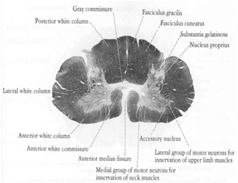
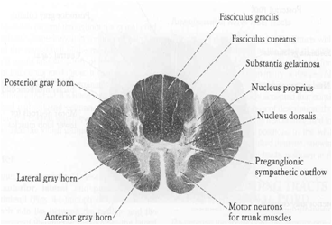
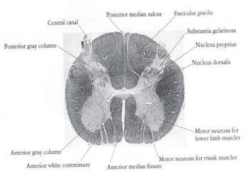
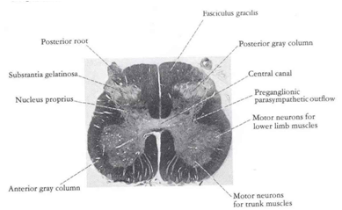
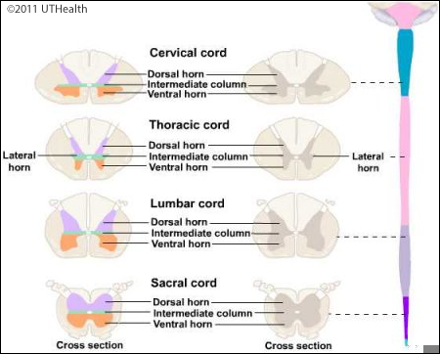
Spinal Cord
Regional Differences
Cervical
Thoracic
Although the general pattern of gray matter is the same throughout spinal cord, regional differences are apparent in transverse sections
The amount of white matter increases in a caudal-to-cranial direction because fibers are added to ascending tracts
The gray matter is increased in volume in cervical & lumbosacral enlargements for innervation of upper & lower limbs
The lateral horn is characteristics of thoracic and upper lumbar segments
Lumbar
Sacral
Extra

Slide 22
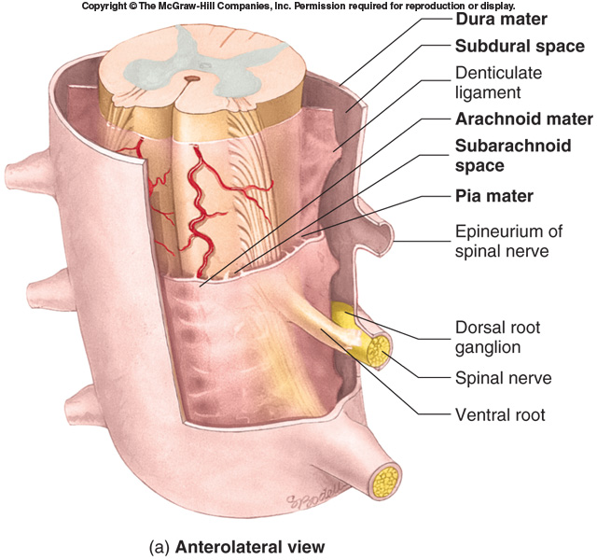
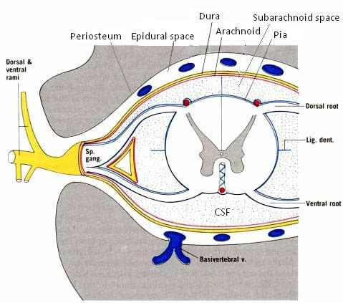
Spinal Meninges
07:07
Three connective tissue membranes* surround spinal cord and brain:
Dura mater: tough outer layer, continuous with epineurium of the spinal nerves
Arachnoid mater: thin and wispy membrane deeper to dura mater
Pia mater: delicate membrane bound tightly to surface of brain and spinal cord and carries blood vessels. Forms the filum terminale, which anchors spinal cord to coccyx and the denticulate ligaments that attach the spinal cord to the dura mater
Spaces:
Epidural: Contains blood vessels, areolar connective tissue and fat. (between dura and bone: skull/vertebra)
Subdural: a potential cavity between the dura and arachnoid mater, contains a small volume of serous fluid.
Subarachnoid: Contains cerebrospinal fluid (CSF) and blood vessels within web-like strands of arachnoid tissue. (between arachnoid and pia mater) CSF can be collected from this space for diagnostic purposes.
P
A
D
Dura → Outside
Pia → Inside

Slide 23
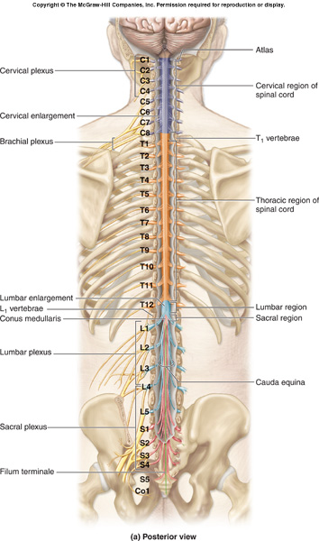
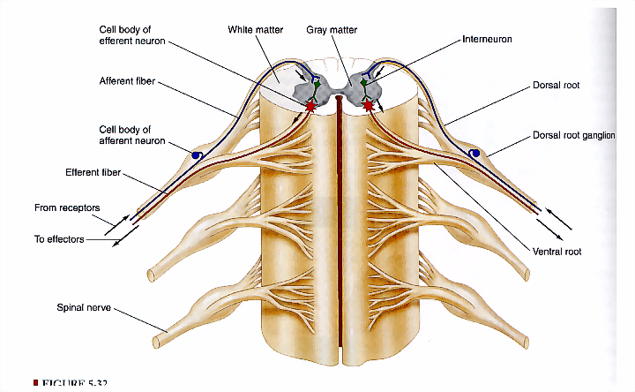
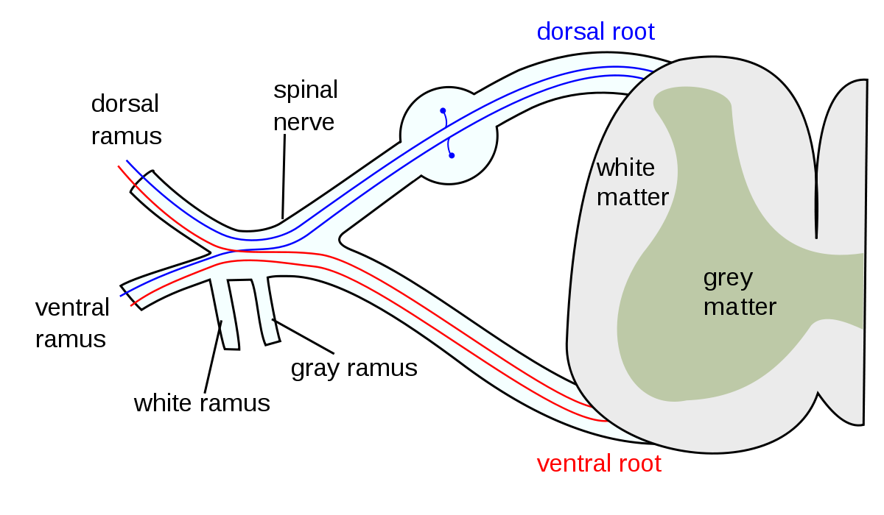
Spinal Nerves
Thirty-one pairs of spinal nerves.
First pair exit vertebral column between skull and atlas, last four pair exit via the sacral foramina and others exit through intervertebral foramina
Eight pair cervical, twelve pair thoracic, five pair lumbar, five pair sacral, one pair coccygeal
Each spinal nerve arises as rootlets which then combine to form dorsal (posterior) purely sensory & ventral (anterior) purely motor Roots.
Two roots merge laterally and form the spinal nerve.
Dorsal (posterior) root has a ganglion (dorsal root/sensory ganglion) that contains the cell bodies of the sensory neurons.
Each spinal nerve then divides into a MIXED smaller dorsal and a larger ventral Ramus
Rootlet → Root → Spinal Nerve → Rami
Dorsal
Purely Sensory
Ventral
Purely Motor
Dorsal
Ventral
Mixed
Extra

Slide 24
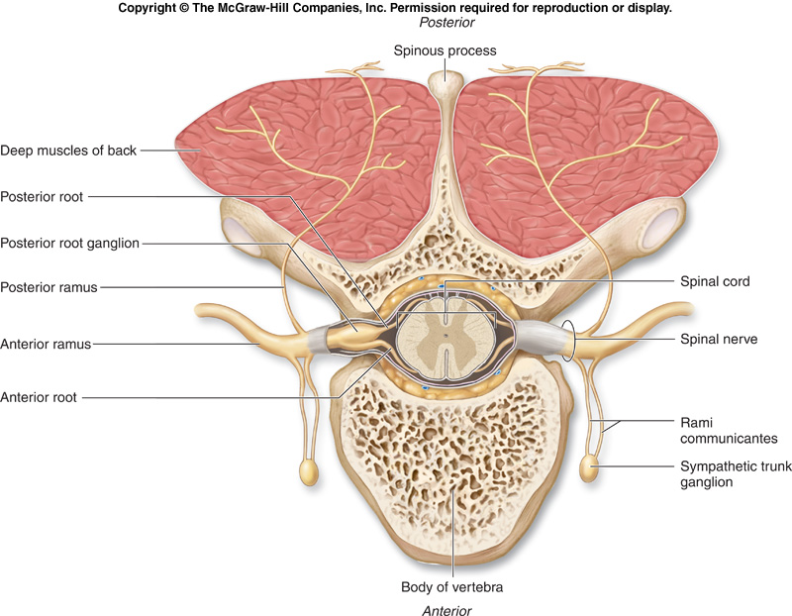
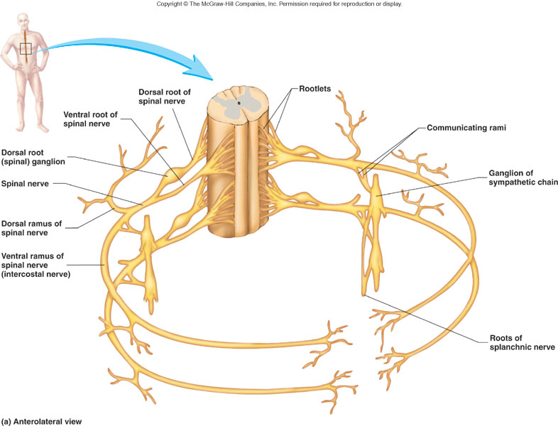
Spinal Nerves
Branches
Ventral = Anterior
Dorsal = Posterior
Dorsal Rami innervate:
  Deep muscles of the trunk responsible for movements of the vertebral column
  Skin near the midline of the back.
Ventral Rami:
  In the thoracic region form intercostal nerves that innervate the intercostal muscles and the skin over the thorax
  Remaining ventral rami form five plexuses *:
    C1 - C4= Cervical plexus
    C5 - T1= Brachial plexus
    L1 - L4= Lumbar plexus
    L4 - S4= Sacral plexus
    S5 & Co= Coccygeal plexus**
(intermingling of nerves)
*see the next slide
**There is variation in this point between boys and girls slides, This is the correct information according to Grey’s Anatomy for Students

Slide 25
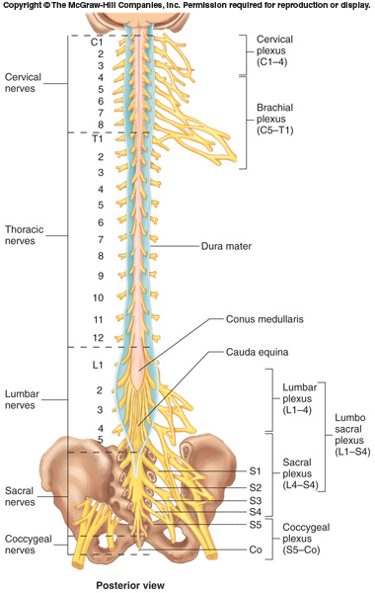
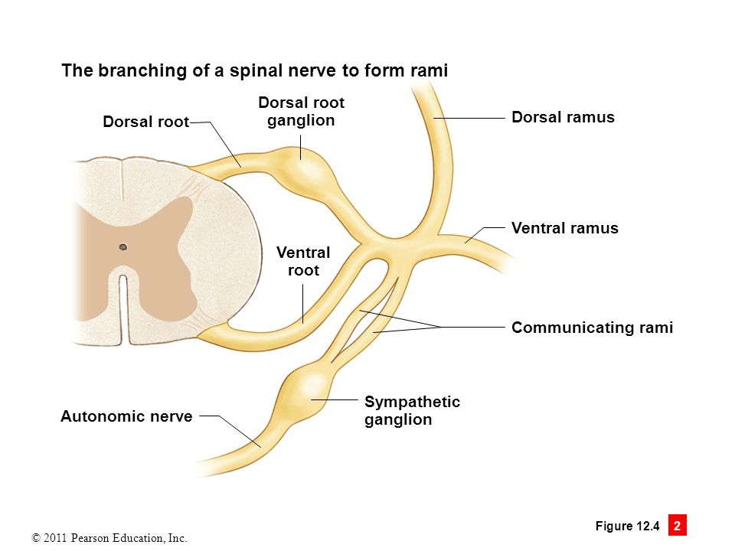
Spinal Nerves
Branches
The spinal nerves are connected to sympathetic chain of ganglia by communicating rami.
Extra

Slide 26
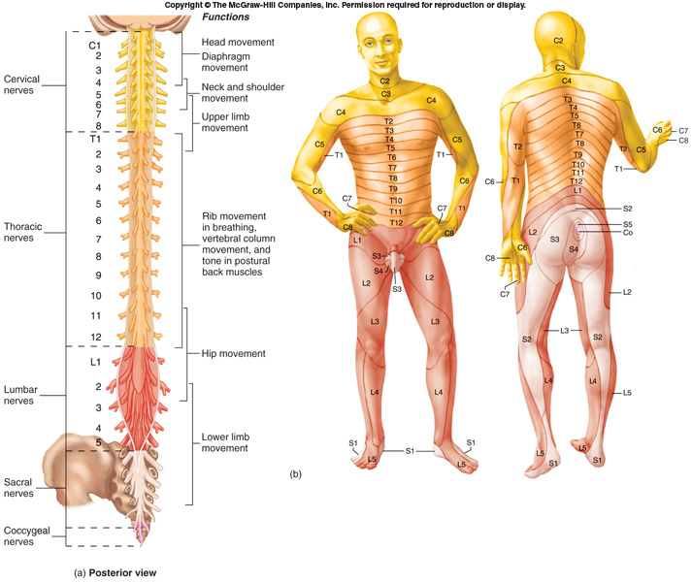
Dermatomes
‘Dermatome’ is a segment of skin supplied by a specific segment of the spinal cord (segmental spinal nerve), i.e, one nerve.
Cutaneous areas supplied by adjacent spinal nerves overlap. There is therefore little or no sensory loss after interruption of a single spinal nerve or dorsal root
Reflex & Reflex Arc
A reflex is a rapid, involuntary, predictable, stereotyped pattern of response brought by a sensory stimulus.
The neural pathway mediating the reflex actions is called reflex arc.
Notes:
Al examination

Slide 27
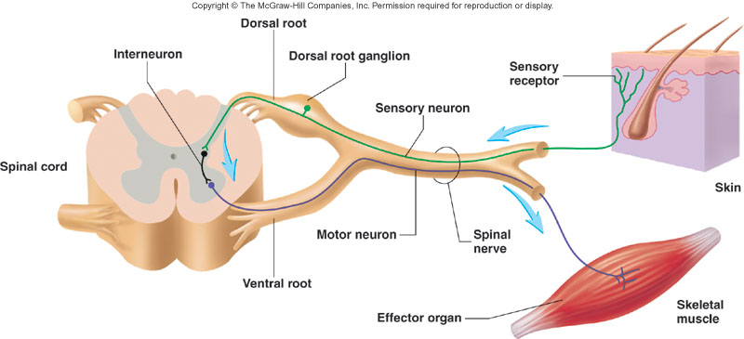
Components of a Reflex Arc
  Action potentials produced in
Sensory receptor
Sensory neuron
Interneuron
  Effector organ which responds with a reflex
Motor neuron
Only on the girls’ slides
Variety of Reflexes
Some integrated within spinal cord; some within brain
Some involve excitatory neurons yielding a response; some involve inhibitory neurons that prevent an action
Higher brain centers can influence, suppress, or exaggerate reflex responses

Slide 28
CLINICAL SIGNIFICANCES
Only in boys slides
Spinal cord injuries can be caused by trauma to the spinal column (stretching, bruising, applying pressure, severing).
Usually, victims of spinal cord injuries will suffer loss of feeling in certain parts of their body.
In milder cases, a victim might only suffer loss of hand or foot function.
More severe injuries may result in paraplegia, tetraplegia (also known as quadriplegia), or full body paralysis below the site of injury to the spinal cord.
Spinal shock and neurogenic shock can occur from a spinal injury.
Spinal shock is usually temporary, lasting only for 24–48 hours, and is a temporary absence of sensory and motor functions.
Neurogenic shock lasts for weeks and can lead to a loss of muscle tone due to disuse of the muscles below the injured site.

Slide 29
MCQs
1. The tapered inferior end of the spinal cord forms:
A- filum terminale
B- conus medullaris
C- cauda equina
D- denticulate ligaments
Answer: B
2. Filum terminale is formed from:
A- dura mater
B- arachnoid mater
C- pia mater
D- spinal nerves
Answer: C
3. If a cross section of the spinal cord is taken from C8 which of the following nerve cell group will be missing?
A- Substantia gelatinosa
B- Nucleus proprius
C- Nucleus dorsalis
D- Visceral afferent nucleus
Answer: D
4. Renshaw cells are present in which horn?
A- Lateral
B- Ventral
C- Dorsal
Answer: B
5. Dorsal root fibers concerned with information from muscle spindles are found in which laminae?
A- II
B- IV
C- VI
D- VII
Answer: D
6. In which segment of the spinal chord can we find lateral horn:
A- cervical
B- thoracic
C- coccygeal
Answer: B
7. A plexus is made of:
A- dorsal root
B- dorsal rami
C- ventral root
D- ventral rami
Answer: D
8. Which of the following is continuous with epineurium of the spinal nerves?
A- dura mater
B- arachnoid mater
C- pia mater
Answer: A

Slide 30
MCQs
9. : the Brachial plexus is from … to … :
A- C1-C4
B- C5-T1
C- L5-Co
D- S4-L$
Answer: B
10. The spinal cord has:
A- 30 pairs of spinal nerves
B- 30 spinal nerves
C- 31 pairs of spinal nerves
D- 31 spinal nerves
Answer: C
SAQ
Q1: Mention the location of Nucleus Dorsalis in the spinal cord ?
Answer:
from C8 to L3-4 segments in the base of the dorsal horn.
Q2: Define Reflex Arc .
Answer:
It’s is a rapid, involuntary, predictable, stereotyped pattern of response brought by a sensory stimulus.

