Slide 2
Objectives
At the end of the lecture, students should be able to:
Define the meaning of a tract.
Distinguish between the different types of tracts.
Locate the position of each tract.
Describe the sensory pathway.
Identify the different sensory spinal tracts and their functions.
Identify the course of each of these tracts.
Know some associated lesions regarding the main tracts.

Slide 3
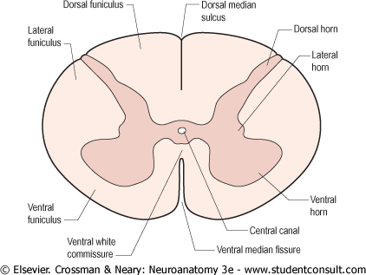
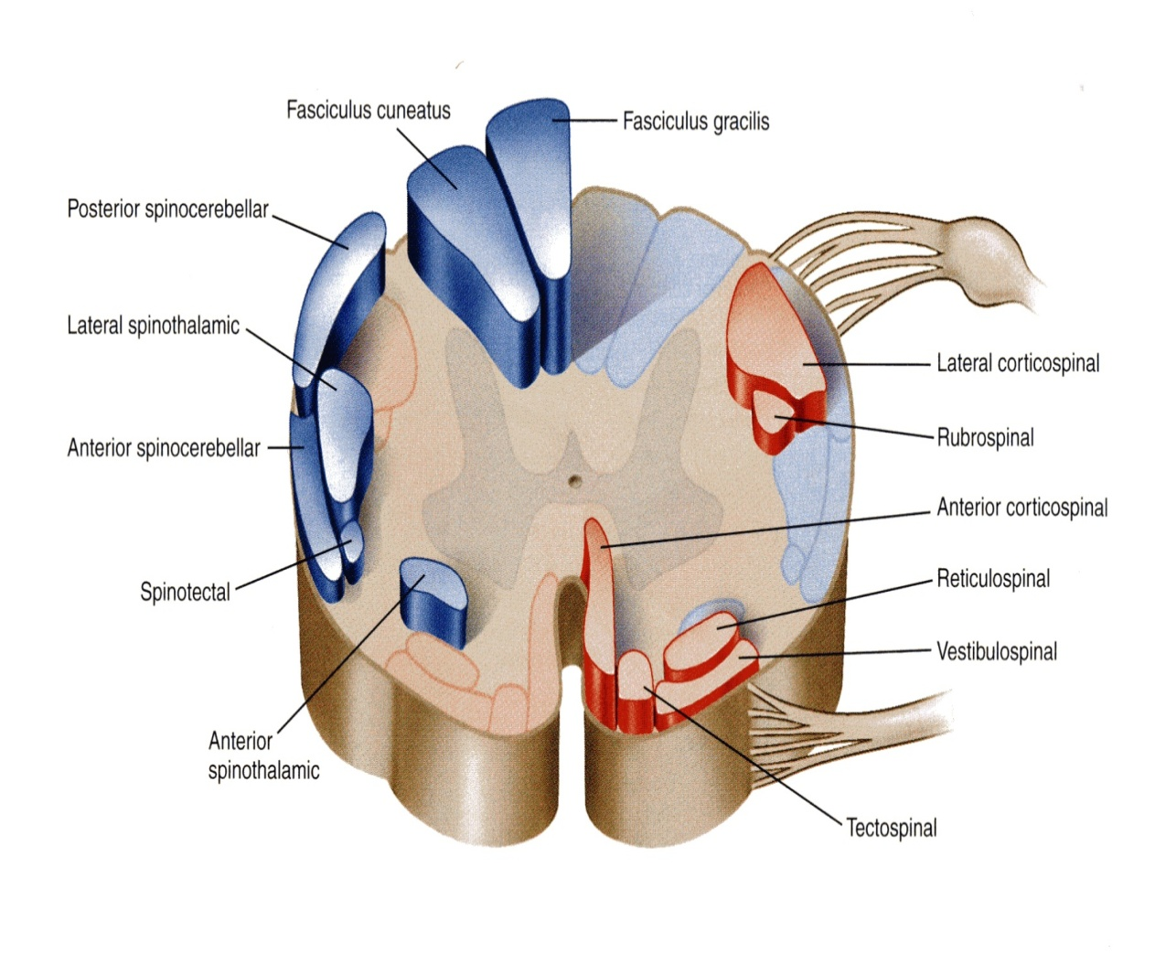
The grey matter of the spinal cord is completely surrounded by the white matter
The white matter of the spinal cord consists of Ascending and Descending Nerve Fibers.
It is divided into Dorsal, Lateral & Ventral Columns or Funiculi.
White matter tracts: bundles or fasciculi of fibers that occupy more or less definite positions in the white matter.
They have the same Origin, Termination and carry the same Function.
Inside CNS → Tract
Outside CNS → Nerve

Slide 4
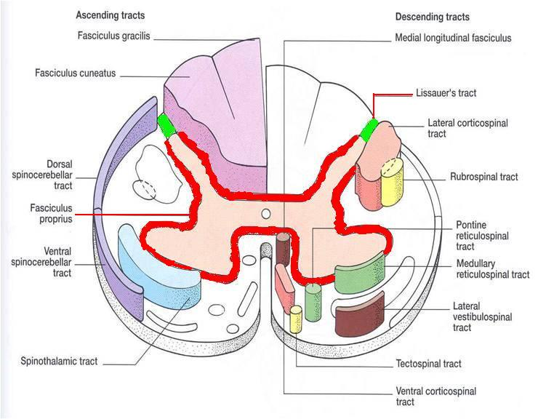
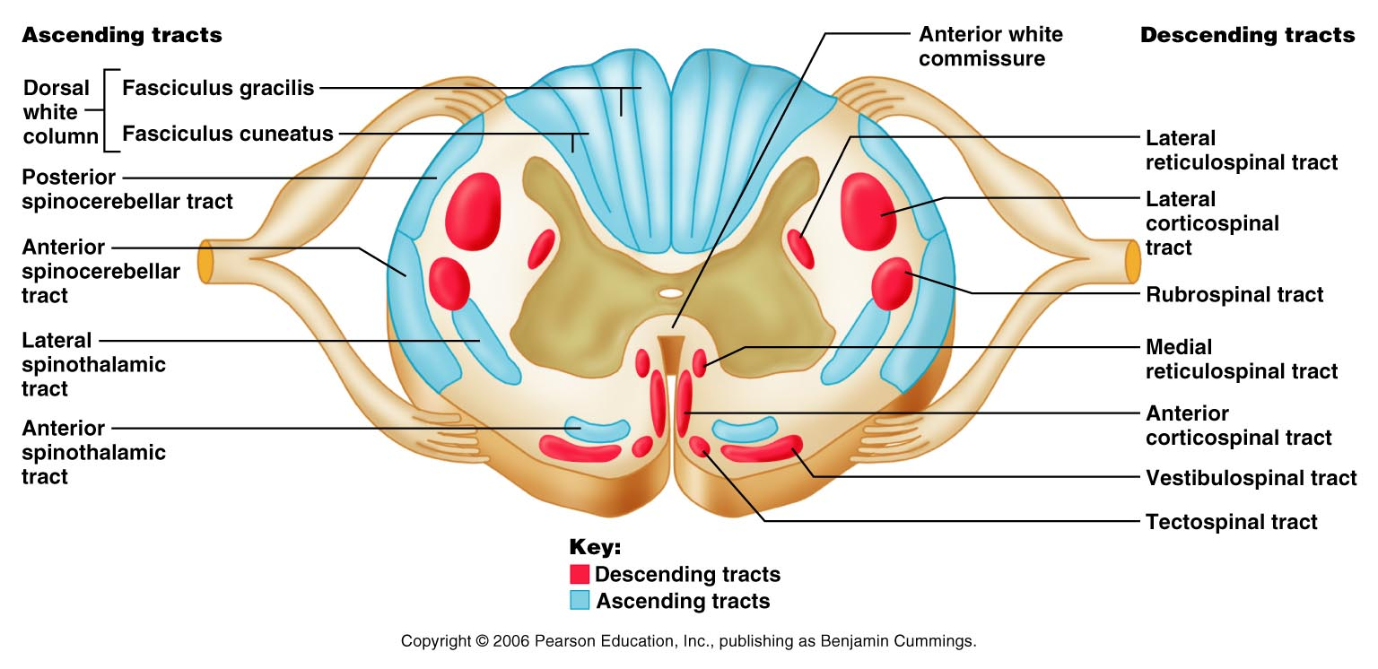
White matter tracts are classified into: (acoding to length)
1. Short Tracts; intersegmental or propriospinal.
Fibers occupy narrow band immediately peripheral to the grey matter (fasciculus proprius).
They interconnect adjacent or distant spinal segments and permit intersegmental coordination. (they do not reach the brain)
2. Long Tracts; divided according to function into:
(a) Ascending (sensory or afferent). (b) Descending (motor or efferent).
They serve to join the brain to the spinal cord.
Note: In this lecture we will only discuss the ascending tracts

Slide 5
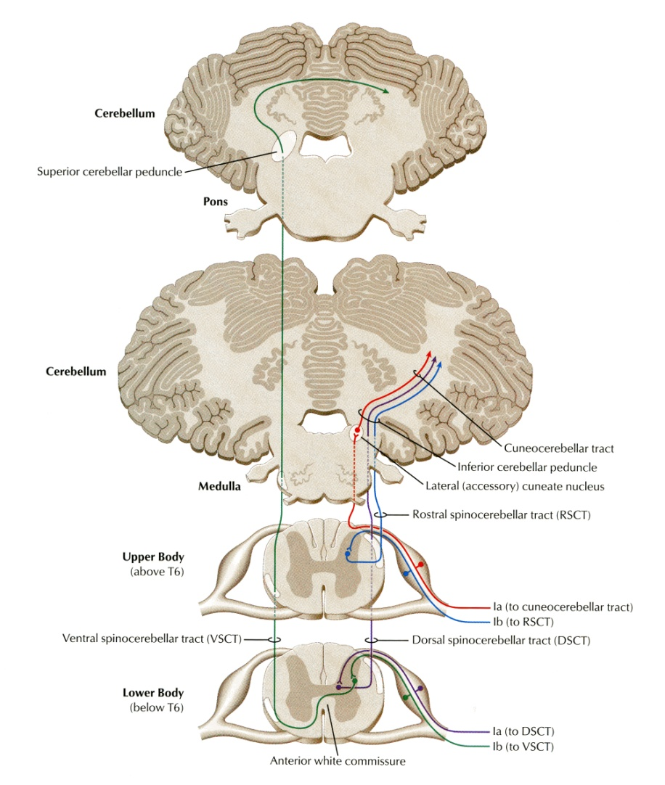
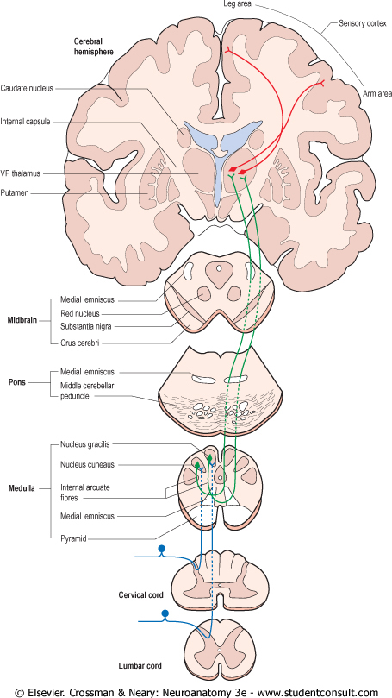
Ascending Tracts;
Carry impulses from pain, thermal, tactile, muscle and joint receptors to the brain.
Some of this information eventually reaches a conscious level (at the cerebral cortex),
while some is destined for subconscious centers (e.g at the cerebellum).
There are 2 types of sensation:
At the conscious level (which we feel): these sensations reach the cerebral cortex.
At the subconscious level (we can’t identify): the sensations only reach the cerebellum.

Slide 6
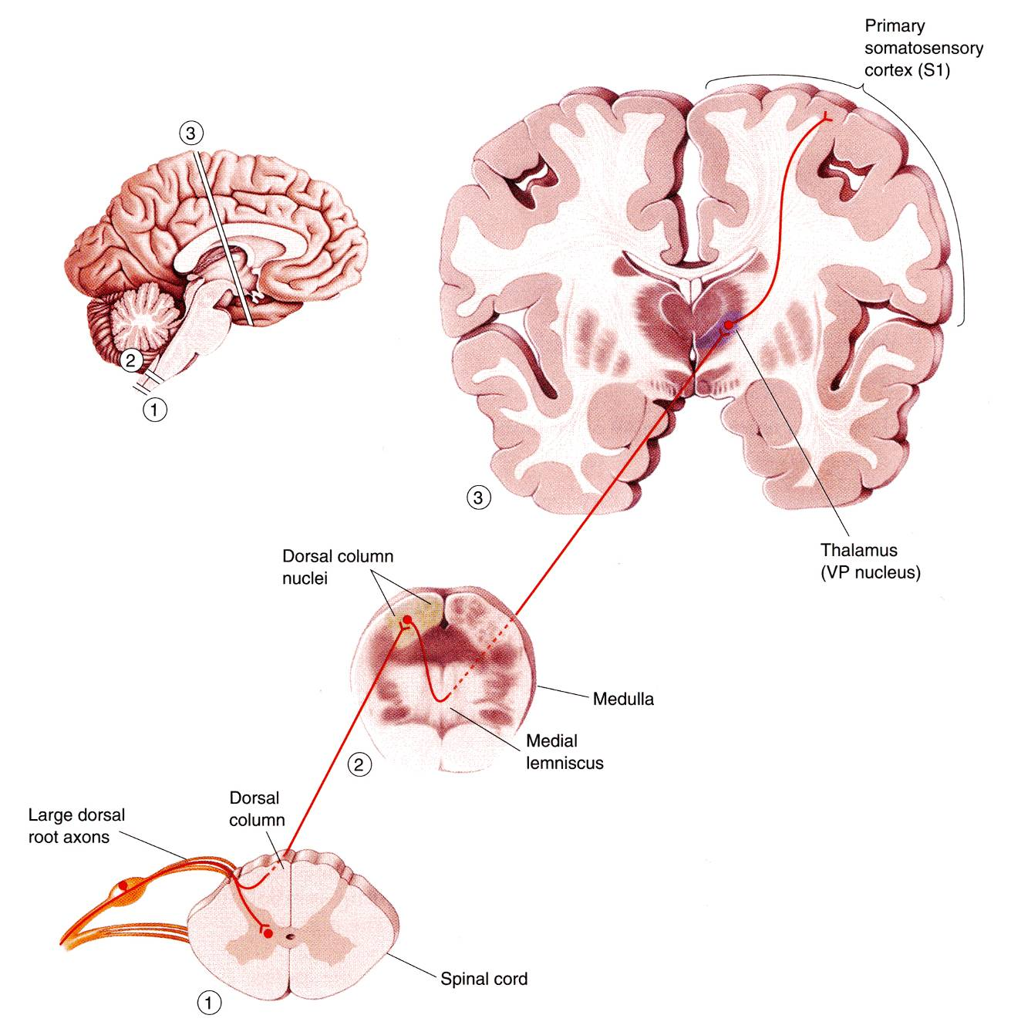
Pathways that carry information to a conscious level share certain common characteristics:
There is a sequence of Three Neurones between the peripheral receptors and the cerebral cortex. (for the information/signal to reach the brain it has to relay/synapse in 3 neurons)
The main fiber remains on the ipsilateral side of the cord and terminates in synaptic contact with the second neurone which lies either in the spinal grey matter or in the medulla oblongata of the brain stem.
2
The axon of the second order neurone crosses over (decussates) to the opposite side of the CNS and ascends to the thalamus, where it terminates.
The axons of the first-order neurone or primary afferent neurone) enters the spinal cord through the dorsal root of a spinal nerve and its cell body lies in the dorsal root ganglion.
1
The third-order neurone has its cell body in the thalamus.
Its axon passes to the somatosensory cortex of the parietal lobe of the cerebral hemisphere.
3

Slide 7
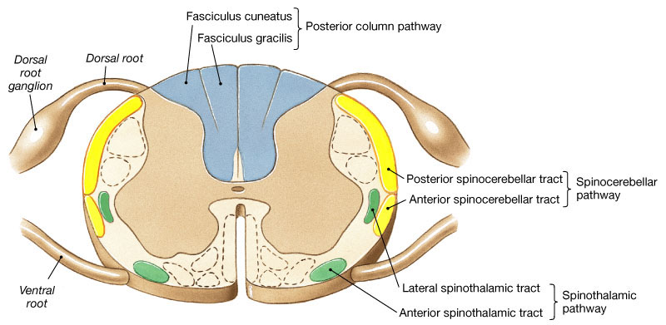
Three major* pathways carry sensory information:
Dorsal (Posterior) column (divided into Gracile & Cuneate fasciculi)
Anterolateral pathway (Spinothalamic) ventral & lateral
Spinocerebellar pathway dorsal & ventral |Carries subconscious sensation.
Carry conscious sensation therefore they will follow the same pathway we discussed in the previous slide
*We will also discuss 3 minor ways: spinotectal, spino-olivary, and spinoreticular.

Slide 8
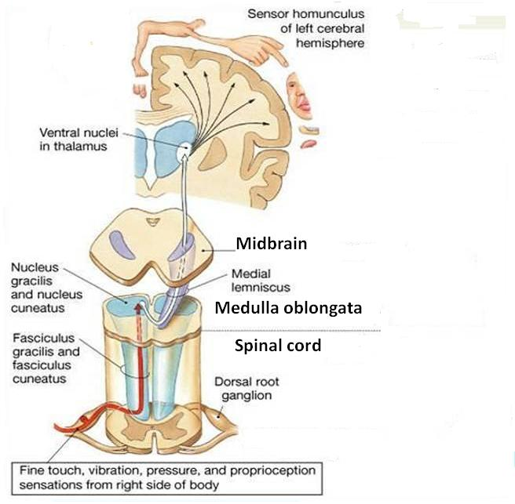
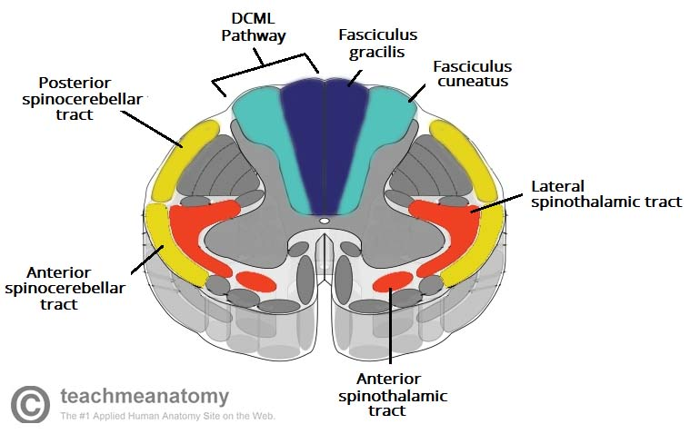
Gracilis → Ground (lower limb)
Cuneatus → Cervical (next to upper limb)
1. Dorsal Column
Contains two tracts;
Fasciculus Gracilis (FG) &
Fasciculus Cuneatus (FC)
Carry impulses concerned with proprioception (movement and joint position) , discriminative touch (fine touch) from ipsilateral* side of the body.*
Contain the axons of primary afferent neurons that have entered cord through dorsal roots of spinal nerves.
Gracilis and cuneate have the same function, and travel in the same pathway but receive fibers from different segments of the spinal cord:
Fasciculus Gracilis contains fibers that are received at sacral, lumbar and lower thoracic levels,
Fasciculus Cuneatus contains fibers that are received at upper thoracic and cervical levels.
Which is medial/lateral?
Cuneatus supplies the upper limbs which are lateral to the lower limbs therefore cuneatus is lateral and gracilis is medial
*There is variation in this point between boys and girls slides, This is the correct information according to Dr. Jameela and Dr. Essam
Extra

Slide 9
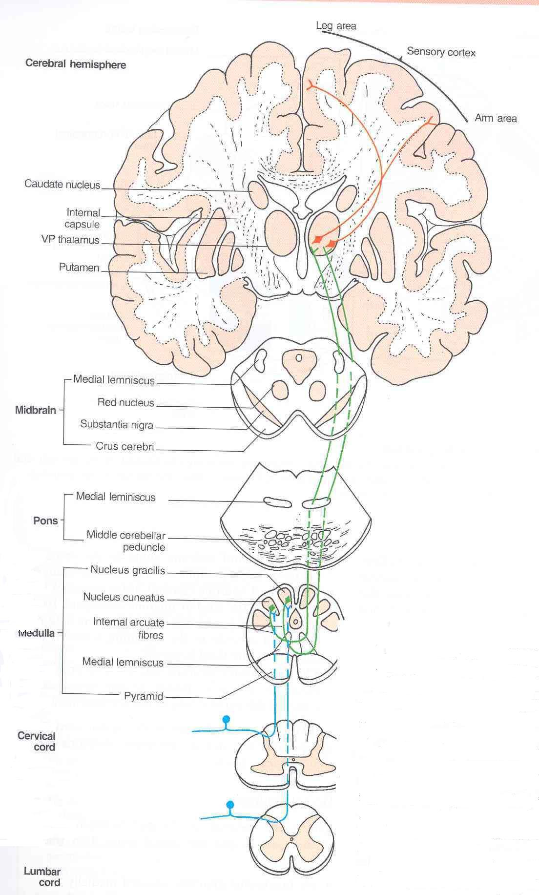
1. Dorsal Column
The primary afferent neurons relayed to the 1st order neurons in the dorsal root ganglion.
Fibers of the first order neurons ascend without interruption where they terminate upon 2nd order neurons in nucleus gracilis and nucleus cuneatus (in the medulla).
The axons of the 2nd order neurons decussate in the medulla as internal arcuate fibers. and ascend through the brain stem as Medial Lemniscus.
The medial lemniscus terminates in the ventral posterior nucleus of the thalamus (3rd order neurons) which project to the somatosensory cortex (thalamocortical fibers)

Slide 10
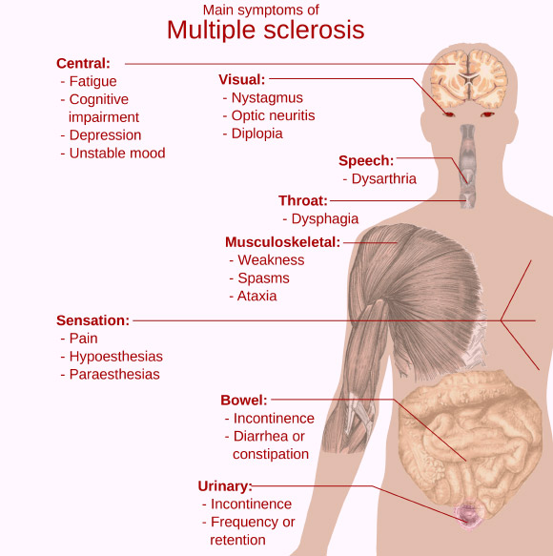
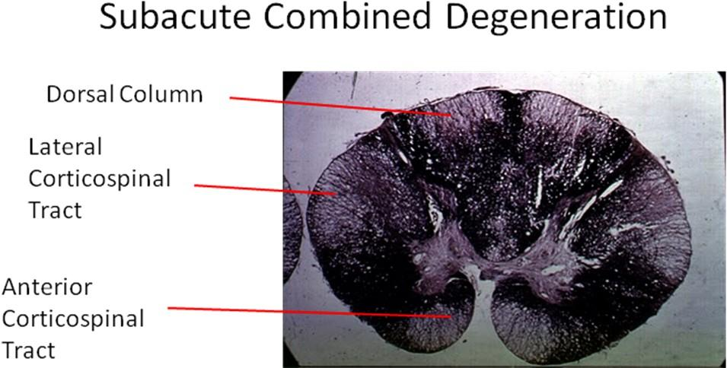
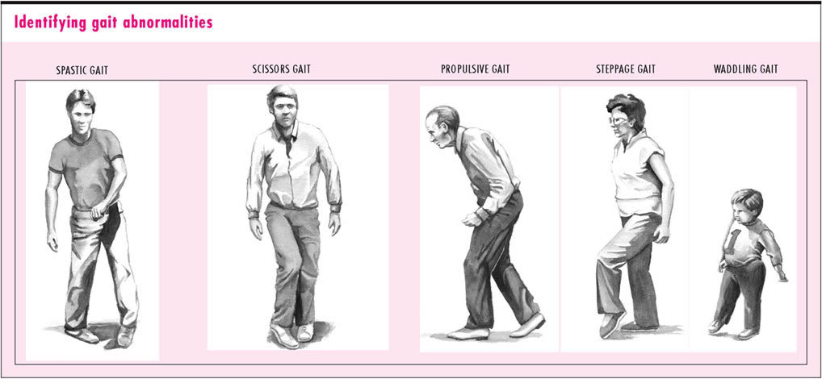
Tabes Dorsalis
A late manifestation of syphilitic infection on the CNS.
Affects the lumbosacral dorsal spinal roots and dorsal columns of the spinal cord.
Leads to loss of proprioception which is manifested by a high Step Page and unsteady gait (Sensory Ataxia). عدم اتزان بالمشي
Subacute Combined Degeneration of the spinal cord
A systemic disease results from B12 deficiency
It produces Sensory Ataxia
Lateral columns are also affected (combined) causing weak and spastic limbs
It is completely recovered by proper treatment with B12 .
Multiple Sclerosis
التصلب اللويحي
An immune disease affects specifically fasciculus Cuneatus of the cervical region. Leads to loss of proprioception in hands and fingers (Asteriognosis) lose of fine touch
11:15
07:07
Notes:
Ataxia is a neurological sign consisting of lack of voluntary coordination of muscle movements that includes gait abnormality. Ataxia is a non-specific clinical manifestation implying dysfunction of the parts of the nervous system that coordinate movement, such as the cerebellum. Ataxia can be limited to one side of the body, which is referred to as hemiataxia. Several possible causes exist for these patterns of neurological dysfunction. Dystaxia is a mild degree of ataxia. Friedreich's ataxia has gait abnormality as the most commonly presented symptom.

Slide 11
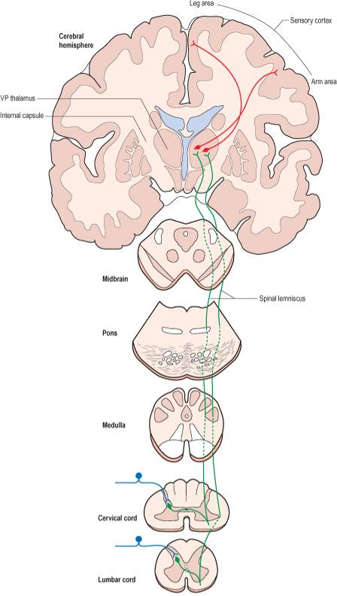
2. Spinothalamic (anterolateral) Tracts
The spinothalamic tracts contain axons of second-order neurones, the cell bodies of which lie in the contralateral* dorsal horn.
Located lateral and ventral to the ventral horn.
Carry impulses concerned with; pain and thermal sensations (Lateral tract) and Non- Discriminative touch (crude) and pressure (Anterior tract), from the contralateral side.*
In brain stem, the two tracts constitute the Spinal Lemniscus (recall the medial lemniscus).
Information is sent to the primary sensory cortex on the opposite side of the body.
*ipsilateral: on the same side of the body.
contralateral: on the opposite side of the body.
*There is variation in this point between boys and girls slides, This is the correct information according to Dr. Jameela and Dr. Essam

Slide 12
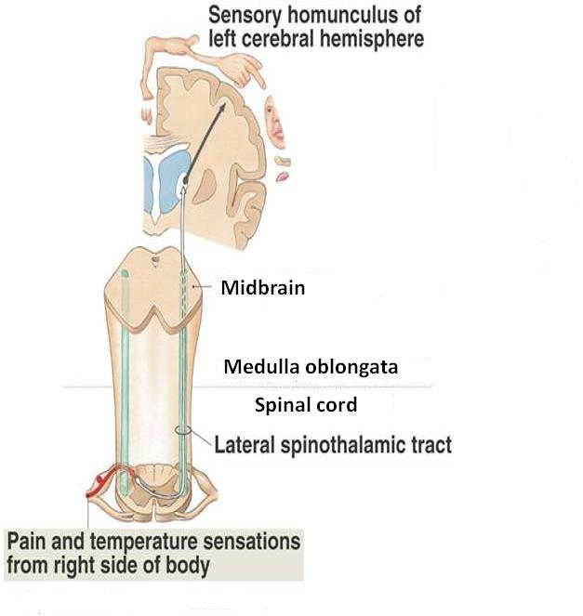
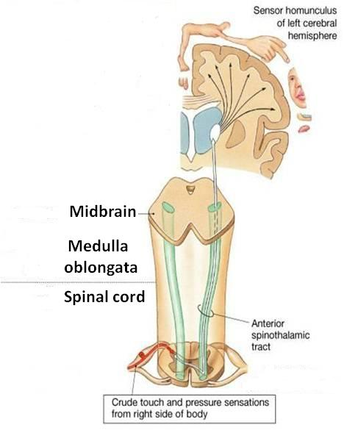
2. Spinothalamic (anterolateral) Tracts
Lateral Spinothalamic Tract |  | Anterior Spinothalamic Tract
Carries pain & Temperature to thalamus and sensory area of the cerebral cortex. | Function | Carries crude touch (non discriminative) & pressure to thalamus and sensory cortex.
Neurone I: Small cells in the dorsal root ganglia. | Neurones: 3 Neurones | Neurone I: Medium sized cells in the dorsal root ganglia.
Neurone II: Cells of substantia gelatinosa of Rolandi in the posterior horn. |  | Neurone II: Cells of main sensory nucleus or (nucleus proprius).
Neurone III: Cells of (VP*) nucleus of the thalamus. |  | Neurone III: Cells of VP* nucleus of thalamus.
Fibers arising from Substantia Gelatinosa & Nucleus Proprius decussate in the Anterior White Commissar and ascend as Spinal Lemniscus
* The lateral & ventical Spinothalamic tract when they ascend together we call the Spinal lemniscus
*Ventral Posterior

Slide 13
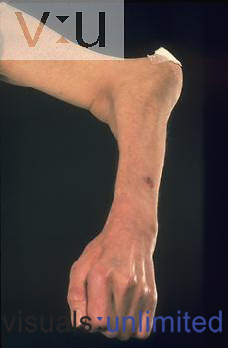
2. Spinothalamic (anterolateral) Tracts
Lesions
The ventral commissure is close to the central canal. So when the central canal enlarges it presses on the fibers passing through it.
It is selectively damaged in Syringomyelia
The central canal becomes enlarged forming a cavity compressing the adjacent nerve fibres
Fibres serving pain and temperature are damaged as they decussate in the ventral white commissure close to the central canal causing selective loss of pain and temperature in the upper limbs (dissociate sensory loss)
Light touch and proprioceptive sensations are retained.
Joints of the limbs become disorganized without discomfort (Charcot's joint). (the joint looks misshapen but does not cause pain)

Slide 14
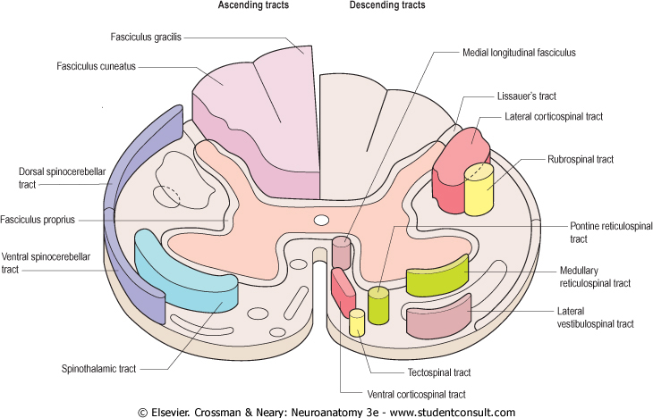
3. Spinocerebellar Tracts
The Spinocerebellar system consists of a sequence of only two neurons;
Neurone I:Large cells of dorsal root ganglia.
Neurone II: cells of the nucleus dorsalis; Clark's nucleus (column) . Carry information to lateral side
Two tracts: Dorsal &Ventral
Located near the dorsolateral and ventrolateral surfaces of the cord
Contain axons of the second order neurons
Carry information derived from muscle spindles, Golgi tendon and tactile receptors to the cerebellum for the control of posture and coordination of movements. (it is responsible for subconscious sensations)

Slide 15
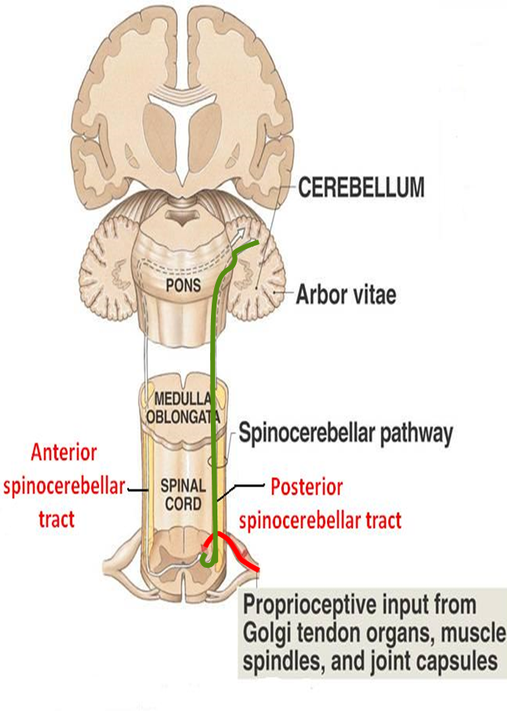
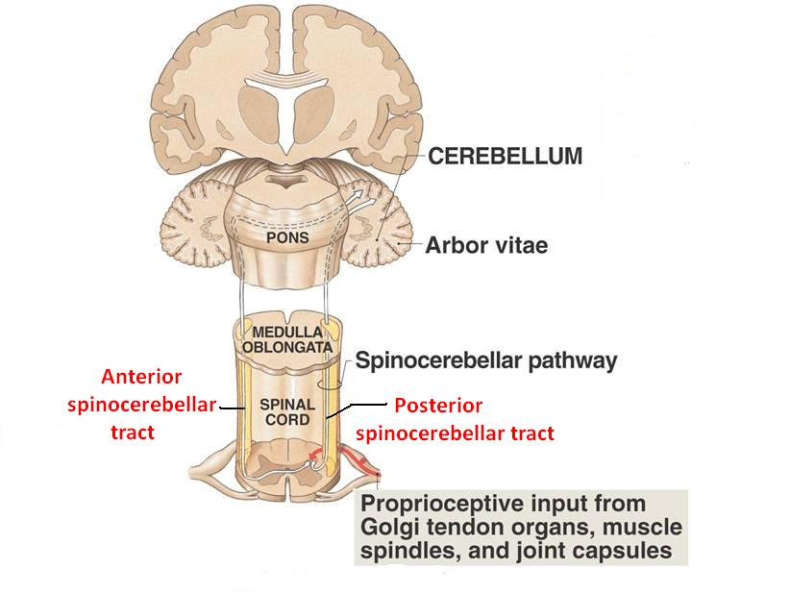
3. Spinocerebellar Tracts
Posterior (Dorsal) Spinocerebellar Tract | Ventral (Anterior) Spinocerebellar Tract
Present only above level L3 The cell bodies of 2nd order neuron lie in Clark’s column Axons of 2nd order neuron terminate ipsilaterally (uncrossed) in the cerebellar cortex by entering through the inferior cerebellar peduncle. Posterior spinocerebellar tract convey sensory information to the same side of the cerebellum | The cell bodies of 2nd order neuron lie in base of the dorsal horn of the lumbosacral segments Axons of 2nd order neuron cross to opposite side, ascend as far as the midbrain, and then make a sharp turn caudally (the fibers cross the midline for the second time) and enter the superior cerebellar peduncle to terminate in the cerebellar cortex So Ventral spinocerebellar tract conveys sensory information to the same side of the cerebellum

Slide 16
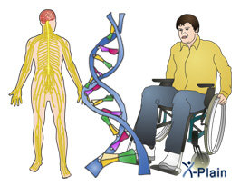
3. Spinocerebellar Tracts
Lesions
Friedrichs ataxia = (ataxia = gait)
An inherited degenerated disease
Affecting the spinocerebellar tracts
Leading to incoordination of arms, intense tremor, wide base reeling gait ataxia
It begins in child hood
Wheelchair is bound by 20 years of age

Slide 17
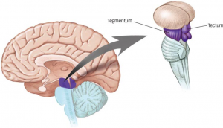
Spinotectal Tract
Ascends in the anterolateral part, in close association with spinothalamic system.
Primary afferents reach dorsal horn through dorsal roots and terminate on 2nd order neurons
The cell bodies of 2nd order neuron lie in base of the dorsal horn.
Axons of 2nd order neuron cross to opposite side, and project to the periaquiductal gray matter and superior colliculus in the midbrain.
Involved in reflexive turning of the head and eyes toward a point of cutaneous stimulation.
Spinotectal: the fibers travel from the spine (spino-) to a region in the midbrain called tectum (-tectal)
Extra

Slide 18
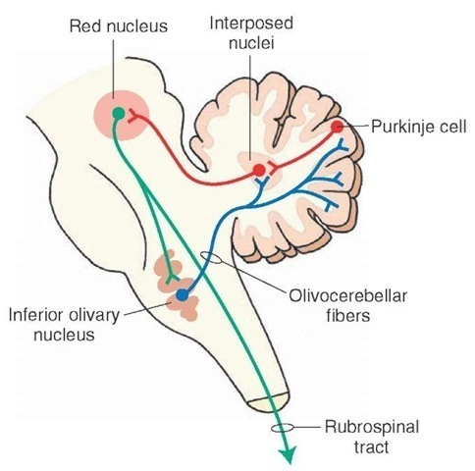
Spino-olivary Tract
Indirect spinocerebellar pathway (spino-olivo-cerebellar) meaning it connects the spinal cord with the cerebellum but indirectly through the olivary nucleus
Impulses from the spinal cord are relayed to the cerebellum via inferior olivary nucleus.
Conveys sensory information to the cerebellum.
Fibers arise at all levels of the spinal cord.
Contribute to movement coordination associated primarily with balance.

Slide 19
Spinoreticular Tract
Originates in the dorsal horn, and ascend in the ventrolateral region of the cord
Contains uncrossed fibers that end in medullary reticular formation & both crossed & uncrossed fibers that terminate in pontine reticular formation, finally to the thalamus; that activate the cerebral cortex
Forms part of the ascending reticular activating system (waking up).
Involved in perception of dull aching (slow pain)

Slide 20
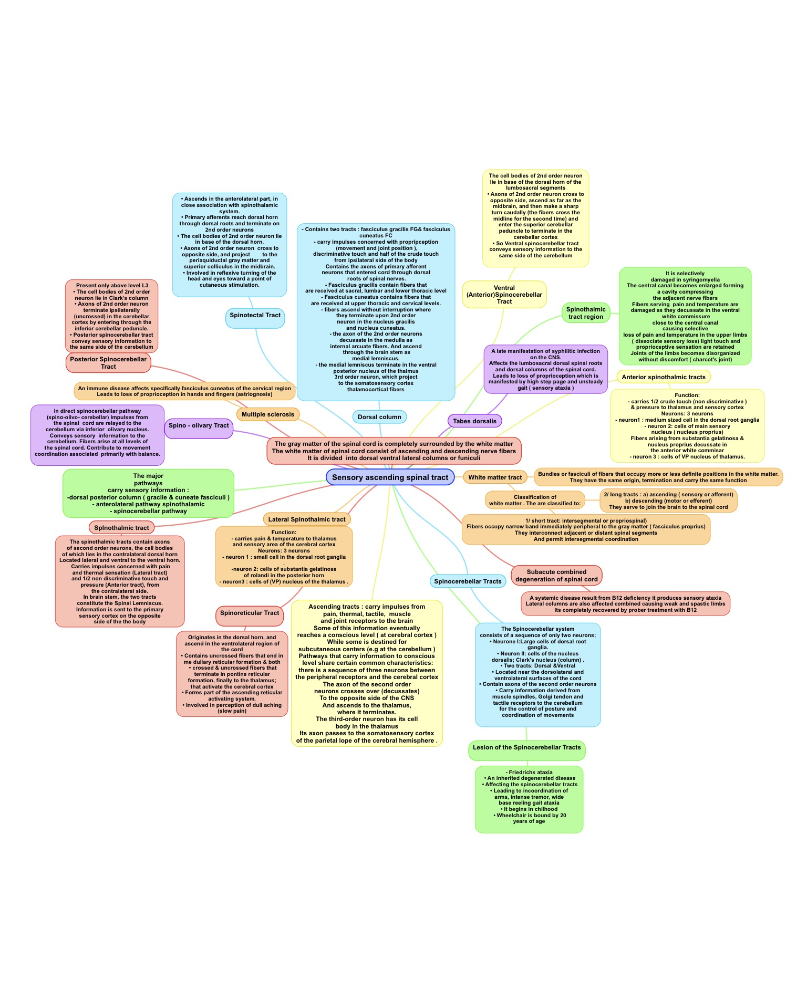
Summary
Special thanks to Jawaher Alkhayyal!

Slide 21
(1) Which of the following is a short white matter tract?
A) fasciculus proprius B) fasciculus gracilis
C) fasciculus cuneatus D) fasciculus thalamus
(2) Pathways that carry information to a conscious level have?
A) 1 order neurons B) 2 order neurons
C) 3 order neurons D) 4 order neurons
(3) The internal arcuate fibers ascend through the brain stem as?
A) Lateral lemniscus B) Medial lemniscus
C) Spinal lemniscus D) Dorsal lemniscus
(4) Tabes dorsalis is a late manifestation of which infection?
A) Meningitis B) Syphilis
C) Syringomyelia D) Non of them
(5) Spinoreticular Tract Originates in _______ & ascend in _______ ?
A) The ventral horn, the ventrolateral region of the cord
B) The dorsal horn, the dorsolateral region of the cord
C) The dorsal horn, the ventrolateral region of the cord
D) The ventral horn, the dorsolateral region of the cord
(6) Spinothalamic tracts send information to primary sensory cortex on the _____ of the body?
A) Same side B) Opposite side
(7) The posterior spinocerebellar tract passes through?
A) Superior cerebellar peduncle
B) Middle cerebellar peduncle
C) Inferior cerebellar peduncle
D) Lateral cerebellar peduncle
(8) Which of the following is involved in the perception of dull aching pain?
A) Spinotectal tract B) Spino-olivary tract
C) Spinoreticular tract D) Spinothalamic
(9) Subacute Combined Degeneration of the spinal cord results from?
A) B12 deficiency B) B9 deficiency
C) B6 deficiency D) B7 deficiency
(10) Multiple sclerosis affects which tract?
A) fasciculus proprius B) fasciculus gracilis
C) fasciculus cuneatus D) fasciculus thalamus

Slide 22
Answers
(1) A (6) B (2) C (7) C (3) B (8) C (4) B (9) A (5) C (10) C

Slide 23
(1) Write down the location of the three order neurons between the peripheral receptors and the cerebral cortex?
First-order neuron • Delivers sensations to the CNS • The cell body is in the dorsal or cranial root ganglion
Second-order neuron • An interneuron with the cell body in the spinal cord (grey matter) or brain stem (medulla oblongata)
Third-order neuron • Transmits information from the thalamus to the cerebral cortex
(2) The three major pathways carry sensory information are?
Dorsal (Posterior) column (divided into Gracile & Cuneate fasciculi)
Spinocerebellar pathway ”dorsal & ventral”
Anterolateral pathway (Spinothalamic) “ventral & lateral”
(3) An immune disease affects specifically fasciculus Cuneatus of the cervical region. Leads to Astereognosis Is ?
Multiple Sclerosis

Slide 25
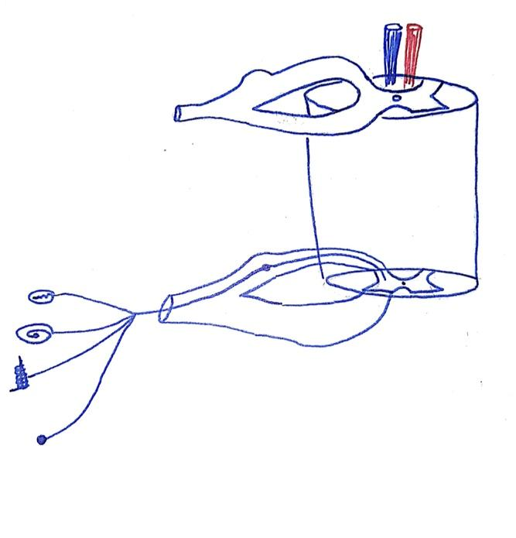
1- Dorsal column
First of all you can start from 45:10 minutes if you already you know these basic concepts : Tract : Bundle of axons in the CNS with common origin and common termination and serve same function. White matter ( have ascending and descending tract ) they organized like : 1- vertical fibers ( up & down ) like Tracts 2- commissar fibers ( right- left ) like corpus callosum 3- association fiber ( ant-pos) - Ascending tract How it works? Stimulus > convert electrochemistry reaction > by receptor > move through sensory nerve > CNS
- Descending How it works? From high center > descending tract > motor nerve > effector system (muscle/ gland ) White matter divided into: Dorsal column > ascending tract Lateral column > ascending & descending Tract Ventral column > ascending & descending Tract Dorsal column = highly myelinated > fast conduction. Ex: fine touch , proprioception , vibration. Give better localization of the sensation + gradations. Ventrolateral = less myelinated > slow condition > pain , temperature , tickling, itchy, sexual. Less localization + lesser gradation

Slide 26
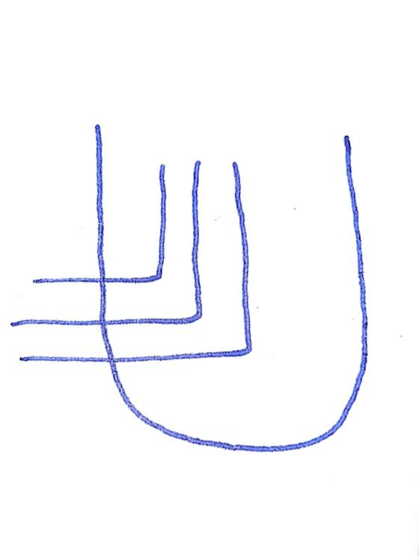
1- Dorsal column
now we will start dealing with individual Tract Dorsal column- 45:10 minutes
First to understand the system we have to start with receptors that will receive the ( fine touch , pressure, vibration, and proprioception ) all these have to take up to the cerebral cortex through: 1- Firsts order neurons = Dorsal root ganglion Then theses root will divided medially and laterally. Medial one going upward and start ascending as dorsal column
Sensations that carried from Lower limb they will deposit medially (fasciculus gracilis ) and from upper limb they will be deposited laterally ( fasciculus canuteos ) because sensation are added So , in the dorsal column fibers that are more laterally are coming from upper limb and and the fiber that are more medially are coming from Lower limb. - What the importance to know this point? Because if there is tumor compress the lateral fibers then upper part of the body sensation will be lost. They are arranged in topographical

Slide 27
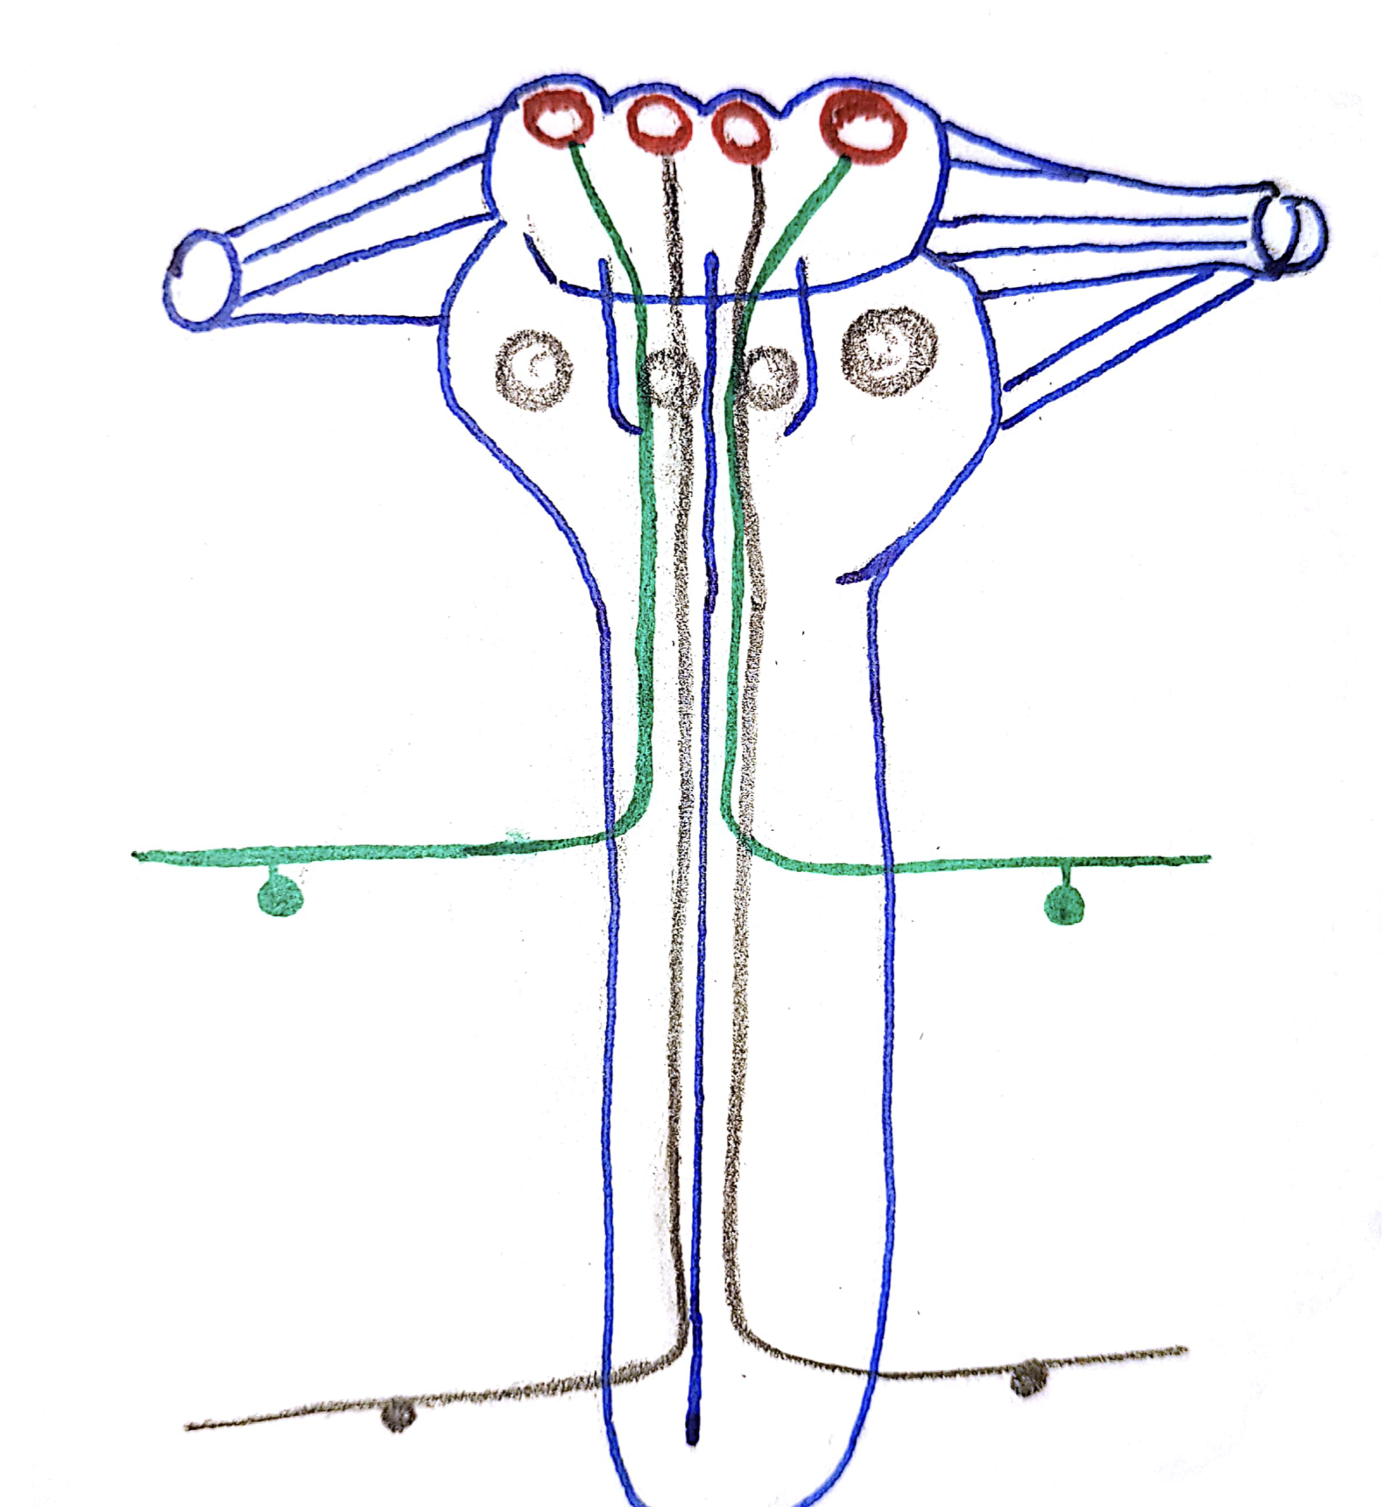
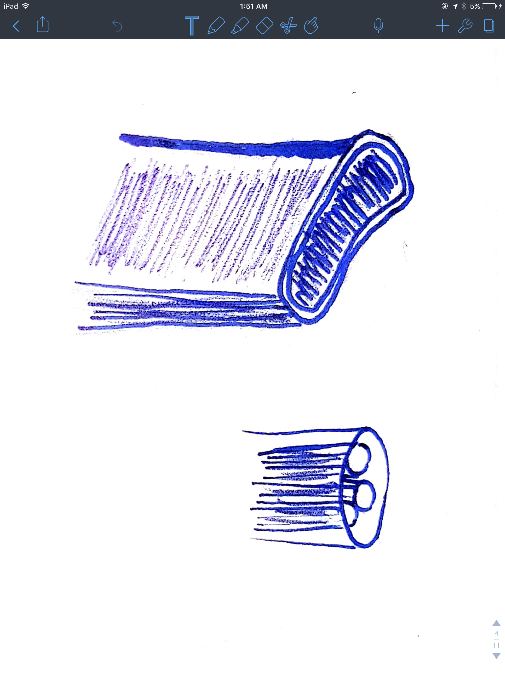
1- Dorsal column
Ascending fibers continue to reach in the medulla oblongata
( we have special nucleus called fasciculus gracilis + fasciculus cuneatus ) = 2nd order neurons. Here we have that right nucleus of cunatus and right nucleus of gracilis their axons emerge out and cross the opposite side and after this crossing these fibers is going upward and making a very special system called ( internal arcuate fibers ) * notice here right fibers are taking the information from the left nucleuses These information going to 3rd nucleus by medial lemniscus )
(Inferior cerebral peduncle) (Medial lemniscus) (lemniscus)
Until 10 minutes

Slide 28
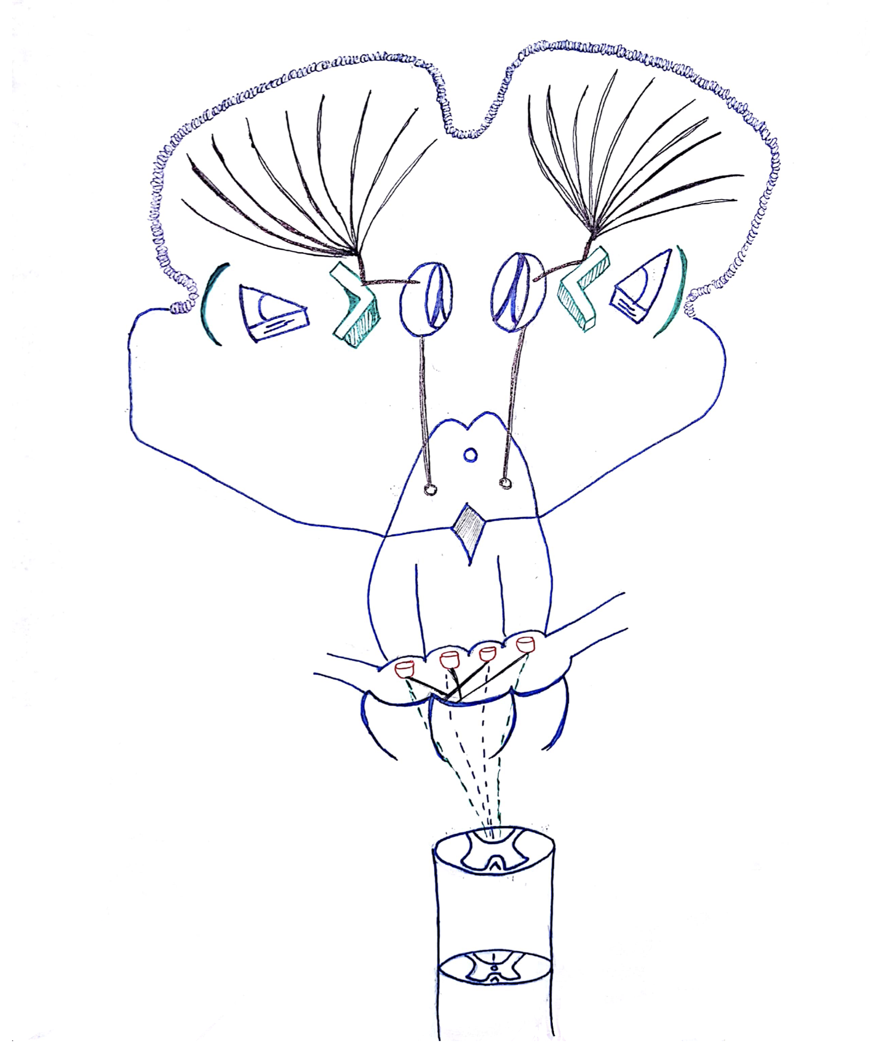
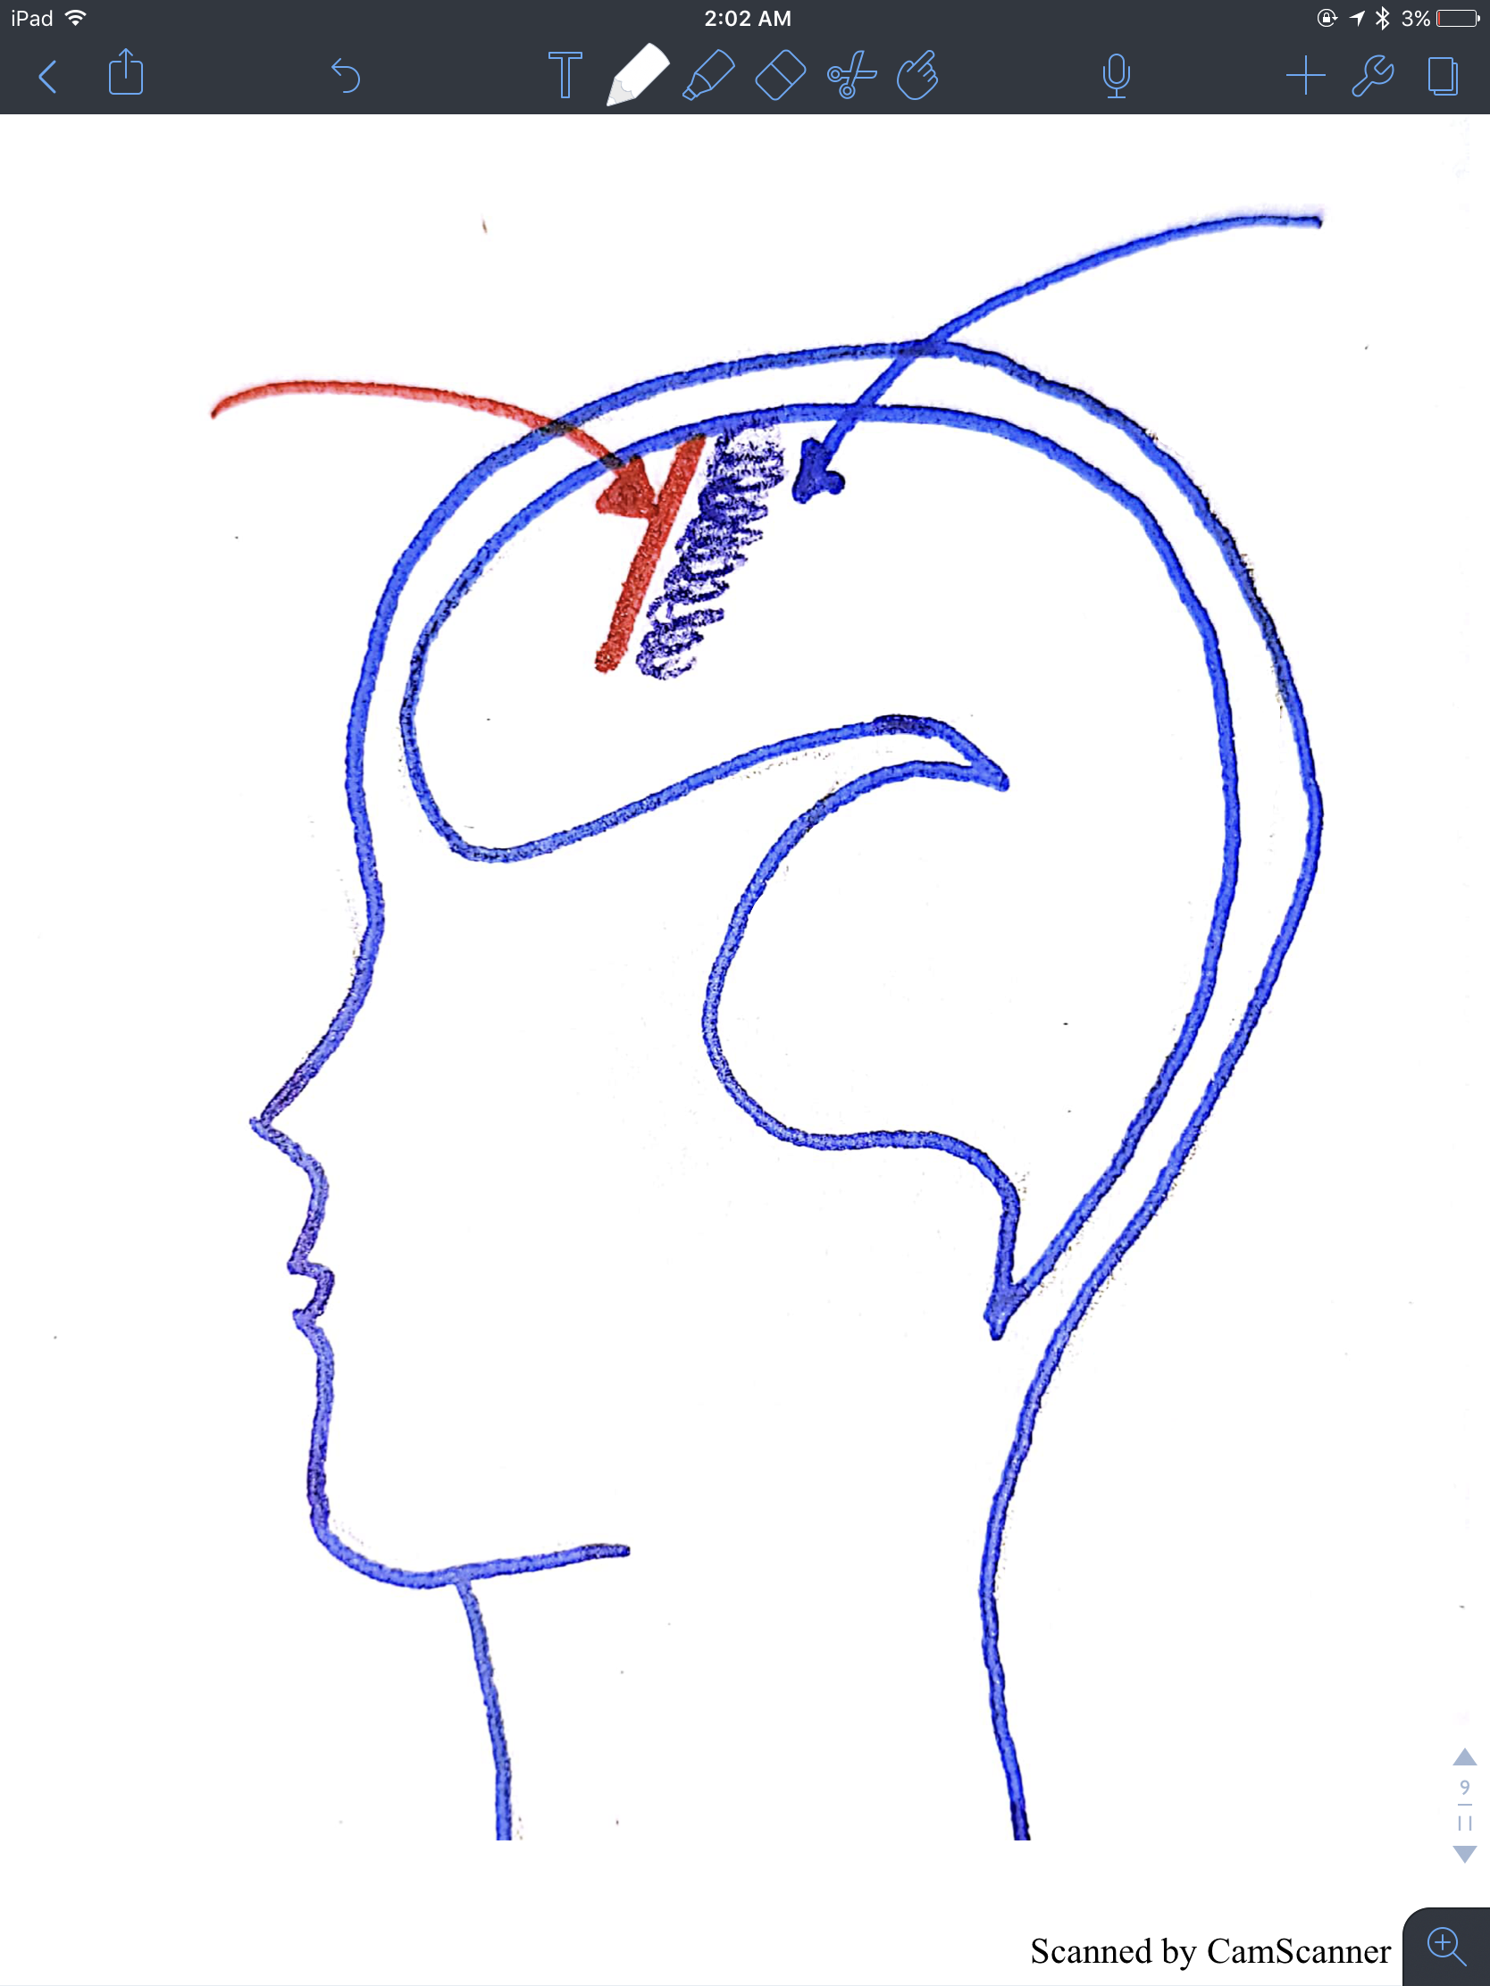
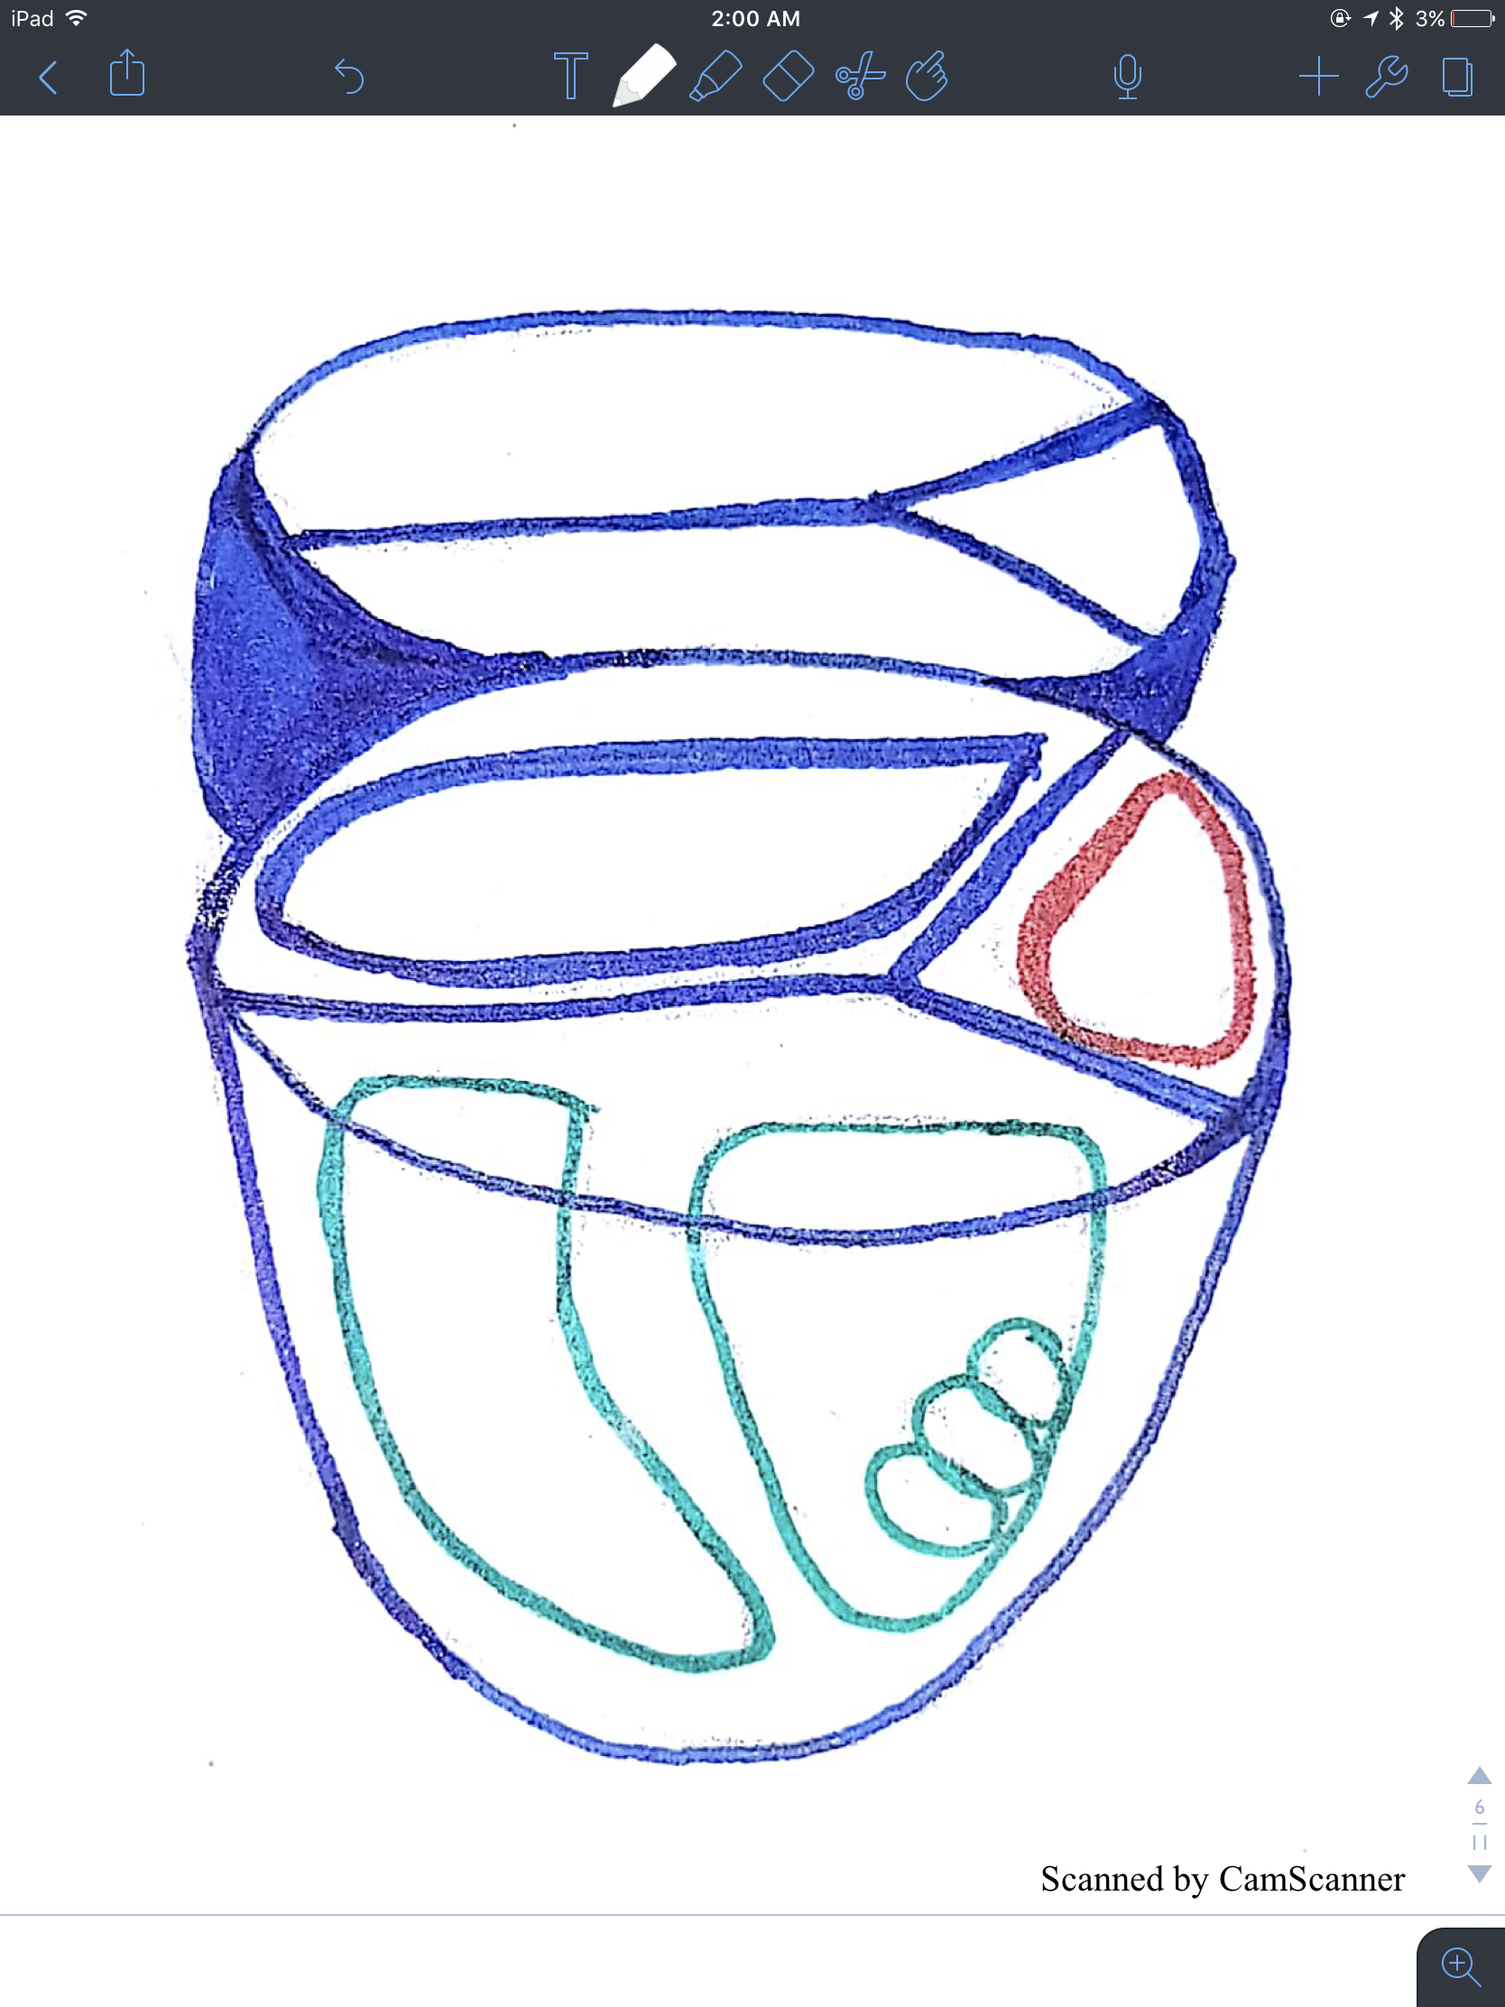
1- Dorsal column
Medial lemniscus going to the Third order neuron
thalamus specifically in the VPL (ventroposterior lateral ) then fibers move laterally in the posterior limb of the internal capsule then fan out to cerebral cortex as corona radiata
Thalamus view divided into : 1- Anterior 2- Medial 3- Lateral divided into : 1- Ventral A- ventral anterior nucleus B- Ventral Intermediate C- Ventral posterior have (1- ventroposterior lateral ) -receive most of the sensation - and medial to it we have ventroposterior medial ) - receive fibers from head & neck fibers 2- Dorsal
corona radiata
Thalamus
Midbrain
Pons
postcentral
gyrus
Medulla
Central
sulcus
Medial
Anterior
White matter
bundles
Posterior limb
Dorsal
Ventral
Caudate nucleus
Lateral
Genu
Internal capsule
Until the end of video
Anterior limb

Slide 29
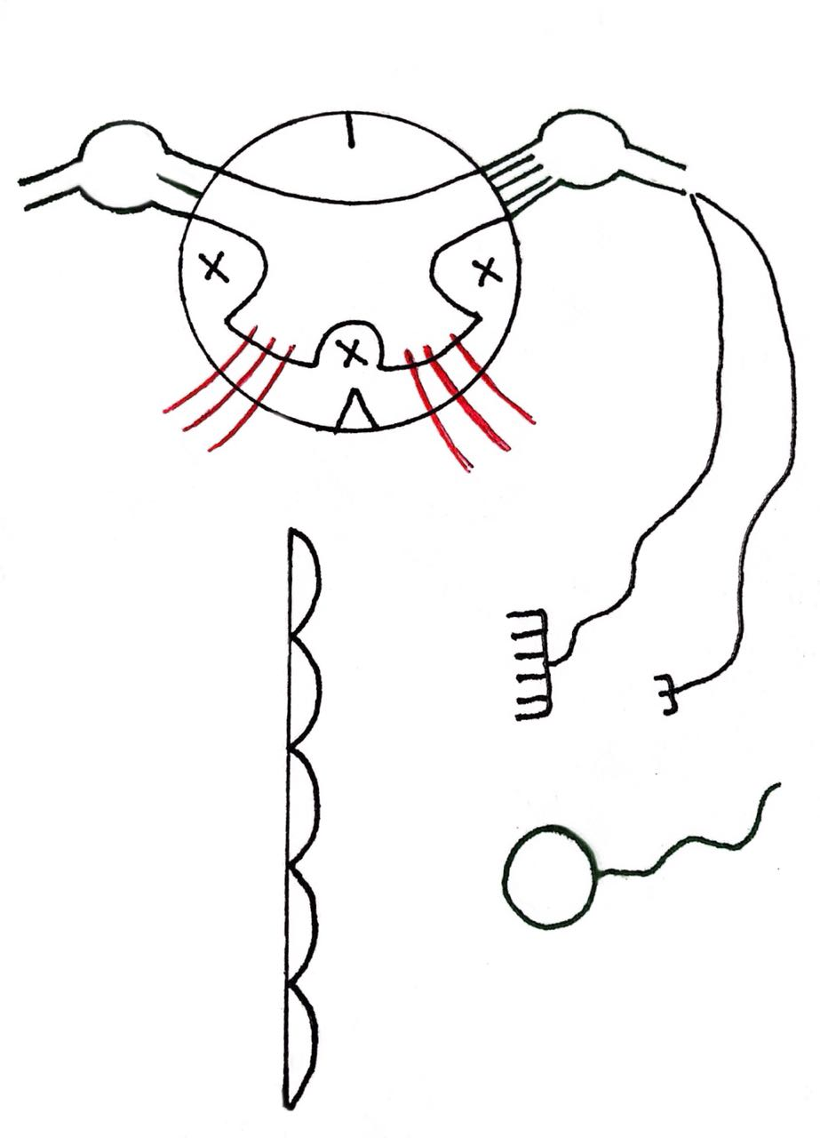
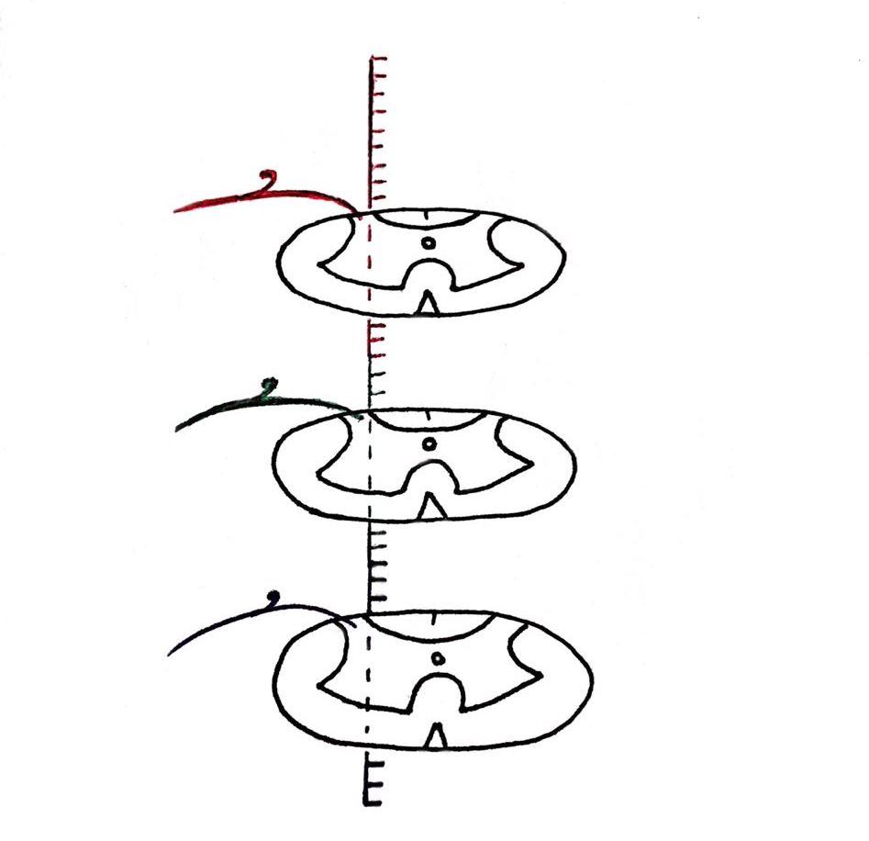
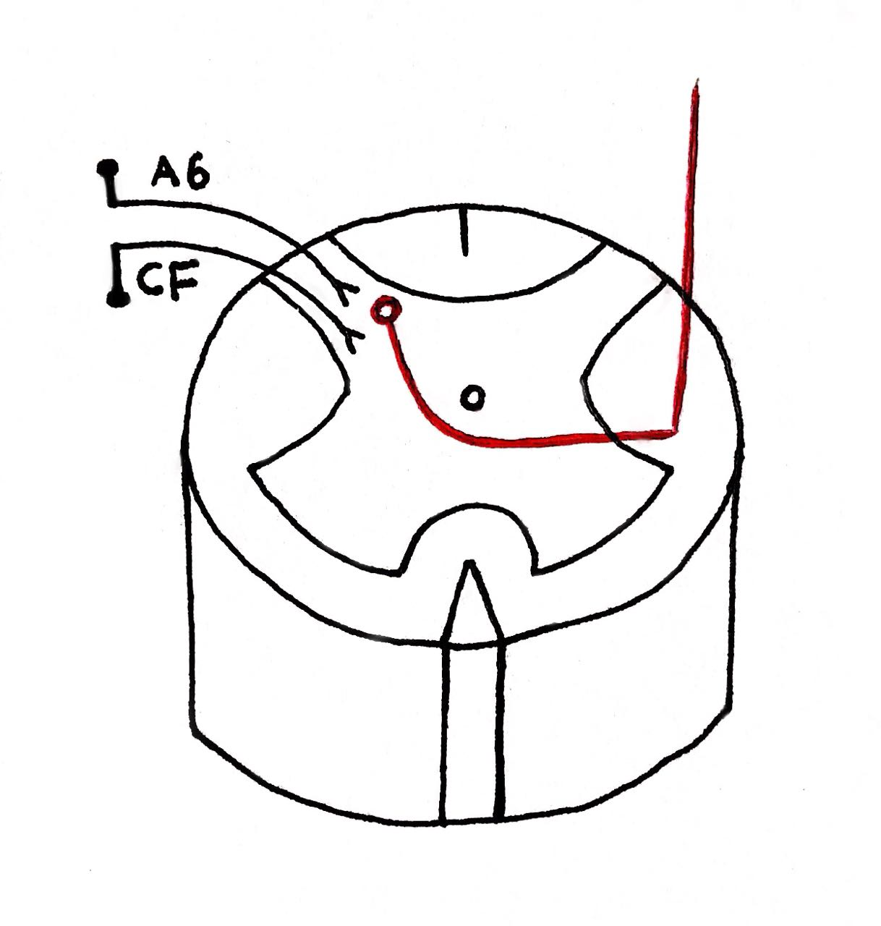
2-Anterolateral tract
Receptors : 1- free nerve ending 2- temperature receptor
Pain pathway :
1- Fast pin brick A-Delta pathway 0.1 sec , Mechanical stimulus or thermal
2- Slow dull- fibers pathway 1hr or longer Mechanical , thermal , chemicals stimulus
Why Sometimes you notice that one of your hand is painful and the other isn’t?
Because we have chemical mediator responsible for stimulation of pain receptor like : 5ht , histamine , bradykinin, acids , K+
What are the substance that decrease the threshold of the pain ? PGs-substance p (peptide)
* Red circle : First neuron = Dorsal root ganglion second neuron :substantia gelatinosa then it’s crossed to contralateral to the third neuron .
This called Dorsolateral tract of “LISSAURE”
It means this tract made of ascending and descending branches of the first neuron as it enter to the spinal cord then connect with second neuron in the subtisa gelatinosa in the same level
*notice here the first neuron not like dorsal column that enter medialy then ascend to nucleus because it is not at the same level
A-Delta
Free nerve ending
C- fibers
Dr.Najeeb lecture 57 min
Follow him & use the sketch
Skin
Thermal receptor
Until 11:05 min
Until 17:52 min

Slide 30
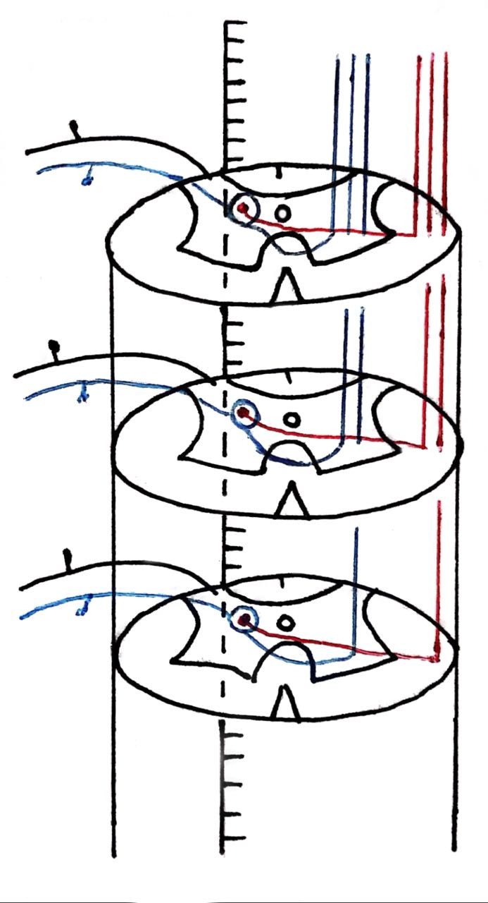
2-Anterolateral tract
Blue tract:
Ventral spinothalamic tract ( crude touch )
Red tract:
Lateral spinothalamic tract
( pain and temperature )
Between Ventral and lateral spinothalamic tract we find spinotectal pathway and going to the tectum(superior colliculus + inferior colliculus ) which is responsible for for spinovisual response
All these tract when reach to the medulla fuse together and called spinal lemniscus
All of them -3- will pass pons & midbrain but only 2 ( ventral spinothalamic and lateral spinothalamic will get connect to the ventroposterior lateral VPLnucleus of the thalmus.
Until 31:00 min
Dr.Najeeb lecture 57 min
Follow him & use the sketch

Slide 31
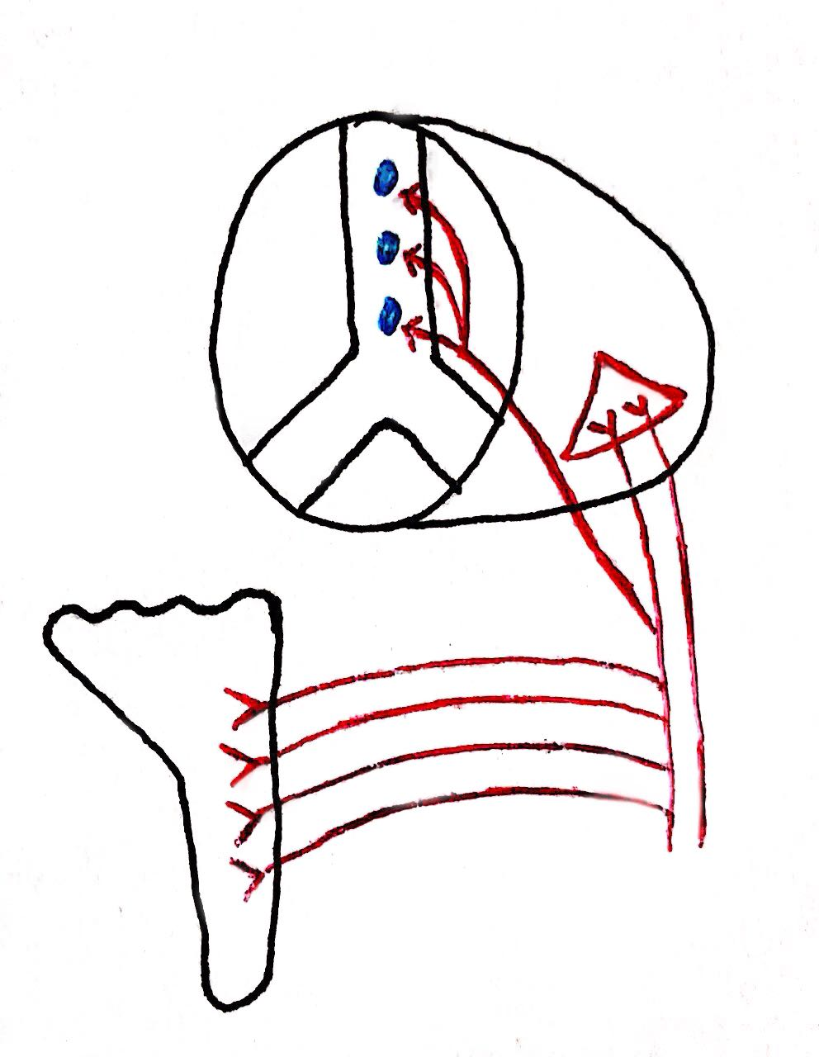
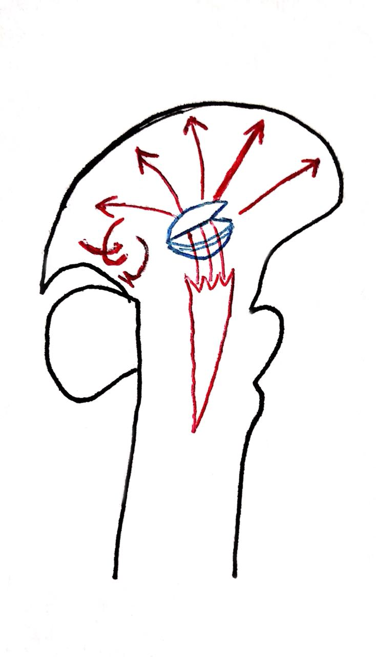
2-Anterolateral tract
Fast pain information reach VP nucleus
Slow pain information reach Intralaminar nuclei and stimulate the reticular formation so all the brain is alert
Reticular formation :
is mixed between gray matter and white matter and its function is switch on\off cerebral cortex activity
Pain pathway pass through VP nucleus then into internal capsule posterior limb and reach to area of cortex (postcentral gyrus)
Connections of the pain tract :
1-(postcentral gyrus): tell you exactly where is the pain if it fast - localized - if it slow poorly localized also the graduation and quality of the pain
2- cingulate gyrus special connection from posterior limb of the internal capsule is considered with emotional
3- Insula
Is considered with Autonomic reaction like tachycardia , sweating
Intralaminar nuclei
VP
Slow pain
Fast pain
Reticular formation
Reticular formation
Until 31:00 min
Dr.Najeeb lecture 57 min
Follow him & use the sketch

Slide 32
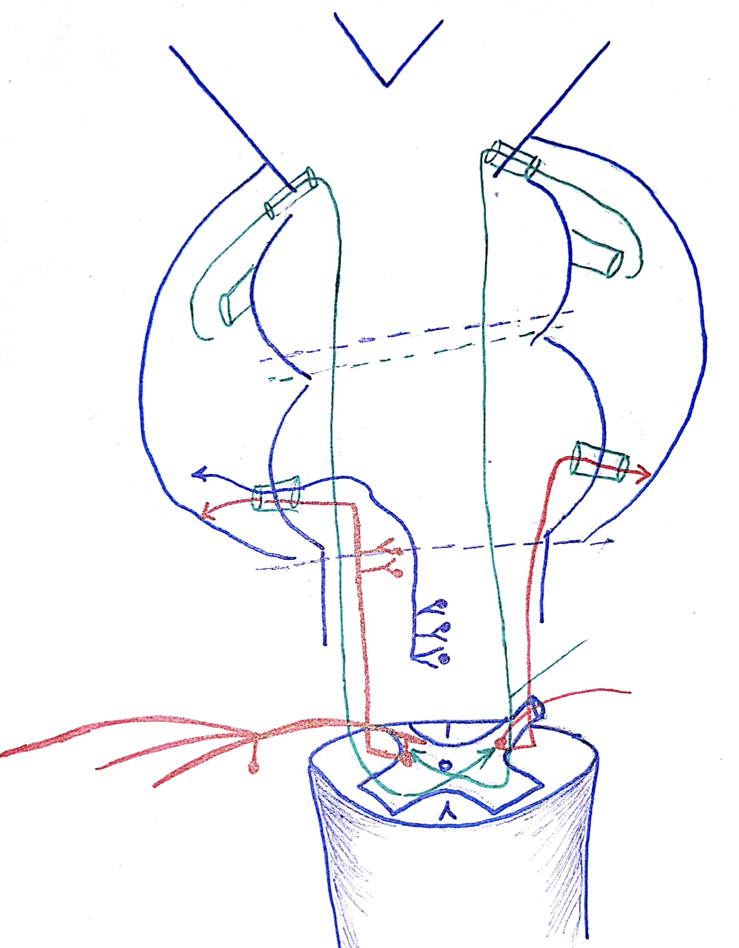
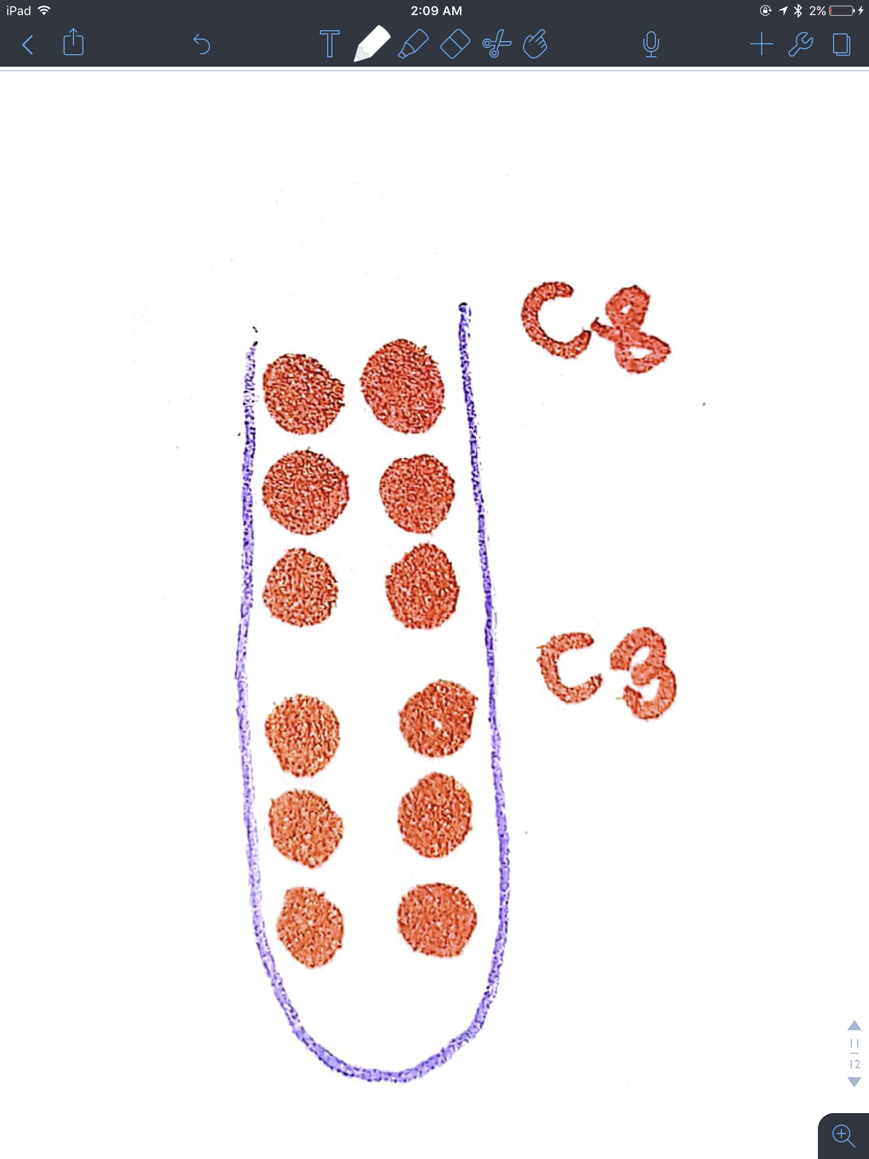
3-Spinocerebellar Pathway
Dorsal Spinocerebellar Tract
Fibers take information from spinal cord to cerebellum. First order neuron has their cell bodies in dorsal root ganglion and terminates in CLARKE nucleus in dorsal Grey horn. Second order neuron ascends through ipsilateral white lateral column and connects with cerebellar cortex of same side via inferior cerebellar peduncle
Clarke nucleus ;This is a large column of neurons which is located in the dorsal Grey horn of the spinal cord, extending from C8 to L3. It receives information from lower limbs and trunk.
Accessory Cuneate Nucleus ; Spinocerebellar tract fiber, above the C8 level enters into the nucleus then ascends and pass through inferior cerebellar peduncle.It receives information from Upper limbs
Cerebellar peduncles ; These are specialized bundles of white matter which connect brainstem with cerebellum.

