Slide 2
Objectives
At the end of this lecture, the students should be able to :
Describe the formation of brachial plexus (site, roots)
List the main branches of brachial plexus
Describe the formation of lumbosacral plexus (site, roots)
List the main branches of lumbosacral plexus
Describe the important Applied Anatomy related to the brachial & lumbosacral plexuses.

Slide 3
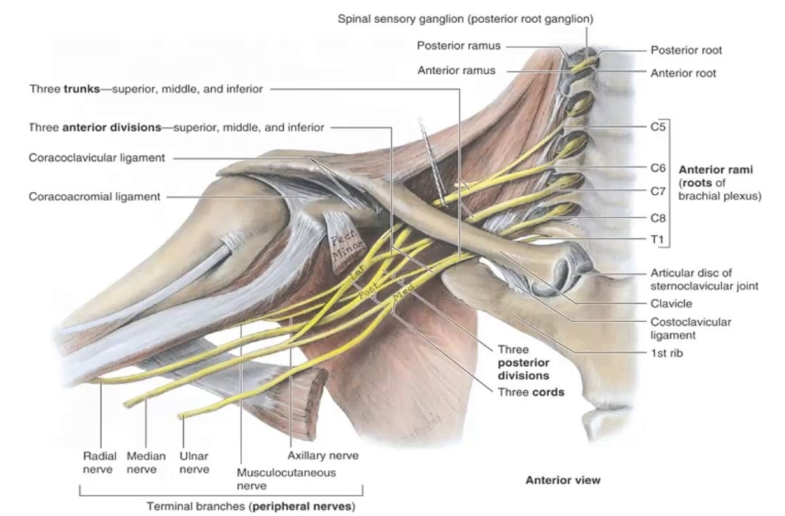
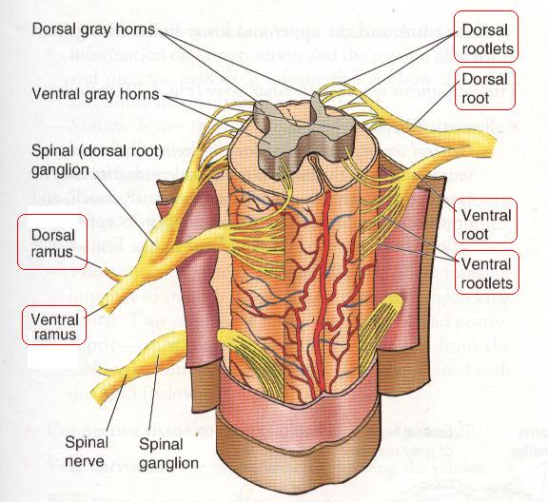
Brachial Plexus Formation
Playlist
It is formed in the posterior triangle of the neck.
It is the union of the anterior rami (or ventral) of the 5th ,6th ,7th ,8th cervical and the 1st thoracic spinal nerves.
The plexus is divided into 5 stages:
Roots
Trunks
Divisions
Cords
Terminal branches
Really Tired? Drink Coffee!
(all the plexuses are made by ventral rami)

Slide 4
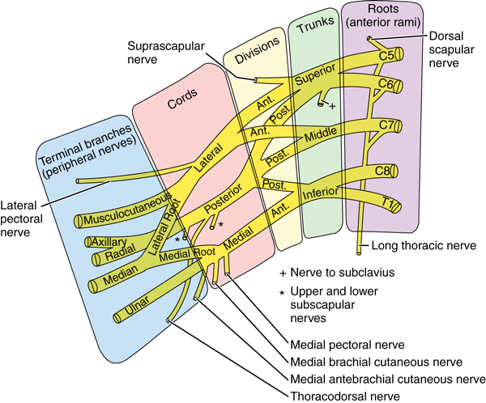
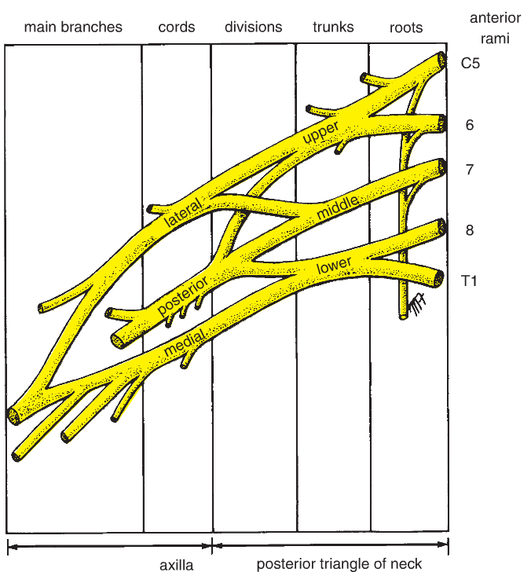
Brachial Plexus
A
P
A
P
P
A

Slide 5
Brachial Plexus
Trunks
Divisions
Cords
Upper (superior) trunk
Union of the roots of C5 & C6
Middle trunk
Continuation of the root of C7
Lower (inferior) trunk
Union of the roots of C8 & T1
Each trunk divides into anterior and posterior division
Posterior cord:
From the 3 posterior divisions of the 3 trunks
Lateral cord:
From the anterior divisions of the upper and middle trunks
Medial cord:
It is the continuation of the anterior division of the lower trunk
Branches
All three cords will give branches in the axilla, those will supply their respective regions.

Slide 6
The Brachial Plexus
Long Thoracic (C5,6,7)
Anterior divisions
Nerve to Subclavius(C5,6)
Posterior divisions
Dorsal Scapular(C5)
upper
trunk
Suprascapular(C5,6)
roots
C5
Lateral Cord
(2LM)
C6
middle
trunk
C7
lower
trunk
C8
T1
Posterior Cord
(ULTRA)
Medial Cord
(4MU)
In the PowerPoint presentation this slide is animated.

Slide 7
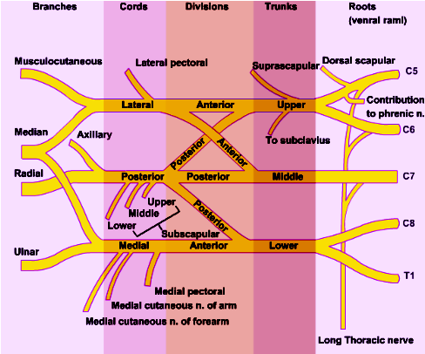
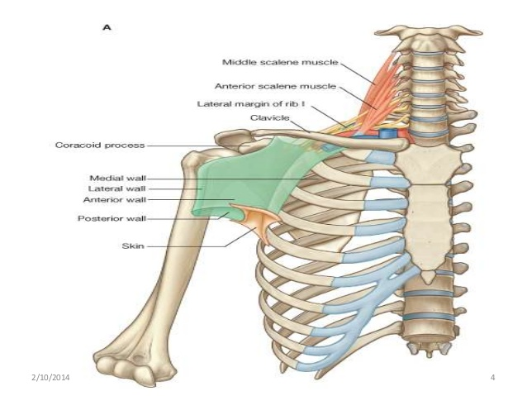
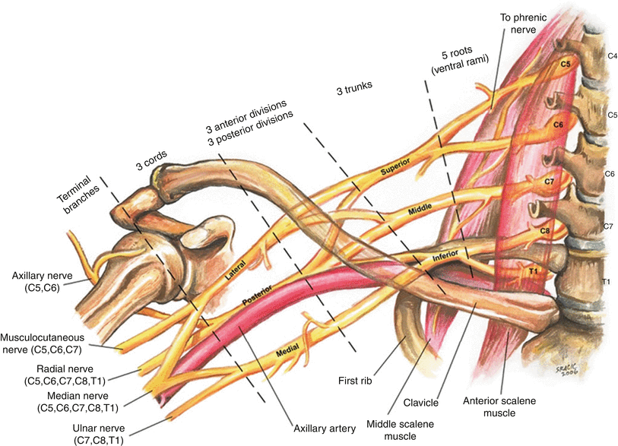
Brachial Plexus
The Plexus can be divided into 5 stages:
Roots: in the posterior ∆ of the neck.
Trunks: in the posterior ∆ of the neck.
Divisions: behind the clavicle.
Cords: in the axilla.
Branches: in the axilla.
The first 2 stages lie in the posterior triangle, while the last 2 sages lie in the axilla.
Extra
Extra
Extra

Slide 8
Brachial Plexus
Branches
(A) From Roots:
1. C5: Nerve to rhomboids (dorsal scapular nerve).
2. C5,6 &7: Long thoracic nerve (supplies serratus anterior).
(B) From Trunk (upper or superior trunk):
C5 & 6: Nerve to subclavius
C5 & 6: Suprascapular nerve (supplies supraspinatus & infraspinatus).
Superior trunk → Suprascapular nerve + nerve to Subclavius

Slide 9
Brachial Plexus
Branches
(C) From Cords:
Lateral Cord: (2LM)
Lateral pectoral nerve.
Lateral root of median nerve
Musculocutaneous nerve.
Posterior Cord: (ULTRA)
Upper subscapular nerve.
Lower subscapular nerve.
Thoracodorsal nerve. Another name is (nerve to latissimus dorsi)
Radial nerve. It is the continuation of the posterior cord
Axillary nerve.
Medial Cord: (4MU)
Medial pectoral nerve.
Medial root of median nerve.
Medial cutaneous nerve of arm.
Medial cutaneous nerve of forearm.
Ulnar nerve.
Lucy Loves Money
Money Makes Many Men Unhappy
Roots value:
All the branches from lateral cord have root value of (C5,C6,C7).
All the branches from medial cord have root value of (C5-T1) except, Ulnar nerve (C7,C8,T1).
Axillary (C5,C6)
Radial nerve (C5-T1)
Median nerve (C5-T1)
Musculocutaneous (C5,C6,C7)

Slide 10
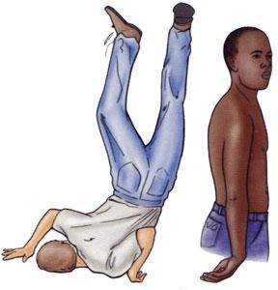
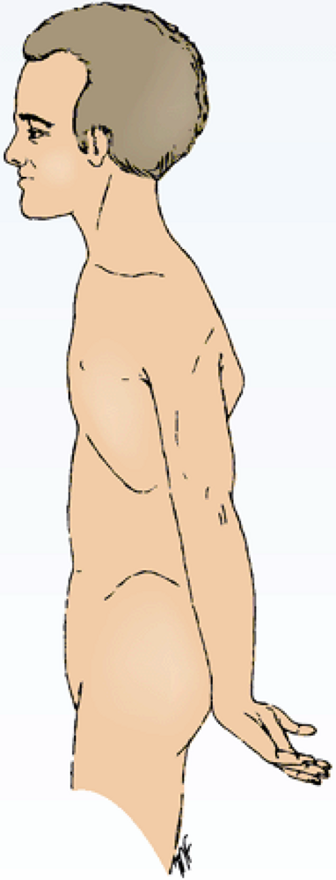
Extra
Brachial Plexus
Injuries
How to remember the lesion and the trunk?
Erb – Duchenne
زي الدش او الصحن فلما نمسك الصحن باطن اليد راح يكون متجه على فوق.Upper Trunk
Upper Lesions of the Brachial Plexus Upper Trunk C5,6
(Erb-Duchenne Palsy)”waiter's tip position”.
Resulting from traumatic injury to the upper part of the brachial plexus resulting from excessive displacement of the head to the opposite side and depression of the shoulder on the same side (a blow or fall on shoulder*).
The position of the upper limb in this condition has been likened to that of a porter or waiter hinting for a tip** or policeman’s tip hand.
The arm hangs by the side and is rotated medially. The forearm is extended and pronated.
*
**
Extra
Extra: This type of injury may also result during child birth if the baby is tugged

Slide 11
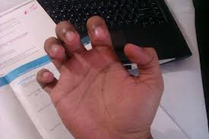
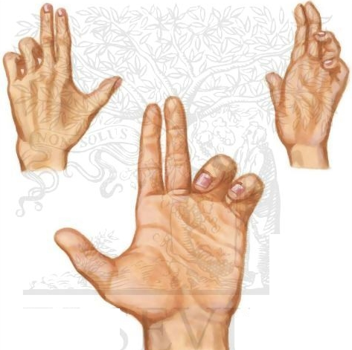
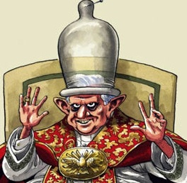
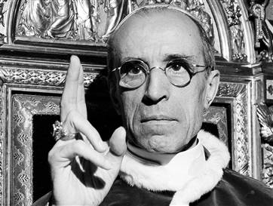
Brachial Plexus
Injuries
How to remember the lesion and the trunk?
Klumpke
الكلمة تشبه ’كلب’ ولما نلمس الكلب اتجاه باطن اليد راح يكون على تحت . Lower Trunk
**
Claw Hand
Lower Lesions of the Brachial Plexus (Klumpke Palsy) / Lower Trunk (C8,T1) Lesion
Lower lesions of the brachial plexus are usually traction* injuries caused by a person falling from a height clutching at an object to save himself**. The first thoracic nerve is usually torn.
The nerve fibers from this segment run in the ulnar and median nerves to supply all the small muscles of the hand. The hand has a clawed appearance due to ulnar nerve injury.
Hand of Benediction or Pope’s Blessings (APE HAND) will result from median nerve injury.
Pope
Ape Hand
DR. CUMAB
DR: Drop wrist – Radial nerve
CU: Claw hand – Ulnar nerve كلو إنا
MAB: Median nerve – Ape hand / hand of Benediction
عيب (ape) عليك تسوي هذا في نص (median) الشارع.
* traction: (جر) the action of drawing or pulling something over a surface

Slide 12
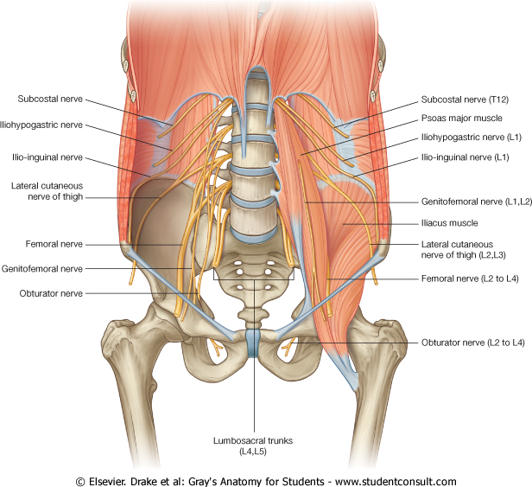
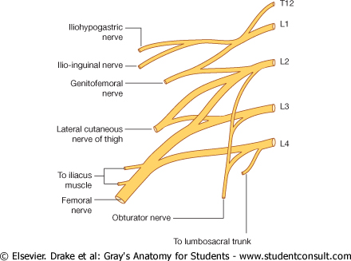
Lumbar Plexus
Formation:
By ventral rami of L1,2,3 and most of L4.
Site:
In the substance of psoas major muscle.
Main branches:
Iliohypogastric & ilioinguinal (L1): to anterior abdominal wall.
Obturator (L2 – L4): to medial compartment of thigh.
Femoral (L2 – L4): to anterior compartment of thigh.
( Iliohypogastic & ilioinguinal & lateral cutaneous nerve of the thigh & femoral nerve ) → they appear from the lateral side of psoas major
Genitofemoral nerve → it appears from the anterior side
Obturator nerve → it appears from the medial side of psoas major

Slide 13
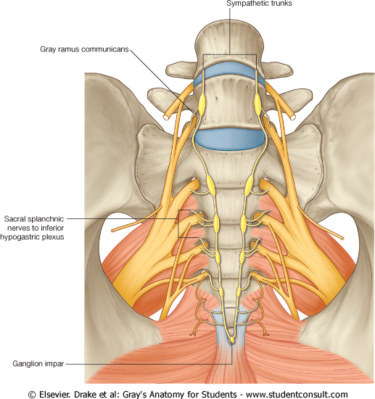
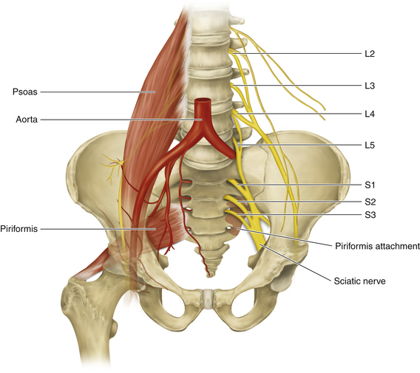
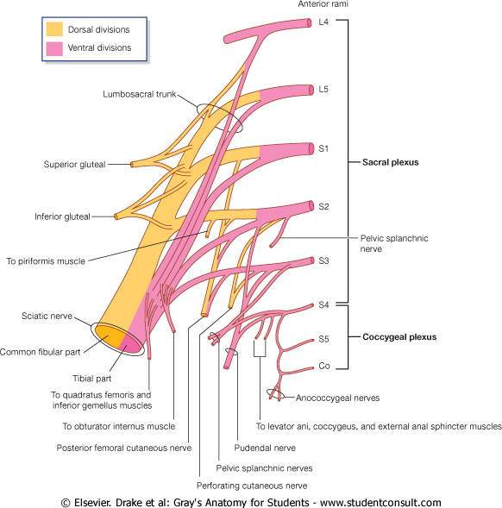
Sacral Plexus
Formation:
By ventral rami of a part of L4 & whole L5 (lumbosacral trunk) + S1, 2, 3 and most of the S4.
Site:
In front of piriformis msucle
Main branches:
Pelvic splanchnic nerve (from sacral plexus): preganglionic parasympathetic to pelvic viscera & hindgut
Pudendal nerve (from sacral plexus): to perineum
Sciatic nerve (from lumbosacral plexus L4,L5 + S1, S2,S3): to lower limb
Extra

Slide 14
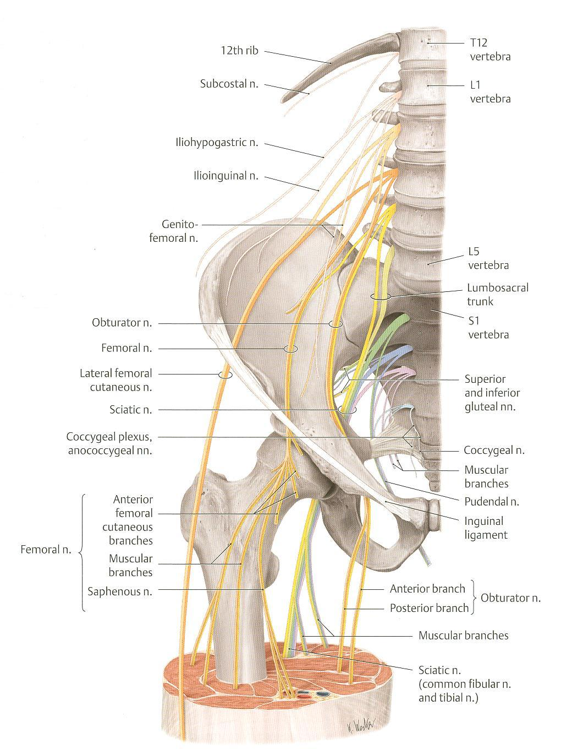
Lumbosacral Plexus
Note: the sacral plexus is also called the lumbosacral plexus, but the lumbar plexus is only called lumbar because it is purely lumbar.
The lumbosacral trunk connects the lumbar and sacral plexus.
The 2 main branches of the lumbar/sacral plexus which we will discuss are:
Femoral nerve (from lumbar)
Sciatic nerve (from sacral) divides into: Tibial nerve and Common peroneal nerve
Compare: Important!
Brachial Plexus | Lumbar Plexus | Sacral Plexus
C5, C6, C7, C8, T1 | L1, L2, L3, L4 | L4*, L5*, S1, S2, S3, S4
Formed in posterior triangle of neck | Formed in psoas major muscle | Formed in front of piriformis muscle
*L4 & L5 make up the lumbosacral trunk

Slide 15
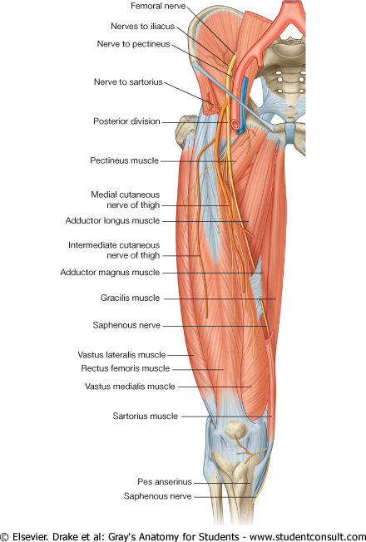
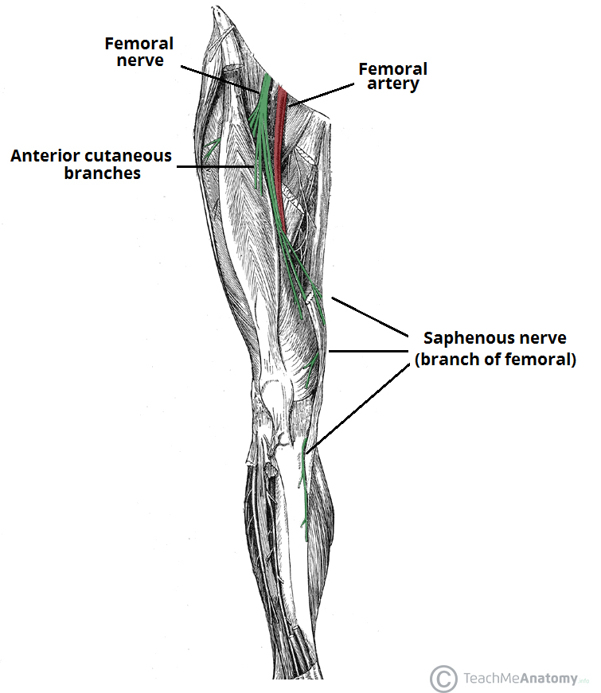
Lumbosacral Plexus
Femoral Nerve
03:14
Origin:
A branch from lumbar plexus (L2,3,4)
Course:
Descends lateral to psoas major & enters the thigh behind the inguinal ligament
Passes lateral to femoral artery & divides into terminal branches (anterior and posterior divisions).
Extra:
The terminal branches are anterior cutaneous nerve and saphenous nerve
Extra

Slide 16
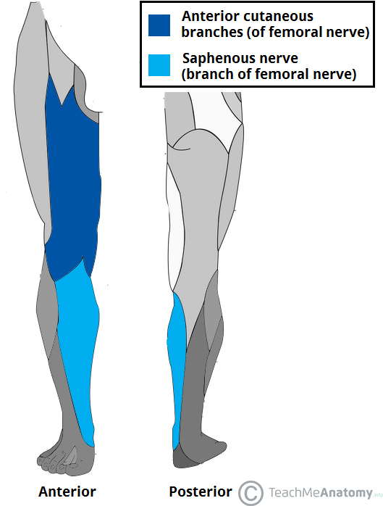
Lumbosacral Plexus
Femoral Nerve
Injury:
Motor effect:
Wasting of quadriceps femoris*
Loss of extension of knee
Weak flexion of hip (psoas major is intact because it takes supply from other fibers of the lumbar plexus)
Sensory effect:
loss of sensation over areas supplied antero-medial aspect of thigh & medial side of leg & foot. (injury of saphenous branch of femoral)
*Recall: action of quadriceps femoris:
Extension of the knee (only muscle that does this)
Flexion of hip (with other muscles)
So if the quadriceps aren’t working we will completely lose the ability to extend the knee but weak flexion of the hip is still possible.
Quadriceps femoris
Extra
Extra

Slide 17
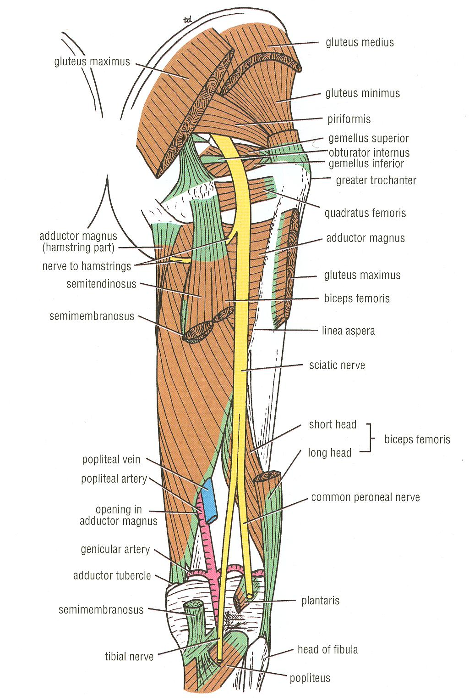
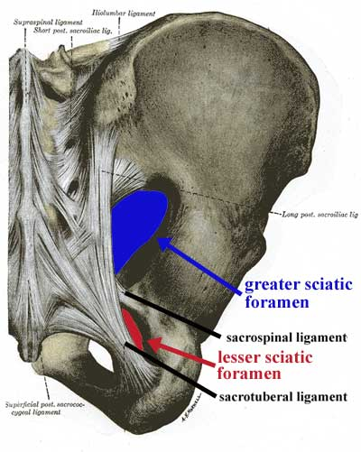
Lumbosacral Plexus
Sciatic Nerve (The largest nerve of the body)
06:55
Ischial tuberosity
Origin:
from sacral plexus (L4, L5, S1, S2, & S3)
It is one of the terminal branch of sacral plexus.
Course:
Leaves the pelvis through greater sciatic foramen, below piriformis & passes in the gluteal region (mid way between ischial tuberosity & greater trochanter) then to posterior compartment of thigh
Divides into tibial & common peroneal (fibular) nerves
Injury:
Injury will affect the flexion of knee, extension o f hip, all movements of leg & foot, as well as loss of sensation of skin of leg and foot (except areas supplied by saphenous branch of femoral nerve.

Slide 18
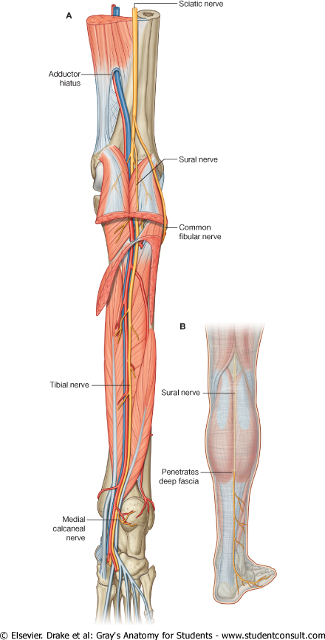
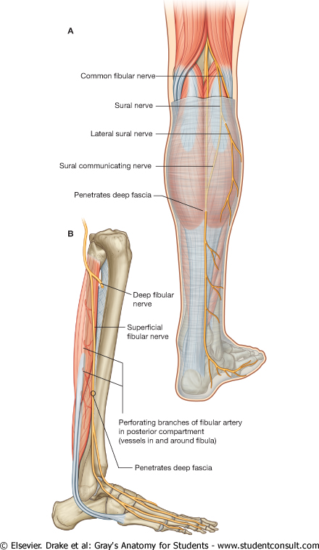
Lumbosacral Plexus
Tibial Nerve
Common Peroneal Nerve
Course:
Descends through popliteal fossa to posterior compartment of leg, accompanied with posterior tibial vessels.
Passes deep to flexor retinaculum to reach the sole of foot where it divides into 2 terminal branches.
Course:
Leaves popliteal fossa & turns around the lateral aspect of neck of fibula. Then divides into:
Superficial peroneal: descends into lateral compartment of leg.
Deep peroneal: descends into anterior compartment of leg.

Slide 19
6.The divisions of brachial plexuses is anatomically found in:
Axilla
Posterior triangle
Behind clavicle
Answer is: C
7.The long thoracic nerve is formed from the union of:
Trunks of C5,C6,C7
Roots of C5,C6,C7
Roots of C4,C5,C6
Answer is: B
8.The musculocutaneous nerve is a branch of:
Lateral cord
Medial cord
Posterior cord
Answer is: A
9.A patient came in with his arm hanging by his side, rotated medially and his forearm is extended and pronated. This lesion is called___ due to__:
Klumpke palsy, lower trunk lesion
Waiter’s tip position, upper trunk lesion
Erb-Duchenne plasy, middle trunk lesion
Answer is: B
10.A young boy fell from a high distanced and clutched on something. What nerve is usually torn?
First thoracic
Ulnar nerve
Median nerve
Answer is: A
1.The Brachial plexuses is formed in :
Behind sternum
Posterior triangle of the neck
Anteriorly to clavicle
Answer is: B
2.All nerve fibers forming the plexuses are union of:
Anterior rami
Dorsal rami
Ganglion
Answer is: A
3.The lower trunk is a union of:
Cord of C8 & T1
Roots of C8 & T2
Roots of C8 & T1
Answer is: C
4.The lateral cord is union of:
Posterior division of upper and middle trunk.
Anterior division of upper and middle trunk.
Continuation of anterior division of upper trunk.
Answer is: B
5.All cords give branches in the:
Clavicle
Posterior triangle
Axilla
Answer is: C

Slide 20
11.Femoral nerve is a main branch of:
Brachial plexuses
Lumbar plexuses
Sacral plexuses
Answer is: B
12.Site of sacral plexuses:
Anteriorly to piriformis muscle
Substance of psoas major
Behind inguinal ring
Answer is: A
13.Femoral nerve injury will cause :
Flexion of knee loss and weak hip extension.
weak knee extension and loss hip flexion
loss of knee extension and weakening of hip flexion
Answer is: C
1.A patient came to the ER with a upper lesion of brachial plexuses.
name the two nerve roots affected?
This injury results from?
Describe the position of arm and forearm.
Give three names to this lesion.
Answers:
C5,C6
Excessive displacement of the head to the opposite side and depression of shoulder on the same side.
Arm hangs by side and is rotated medially, forearm is extended and pronated.
Policeman’s tip hand,Erb-Duchenne,Waiter’s tip position.
2.A patient came in with a klupke palsy injury.
What is the usual scenario to this injury?
What nerve is usually torn in this lesion?
This lesion will cause injury to two nerve name them and the result of their injury.
Answers:
Falling from a height and clutching at an object.
First thoracic.
Ulnar nerve:
Clawed hand appearance.
Median nerve:
Ape hand.
3.Femoral nerve injury will have two effects motor and sensory.
Name the effects of this injury.
Answer:
Motor:
Wasting of quadriceps femoris
Loss of knee extension
Weak flexion of hip
Sensory:
Loss of sensation over anterio-medial aspect of thigh
Loss of sensation over medial side of leg and foot.

Slide 21
BRACHIAL PLEXUS
cords | Divisions | Brachial Plexus Injuries | Trunks | Roots Ventral rami
Lateral cord | anterior | Erb-Duchenne Palsy ”waiter's tip position” | Upper trunk | C5
Posterior cord | posterior |  |  | C6
Lateral cord | anterior | - | Middle trunk | C7
Posterior cord | posterior
Medial cord | anterior | Klumpke Palsy *claw hand due to ulnar nerve injury. *APE hand due to median nerve injury. | Lower trunk | C8
Posterior cord | posterior |  |  | T1
BRANCHES
From Cords |  |  | From Trunks | From Roots
Medial cord *4MU | Posterior cord *ULTRA | Lateral cord *2LM | (upper trunk): -Nerve to subclavius -Suprascapular nerve (supplies supraspinatus & infraspinatus) | C5:Nerve to rhomboids (dorsal scapular nerve).
-Medial pectoral n. -Medial root of median n. -Medial cutaneous n of arm. -Medial cutaneous n of forearm. -Ulnar n. | .Upper subscapular n .Lower subscapular n .Thoracodorsal n .Radial n .Axillary n | -Lateral pectoral n -Lateral root of median n -Musculocutaneous n |  | C5,6 &7: Long thoracic nerve (supplies serratus anterior).

Slide 22
SACRAL PLEXUS (LUMBOSACRAL TRUNK) | LUMBAR PLEXUS
By ventral rami of a part of L4 & whole L5 (lumbosacral trunk) + S1, 2, 3 and most of the S4 | Ventral rami of L1,2,3 AND most of L4 | Formation
In front of piriformis muscle | In the substance of psoas major muscle. | Site
1-Pelvic splanchnic nerve (from sacral). 2-Pudendal nerve (from sacral plexus). 3-Sciatic nerve (from Lumbosacral plexus: L4&5+S1,2,3). | 1-Iliohypogastric & ilioinguinal. 2-Obturator. 3-Femoral. | Main Branches
SCIATIC NERVE | FEMORAL NERVE
sacral plexus (L4, 5, S1, 2, & 3) | lumbar plexus (L2,3,4) | Origin
Its injury will affect the flexion of knee, extension of hip, all movements of leg & foot, as well as loss of sensation of skin of leg & foot (except areas supplied by saphenous branch of femoral nerve) | Its injury will affect the flexion of hip & extension of knee as well as loss of sensation of skin of anteromedial aspects of the thigh, medial side of knee, leg and foot (Saphenous br.of femoral). | injury

