Slide 2
Objectives
At the end of the lecture, students should be able to:
List the components of brain stem.
Describe the site of brain stem.
Describe the relations between components of brain stem & their relations to cerebellum.
Describe the external features of both ventral & dorsal surfaces of brain stem.
List cranial nerves emerging from brain stem.
Describe the site of emergence of each cranial nerve.

Slide 3
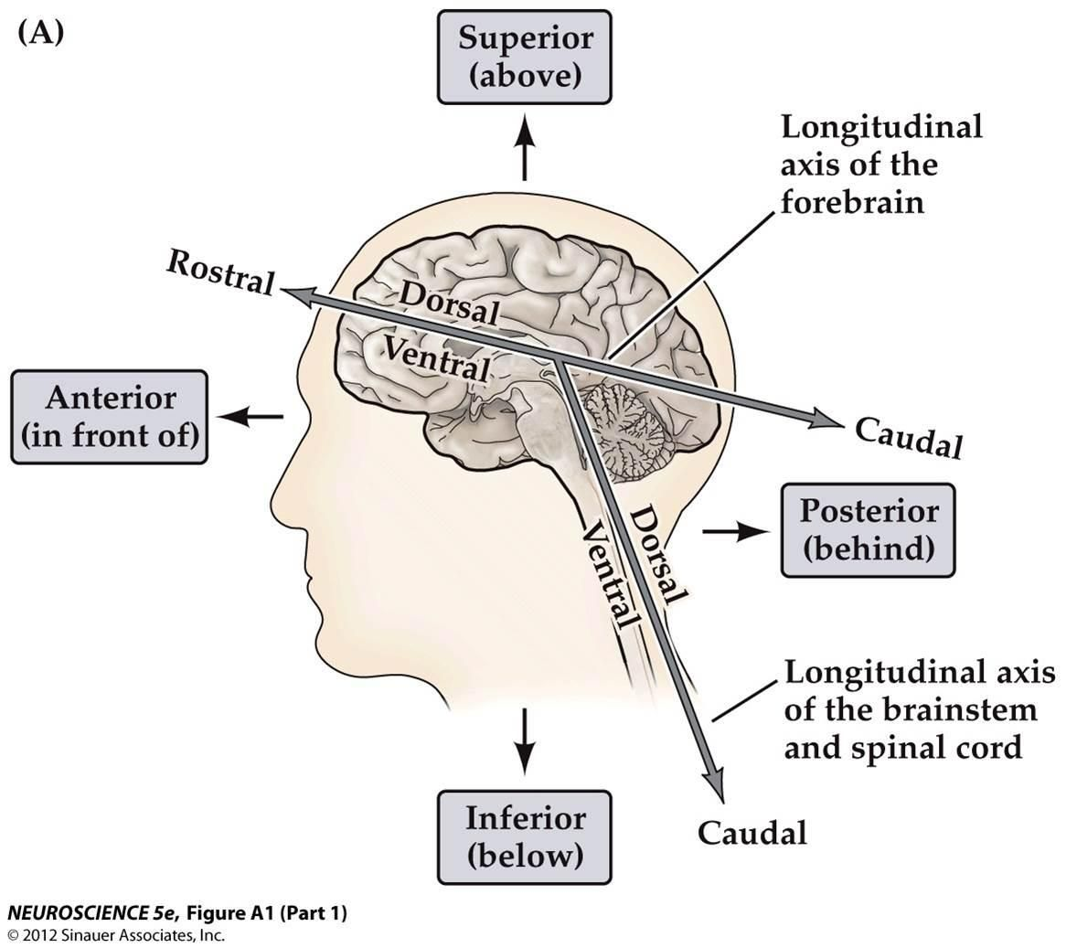
*Anatomical plane and directions of neuroanatomy (Extra picture) to better understand

Slide 4
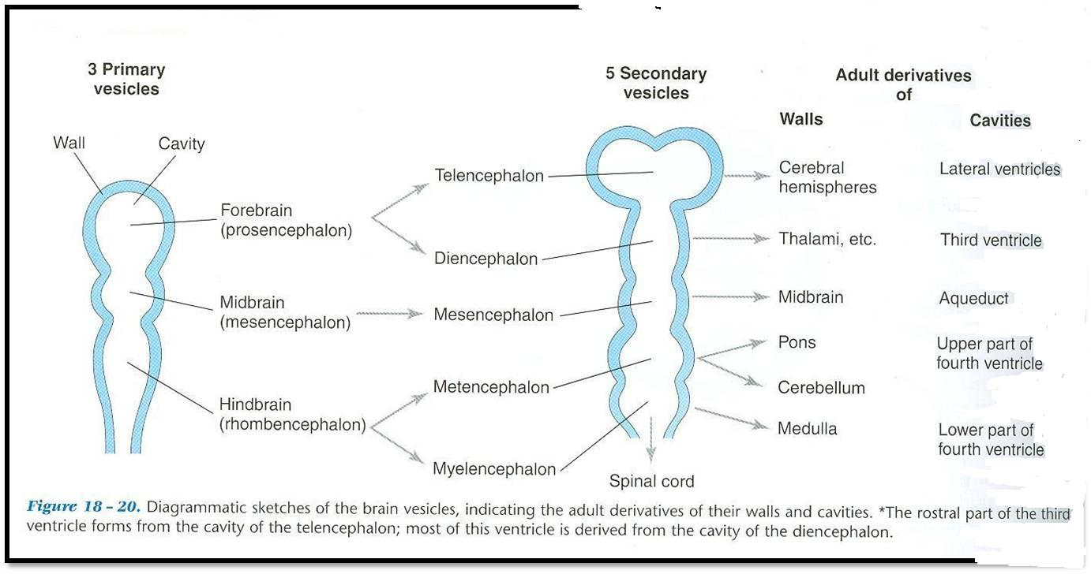
Development of the Brain
The brain develops from the cranial part of neural tube*.
The cranial part is divided into 3 parts:
*recall from embryology the caudal 2/3 forms the spinal cord and the cranial or upper 1/3 forms the brain
 | FOREBRAIN |  | MIDBRAIN | HINDBRAIN
Cavity | 2 lateral ventricles | 3rd ventricle | cerebral aqueduct | 4th ventricle
Subdivided into | Two cerebral hemispheres | Diencephalon: 1-Thalamus 2-Hypothalamus 3-Epithalamus 4-Subthalamus | The midbrain is also called mesencephalon | 1-Pons 2-cerebellum 3-Medulla oblongata
Note: the brain stem develops from 2 different parts. The pons and medulla oblongata develop from the hindbrain where as the midbrain develops from the midbrain.

Slide 5
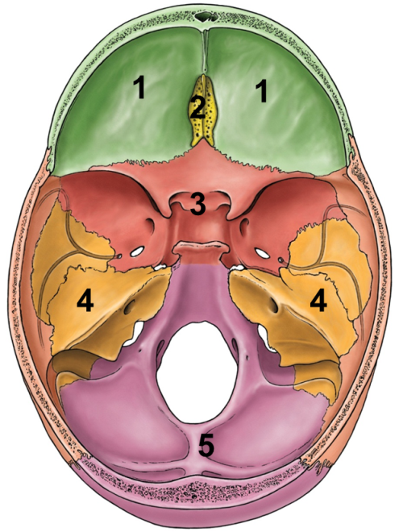
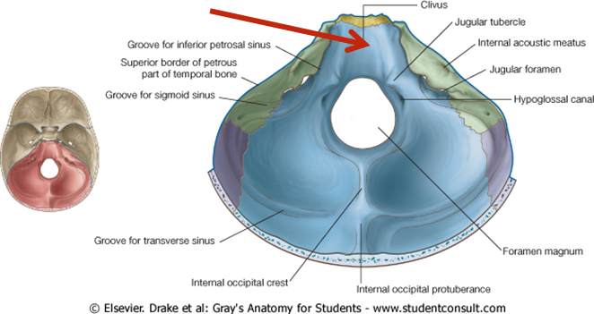
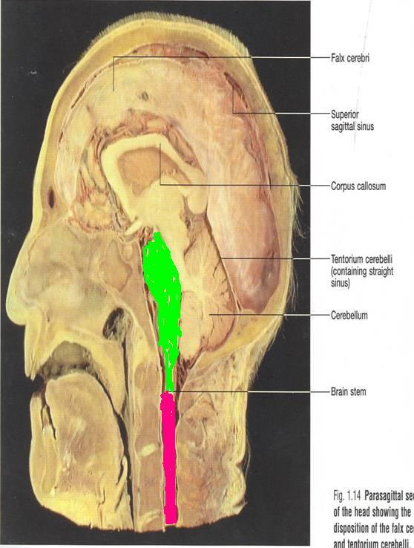
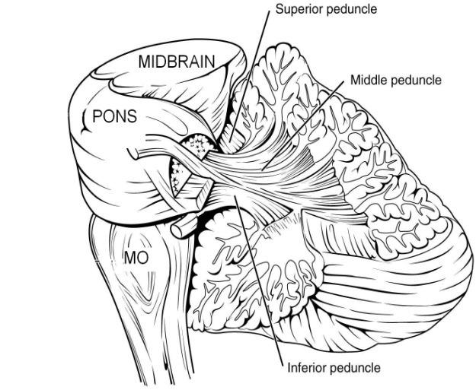
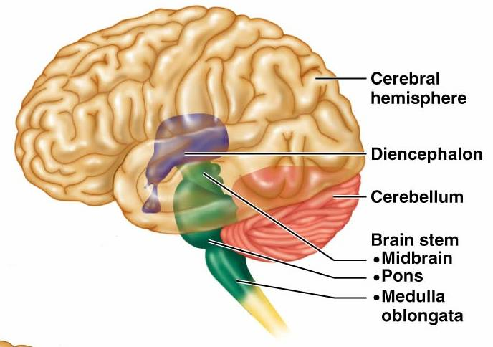
Brain stem
01:58
The brainstem is the region of the brain that connects the cerebrum with the spinal cord
SITE:
It lies on the basilar part of occipital bone (clivus).
PARTS: From above downwards:
Mid brain, pons & medulla oblongata
CONNECTIONS WITH CEREBELLUM:
Each part of brain stem is connected to cerebellum by cerebellar peduncles “White matter” (superior, middle & inferior).
Clivus
Superior peduncle connects midbrain with cerebellum
Middle peduncle connects pons with cerebellum
Inferior peduncle connects medulla oblongata with cerebellum

Slide 6
Only on the boy’s slides
Sagittal Section Of Brain
Thalamus
Cerebellum
Superior
cerebellar
peduncle
Mid brain
Pons
Medulla

Slide 7
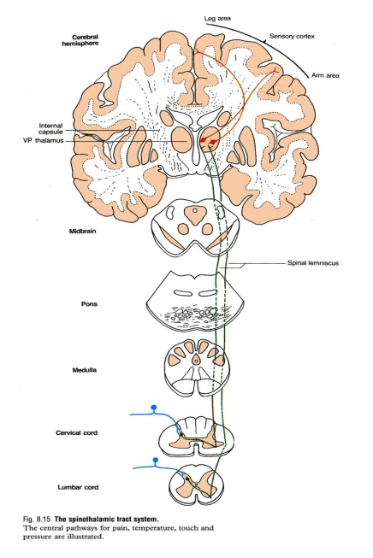
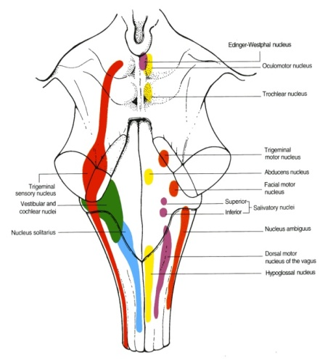
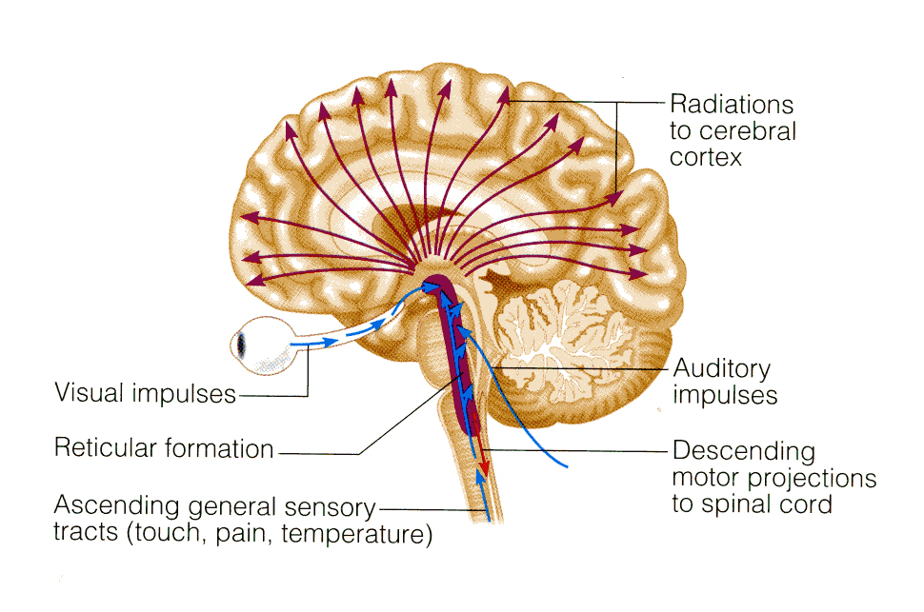
Functions of the Brain Stem
Pathway of tracts between cerebral cortex & spinal cord (ascending and descending tracts).
Site of origin of nuclei of cranial nerves (from 3rd to 12th).
Site of emergence of cranial nerves (from 3rd to 12th).
Contains groups of nuclei & related fibers known as reticular formation* responsible for: control of level of consciousness, perception of pain, regulation of cardiovascular & respiratory systems.
1
2 & 3
*Complex matrix of nuclei and related fibers/axons located throughout the brain stem
4

Slide 8
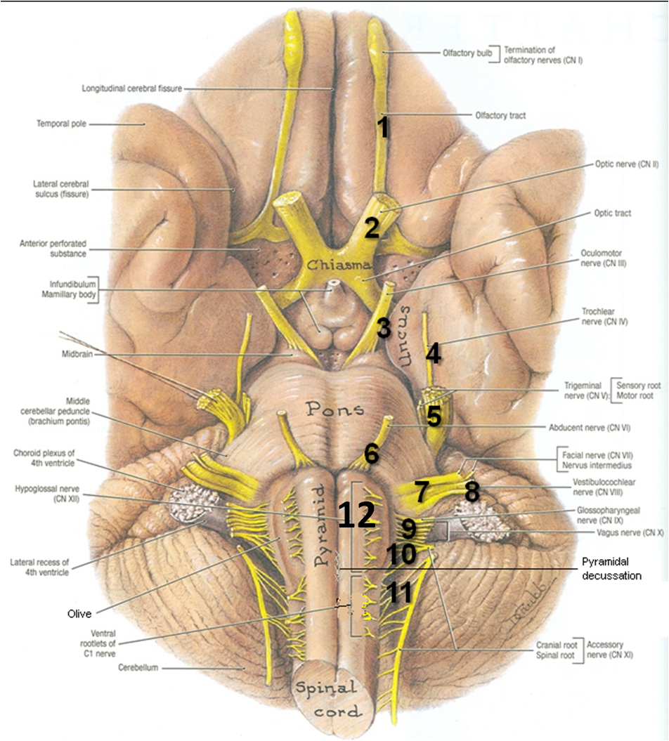
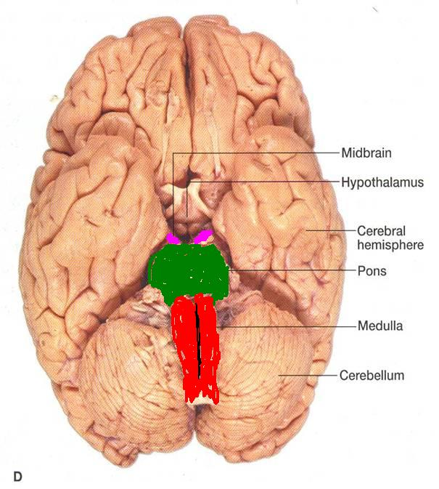
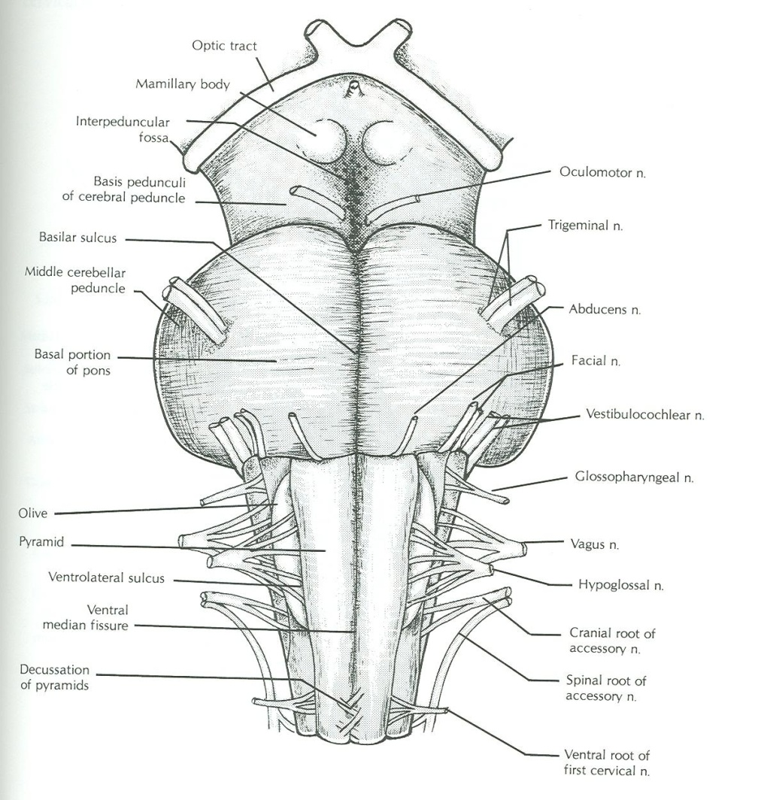
Brain Stem
Ventral Surface
Outline of the lecture
We will discuss the ventral surface of each part (medulla, pons, midbrain) then we will discuss the dorsal.
In each side (ventral/dorsal) we will see the general feature and the nerves coming out. Note: the numbers refer to the cranial nerves

Slide 9
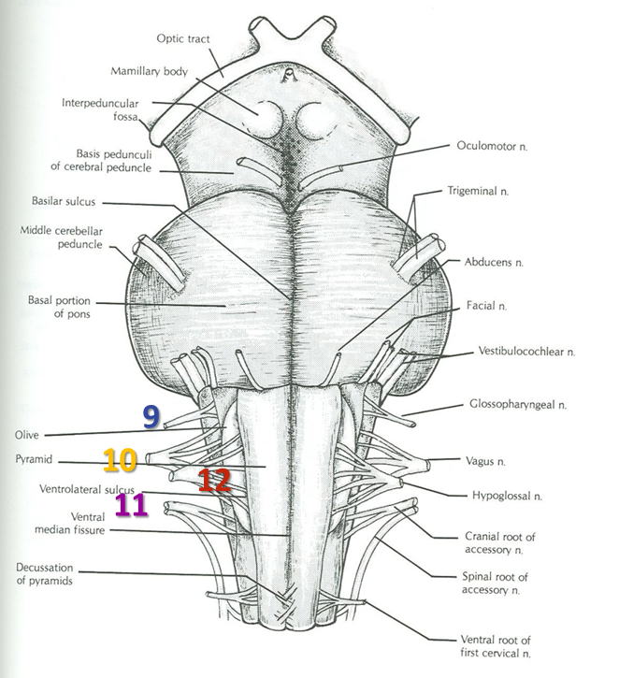
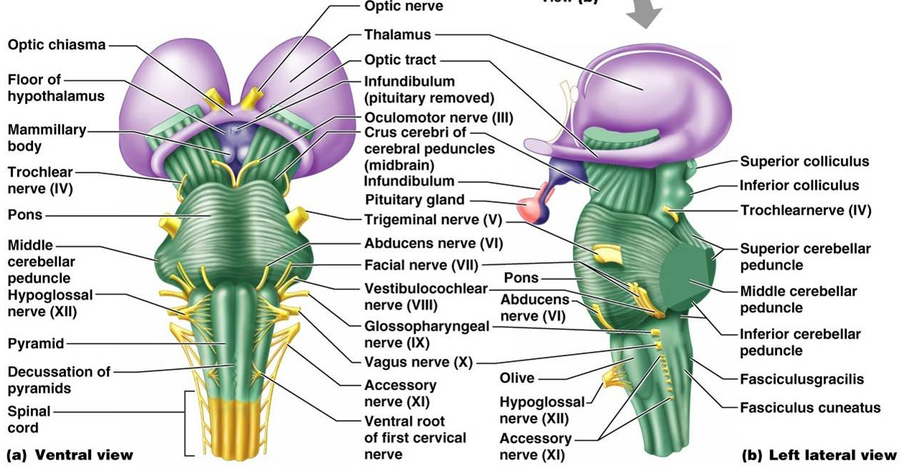
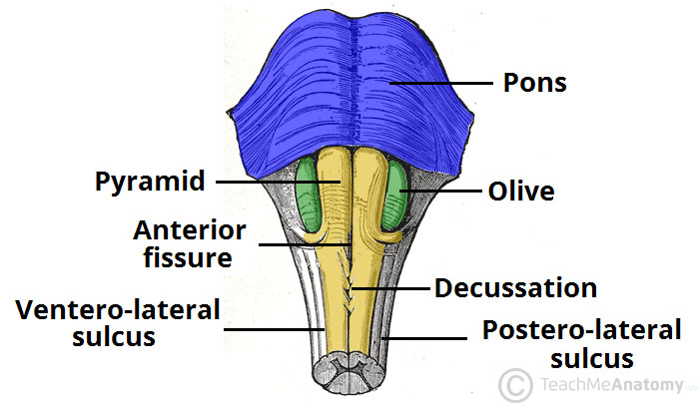
Medulla
Ventral Surface
Ventral median fissure:
Continuation of ventral median fissure of spinal cord.
Divides the medulla into 2 halves
Its lower part is marked by decussation of most of pyramidal (corticospinal) fibers (75%-90%).
Pyramid:
An elevation (انتفاخ), lies on either (lateral) side of ventral median fissure
Produced by corticospinal tract.
Olive:
An elevation, lies lateral to the pyramid.
Produced by inferior olivary nucleus* (important in control of movement).
Nerves emerging from Medulla (4 nerves):
Hypoglossal (12th): from sulcus between pyramid & olive (must medial compared to )
Glossopharyngeal (9th), vagus (10th) & cranial part of accessory (11th): from sulcus dorsolateral to olive (from above downwards)
Extra
Extra

Slide 10
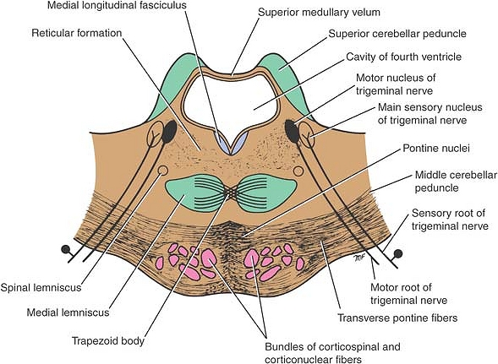
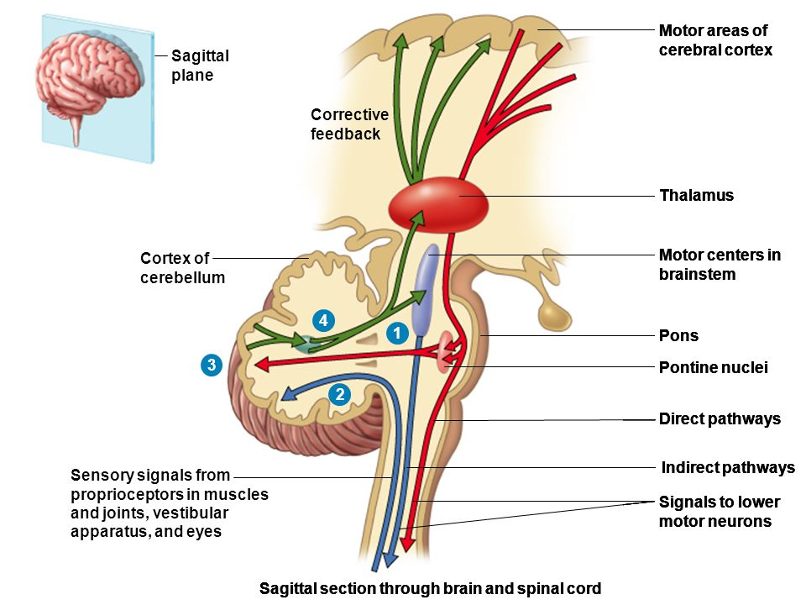
*Pure motor (must medial)
*Pure sensory (must lateral)
*Mixed (middle)
*Ventral surface of pons & medulla white matter because of motor fiber
Pons
Ventral Surface
Basilar sulcus:
Divides the pons into 2 halves, occupied by basilar artery.
Transverse pontine (pontocerebellar) fibers:
Originate from pontine nuclei
They cross the midline & pass through the contralateral middle cerebellar peduncle to enter the opposite cerebellar hemisphere.
Nerves emerging from Pons (4 nerves):
Trigeminal (5th): from the middle of ventrolateral aspect of pons, as 2 roots: a small medial motor root & a large lateral sensory root*.
Abducent (6th): from sulcus/junction between pons & pyramid.
Facial (7th) & Vestibulocochlear (8th): at cerebellopontine angle (junction between medulla, pons & cerebellum). Both nerves emerge as 2 roots: from medial to lateral: motor root of 7th, sensory root of 7th, vestibular part of 8th & cochlear part of 8th
5
7
*
8
6
*
Extra
Extra

Slide 11
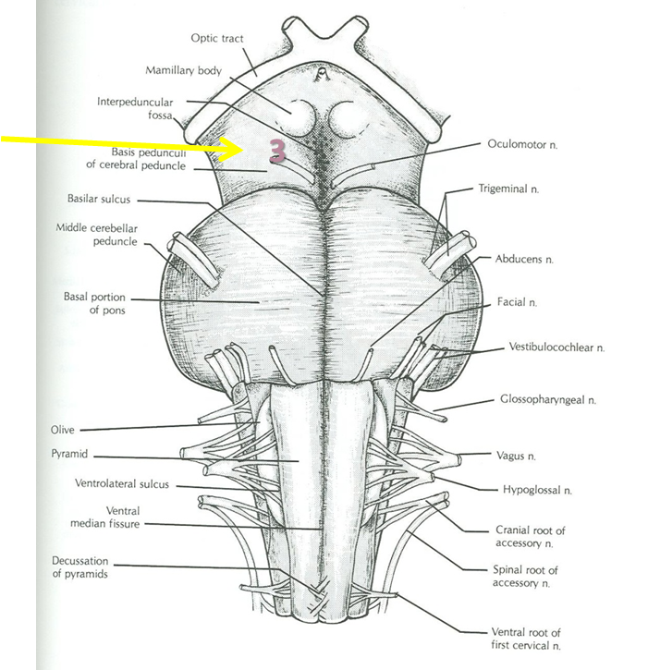
Midbrain
Ventral Surface
*“descending motor fiber”:
Corticocerebellar
Corticobulbar
Corticospinal
It is formed of a large column of descending fibers (crus cerebri “descending motor fiber”* or basis pedunculi), on either side.
The 2 crura cerebri are separated by a depression called the interpeduncular fossa.
Nerve emerging from Midbrain (one):
Occulomotor (3rd): from medial aspect of crus cerebri.
Crus Cerebri
*
Trochlear (4th) is in the posterior (dorsal) aspect
Muscle arising from:
1- myotome by spinal nerve (general motor)
2- pharyngeal arch (special motor)
Extra

Slide 12
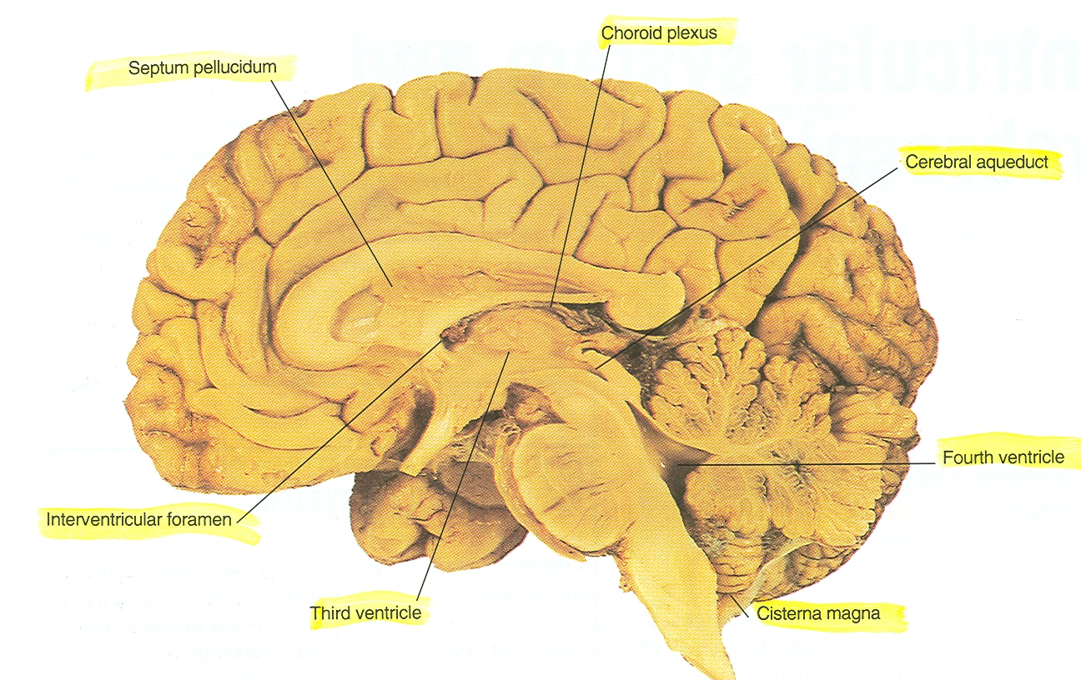
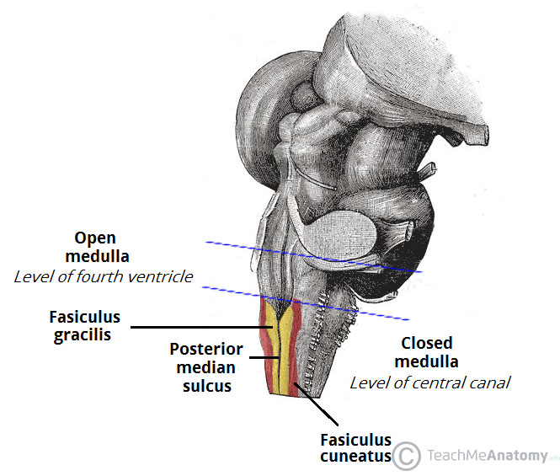
Medulla
Dorsal Surface
The features differ in the caudal part (closed medulla) and the cranial part (open medulla).
The caudal part closes around the fourth ventricle forming the central canal so it is called closed medulla.
open medulla
closed medulla
Extra

Slide 13
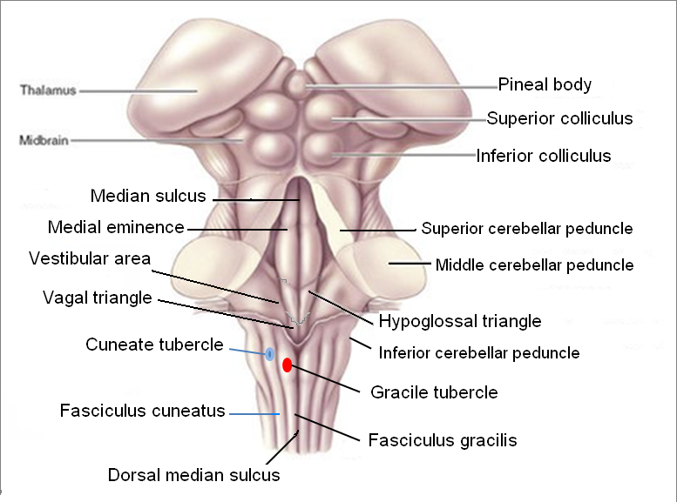
Medulla (Closed)
Dorsal Surface
Cavity: central canal.
Composed of:
Dorsal median sulcus: divides the closed medulla into 2 halves.
Fasciculus gracilis: on either side of dorsal median sulcus.
Gracile tubercle: an elevation produced at the upper part of fasciculus gracilis, marks the site of gracile nucleus.
Fasciculus cuneatus: on either side of fasciculus gracilis.
Cuneate tubercle: an elevation produced at the upper part of fasciculus cuneatus, marks the site of cuneate nucleus.
Recall: Fasciculus gracilis and fasciculus cuneatus are ascending tracts in the dorsal white column which terminate on their respective nuclei: gracile nucleus and cuneate nucleus.

Slide 14
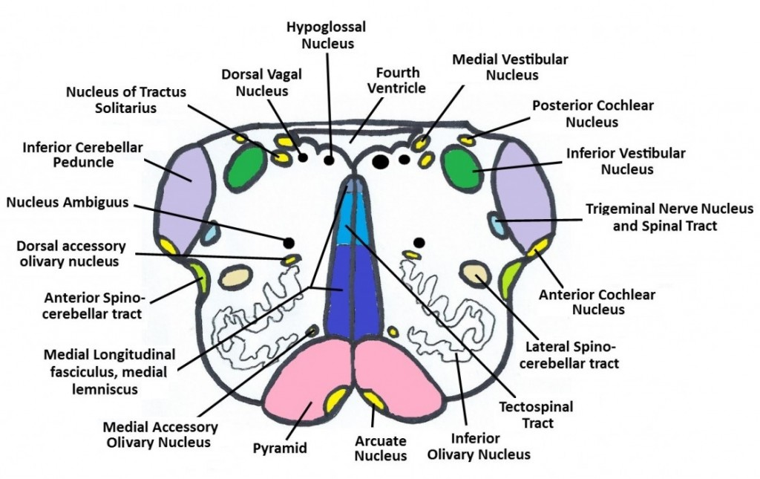
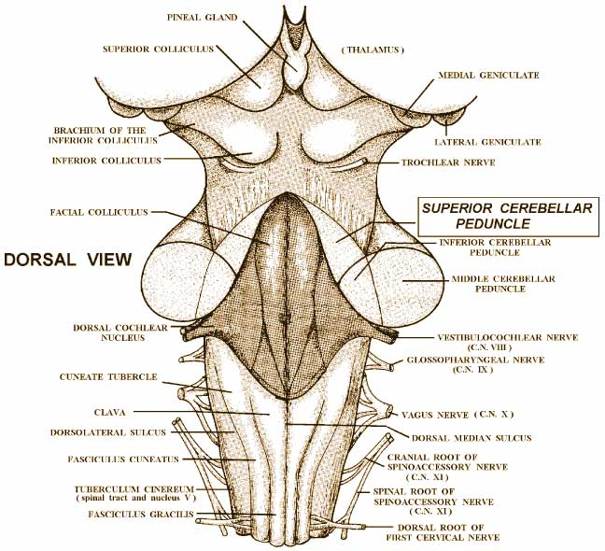
Medulla (Open)
Dorsal Surface
Cavity: 4th ventricle
On either side, an inverted V-shaped sulcus divides the area into 3 parts (from medial to lateral):
. Hypoglossal triangle: overlies hypoglossal nucleus.
Vagal triangle: overlies dorsal vagal nucleus.
Vestibular area: overlies vestibular nuclei
Extra

Slide 15
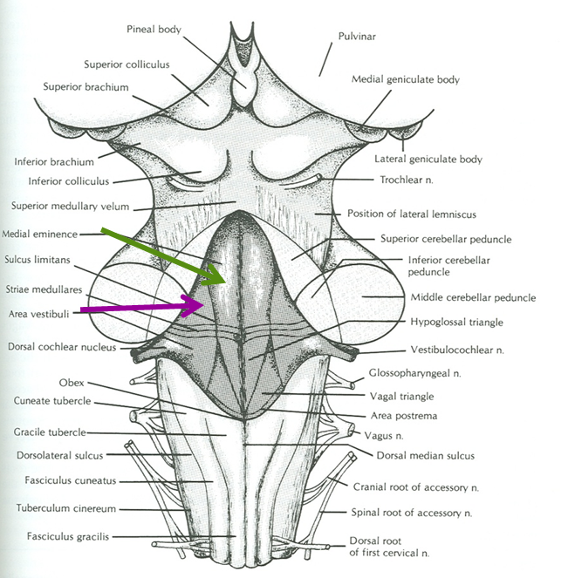
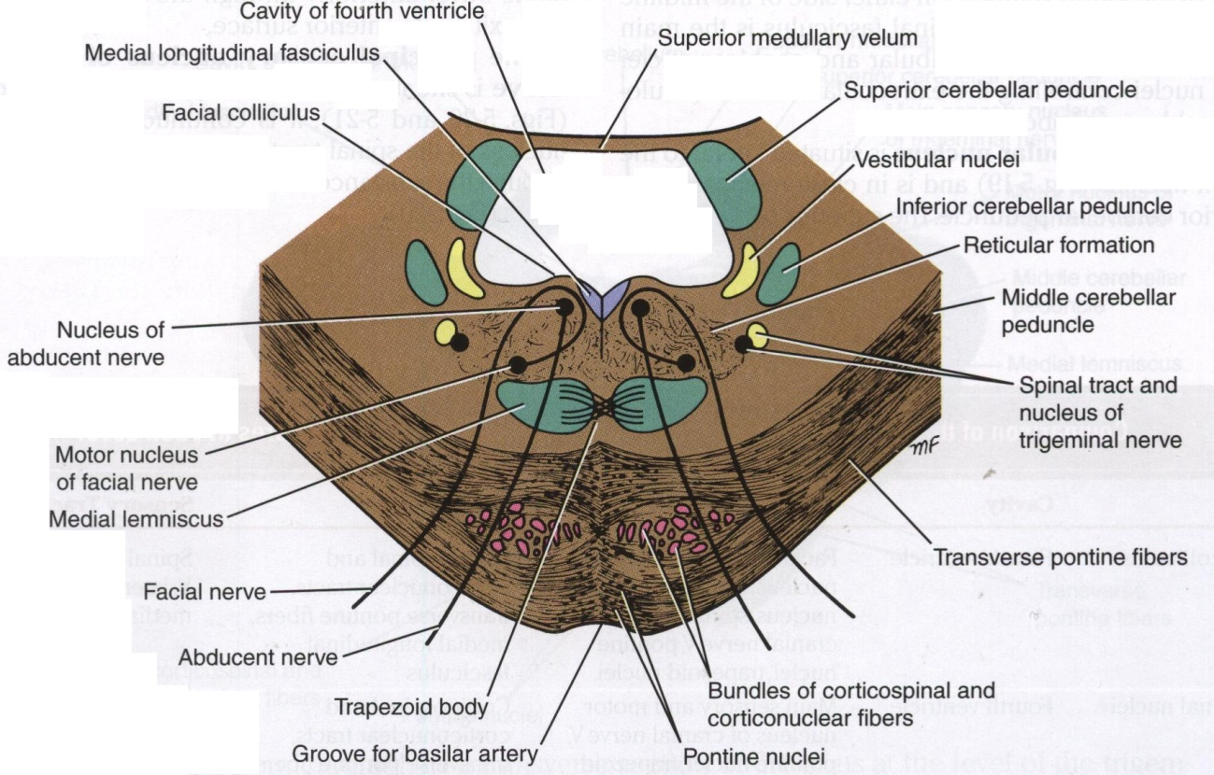
Pons
Dorsal Surface
Separated from open medulla by an imaginary line passing between the caudal margins of middle cerebellar peduncle.
On either side of median sulcus, it divides into 2 parts (from medial to lateral):
Medial eminence & facial colliculus: overlies abducent nucleus
The abducent nucleus lies medially, and below it is the fiber of the facial nerve which goes above and around it and forms the facial colliculus.
Vestibular area: overlies vestibular nuclei. *Same medulla dorsal surface
*
*
Extra

Slide 16
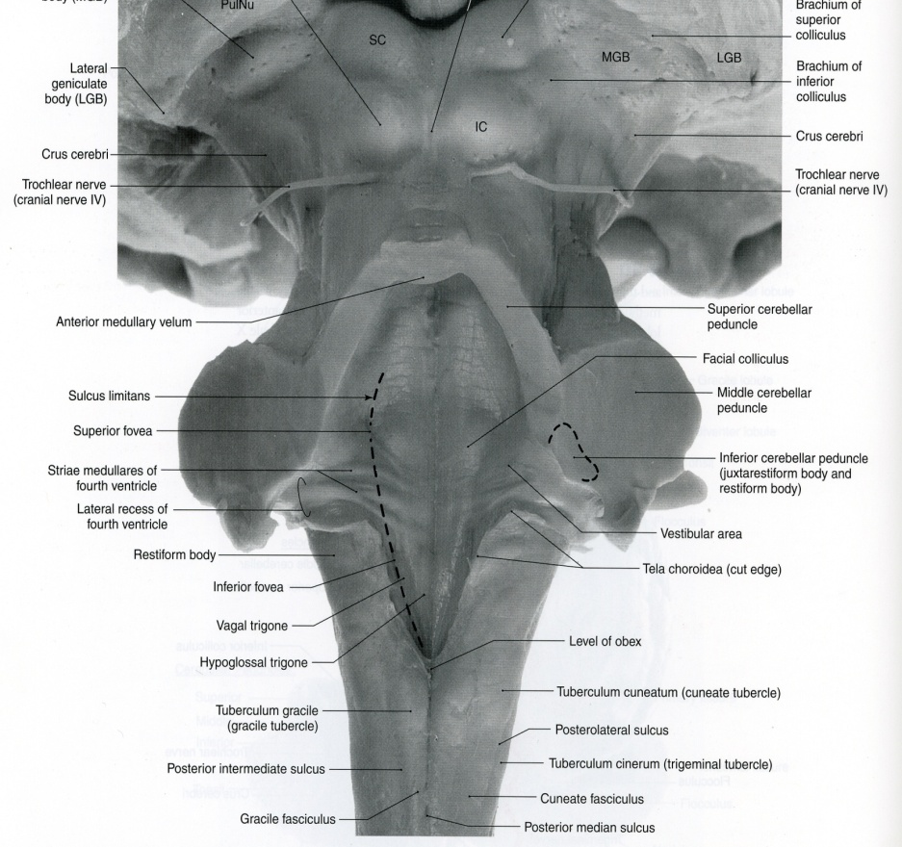
Only on the girl’s slides
The dorsal surfaces of open medulla and pons lie in the caudal 1/3rd and the rostral 2/3rd of the floor of the 4th ventricle respectively.
Dorsal surface of pons → rostral or cranial 2/3rd of 4th ventricle
Dorsal surface of open medulla → caudal 1/3rd of 4th ventricle
pons
P
Open M
MO
closed M

Slide 17
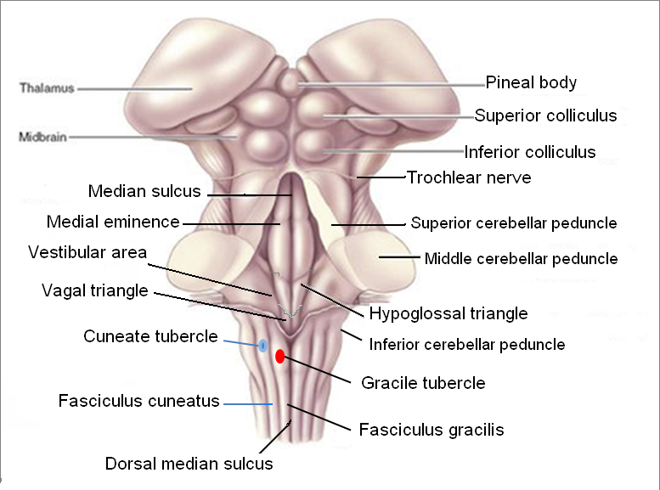
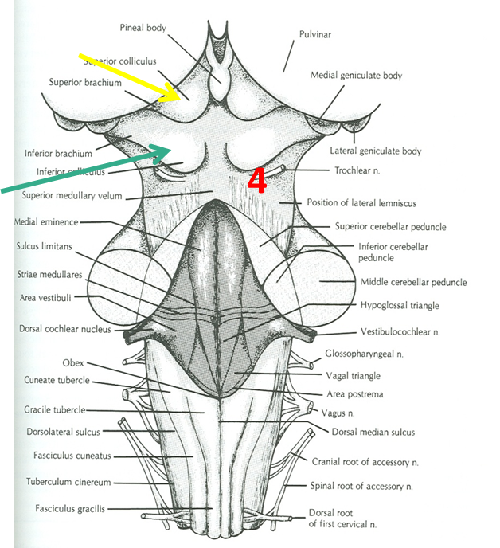
*To remember: he superior colliculi is concerned with the eyes (auditory) & the eyes are at the top of the face (superior).
Midbrain
Dorsal Surface
Marked by 4 elevations/colliculi:
Two superior colliculi: concerned with visual reflexes*.
Two inferior colliculi: forms part of auditory pathway.
Nerve emerging from Midbrain (one):
Trochlear (4th): just caudal to inferior colliculus (The only cranial nerve emerging from dorsal surface of brain stem, the rest were from the ventral).
To remember:
The trochlear is the only cranial nerve that emerges from the dorsal / posterior surface.
تركوه وراء!

Slide 18
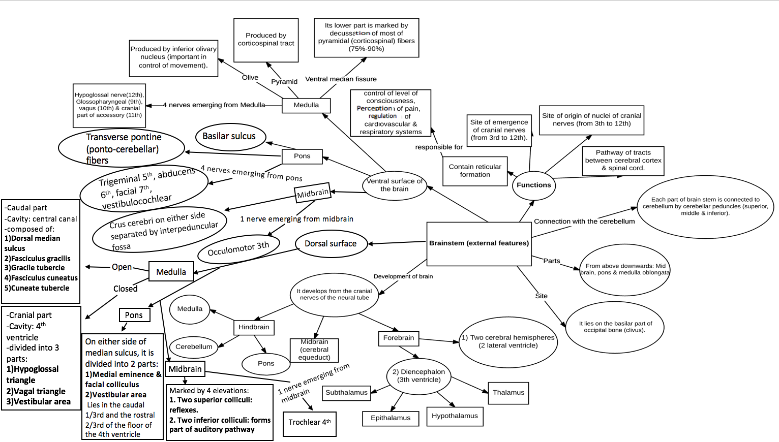
8th
closed
open
Dorsal surface of pons lies in rostral 2/3rd of 4th ventricle
visual reflexes

Slide 19
SUMMARY
The brain stem is composed (from above downwards) of: midbrain, pons & medulla oblongata which are continuous with each other, and with diencephalon above & with spinal cord below.
The brain stem is connected with cerebellum through three pair of cerebellar peduncles.
The brain stem is the site of (1) cranial nuclei, (2) the pathway of important ascending & descending tracts & (3) the site of emergence of cranial nerves (from 3rd to 12th).
Cranial nerves (with the exception of 4th) emerge from ventral surface of brain stem.

Slide 20
(1) The trigeminal nerve emerge from the ________ aspect of pons?
A) Ventrolateral B) Ventromedial
C) Dorsolateral D) Dorsomedial
(2) This cranial nerve exits from the dorsal side of the brain?
A) CN 1 B) CN 2
C) CN 3 D) CN 4
(3) The brainstem is the site of origin and emergence of the following cranial nerves?
A) All cranial nerves B) From 3rd to 12th
C) From 1st to 10th D) 7th nerve only
(4) Nucleus of cranial nerve 3 is located in?
A) Intramedullary fossa B) Pons
C) Midbrain D) Spinal coed
(5) The ________ part of medulla is marked by decussation of most of ________ fibers?
A) Middle, corticobulbar B) Lower, corticospinal
C) Upper, corticospinal D) Lower, corticobulbar
(6) The cranial nerves originating from the cerebellopontine angle are?
A) 6th and 3rd B) Trochlear nerve
C) 7th and 8th D) None of the above
(7) Basilar sulcus of the pons is occupied by?
A) Basilar vein B) Basilar artery
C) Basilar nerve D) Basilar nucleus
(8) Cranial nerve 4 is located inferior to what landmark?
A) Lateral colliculus B) Medial colliculus
C) Superior colliculus D) Inferior colliculus
(9) At the dorsal surface of open medulla an inverted V-shaped sulcus divides the area into 3 parts (from medial to lateral)?
A) Vagal triangle , Vestibular area , Hypoglossal triangle
B) Vestibular area , vagal triangle , Hypoglossal triangle
C) Hypoglossal triangle , vagal area , Vestibular triangle
D) Vestibular area , vagal triangle , glossopharyngeal triangle
(10) Nerves emerging from Pons?
A) 3rd , 4th , 5th , 6th B) 3rd , 4th , 5th
C) 5th , 6th , 7th , 8th D) 5th , 6th , 7th

Slide 21
Answers
(1) A (6) C (2) D (7) B (3) B (8) D (4) C (9) C (5) B (10) C

Slide 22
(1) Describe the pathway of the pontocerebellar fibers?
Originate from pontine nuclei → cross the midline and pass through the contralateral middle cerebellar peduncle → enter the opposite cerebellar hemisphere.
(2) Mention the cavities located in the following structures: forebrain, midbrain, and hindbrain?
Forebrain: cerebral hemispheres → 2 lateral ventricles, Diencephalon → 3rd ventricle
Midbrain: cerebral aqueduct
Hindbrain: 4th ventricle
(3) Name the roots of the nerves that located at cerebellopontine angle , “from medial to lateral”?
Motor root of 7th, sensory root of 7th vestibular part of 8th & cochlear part of 8th

