Slide 2
Objectives
At the end of the lecture, students should be able to:
Distinguish the internal structure of the components of the brain stem in different levels and the specific criteria of each level. 1- Medulla oblongata (closed, mid and open medulla) 2- Pons (caudal, mid “Trigeminal level” and rostral). 3- Mid brain ( superior and inferior colliculi).

Slide 3
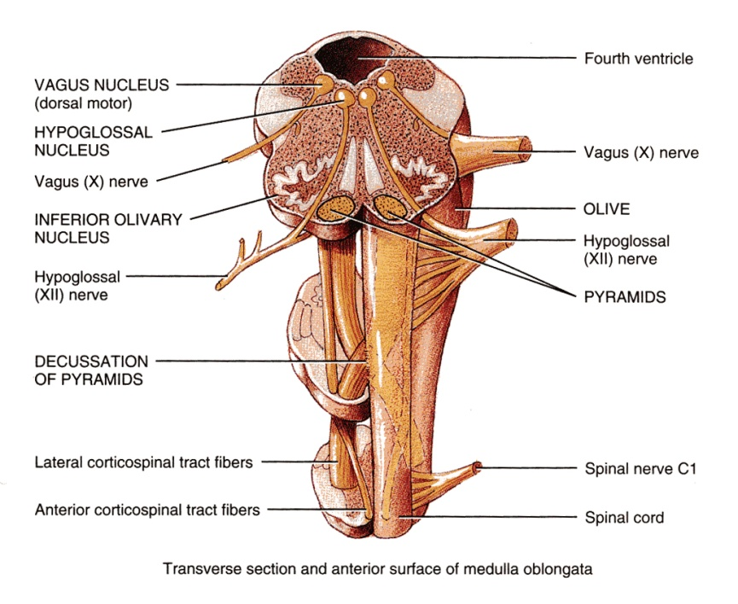
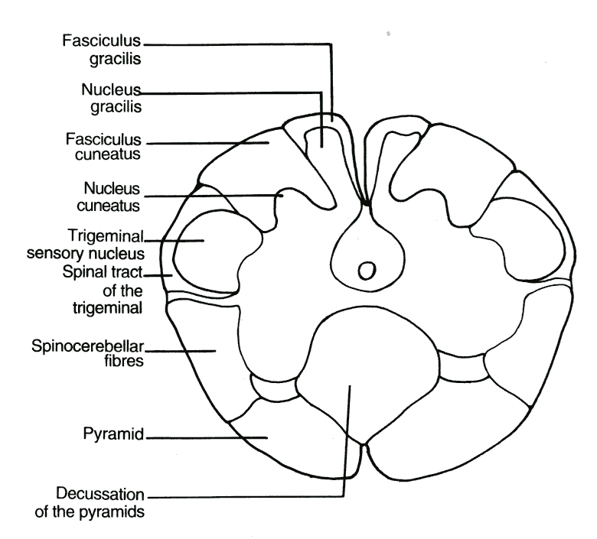
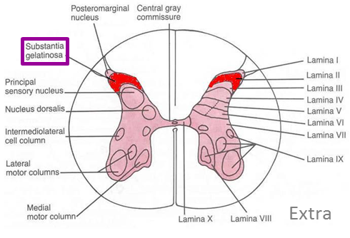
Medulla (Closed)
Caudal surface
Traversed* by the Central Canal.
Motor Decussation**.
Spinal Nucleus of Trigeminal nerve (Trigeminal sensory nucleus):
It is a larger sensory nucleus.
It is the brain stem continuation of the Substantia Gelatinosa of spinal cord.
* Traversed = travel across or through
**Decuss- = crossing
Doctor’s note: the major thing we see in the closed Medulla is The Motor Decussation.
T.S of Caudal part of M.O.

Slide 4
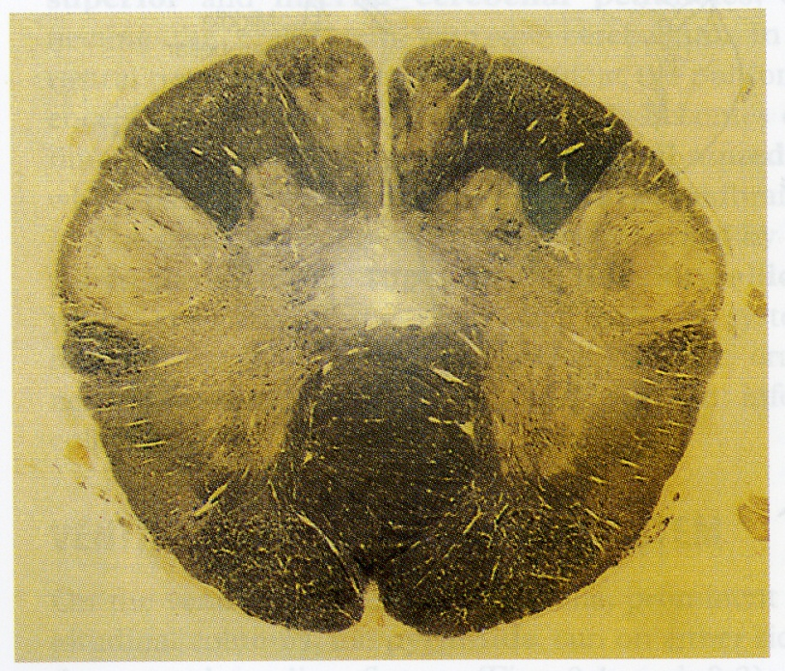
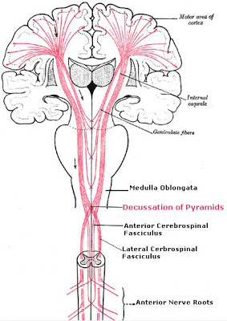
Medulla (Closed)
Caudal surface
Trigeminal Sensory Nucleus & Tract
The Nucleus Extends :
Through the whole length of the brain stem and into upper segments of spinal cord.
It lies in all levels of medulla oblongata, medial to the spinal tract of the trigeminal.
It receives pain and temperature from face and forehead Its tract present in all levels of M.O. is formed of ascending fibers that terminate in the trigeminal nucleus.
Pyramidal Decussation
Pyramidal decussation is Motor Decussation Formed by pyramidal fibers, (75-90%) cross to the opposite side
They descend in the lateral white column of the spinal cord as the lateral corticospinal tract.
The uncrossed fibers form the ventral corticospinal tract.
*Decuss- = crossing

Slide 5
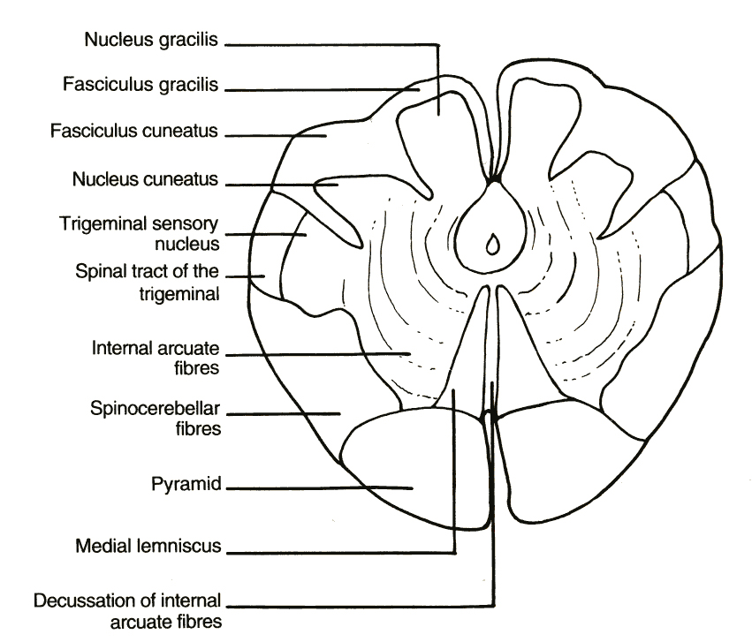
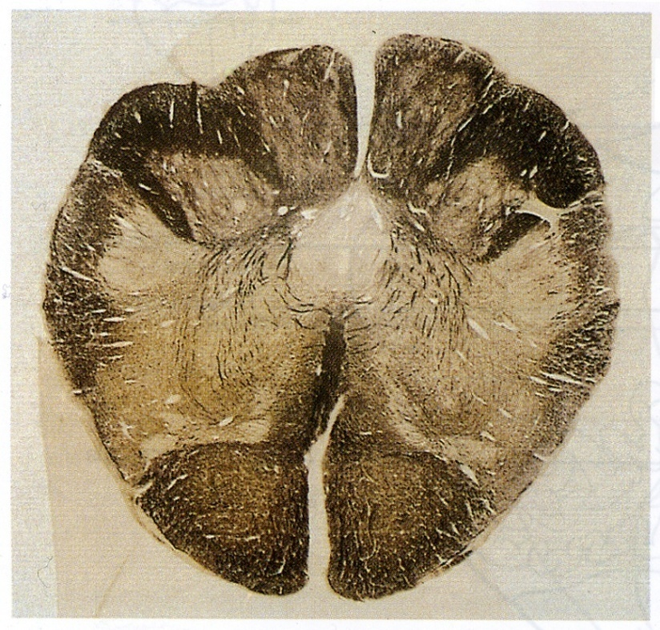
Medulla
Mid medulla
Traversed by Central Canal.
Larger size Gracile & Cuneate nuclei, concerned with proprioceptive (knowing the normal body position) deep sensations of the body.
Axons of Gracile & Cuneate nuclei form the internal arcuate fibers; Sensory Decussation.*
Pyramids are prominent ventrally.
Motor decussation (pyramids): Closed/Caudal Medulla
Sensory decussation (internal arcuate fibers): Mid Medulla

Slide 6
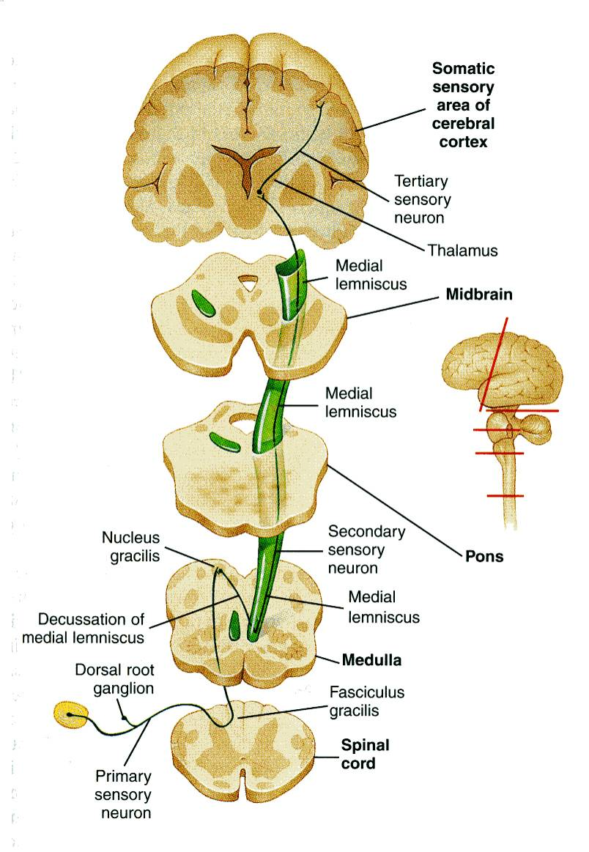
Medulla
Mid medulla
Doctor’s note: don’t be confused about Tracts , Fasciculus , Leminiscus . They are all tracts with different locations and shapes.
After crossing and they ascend and form the medial leminsicus.
Sensory Decussation
Formed by the crossed internal arcuate fibers.
Medial Leminiscus*:
Composed of the ascending internal arcuate fibers after their crossing.
Lies adjacent to the middle line ventral to the central canal
Terminates in thalamus.
Concerned with proprioceptive deep sensation.
*lemniscus = ribbon
At the level of the crossing it is called sensory decussation
Before they cross they are the internal arcuate fibers from gracile and cuneate nuclei
Medial Lemniscus

Slide 7
Medulla (Open)
Rostral Part
On the ventral aspect :
The pyramid is clear, with medial lemniscus on either sides of middle line dorsal to the pyramid
Inferior Olivary Nucleus:
A convoluted mass of gray matter., lies posterolateral to the pyramids & lateral to the medial leminiscus.
It is concerned with the control of movement. The fibers in here will come from the cerebellum.
On the dorsal aspect:
Lower part of the floor of the 4th ventricle.
The Inferior Cerebellar Peduncle is, connecting Medulla Oblongata with cerebellum.
Dorsal and lateral to the Inferior cerebellar peduncle lie the Cochlear nuclei (dorsal and ventral).
Doctor’s Note: we call it open medulla because the central canal will open at this level into the 4th ventricle.

Slide 8
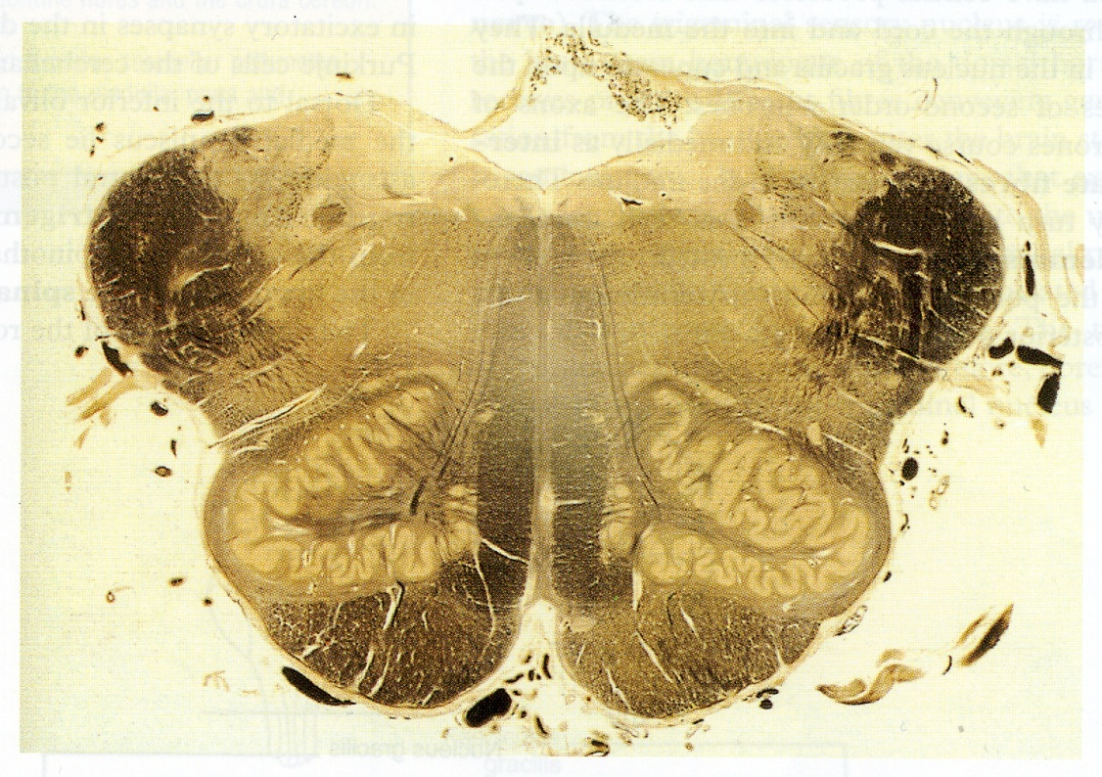
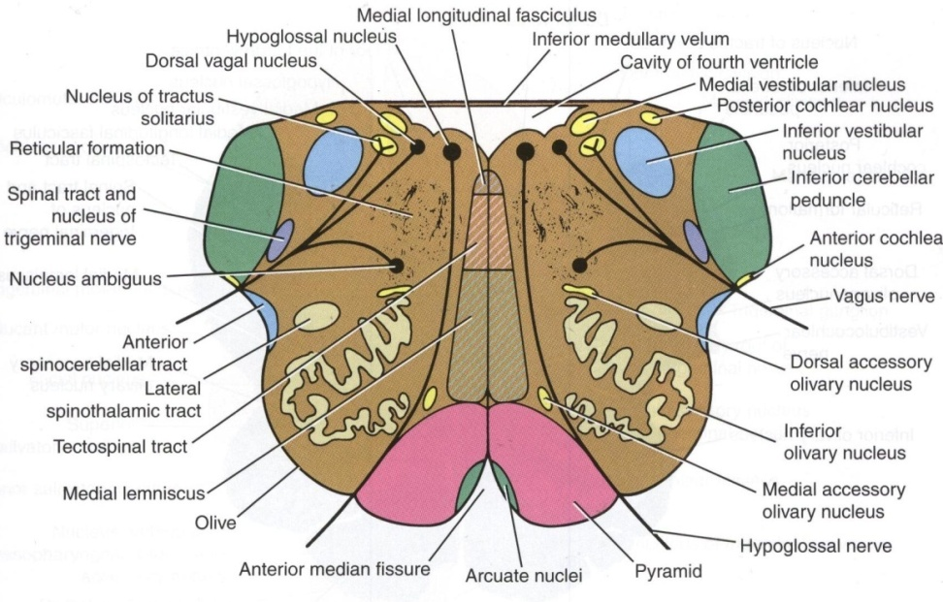
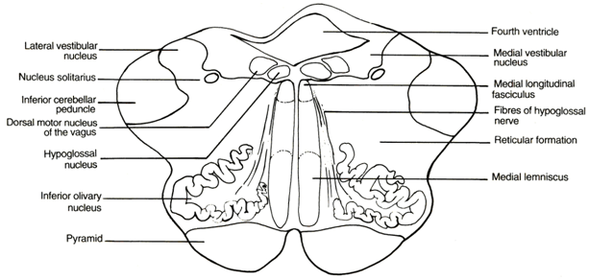

Slide 9
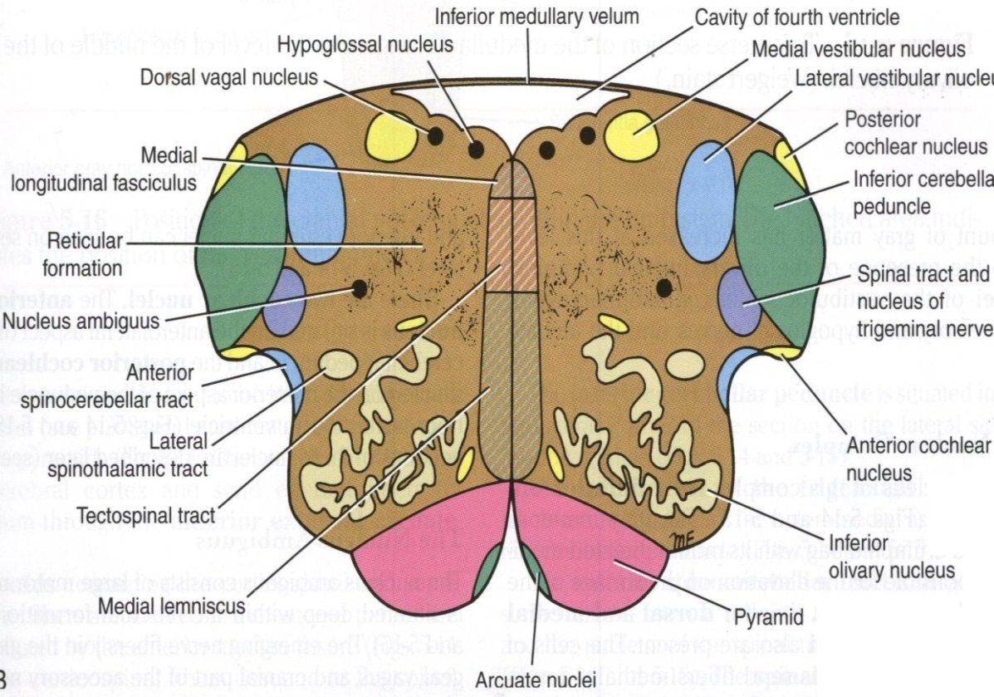
Medulla (Open)
Rostral Part
Beneath the floor of 4th ventricle lie :
1. Hypoglossal Nucleus.
2. Dorsal Nucleus of Vagus
lateral to the hypoglossal nucleus, contains preganglionic parasympathetic fibers.
3. Medial longitudinal fasciculus, it is important association tract, lies close to the midline, ventromedial to the hypoglossal nucleus. Function:
4. Vestibular nuclei complex : concerned with equilibrium.
Upwards : It links the vestibular nuclei with nuclei of extraocular muscles (in CN 3,4&6) as (vestibulo-ocular tract) to help coordination of eye movements with head movements.
Downwards :
It links vestibular nuclei with anterior horn cells of spinal cord (cervical & upper thoracic segments) as (vestibulo-spinal tract) so, the neck & trunk move with head movements

Slide 10
Medulla (Open)
Rostral Part
5. Nucleus Ambiguus: (motor nucleus) : lies dorsal to olivary nucleus gives motor fibers along glossopharyngeal N. & vagus N. to motor supply of the constrictors of the pharynx, intrinsic muscles of the larynx & palate.
6. Solitary nucleus (sensory nucleus) : lies ventrolateral to dorsal nucleus of vagus, receive taste sensation from the tongue along the facial (VII), glossopharyngeal (IX) and vagus (X).
7. Tectospinal tract : between tectum of midbrain and spinal cord (involved in head movements during visual and auditory tracking).
Extra

Slide 11
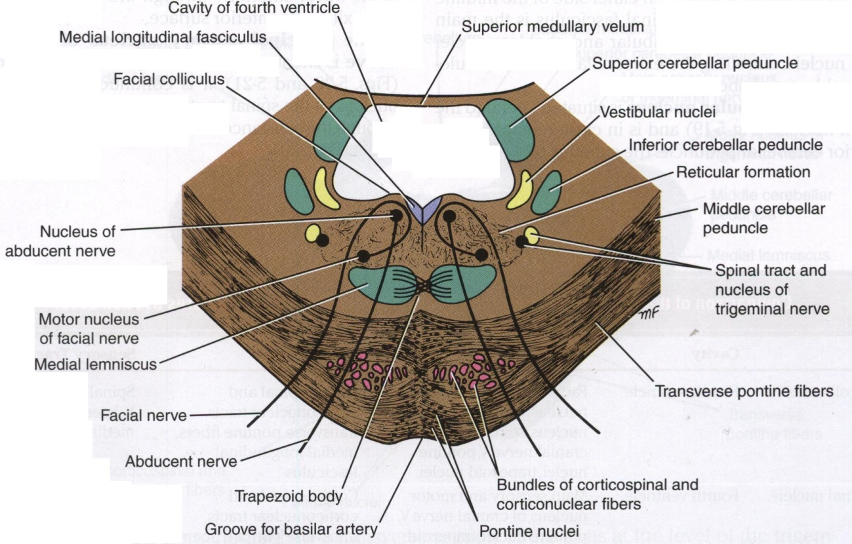
Pons
Divided into an anterior part (basis pontis) & a posterior part (Tegmentum) by the Trapezoid Body.*
The trapezoid body consists of acoustic fibres from cochlear nuclei to ascend into midbrain as lateral lemniscus and terminate in inferior colliculus.
The ventral (anterior) portion is marked by numerous transversely oriented fascicles of pontocerebellar fibres that originate from scattered cell groups, the pontine nuclei and that pass to the contralateral side of the cerebellum through the massive middle cerebellar peduncle. *Trapezoid body between basepoints & tegmentum
Compare:
Medial lemniscus | Lateral lemniscus
Ascending internal arcuate fibers | Acoustic fibres from cochlear nuclei
Terminates in thalamus | Terminate in inferior colliculus

Slide 12
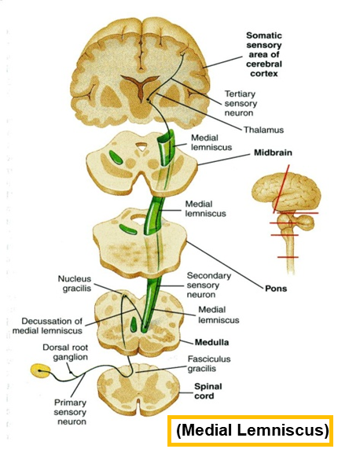
Pons
Caudal Part
5. Deep origin of cranial nerve nuclei :
Abducent nucleus
Facial motor nucleus
3. The ascending fibres of the medial lemniscus
become separated from the pyramid and displaced dorsally.
The Medial Lemniscus rotates 90 degrees and lies almost horizontally.
4. Spinal tract & nucleus of Trigeminal. (they become smaller)
2. Bundles of corticospinal & corticonuclear fibres (Pyramidal fibres)
1. Pontine Nuclei: are small masses of nerve cells, receive corticopontine fibers (involved in motor activity) Their axons form the transverse pontocerebellar fibers which pass to the contralateral side of the cerebellum through Middle Cerebellar peduncles.

Slide 13
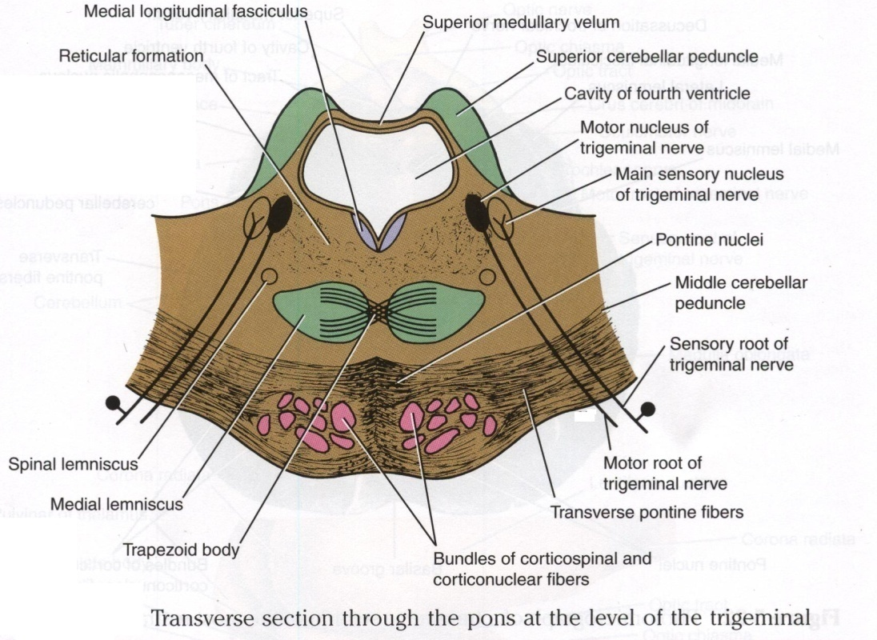
Pons
Level of Trigeminal Nerve (Mid Pons)
Motor nucleus of the trigeminal nerve: Lies in the lateral part of the floor of the 4th ventricle.
Main sensory nucleus of the trigeminal nerve: Reaches its maximum extent in the pons and it lies lateral to the motor nucleus.
Rostral Part
Superior cerebellar peduncles :
form the lateral boundary of the 4th ventricle.
Superior Medullary Velum:
Passes between the two peduncles & forms the roof of the 4th ventricle.
Medial longitudinal fasciculus:
Lies close to the midline beneath the floor of the 4th ventricle.

Slide 14
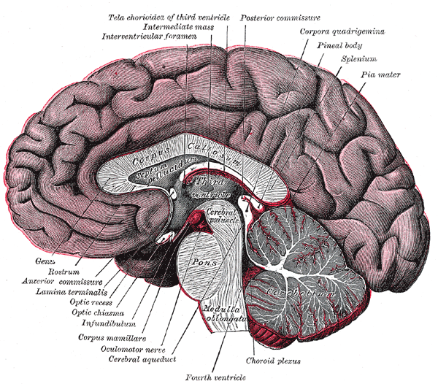
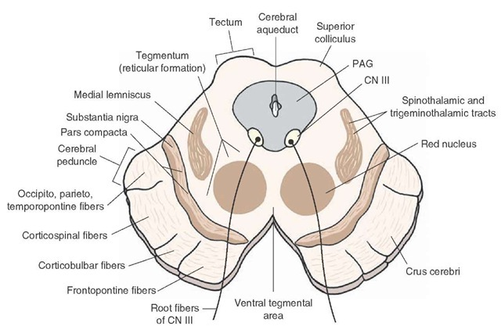
Midbrain
It is divided at the level of the cerebral aqueduct into :
a dorsal part (Tectum) and
a ventral part (Tegmentum)
In pons it will be the opposite.
The cerebral aqueduct is surrounded by a pear shaped periaqueductal (central) gray matter.
The most ventral part of the tegmentum is the massive fibrous mass (Crus Cerebri).
Extra

Slide 15
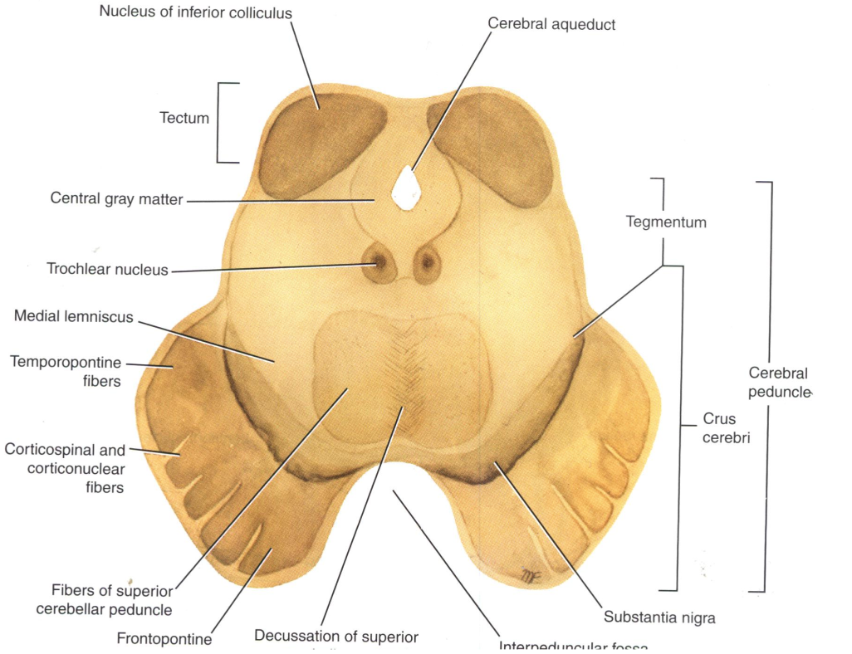
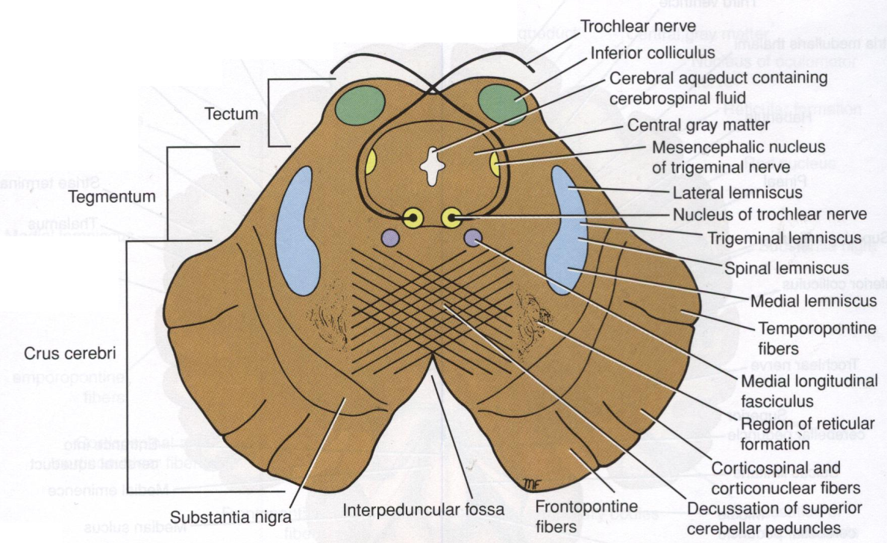
Midbrain
Inferior Colliculus Level
Inferior colliculus is a large nucleus of gray matter that lies beneath a corresponding surface elevation.
It is part of the auditory pathway.
It receives fibers from the lateral lemniscus.
Its efferent fibers pass to the thalamus.
Structures:
1. Trochlear nucleus:
lies in the central gray matter close to the median plane just posterior to the medial longitudinal bundle.
The fibers of the trochlear nerve decussate in the superior medullary velum.
2. Decussation of the superior cerebellar peduncles in the mid line.
Extra

Slide 16
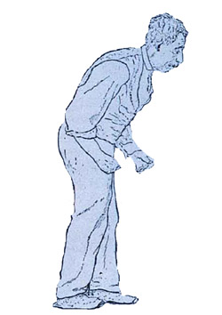
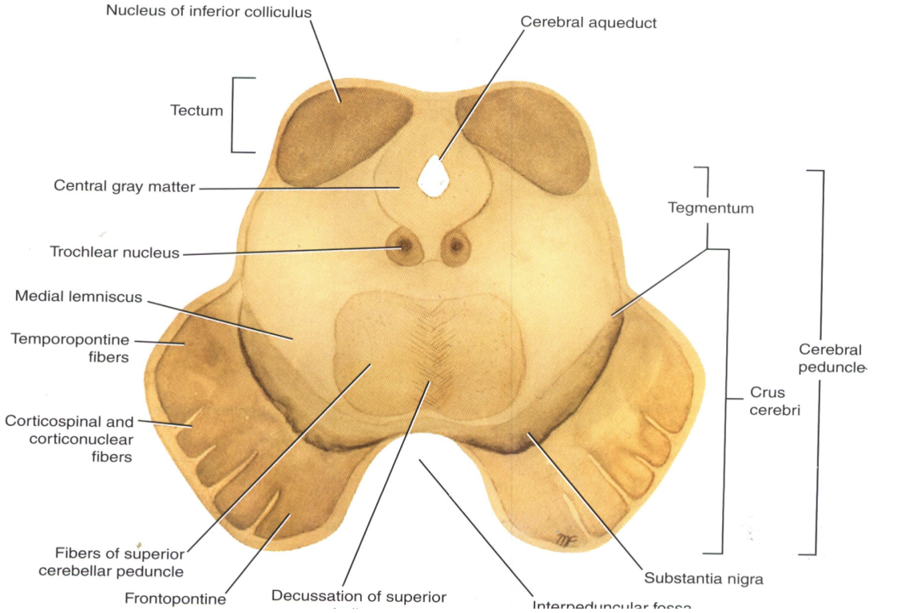
Midbrain
Inferior Colliculus Level
08:59
Mask Face
Extra
3. Substantia nigra :
Occupies the most ventral part of the tegmentum.
It consists of pigmented, melanin containing neurones.
It projects to the basal ganglia. Its degeneration is associated with Parkinson’s disease*.
Tone of the muscle will be lost.
4. Ascending Leminisci:
Composed Of:
Medial lemniscus.
Spinal (Lateral & anterior spinothalamic tracts)
Trigeminal (Lateral & medial).
Lateral lemniscus.
Flexion of the Trunk
Pill-Rolling Tremors
*
Slow Shuffling Feet movement

Slide 17
3. Midbrain
Crus Cerebri
It is a massive mass ventral to the substantia nigra.
It consists entirely of descending cortical efferent fibers (Frontopontine, Corticospinal & corticobulbar and Temporopontine Fibres) to the motor cranial nerve nuclei and to anterior horn cells.
Involved in the coordination of movement.
Present in both levels of colliculi (inferior and superior).

Slide 18
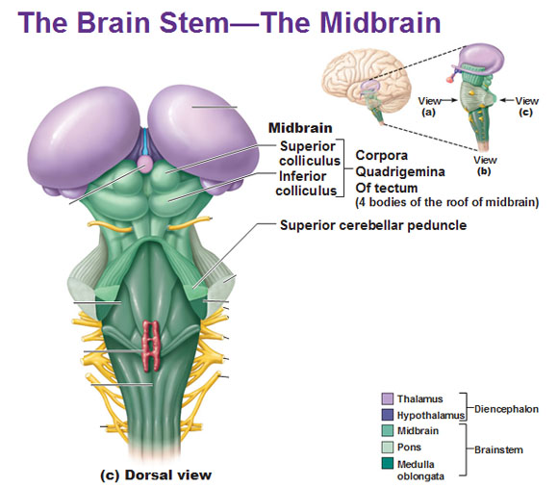
Midbrain
Superior colliculus level
*to remember:
The eyes are on top so the superior colliculus → visual
A large nucleus of gray matter that lies beneath corresponding elevation.
It forms part of the visual reflexes*.
Its efferent fibers go to the anterior horn cells & to cranial nuclei 3, 4, 6, 7 & 11.
It is responsible for the reflex movements of the eyes, head and neck in response to visual stimuli, as in following a moving object or altering the direction of the gaze.

Slide 19
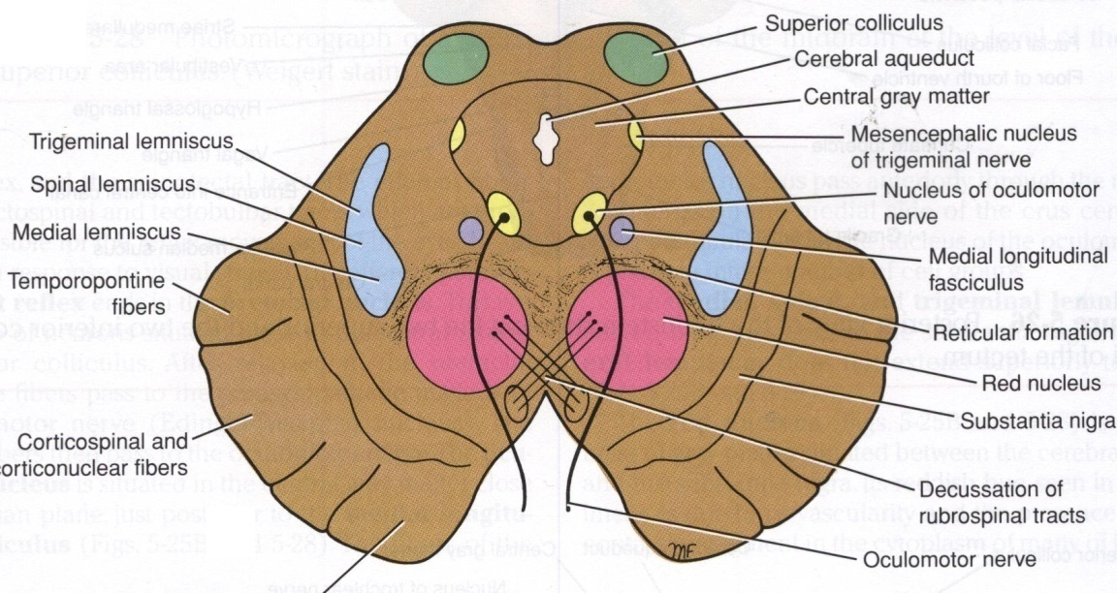
Midbrain
Superior colliculus level
1. Oculomotor nucleus:
Situated in the central gray matter close to the median plane.
The fibers of the oculomotor nerve passes anteriorly through the red nucleus to emerge on the medial side of the crus cerebri.
2. Red nucleus :
A rounded mass of gray matter that lies in the central portion of the tegmentum.
Its red coloration is due to its vascularity and the presence of an iron containing pigment in the cytoplasm of its neurons. (Important)
It is involved in motor control.
Interpeduncular fossa

Slide 20
Pons | Caudal | Trapezoid body (divides it into basis pontis and tegmentum) Transverse pontocerebellar fibers Pontine nuclei Bundles of corticospinal & corticonuclear fibers. Medial lemniscus Spinal tract & nucleus of trigeminal Deep origin of CN 6 & 7
 | Mid (level of trigeminal) | Motor nucleus of trigeminal Main sensory nucleus of the trigeminal Superior cerebellar peduncle (forms lateral boundary of 4th ventricle)
 | Rostral | Superior medullary velum Medial longitudinal fasciculus
Summary of levels and structures:
Medulla | Caudal / Closed | Traversed by central canal Motor decussation Trigmenial sensory nucleus
 | Mid | Traversed by central canal Gracile and cuneate nuclei Internal arcuate fibers Sensory decussation Medial leminiscus
 | Rostral / Open | Dorsal surface forms lower part of floor of 4th ventricle Cochlear nuclei (dorsal and ventral) Hypoglossal nucleus Dorsal nucleus of vagus Medial longitudinal fasciculus Vestibular nuclei complex Nucleus ambiguus Solitary nucleus Tectospinal tract
Midbrain | Inferior colliculi (auditory) | Trochlear nucleus Decussation of cerebellar peduncle sin the midline Substantia nigra (parkinsons) Ascending lemnisci
 | Crus cerebri | Descending cortical efferent fibers (present in superior and inferior colliculi)
 | Superior colliculi (visual) | Occulomotor nucleus Red nucleus

Slide 21
(1) Most axons of cochlear nuclei cross the midline of pons forming?
A) The medial lemniscus B) The red nucleus
C) Trapezoid body D) The medial longitudinal fasciculus
(2) The axons of the cochlear nuclei are represented in?
A) Trapezoid body B) Medial longitudinal bundle
C) Tectospinal tract D) Spinal lemniscus
(3) Which of the following lies in the tegmentum of the midbrain?
A) Oculomotor nuclei B) Trochlear nucleus
C) Red nucleus D) Fascial nucleus
(4) Parkinsons disease results from degeneration of?
A) Red nucleus B) Substantia nigra
C) Inferior olivary nucleus D) Non of them
(5) Which of the following bands carry corticopontine fibers?
A) Crus cerebri B) Medial eminence
C) Medullary Pyramid D) Basis pontis
(6) The caudal pons give have deep nuclei of which nerve?
A) Vagus B) Facial
C) Trigeminal D) Basilar
(7) Which nerve fibers emerge on the medial side of the crus?
A) Cerebri B) Occulomotor
C) Opthalmic D) Vestibulocochlear
(8) A rounded mass of gray matter that lies in the central portion of the tegmentum?
A) Oculomotor nucleus B) Raphe nuclei
C) Red nucleus D) Locus Ceruleus
(9) The fibers of the oculomotor nerve passes________ through the red nucleus to emerge on the ________ side of the crus cerebri?
A) Anteriorly , medial B) Anteriorly , lateral
C) Posteriorly , medial D) Posteriorly , lateral
(10) Solitary nucleus is responsible for which of the following?
A) Hearing B) Taste sensation
C) Vision D) Fine touch

Slide 22
Answers
(1) C (6) B (2) A (7) A (3) C (8) C (4) B (9) A (5) A (10) B

Slide 23
(1) Ascending Leminisci Composed Of?
• Medial lemniscus.
• Spinal (Lateral & anterior spinothalamic tracts)
• Trigeminal (Lateral & medial).
• Lateral lemniscus.
(2) The Descending cortical efferent fibers that form the crus cerebri are ?
Frontopontine, Corticospinal &corticobulbar andTemporopontine Fibres.
(3) Name 4 things that lie Beneath the floor of 4th ventricle in the open medulla?
1.Hypoglossal Nucleus.
2. Dorsal Nucleus of Vagus
3. Medial longitudinal fasciculus.
4. Vestibular nuclei complex.
5. Nucleus Ambiguus.
6. Solitary nucleus.
7. Tectospinal tract.

