Slide 2
Objectives
By the end of the lecture, students should be able to:
List the nuclei of the deep origin of the trigeminal and facial nerves in the brain stem.
Describe the type and site of each nucleus.
Describe the superficial attachment of trigeminal and facial nerves to the brain stem.
Describe the main course and distribution of trigeminal and facial nerves in the face.
Describe the main motor & sensory manifestation in case of lesion of the trigeminal & facial nerves.

Slide 3
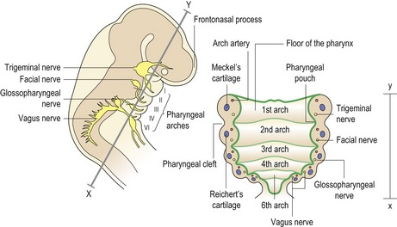
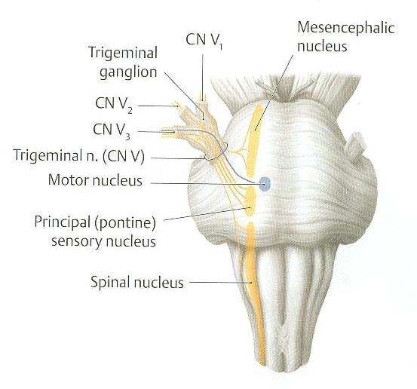
Trigeminal (V) 5th Cranial Nerve
Type: Mixed (sensory & motor).
Fibers:
General somatic afferent: afferent → sensory
Carrying general sensations from face, and anterior part of scalp.
2. Special visceral efferent: efferent → motor
Supplying muscles developed from the 1st pharyngeal arch, (8 muscles will be mentioned in slide 5).
Extra
Trigeminal Ganglion
Site: Occupies a depression in the middle cranial fossa )Trigeminal impression).
Importance: Contains cell bodies:
Whose dendrites carry sensations from the face and scalp.
Whose axons form the sensory root of trigeminal nerve.
see next slide

Slide 4
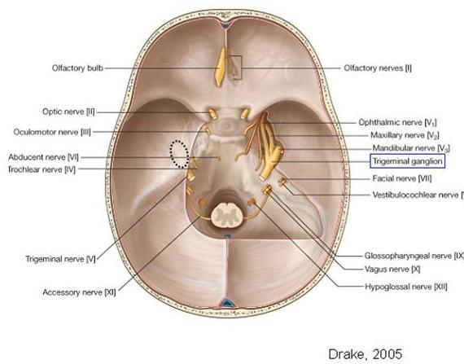
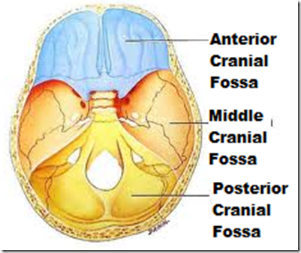
Trigeminal (V) 5th Cranial Nerve
Nuclei (deep origin)
3 sensory + 1 Motor
Extra

Slide 5
Trigeminal (V) 5th Cranial Nerve
Nuclei
Four nuclei: (3 sensory + 1 Motor).
*chewing
General somatic afferent:
Special visceral efferent:
Mesencephalic nucleus (midbrain &pons): receives proprioceptive fibers from muscles of mastication*.
Motor nucleus (pons): supplies:
Four Muscles of mastication* (temporalis, masseter, medial & lateral pterygoid).
Other four muscles (Anterior belly of digastric, mylohyoid, tensor palati & tensor tympani).
Spinal nucleus (pons, medulla & upper 2-3 cervical segments of spinal cord): receives pain & temperature sensations from face & scalp.
Principal (main) sensory nucleus (pons): receives touch fibers from face & scalp
Mnemonics:
Masseter = master
Pterygoid = pretty good
the other name of it is tractus nucleus
لانها زي التراكت نازلة لتحت.
For the diagrams see next slide

Slide 6
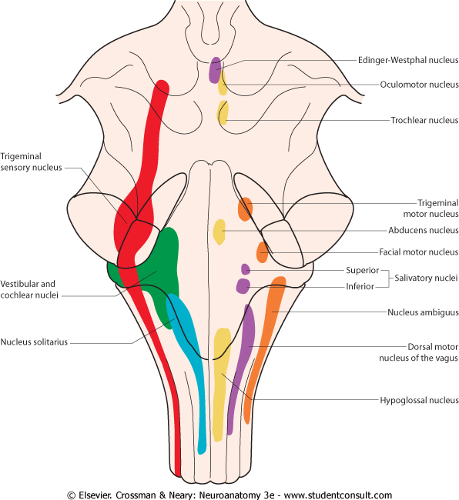
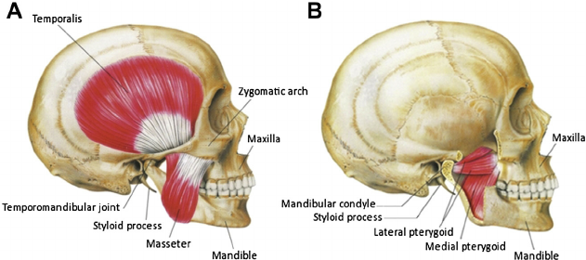
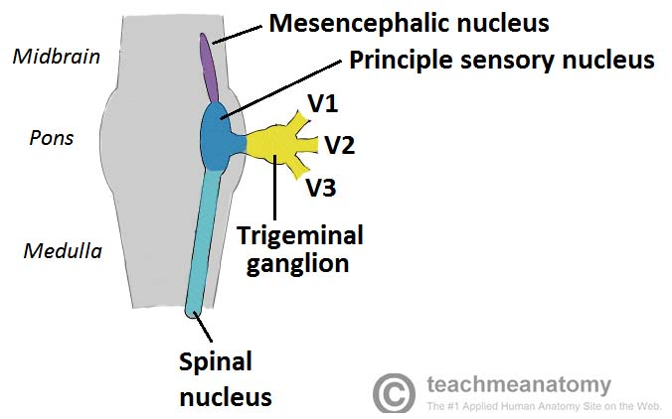
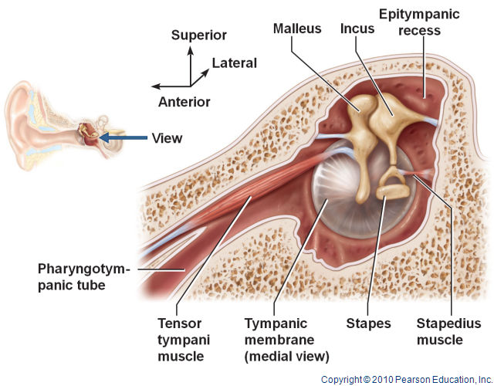
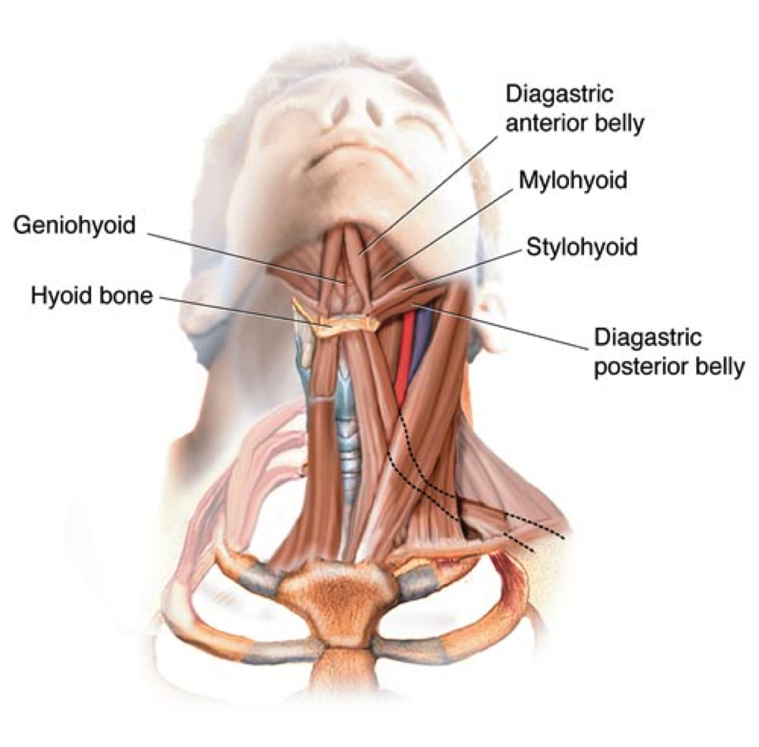
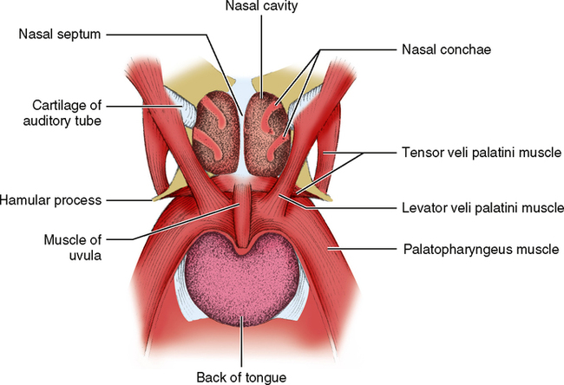
Extra
Extra
Extra
Extra
Extra

Slide 7
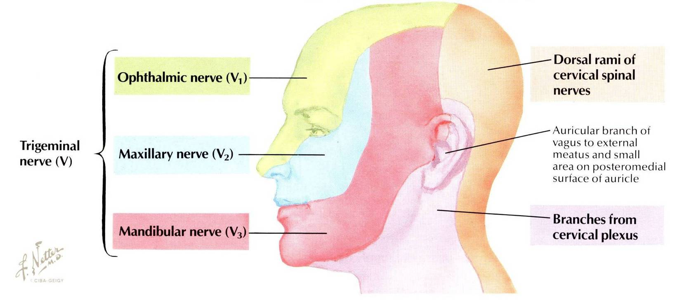
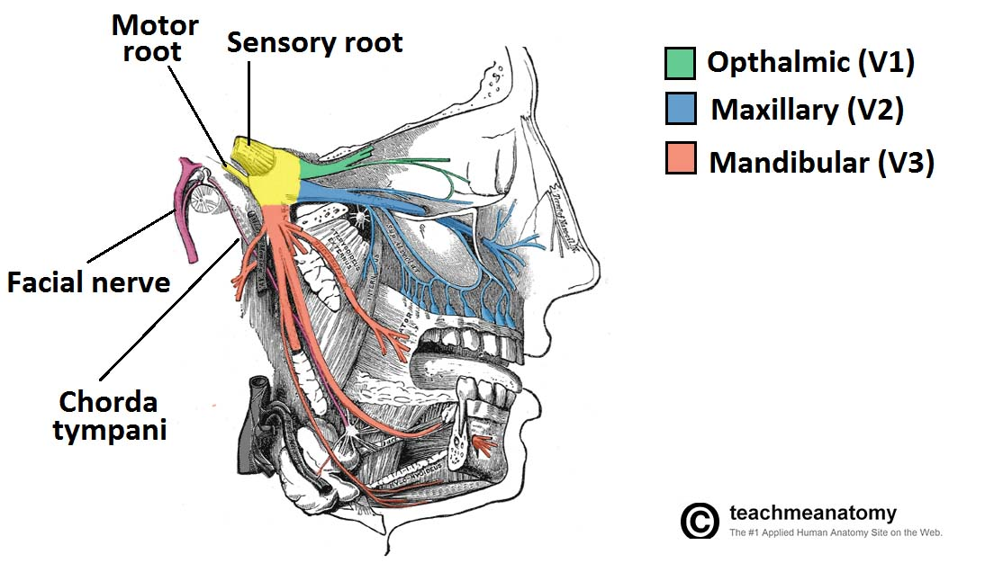
* To remember:
Motor → medial
Large → Lateral
Trigeminal (V) 5th Cranial Nerve
Emerges from the middle of the ventral surface of the pons by 2 roots (Large Lateral sensory root & small medial motor root)*.
Divides into 3 divisions (dendrites of trigeminal ganglion):
Ophthalmic, CV1
Maxillary, CV2
Mandibular, CV3
Axons of cells of motor nucleus join only the mandibular division.
Pure Sensory
Motor & Sensory
Very important:
1- ophthalmic nerve supplies tip of the nose and the upper eyelid
2- maxillary nerve supplies the lower eyelid, ala of the nose ( wing of the nose ) and the upper lip
3- mandibular nerve supplies the lower lip
The trigeminal nerve doesn’t supply the area above the parotid gland
Extra

Slide 8
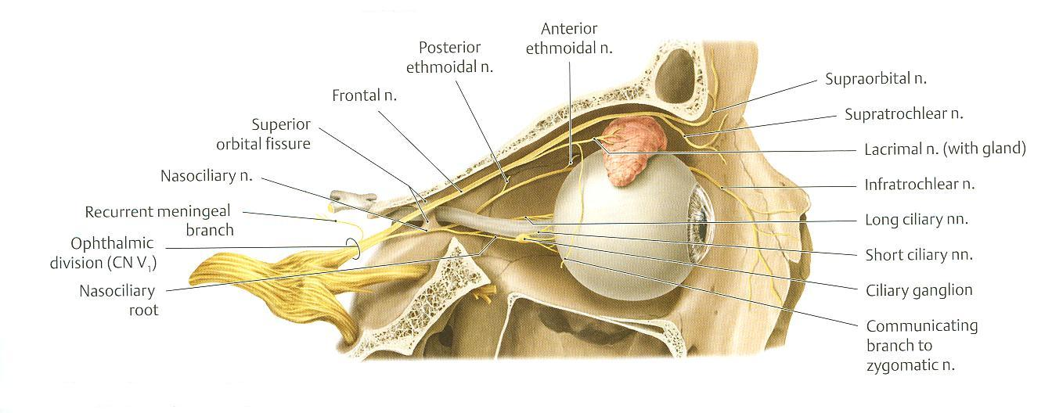
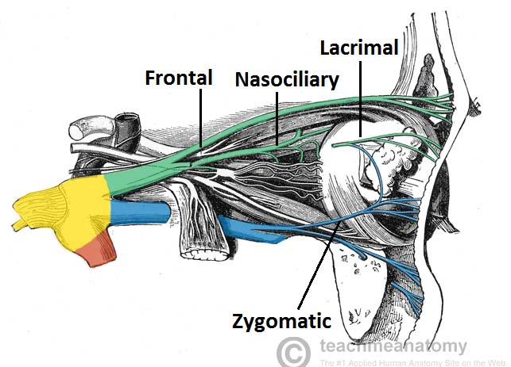
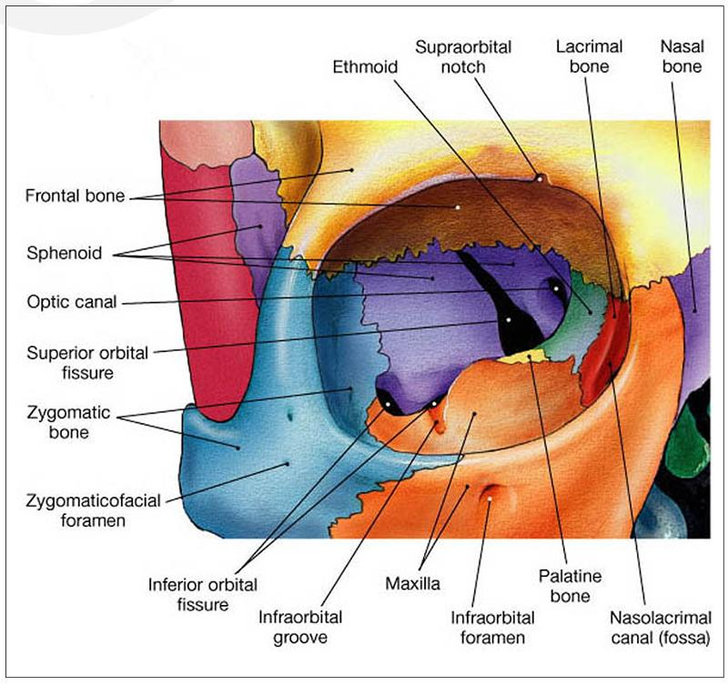
Trigeminal (V) 5th Cranial Nerve
1. Ophthalmic nerve
1
PURE SENSORY
Divides into 3 branches which pass through superior orbital fissure to the orbit:
Frontal: supplies skin of face & scalp.
Lacrimal: supplies skin of face & lacrimal gland. (just sensation the secretion is from facial nerve)
Nasociliary: supplies skin of face, nasal cavity & eyeball.
2
3
اعرفها من اسمها+ supply skin of the face
Extra
Extra

Slide 9
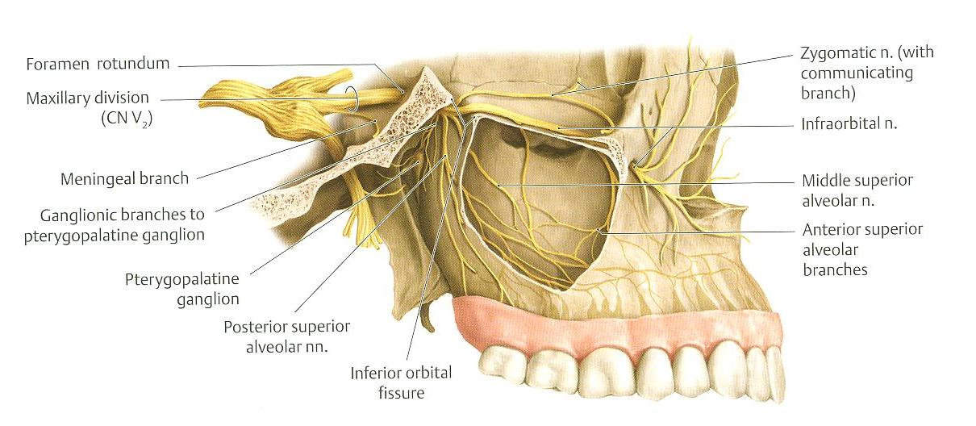
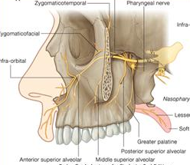
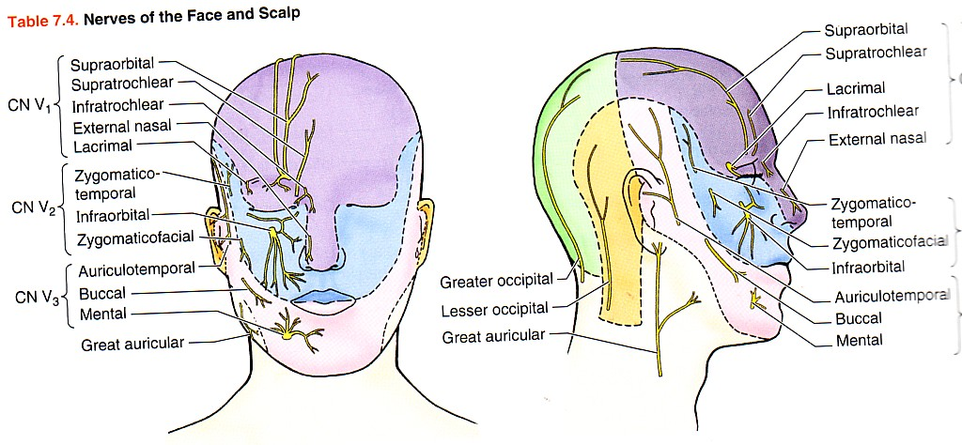
Extra
Trigeminal (V) 5th Cranial Nerve
2. Maxillary nerve
PURE SENSORY
Supplies:
Upper teeth, gums & maxillary air sinus (posterior, middle & anterior superior alveolar nerves).
Face: (zygomaticofacial & infraorbital nerves).
Extra

Slide 10
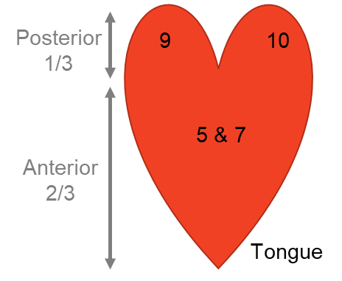
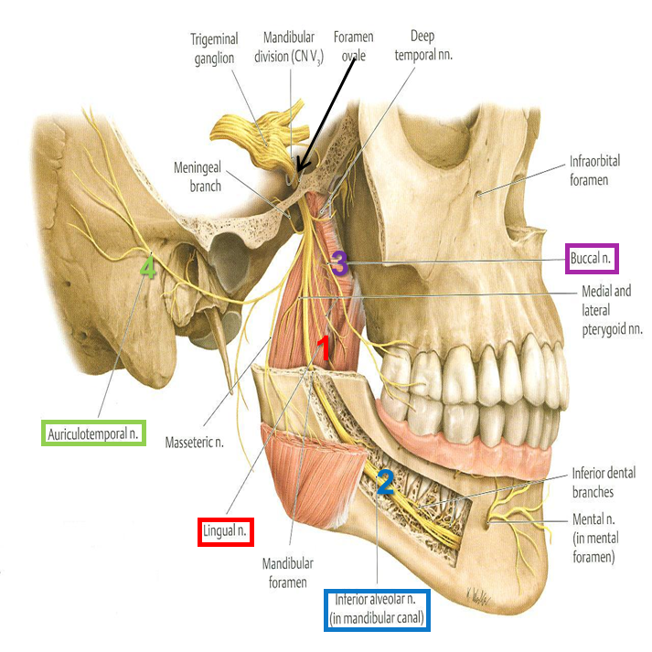
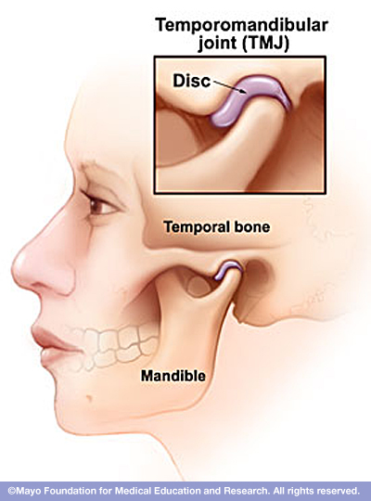
Trigeminal (V) 5th Cranial Nerve
3. Mandibular
MIXED (sensory and motor)
Motor Branches
Sensory Branches
وليس التذوق حار وبارد
to 8 muscles (4 muscles of mastication & other 4 muscles).
Lingual:
receives General sensations from anterior 2/3 the of tongue.
4. Auriculotemporal:
supplies auricle, temple, parotid gland & TMJ tempromendibular joint.
General sensation = pain + temperature + touch
Special = taste
2. Inferior alveolar: supplies Lower teeth, gums & face.
Through mandible bone through mandibular canal
Buccal:
supplies Face
(cheek on upper jaw)
we have two nerves called ( buccal ) :
- From trigeminal sensory
- From facial motor ( from the 2nd arch )

Slide 11
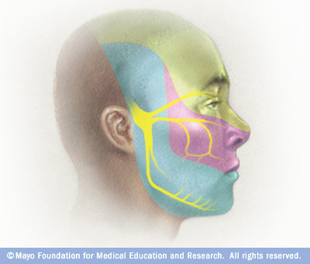
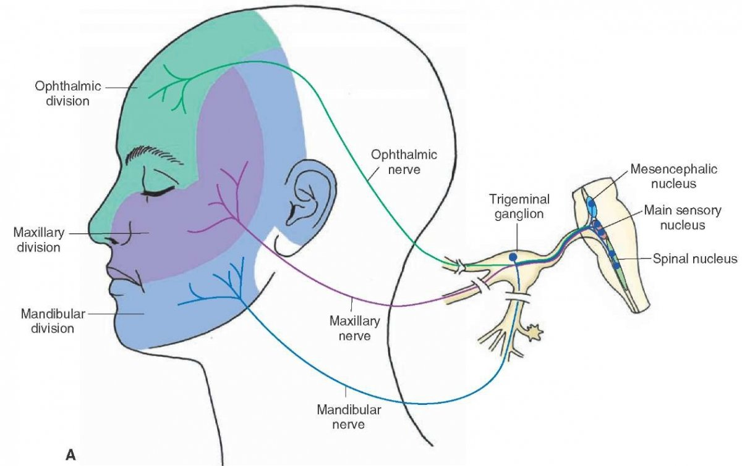
Trigeminal (V) 5th Cranial Nerve
Trigeminal Neuralgia
المريض يجي يشتكي من الم رهيب عند وضع المشط زي الدبابيس في الوجه
Compression, degeneration or inflammation of the 5th cranial nerve may result in a condition called trigeminal neuralgia or tic douloureux (spasmodic contraction of the muscles, most often in the face)
This condition is characterized by recurring episodes of intense stabbing excruciating pain radiating from the angle of the jaw along a branches of the trigeminal nerve.
Usually involves maxillary & mandibular branches, rarely in the ophthalmic division.
Extra

Slide 12
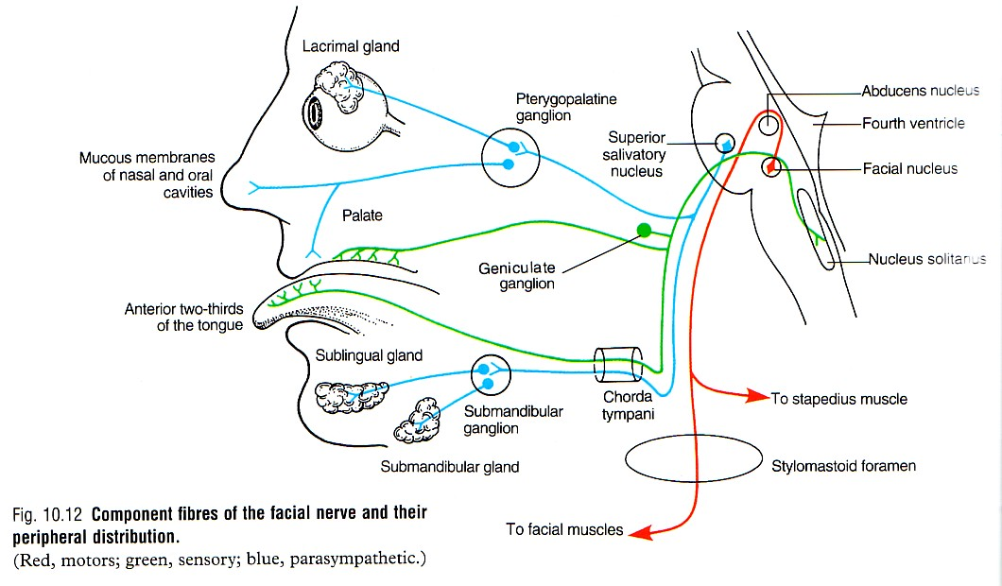
Facial (VII) 7th Cranial Nerve
Type: Mixed (Motor, special sensory للتذوق)), parasympathetic).
Fibers:
Special visceral afferent: carrying taste sensation from anterior 2/3 of the tongue.
Special visceral efferent: supplying muscles developed from the 2nd pharyngeal arch. (muscles of facial expression)
General visceral efferent: supplying parasympathetic secretory fibers (secretomotor) to submandibular, sublingual, lacrimal, nasal & palatine glands.
Parasymp.
taste sensation
motor

Slide 13
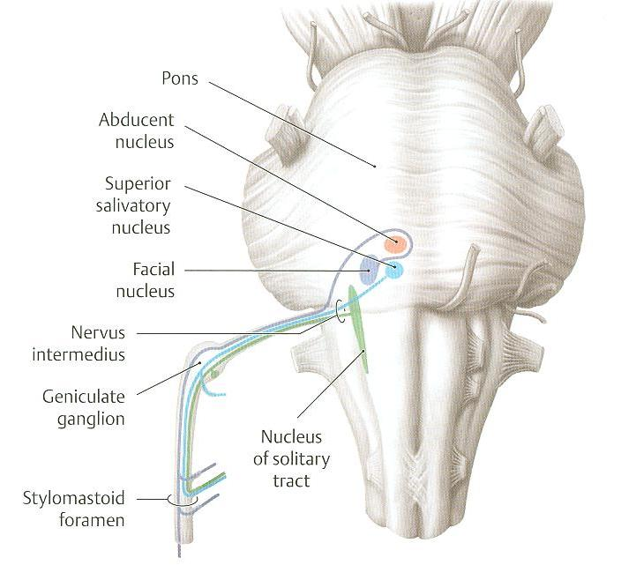
Facial (VII) 7th Cranial Nerve
Nuclei
Remember :The nerves of taste have to go to solitarius nucleus:
- Anterior 2/3 is supplied by facial
- Posterior 1/3 is supplied by glossopharyngeal
- Root of the tongue is supplied vagus
3 Nuclei :
Special visceral afferent: (nucleus solitarius):
receives taste from the anterior 2/3 of tongue.
Special visceral efferent: (motor nucleus of facial nerve): supplies: Muscles of the face,
Muscles of scalp, (Occipitofrontalis).
Muscles of the auricle.
Posterior belly of digastric,
Platysma,
Stylohyoid,
Stapedius,
General visceral efferent: (superior salivatory nucleus): sends preganglionic parasympathetic secretory fibers to sublingual, submandibular, lacrimal, nasal & palatine glands.
هي اللي تتذوق
All develop from 2nd pharyngeal arch
2
3
1
Sublingual and submandibular are related to salivary gland

Slide 14
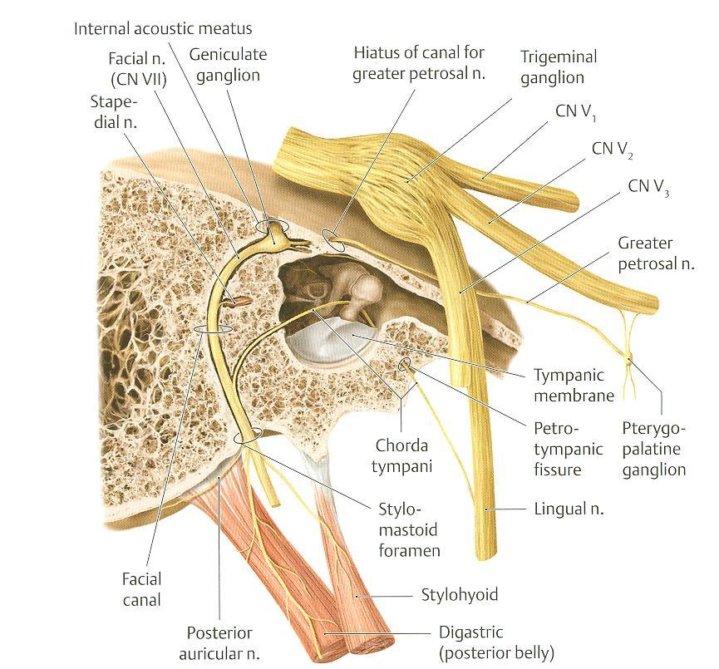
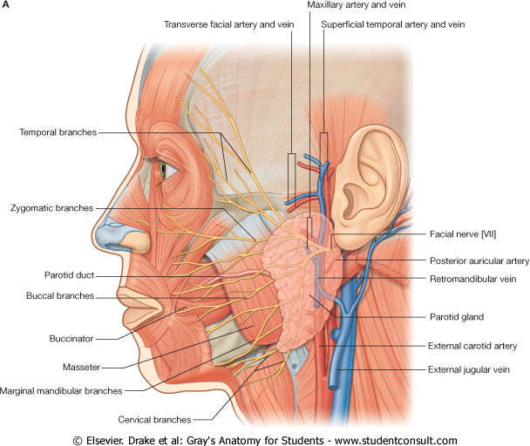
Facial (VII) 7th Cranial Nerve
Course
Emerges from the cerebellopontine angle by 2 roots:
Medial motor root: contains motor fibers.
Lateral root (nervous intermedius): contains parasympathetic & taste fibers.
Course:
Passes through internal auditory meatus to inner ear where it runs in facial canal.
Emerges from the stylomastoid foramen & enters the parotid gland where it ends.
To remember:
Motor → medial
7th and 8th cranial nerves and vestibular artery run in facial canal

Slide 15
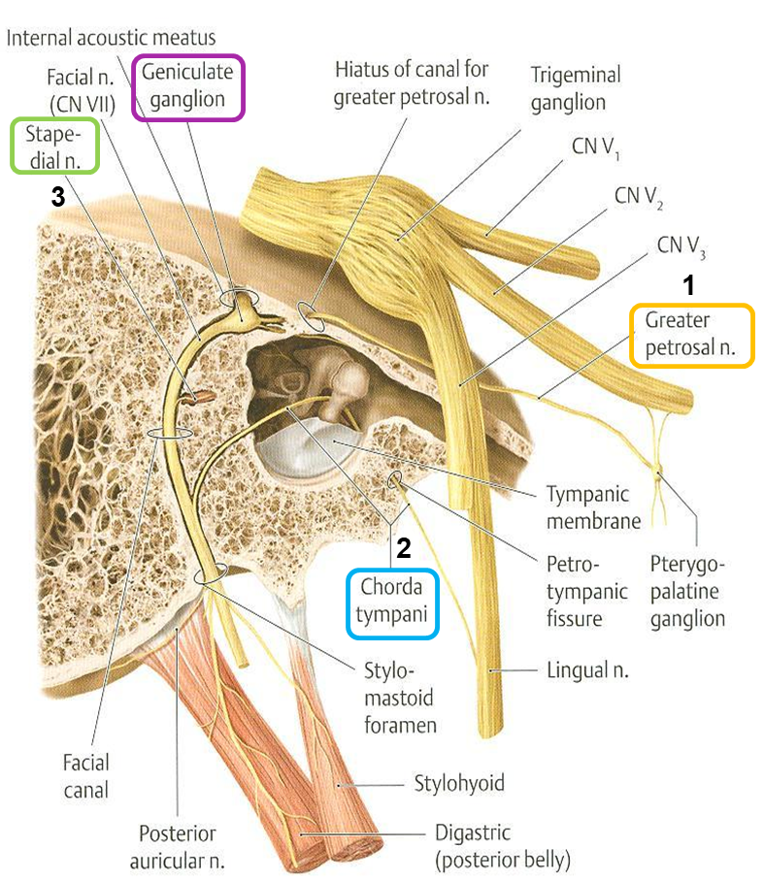
Facial (VII) 7th Cranial Nerve
Branches
In facial Canal
As it emerges from the stylomastoid foramen
Inside parotid gland
Greater petrosal nerve:
carries preganglionic parasympathetic fibers to pterygopalatine ganglion then postganglionic to lacrimal, nasal & palatine glands تخليك تعيط.
3. Nerve to stapedius :
control the amplitude of sound waves from the external environment to the inner ear.
2. Chorda tympani: carries
a) preganglionic parasympathetic fibers to submandibular & sublingual glands.
b) taste fibers from anterior 2/3 of tongue.
N.B.: Geniculate ganglion: contains cell bodies of neurones ; its fibres carrying taste sensations from anterior 2/3 of tongue; ending in solitary nucleus in M.O. Lies in internal acoustic meatus.

Slide 16
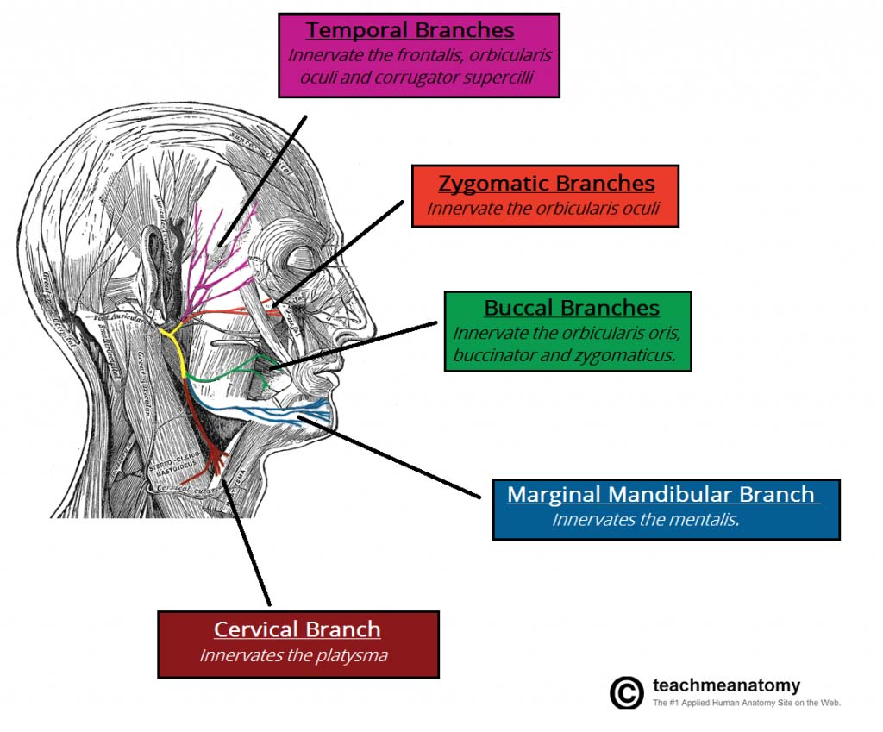
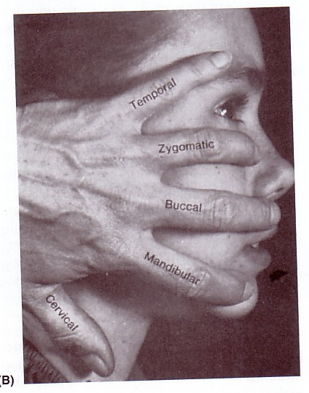
Facial (VII) 7th Cranial Nerve
Branches
In facial Canal
As it emerges from the stylomastoid foramen
Inside parotid gland
gives 5 terminal motor branches to the muscles of the face:
Posterior auricular:
to occipitofrontalis muscle.
2. Muscular branches to:
Temporal
Zygomatic
stylohyoid
Buccal
Mandibular
posterior belly of digastric
Cervical
Extra

Slide 17
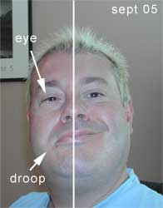
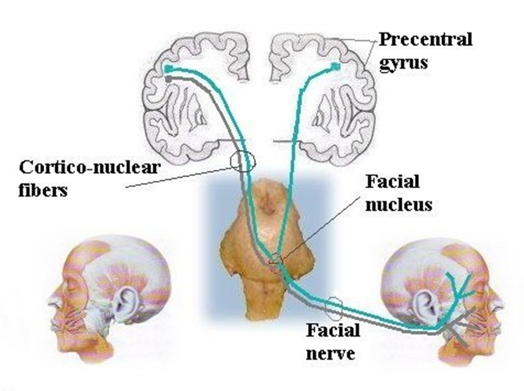
Facial (VII) 7th Cranial Nerve
Bell’s Palsy
Damage of the facial nerve results in paralysis of muscles of facial expressions : Facial (Bell’s) palsy; also called lower motor neuron lesion (whole face affected)
NB. In upper motor neuron lesion (upper face is intact) .
Face is distorted: (effect is on the same side of injury)
Drooping of lower eyelid,
Sagging of mouth angle,
Dribbling of saliva,
Loss of facial expressions,
Loss of chewing,
Loss of blowing,
Loss of sucking,
Unable to show teeth or close the eye on that side.
يا انو اكل خبطة على وشو او يكون من جو حار وبارد ويلتهب
.زي اللي تصير في الجلطات يكون الجزء العلوي شغال لانو ياخذ سبلاي من الجهتين

Slide 18
For Your Information
This slide is extra from Dr. Sanaa to differentiate between upper and lower motor lesions.
Only on the girls’ slides
Lower Motor Neuron Lesion | Upper Motor Neuron Lesion
Results from injury of facial nerve fibres: in internal acoustic meatus; in the middle ear; in the facial canal, or in parotid gland. | This occurs after injury to the pyramidal tract (corticonuclear) above facial nucleus...
Manifested by complete paralysis of facial muscles on the same side of lesion. | Leads to paralysis of facial muscles of lower ½ of face of opposite side but the upper ½ of the face not affected because the lower part of facial nucleus & Ms.of lower ½ of face receive pyramidal fibres from opposite cerebral cortex only, while Ms..of upper ½ of face are normal because they receive pyramidal fibres from both cerebral hemispheres.
If lesion of facial nerve above the origin of chorda tympani and nerve to stapedius, the paralysis of facial muscles will be associated with : 1- Hyperacusis : sounds are heard more acute due to paralysis of stapedius ms. 2- Loss of taste sensation from anterior 2/3 of tongue.

Slide 19
Fibers
GSA
SVE
nuclei
Mesencephalic nucleus
(midbrain & pon)
Main sensory nucleus
(pons)
Spinal nucleus
(pons,M.O,upper2-3 cervical segments)
division
Ophthalmic
(sensory)
Maxillary
(sensory)
Mandibular
(mixed)
frontal
lacrimal
nasociliary
Post. , middle, anter. Superior alveolar nerves
Zygomaticofacial
& infraorbital
Sensory : lingual ,inferior alveolar , buccal , auriculotemporal
Motor :
To 4 mastication MS & 4 other MS
Motor nucleus
(pons)
Trigeminal nerve
(mixed : sensory & motor)
Fibers
SVA
SVE
nuclei
Nucleus solitarius
Motor nucleus
Superior salivatory nucleus
branches
In facial canal
As its emerge from stylomastoid foramen
Inside parotid gland
Chorda tympani
Nerve to stapedius
Greater petrosal
Posterior auricular
Muscular branches
1. Temporal
2. Zygomatic
3.Buccal
4. Mandibular
5.cervical
GVE
Facial nerve
(mixed: motor,sensory,parasympathetic)

Slide 20
Summary
Both trigeminal & facial nerves are mixed.
Nuclei of trigeminal nerve are found in midbrain, pons & medulla. They are of the general somatic afferent & special visceral efferent types.
The trigeminal nerve emerges from the pons and divides into: ophthalmic, maxillary & mandibular divisions that receive sensory supply from the face (with an exception of a small area over ramus of mandible).
All motor fibers are included in the mandibular division & supply muscles of mastication.
Nuclei of facial nerve are found in pons. They are of the special visceral afferent & efferent, as well as general visceral efferent type.
The facial nerve emerges from the cerebellopontine angle, gives motor fibers to muscles of facial expression, secretory fibers to submandibular, sublingual, lacrimal, nasal & palatine glands & receives taste fibers from anterior 2/3 of tongue.

Slide 21
Questions
1-The special visceral efferent fibers of the trigeminal nerve supplies:
A- temporalis muscle
B- posterior belly of digastric
C- omohyoid
D- ventral pterygoid
Answer: A
4- the posterior aulicular branch of the FACIAL nerve supply :
A- posterior belly of digastric
B-stylohyoid
C-occipitofrontalis muscle
D-A&B
Answer:C
2- which of the following true about the TRIGEMINAL nerve is true :
A- the axons of the cells of motor nucleus join only maxillary division
B- it emerges the middle of the dorsal surface of the pons
C- the TRIGEMINAL GANGLION occupies the middle cranial fossa
D- all the above
Answer :C
5-Damage of the FACIAL nerve will lead to which of the following deformities :
A-Erb-Duchenne palsy
B-Klumpke palsy
C-Bell’s palsy
D-Cerebral palsy
Answer: C
6-List the branches of the ophthalmic division of the trigeminal nerve.
FRONTAL ,LACRIMAL ,NASOCILIARY
7- list the branches of the facial nerve inside parotid gland and what do they supply .
TEMPORAL ,ZYGOMTIC ,BUCCAL, MANDIBULAR ,CERVICAL → muscles of the face
3-TRIGEMINAL NEURALGIA rarely involves :
A-maxillary branch
B-mandibular branch branch
C- ophthalmic
D-all the above
Answer: C

