Slide 1
Development of
Spinal Cord & Vertebral Column
Color Code:
Important
Doctors Notes
Extra explanation
Done

Slide 2
OBJECTIVES:
Describe the development of the spinal cord from the neural tube.
List the layers of the spinal cord and its contents.
List subdivisions of mantle & marginal zones.
List meningeal layers and describe positional changes of spinal cord.
Describe development of vertebral column from sclerotomic portion of paraxial mesoderm.
Describe chondrification & ossification stages in vertebral development.
Describe spina bifida and its types.

Slide 3
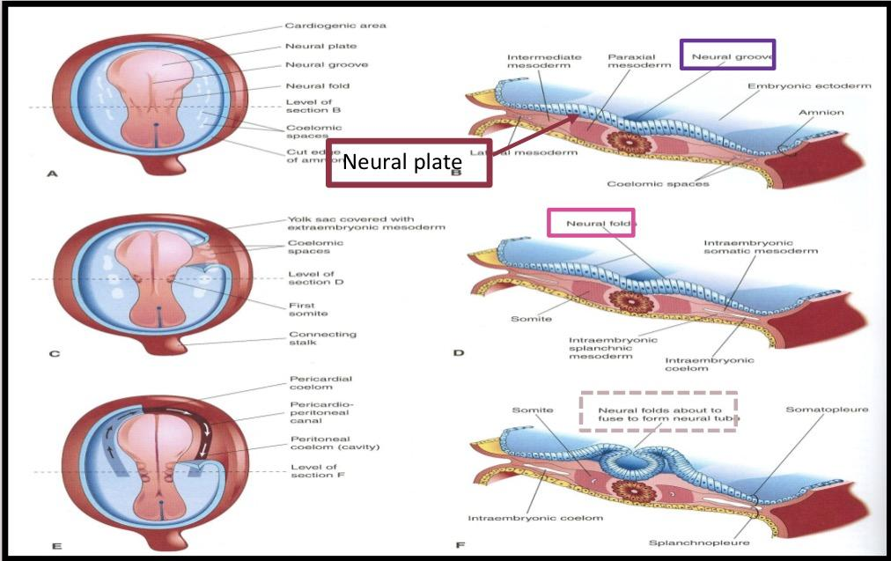
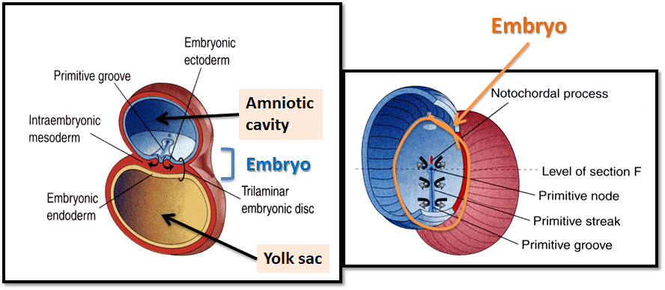
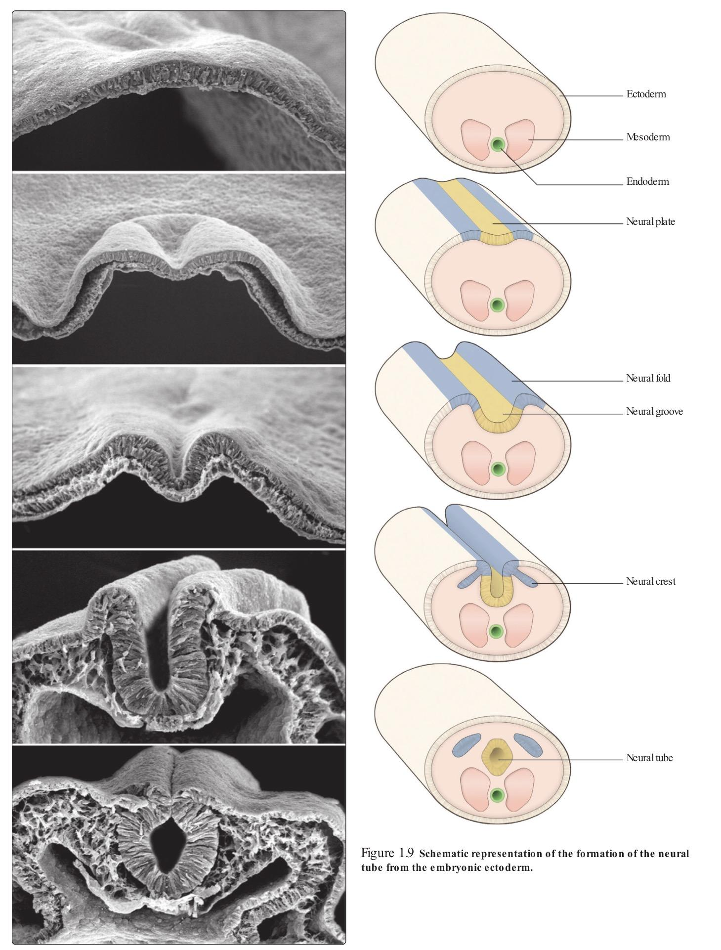
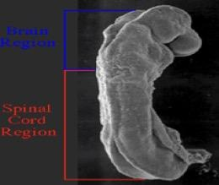
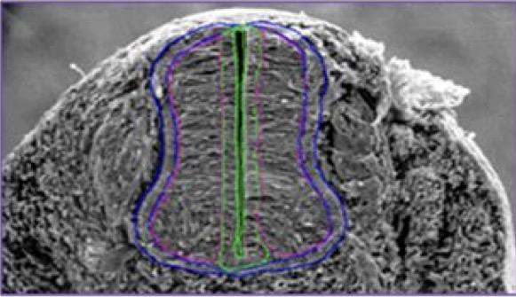
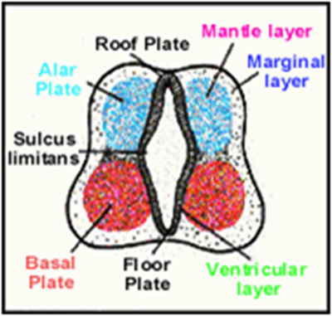
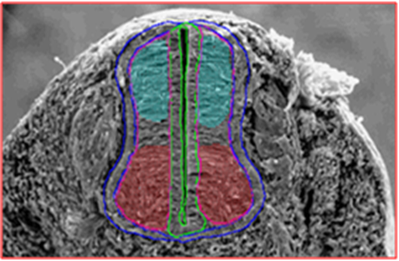
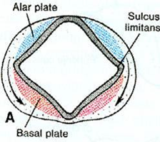
The Three Germ Layers:
Ectoderm, Mesoderm, Endoderm
The Neural Tube is a derivative of the ectoderm. Notochord stimulates neural tube formation which in turn stimulates development of the vertebral column.
Development of Neural Tube:
Ectodermal cells dorsal to notochord thicken to form the neural plate.
A longitudinal groove, neural groove, develops in the neural plate.
The margins of the neural plate (neural folds) approach to each other and fuse to form the neural tube.
Development of the Spinal Cord: brain الثلث الأول يتكون منه ال
The spinal cord develops from the caudal 2/3 of the neural tube.
The cells of the neural tube are arranged in three layers:
Mantle Layer of Spinal Cord:
Neurons of mantle layer (future grey matter) differentiate into :
The 2 areas are separated by a longitudinal groove (sulcus limitans).
Neural tube gives rise to Spinal Cord and Brain
Notochord acts as an axis which will be formed around it the Vertebral column. It helps in vertebral column development
الـ notochord بتحفز الـ ectoderm على أنها تتكثف وتكون لي شكل مسطح اللي هو neural plate بعد كذا هذا الـ neural plate بيبدأ يسوي لي شكل زبدية وهو نسميه neural groove
نهاية هذا الـ neural groove فيه طيات نسميها neural fold اللي راح يلتحم مع بعض ويتسكر علشان يسوي لي neural tube
ventricular zone | mantle zone | marginal zone
Inner | Middle | Outer
undifferentiated cells | cell bodies of neurons (future grey matter) | nerve fibers or axons of neurons (future white matter)
هنا الـ neural tube مكون من ثلاث طبقات، أول طبقة (الداخلية) مكونة من خلايا غير معروفة.
الطبقة الثانية (الوسطى) بتكون Grey matter مستقبلًا، والطبقة الأخيرة (الخارجية) بتكون White matter مستقبلًا
مثل ما قلنا الطبقة الوسطى راح تكون grey matter مستقبلًا، لذلك بتنقسم إلى قسمين:
1- القسم الخلفي (Dorsal alar plate) اللي راح يكون Dorsal horn مستقبلًا
2- القسم الأمامي (Ventral basal plate) اللي راح يكون Ventral horn مستقبلًا
Dorsal alar plate | Ventral basal plate
future dorsal horn | future ventral horn
containing sensory neurons | containing motor neurons

Slide 4
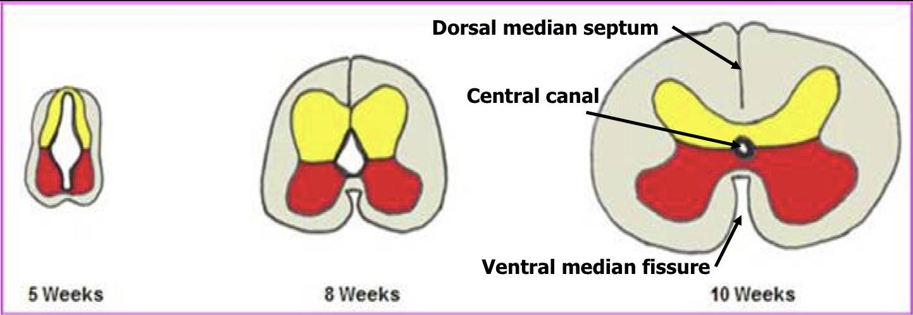
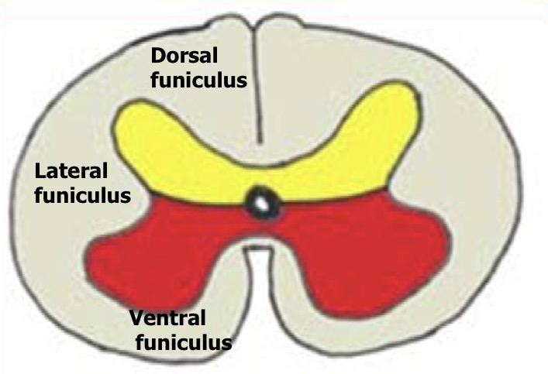
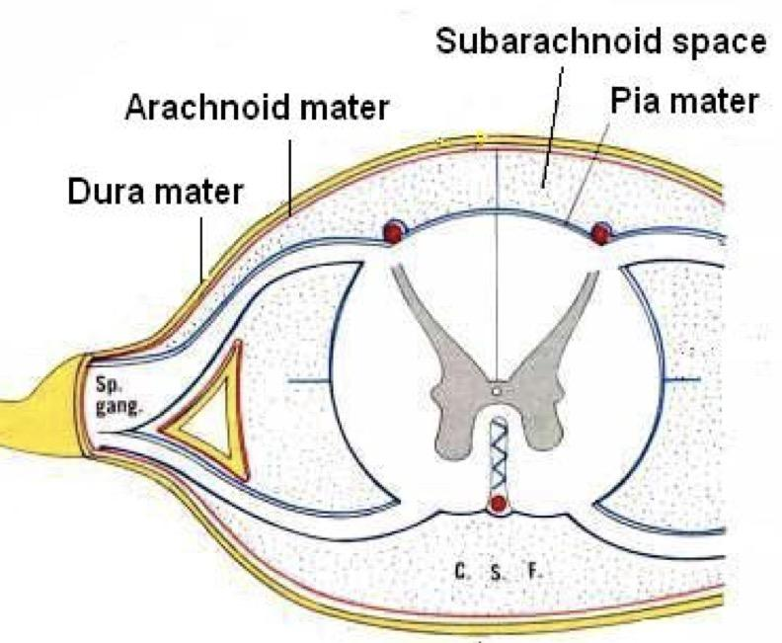
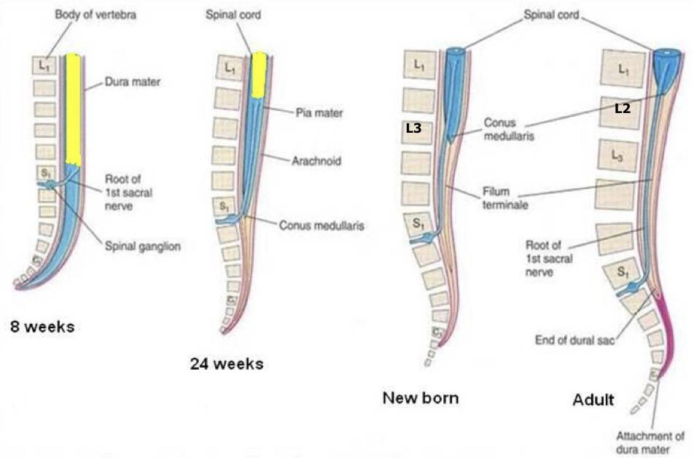
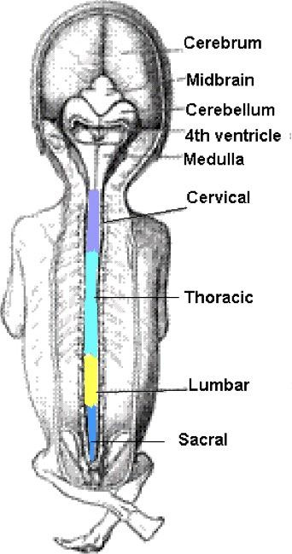
تبدأ الخلايا الموجودة في Dorsal alar plate والـ Ventral basal plate تتكاثر وتتكثف إلى ان تقترب المنطقتين من بعض، هذا التقارب بيصير له نتائج
Proliferation and bulging of both alar & basal plates result in:
Formation of dorsal median septum.
Formation of ventral median fissure.
Narrowing of the lumen of the neural tube to form a small central canal.
The marginal layer (future white matter):
increases in size due to addition of ascending, descending & intersegmental nerve fibers
and it is divided into : dorsal, lateral and ventral funiculi (white column)
Myelination of nerve fibers starts at 4th month & continues during the 1st postnatal year.
Motor fibers myelinate before sensory fibers. So, After a nerve injury, both motor and sensory axons have the ability to regenerate and, given a proper pathway.
Meninges:
These Are 3 Membranes covering the neural tube:
A cavity appears between the arachnoid & the pia mater (subarachnoid space) becomes filled with cerebrospinal fluid (CSF)
Positional Changes of Spinal Cord:
Initially, the spinal cord occupies the whole length of the vertebral canal.
As a result a faster growth of vertebral column, the caudal end of spinal cord (conus medullaris) shifts gradually to a higher level
Motor fibers myelination is faster than sensory fibers
Outer thick dura mater | Middle arachnoid mater | Inner thin pia mater
MESODERMAL in origin | ECTODERMAL in origin
في البداية يكون طول الـ spinal cord مساوي لطول فقرات الظهر..
لكن بعد ما تبدأ تنمو فقرات الظهر تصير أطول من الـ spinal cord
Prenatal periods is consistent of two periods:
1- embryonic period: since fertilization to the end of 8th week
2- fetal period: beginning of 9th week to birth
End of embryonic period: Spinal cord at the end of vertebral column
Shift upward: Spinal cord at S1
Spinal cord at L3
Spinal cord at L1-L2

Slide 5
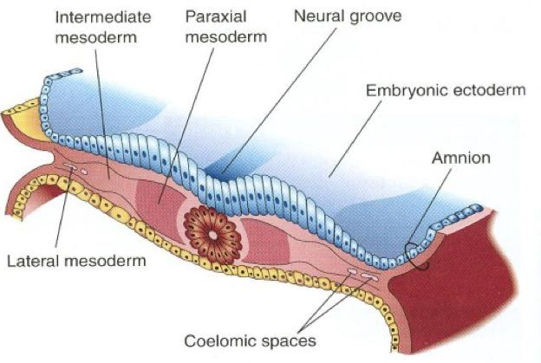
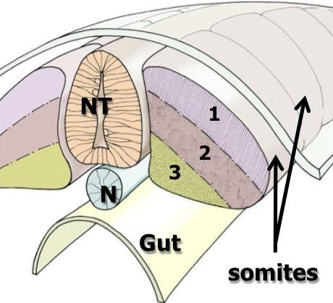
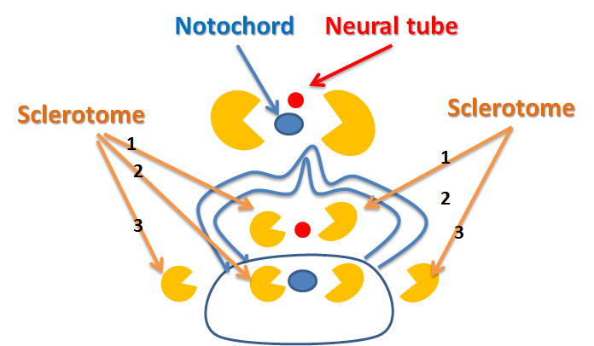
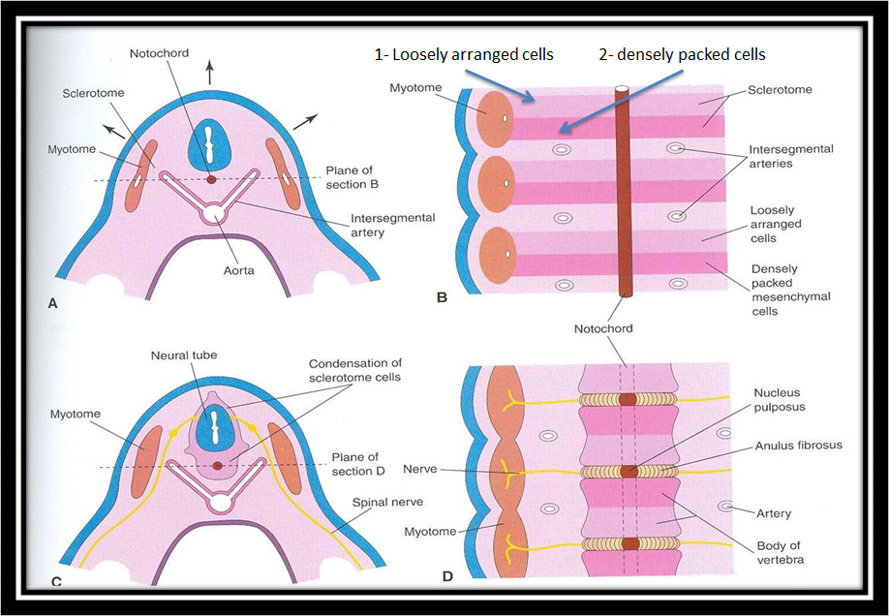
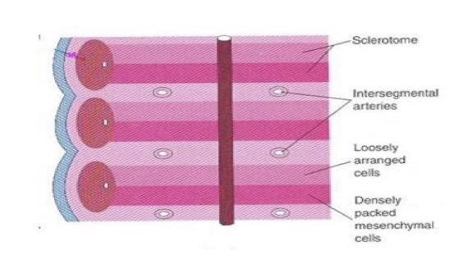
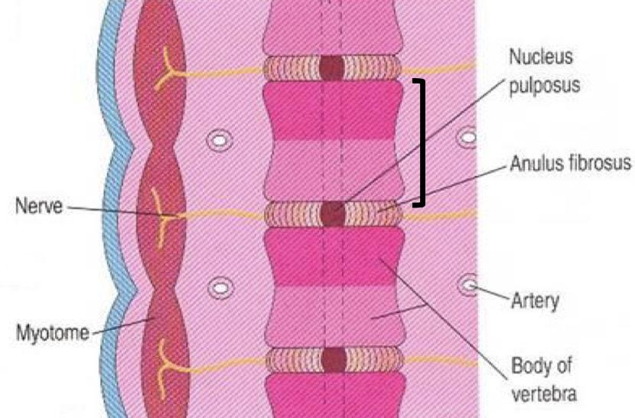
Development of the Vertebral Column:
The vertebral column develops from the ventromedial parts (sclerotomes) of the somites. The somites develop from the para-axial mesoderm.
Intraembryonic Mesoderm:
Located between Ectoderm & Endoderm EXCEPT in the central axis of embryo where NOTOCHORD is found.
Differentiates into 3 parts:
Paraxial mesoderm
Intermediate mesoderm
Lateral mesoderm
Paraxial mesoderm divides into segments called ‘somites’.
Each somite divides into 3 parts:
Dermatome
Myotome
Sclerotome
DEVELOPMENT OF VERTEBRA:
Sclerotome around neural tube: forms vertebral (neural) arch.
Sclerotome around notochord: forms body of vertebra.
Sclerotome in body wall near to neural tube and notochord: forms costal
process ( gives ribs in thoracic region only ).
Formation of Body of Vertebra:
At 4th week, each sclerotome becomes subdivided into two parts :
an cranial part, consisting of loosely arranged cells.
a caudal part, of more condensed tissue.
The Caudal Part Of each somite fuses with the cranial part of the consecutive somite,
around the notochord to form the body of the vertebra, called the centrum.
Thus each centrum develops from 2 adjacent sclerotomes.
طبقة الـ mesoderm تقسم إلى ثلاث أقسام من اليمين واليسار ويفصل بين اليمين واليسار الـ notochord.
أول قسم هو الـ para-axial mesoderm وهذا القسم يقسم إلى ثلاث أجزاء:
Sclerotome, Dermatome, Myotome .. من الـ Sclerotome يتكون لنا عظام فقرات الظهر
Future skin
Future muscles
Future bones

Slide 6
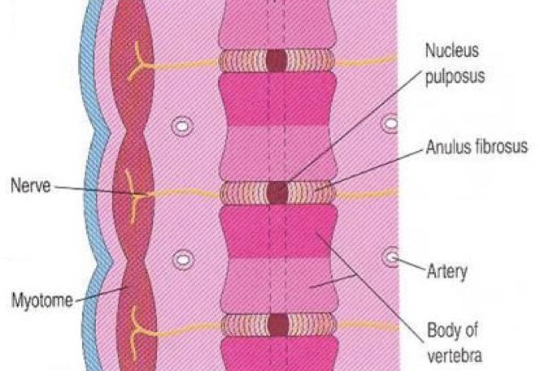
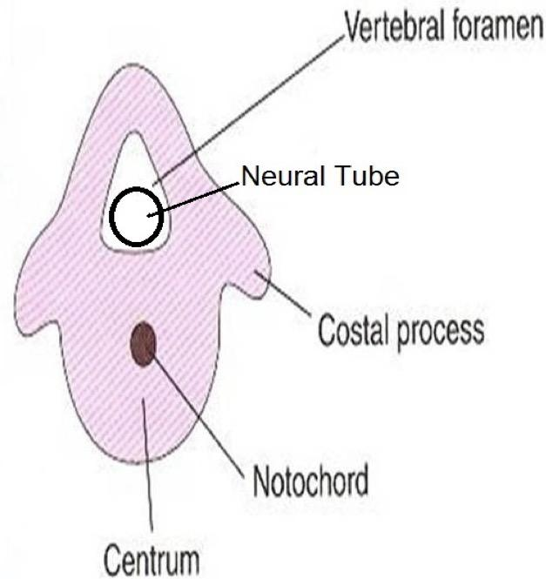
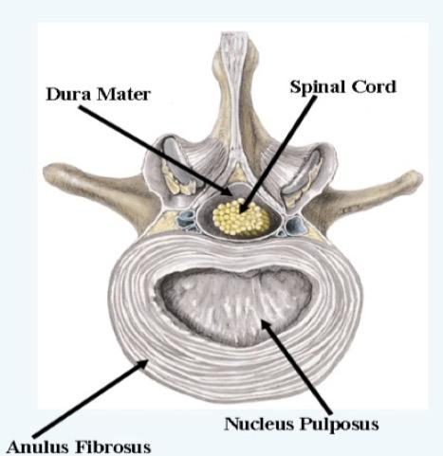
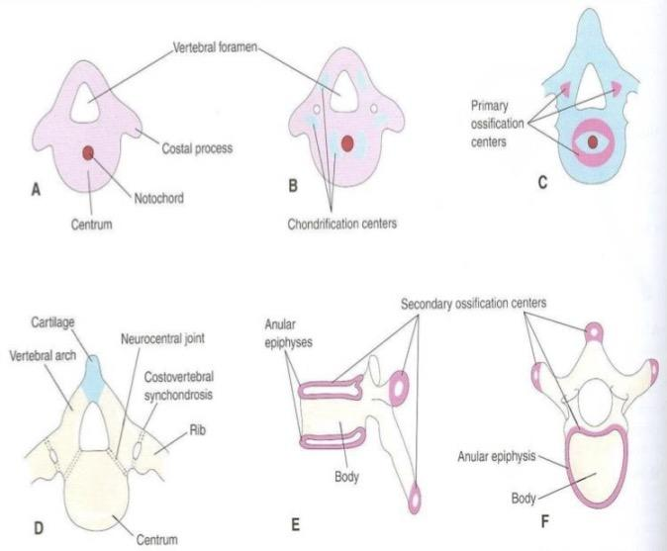
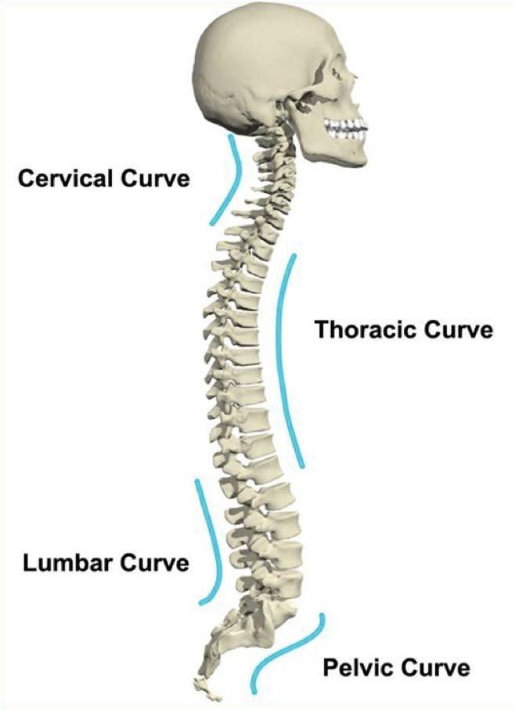
Fate of Notochord:
In the region of the bodies of vertebrae: It degenerates Between bodies of vertebrae: It forms the central part, ’nucleus pulposus’ of the intervertebral discs.
Annulus fibrosus part of the intervertebral discs is formed by the mesoderm surrounding the notochord.
The fused sclerotomes grow dorsally around the neural tube and
form the vertebral (neural) arch.
Ventrolaterally, costal processes develop that give rise to ribs
in thoracic region.
Vertebral Development:
Curvatures of Vertebral Column:
Nucleus pulposus developed from the remnants of notochord
Annulus fibrosus developed from mesoderm surrounding the notochord
This picture represents the changes that occurs into 2 stages : chondrification stage and ossification stage.
- The chondrification centers appears at 6th week (cartilage):(Pic.B)
- And by the (at the end of 8th week) the 3 primary ossification centers appears (bone): (Pic.c)
- And The 5 secondary ossification centers appear at puberty.
Fusion of bony halves of vertebral arch occurs at 3-5 years (pic.D). and Fusion of centrum with vertebral arch occurs at 4-6 years (pic.D). All centers unite around 25 years. SO, Ossification starts at the end of embryonic period ( end of 8th week) and ends at adult age 25 years.
Dr.sanaa Notes ( 435 team )
تكون العظام بنهاية embryonic period
Mesenchymal Stage
Chondrification Stage
Primary Ossification Stage
Stage of fusion
Stage of Secondary Ossification
Primary curvatures : (concave anterior) | Secondary curvatures: (convex anterior)
develop prenatally قبل الولادة | develop postnatally بعد الولادة
1.Thoracic 2.Pelvic or Sacral | 1.Cervical: as a result of lifting the head 2.Lumbar: as a result of walking
Vertebral column is concave anterior during the prenatal period
The it convex in 2 areas
Cervical - as results when baby is lifting his head
Thoracic - as result when the baby walks

Slide 7
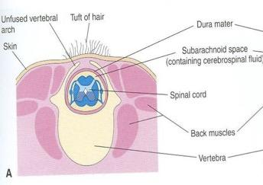
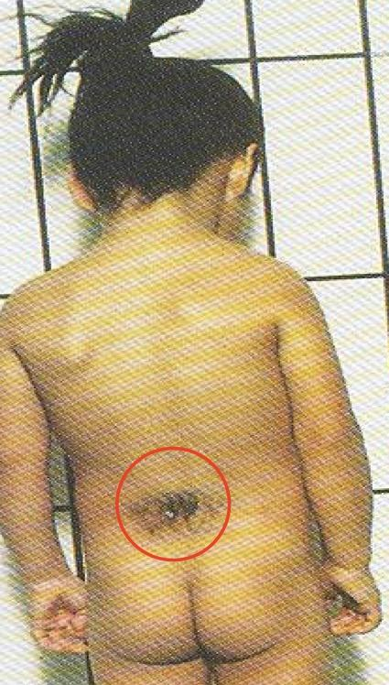
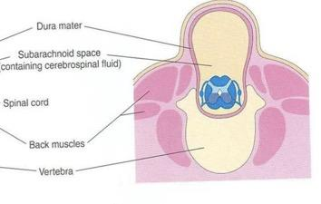
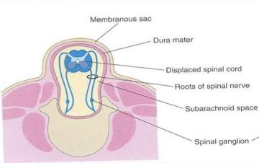
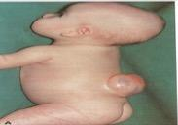
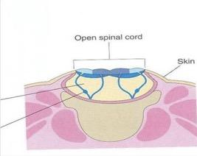
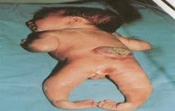
Spina Bifida
Cause: Failure of fusion of the halves of vertebral arches
Incidence: 0.04-0.15% Sex: more frequent in females
Types:
Meningo = meninges
myelo = spinal cord
ocoele = sac contains fluid or cysist
schisis= opening
1.Spina bifida occulta (20%) | 2.Spina bifida cystica (80%)
The closed type Only one vertebra is affected No clinical symptoms Skin overlying it is intact. Sometimes covered by a tuft of hair. Usually Doesn't Involve underlying neural tissue. هنا فقط الفقرة هي اللي تأثرت ومافي أي شيء طالع من السباينل كورد | The open type Cystica is the most severe and complex form of spina bifida. It usually involves serious or fatal neurological problems. A portion of the nerves and the spinal cord are exposed outside the body Neurological symptoms are present Subdivided into: Spina bifida with meningocoele Spina bifida with meningomyelocoele Spina bifida with myeloschisis
Better prognosis
1.Spina bifida with meningocoele | 2.Spina bifida with meningomyelocoele | 3.Spina bifida with myeloschisis
protrusion of sac containing meninges and cerebrospinal fluid. | protrusion of sac containing meninges with spinal cord and/or nerve roots. | spinal cord is open due to failure of fusion of neural folds.
هنا الفقرة تأثرت وطالع زي الكيس داخله Meninges and CSF | هنا الفقرة تأثرت وطالع زي الكيس داخله Meninges and spinal cord | هنا الفقرة تأثرت والسباينل كورد طالع ومافي أي شيء يغطيه
Failure in development of neural tube and neural fold

Slide 8
Summary
Structure | Origin
Neural tube | Ectoderm
Spinal cord | Caudal 2\3 of the neural tube.
Grey matter | Mantle layer.
White matter | Marginal layer.
arachnoid mater and pia mater | Ectoderm
Dura matter | mesoderm
Vertebral column | ventromedial parts (sclerotomes)of the somites.
Somaits | Para-axial mesoderm.
nucleus pulposus | Notochord between the bodies of vertebrae.
Annulus fibrosus | Mesoderm
Time | Changes
3rd week (early) | Three germ cell layers
4th week | Each sclerotome becomes subdivided into cranial and caudal part.
6th week | Chondrification centers appear.
End of 8th week | 3 primary ossification centers appear.
4th month | Starting of myelination of nerve fibers.
During 1st postnatal year | Continuation of the myelination of nerve fibers.
3-5 years | Fusion occurs (fusion of 2 vertebral arches)
4-6 years | Fusion of centrum with vertebral arch.
At puberty | 5 secondary ossification centers appear.
25 years | All centers unite.
During development the end of spinal cord shifts its position: at (level of S1), at birth (level of L3), adult position (level of L1-L2).

Slide 9
Questions
spina bifida with ............. Is a protrusion of sac containing meninges with spinal cord: |  | 2. Mantle zone is a future ........... and marginal is zone is a future ........... .
 | Spina Bifida Occulta |  | Grey Matter–white matter
B. | Spina bifida with meningomyelocoele | B. | Central canal – grey matter
C. | Spina bifida with meningocele | C. | White matter – grey matter
D. | Spina bifida with myeloschisis | D. | White Matter–central canal
3. 16-Which one of the following regions of spinal cord contains cell bodies of sensory neurons? |  | 4. As a result of fast growth of vertebral column, which part of spinal cord shifts gradually up?
 | Alar plate |  | Cauda Equina
B. | Ventricular zone | B. | Conus Medullaris
C. | Basal plate | C. | Clarke's column
D. | Dorsal funiculus | D. | Central canal
5. The dorsal alar plate and ventral basal plate are separated by: |  | 6. which one of the following periods of life fusion between vertebral arch & body of vertebra occurs?
 | Marginal layer |  | 8th week
B. | Ventricular layer | B. | Puberty
C. | Sulcus limitans | C. | 4-6 years
D. | Ventral Media Fissure | D. | Around 25 Years
7. 14-Regarding spina bifida which one of the following statements is correct? |  | 8. Myelination of nerve fibers continues after birth during:
 | The Closed Type Is More Frequent Than The Open type |  | First 2 Months
B. | The closed type presents with clinical symptoms. | B. | First 4 Months
C. | Spina bifida is due to failure of fusion between the halves of vertebral arch. | C. | First 8 Months
D. | In cases of spina bifida with meningocoele, the spinal cord is open. | D. | First 12 Months
Q | 1 | 2 | 3 | 4 | 5 | 6 | 7 | 8
Answers | B | A | A | B | C | C | C | D

Slide 10
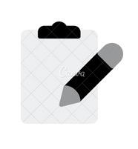
( يَرْفَعِ اللَّهُ الَّذِينَ آمَنُوا مِنكُمْ وَالَّذِينَ أُوتُوا الْعِلْمَ دَرَجَاتٍ وَاللَّهُ بِمَا تَعْمَلُونَ خَبِير )
Team leaders
ميعاد النفيعي - فهد النهابي
Team members
غادة القرني - ساره البليهد - عهد القرين - بلقيس الراجحي - ليلى الصّباغ
Embryologyteam437@gmail.com
‪@embryology437
Your feedback
Editing file

