Slide 1
DEVELOPMENT of
CEREBRUM & CEREBELLUM
Color Code:
Important
Doctors Notes
Extra explanation

Slide 2
OBJECTIVES:
Describe the formation of the neural tube.
List the 3 brain vesicles and their derivatives.
Describe the brain flexures.
Describe briefly the development of the cerebrum.
Describe briefly the development of the cerebellum.

Slide 3
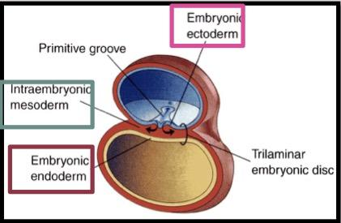
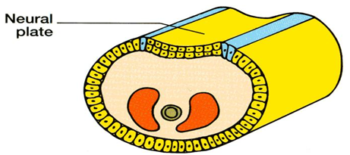
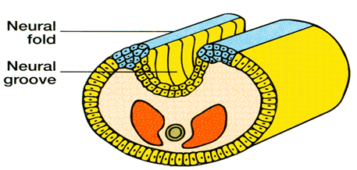
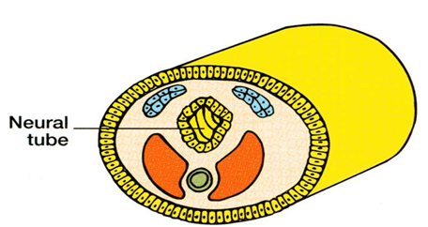
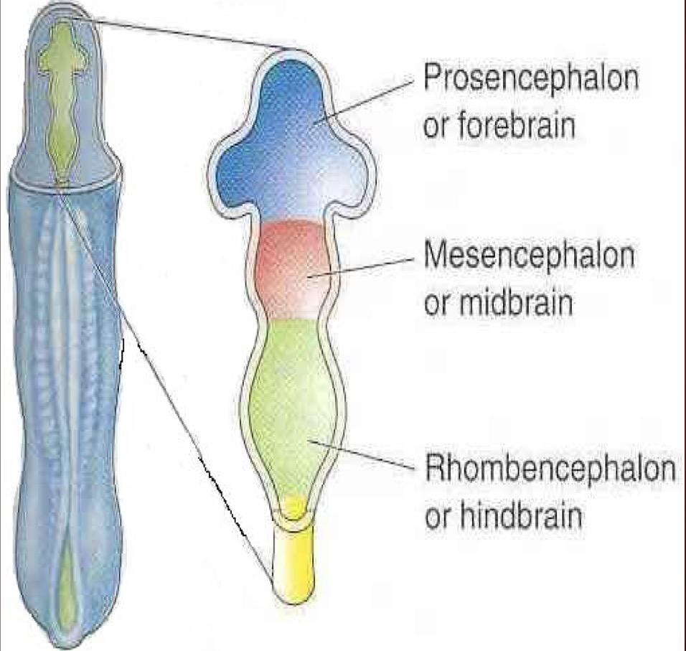
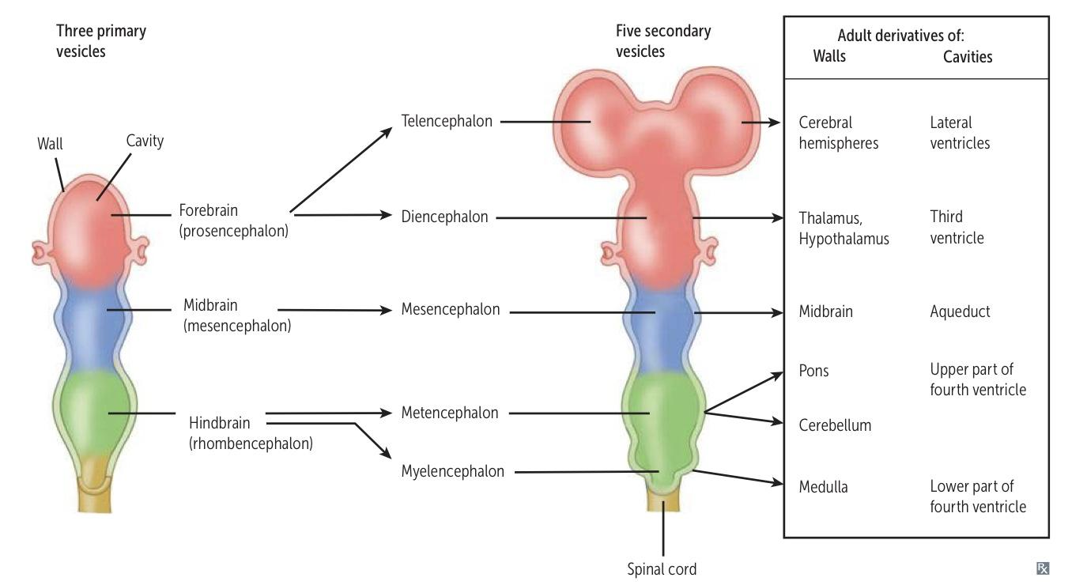
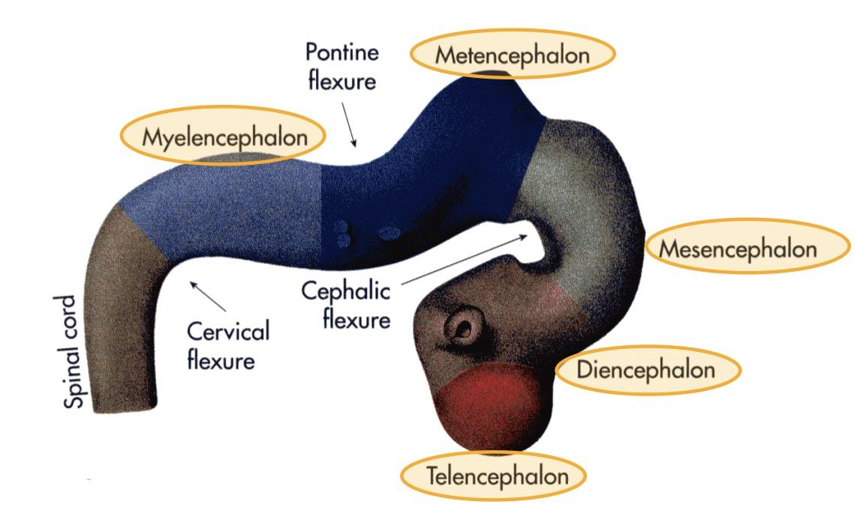
Introduction:
By the beginning of the 3rd week of development, three germ cell layers become established.
Ectoderm, Mesoderm and Endoderm.
Early Development:
During the middle of the 3rd week(16-17 days)the dorsal midline ectoderm undergoes thickening to form the neural plate (neuroectoderm).
The 2 margins of the plate elevate, forming neural folds
A longitudinal, midline depression, called the neural groove is formed.
The 2 neural folds approximate then fuse together, thus sealing the neural groove and creating the neural tube. (complete close).
Formation of neural tube is completed by the middle of 4th week.
Neural Tube Development:
Brain develops from cranial 1\3 of neural tube
تنقسم مرحلة تكون إلى مرحلتين
Three- primary brain vesicles stage (end of 4th week) (28 days) Neural tube upper end dilates and shows 3 vesicles This 3 vesicles are: (from up to down)
Prosencephalon (Forebrain)
2. Mesencephalon (Midbrain)
3. Rhombencephalon (Hindbrain)
five secondary brain vesicles stage (5th week)
Prosencephalon divides into: | Telencephalon
 | 2. Diencephalon
Mesencephalon | Mesencephalon
Rhombencephalon divides into: | Metencephalon
 | 2. Myelencephalon

Slide 4
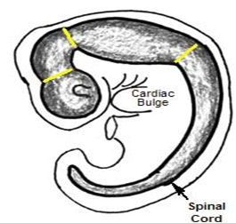
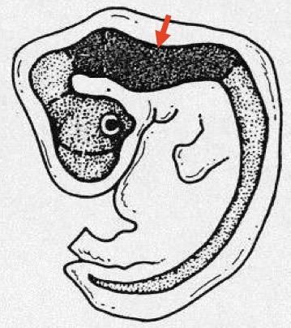
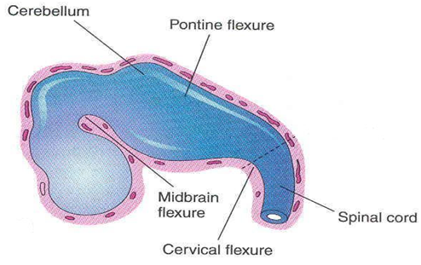
Derivatives of Brain Vesicles: important
By the 4th week, The neural tube grows rapidly and faster than cranial cavity.
There are 3 brain flexures
1. Cervical flexure (ventral) 2. Midbrain flexure (ventral) 3. Pontine flexure (dorsal flexure)
The neural tube grows rapidly and bends ventrally, producing two flexures:
1. Midbrain flexure: ( cephalic ) between the prosencephalon & the mesencephalon (midbrain) 2. Cervical flexure: between the Rhombencephalon (hindbrain) & the spinal cord.
Later Pontine flexure: appears in the hindbrain, in the opposite direction, resulting in thinning of the roof of the hindbrain.
Primary Brain Vesicles |  | Secondary Brain Vesicles |  | Derivatives In Mature Brain
Prosencephalon (forebrain) |  | 1. Two telencephalon |  | Cerebral hemisphere
 |  | 2.. Diencephalon |  | thalamus
Mesencephalon (midbrain) |  | mesencephalon |  | midbrain
Rhombencephalon (hindbrain) |  | metencephalon |  | Pons Cerebellum
 |  | 2. myelencephalon |  | Medulla oblongata
Mesencephalon
Rhombencephalon
Prosencephalon

Slide 5
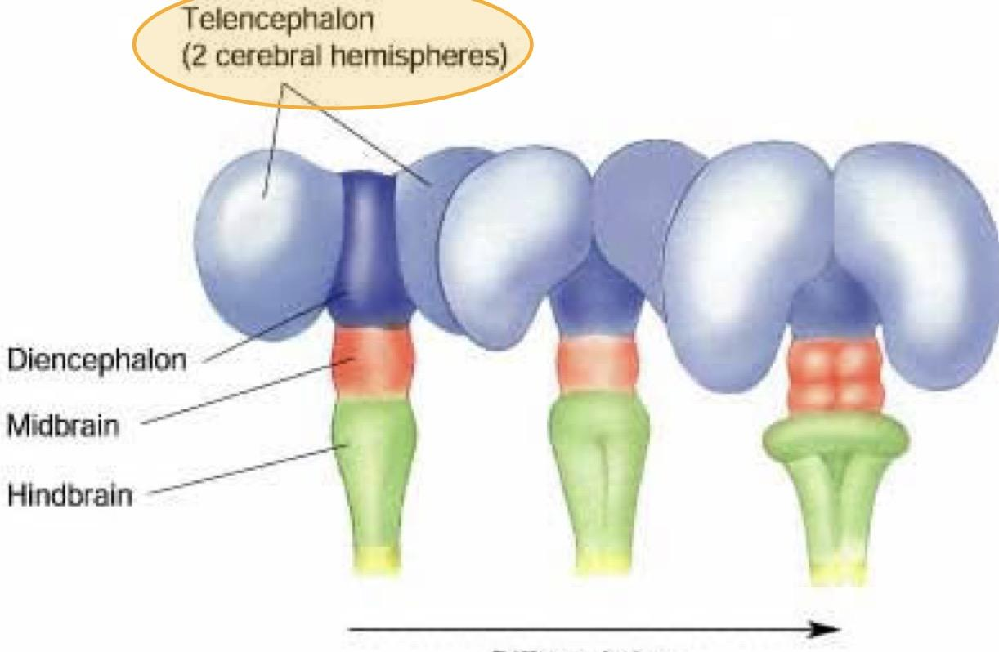
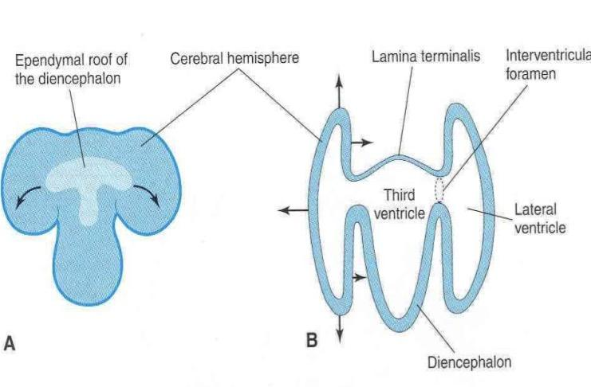
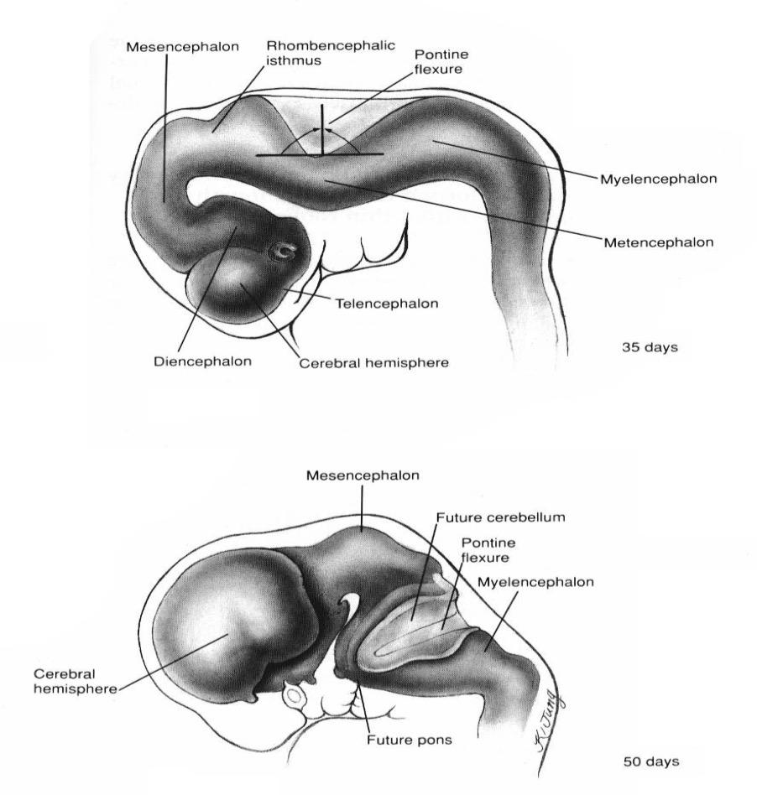
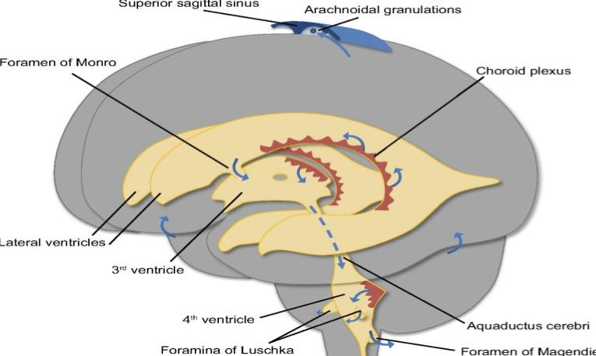
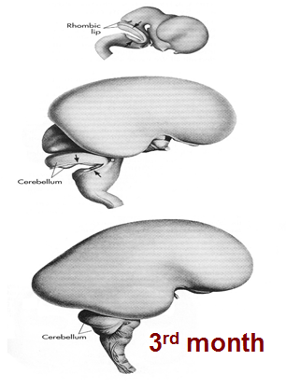
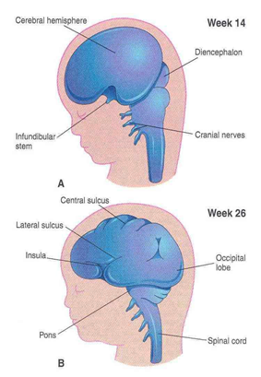
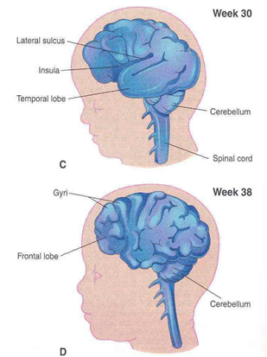
Development of the cerebrum (cerebral hemisphere):
The cerebrum develops from the Telencephalon.
Differentiation of Forebrain Vesicle:
The (prosencephalon) or the forebrain vesicle differentiates into a: 1. Median part (diencephalon). 2. Two lateral cerebral vesicles or ( telencephalic vesicles.)
The lumen gives the 2 lateral ventricles and the 3rd ventricle.
Both cavities communicating with each other through a wide interventricular foramen.
The cerebral hemispheres expand in all directions .
Its medial wall becomes thin, flat and it is the site of choroid plexus of the lateral ventricle.
The Cerebral hemispheres first appear on the day 32 of pregnancy as a pair of bubble-like outgrowths of the Telencephalon.
By 16 Weeks,the rapidly growing hemispheres are oval and have expanded back to cover the diencephalon.
By the end of the 3rd month the surfaces of the cerebral hemispheres are smooth.
By the 4th month the grey matter grows faster than the white matter, so, the cortex becomes folded into gyri separated by sulci.
The gyri and sulci effectively increase the surface area of the brain.
The detailed pattern of gyri & sulci varies somewhat from individual to individual.

Slide 6
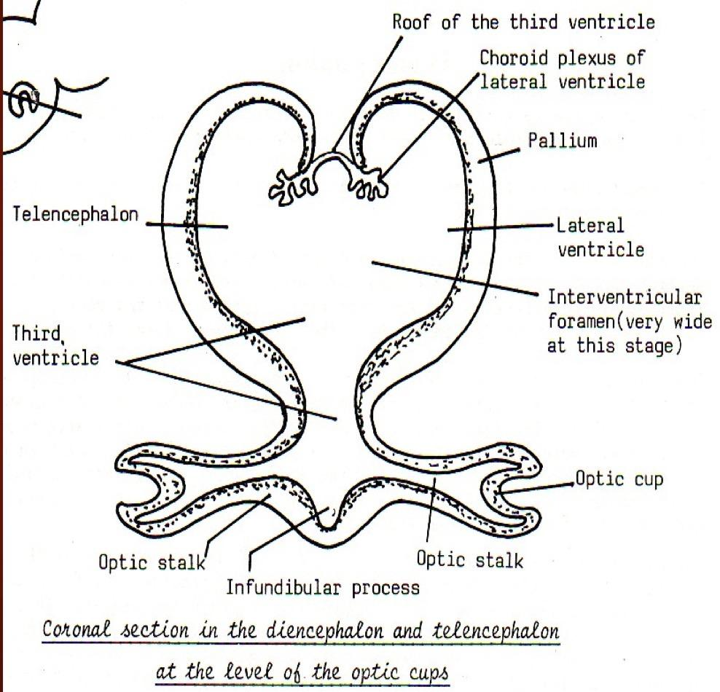
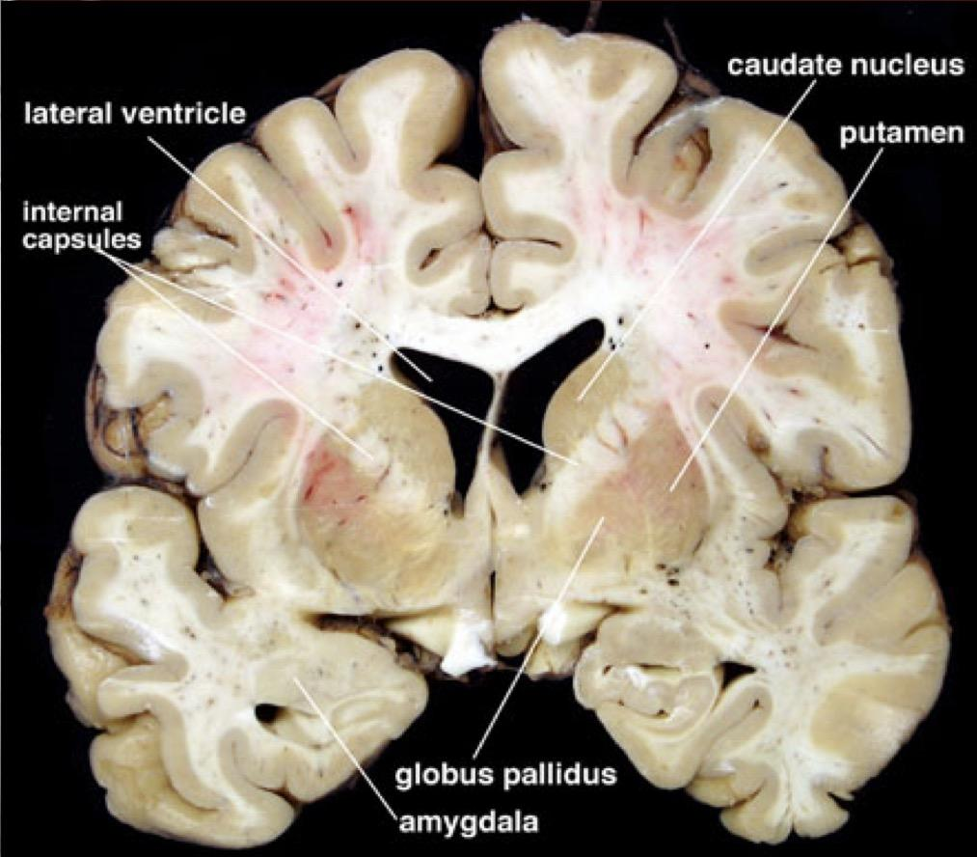
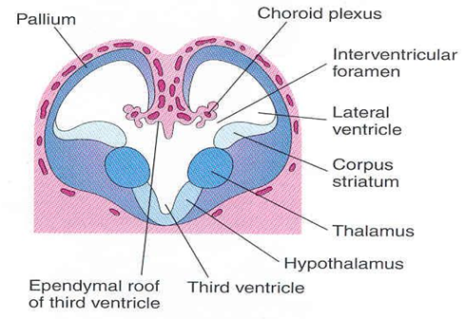
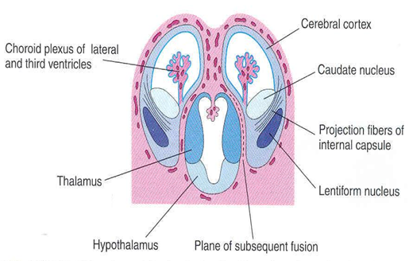
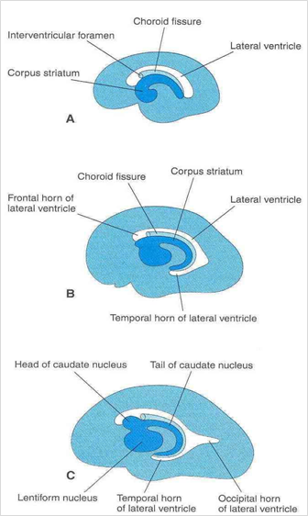
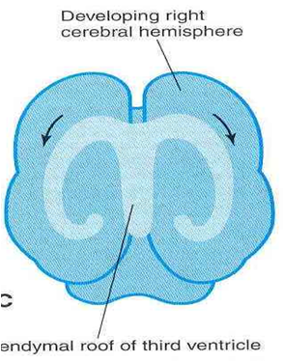
Development of the cerebrum:
The wall of the telencephalon is formed of 3 layers :
As development proceeds the following changes occur:
Most of the nerve cells in mantle layer migrate to the marginal layer forming the cerebral cortex.
Some cells do not migrate and remains to form the basal ganglia.
Corpus striatum: is the basal ganglia nuclei in the cerebral hemisphere.
It appears in 6th week in the floor of each cerebral hemisphere. As the cerebral cortex differentiates and the fibers passing to and from it, pass through the corpus striatum. The corpus striatum now divides into : 1. caudate nucleus. 2. lentiform nucleus.
This fiber pathway forms the internal capsule.
Ependymal | Mantel | Marginal
lining the cavity of the lateral ventricle. | nerve cells forming the grey matter. | nerve fibers forming the white matter.
‏ليه صار هذا الإنتقال في المخ وما صار في الحبل الشوكي ؟ ‏لأن القشرة الخارجية للدماغ تتكون من القراي ماتر وجوّا وايت ماتر بعكس الحبل الشوكي ، ولكن مو جميع الخلايا تنتقل فيه جزء قليل منها يبقى .. ليه؟ لأن هذا الجزء الباقي بيكون البيزال قانقليا اللي هي عبارة عن قراي ماتر جوّا الوايت ماتر .
Internal capsule
جت بعد ما حصل لها
Well differentiation of cerebral cortex
Further expansion of cerebral hemisphere gives C- shape appearance to the hemisphere itself as well as its cavity (lateral ventricle).
Also the caudate nucleus elongates and assumes the shape of the lateral ventricle and remains related to it.
الي برا grow faster
الي جوا grow slower

Slide 7
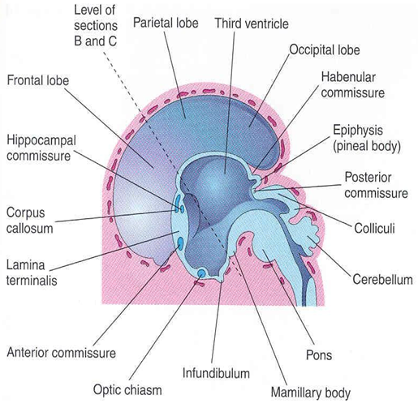
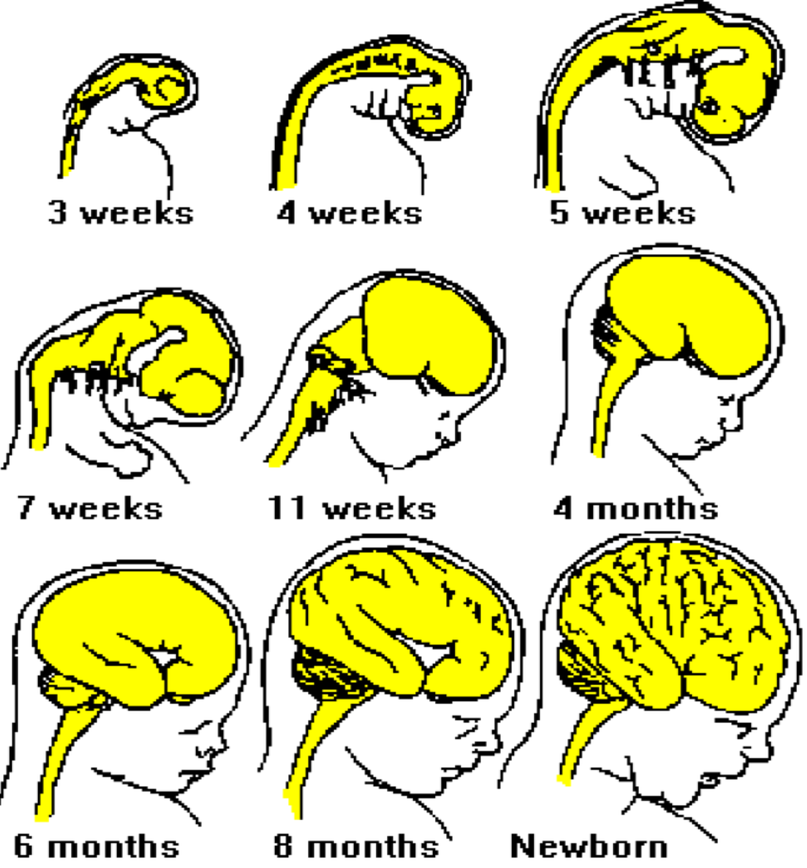
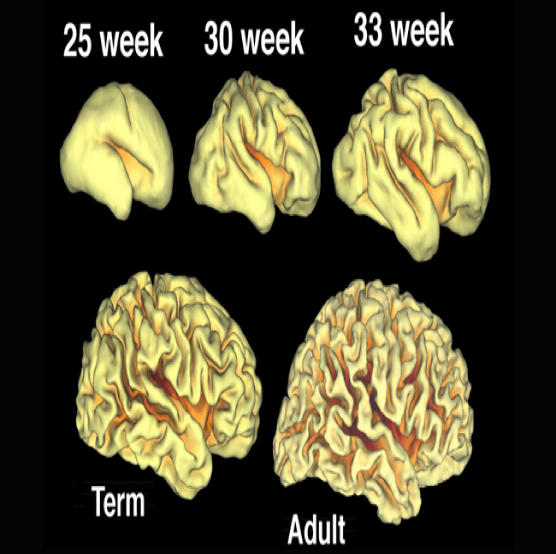
Development of the Cerebral Commissures:
As the cerebral cortex develops, group of fibers, (commissures), connect the corresponding regions of the cortex. These are: - Lamina terminalis. - Optic chiasma. - Anterior commissure. - Posterior commissure. - Hippocampal commissure. - Habenular commissure. - Corpus callosum.(is a major commissural fibres that connect the two cerebral hemispheres). (Important)
Development of Insula: The cortex covering the surface of the corpus striatum grows relatively slower than the other cortices, so it is overgrown by the rest of the hemisphere and lies in the depth of the lateral sulcus.
This is called the insula. So, the insular lobe is a portion of cerebral cortex that has invaginated to lie deep within the lateral sulcus.
اهم شي corpus callosum
Transverse axons between 2 cerebral hemisphere
‏القشرة الخارجية تنمو أسرع من القشرة اللي تغطي الكوربس ستريتم ، علشان كذا الكروبس ستريتم والقشرة اللي بتغطيها بتكون بالعمق لأن القشرة الخارجية نمت أسرع .. علشان كذا لما نوخر القشرة الخارجية بنقدر نشوف القشرة " البطيئة " جوا اللي هي الإنسيولا .

Slide 8
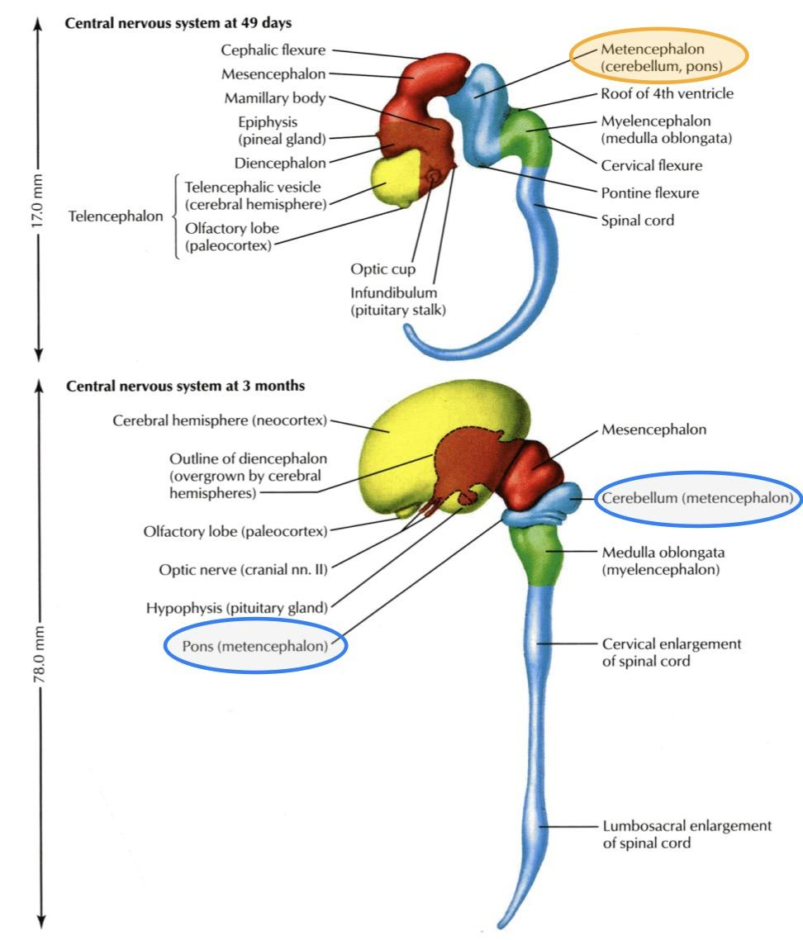
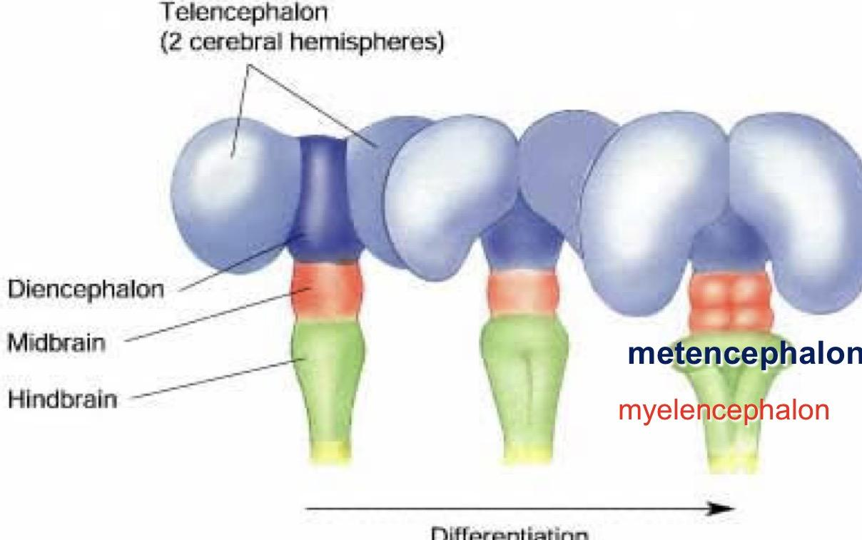
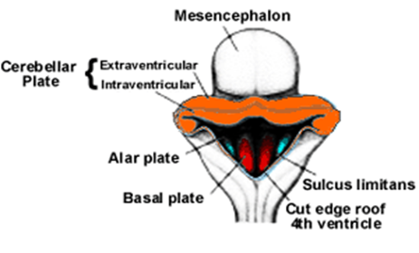
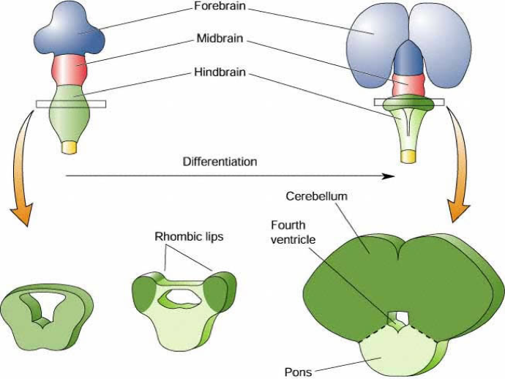
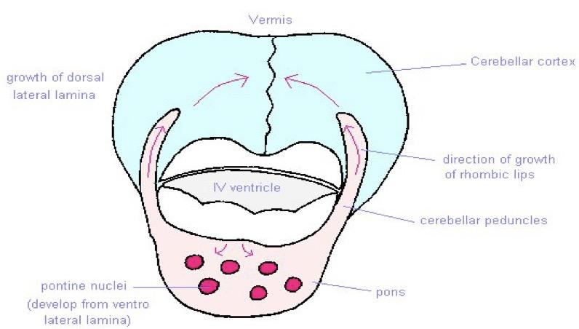
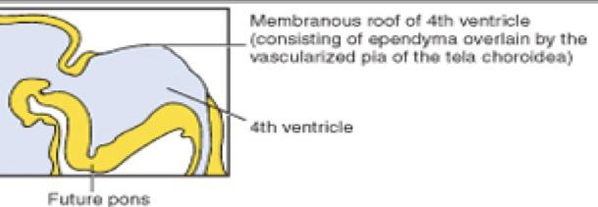
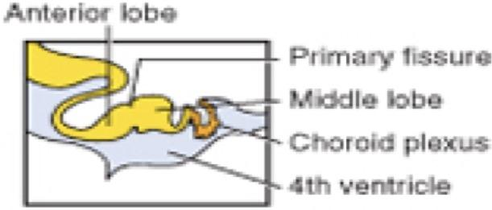
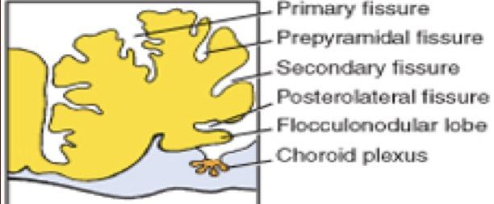
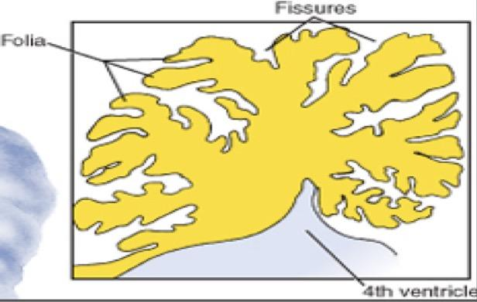
Development of the cerebellum:
It develops from the dorsal part of the Metencephalon.
Pontine flexure results in: 1. Moving the 2 alar plates laterally then pending medially. 2. Stretching and thinning of the roof plate. 3. Widening of the cavity to form the 4th ventricle.
Metencephalon Changes in Alar plates : a. The dorsal parts thicken to form Rhombic lips, that will give rise to the cerebellum. b. Some neuroblasts migrate from the mantle layer to the marginal layer and form the cerebellar cortex. Others remains in the mantle layer and give rise to the cerebellar nuclei c. The cerebellar peduncles develop later as the axons of the neurons of the cerebellar nuclei grow out to reach the brain stem.
The surface of the cerebellum
As the cerebellar hemispheres develops they undergo a complicated process of transverse folding to form closely packed, leaf-like transverse gyri called folia.
These processes of fissure formation and foliation continue throughout embryonic, fetal, and postnatal life, and they vastly (extremely) increase the surface area of the cerebellar cortex.
The metencephalon develops into the pons (anteriorly) and overlying Cerebellum (posteriorly)
35d 50d 90d 150d
Transverse folding “folia”Separated by fissures

Slide 9
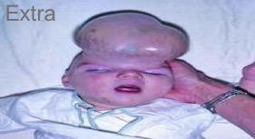
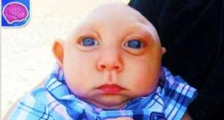
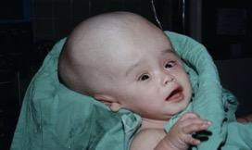
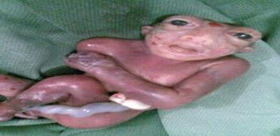
The 2 ends of the neural tube are opened.
The upper end is closed on the 23rd to 26th day of development.
While the lower end is closed by the 27th day of development.
If the upper end fail to close it will lead to anencephaly
If the lower opening fail to close it will lead to spina bifida.
Congenital Anomalies of The Brain
Mental retardation.
2. Seizures | changes in electrical activity.
3. Cerebral palsy. الشلل الدماغي .. يوجد إعاقة بالحركة
4. Agenesis of corpus callosum.
5. Cranium bifidum with or without meningocele & meningoencephalocele.
6. Microcephaly | abnormal smallness of the head, a congenital condition associated with incomplete brain development).
7. Hydrocephalus | Increase secretion of (CSF) and decrease absorption of it .
8. Arnold-Chiari Malformation | herniated part of cerebellum through the foramen magnum leading to CSF obstruction ,so hydrocephalus results), also in aqueductal stenosis between the 4th and 3rd ventricles and in brain tumours.
9. Anencephaly | It is due to failure of closure of the cranial neuropore of the neural tube. the brain and skull are minute and the infant does not usually survive. The frequency of this case 1:1000.
Which leads to Enlargement of lateral ventricles

Slide 10
Summary
Time | Changes
Beginning of the 3rd week | Formation of 3 germ cell layers (ectoderm,mesoderm,endoderm)
Middle of 3rd week | Forming Neural plate (Beginning of neural tube formation)
4th week | Forming brain flexures
Middle of the 4th week | End of neural tube formation
End of 4th week | Three vesicles stage (3 primary vesicles)
5th week | Five vesicles stage (2ry brain vesicles)
Development of cerebrum
Day 32 (between 4th and 5th week) | The Cerebral hemispheres appear as a pair of bubble-like outgrowths of the Telencephalon.
6th week | Formation of corpus striatum
16 week | Cerebral hemispheres are oval and have expanded back to cover the diencephalon
The end of 3rd month | Smooth Surfaces of the cerebral hemispheres
4th month | The cortex become folded into gyri separated by sulci
Time
Changes

Slide 11
Questions
aqueductal stenosis is an acquired condition that cause: |  | 2. nerve cells forming the grey matter called:
 | Microcephaly |  | Marginal
B. | Hydrocephalus | B. | Mantle
C. | Seizures | C. | Ependymal
D. | Cerebral palsy | D. | Both A & B
3. Processes of fissure formation and foliation: |  | 4. The distinguish of five secondary brain vesicles from the primary vesicles is in:
 | Stop at 4th month |  | 3rd month
B. | Stop at 3rd month | B. | 4th month
C. | Continue through postnatal life | C. | 5th week
D. | Stop at 5th week | D. | 3rd week
5. Surfaces of the cerebral hemispheres are smooth in the: |  | 6. is a major commissural fibers that connect the two cerebral hemisphere:
 | End of 3rd month |  | Hippocampal commissure
B. | 6th week | B. | Anterior commissure
C. | Beginning of 3rd month | C. | Corpus callosum
D. | 4th month | D. | Posterior commissure
7. Metencephalon develops into: |  | 8. Corpus striatum appears in the floor of each cerebral hemisphere in the:
 | Pons and cerebellum |  | 3rd month
B. | Cerebral hemisphere | B. | 4th month
C. | Pons | C. | 3rd week
D. | Medulla oblongata | D. | 6th week
Q | 1 | 2 | 3 | 4 | 5 | 6 | 7 | 8
Answers | B | B | C | C | A | C | A | D

Slide 12
( يَرْفَعِ اللَّهُ الَّذِينَ آمَنُوا مِنكُمْ وَالَّذِينَ أُوتُوا الْعِلْمَ دَرَجَاتٍ وَاللَّهُ بِمَا تَعْمَلُونَ خَبِير )
Team leaders
ميعاد النفيعي - فهد النهابي
Team members
ليلى الصباغ - سارة البليهد - علي شحادة
Embryologyteam437@gmail.com
‪@embryology437
Your feedback
Editing file

