Slide 1
Objectives:
Define middle ear infection
Know the classification of otitis media (OM).
Know the epidemiology of OM
Know the pathogenesis & risk factors of OM.
List the clinical features of OM.
Know the diagnostic approaches of OM.
Know the management of OM.
Recall common complications of OM.

Slide 2
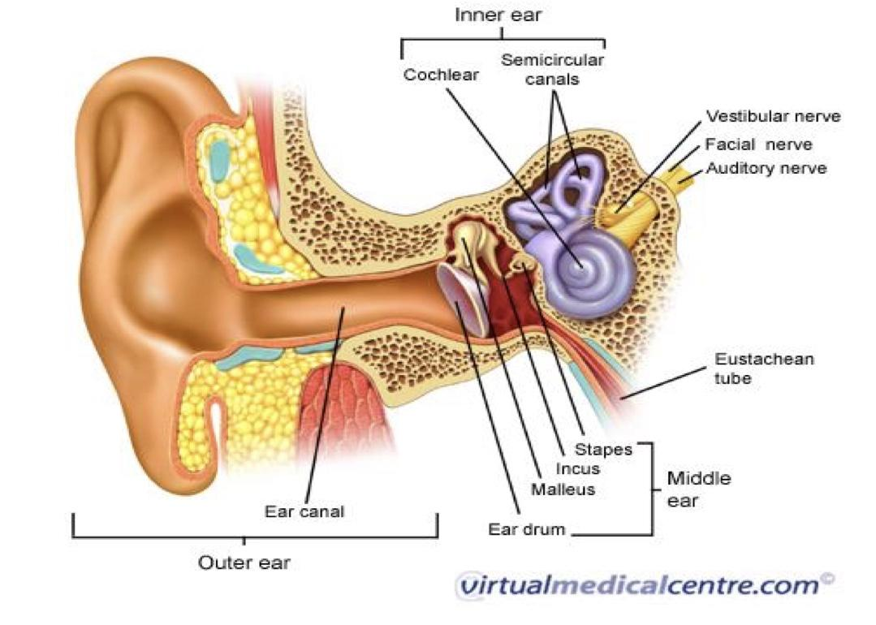
Definitions
Middle ear: is the area between the tympanic membrane and the inner ear including the Eustachian tube. | Otitis media (OM): is inflammation of the middle ear.
Anatomy of the middle ear
Classification
1. Acute 2. Secretory (Serous) 3. Chronic
Epidemiology
Most common in infants 6 to 18 months of age (2/3 of cases). (Due to disappearance of IgG) Improves with age, why ? The Eustachian Tube which vents the middle ear to the Nasopharynx is horizontal in infants, difficult to drain naturally, its surface is cartilage ,and the lymphatic tissue lining is an extension of adenoidal tissue from the back of the nose. - Often preceded by viral upper respiratory infection (URTI).

Slide 3
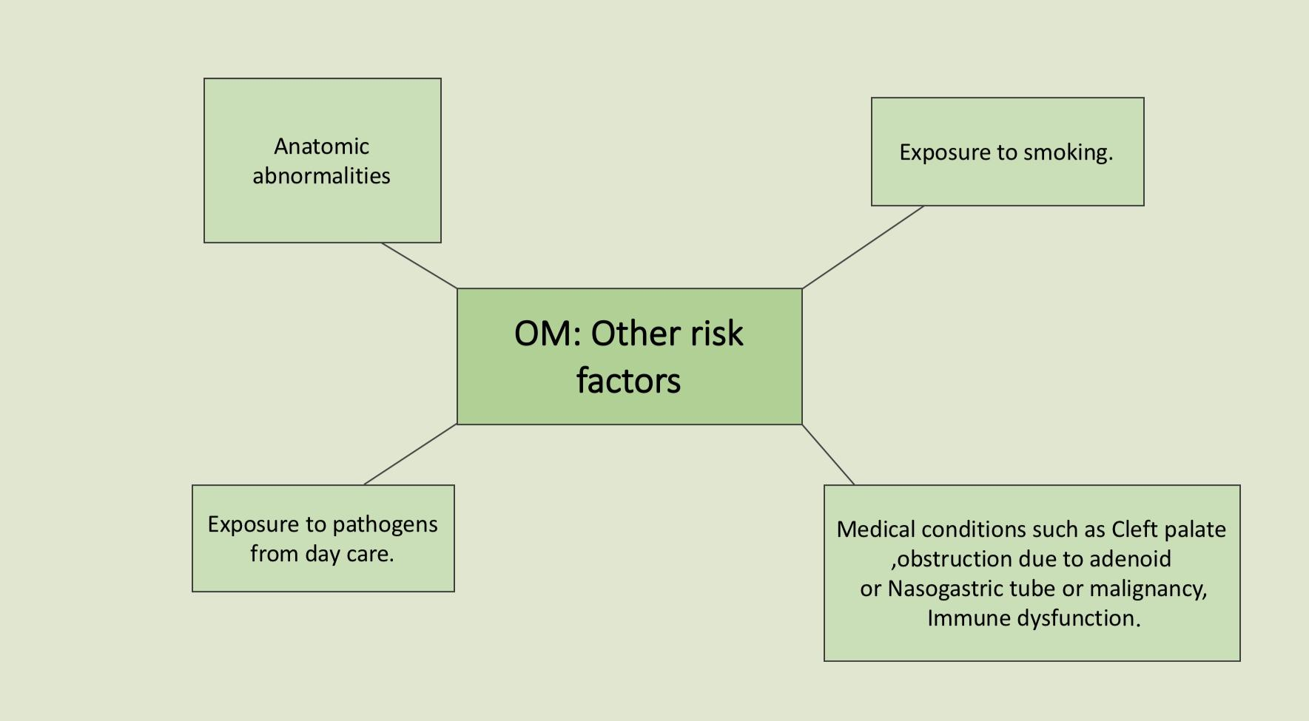
لحمية

Slide 4
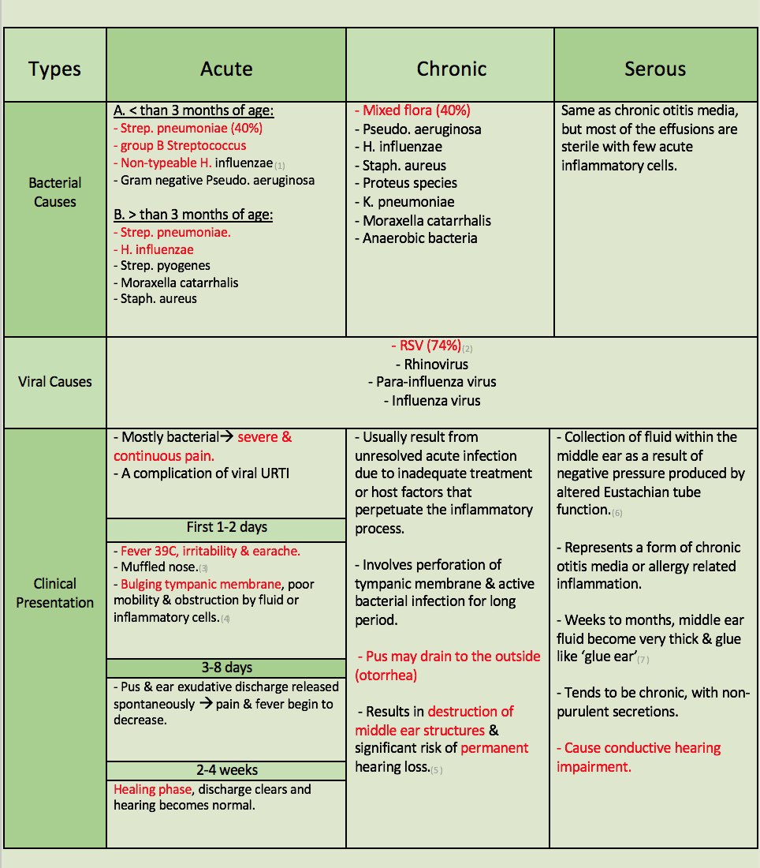
Otitis Media

Slide 5
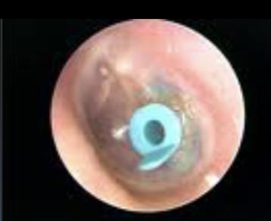
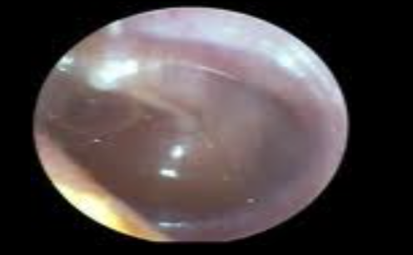
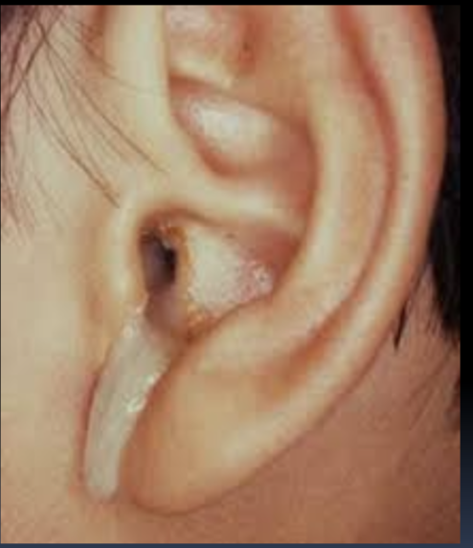
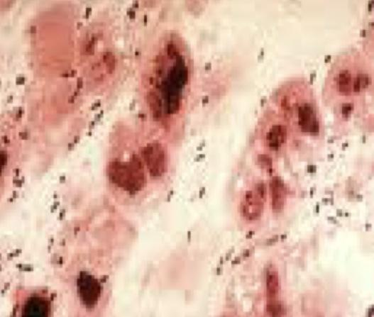
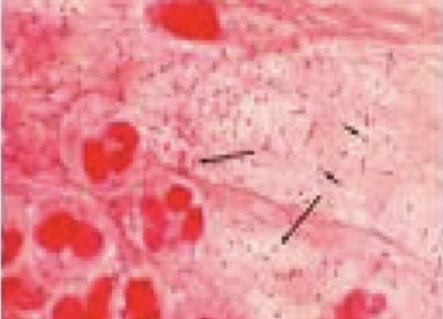
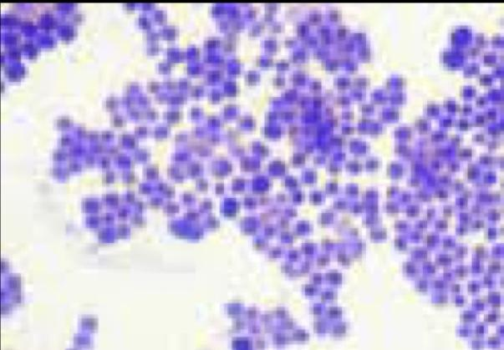
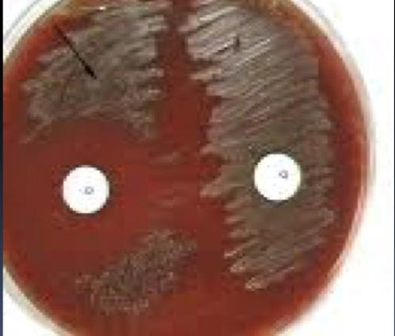
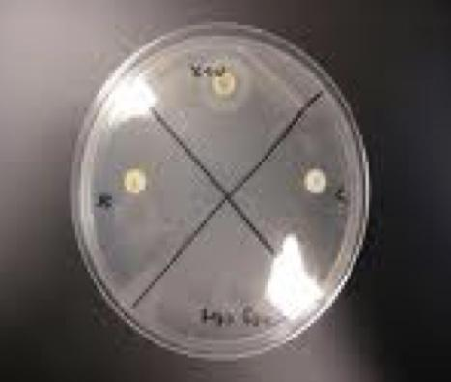
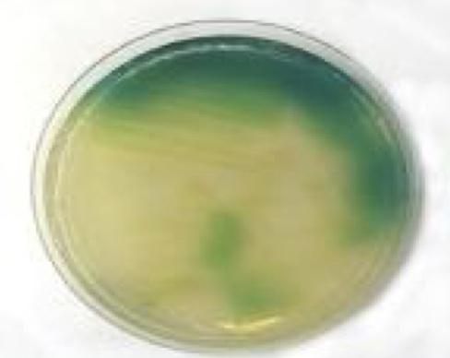
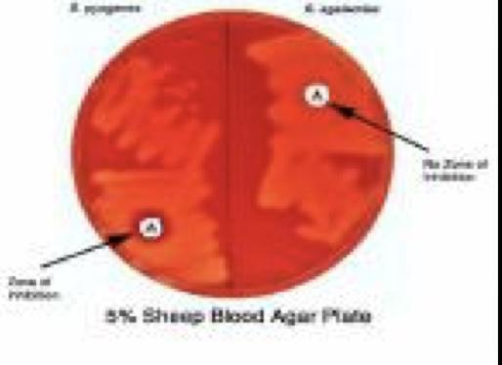
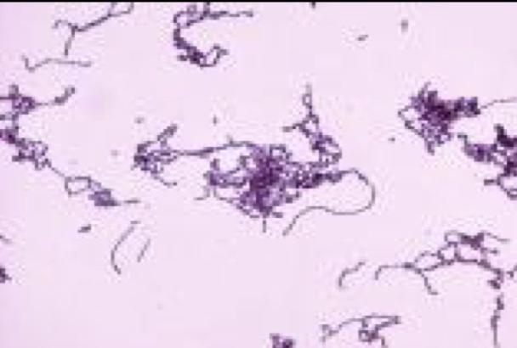
Tube to decrease the tension and the ear discharge in serous OM
Sticky fluid (glue ear)
Ear discharge in chronic OM
Microbiology of Otitis Media
Gram + diplococci
Strep. pneumonia
Gram + cocci in clusters
Staph. Aureus
Gram - coccobacilli
Strep. pneumonia sensitive to optochin
Viridans streptococci resistant to optochin
X+V factor test to identify H. influenzae by its unique growth
DNase test to identify Staph. Aureus
Pseudo. Aeruginosa
Beta hemolytic streptococci sensitive to bacitracin
Gram + streptococci in chains

Slide 6
Diagnostic approaches of Otitis Media
Clinical examination Tympanometry (detect the presence of fluid) Gram stain & culture of aspirated fluid to determine the etiologic agents.(sample not swab)
Management of Otitis Media
Acute OM requires antimicrobial therapy & careful follow up. Antimicrobial usually empirical depending on the most likely bacterial pathogens, usually to cover S.pneumoniae and H.influenzae. Drainage of exudates may be required. Chronic or serous OM need complex management, possibly surgical.
Antibiotics
Complications of Otitis Media
Extracranial Hearing loss Tympanic membrane Perforation Mastoiditis Cholesteatoma Labyrinthitis & others | Intracranial Meningitis Extradural abscess Subdural empyema Brain abscess & others
(Alsomily only mentioned amox-clav)

Slide 7
Alsomily’s notes
- Otitis media can be clinically diagnosed
- Middle ear is more susceptible for infections because it’s opened into the nasopharynx through the eustachian tube
- The function of eustachian tube is to equalize the pressure b/w the ear and the nasopharynx
بنتكلم عن (symptoms, common microorganism, diagnosing and treatment)
(eustachian tube) مهمة في توازن الضغط بين البلعوم والاذن و لكن لو فيه اي التهاب او مشاكل وراثية ممكن تنسد ويكون الضغط (negative) وتنشفط السوائل داخل الأذن
the fluid that comes from the oropharynx isn’t sterile so it’s filled with normal flora like moraxella, strep. pneumoniae, haemophilus, neisseria which will cause inflammation to the middle ear.
Types of otitis: acute(2-3 days)- chronic (if untreated)
Secretory Otitis media is not an infection but maybe a result of infection
- Infants from 6-18 months are predisposed to otitis media, why? Bc eustachian tube is short and horizontal (wide)
- Why not at risk from 1st month? Because of mother antibodies
- Breastfeeding can prevent otitis media
- Otitis media can occur with a viral infection or after a viral infection
- Risk factors are the characteristic that increase the risk of developing an infection or a disease so we should know them in order to avoid them and to also avoid recurrent infection
- For example ppl who have viral upper respiratory tract infection or ppl who have allergies.
Pathogenesis:
functional abnormalities in the tube that would lead to ineffective clearance
oxygen loss leading to negative pressure
Risk factors:
congenital abnormalities like cleft palate bc the palate will elongate and reach the nasopharynx and also bc of the abnormal position of the muscles and tendons in children with cleft palate, the eustachian tube cannot drain the ear.
ppl who has nasogastric tube, why? because it might affect the pressure of the ear which will affect the function of the eustachian tube.
tumor or immune dysfunction
children attending day care centers might be infected with resistant organisms and when they get a viral infection they will mostly treat it using antibiotic for sensitive organisms and it won’t help since the kid is suffering from an infection caused by resistant organism
smoking bc it will destroy the cilia therefore it increase the secretions which will cause edema then inflammation
Microbiology: Whats the normal flora of the oropharynx?
Haemophilus, streptococcus pneumonia, moraxella, and staph aureus less common
the most common organisms in children who are younger than 3 months, are group b strep. pneumonia, gram negative bacteria, and normal flora.
(In chronic we can find any organism) and in (serous nothing)
It also can be viral so we usually wait for 2-3 days if the patient isn't really sick
Most commonly (RSV, rhinovirus) virus infect directly from blood

Slide 8
AlSomily’s notes cont.
Clinical presentation:
- They will have initially fever, ear pain (otalgia) and if you examine them you will find (a bulging tympanic membrane)
- In babies they will have fever, lethargy (lack of energy) &, poor feeding (general symptoms) their mom will notice and know. Some children will try to hit their ear (bc of the pain)
فيه قصص اطفال زي واحد عمره سنتين اتصلو من مستشفى
فقالو البيبي عنده strep pneumonia in CSF
قبلها ب 3 ايام فحصة الدكتور قال عنده التهاب في الحلق
المهم جانا بعد 3 ايام braindead due to stroke
فعند الأطفال مهم متى تعالج متى تنتظر بس ال decision صعب عليكم
لكن اعرفوا المبدأ
some infections at certain age group is very dangerous and has to be diagnosed properly otherwise in can lead to morbidity and mortality
After three days from the infection pus is formed and exudate discharge & pain might be present.
Serous is not an infection but might occur as a result of an infection.
Chronic is complication of acute and it will be caused by multiple organisms.
Diagnosis is mainly clinical: otoscope, history, and physical examination.
- you don't touch the tympanic membrane and take sample if the baby is well. Like when the fever isn't that high, and he's stable
- If the baby is sick or young (less than 2 years) you give him antibiotics
- Treatment: amoxi-clav ( amoxicillin-clavulanic acid) and drainage may be required in chronic.
(EXTRA)In adult we use fluoroquinolones esp. in diabetics because the most common cause organism is pseudomonas
- Complications: extracranial and intracranial
Extracranial (related to ear):hearing loss, mastoiditis, tympanic m. proliferation
Intracranial: meningitis, subdural empyema (pus), and brain abscess.

Slide 9
Summary
Otitis media: inflammation of the middle ear.
Epidemiology: | common in infants 6-18 months. |  | Due to: The Eustachian Tube is horizontal in infants, difficult to drain naturally.
Pathogenesis: | 1-URTI or allergic condition cause edema or inflammation of the eustachian tube. 2-O2 lost lead to negative pressure. 3-Pathogens enter from nasopharynx into the middle ear. 4-Colonization and infection result.
Risk factors: | 1-Anatomic abnormalities. 2-Cleft palate. 3-Exposure to pathogens from day care. |  |  |  | 4-Exposure to smoking. 5-obstruction due to adenoid or Nasogastric tube or malignancy 6-immune dysfunction.
Types: | Acute OM |  |  |  | Chronic OM |  | Serous OM
 | Younger than 3months | Older than 3 months
Microbiology | H.influenzae
 | S.pneumoniae |  |  |  | -Mixed flora. -P.aeruginosa. -S.aureus. - Proteus species. -K.pneumoniae. -Moraxella catarrhalis. -anaerobic bacteria. |  | Same as chronic, but most of the effusions are sterile Few acute inflammatory cells.
 | - group B Streptococcus. -Gram negative bacteria, including P.aeruginosa. | -S.pyogenes. -Moraxella catarrhalis. -S.aureus.
 | RSV( Respiratory Syncytial Virus). Rhinovirus. Para-influenza virus. Influenza virus.
Clinical presentation: | 1-2 days: Fever (39 C), irritability, Bulging tympanic membrane. |  |  |  | - result from unresolved acute infection. -Involves perforation of tympanic membrane and active bacterial infection. - otorrhea. | Over weeks to months, fluid become very thick and glue like (glue ear). -Collection of fluid within the middle ear. -Tends to be chronic
 | 3-8 days: Pus and ear exudative discharge, pain and fever begin to decrease.
 | 2-4 weeks: Healing phase, discharge clears and hearing becomes normal.
Result in: |  |  |  |  | destruction of middle ear structures. risk of permanent hearing loss. | conductive hearing impairment.
Diagnosis: | 1-Clinical examination 2-Tympanometry 3-Gram stain and culture of aspirated fluid to determine the etiologic agents.
Management: | Acute OM requires antimicrobial therapy (empirical) . Drainage of exudates may be required. Chronic or serous OM need complex management, possibly surgical.
Complications: | Extracranial: |  |  | Intracranial:
 | Hearing loss Tympanic membrane perforation Mastoiditis Cholestatoma Labyrinthitis |  |  | Meningitis Extradural abscess Subdural empyema Brain abscess

Slide 10
MCQs:
4- After car accident the patient isn’t able to eat properly, the doctors has decided to insert a plastic tube (nasogastric tube) in order to feed him. This increases his chance at developing??
A- Coma
B- Fever
C- Otitis media.
D- Septicemia.
5- Which one in an intracranial complication of OM?
A- Cholesteatoma.
B- Mastoiditis.
C- Meningitis.
D- Labyrinthitis
6-A patient has suffered from recurrent acute infection, he is at risk to develop ?
A- Chronic OM.
B- Acute OM.
C- Serous OM.
D- None of the above.
1- When does the healing phase begin?
A- First two days
B- Three to eight days
C- Two to four weeks
D- None of the above
2-The pathogens is more likely to enter the middle ear to cause OM from?
A- External ear.
B- Nasopharynx.
C- Bloodstream.
D- Lesion behind the ear.
3- Which one has higher chance to develop OM?
A- Adult 20-30.
B- Children less than year and half.
C- Old people.
D- Children older than 2 years.
SAQ:
1- List the names of virus the could cause OM?
RSV( Respiratory Syncytial Virus) - Rhinovirus.
Para-influenza virus - Influenza virus.
2- A 2 years child is febrile, the mother had notice that he keep hitting his ears. What is your diagnosis? And what is the most likely organism?
Acute OM / S.pneumoniae - H.influenzae - S.pyogenes - Moraxella catarrhalis - S.aureus
3- Describe the course of the disease ?
Slide 4
4- What are the diagnostic approaches would you use ?
1-Clinical examination -2-Tympanometry -3-Gram stain and culture of aspirated fluid to determine the etiologic agents.
1-C 4-C
2-B 5-C
3-B 6-A

Slide 11
ALANOUD AL-MANSOUR & KHALED AL-OQEELY
Alanoud al-essa
Nouf al-otaibi
Reema al-dihan
Reem Al-qahtani
Sara al-sultan

