Slide 1
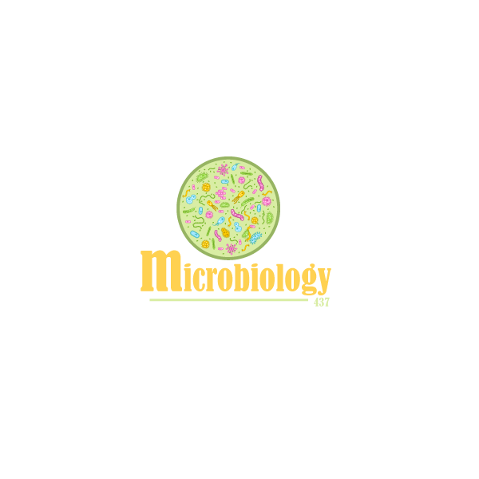
Objectives:
Definition
Epidemiology
Etiology according to the age and common serotypes of the main causative pathogens
Identification
Pathogenesis
Complications
Clinical presentation and comparison between normal and abnormal CSF analysis.
Diagnostic approaches
Management and Prevention Of pyogenic meningitis.

Slide 2
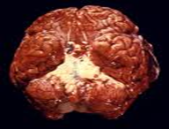
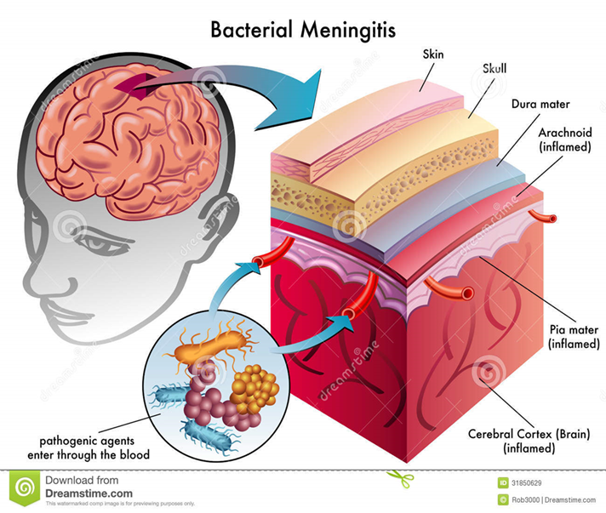
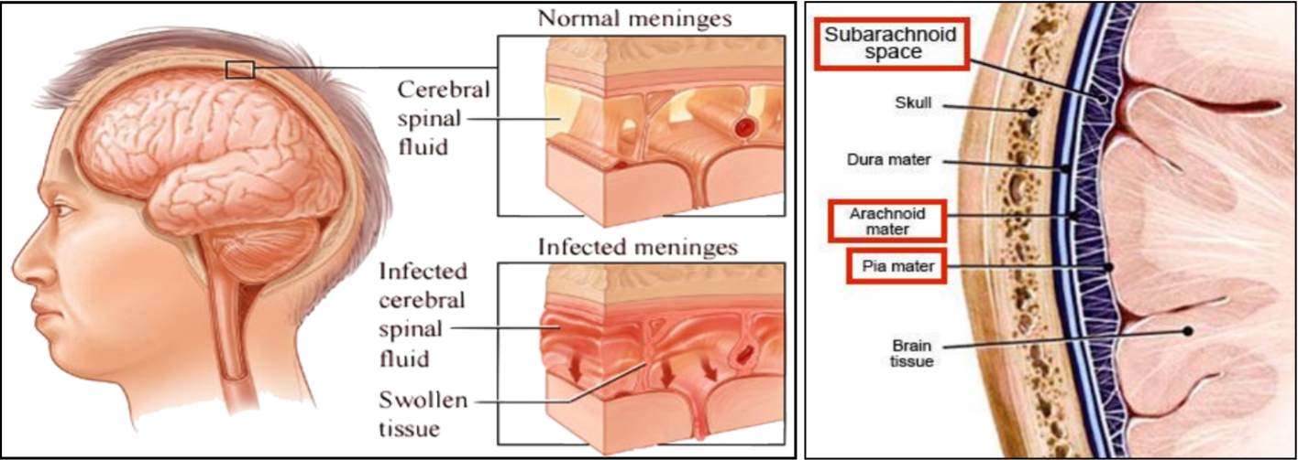
Definition
What is Pyogenic Meningitis?
Pyogenic meningitis is an inflammation of the meninges affecting Pia , Arachnoid and subarachnoid space.
Its a serious infection ,associated with marked inflammatory exudation.
Acute in onset.
Usually caused by bacterial infections.
May be preceded by URTI.
How serious is Pyogenic Meningitis?
Can be fatal if untreated.
Common Etiologic Agents
Three main bacterial pathogens:
Neisseria meningitidis
Streptococcus pneumoniae
Haemophilus influenzae

Slide 3
Causes according to the age
Newborns Infants / Children Adults Special circumstances special procedures such as surgery, tumor or severe trauma enhance organisms to cause meningitis that usually don’t . | Group B Streptococcus, E.coli (and other gram negative bacilli) Listeria monocytogenes. S.pneumoniae, N.meningitidis, & H.influenzae S.pneumoniae, N.meningitidis S.aureus, S.epidermidis, S.pneumoniae, anaerobes, & P.aeruginosa
Epidemiology of Meningitis
A worldwide disease, there are 1.2 million cases annually and about 135,000 deaths.
Bacterial meningitis is one of the top ten infections which cause death worldwide.
Half of the survivals suffer neurological damage, and /or permanent side effects.

Slide 4
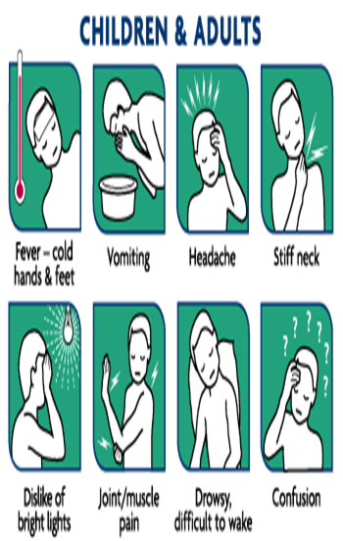
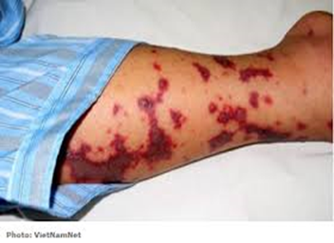
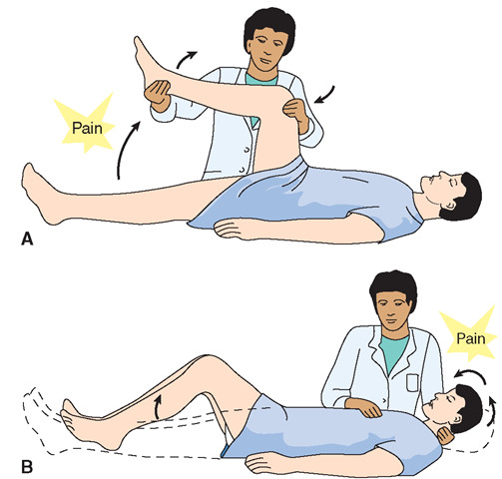
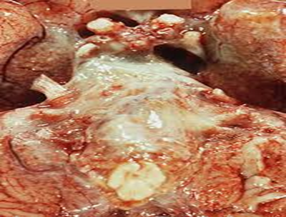
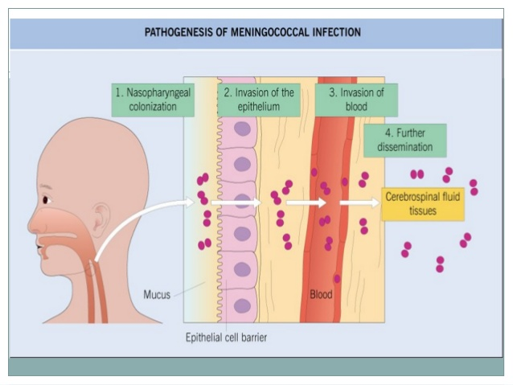
Signs/Symptoms of Acute Meningitis
Most Common Fever Headache (severe) Stiff neck (severe) Nausea & vomiting Sensitivity to light ,Confusion In infants Fever (mainly) Inactivity Irritability Vomiting Poor feeding Lethargy | Advanced Cases bruises under skin (hemorrhagic rashes) rapidly spread Advanced Disease: Brain damage Coma Death
(bruise related to “disseminated intravascular coagulation” when the patient has severe meningitis that causes coagulation and bleeding. دم متخثر فوق الجلد)
Kernig’s sign
Brudzinski’s sign
Non specific signs
Pathogenesis
Microorganisms colonize the nasopharynx or the birth canal → Septicemia → Organisms cross the BBB → Cause widespread endothelial damage → Bleeding → Skin rash and adrenal hemorrhage → Coagulation activated → Platelets aggregation and thrombosis.(the pathogenesis in short)

Slide 5
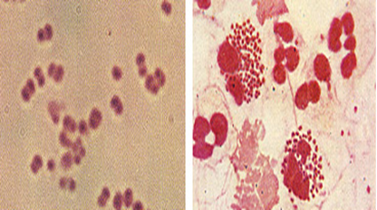
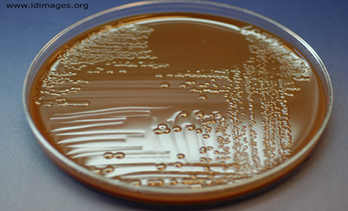
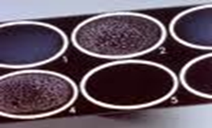
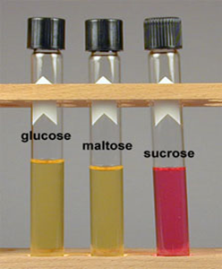
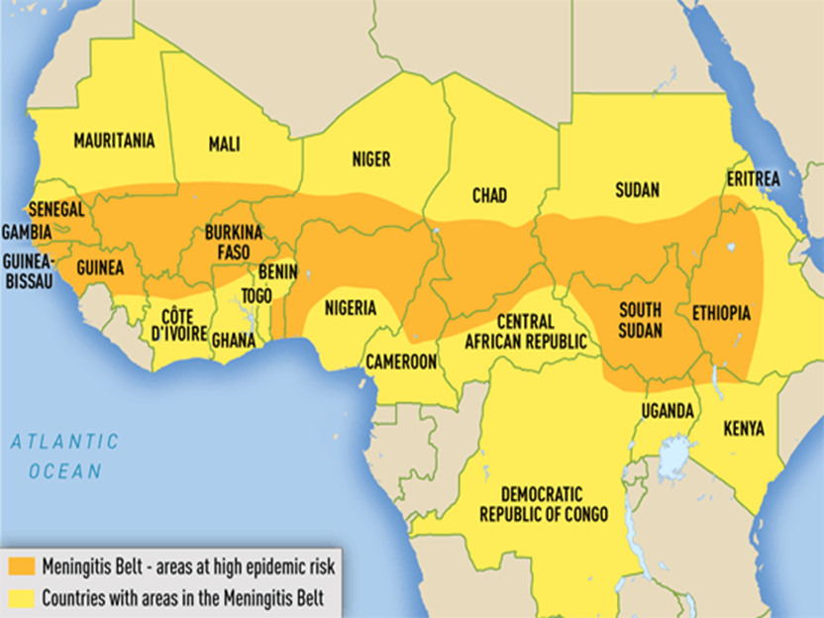
N.meningitidis
General info. | A Gram negative diplococci present in the nasopharynx of 10 % of people.
Transmission | by inhalation of aerosolized droplets & close contact.
Prevalence | Common in children < 6 years
Risk factor | susceptible individuals.
Serotypes | B,C,Y,W135 cause isolated ,sporadic small epidemics in close population. Serotype A has an epidemic potential in sub-Saharan Africa (meningitis belt).
Pathogenesis | In carriers ; it stimulates antibody production Pili attach to microvilli of nasopharynx , invasion ,then bacteremia, endotoxin (LPS) produced which spreads to the meninges. Capsule resists phagocytosis.
Prognosis | 11-20 % of recovered patients suffer permanent hearing loss, mental retardation. 10-14 % of cases are fatal.
A
B
C
D
E
See the pictures:
Gram negative diplococci
Specific agar for n. meningitidis called (thayer-martin agar)
This is called Latex agglutination basically we mix specific antibodies with neisseria(وراح تسبب تخثر)
This is called sugar utilization. How do we differentiate between different neisseria species let's say the patient has gram negative diplococci is it neisseria meningitidis?is it neisseria gonorrhoeae? Or other neisseria? They all utilize glucose;
It’s so easy N.meningitidis has the letter M so it utilizes maltose, while N.gonorrhoeae only glucose
African meningitis belt

Slide 6
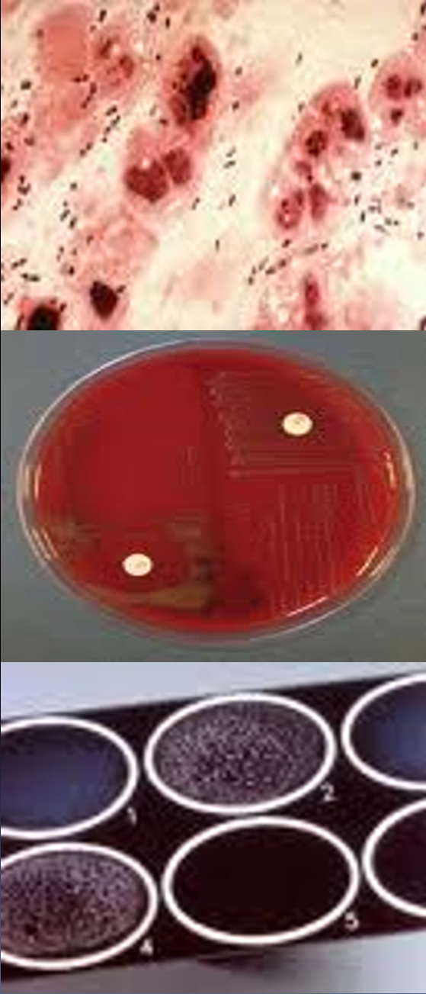
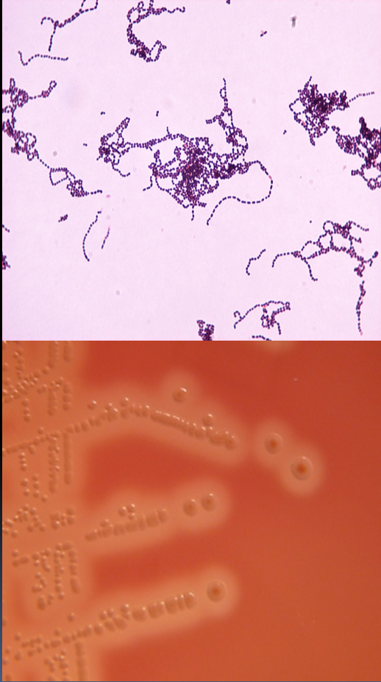
S.pneumoniae
General info. | A Gram positive diplococci.
Risk factors | May develop after trauma to the skull. Non vaccinated patient (because Infection rate decreased due to vaccination) .
Pathogenesis | Meningitis may follow pneumococcal pneumonia, OM, or other infections with the bacteria. Pneumolysin toxin decreases inflammatory immune response and leads to severe infection. Capsule is a polysaccharide polymer
Prognosis | High mortality rate >30% due to invasive disease. Recovered cases develop sustained learning disabilities.
Group B Streptococcus (GBS)
General info. | Gram positive cocci in chains Resident bacteria in GIT & vagina (10-30%)
Risk factors: | premature rupture of membrane, prematurity, low infant innate immunity.
Pathogenesis | Gain access to amniotic fluid during delivery or colonize newborn during passage through birth canal. Causes sepsis and meningitis in the first few days of life and after 4 weeks

Slide 7
H. influenzae
General info. | A small Gram negative coccobacilli Has polysaccharide capsule , other species has no capsule. Need blood for optimal growth, Hematin (factor X) and NAD (factor V) Found in the nasopharynx normal flora Major cause of lower RTI , occasionally invade deeper tissues and cause bacteremia. Bacteremia : bacteria spread to the CNS ,bones or other organs. Infection rate decreased since the routine use of Hib vaccine .
serotype | Many serotypes a-f , H.influenzae type b has a capsule made of a polymer of PRP (Polyribosyl Ribitol Phosphate) causes acute life threatening invasive infections
Prognosis | 3-6% mortality rate 1/3 of survivals have significant neurological sequelae

Slide 8
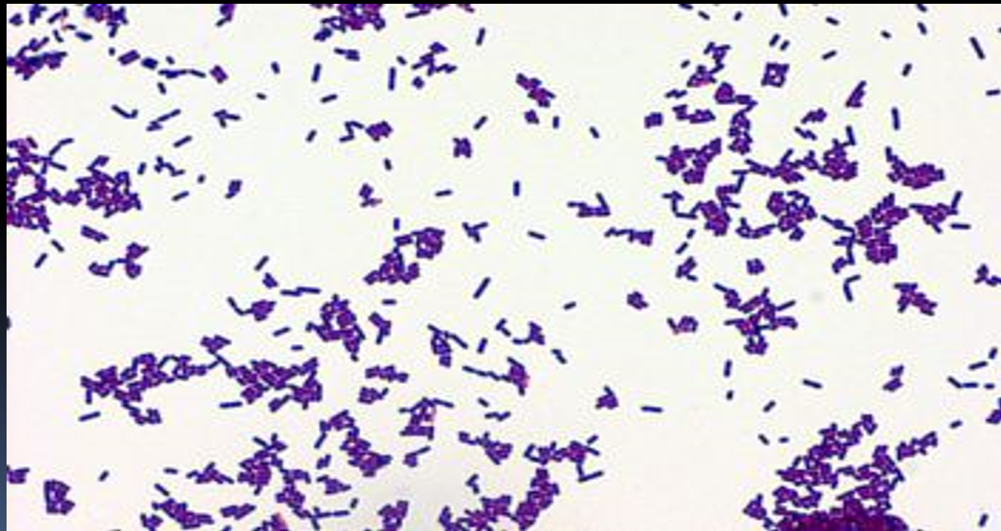
E. coli
General info. | A Gram negative bacilli Most common cause of neonatal meningitis Many features similar to Group.B.S.
Pathogenesis | Vaginal E.coli colonize infant via rupture of amniotic membrane or during birth. Failure of preterm maternal IgM to cross placenta & special susceptibility of newborn. K1 sialic acid capsule of some strains invade brain microvascular endothelial cells. (this makes it more broad to produce meningitis)
Listeria Monocytogenes
General info. | Gram positive rods (diphtheroids like) Human intestinal colonization (2-12%) Causes meningitis in newborns and immunosuppressed patients.
Pathogenesis | Widespread among animals in nature including those associated with certain foods (cheese and meat). Spread to fetus following hematogenous spread in mother or from birth canal. Has tropism to the CNS.

Slide 9
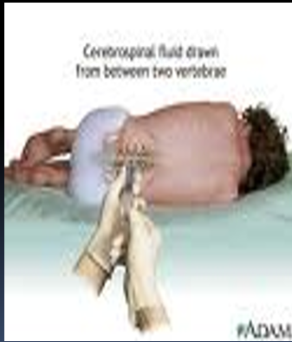
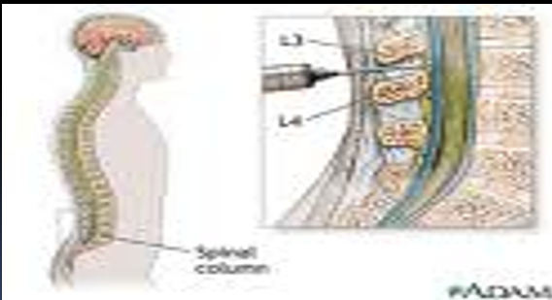
Diagnosis of Meningitis
CNS Parameters
Clinically: signs & symptoms Specimens : CSF acquired through lumbar puncture and blood specimen for culture. CSF :analysis of cells, protein, glucose and chloride in addition to culture and antimicrobial susceptibility testing.
Normal CSF |  | Pyogenic Meningitis
Adult | WBC =0-5 /cmm3 PMN= 0 % Glucose= > 60 % of blood Protein =< 30 mg/dl Chloride = 115-130 mmol/l | WBC= 5 - 5000/cmm3 PMN= > 60% Glucose = < 45 % of blood, (it is decreased because it is used by bacteria) Protein= >60 mg/dl Chloride= 110 mmol/l
Neonates | Term (mature): WBC =0-32 /cmm3, PMN=>60 %, glucose = >60 % of blood,protein= 20-170 mg/dl Preterm (premature): WBC= 0-29/cmm3, PMN= <60 %, glucose = >60 % of blood, protein= 60-150 mg/dl

Slide 10
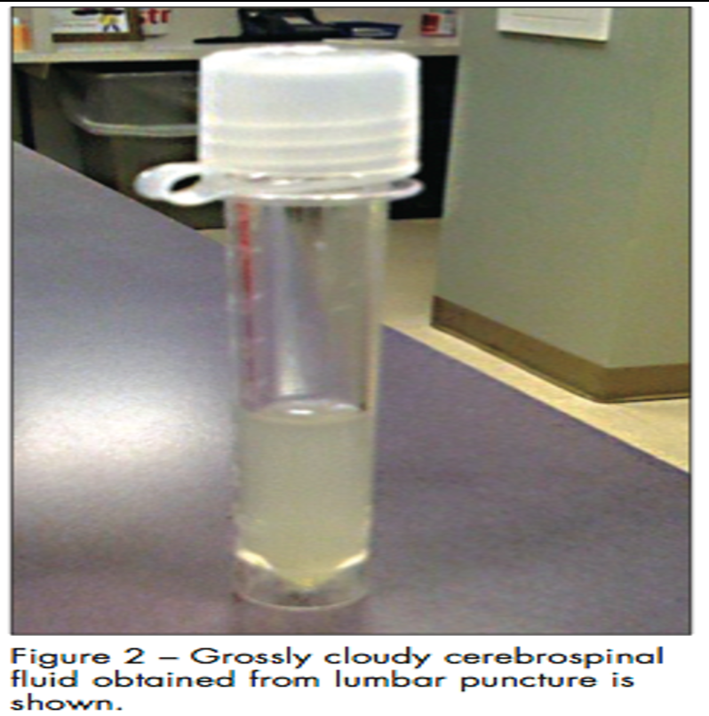
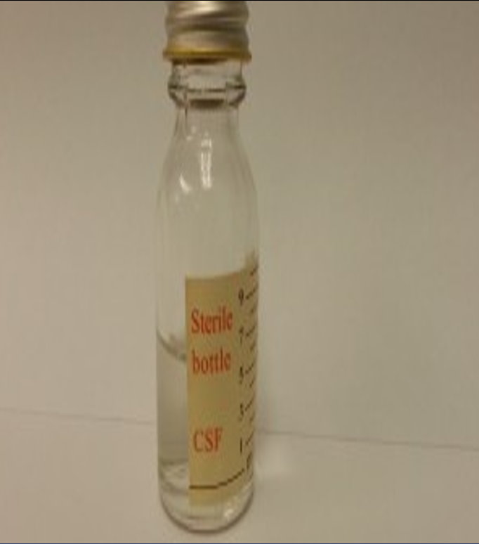
Normal & Turbid CSF
Tip:don't memorize the exact numbers just know how to differentiate
Condition | WBC | Protein (mg/dL) | Glucose (mg/dL)
Normal | <5, ≥75% lymphos | 20-45 | >50 (or 75% serum glucose)
Bacterial, acute | 100-10,000 or more; usually 300-2,000; Neutros predominate | Usually 100-500 | Decreased, usually <40 (or <50% serum glucose)
Bacterial, part rx’d | 5-10,000 | Usually 100-500 | Low to normal
TB | 10-500 | 100-3000 | <50
Viral or Meningoencephalitis | Rarely > 1000 | Usually 50-200 | Generally normal; may be decreased
Abnormal findings of CSF in some pathological conditions
Parameter | Confition
 | Bacterial Meningitis | Tuberculous Meningitis | Viral Meningitis | Brain Tumor
Protein | ↑↑ | ↑↑ | Normal | ↑
Glucose | ↓↓ | ↓↓ | Normal or slightly ↓ | ↓
Chlorides | ↓↓ | ↓↓ | Normal or ↓ | Normal or ↓
-Bacterial: WBC very high---glucose vey low
-Viral: WBC very low (ما توصل الف)---normal glucose or slightly low
-TB: WBC usually hundreds-- low glucose
-Protein is elevated in all of them , but mainly in TB or bacteria
TB symptoms are more subacute not 1-2 days its1-2 weeks usually
dr.notes

Slide 11
Management
A MEDICAL EMERGENCY Antibiotics given after taking specimens for lab diagnosis. Parenteral administration.
Children & Adults: | Ceftriaxone (or Cefotaxime) + Vancomycin (cover the main 3 pathogens). Add ampicillin if >50 or at risk for Listeria
Neonates: | Ampicillin + Gentamicin or Cefotaxime (we don't give Ceftriaxone in this case because it’ll effect biliary tract, so in instead of it we use Cefotaxime because it has less side effect) Modify treatment after lab results (as needed).
Duration: | 10-14 days ( or more ) according to the medical condition.
Prevention: | Vaccination Prophylactic antimicrobial agent for contacts (Hib & N. meningitidis)
1 month or less

Slide 12
Prof. Hanan’s Notes
The causative agents for meningitis differ with age so you should be able to identify each one.
The symptoms of Acute meningitis in infants and adults are severe and if not treated quickly the patient may develop big bloody rashes on the fingers.
If we take a swab from 10% of the population we will find N. meningitidis but those ppl won’t develop meningitis, why?
Because it is part of the normal non pathogenic flora in the nasopharynx of those 10% carriers, but the pathogen might be transmitted by inhalation and close contact with one of the carriers to a non carrier where it will cause meningitis in the non carrier.
A patient came from Africa complined from severe fever, severe headache and neck stiffness. What is the causative agent? N. Meningitidis stereotype A.
H. influenzae Type B is the most important and it can lead to serious infections.
Meningitis caused by H. imfluznea is more common in children up to 5 years
(2 months - 5 years), why? Because the development of antibody so after 5 yo the antibody formation is completed and it it infectious rate become less common.
The management of meningitis is very important:
As soon the doctor suspect a meningitis they should put the patient in an ICU, and give them intravenous ceftriaxone (3rd generation cephalosporin) and vancomycin which will cover the all three main pathogens till the lab work is reveleid and depending on the pathogen the doctor will either change the antibiotics for something more specific or keep the same antibiotic they used for the next 10-14 days.
Case:
A 60 years old, diabetic, or on chemotherapy, he developed nausea, confusion, and severe headache. The blood culture showed gram + rods diphtheroids like. What is the pathogen? Listeria monocytogenes

Slide 13
Notes (1):
Common etiologies: strept pneumoniae H.influenzae and Neisseria meningitidis اعرفوا الاخيرة كويس
Viral meningitis can be seen in children but self limiting, Bacterial can be deadly thus it is a medical emergency.
Most of those people have some sort of immunodeficiency
Neonates (first month or less) usually get meningitis while being delivered which means that the mom has the bacteria as a normal flora or it could colonize in the vagina.
Lumbar puncture and complete work up should be done to a neonate that comes with fever.
In children and even adults it’s mainly S. pneumonia, N. meningitidis.
H. influenza is not common anymore due to vaccination.
Older adults> 50 are also susceptible to be infected with Listeria monocytogenes along with S. pneumonia, Neisseria. Meningitidis
Headache, fever, and stiff neck are the most common presentations.
In infants it’s mainly fever and other symptoms like poor feeding and lethargy.
Some clinical examinations are positive in some patients in meningitis which are brudzinski’s and Kernig’s. اعرفوها بشكل عام
Neisseria meningitidis is a gram – diplococci. Some patients are colonized with it. Can be seen in collaged age groups in which they cross colonize because they share drinks and other practices.
The types of Neisseria depend on the type of capsule. Neisseria, haemophilus, and strept pneumonia are all encapsulated.
They have to take N.meningitidis when they are going to hajj and at least 10 days before.
Immunocompetent are protected by their antibodies and can be boosted by vaccinations.
How do we differentiate between Neisseria species? Sugar utilization .. glucose and maltose utilization for Neisseria Meningitidis
S. pneumoniae and can start as pneumonia or URTI and potentially can develop meningitis.
Pneumolysin is important in the pathology. Alpha hemolytic and we can differentiate it from s.viridans
by bile solubility and optochin sensitivity.
H. influenza is nutritionally selective and needs factors X and V for growth.
Type B of H.influenza is the most important type and can cause epiglottitis and meningitis in the pediatric age group. Now has decreased due to vaccines. Why is it more virulent than others? Because its capsule is composed of polyribosylribitol phosphate.
Lots of females can be colonized with Group B strept. If the moms are colonized then they are given ampicillin before birth.
E.coli is a lactose fermenter that can colonize the vagina and can spread during birth and the risk can be increased by premature rupture of the amniotic membrane.
Listeria Monocytogenes is found in animals and can spread through foods that are not pasteurized well. Important feature of it is that it can grow at fridge temperature. It’s potential in elderly above 50, pregnants and immunocompromised. Can spread through the blood or through the birth canal.

Slide 14
Notes (2):
Antibiotics:
-ceftriaxone covers Neisseria and strept pneumoniae and haemophilus. But why do we add vancomycin?
Because there is a risk of resistant to strept pneumoniae. If it’s turns to be sensitive to Ceftriaxone than they stop vancomycin and they continue with ceftriaxone and if it was very sensitive they may step down to penicillin.
Elderly(>50)? Add ampicillin. Why? Because it covers listeria **تذكروها listeria is resistant to cephalosporins
-When a patient comes with signs of meningitis it’s very important take CSF and blood cultures before giving the antibiotics(1-take samples 2-treat empirically 3-when we get results we can change the treatment)
-Neonates? The most important organisms are group B, E.coli, and listeria monocytogenes.
Antibiotics?
Ampicillin: covers listeria, group B strept, and sometimes to cover E.coli
Cefotaxime: if there is resistant to E.coli( but dont use ceftriaxone).
NO ceftriaxone because it may affect their biliary tract
Gentamicin: active against E.coli and provide synergistic activity for group B strept
-Case1:
A 60-year-old came to the ER with symptoms of fever, headache, neck stiffness. Clinical examination shows positive Kernig’s and Brudzinski’s signs. The patient also complains of stomach pain after eating a cheese sandwich. CSF examination revealed increased Neutrophils, elevated protein and decreased glucose. Culture shows gram + rod diphtheroid like.
Diagnosis? Acute pyogenic meningitis
causative agent? Listeria monocytogene
Treatment? Empirically: Ceftriaxone, Vancomycin, and Ampicillin. When we know the gram stain we can step down to Ampicillin.
-Case2:
A 35-year-old came to the ER with fever, headache, and stiff neck which began two days ago. CSF showed gram + diplococci, increased in white blood cells, proteins and decreased in glucose.
Diagnosis? Acute pyogenic meningitis
causative agent? strept. Pneumoniae(alpha hemolytic)
Treatment? Empirically Ceftriaxone, Vancomycin and step down later depending on the sensitivity.
-It’s very important to know the presentations of the neonates which are:
Fever, poor feeding, Lethargy, Irritability
we begin with empiric treatment until we get the gram stain results.

Slide 15
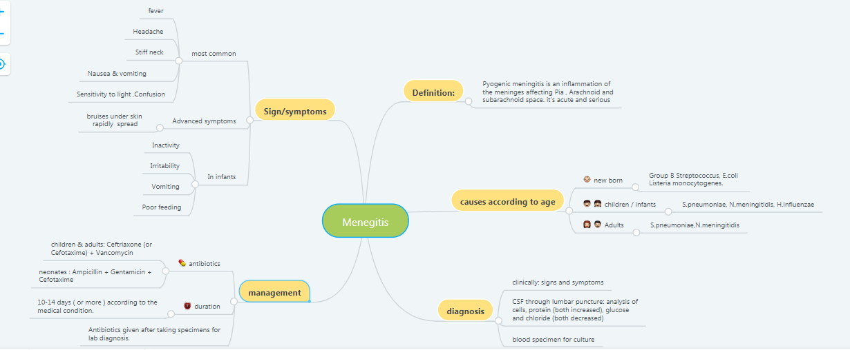
Summary
Laboratory tests | Cause meningitis to : | Some features | shape | Gram stain | organism
-maltose / glucose utilizer -grows in thayer martin agar | Children - adults | Endotoxin LPS | diplococci | -ve | N.meningitidis
α-hemolytic Optochin sensetive Bile soluble |  | Pneumolysin toxin |  | +ve | S.pneumonia
-Needs Hematin (factor X) and NAD (factor v) For growth -Grows in chocolate agar | children | Has a polysaccharide capsule (not every type ) | coccobacilli | -ve | H.influenzae
β-hemolytic | Neonates | Gain access to amniotic fluid during delivery or colonize newborn | Cocci in chains | +ve | Group B Strept.
-lactose fermenter |  | Vaginal E.coli colonize infant via rupture of amniotic membrane or during birth. -K1 sialic acid capsule of some strains | bacilli | -ve | E.coli
-(EXTRA) oxidase negative |  | -associated with certain foods (cheese and meat) -may affect elderly | rods | +ve | Listeria monocytogenes

Slide 16
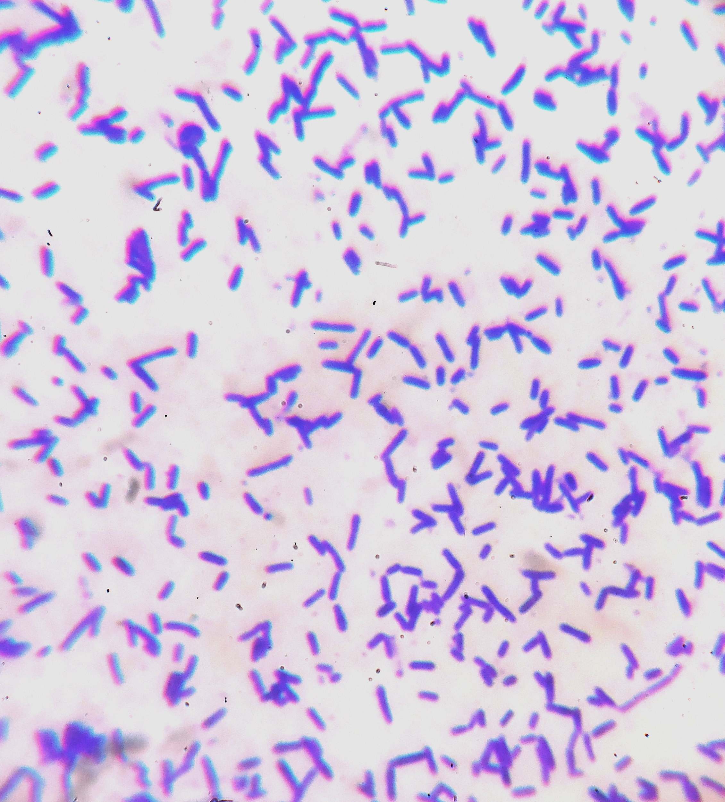
Quiz:
1.What is the most common cause of meningitis in neonates
staph.aureus
streptococcus pneumonia
E.coli
-klebsiella
2.A 6 month old infant is admitted to the hospital with acute meningitis. The gram stain reveal is gram negative, short rods(coccobacilli), and the mother indicates that the child has received “ all “ of the meningitis vaccination. Which of the following is the most likely cause?
Haemophilus influenzae
Listeria monocytogenes
Neisseria meningitidis
Streptococcus pneumonia
3.A- 55 years old man came to the clinic complaining about increase sensitivity to light and headache.Lumbar puncture staining revealed a gram negative diplococci what is the most likely causative organism in this case ?
Haemophilus influenzae
Listeria monocytogenes
Neisseria meningitidis
Streptococcus pneumonia
4.In Q.3 which one of the following antibiotic therapies is the most appropriate treatment for the patient?
Gentamicin
Fluoroquinolone
Ampicillin
Ceftriaxone
5.which one of the following is characteristic of N.meningitidis?
It colonize newborn during passage through birth canal.
It isn't capsulated
It may develop after head trauma
It has a billi attach to microvilli of the nasopharynx
6.1 week-old newborn develop meningitis.
Short, gram positive rods are isolated. History reveal that the mother had eaten unpasteurized cheese from Mexico during pregnancy, she recalled having flu-like illness.
What is the most likely organism?
Listeria monocytogenes .
What is the management in this case?
Gentamicin and Ampicillin. 10-14 days
7.A cluster of cases of meningitis occurred among elderly people (age 65 years) over a large geographic region. The causative agent, isolated from the CSF of infected patients, had the cell and colony morphology shown. The only common feature among the patients was that they all consumed fresh cantaloupe within a week of onset of symptoms.
What is the cell and colony morphology of the bacterium shown?
Gram positive bacilli
What is the most likely etiology and infection?
He most likely have meningitis caused by Listeria monocytogenes .
What did you expect the levels of (protein,glucose)And PMN count After performing an analysis of the CSF ?
PMN= > 60% Glucose = < 45 % of blood Protein= >60 mg/dl
answers :
1-C
2-A
3-C
4-D
5-D

Slide 17
ALANOUD AL-MANSOUR & KHALED AL-OQEELY
abdulhakim al-onaiq
anas al-saif
khaled al-dosari
mohammed al-dwaghri
saad al-hadab
saif al-meshari

