Slide 1
Objectives:
Acute viral infections of the CNS.
Aseptic meningitis, Paralysis & Encephalitis
Etiological agents
Enteroviruses & polioviruses.
Herpes simplex virus 1.
Rabies virus.
Arboviruses (West Nile virus).
For each one you should know the structure, epidemiology, pathogenesis, clinical presentations, lab diagnosis, treatment & prevention.

Slide 2
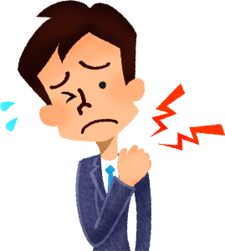
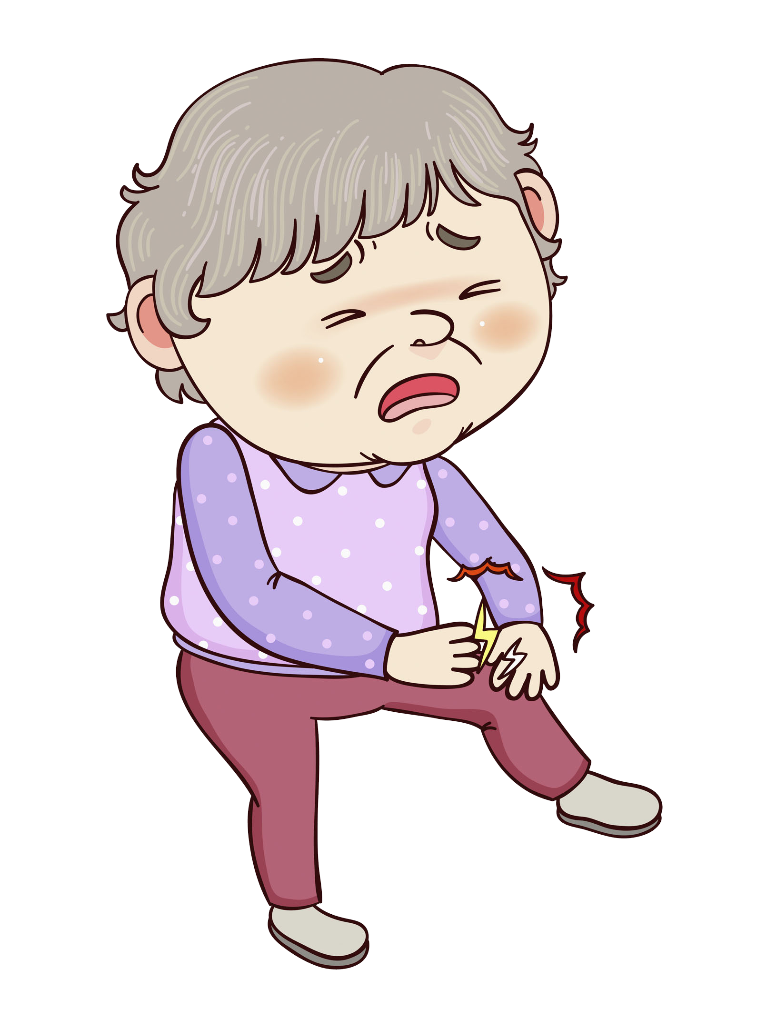
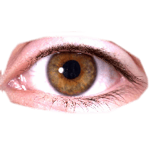
Causes of Meningitis
Infectious |  |  |  | Non- infectious
Viral | Bacterial | Fungi | Protozoa
Aseptic meningitis Less severe Resolve without specific treatment within a week or two | Septic meningitis Severe and may result in: Brain damage Hearing loss Learning disability It would cause death
Signs & Symptoms
Vomiting | Headache | Light aversion | Joint pain
Fever | Neck stiffness | Drowsiness | Fitting
Cerebrospinal fluid (CSF) analysis
 | Normal | Aseptic Meningitis | Septic Meningitis
Color | Clear | Clear | Cloudy₁
Cells/ mm³ | <5 | Increase 100-1000 lymphocytes | Increase 200-20000 neutrophils
Glucose mg/dl | 45-85 | Normal or slightly changed | Low <45
Causes | - | Viruses or others | Bacteria
₁ Because of the presence of pus cells and protein

Slide 3
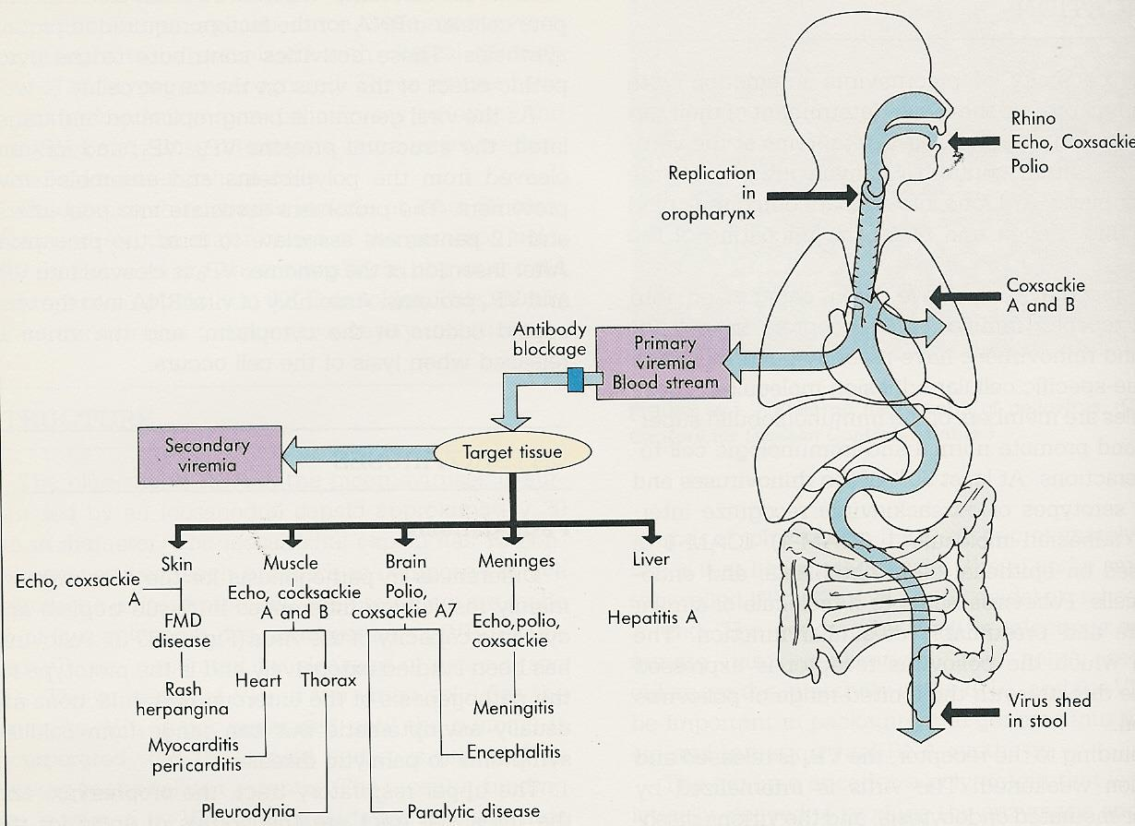
Viral Meningitis (Aseptic Meningitis)
Etiology
It’s mainly caused by Enteroviru and other viruses such as: Mumps virus Arboviruses. Herpes viruses. Human Immunodeficiency Virus. Lymphocytic choriomeningitis virus. Enterovirus belong to the Picornaviridae₁ family which is a non enveloped, icosahedral, positive single stranded RNA genome (+ ssRNA)₂ Which includes: : Poliovirus (Type 1,2 & 3) Coxsackieviruses (A&B) Echoviruses Entroviruses (68-71)
Epidemiology
Reservoir | Spread | Age | Seasonal Distribution
Human | Fecal - oral route (mainly) Inhalation of Infectious aerosols (Crowded, poor hygiene & sanitation) | Children > adults | Summer & fall
Pathogenesis:
The main route for enterovirus is the fecal oral route → replicate in the GIT → reaches the blood (viremia) → it targets many organs such meninges, brain, muscles and askin.
₁ Pico means small and rna is its genome while virdiae means virus
₂ +ssRNA translate into protein directly while -ssRNA (like rabies) has to go through transcription 1st

Slide 4
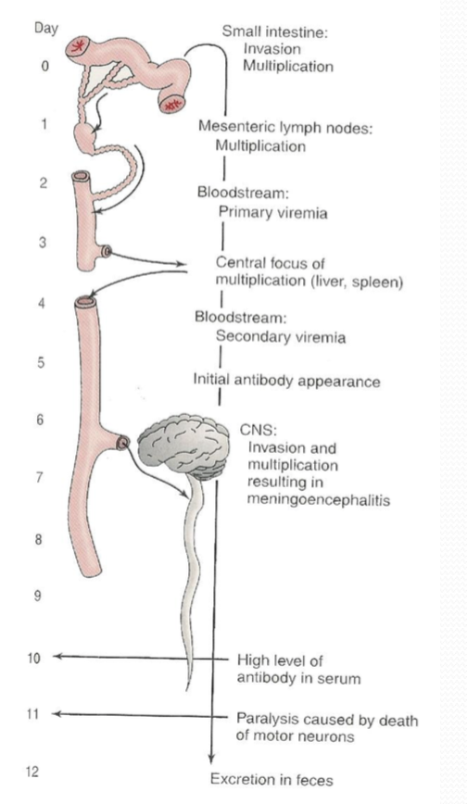
Pathogenesis of Poliovirus:
Enteroviral Infection (Asymptomatic Infections)
Neurologic Diseases | Non- Neurologic Diseases
Aseptic Meningitis₁ Paralysis Encephalitis₂ | Respiratory Tract Infections Skin & Mucosa Infections Herpangina, Hand-foot-and-mouth disease, & Exanthems Cardiac Infections Pleurodynia (epidemic myalgia), Myocarditis, & Pericarditis Acute hemorrhagic conjunctivitis Others
Pathway to CNS by:
Blood
Peripheral nerves
Causing destruction of motor neurons of AHCs₃
Rarely affects brainstem (bulber poliomyelitis)
Immunity: IgA & IgG
lifelong type-specific immunity₄
₅₆₇
Poliovirus Infections
1-2% | 4-8% | 90-95%
Major illness | Minor illness | No illness
Nonparalytic poliomyelitis (Aseptic meningitis) Paralytic poliomyelitis₅ (Flaccid paralysis) | Abortive poliomyelitis (no CNS involvement) | Asymptomatic₆
₁ Most common form of CNS infection caused by enterovirus
₂ Rarely caused by poliovirus
₃ It causes a lower motor neuron lesion → results in paralysis
₄ When someone get infected they will later on develop a lifelong immunity
₅ Paralytic poliomyelitis: it is asymmetrical, may have residual paralysis of the affected muscle. It’s a disease of children but the risk of paralysis increase w/ age. So it mostly present it kids but might be seen in adult and in a more severe form.
₆ Can be transmitted to others.

Slide 5
Lab Diagnosis of Enteroviruses
Virus isolation | CSF in aseptic meningitis | Serology
Samples: Stool (best), rectal or throat swabs & CSF Inoculate in cell cultures: all enteroviruses grow expect some strands of Cox A viruses Observe for CPE (cytopathic effect) Identify the type | Lymphocytosis Glucose levels N to slightly ↓ Protein levels N or slightly ↑ Isolation rate is variable RNA detected in CSF by RT-PCR | Limited value
Management
Treatment (Rx) | No antiviral
Prevention | Sanitation and hygienic measures Poliovirus vaccines: Inactivated polio vaccine (IPV): (salk, killed) (S/C or IM) Live attenuated polio vaccine (OPV): (sabin, oral)
Doses | 4 doses of PV; 2,4, 6-18 months & 4-6 years
Combination Vaccine | IPV, DTaP, Hib & HB vaccines
Adverse Reactions | IPV → local reactions Vaccine-associated paralytic poliomyelitis (OPV) ,therefore adults and immunocompromised need to get the killed one
Indication of Polio Vaccination of Adults (IPV) | Adults should get the IPV one. Travelers to polio-endemic countries Health Care Workers
Features of Polio Vaccines
Attribute | Killed (IPV) injected | Live (OPV) orally
3 types (trivalent) | Yes | Yes
Prevent disease | Yes(short duration) | Yes (long duration)
Induce humoral IgG | Yes | Yes
Route of administration | Injection | Oral
Transmission others | No | Yes
Affords secondary protection by spread to others | No | Yes
Reverts to virulence | No | Yes (rarely)
Cause disease in immunocompromised | No | Yes

Slide 6
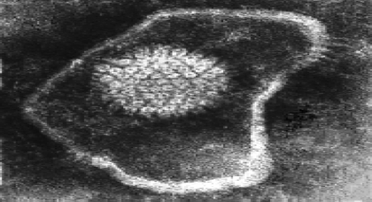
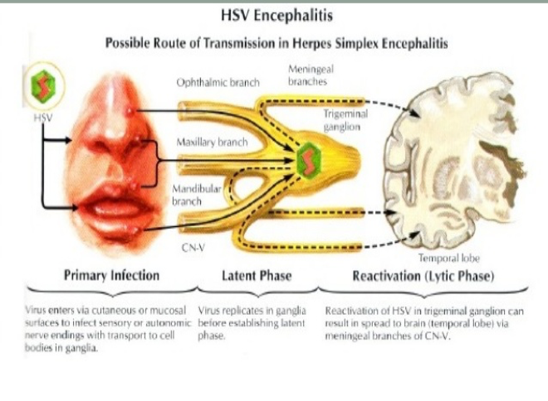
Viral Encephalitis
Enteroviruses, Herpes viruses, Rabies virus, Arboviruses, Others
Pathogenesis:
Herpes Simplex Encephalitis
Caused by | Herpes simplex virus -1(HSV-1) dsDNA, enveloped, icosahedral virus
Clinical Findings | Fever, headache, vomiting, seizures & altered mental status. High mortality rate The only treatable viral CNS infection
Diagnosis | MRI → Reveal the temporal lesion CSF → Lymph, glucose is normal & Protein is high PCR → Detection of HSV-1 DNA
Treatment | Acyclovir.
necrotic lesion in temporal area
It presents as skin lesions around the mouth and the nose → go to the sensory ganglion where it will replicated there → peripheral nerve → reaches the temporal area of the brain → result in a temporal lesion

Slide 7
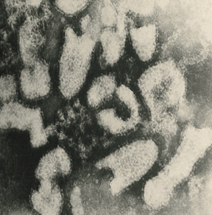
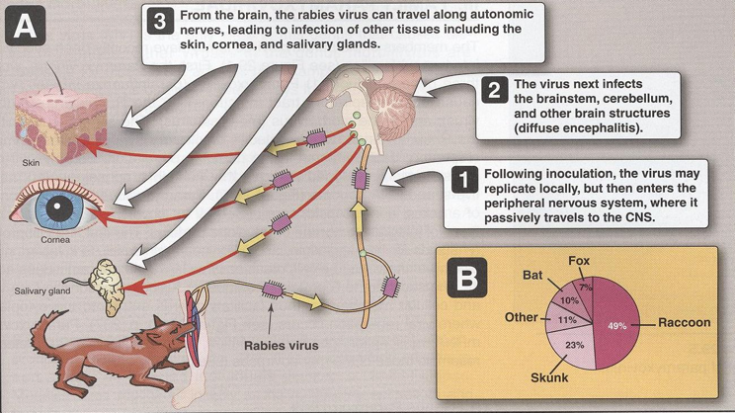
Rabies Encephalitis
Rabies → A fatal acute encephalitis zoonotic₁ disease
Rhabdoviridae: ss (-) RNA genome, helical, nucleocapsid, enveloped & bullet shaped virus
Epidemiology
Reservoir | Major; Raccoons , foxes, wolves, bats, cats & dogs
Transmission | Common route: Bite of a rabid animal Uncommon route: Corneal transplant Inhalation while in a bat infested cave
Pathogenesis
most common mode of transmission
After getting a bite from a rabid animal that is infected rabies → the virus will enter the PNS → reaches spinal cord, medulla & brain → from the brain it travel down to infect other tissues like the cornea, skin & salivary glands .
Phases
1. The incubation period₂ | 1-3 months or longer
2. The prodromal phase | Fever, headache , malaise , anorexia, nausea & vomiting Abnormal sensation around the wound.
3. Neurological phase | Encephalitis Nervous , Lacrimation , salivation, hydrophobia₃, convulsion, coma & death b. Paralytic illness; ascending, death, and it’s associated with bat bite.₄
4. Recovery | Extremely rare₅
₁ Transmitted from animals
₂ If the patient visit the hospital during this period before the symptoms start they could treat them & saving them would be possible
₃ A classical sign of rabies, damage to the oropharyngeal muscles, the swallowing & breathing centers in the brain, the person infected with rabies is unable to swallow, especially liquid, & has the sensation of choking when they try to drink
₄ Less dramatic characterized by symmetrical paralysis associated with spinal cord infection and immediately lead to death
₅ Once signs and symptoms appear 99% will die

Slide 8
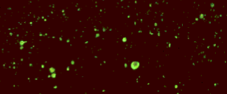
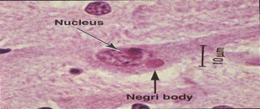
Laboratory Diagnosis
PCR | Rabies RNA in saliva
Rapid virus antigen detection (IF) | Neck skin biopsy, corneal impressions, & brain tissue
Histopathology | Neuronal brain cells intracytoplasmic inclusions (Negri bodies)
Virus cultivation ₁
Serology
Rabid brain stained with Fluorescent anti-rabies antibody
Negri bodies are diagnostic of rabies.
Prevention
Control measures against canine rabies | stray animals control Vaccination of domestic animals₂
Pre-exposure​ Prophylaxis (Vaccine): | People at increased risk of rabies e.g. vets, animal handlers … etc.
Post-exposure​₃ Prophylaxis: | wound treatment₄ passive immunization₅: Human anti-rabies immunoglobulin around the wound and IM Active immunization₆ Human Diploid Cell Vaccine (HDCV) 5-6 doses
₁ It takes a long time so ppl don’t use it anymore
₂ Like cats and dogs
₃ After the bite
₄ Cleaning the bite
₅ We give the patient antibodies
₆ We give the patient killed virus to induce the human response so it would form antibodies

Slide 9
Arthropod–borne Viruses
Arboviruses > 500 Vs
Reservoir | Wild birds & Mammals
Vector | Mosquito, ticks & Sandfly
Transmission | Bite of infected vector
Infections | Asymptomatic Infections Diseases Fever, Rash & arthralgia Hemorrhagic fever ± hepatitis CNS disease (meningitis & encephalitis)
ArboVs associated with CNS disease:
Virus | Vector | Reservoir | Distribution
Eastern Equine Encephalitis (EEEV) | mosquito | birds | America
Western Equine Encephalitis (WEEV) | mosquito | birds | America
Venezuelan Equine Encephalitis (VEEV) | mosquito | rodent | America
Japanese Encephalitis V | mosquito | Birds pigs | Orient
Murray Valley Encephalitis V | mosquito | birds | Australia
West Nile V | mosquito | birds | Europe, Africa, Middle East Asia, America
Dr. said we’ll only concentrate in this
West Nile Virus
Features | Flaviviridae: enveloped ssRNA Causes Febrile illness → meningitis & encephalitis Vector: mosquitoes Reservoir: birds 80% is asymptomatic & 20% might develop west nile fever
Laboratory Diagnosis | Isolation (Gold standard, reference lab) Samples: blood, CSF, & viscera Cell culture: CPE & identify by IF IgM-AB → ELISA & IF (most used) Arbovirus RNA by RT-PCR
Prevention | Vector Control: Elimination of vector breeding sites using insecticides Avoidance contact with vectors (repellants & net) | Vaccines: Tick-borne encephalitis vaccine Japanese encephalitis vaccine

Slide 10
Notes
Aseptic meningitis is mostly self-limiting and need no treatment
Septic meningitis is serious and need immediate treatment
The main cause of aseptic meningitis Enterovirus
Infections caused by poliovirus are decreasing why? Because of vaccination
It's important to know that enterovirus replicate in the GIT.
Entero means intestinal tract
Poliovirus is an enterovirus thus it occurs via the fecal-oral route → replicates in the GIT:
After it might get excreted with feces (asymptomatic infection) or it might reach the blood → abortive poliomyelitis
Or from the blood it could reach the CNS and either cause → non paralytic poliomyelitis (aseptic meningitis) or paralytic poliomyelitis (rarely)
Pay a very good attention to the questions; when they ask about the most common poliovirus infection your answer should be asymptomatic but if the question was the most common clinical presented poliovirus infection your answer should be abortive poliomyelitis
-7.days incubation period(no symptoms)-5.days prodromal(systemic symptoms)-5.days neural symptoms
Poliovirus vaccination:
Why don’t we use the OPV with immunocompromised patients? Bc it can reverse to its natural virulence state and it will cause paralysis
The live vaccine is live attenuated and in very rare cases will cause paralytic illness in immunocompromised patients so they are given killed vaccine
For adults the killed is better to avoid the complications
What characterizes HSV encephalitis? Temporal lesion
HSV encephalitis is the only treatable CNS viral infection
There’s no viremia stage in rabies
Poliovirus → prevented but not treated
HSV → treated but not prevented
Rabies → prevented but not treated

Slide 11
Summary
Big thanks to 435❤
Viral Meningitis (Aseptic meningitis)
Pathogen: | Enteroviruses - Herpes viruses - HIV - Arboviruses - Mumps virus
Enteroviruses
Family | Picornaviridae |  | Include: |  | Poliovirus (1, 2,3 types) Coxsackieviruses (A&B) Echoviruses Enteroviruses (68-71)
Character | ss (+) RNA Nonenveloped , icosahedral Affect children more
Reservoir | Human |  | Spread: |  | Fecal - oral route (mainly) - Inhalation.
Enteroviral infections | Asymptomatic Infections: |  | Neurologic Diseases |  | Aseptic meningitis - Paralysis Encephalitis
 |  |  | Non-Neurologic Diseases
Poliovirus | Pathogenesis | - GIT → spread to CNS by ​blood​ or ​peripheral nerves​ → ​destruction of AHCs (LMNL)​ → paralysis. - Rarely affect brainstem →bulber poliomyelitis Immunity: IgA & IgG Lifelong type-specific immunity
 | Poliovirus infection | - 90% → Asymptomatic. (but can transmit the virus) - 4-8% → minor illness → Abortive poliomyelitis (No CNS involvement).(children) - 1-2% → major illness: 1- Nonparalytic poliomyelitis (​Aseptic meningitis​). 2- Paralytic poliomyelitis: (​Flaccid paralysis​). (adult)
Lab Diagnosis | Virus isolation | Samples: Stool, Rectal, throat swabs & CSF → Inoculate in cell cultures (all EV grow except some strains of Cox A) → Observe for CPE → Identify the type.
 | CSF in aseptic meningitis | Lymphocytosis - Glucose level normal to slightly ↓ - Protein level normal or slightly ↑ |  |  |  | RT-PCR test: To detecte EV RNA in CSF
Management | No antiviral Rx Prevention: Sanitation & Hygienic measures Poliovirus vaccines |  | Poliovirus Vaccine: A- Inactivated polio vaccine (salk) (best for adult and immunocompromised ) B- Live-attenuated polio vaccine (sabin) (may cause vaccine-associated paralytic poliomyelitis in adult and immunity)
Viral Encephalitis
Pathogen | Enteroviruses - Herpes viruses - Rabies virus - Arboviruses.
 | Herpes Simplex Encephalitis |  |  | Rabies encephalitis (zoonotic disease)
Caused by | Herpes simplex virus -1 dsDNA , Enveloped , Icosahedral Virus |  |  | Rabies virus Rhabdoviridae, s.s (-)RNA, Enveloped virus.
Symptoms | Seizures and altered mental status |  |  | -The prodromal phase: Abnormal sensation around the wound -Neurological phase - Hydrophobia
Diagnosis | MRl (temporal lesion) CSF: Lymph, Protein PCR |  |  | PCR: from saliva Rapid virus antigen detection(IF): from neck skin, and corneal impression. Histopathology: Negri bodies
Treatment | Acyclovir (only CNS viral infection that is treatable) (no vaccines) |  |  | Vaccination only : 1-Vaccination of domestic animals 2-Pre-exposure prophylaxis: to people at risk of rabies 3-Post-exposure prophylaxis: -Passive immunization: human anti-rabies immunoglobulin -Active immunization: Human Diploid Cell Vaccine.
Arthropod –borne Viruses (Arbovirus) : Associated with CNS Disease (West Nile virus)
 | West Nile V ​→ Flaviviridae.→ meningitis, encephalitis (transmission by birds)
Diagnosis | A-Isolation (Gold standard) B -IgM -AB* - ELISA, IF C - Arbovirus RNA by RT-PCR
Prevention | Elimination of vector breeding sites using insecticides Vaccines: Tick-borne encephalitis vaccine Japanese encephalitis vaccine

Slide 12
MCQs:
4-Which vaccine should not be given to HIV patients?
A- Tick-borne encephalitis.
B- Inactivated polio vaccine.
C- Human diploid cell vaccine.
D- Live-attenuated polio vaccine.
5-Which of the following viral CNS infection is treatable?
A- Herpes simplex encephalitis.
B- Brucellosis
C- Rabies encephalitis.
D- Enterovirus.
6- A patient has died of unknown cause, after autopsy, negri bodies was found in the brain tissue. What is the most likely cause of death?
A-Rabies encephalitis.
B- Viral meningitis.
C- Herpes simplex encephalitis.
1- What is the most common form of CNS infection caused by enterovirus?
A- Encephalitis.
B- Acute hemorrhagic conjunctivitis.
C- Aseptic meningitis.
D- Paralysis.
2-Which of the following is found in herpes simplex encephalitis ?
A- Hydrophobia.
B- Lacrimation.
C- Rash.
D- Temporal lesion.
3-Poliovirus affect which part of the CNS?
A- Spinothalamic tract.
B- Anterior horn cell.
C- Descending tract.
D-Lateral horn cell.
SAQ:
1-C 4-D
2-D 5-A
3-B 6-A
- A 10 years old boy brought to the hospital. He was complained of headache, fever. His mom said he was vomiting too. After taking the history she told you that he was bite by a dog 2 days earlier.
1- What is your diagnosis?
Rabies encephalitis
2- What further test would you order ?
PCR - Rapid virus antigen detection
3-what is the proper way to treat him?
Wound treatment
Post-exposure prophylaxis:
-Passive immunization: human anti-rabies immunoglobulin
-Active immunization: Human Diploid Cell Vaccine.
4- What stage of the disease do think he is in? What clinical manifestations are associated with the neurological phase of the disease?
Prodromal phase, nervous - lacrimation - salivation - hydrophobia

Slide 13
ALANOUD AL-MANSOUR & KHALED AL-OQEELY
Alanoud al-mufarrej
Dana al-rasheed
Lina al-ohali
Nada al-obaid
Reem Al-qahtani
Sara al-sultan

